Slide 1
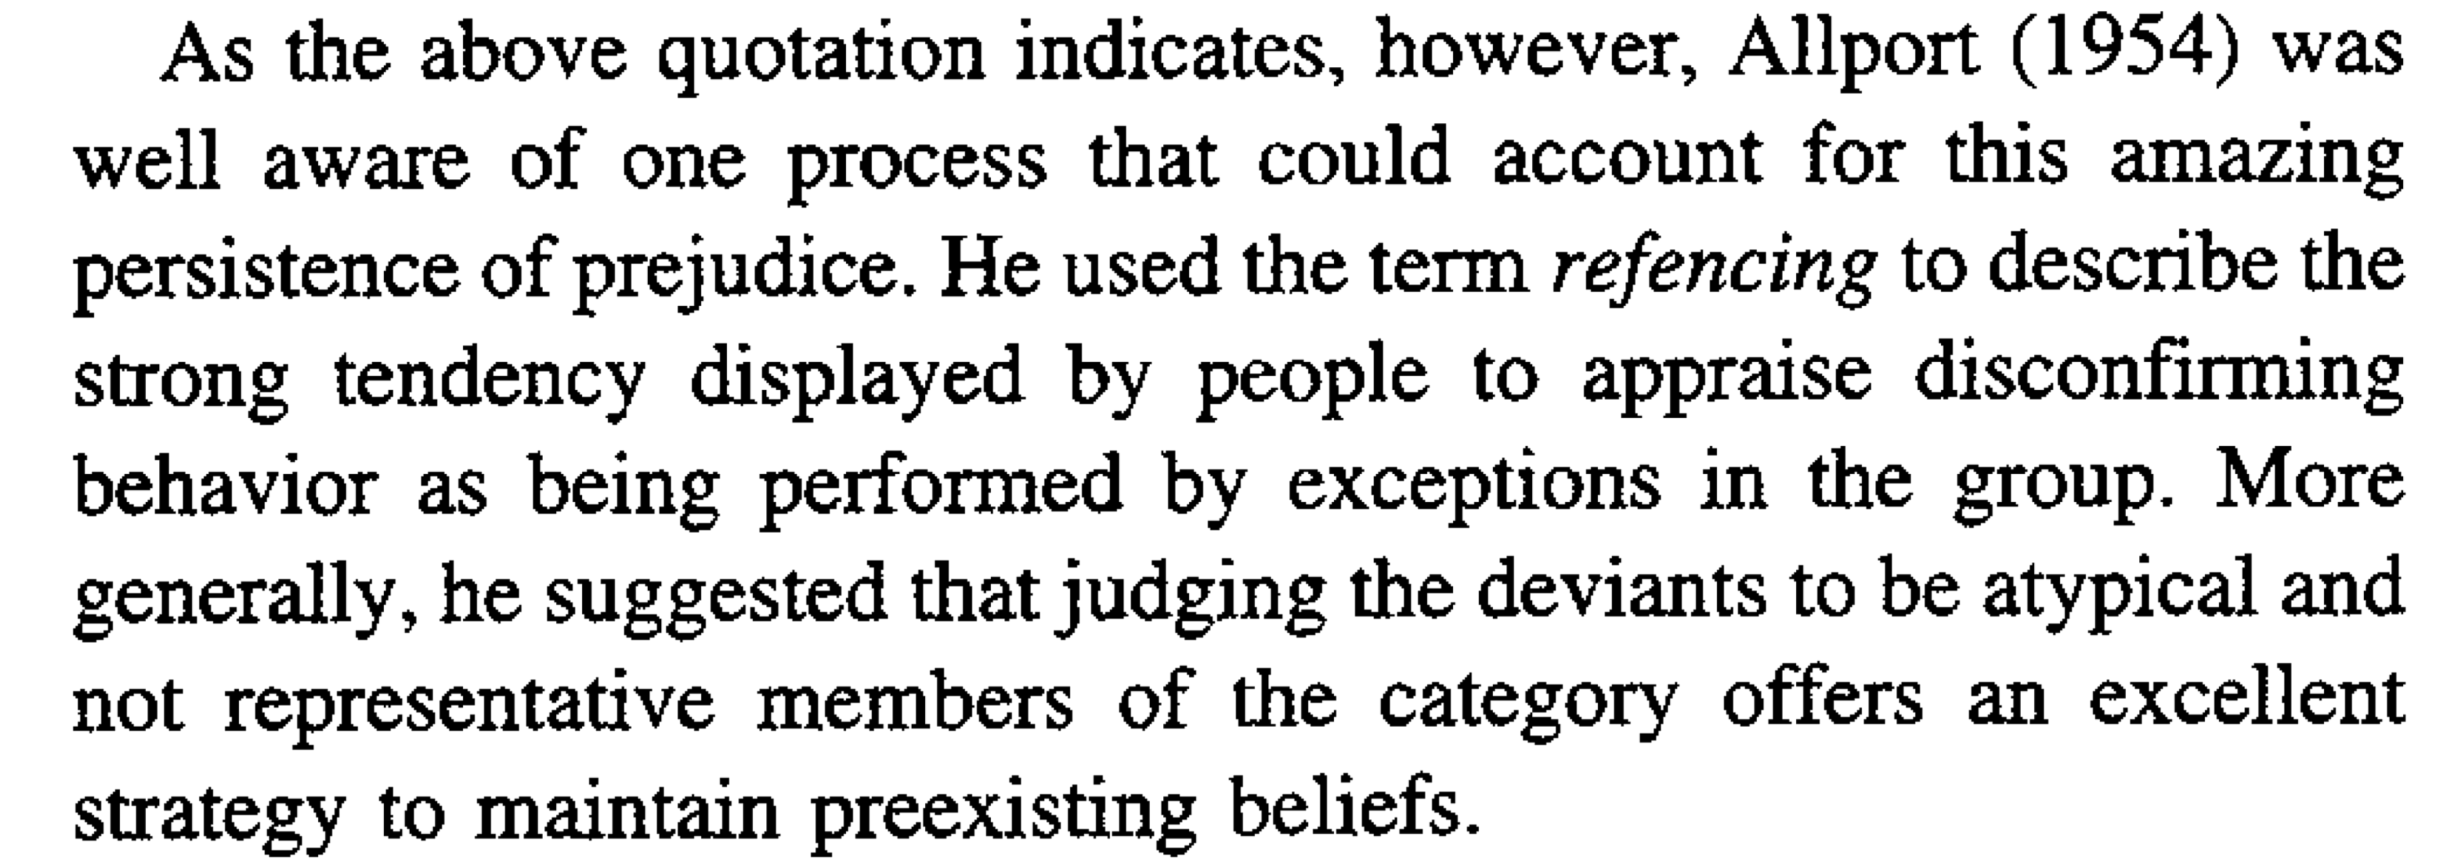
Yzerbyt et al. 1999

Slide 2
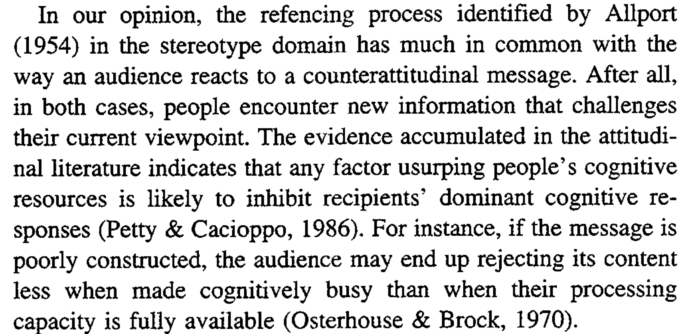
Yzerbyt et al. 1999

Slide 3
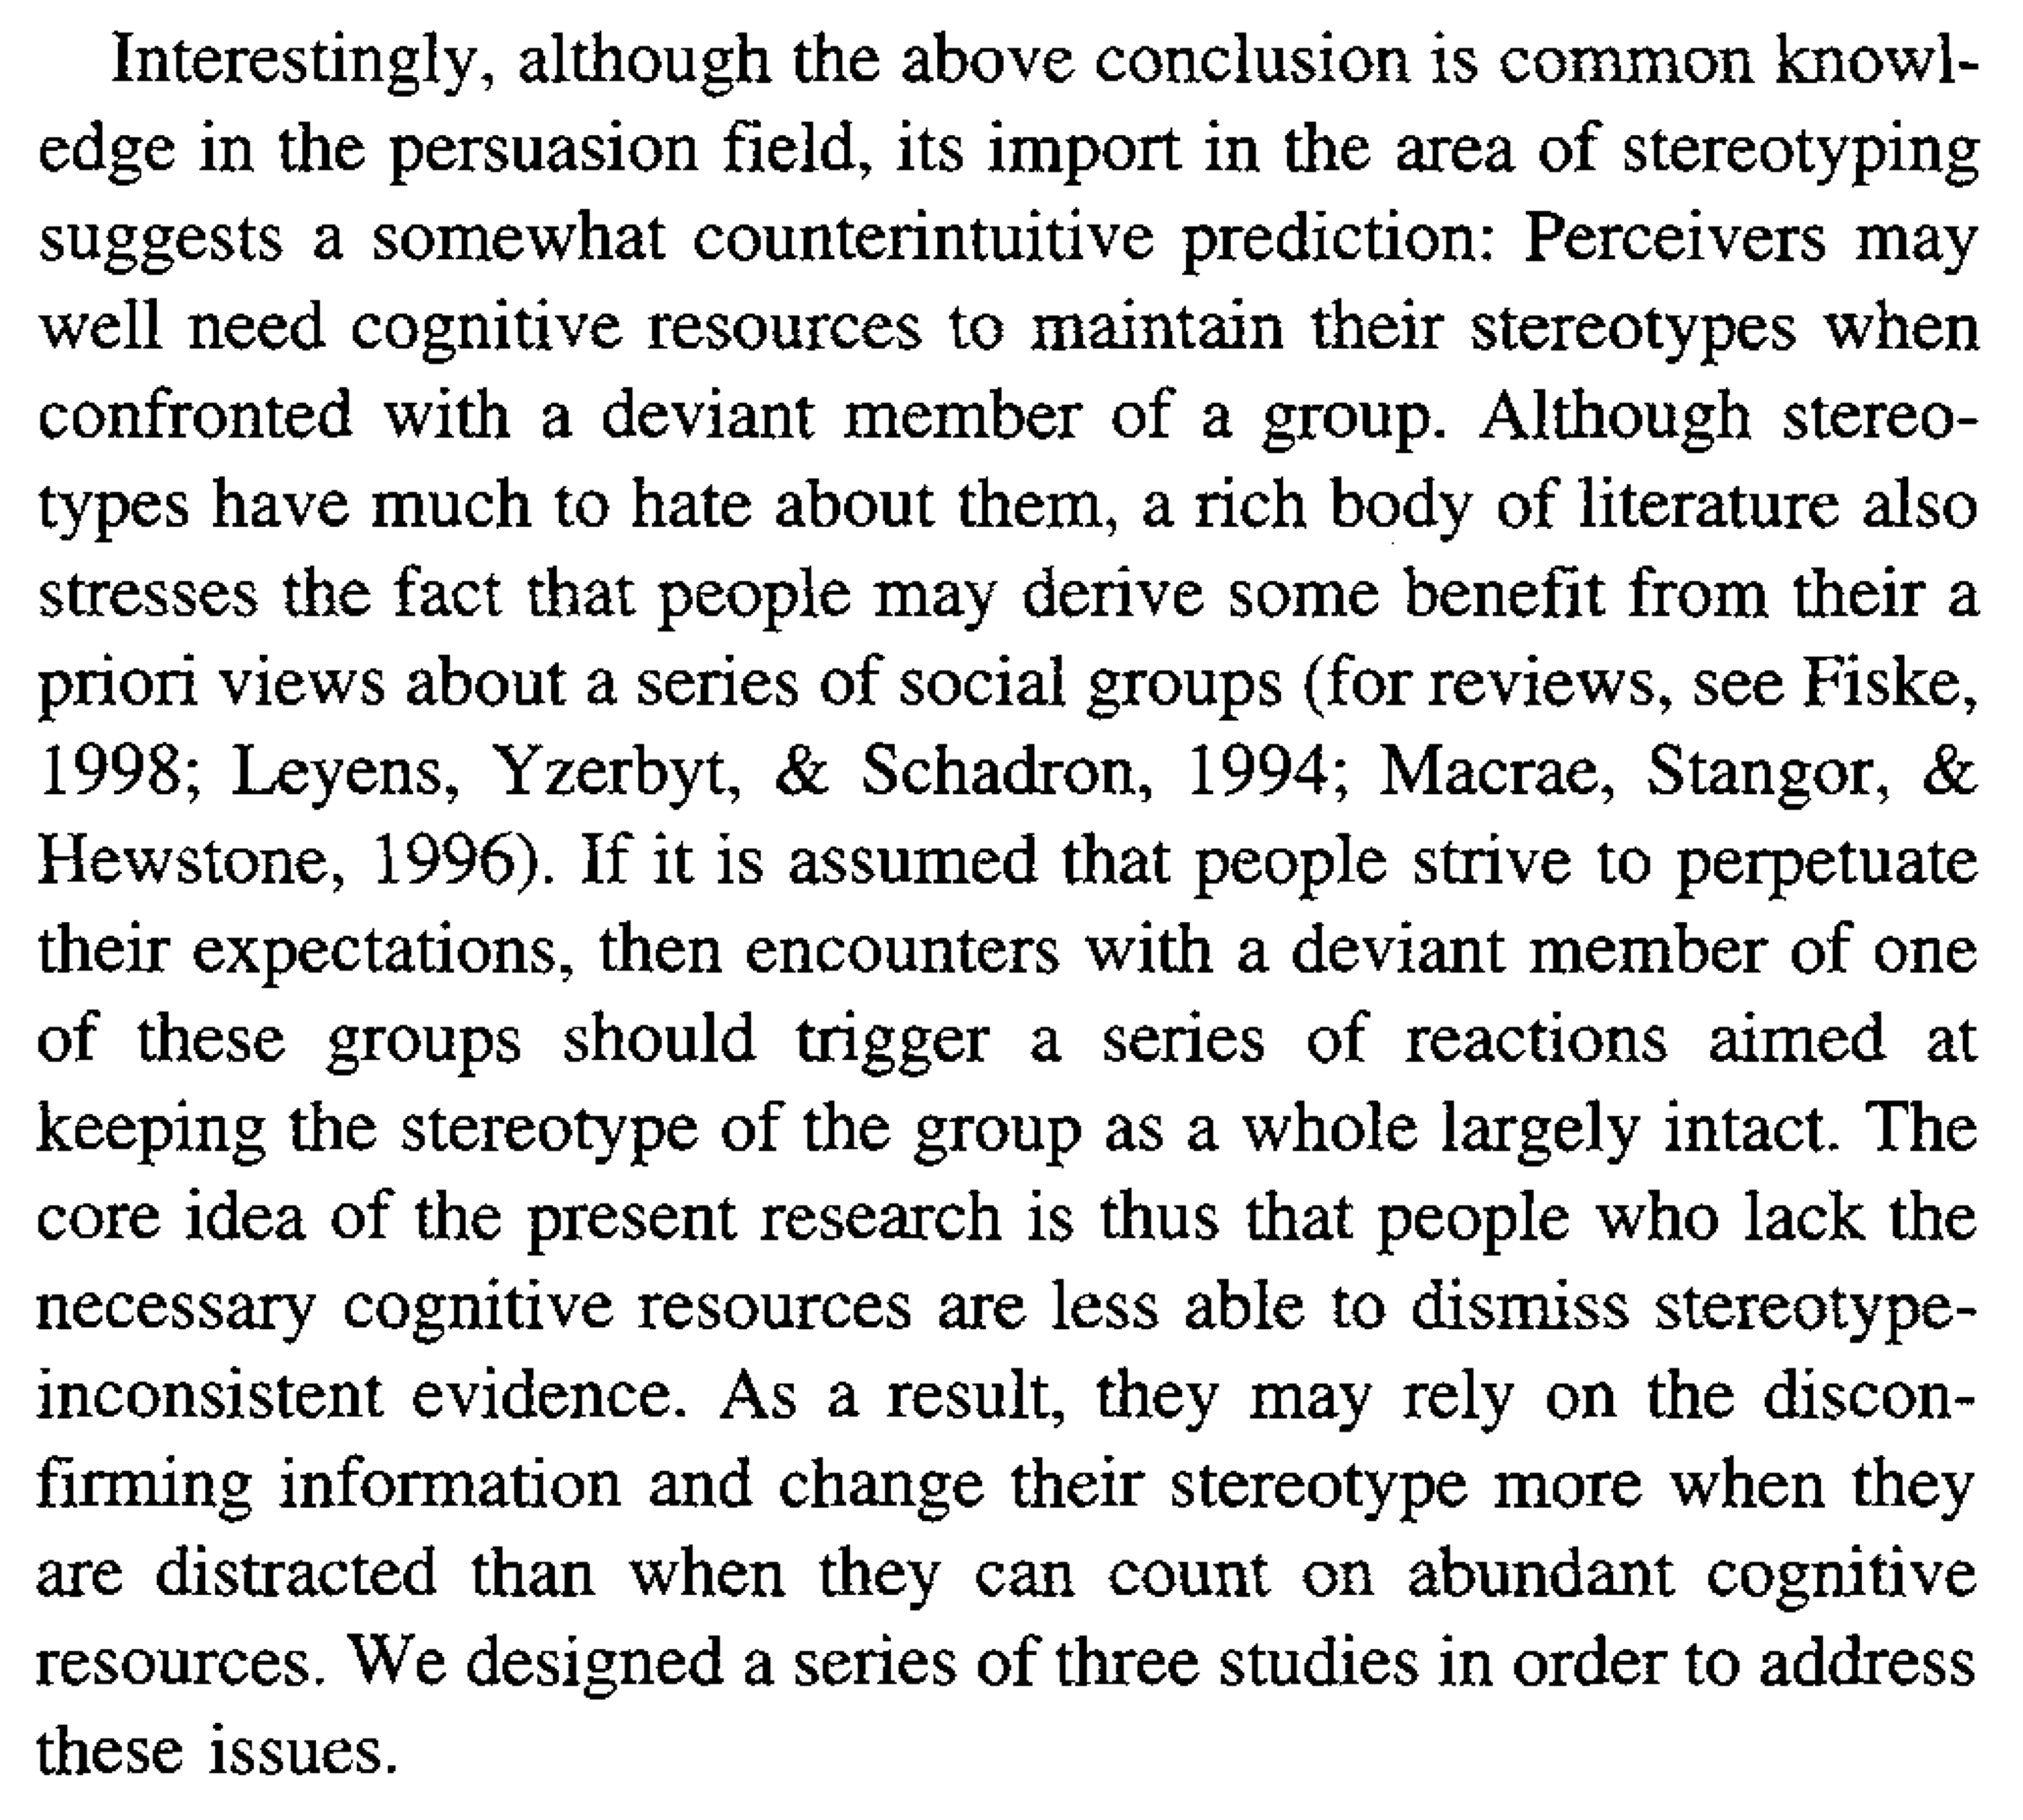
Yzerbyt et al. 1999

Slide 4
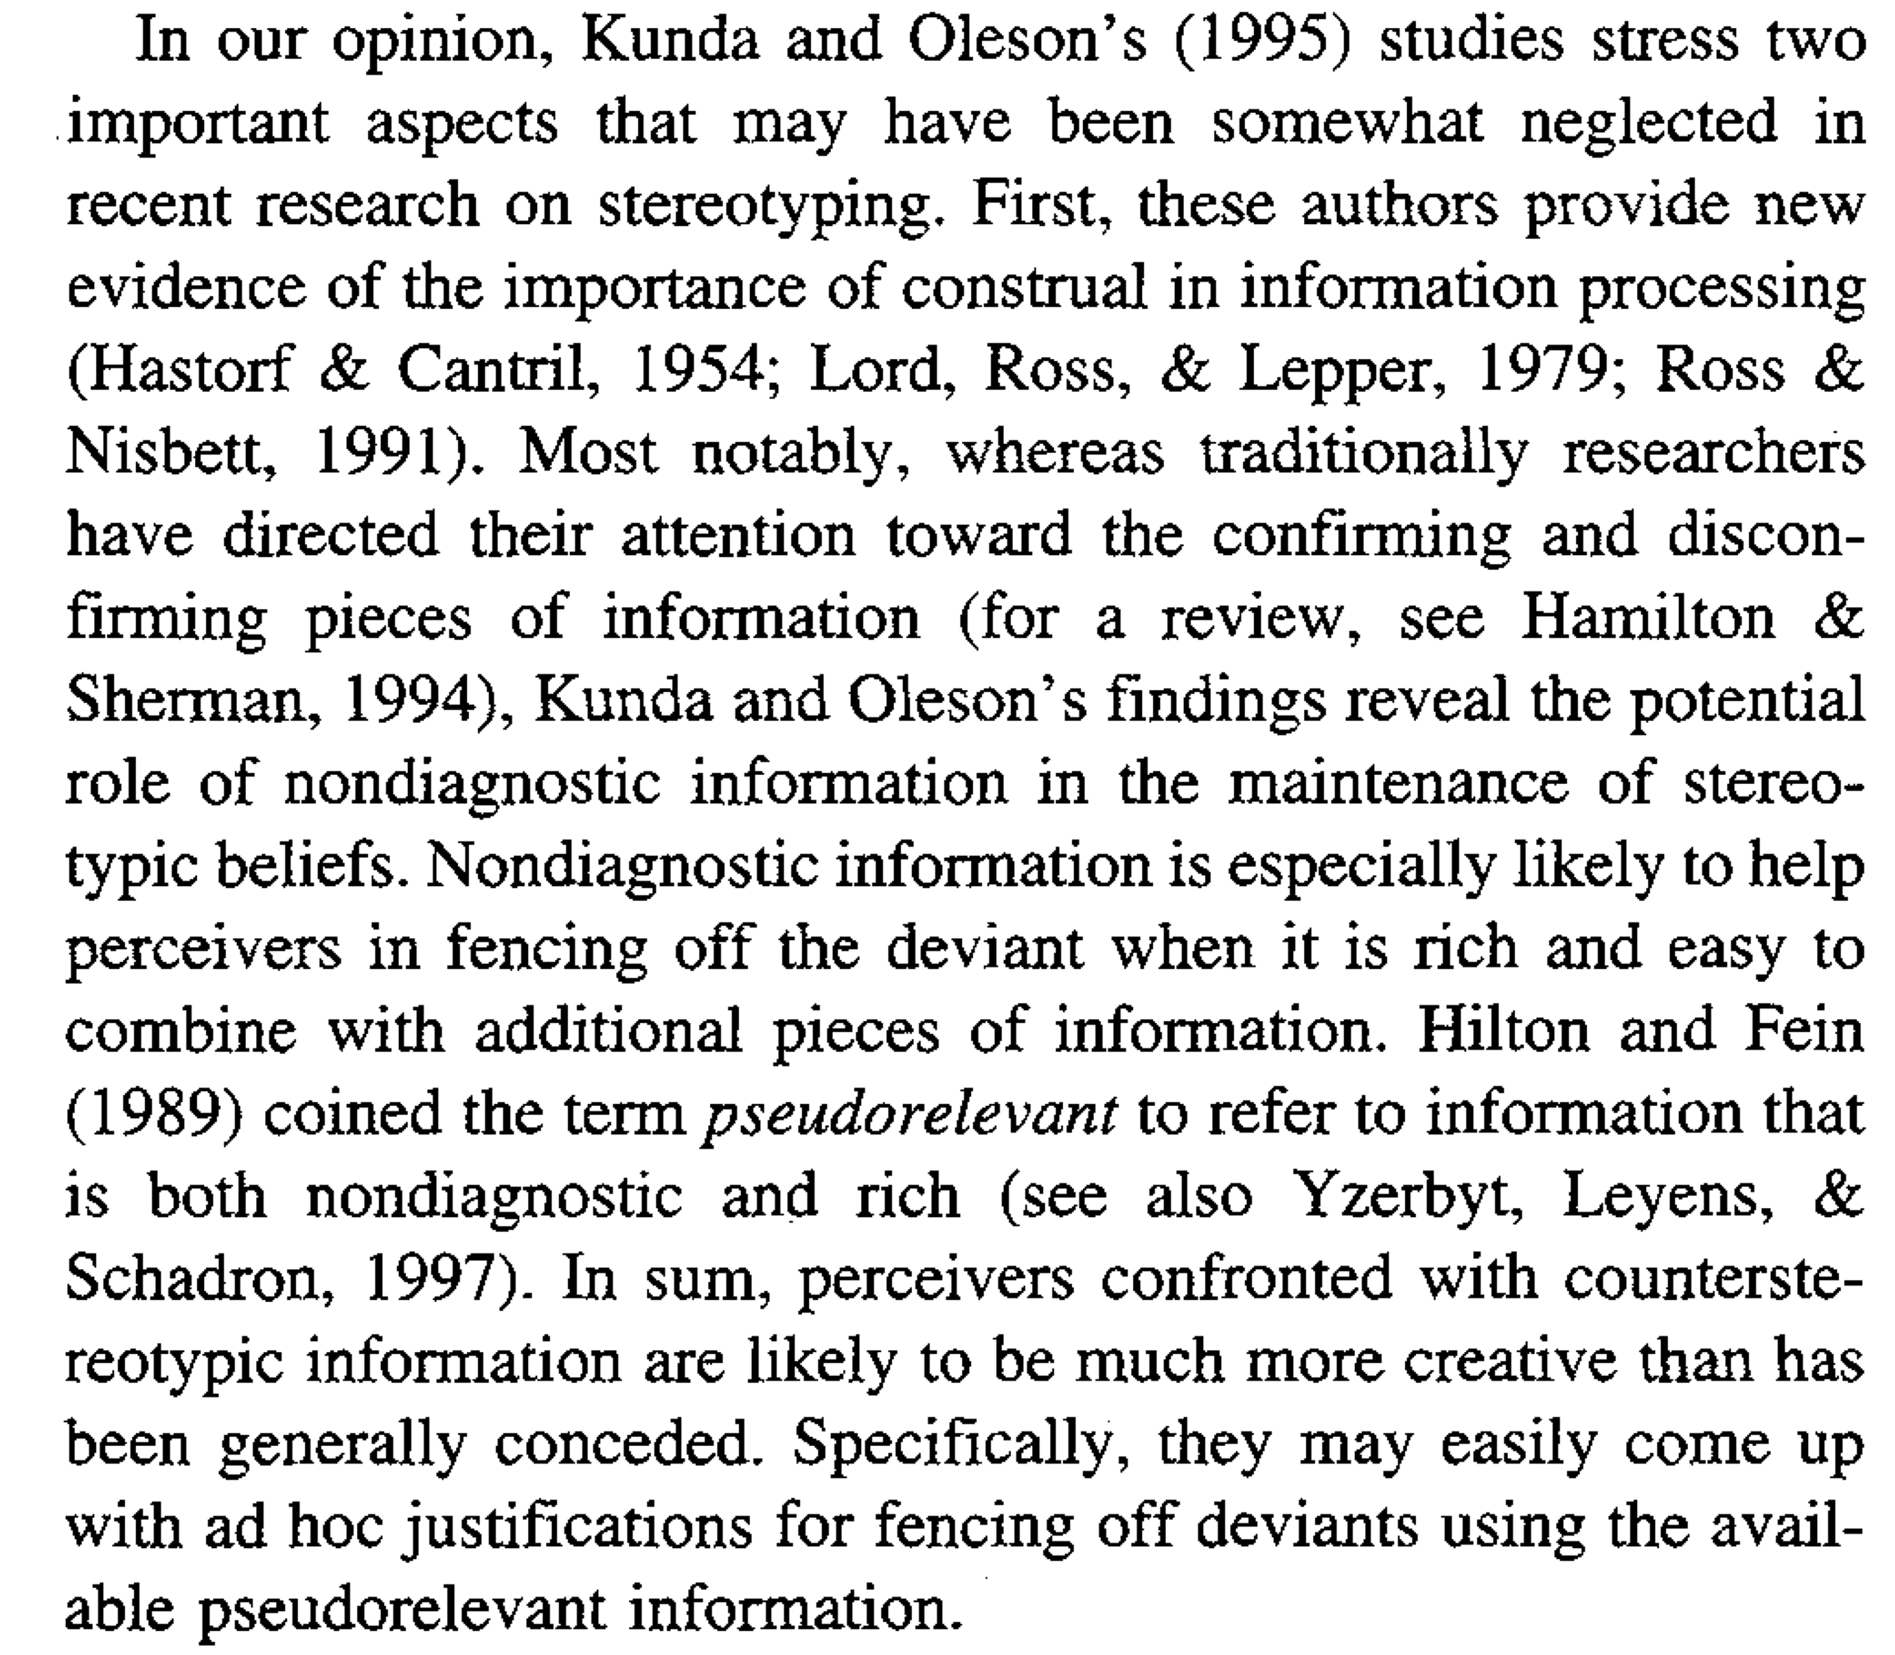
Yzerbyt et al. 1999

Slide 5
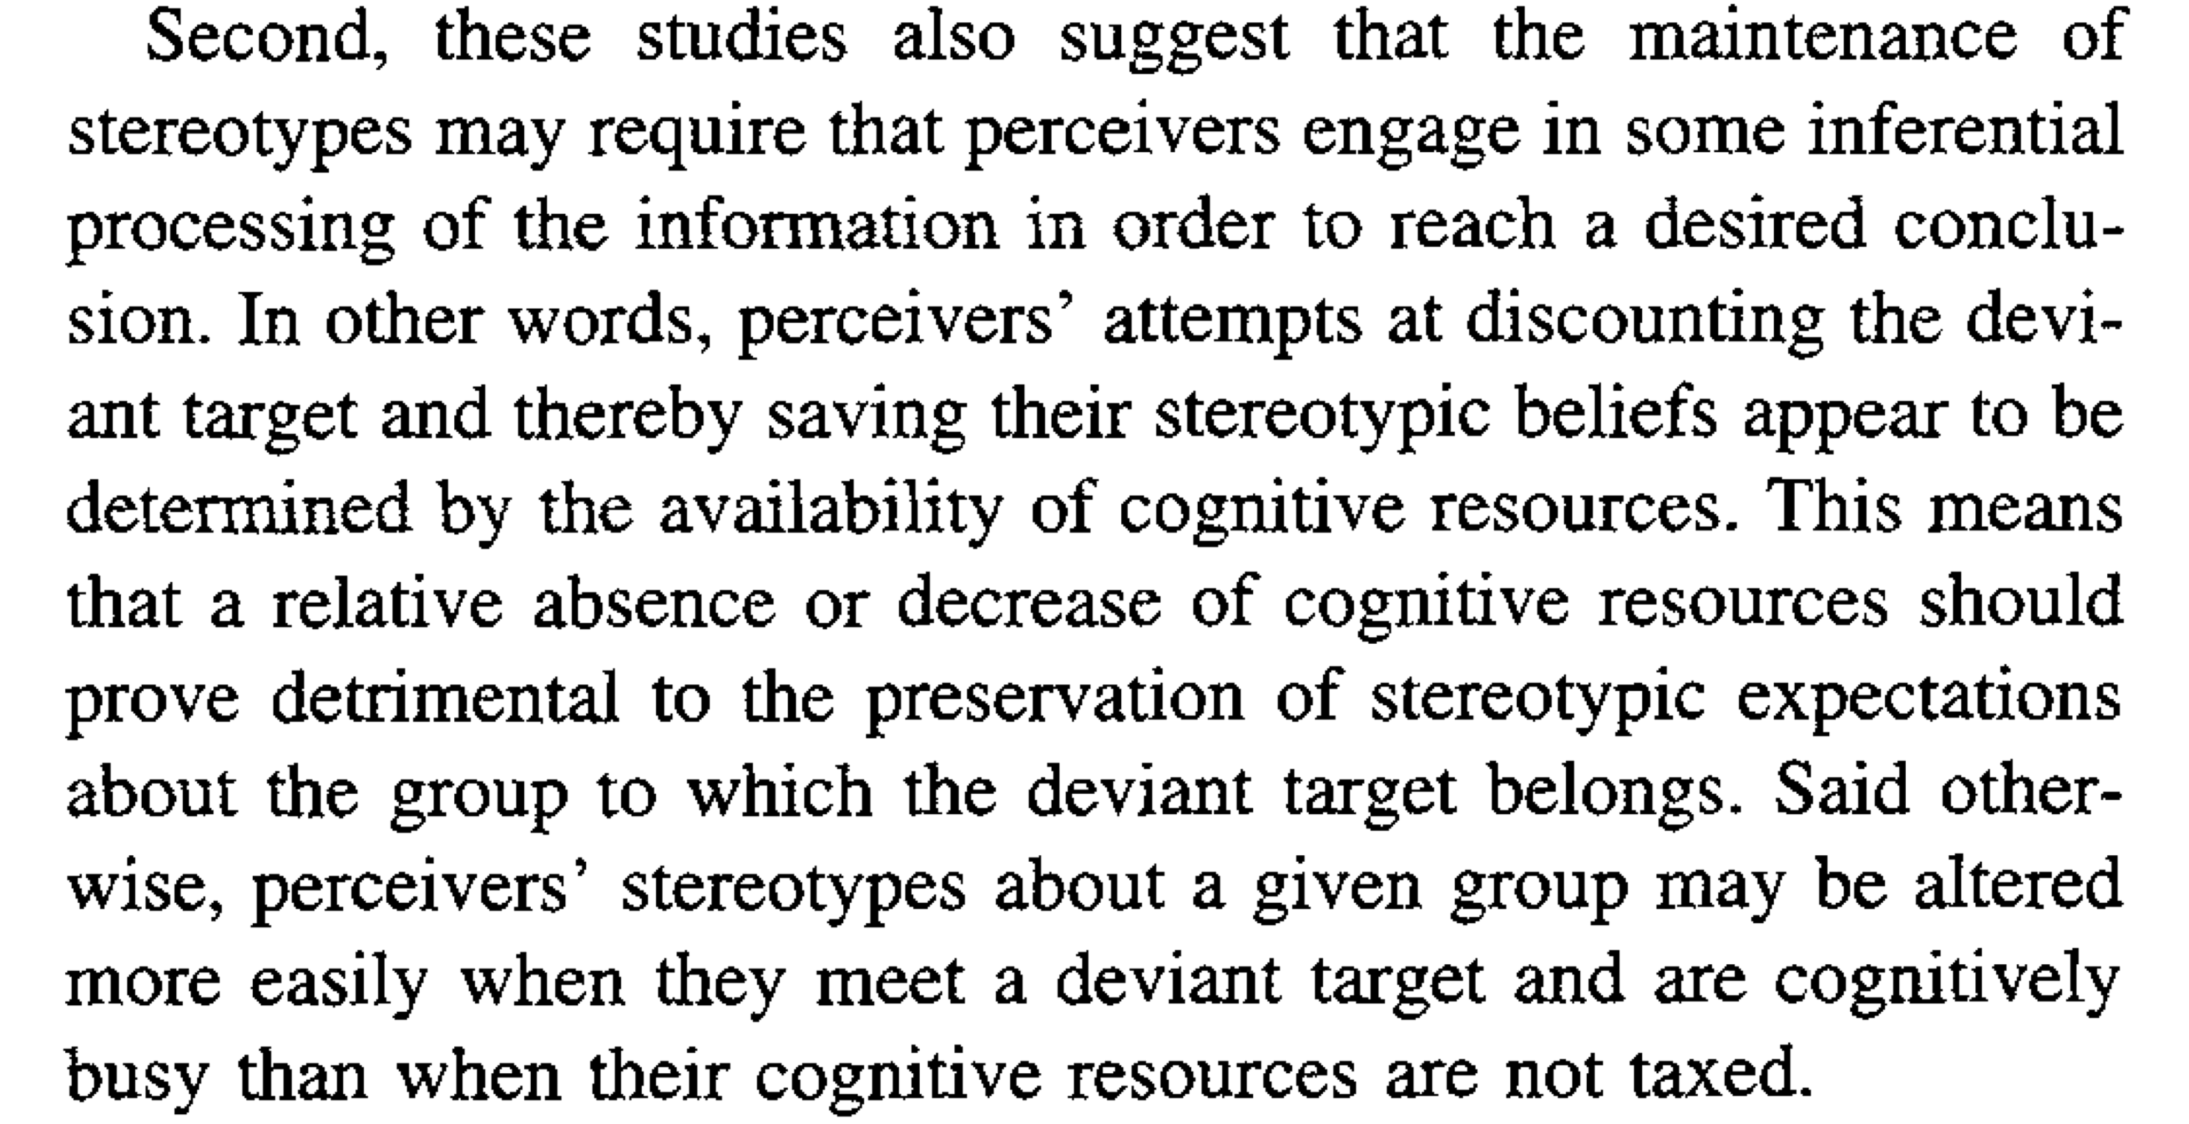
Yzerbyt et al. 1999

Slide 6
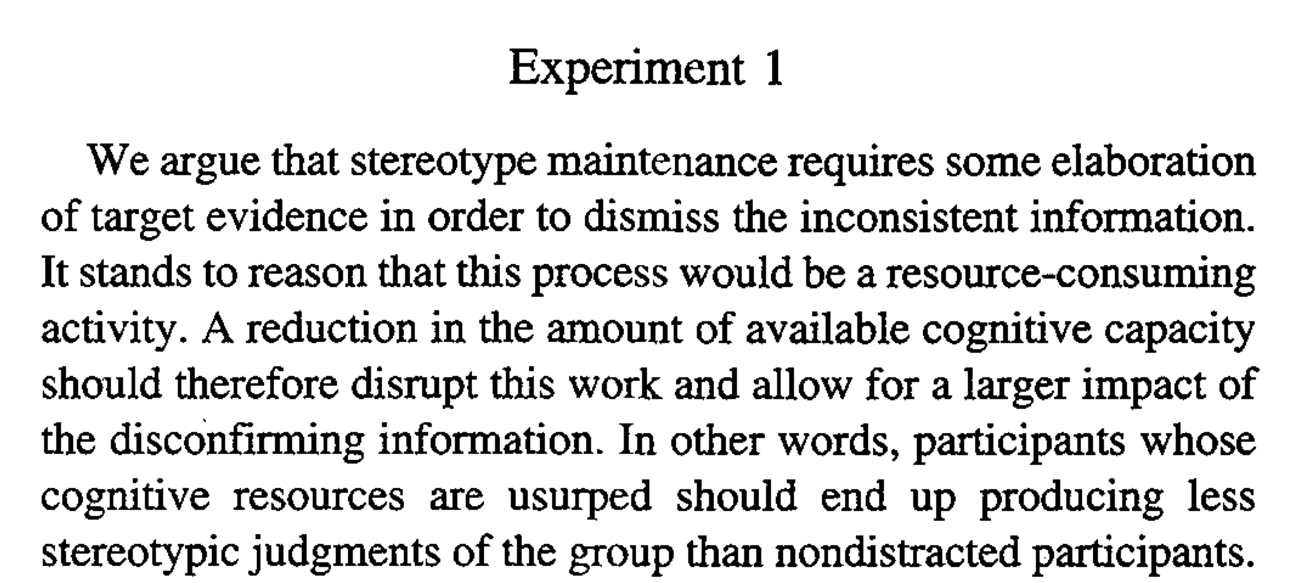
Yzerbyt et al. 1999

Slide 7
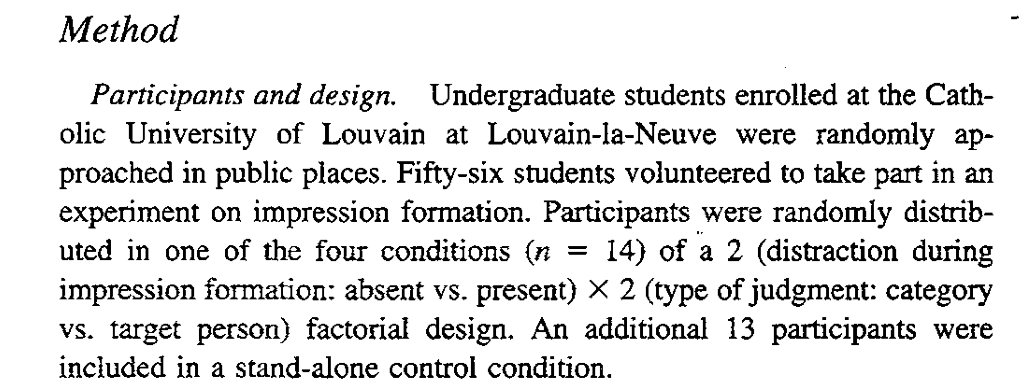
Yzerbyt et al. 1999

Slide 8
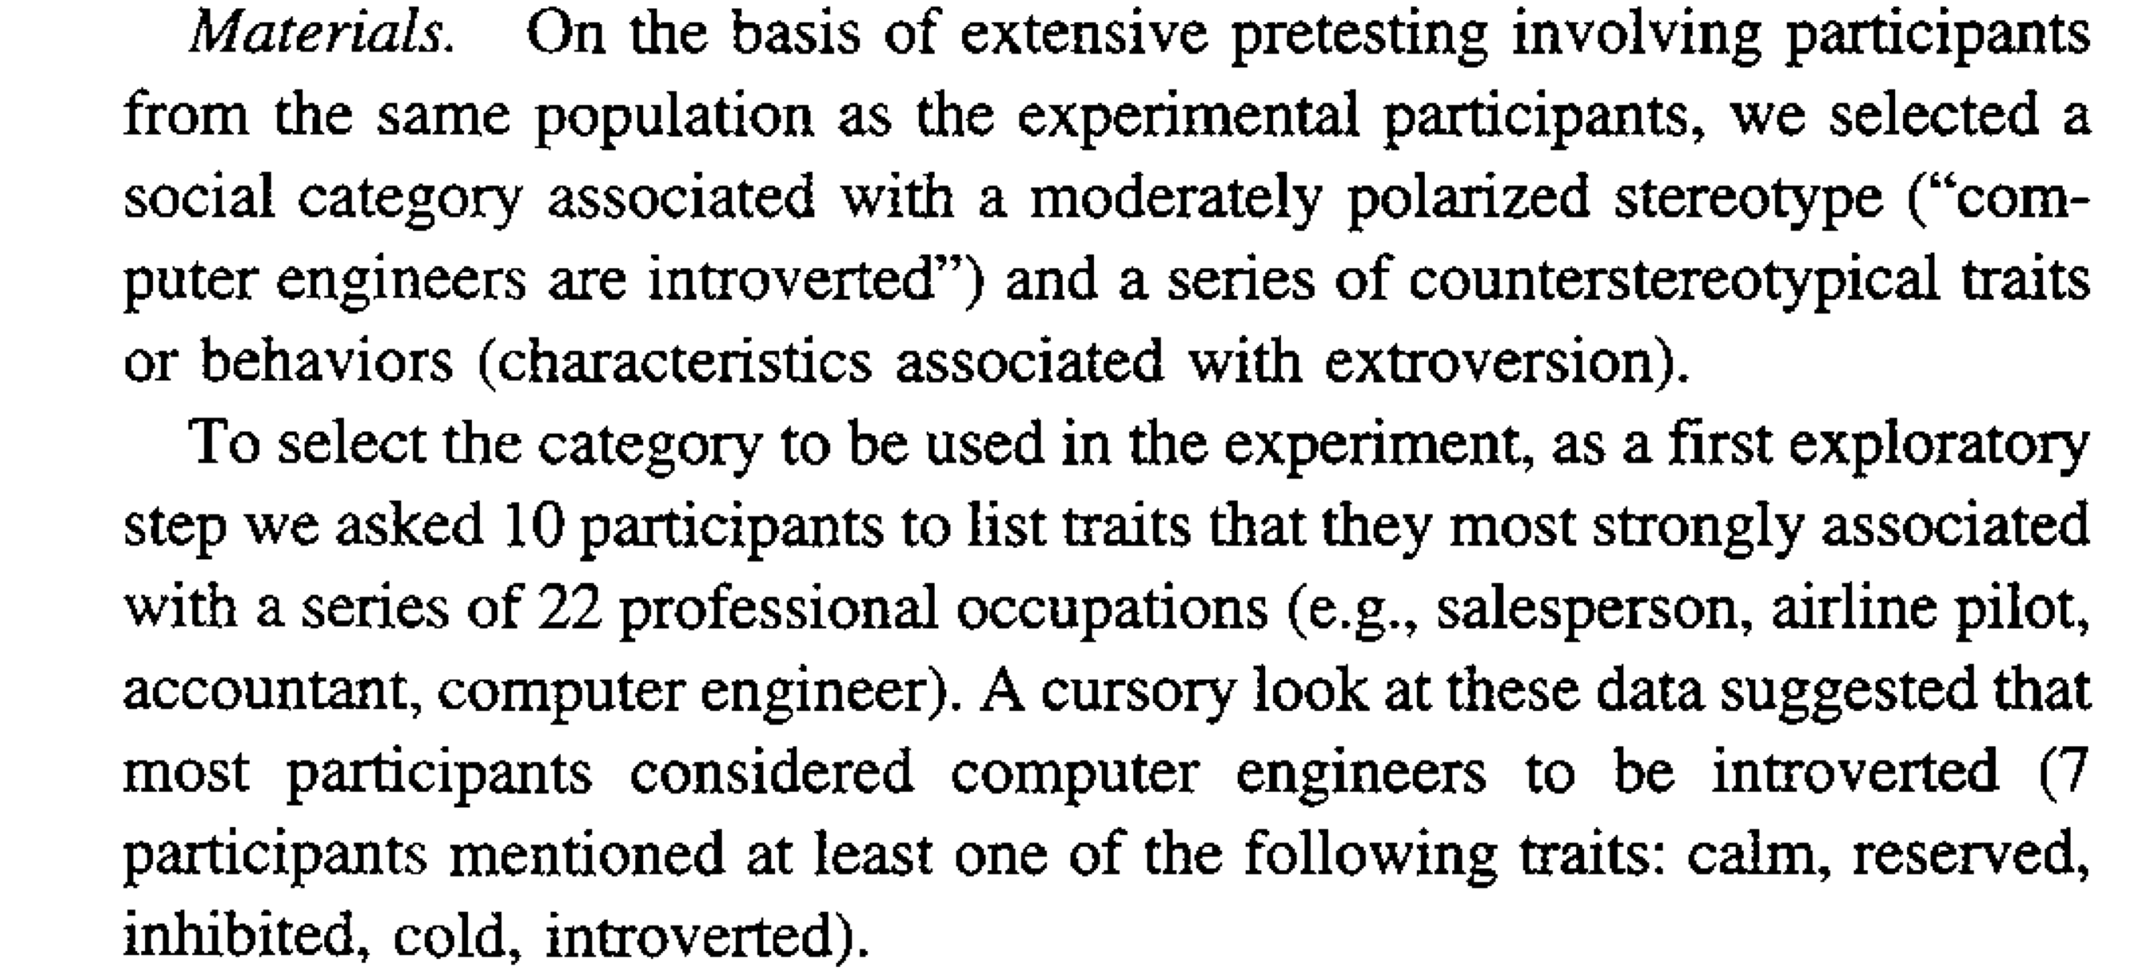
Yzerbyt et al. 1999

Slide 9
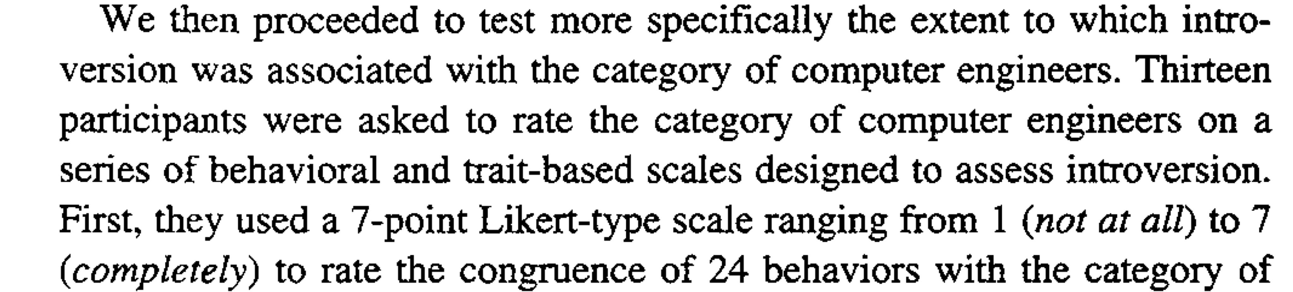
Yzerbyt et al. 1999

Slide 10
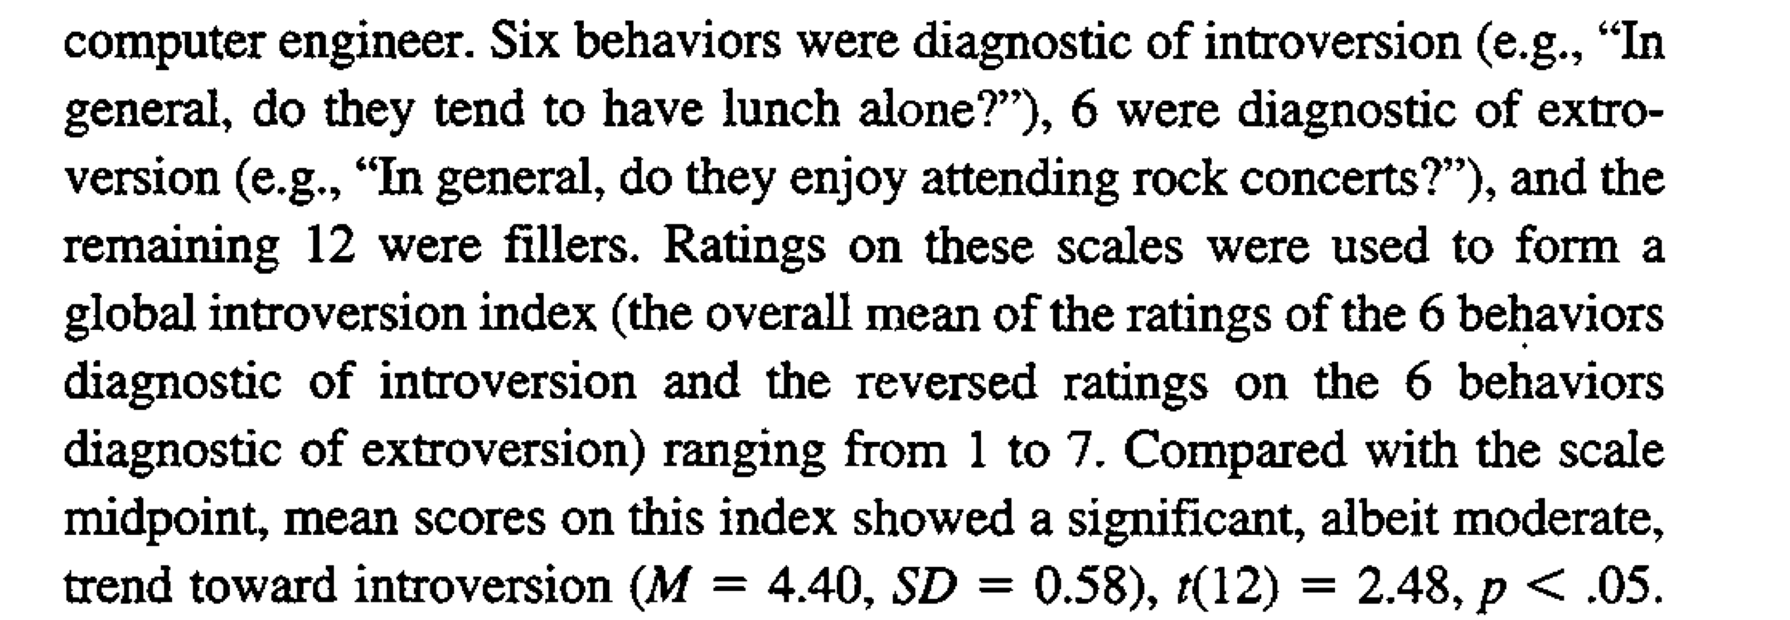
Yzerbyt et al. 1999

Slide 11
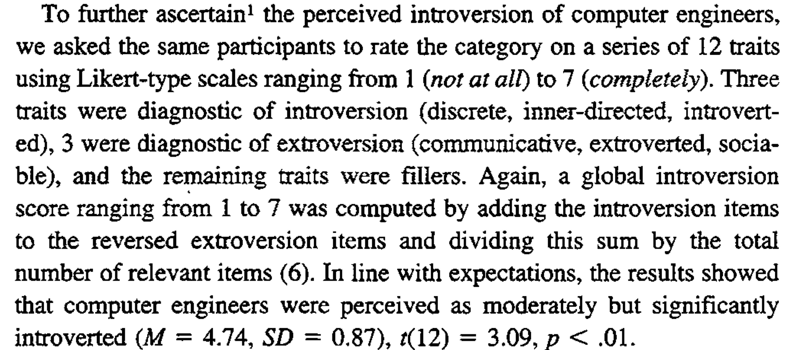
Yzerbyt et al. 1999

Slide 12
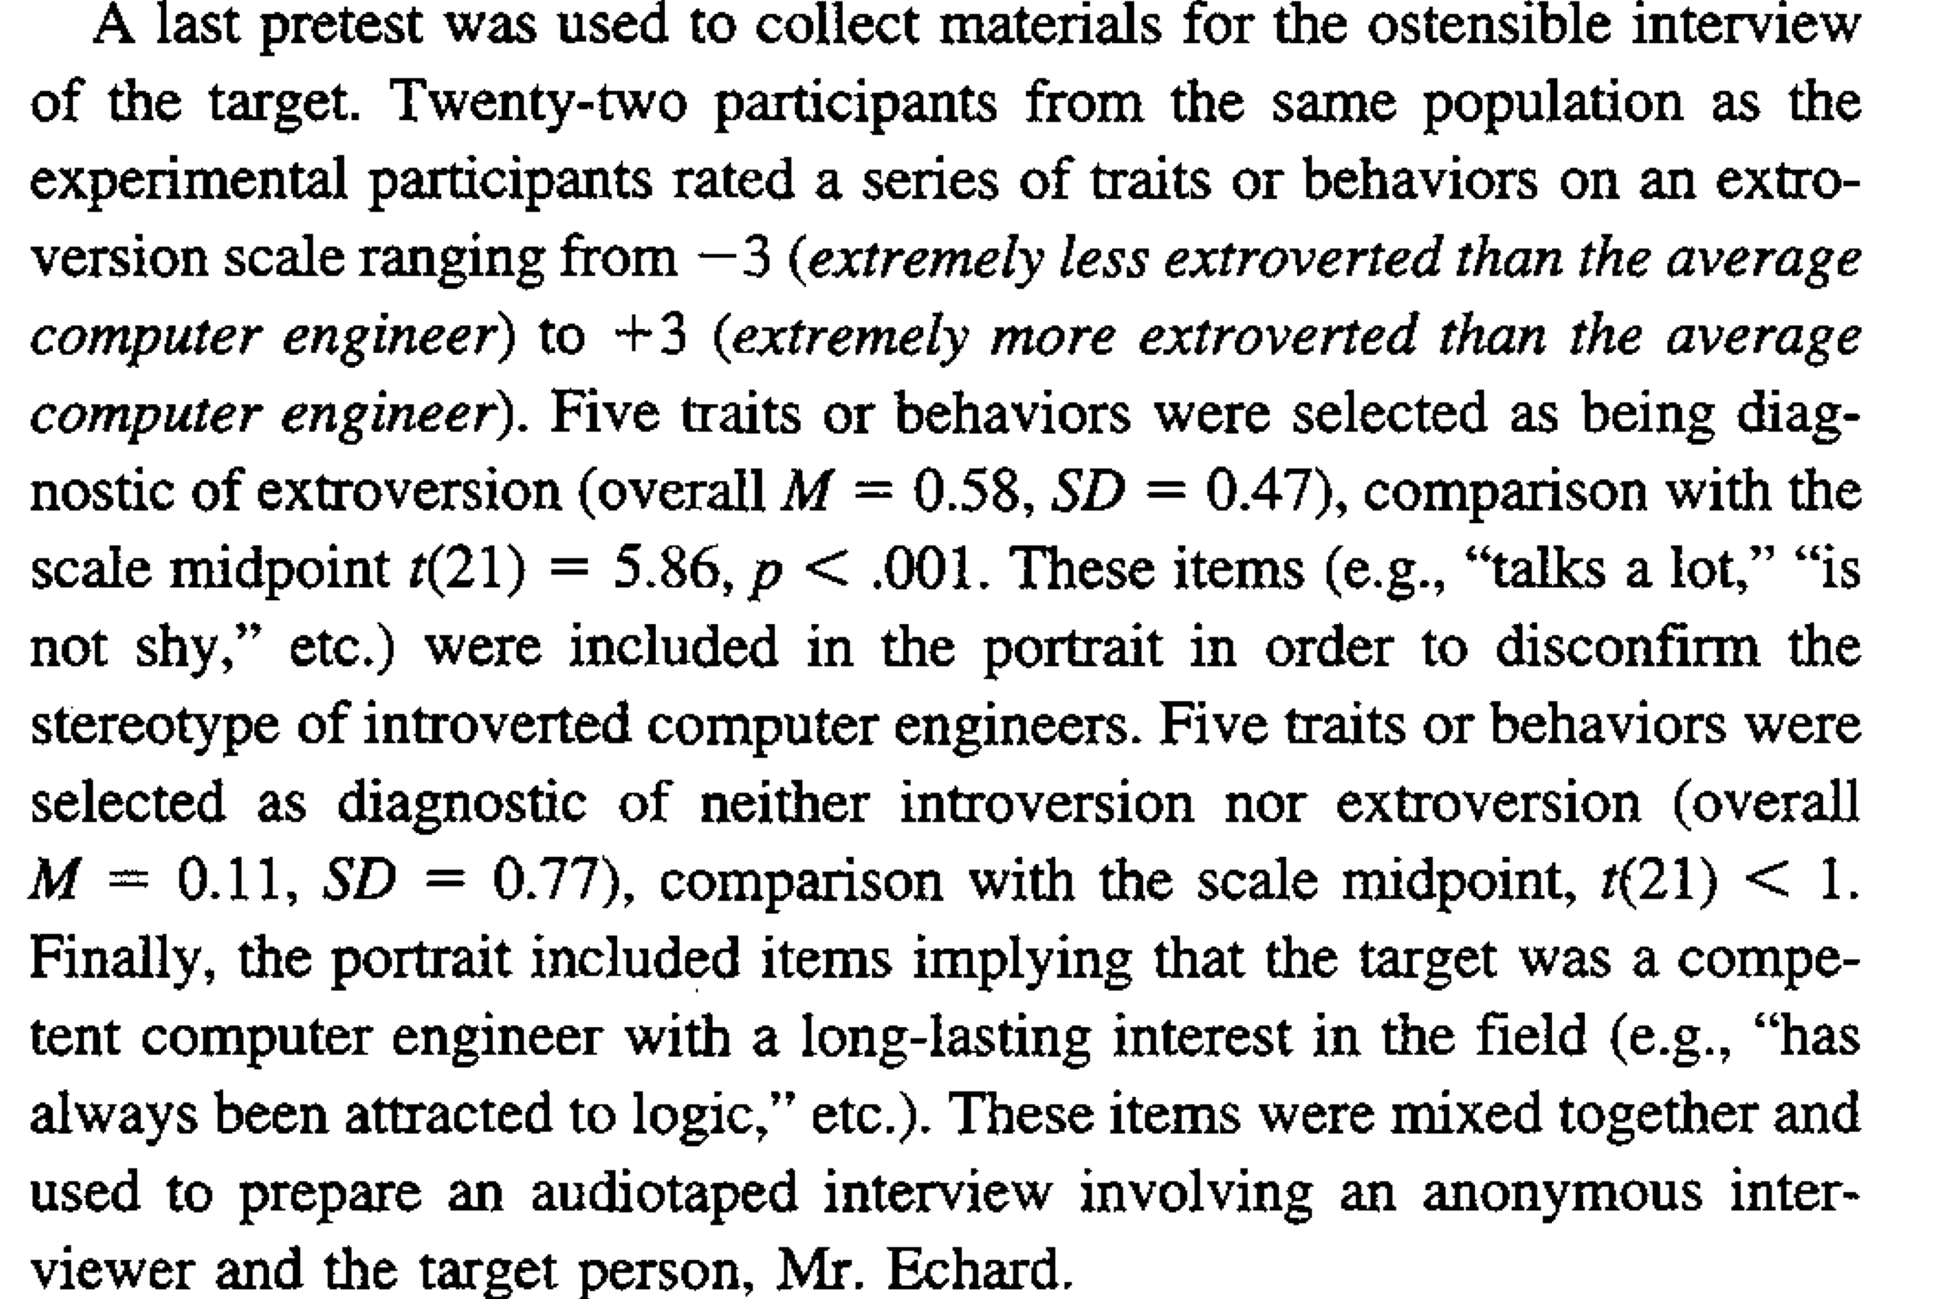
Yzerbyt et al. 1999

Slide 13
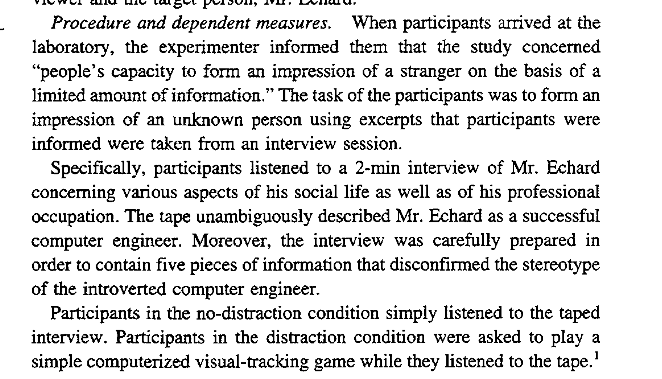
Yzerbyt et al. 1999

Slide 14
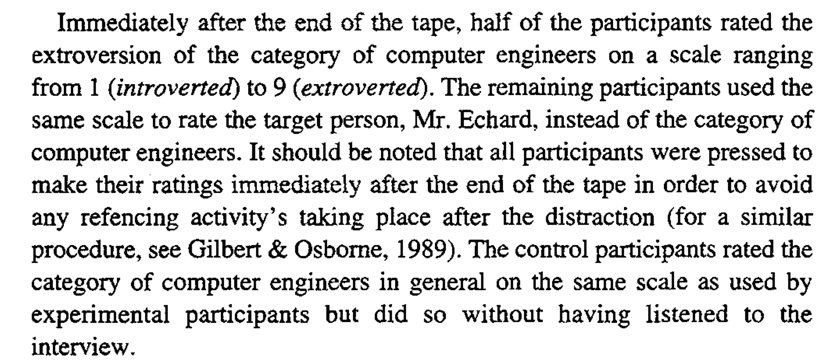
Yzerbyt et al. 1999

Slide 15
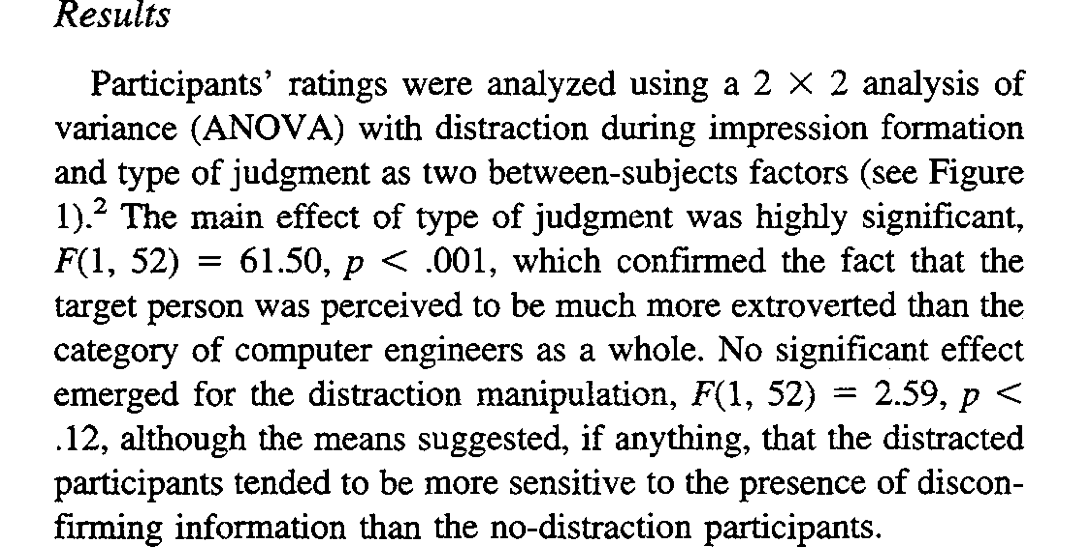
Yzerbyt et al. 1999

Slide 16
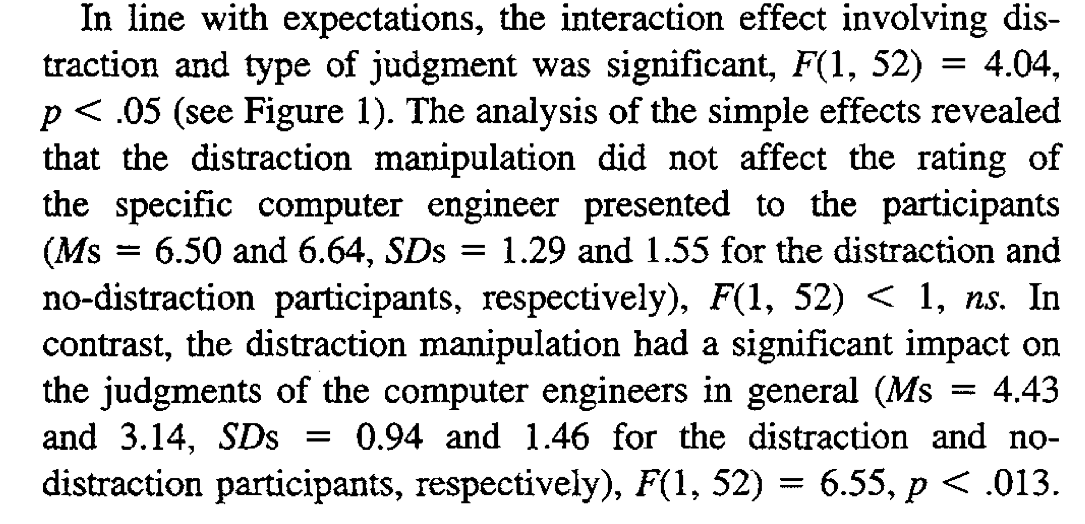
Yzerbyt et al. 1999

Slide 17
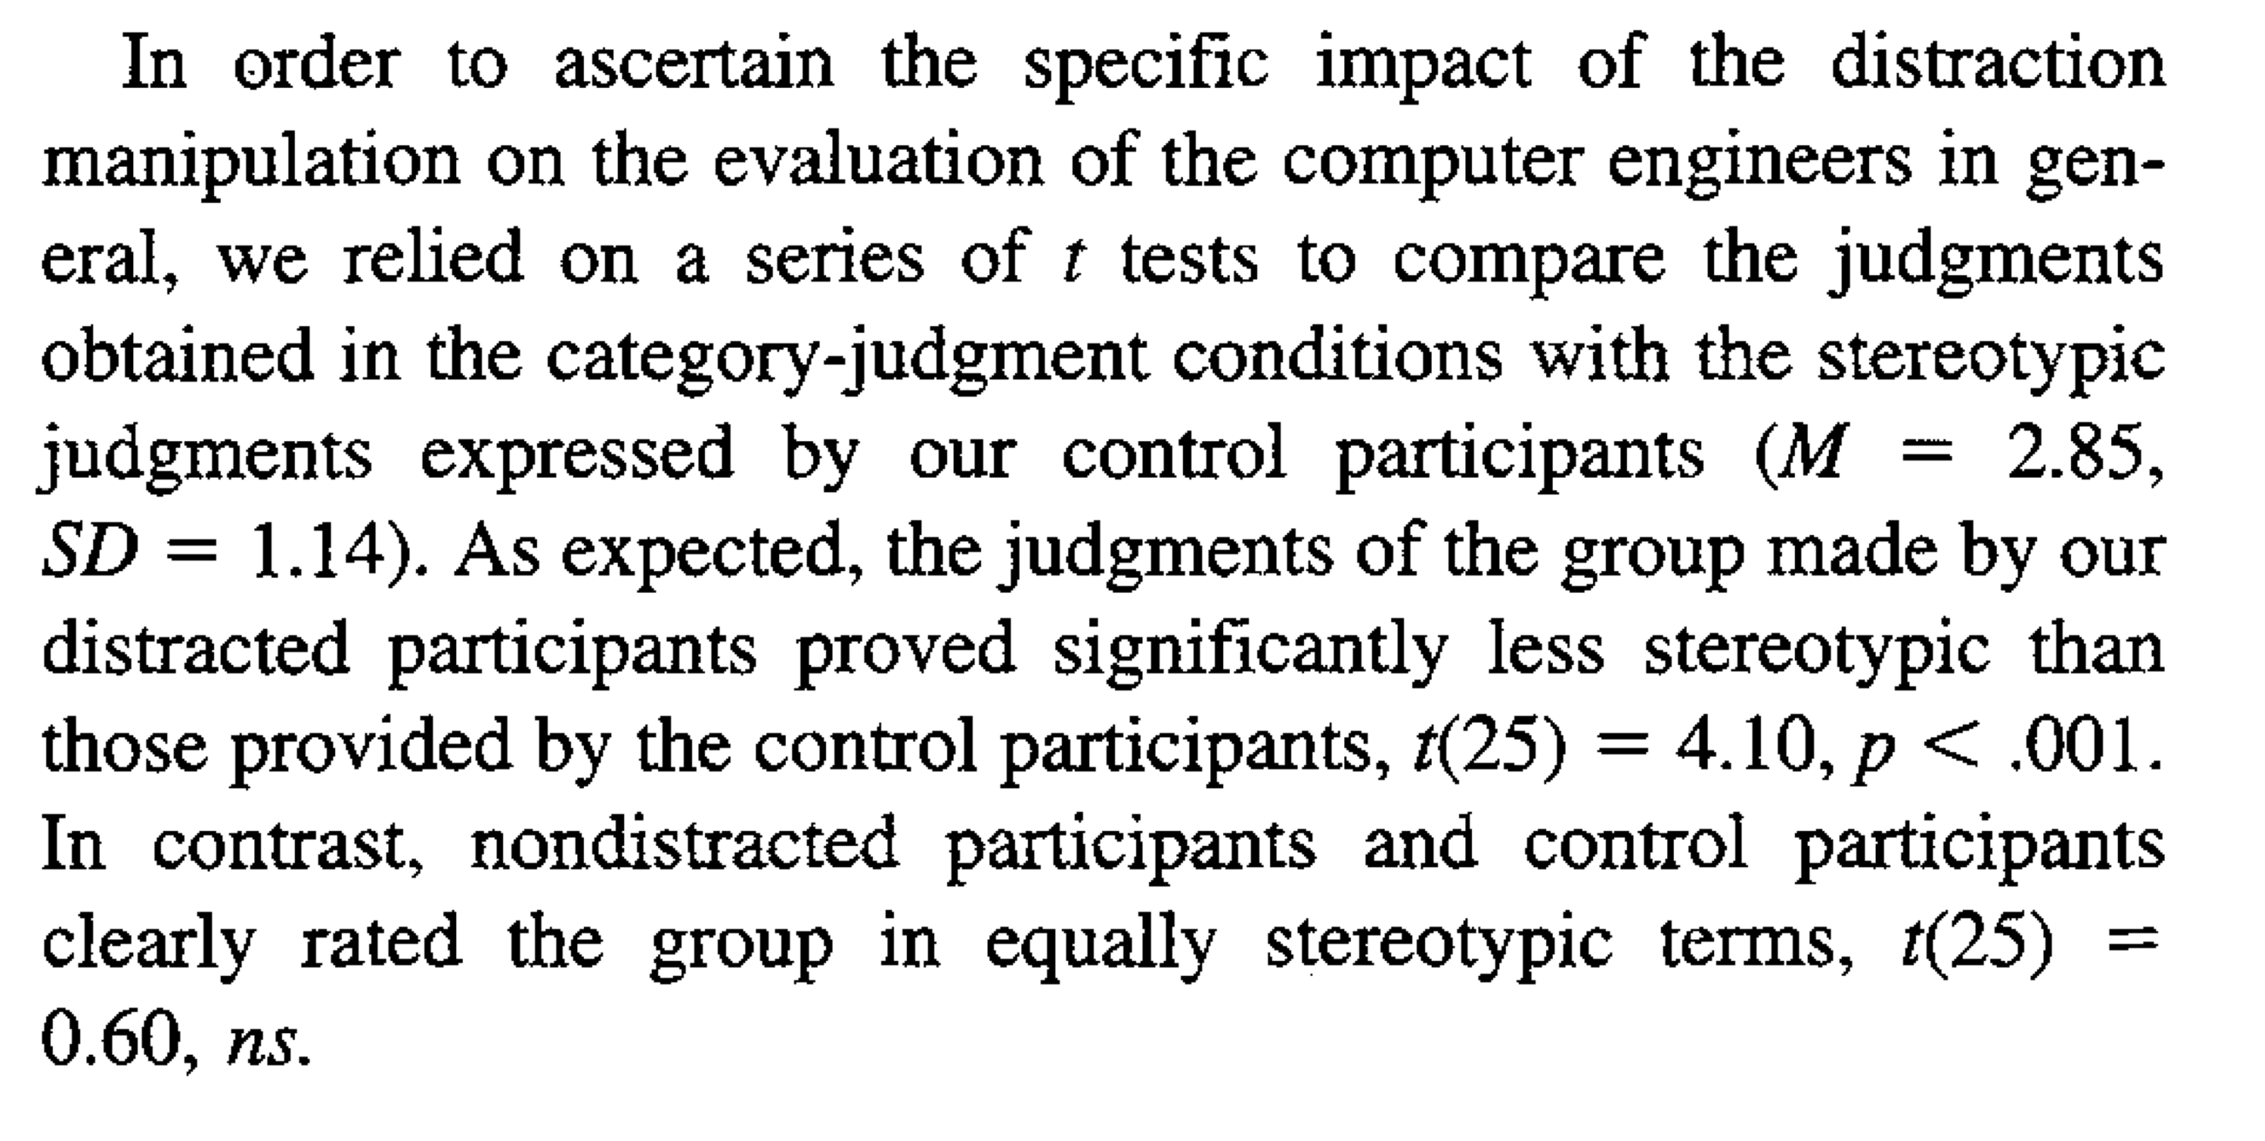
Yzerbyt et al. 1999

Slide 18
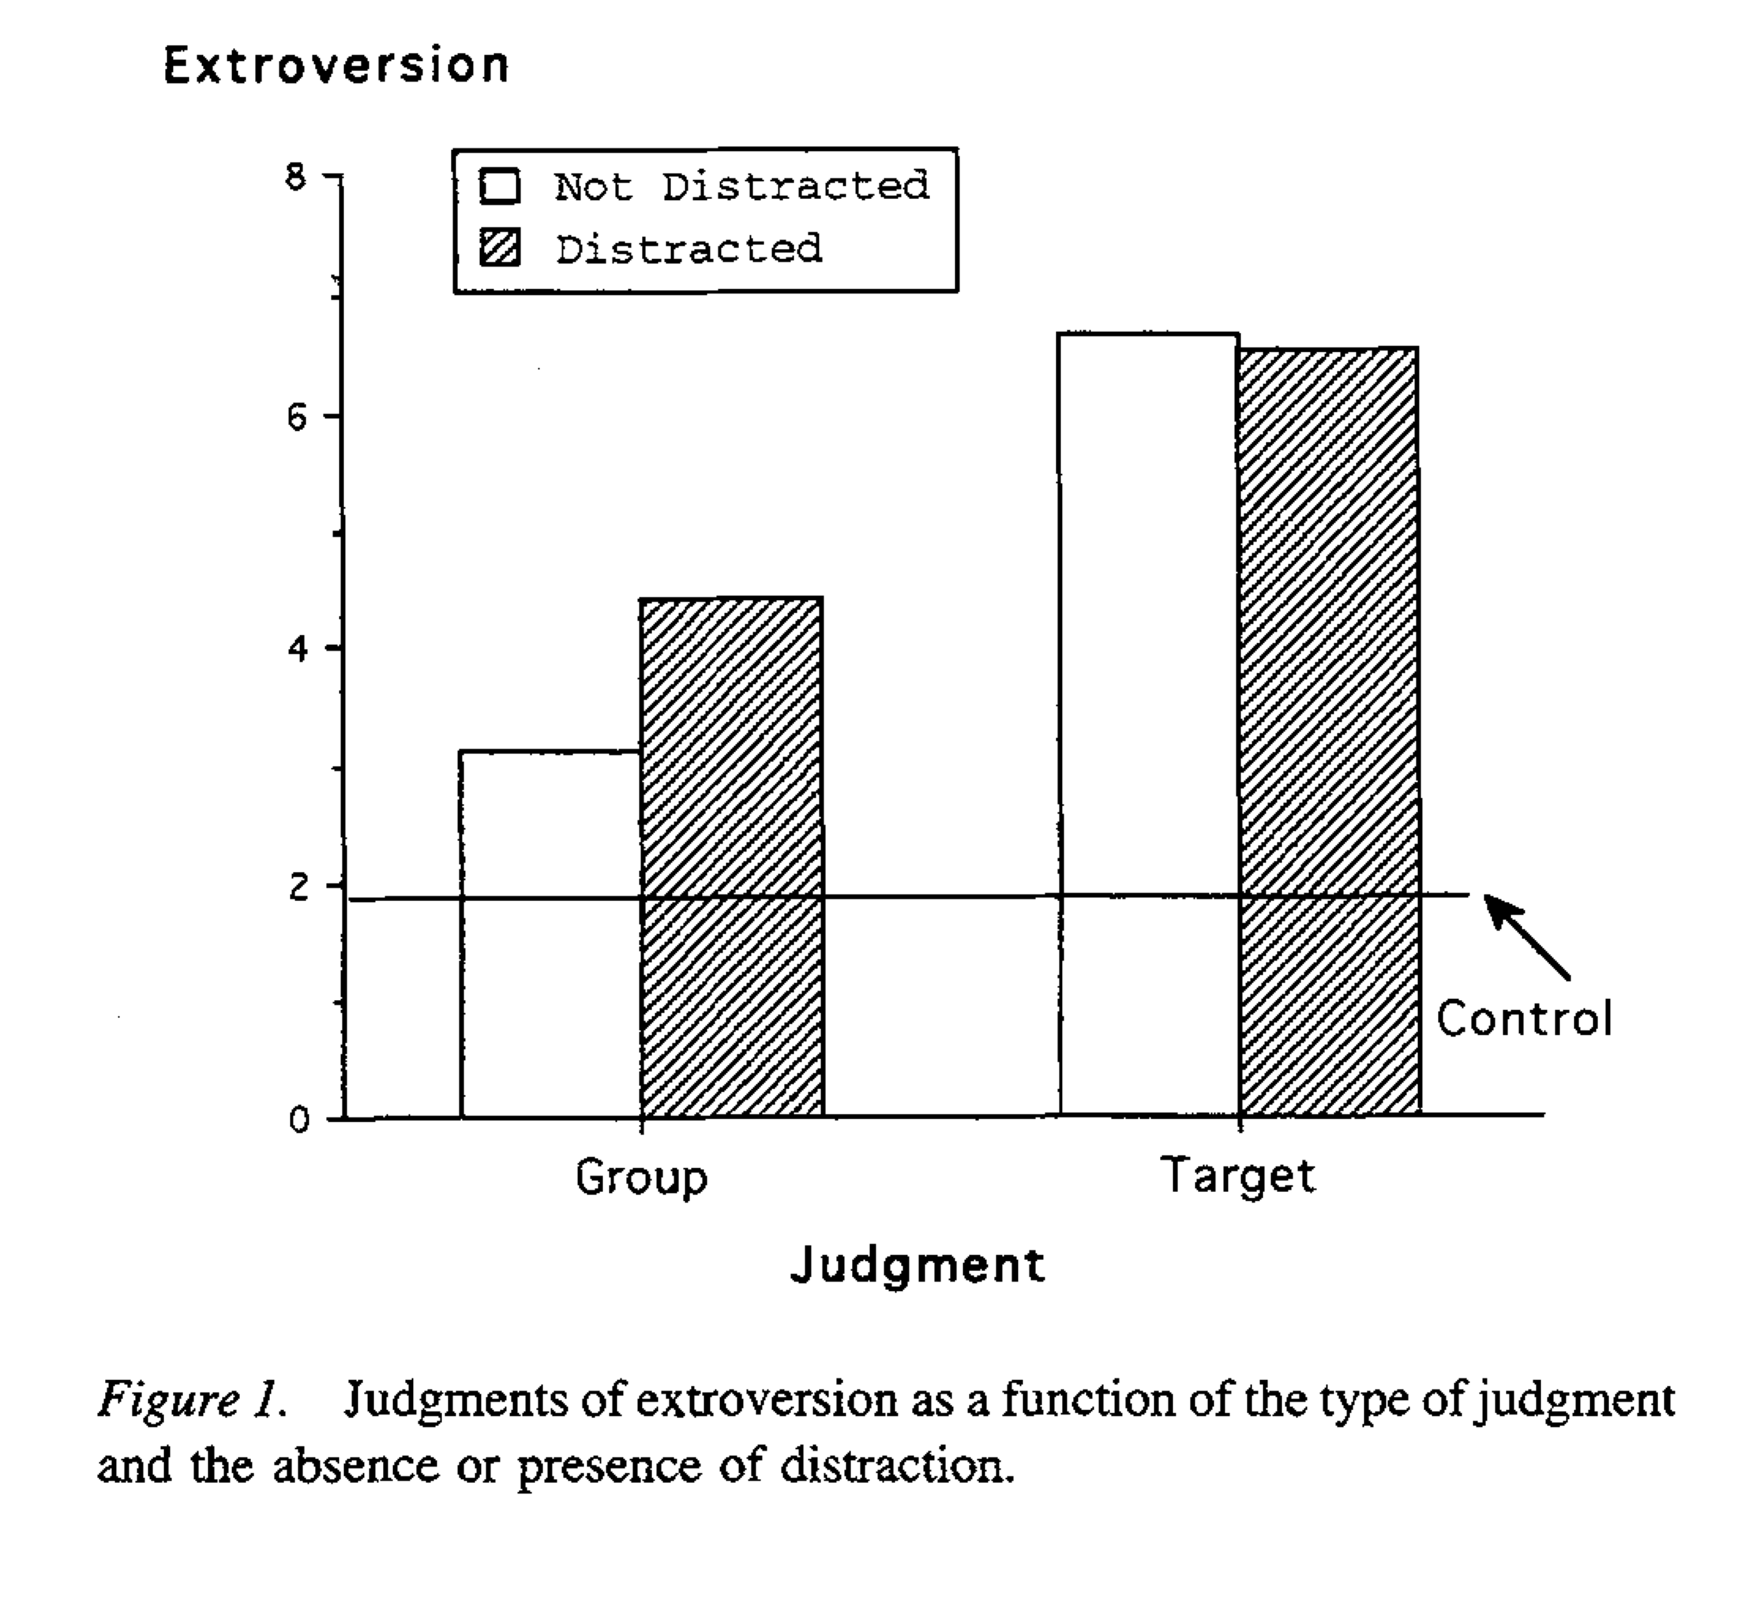
Yzerbyt et al. 1999

Slide 19
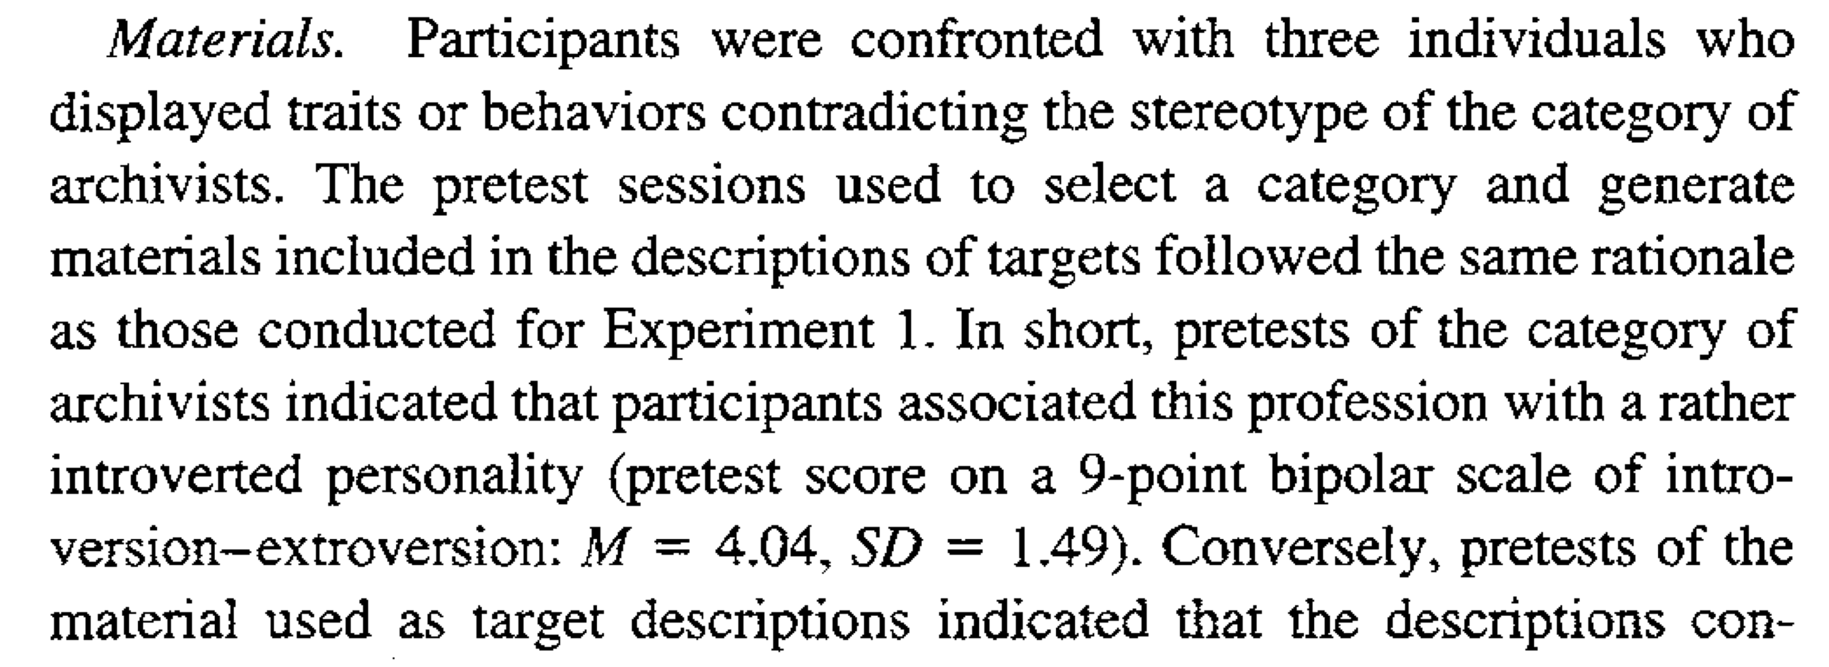
Yzerbyt et al. 1999 study 2

Slide 20
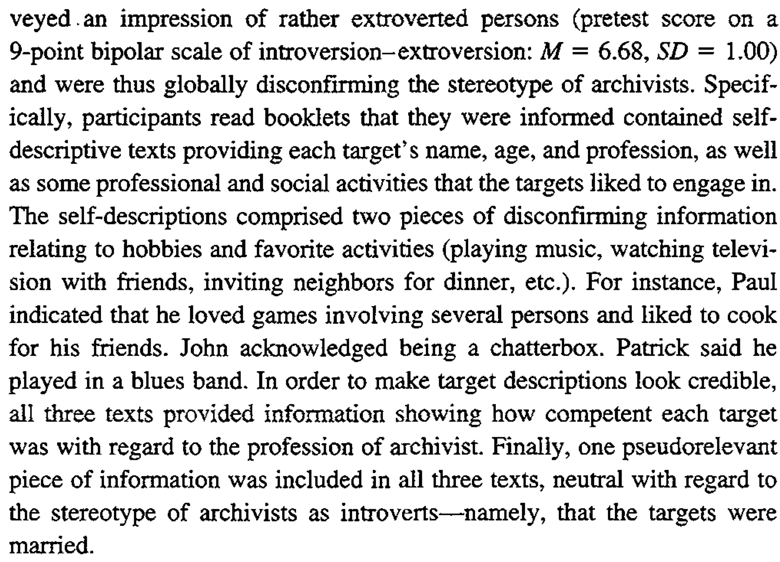
Yzerbyt et al. 1999 study 2

Slide 21
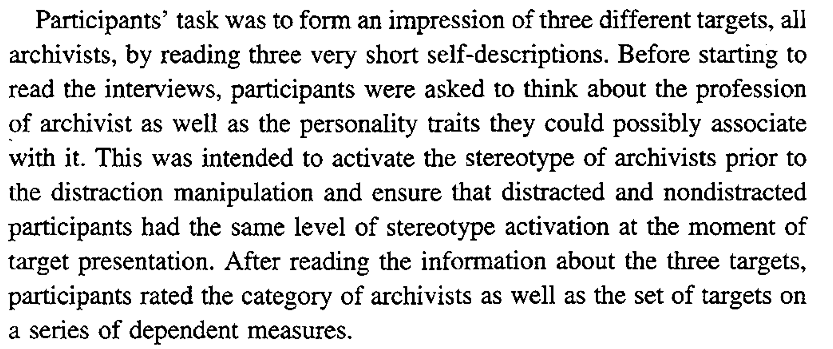
Yzerbyt et al. 1999 study 2

Slide 22
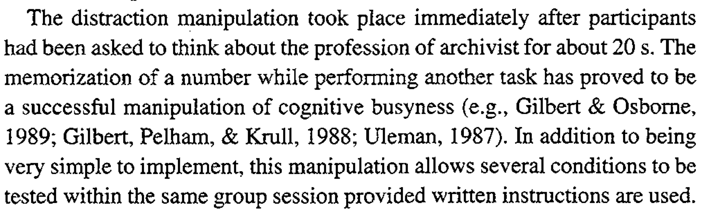
Yzerbyt et al. 1999 study 2

Slide 23
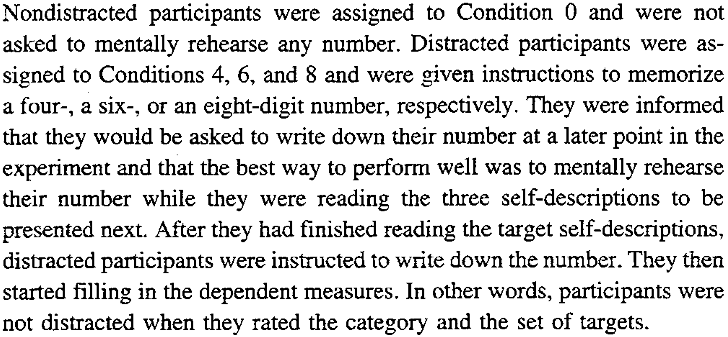
Yzerbyt et al. 1999 study 2

Slide 24
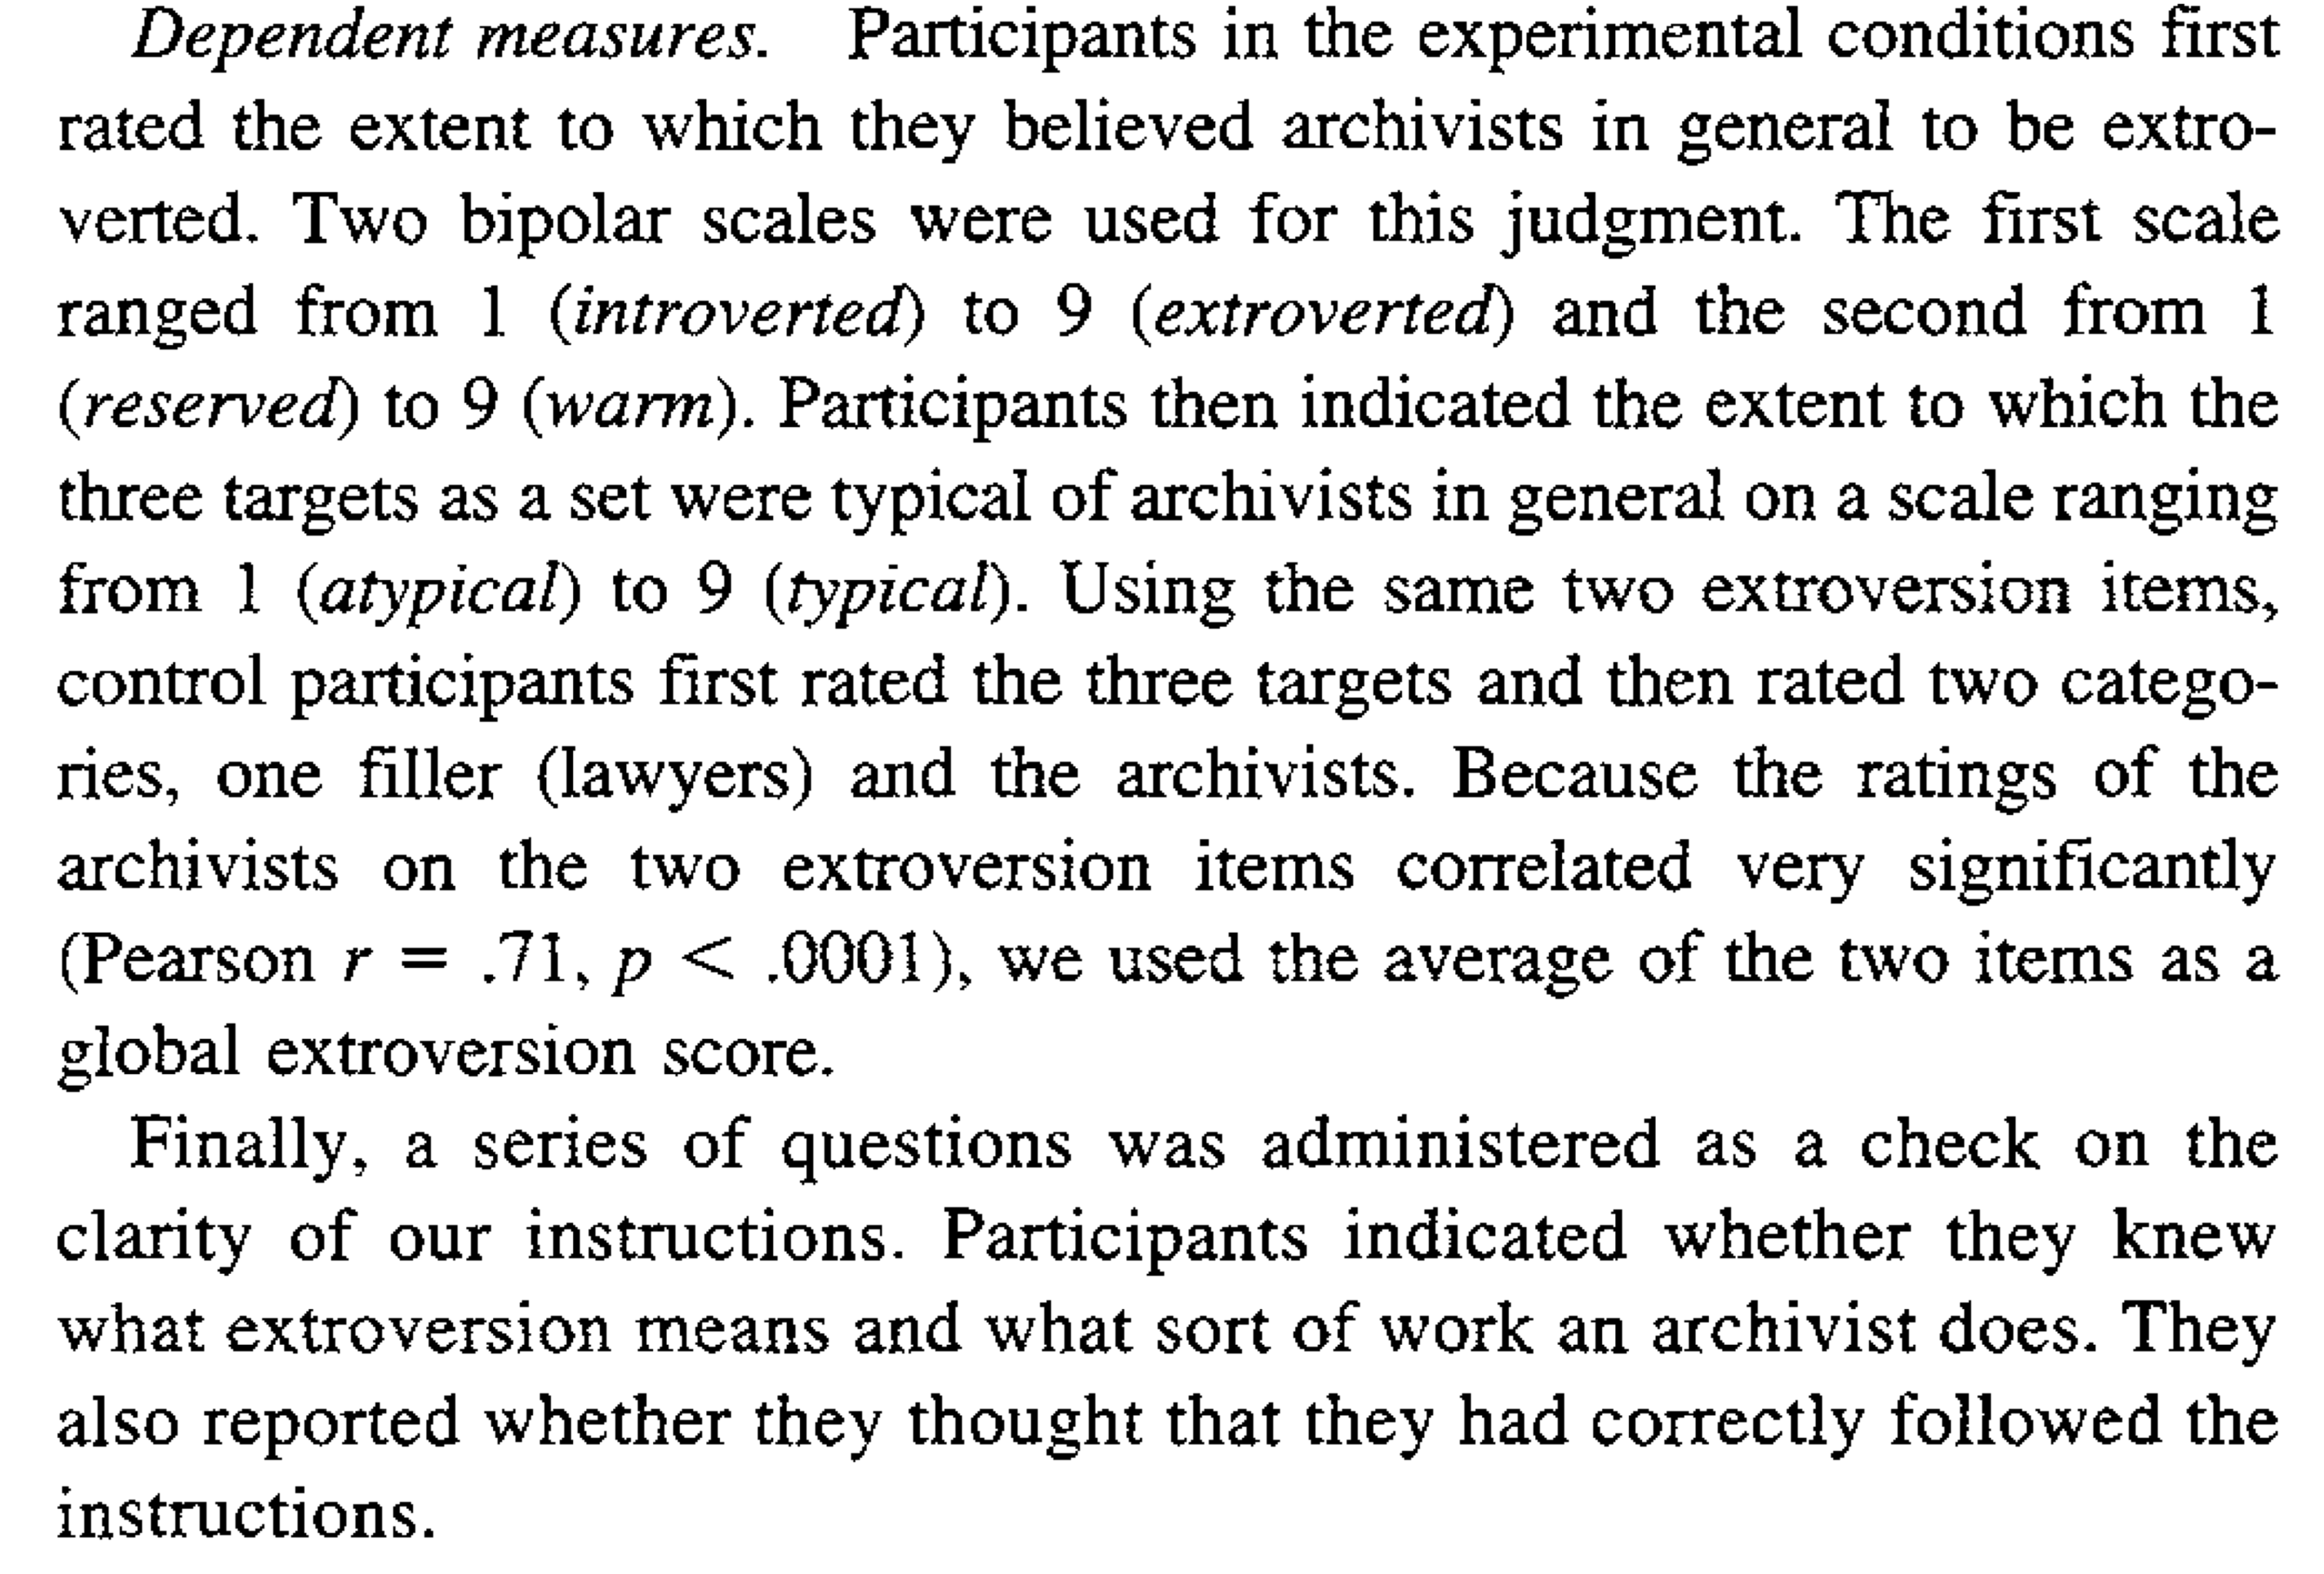
Yzerbyt et al. 1999 study 2

Slide 25
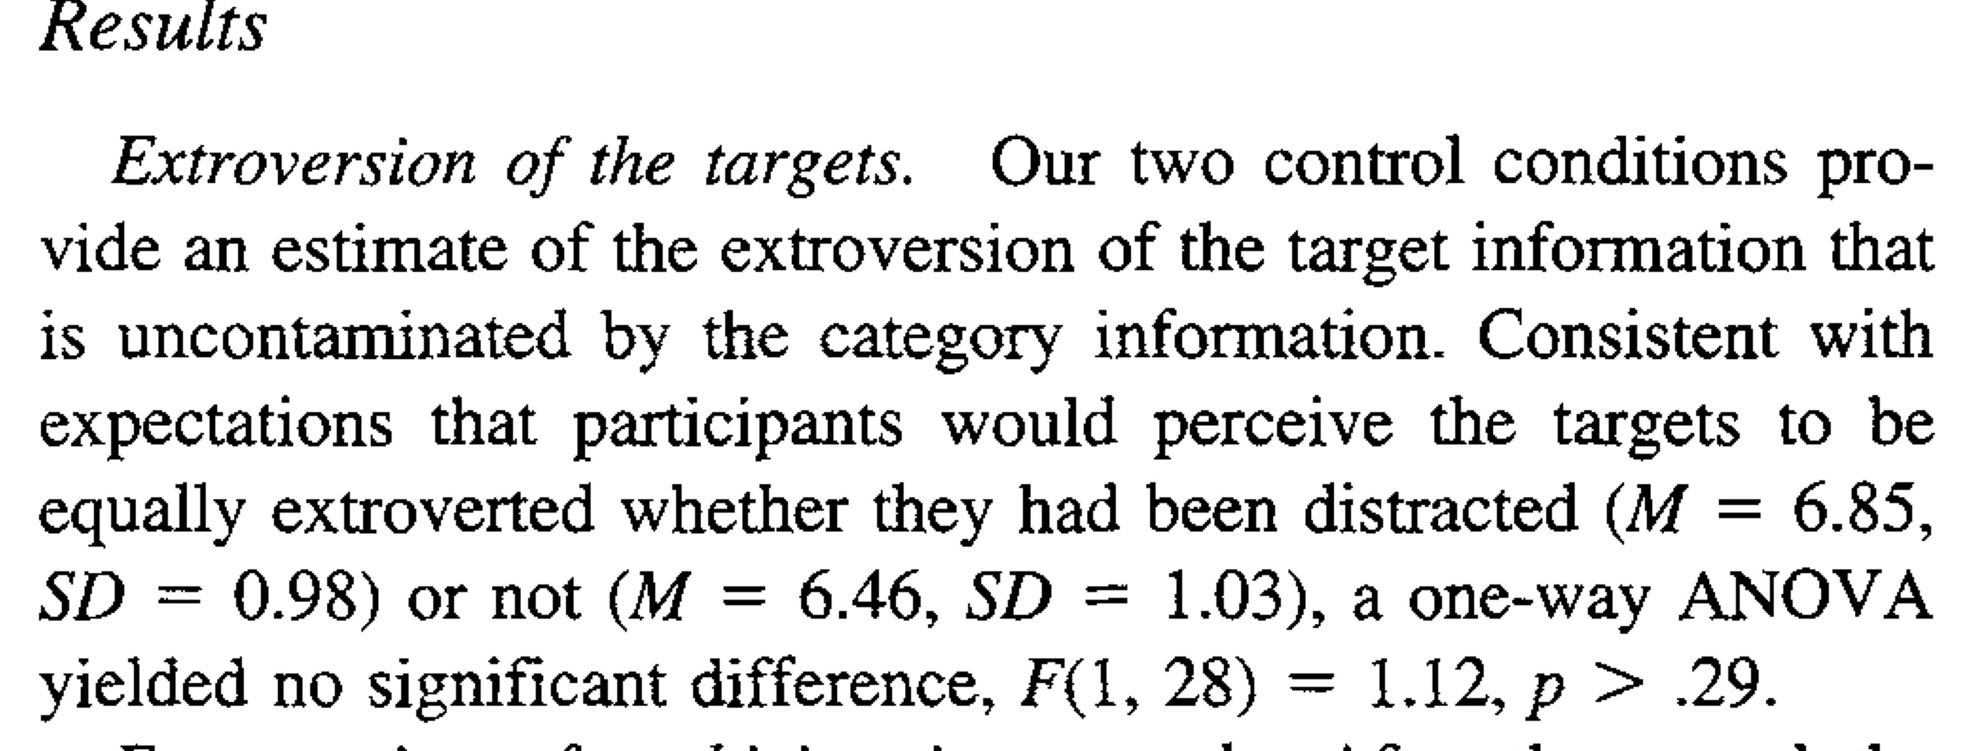
Yzerbyt et al. 1999 study 2

Slide 26
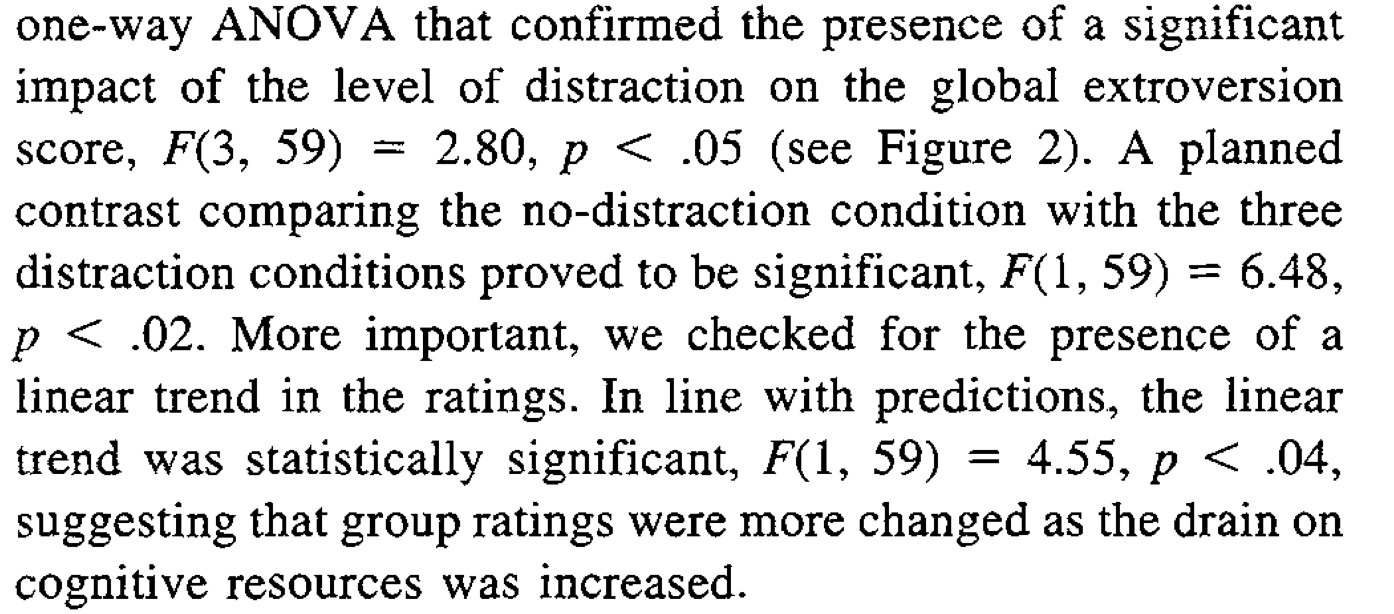
Yzerbyt et al. 1999 study 2 –group

Slide 27
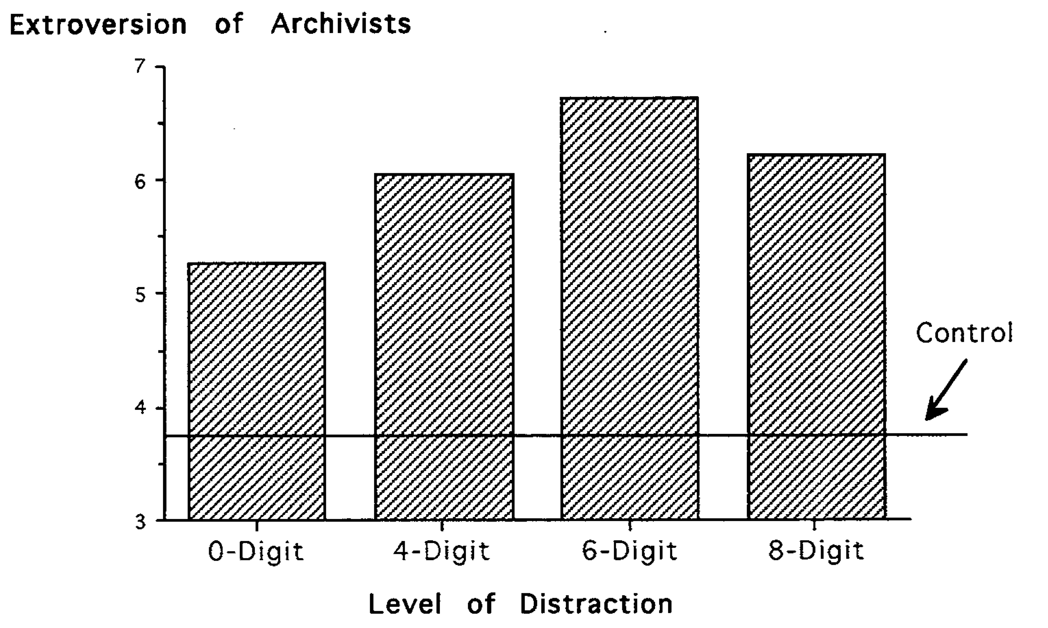
Yzerbyt et al. 1999 study 2 –group

Slide 28
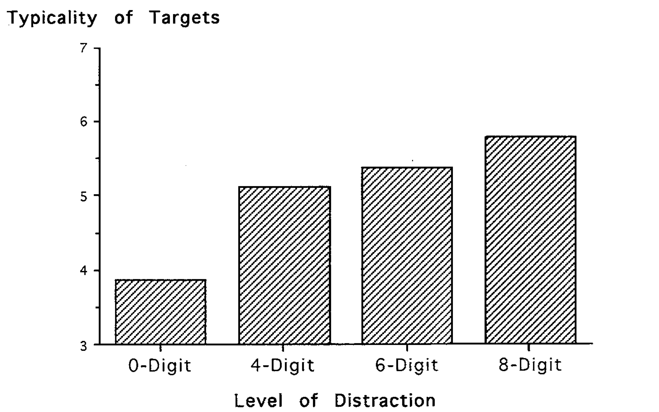
Yzerbyt et al. 1999 study 2 –group

Slide 29
Yzerbyt et al. 1999 study 2 –

Slide 30
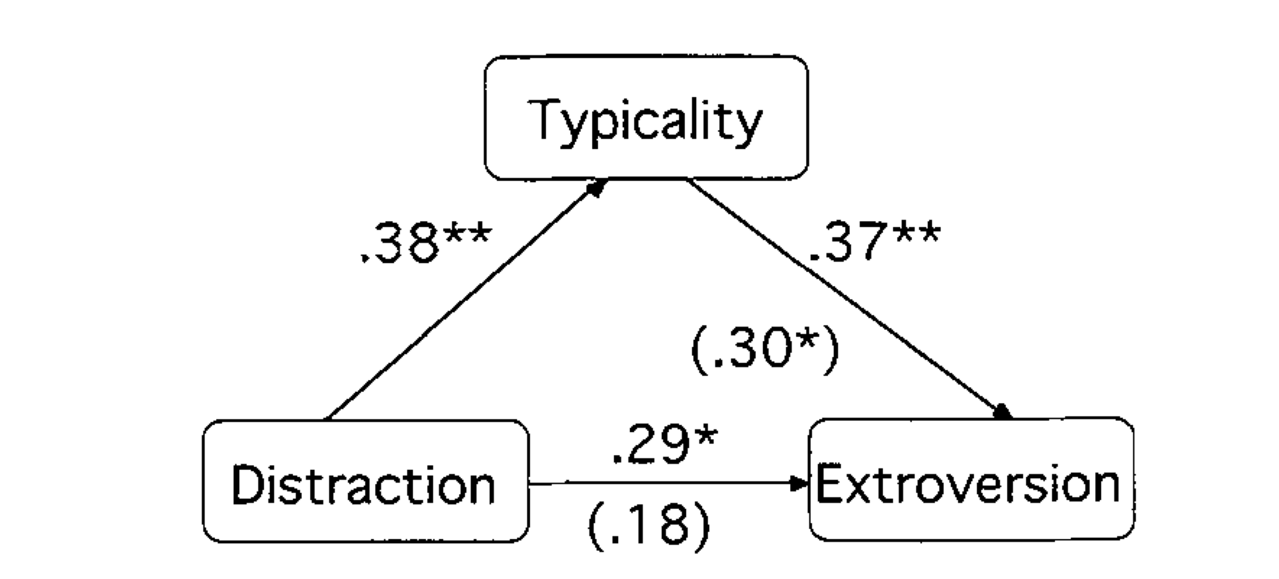
Yzerbyt et al. 1999 study 2 –

Slide 31
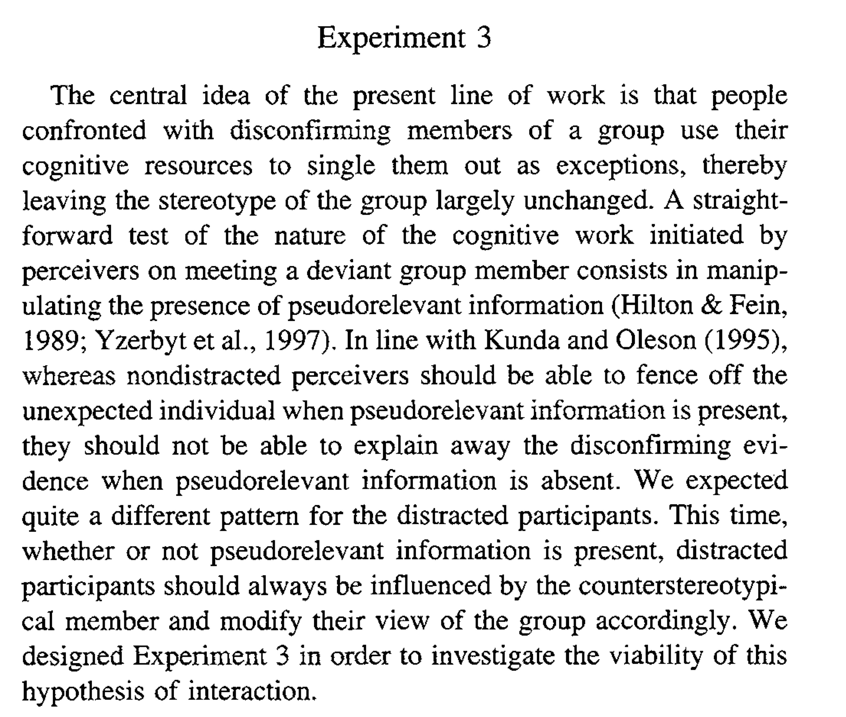
Yzerbyt et al. 1999 study 3 –

Slide 32
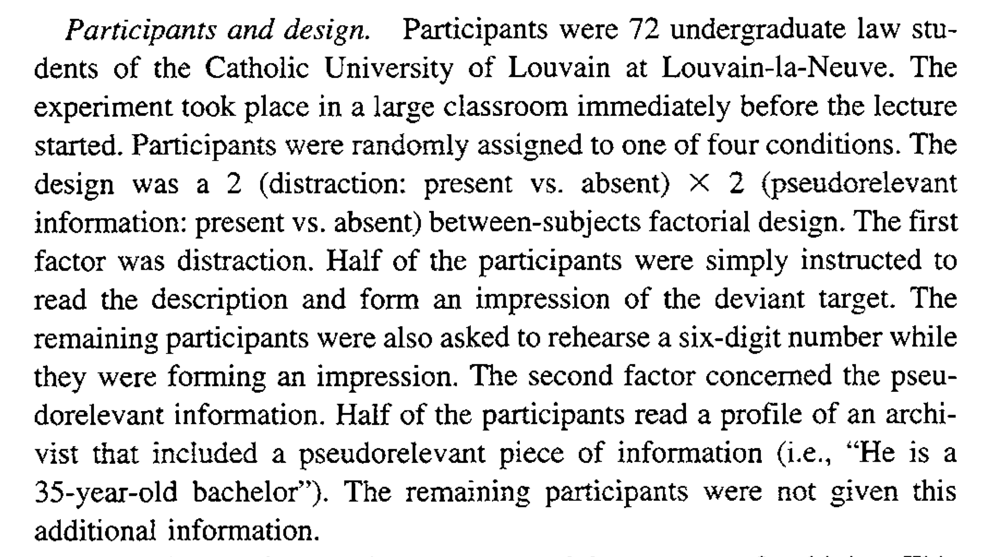
Yzerbyt et al. 1999 study 3 –

Slide 33
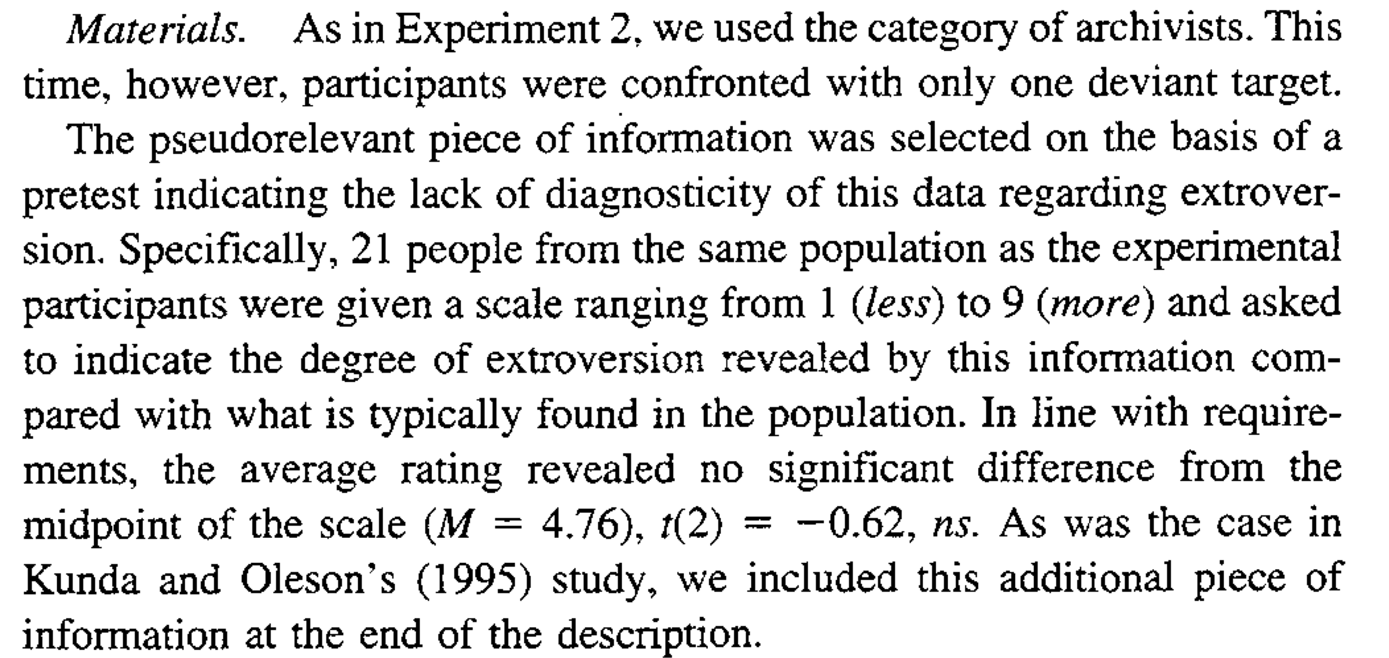
Yzerbyt et al. 1999 study 3 –

Slide 34
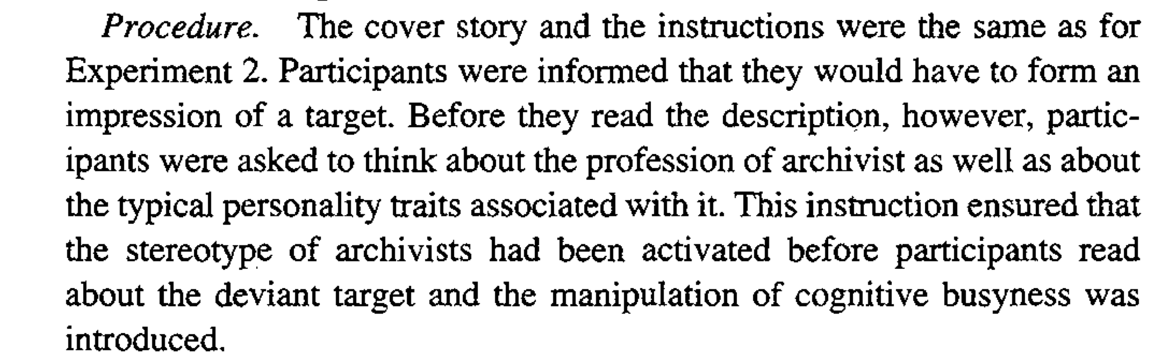
Yzerbyt et al. 1999 study 3 –

Slide 35
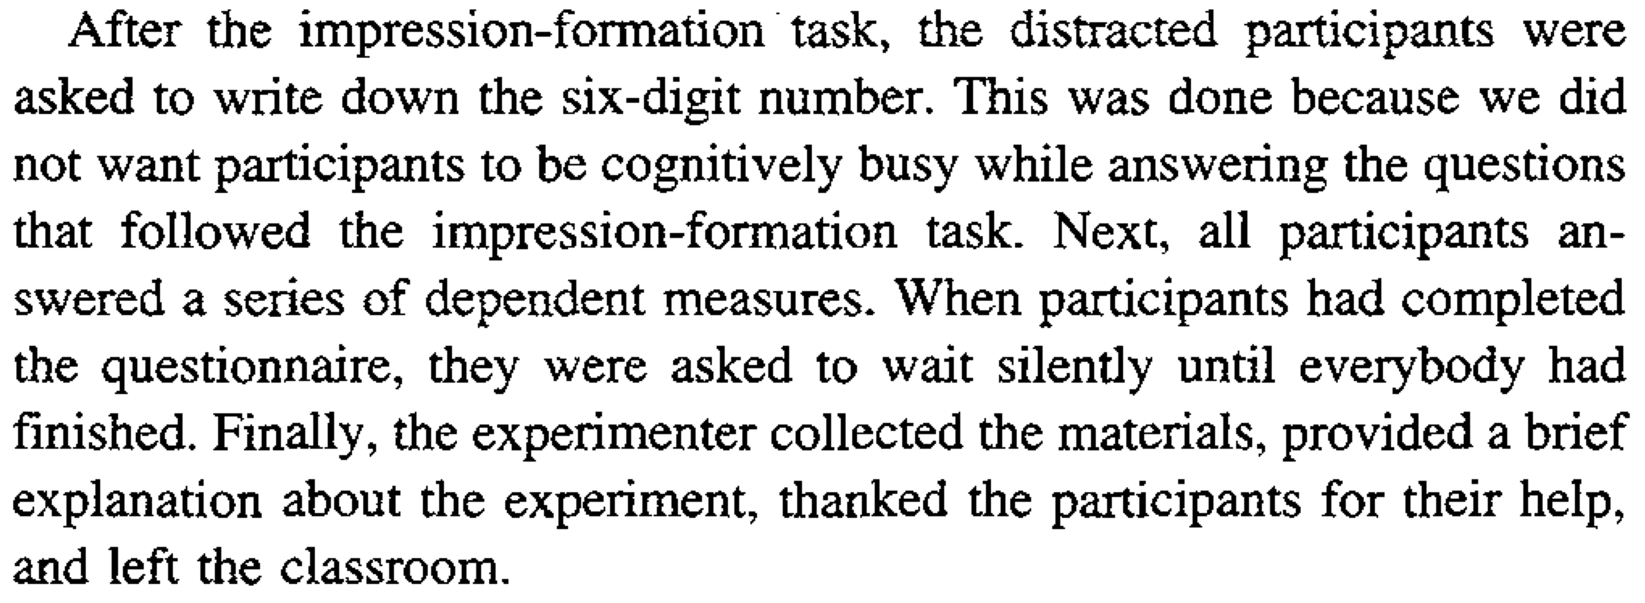
Yzerbyt et al. 1999 study 3 –

Slide 36
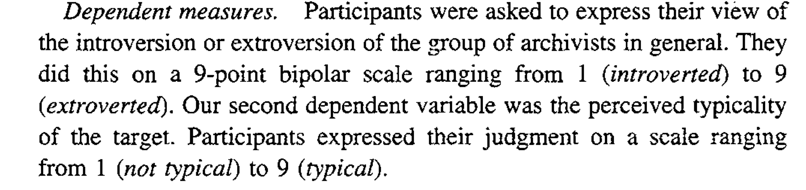
Yzerbyt et al. 1999 study 3 –

Slide 37
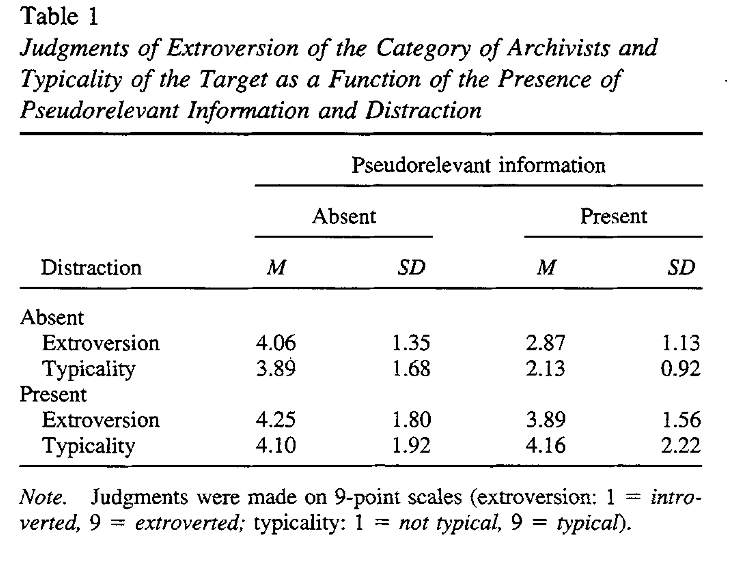
Yzerbyt et al. 1999 study 3 –

Slide 38
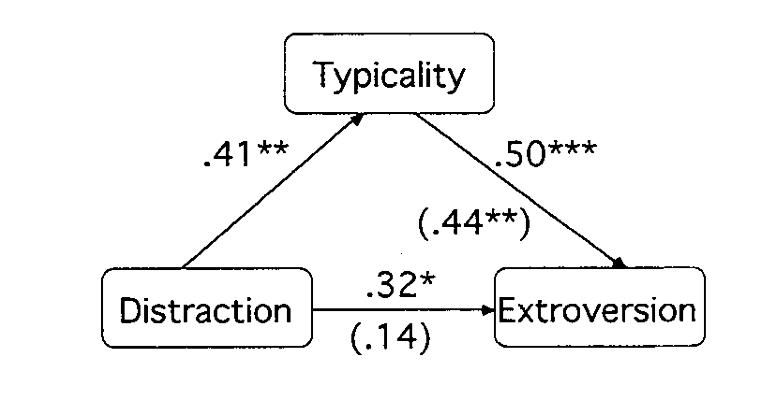
Yzerbyt et al. 1999 study 3 –

