Slide 1
University of Trieste: GLOBAL CHANGE ECOLOGY a.a. 2018-2019
Conservation & Management in Marine Protected Areas
Dr. Stanislao Bevilacqua (sbevilacqua@units.it)
Main EU Directives on marine environments

Slide 2
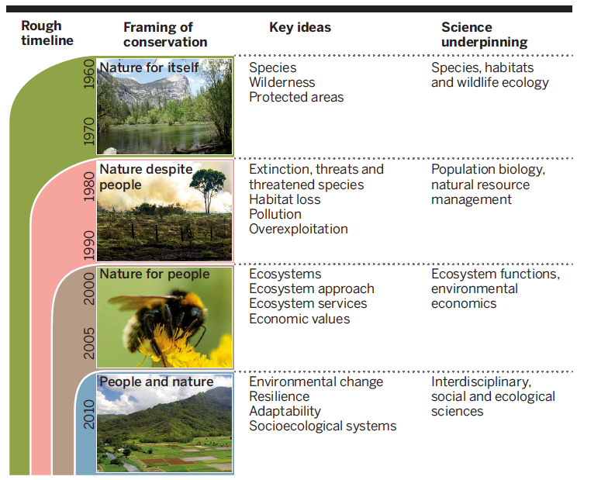
Historical evolution of conservation purposes
Modified from Mace, 2014
Notes:
Nel corso degli ultimi decenni, a mare cosi con a terra, il concetto di protezione si è evoluto, passando dalla protezione della natura in quanto tale (il posto bello, il bel paesaggio selvaggio e incontaminato), alla protezione delle specie e recupero delle loro popolazioni, soprattutto di valore economico, ecologico, o specie emblematiche, fino ad arrivare al concetto più olistico di protezione dell’ecosistema marino e, in ultimo, della mitigazione del disturbo e sostegno della resilienza dei sistemi.

Slide 3
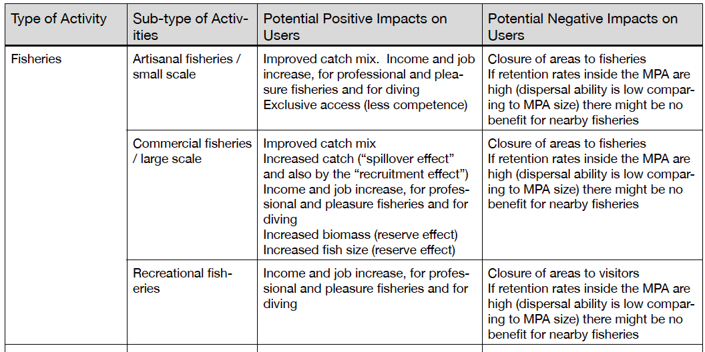
Impact on socio-economy

Slide 4
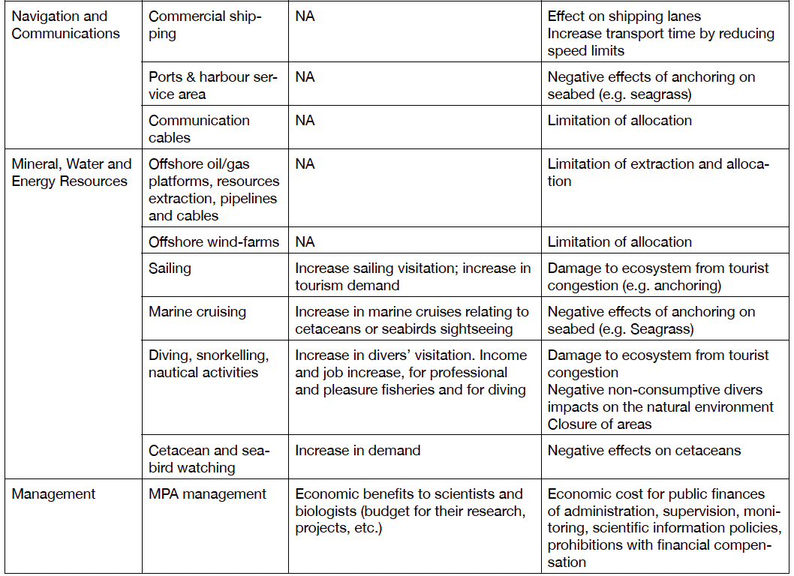
Impact on socio-economy

Slide 5
Effects on socio-economy
Smallhorn-West et al. 2020

Slide 6
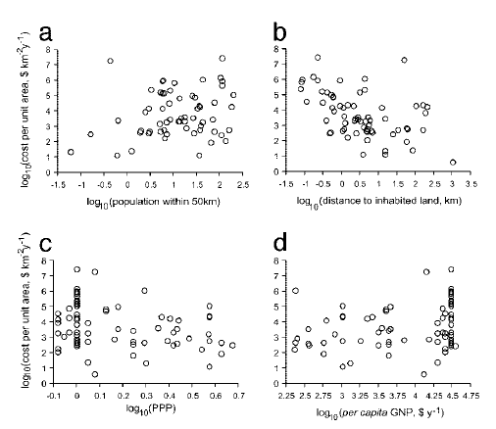
How much does conservation cost?
Balmford et al. 2004

Slide 7
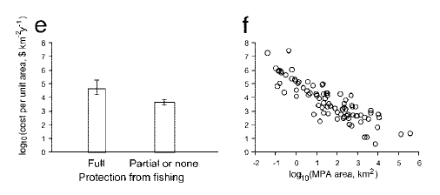
How much does conservation cost?
Balmford et al. 2004
Cost ranges between 0 and about 30 millions US dollars per square km year , depending significantly on the size of the MPA and the level of anthropization (population and urbanization)

Slide 8
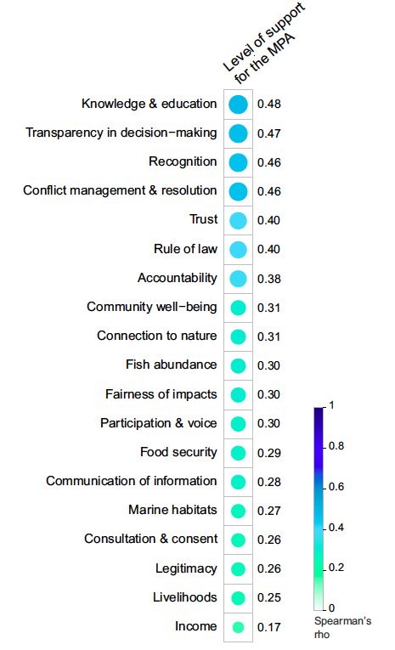
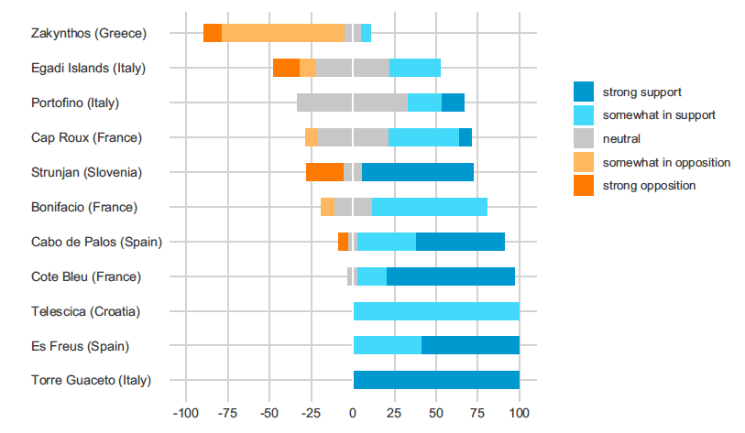
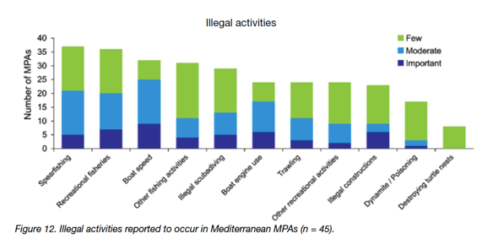
Compliance
Bennet et al. 2018
Bennet et al. 2019

Slide 9
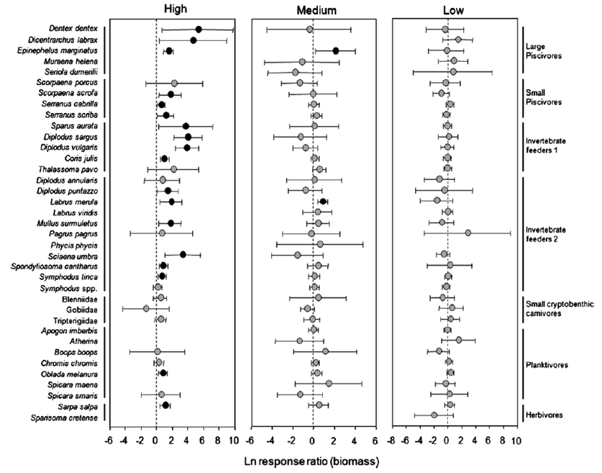
The role of enforcement
Guidetti et al., 2008

Slide 10
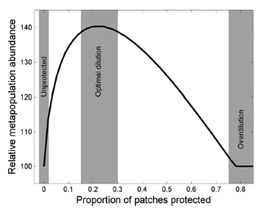
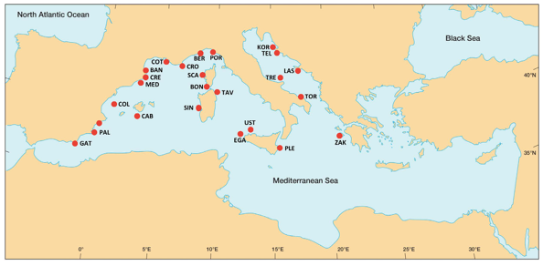
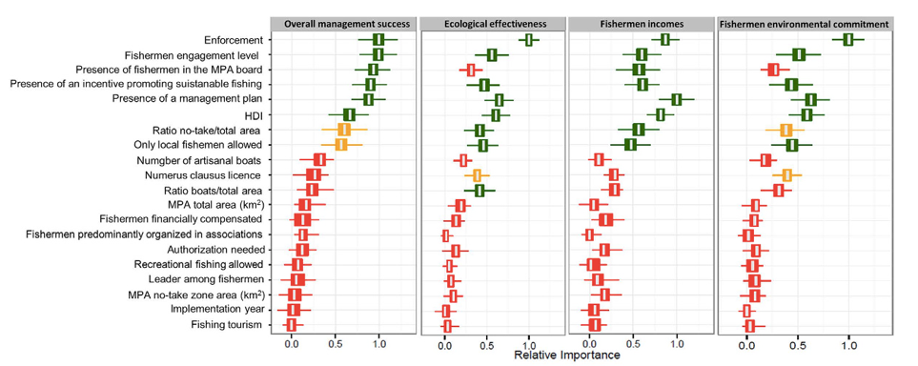
Key factors in MPA effectiveness
Kuempel et al., 2017
Di Franco et al., 2016
Notes:
Kuemperl effetto su pesca con enforcement fissato a crescita area: deve essere proporzionato all’area

Slide 11
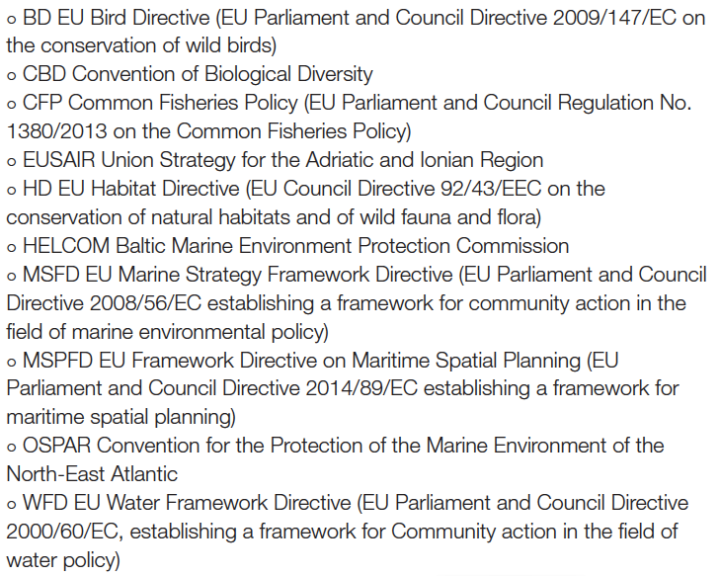
Main international regulations and agreements
Palmer et al 2006
Notes:
Overlapping and not always coordinated. Moreover, transboundary actions are limited when involving extra-EU countries

Slide 12
Water Framework Directive
DIRECTIVE 2000/60/EC (D.Lgs. 152/2006)
The purpose of this Directive is to establish a framework for the protection of inland surface waters, transitional waters, coastal waters and groundwater which:
prevents further deterioration and protects and enhances the status of aquatic ecosystems and, with regard to their water needs, terrestrial ecosystems and wetlands directly depending on the aquatic ecosystems;
promotes sustainable water use based on a long-term protection of available water resources;
aims at enhanced protection and improvement of the aquatic environment, inter alia, through specific measures for the progressive reduction of discharges, emissions and losses of priority substances and the cessation or phasing-out of discharges, emissions and losses of the priority hazardous substances;
ensures the progressive reduction of pollution of groundwater and prevents its further pollution, and
contributes to mitigating the effects of floods and droughts
Monitoring the status of waters every six years to achieve a good quality status
Operational monitoring: water bodies at risk or not in good status
Surveillance monitoring: water bodies
Investigative monitoring: water bodies not in good status to understand and clarify causes

Slide 13
Habitat Directive
Directive 92/43/EEC
D.P.R. 357/1997
The aim of this Directive shall be to contribute towards ensuring biodiversity through the conservation of natural habitats, and species of particular relevance. Report every six years.
A coherent European ecological network of special areas of conservation shall be set up under the title Natura 2000 . This network, composed of sites hosting the natural habitat types listed in Annex I and habitats of the species listed in Annex II, shall enable the natural habitat types and the species' habitats concerned to be maintained or, where appropriate, restored at a favourable conservation status in their natural range . The Natura 2000 network shall include the special protection areas classified by the Member States pursuant to Directive 79 /409 /EEC.
Marine habitats of community interest included:
Sand banks which are slightly covered by sea water all the time
* Posidonia beds Submerged or partly submerged sea caves
Estuaries
Mudflats and sandflats not covered by seawater at low tide
*Lagoons
Large shallow inlets and bays
Reefs Marine 'columns' in shallow water made by leaking gases
Palmer et al 2006

Slide 14
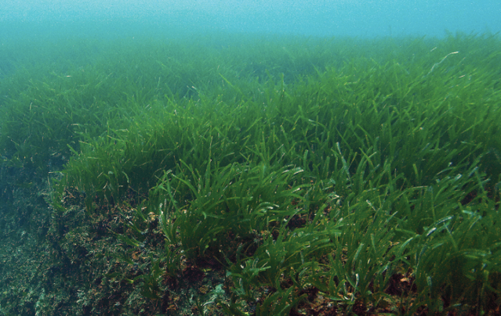
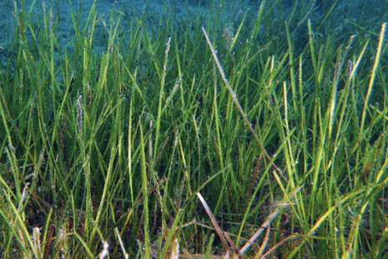
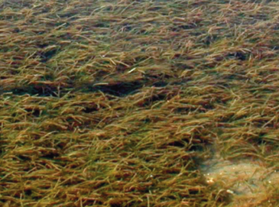
Protected or regulated species

Slide 15
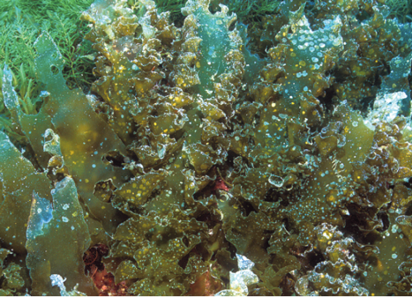
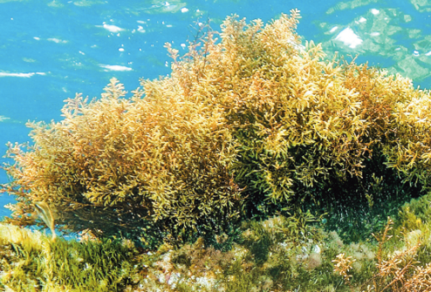
Protected or regulated species

Slide 16
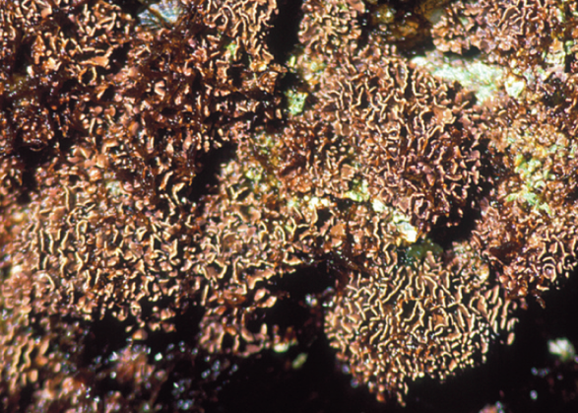
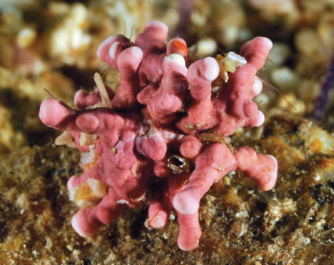
Protected or regulated species

Slide 17
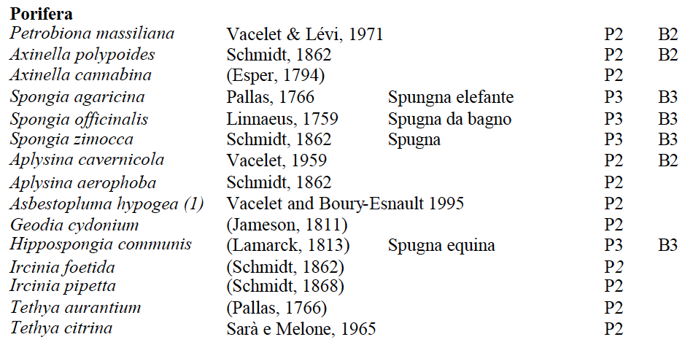
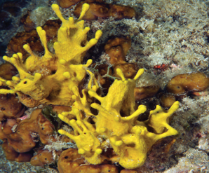
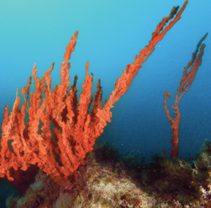
Protected or regulated species

Slide 18
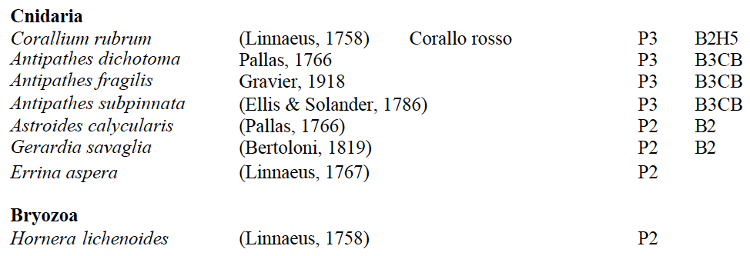
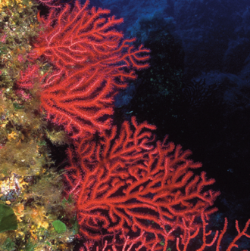
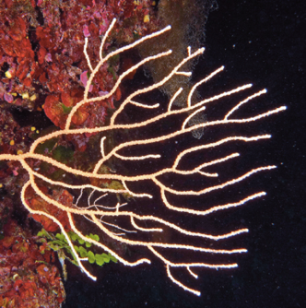
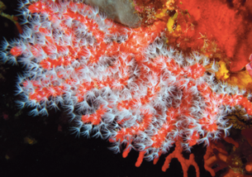
Protected or regulated species

Slide 19
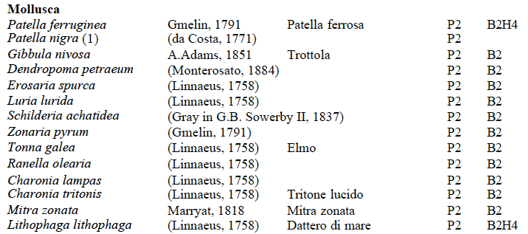
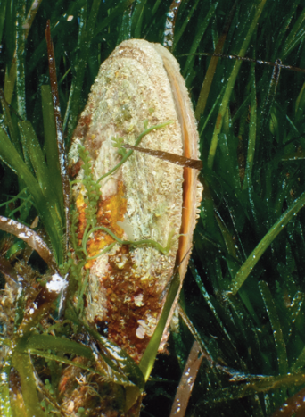
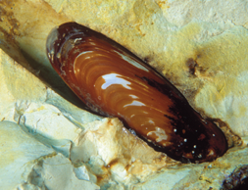
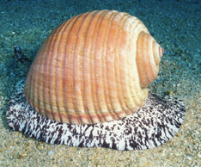
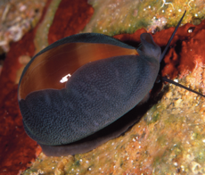
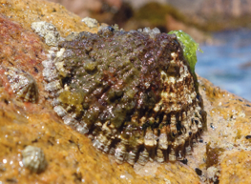
Protected or regulated species

Slide 20
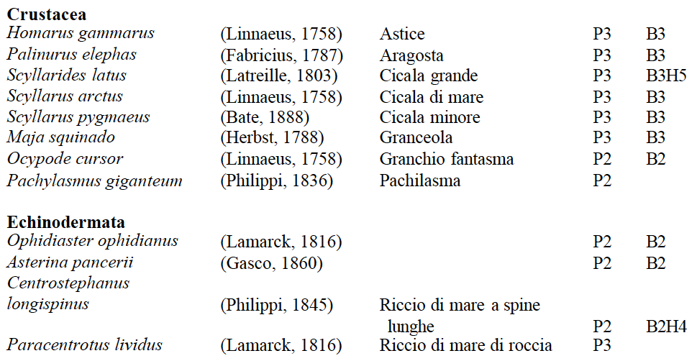
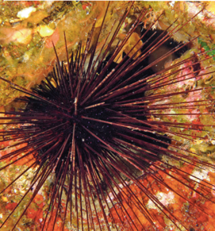
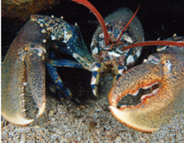
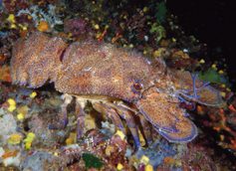
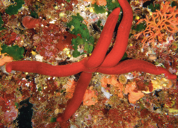
Protected or regulated species

Slide 21
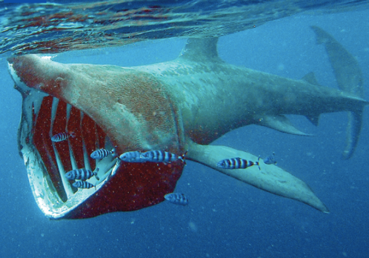
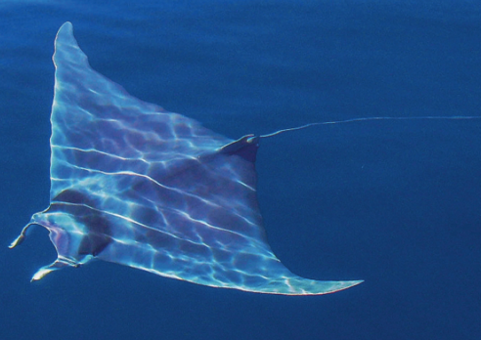
Protected or regulated species

Slide 22
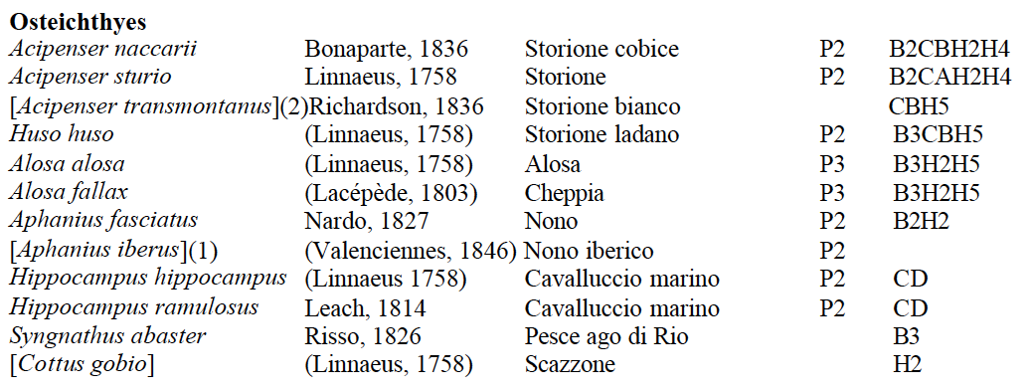
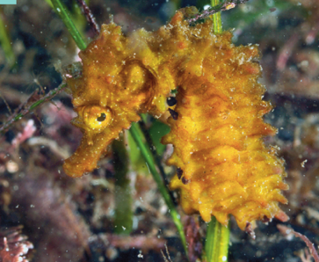
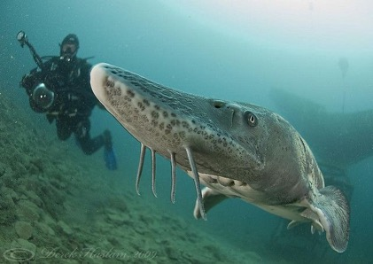
Protected or regulated species

Slide 23
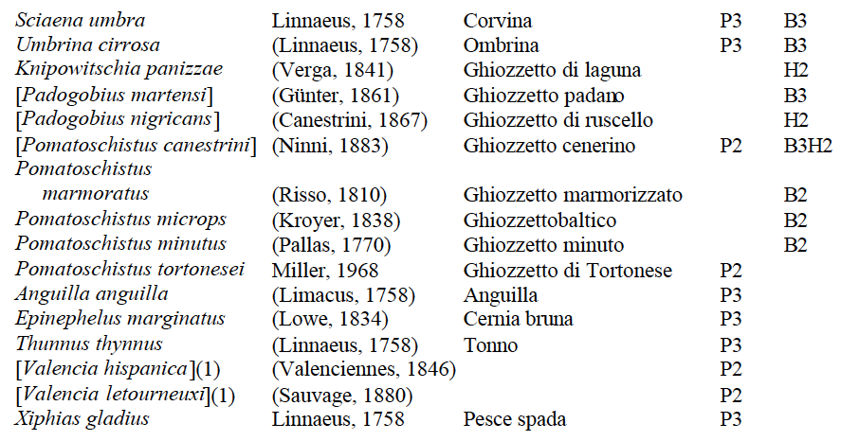
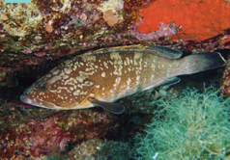
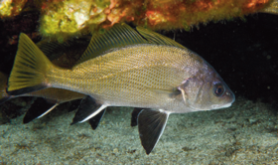
Protected or regulated species

Slide 24
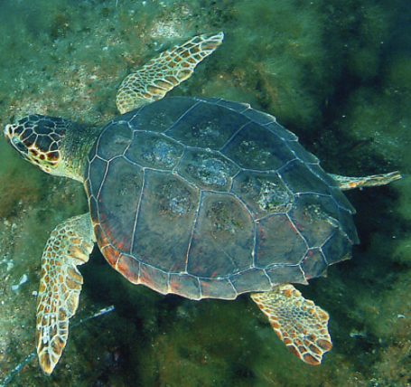
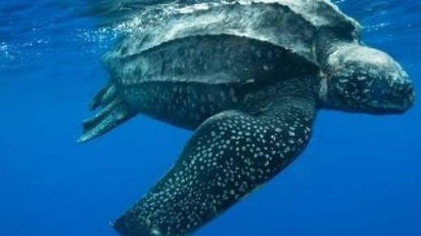
Protected or regulated species

Slide 25
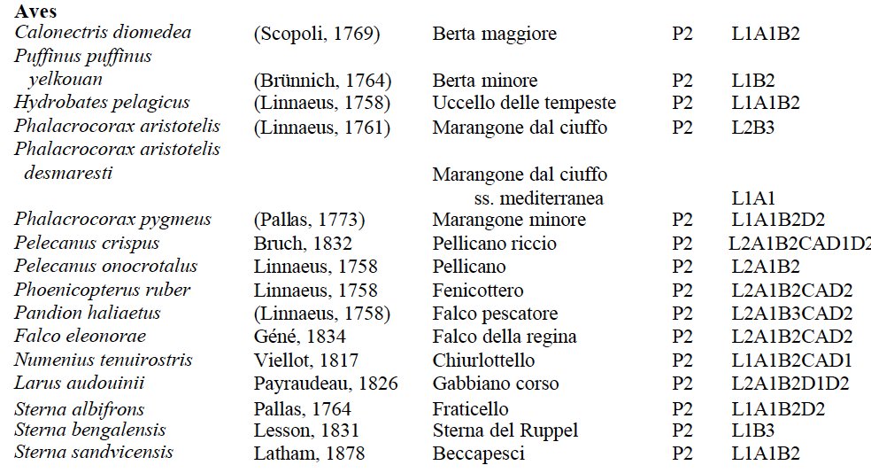
Protected or regulated species

Slide 26
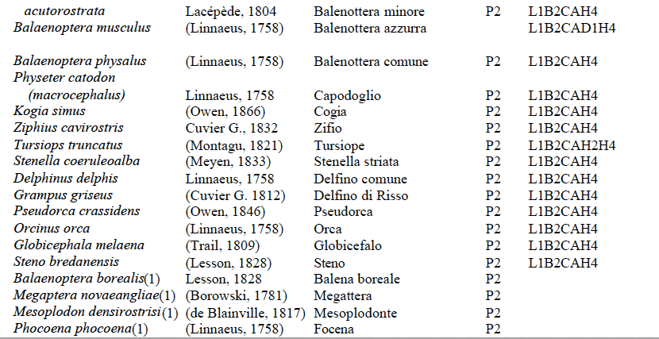
Protected or regulated species

Slide 27
Marine Strategy Framework Directive (MSFW)
For the MSFW (2008/CE/56) each EU country has to develop its strategy, in agreement and coordinated with all other countries in each marine region, to achieve and maintain the Good Environmental Status (GES) in 2020.
GES means that the environmental conditions of sea water are adequate to preserve diversity and functioning of seas and oceans, which are expected to be clean, healthy and productive, with a sustainable use of marine resources.
The structure, functions, and processes of marine ecosystems should work allowing their resilience. Species and habitats are protected and their persistence insured, avoiding biodiversity loss due to human activities. Physical-chemical, hydrologic, and geomorphologic features are in good conditions to sustain biodiversity and ecosystem functioning, and matter and energy inputs from human activities do not determine risks for marine biodiversity, ecosystems and environments, and for the human health and human use of resources.
In Italy, D.Lgs. n. 190/2010
Palmer et al 2006

Slide 28
Development of MSFD
2012
2014
2015-16
Initial assessment of the status of marine environment
and indicator to assess thier achievement
Monitoring and adaptation of target
Six-year cycle of reiteration of the adaptative process to maintain and or achieve GES
Baltic Sea
NE Atlantic Ocean
Mediterranean Sea
Black Sea
W Mediterranean Sea
Adriatic Sea
Ionian and Central Mediterranean Sea
E Aegean Sea

Slide 29
Initial assessment
Analysis of main components and features of current environmental state in marine regions and subregions based on 11 descriptors.
Analysis of main human impacts and pressures affecting marine ecosystems in the regions or subregions, their trends and potential cumulative effects
Analysis of socio-economic factors and of uses of marine resources, along with environmental costs of degradation
Components
Impacts
Socio-economy

Slide 30
Descriptors
energy
11 descriptors
1.Biodiversity is maintained
5. Eutrophication is minimised
9. Contaminants in seafood are below safe levels
2. Non-indigenous species do not adversely alter the ecosystem
6. The sea floor integrity ensures functioning of the ecosystem
10. Marine litter does not cause harm
3. The population of commercial fish species is healthy
7. Permanent alteration of hydrolographical conditions does not adversely affect the ecosystem
11. Introduction of energy (including underwater noise) does not adversely affect the ecosystem
4. Element of food webs ensure long-term abundance and reproduction
8. Concentrations of contaminants give no effects

Slide 31
Indicators
1. Biodiversity
Species
Population size
Abundance or biomass
Conditions
Demography
Genetic structure
Habitats
Habitat extent
Surface
Conditions
Conditions of typical species or communities
Abundance or biomass
2. Non-indigenous species (NIS)
Abundance and conditions of NIS with a particular focus on invasive species
Trends in abundance, frequency of occurrence, and distribution of NIS
Impact of NIS on native species, habitat and ecosystems
Commercially exploited species
Fishing pressure
Fishing catches / biomass-catch ratio
Reproductive ability of stocks
Biomass of reproductive stocks – other indices
Age and size distribution

Slide 32
Indicators
4. Marine food webs
Proportion of top predators
Large fish predators
Abundance/distribution of trophic guilds
Trends in abundance of functionally important guilds
5. Eutrophication
Nutrient levels
Concentration of nutrient in the water column
Acculmulatin rates
Direct effect of nutrient overload
Chlorophyll concentration in the water column
Water turbidity due to phytoplankton
Changes in phytoplankton assemblages
Indirect effects
Dissolved oxygen and extent of depleted areas
6. Sea floor integrity
Physical damage on different substrates
Area of seabed, for each habitat, significantly affected by human activities
Age and size distribution

Slide 33
Indicators
7. Hydrographical conditions
Spatial attributes of permanent alterations
Surface of areas permanently alterated
8. Contaminants
Concentration
Concentration of pollutants in environmental matrices
Effects
Effects of pollutants on contaminated ecosystem based on known cause-effect relationships that require monitoring
9. Human health
Level, number, and frequency of contaminants
Number of pollutants and concentration beyond safe threshold definide by law
Frequency of exceeding thresholds

Slide 34
Indicators
10. Marine litter
Characteristics of marine litter
Trends in the amount of litter thrown in the sea and coastline, including composition, spatial distribution, and origin, if possible
Trends in the composition and distributin of microplastics
Impact of litter on marine life
Trends in the amount and composition of litter ingested by marine organisms
11. Energy inputs
Spatial and temporal distribution of underwater sounds
Year-round proportio and distribution of anthropogenic noise in the affected areas when exceeding levels potentially harmful for marine organisms
Effects
Effects of pollutants on contaminated ecosystem based on known cause-effect relationships that require monitoring

Slide 35
Targets
1. Biodiversity
2. NIS
2. Commercial species
Species and habitat listed in the HD and other regulations maintain or achieve a good conservation status
MPAs maintain or achieve the status of SPAMI
A representative and functionally connected network of MPAs covering the 10% of Italian marine waters is implemented
Early-warning systems in all large harbours
Response system of authorities in harbours and aquaculture farms activated
Import, or movements of NIS for aquaculture tracked
Knowledge of NIS impact is increased
Mortality by fishing of overexploited species is reduced by 2020
Illegal fishing practices are reduced by 2020
Recreational fishing is regulated and its impact estimated
Minimum landing size for commercially exploited sharks
4. Food webs
6. Sea floor integrity
7. Hydrography
The status of all components is improved through the achievement of targets for D1,3,5,6 with respect to bone fish, sharks, marine mammals, reptiles, benthic and planktonic communites
Impact of construction or deployement of structure on biogenic habitat are reduced
Abrasion is avoided on 10% of sea floor suitable for fishing exploitation
No fishing on biogenic substrates
Vessels for seabed fishing are tracked
Hydrographic effects of on-shore and offshore human structures existing, in construction, or projected are assessed
8. Contaminants
5. Eutrophication
Level of contaminants above thresholds are reduced
Knowledge on their impact is increased
Frequency of events is reduced
Several targets of reduction and regulation of sewage discharge
Hypoxia and anoxia are reduced

Slide 36
Targets
9. Human health
10. Litter
11. Energy
Pollutant levels exceeding thresholds for safety in seafood from national waters are decreasing
Frequency of cases of contamination in seafood from national waters is decreasing
The amount of litter on coasts, seabed, and in the water column, including floating, litter is decreasing
Ingested items in marine organisms is decreasing
Knowledge on the origin, composition, distribution, dispersion and impact of marine litter is increased
The register of underwater noise on human activity producing pulse sounds within the range of 10 Hz-10kHz is implemented
A baseline level of ambient noise (continuos sounds a low frequency) is defined

