Slide 1
Precipitation/coprecipitation
Weimarn’s law
D x C₀ = constant
C₀ = initial concentration
D = particle dimention
C_{s} = solubility
L₁’ > L₁” > L₁”’ = solubility
When C₀ is high = the precipitation is controlled by nuclei formation
When C₀ is small = the precipitation is controlled by the rate of nuclei growth

Slide 2
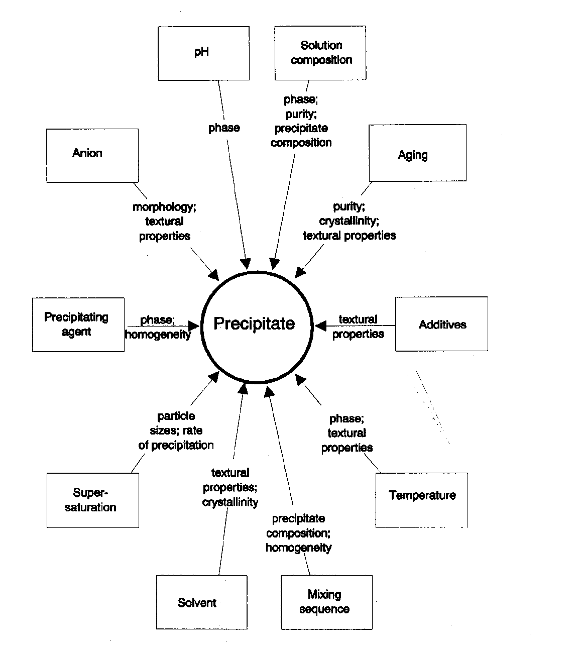
Factors influencing precipitate formations

Slide 3
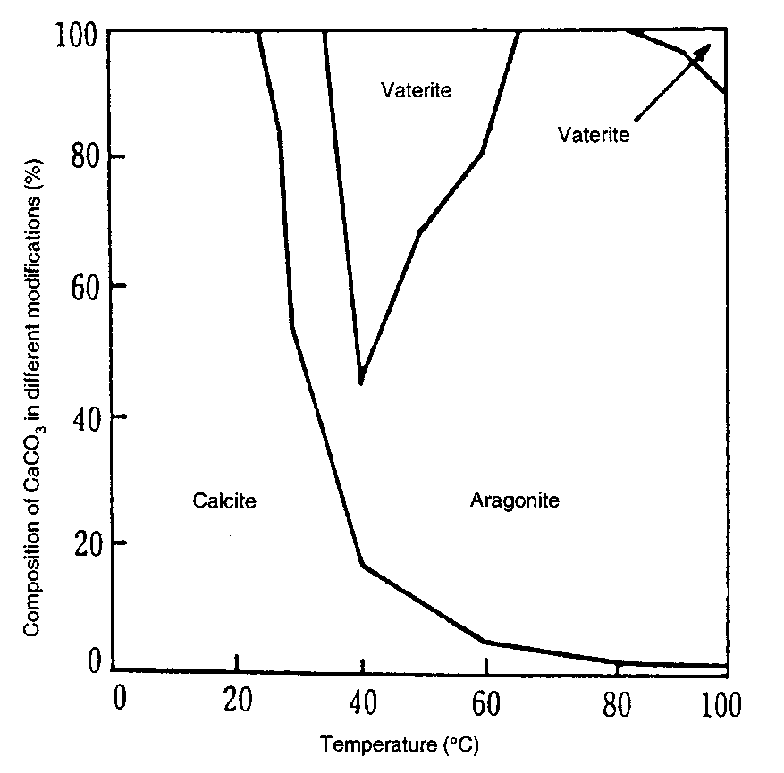
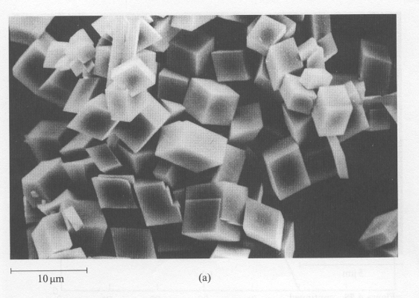
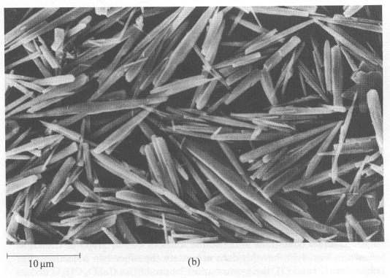
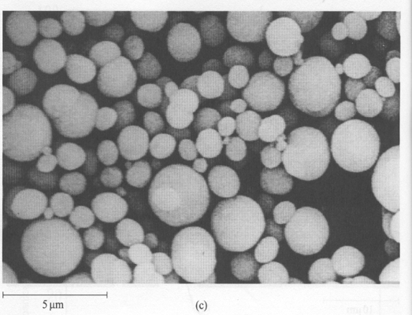
Precipitation/coprecipitation
Effect of Temperature and Concentration on the precipitation of CaCO₃
(a) Calcite (T<25°C)
(b)Aragonite (70-80°C)
(c) Vaterite (T> 40°C high concentration)
Ca(HCO₃)₂ (aq) → CaCO₃ ↓ + H₂O + CO₂

Slide 4
Precipitation/coprecipitation
Ca(OH)₂
CaCl_{2 (aq)}+2 NaOH _{(aq)} → Ca(OH)₂ _{(s)} + 2 NaCl _{(aq)}

Slide 5
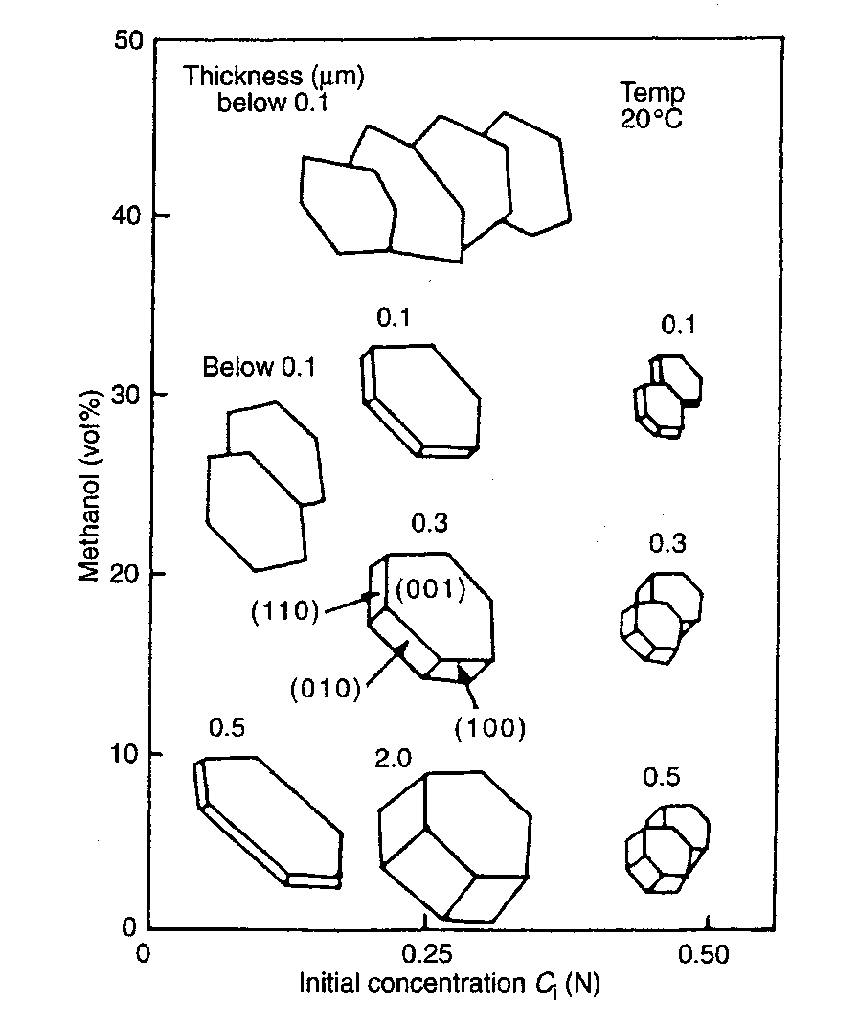
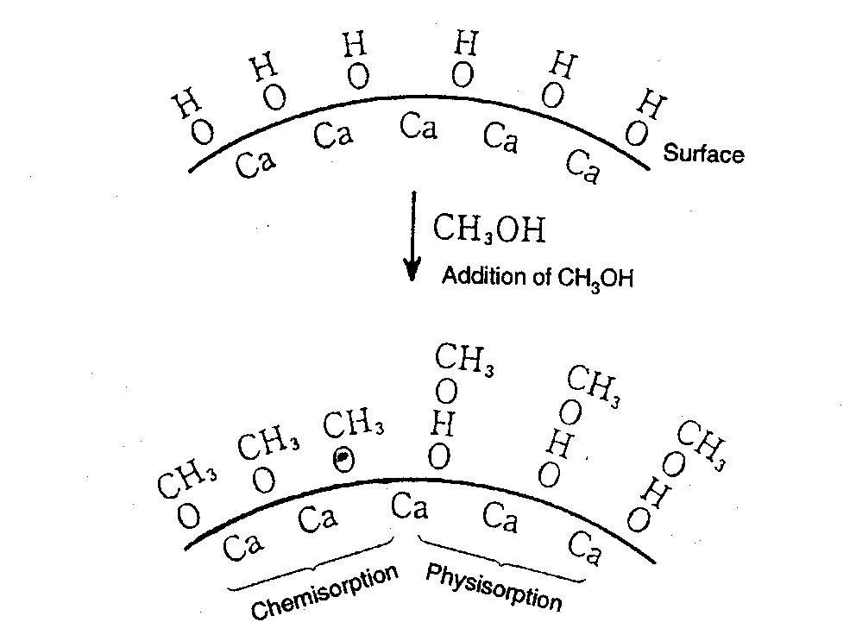
Precipitation/coprecipitation
Addition of NaOH to a CaCl₂/H₂O/methanol solution
Adsorption of •OCH₃ on the 001 facets with the suppression /inhibition of their growth

Slide 6
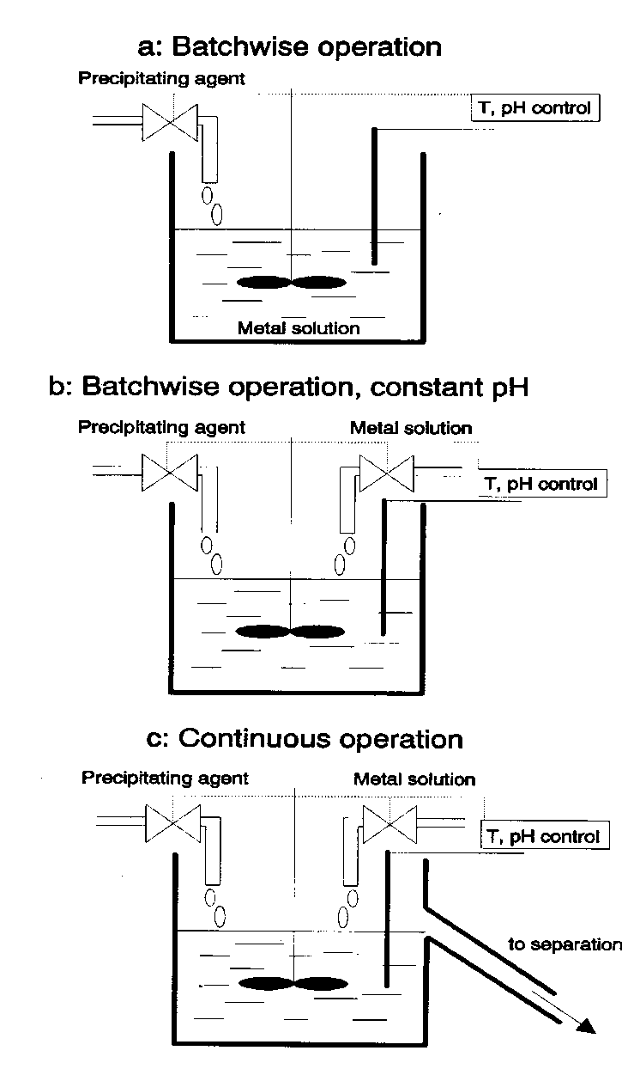
Precipitation by increasing pH
:
  increasing the pH (one element to precipitate)
  at constant pH (the most used case)
  at constant pH in a continuous flow

Slide 7
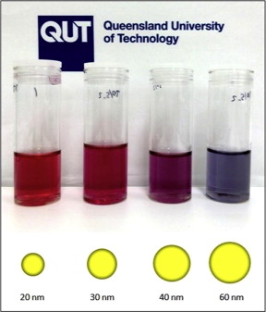
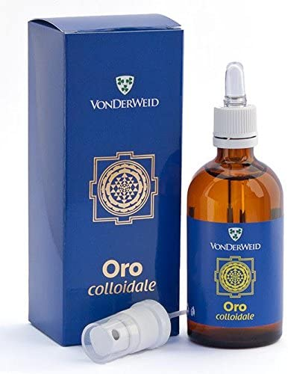
Colloidal Chemical Methods
Examples: Gold
  A common method for preparing colloidal gold nanoparticles involves combining hydrogen tetrachloroaurate (HAuCl₄) and sodium citrate (Na₃C₆H₅O₇) in a dilute solution.
  Upon dissociation, the citrate ions (C₆H₅O₇³⁻) reduce Au³⁺ to yield 30-40 nm gold particles.

Slide 8
Formation of Gold Nanoparticles
Sodium
Citrate
Red Color = Gold NP
HAuCl₄
HAuCl₄
Gold
NP
Heat
Heat a solution of chloroauric acid (HAuCl₄) up to reflux (boiling). HAuCl₄ is a water soluble gold salt.
Add trisodium citrate, which is a reducing agent.
Continue stirring and heating for about 10 minutes.
  During this time, the sodium citrate reduces the gold salt (Au³⁺) to metallic gold (Au⁰).
  The neutral gold atoms aggregate into seed crystals.
  The seed crystals continue to grow and eventually form gold nanoparticles.
J. Chem. Ed. 2004, 81, 544A.

Slide 9
Formation of Gold Nanoparticles
Reduction of gold ions: Au(III) + 3e⁻ → Au(0)
Seed Crystal
10’s to 100’s of Atoms
Nucleation of Au(0) seed crystals:
Growth of nanoparticles:
Isotropic
Growth
Spherical
Nanoparticles
Surface capped
with citrate anions
Seed
Adding surfactant to growth solution
caps certain crystal faces and promotes
growth only in selected directions.
Anisotropic
Growth
Nanorods

Slide 10
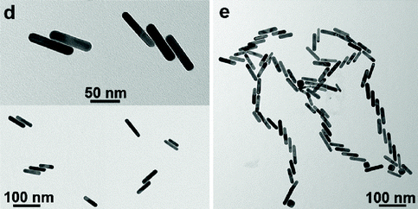
Colloidal Gold Nanorod Clusters
A seed solution of gold nanoparticles was prepared by borohydride (30 mM, 0.3 mL) reduction of HAuCl₄ (0.25 mM, 5 mL) in aqueous cetyltrimethylammonium bromide (CTAB) solution (0.1 M).
2. An aliquot of seed solution (24 μL) was added to a growth solution (10 mL) containing CTAB (0.1 M), HAuCl₄ (0.5 mM), ascorbic acid (0.8 mM), …... Mixtures were left undisturbed for 4 h at 27 °C.
Langmuir 2012, 28, 24, 8826-8833

Slide 11
Colloidal methods : Molybdenum
  1-5 nm molybdenum nanoparticles can be created at room temperature by reducing MoCl₃ in a toluene solution in the presence of sodium triethylborohydride (NaBEt₃H).
  MoCl₃ + 3NaBEt₃H → Mo + 3NaCl + 3BEt₃ + (3/2) H₂
The main applications of molybdenum nanoparticles are as additives in alloys for hi-tech applications, such as high-vacuum or corrosive environments.
Some of these areas are as follows:
- High-temperature lubrication;
- Hard alloys, cutting tools, textiles;
- Microelectronics films;
- Sintering additives, coatings, plastics, nanowire and nanofiber;
- High-power vacuum valve, heater tube and X-ray tube.

Slide 12
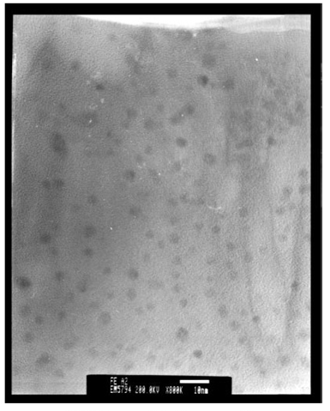
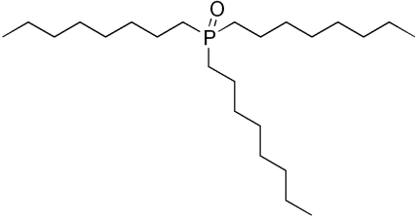
Colloidal methods: Iron
  3 nm Fe nanoparticles produced by reducing FeCl₂ with sodium borohydride (NaBH₄) in xylene.
  Trioctylphosphine oxide (TOPO) was introduced as a capping agent to prevent oxidation and aggregation.
TEM image of Fe nanoparticles
Phys. Chem. Chem. Phys., 2001, 3, 1661-1665

Slide 13
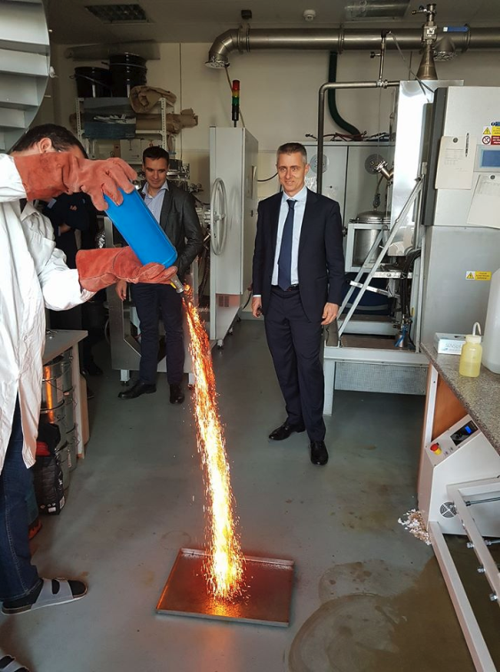
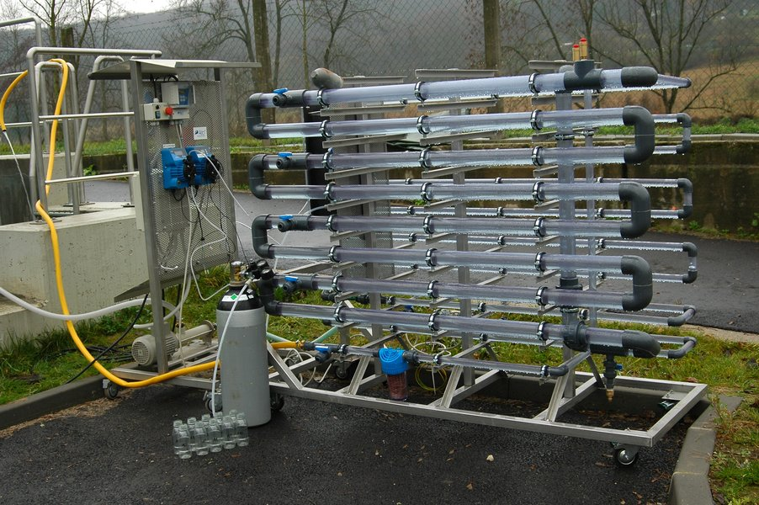
Colloidal methods : Iron
NaBH₄ (0.2 M) is added into FeCl₃•6H₂O (0.05 M) solution (~1:1 volume ratio). Ferric iron is reduced via the following reaction:
4 Fe³⁺ + 3BH₄ ⁻ + 9H₂O → 4Fe⁰ + 3H₂BO₃⁻ + 12H⁺ + 6H₂
Nano zero-valent iron for groundwater cleanup, have been deployed at full-scale cleanup sites
https://nanoiron.cz/en/

Slide 14
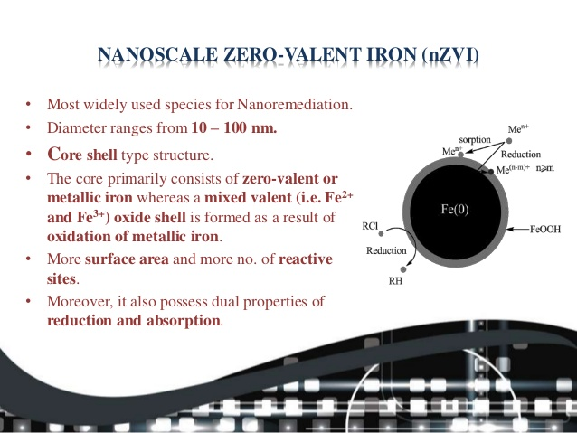

Slide 15


Slide 16
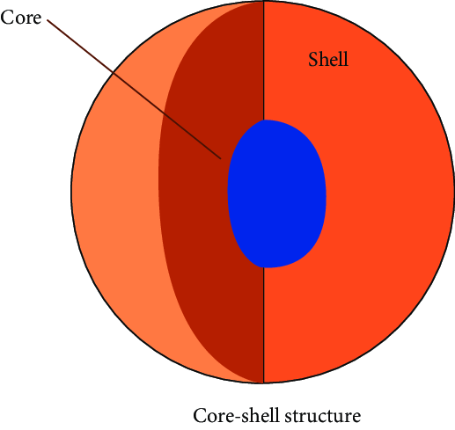
Colloidal methods : M/Fe core-shell nanoparticles
Palladized Fe particles are prepared by soaking the nanoscale iron particles with an ethanol solution of 1wt% of palladium acetate ([Pd(C₂H₃O₂)₂]₃). This causes the reduction and deposition of Pd on the Fe surface:
Pd²⁺ + Fe ⁰ → Pd⁰ + Fe²⁺
Similar methods may be used to prepared Fe/Pt, Fe/Ag, Fe/Ni, Fe/Co, and Fe/Cu bimetallic particles. With the above methods, nanoparticles of diameter 50-70 nm may be produced. The average specific surface area of Pd/Fe particles is about 35 m²/g.

