Slide 1
Mobile Robotics
Part II.2
a.a. 2020-2021
Mobile Robots

Slide 2
Relative Position sensing
Mobile Robotics

Slide 3
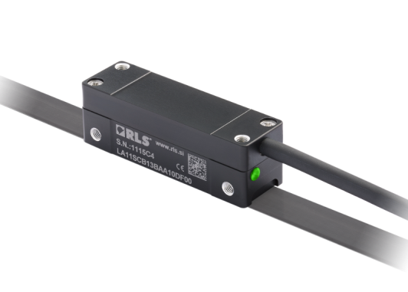
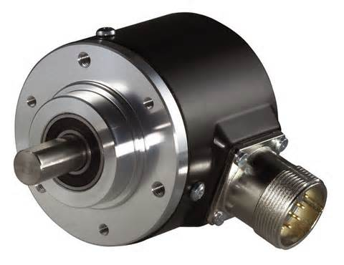
Relative position sensors
Relative position sensors
  They provide a signal proportional to the displacement measured between a part and a reference position
  Linear
    Linear potentiometers, linear encoders
  Angular
    Potentiometers, rotary encoders, resolvers

Slide 4
Principle
Transducer
Transduction
Physical quantity
Digital signal
Position:
Linear
Angular
Digital signal

Slide 5
Encoders type
Incremental
  Measures single increments
  Requires definition of a reference
Absolute
  Measures the position relative to a reference
  Immediate measure
  Reference is intrinsic

Slide 6
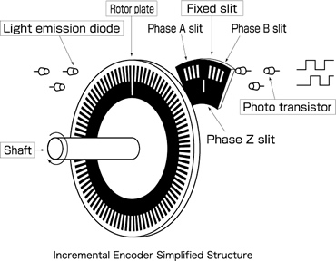
Incremental encoders
Structure and function
One or more slits array
Measurement of single increments
No intrinsic “memory”
Rotary incremental encoder

Slide 7
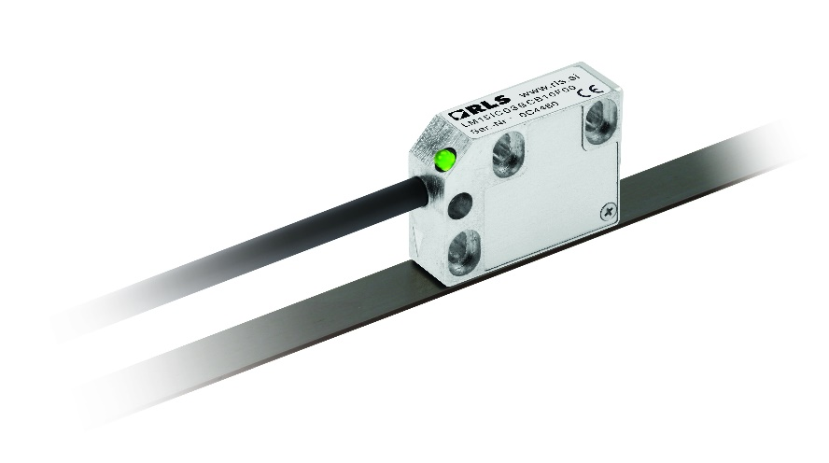
Incremental encoders
Principle
Photodiode
Motion
Linear incremental encoder
Emitter
Signal
Counts/steps
Value
1
2
3
4…
time

Slide 8
Incremental encoders
Reference
Requirement: reference
Options:
  Additional slit with the zero-reference
  Limits sensors directly on the joint

Slide 9
Incremental encoders
Direction determination (1)
Single slit array (quadrature enc.)
  Detects steps
  Does not differentiate direction
Double slit arrays
  Detect steps
  Detects direction
No difference detected
Photodiode A
Photodiode B
A
B
Emitters
A
B
0
0
1
1
0
0
1
…
0
1
1
0
0
1
1

Slide 10
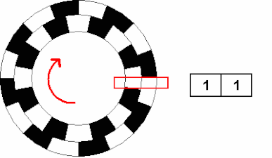
Incremental encoders
Direction determination (2)
Photodiode A
Photodiode B
A
B
Emitters
A
0 | 0 | 1 | 1 | 0
0 | 1 | 1 | 0 | 0
B
0
0
1
1
0
0
1
…
0
1
1
0
0
1
1

Slide 11
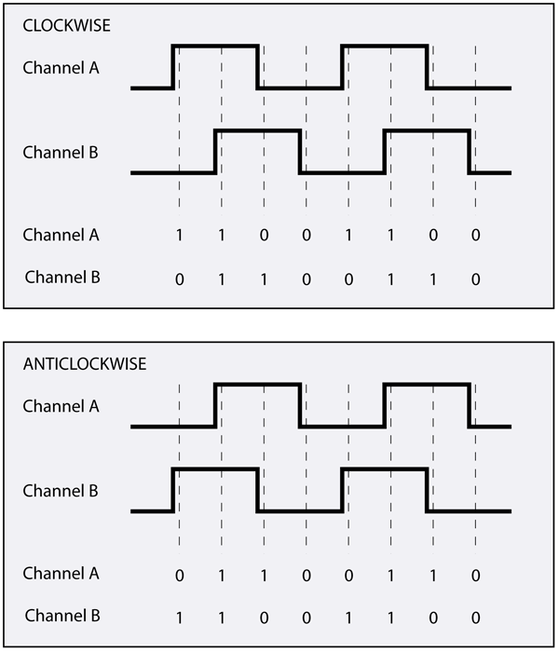

Incremental encoders
Operation
Sensor A
Comparison table
Step
Integrator
Sensor B
Direction
A
Current position:
$$x_{i}=x_{i−1}+k_{sign}δx$$
where:
$k_{sign}=1$ if clockwise, $k_{sign}=−1$ if anti-cw,
$δx$ step
B

Slide 12
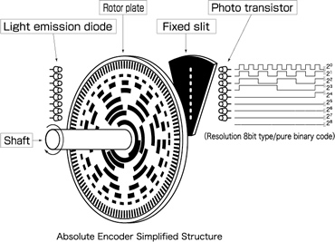

Absolute encoders
Structure and function

Slide 13
Absolute encoders
Principle
90°
135°
45°
0°
1
1
1
0
1
1
0
1
0
0
0
0
0°
45°
90°
135°
Position is ENCODED in the disk

Slide 14
Absolute encoders
Operation
Current position
Sensor track 1
Decoder
Sensor track 2
Sensor track 3
Track 1 | Track 2 | Track 3 | Position
1 | 1 | 1 | 0°
0 | 1 | 1 | 45°
0 | 1 | 0 | 90°
0 | 0 | 0 | 135°
…
Sensor track n
Track 3
Track 2
Track 1

Slide 15
Encoder technologies
Mobile Robotics

Slide 16
Incremental encoders
Technologies
Electro-mechanical
Optical
Magnetic (Hall-effect)

Slide 17
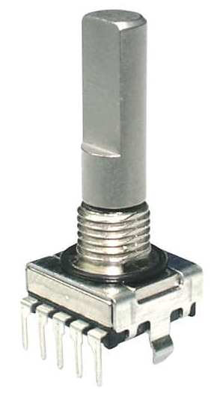
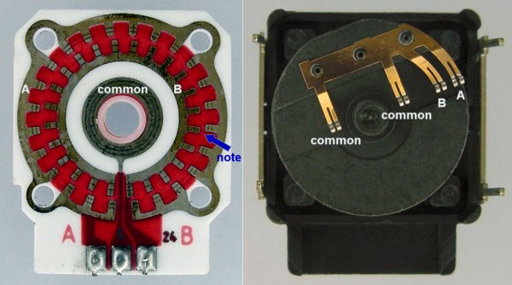
Incremental encoders
Electro-mechanical
Typically used in electronics for hand-operated controls
Cheap component
Low accuracy due to limited number of contacts
Low durability due to wear

Slide 18
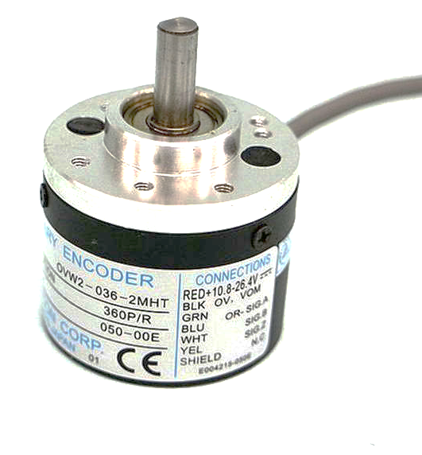
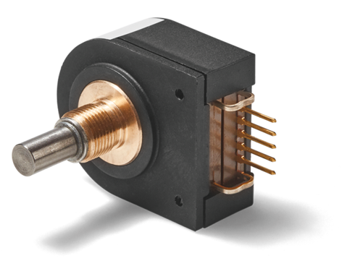
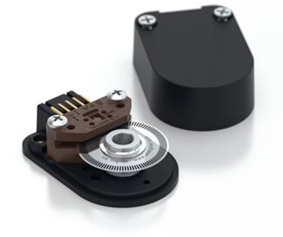
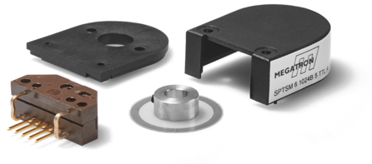
Incremental encoders
Optical
Typically used for high-fidelity measurements, high performance CNC machining, measurement systems, etc.
High accuracy with glass scales, etching etc.
High durability due to contactless operation
Expensive component

Slide 19
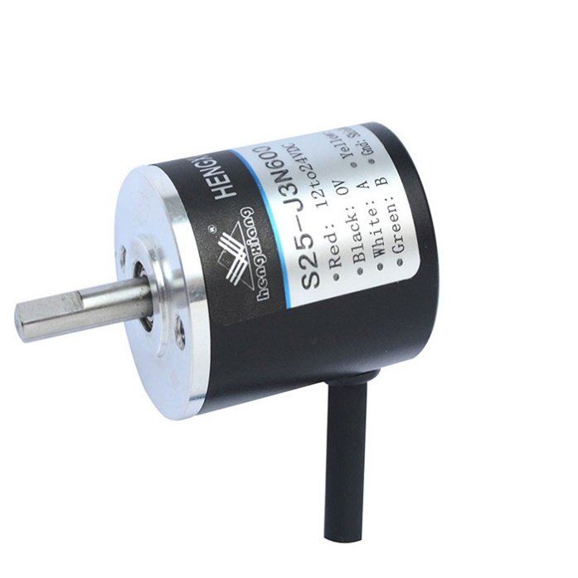
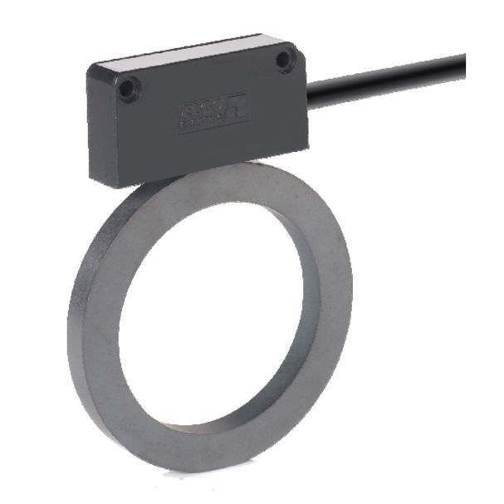
Incremental encoders
Magnetic (Hall-effect)
Typically used for medium-fidelity measurements: motor control, robot axis control
Good accuracy with proper installation and high-quality magnetized materials
High durability due to contactless operation
Medium-price component
Sensor A
A
N
N
S
N
S
N
S
N
S
N
S
N
S
S
B
Sensor B

Slide 20
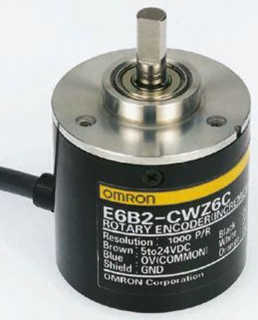
Incremental encoders
Rating
Angular resolution is usually measured in pulses per revolution, P/R

Slide 21
Absolute encoders
Technologies
Electro-mechanical (impractical in most cases)
Optical
Magnetic (Hall-effect)
Capacitive
Pros and cons are the same as for incremental encoders

Slide 22
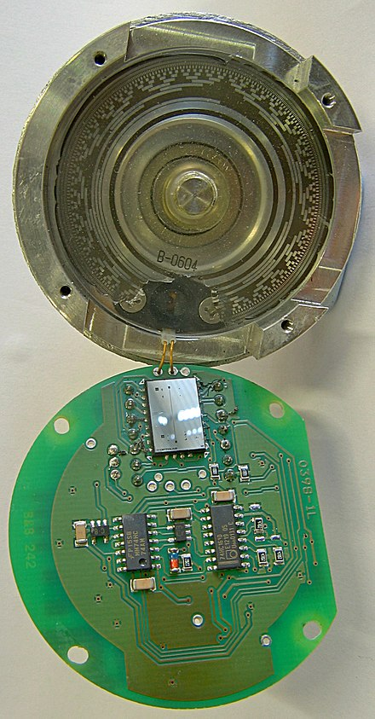
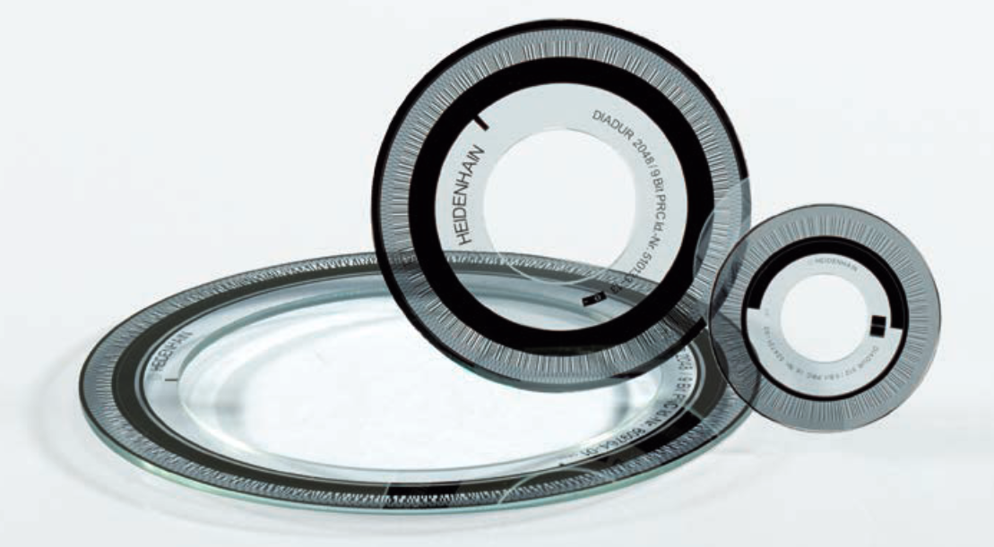
Absolute encoders
Optical
Rotor often made of etched/printed glass
Expensive

Slide 23
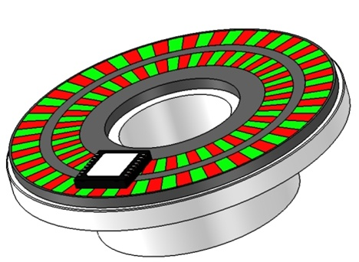
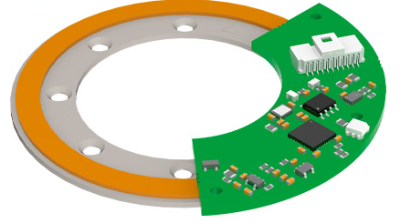
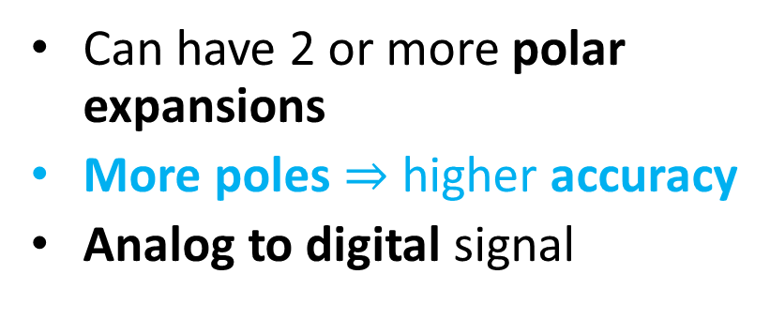
Absolute encoders
Magnetic (Hall-effect)
Can have 2 or more polar expansions
More poles $⇒$ higher accuracy
Analog to digital signal
Sensor A
A
N
S
B
Sensor B

Slide 24
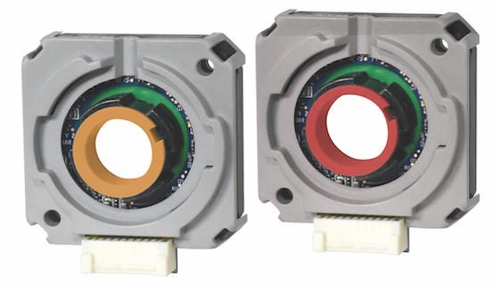
Absolute encoders
Capacitive
Innovative approach
Similar principle to that of Hall-effect encoders
Sensor A
A
B
Sensor B

Slide 25
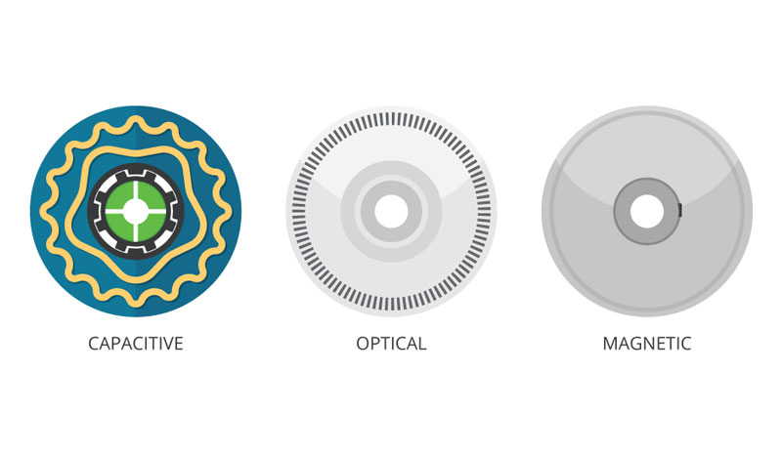
Encoders
Comparison

