Slide 1
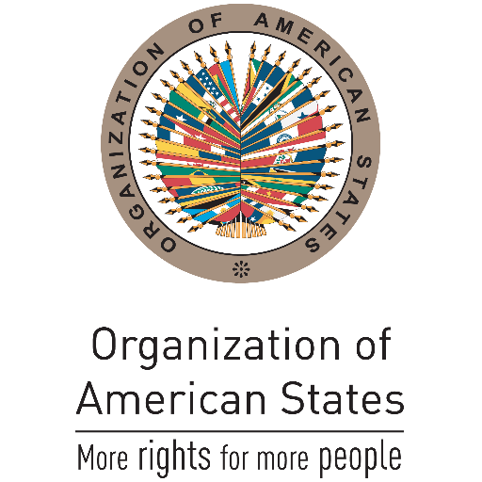
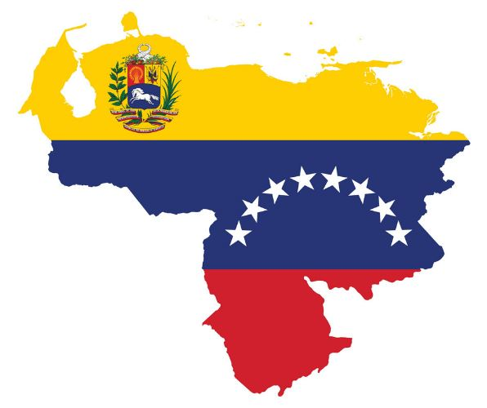
L’Organizzazione degli Stati americani, il sistema interamericano di tutela dei diritti umani e la questione del Venezuela 13 maggio 2021 Dott. Gabriele Asta UNIVERSITà DEGLI STUDI DI sASSARI

Slide 2
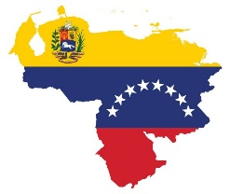
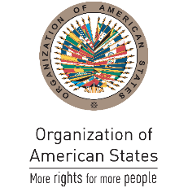
Le origini del processo di integrazione interamericano
1826: Congresso di Panama
1889-1890: Prima Conferenza internazionale degli Stati americani (Washington D.C.)
Istituzione dell’Unione internazionale delle repubbliche americane (in seguito, Unione panamericana)
1923: Quinta Conferenza internazionale (Santiago de Chile) – adozione del Trattato per evitare e prevenire i conflitti tra gli Stati americani (c.d. Trattato di Gondra)
1933: Settima Conferenza internazionale (Montevideo) – adozione della Convenzione sui diritti e doveri degli Stati
1948: Nona Conferenza internazionale (Bogotá) – adozione della Carta dell’Organizzazione degli Stati americani (OSA)

Slide 3
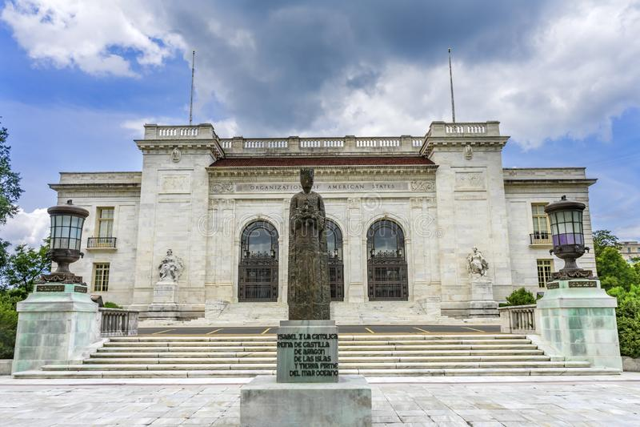
Inizialmente, 21 Stati membri attualmente (e “ufficialmente”) 35 Stati membri
Quattro protocolli di emendamento della Carta OSA: Buenos Aires (1967), Cartagena de Indias (1985), Washington (1992), Managua (1993).
Carta OSA, art. 53: “The Organization of American States accomplishes its purposes by means of:
a) The General Assembly;
b) The Meeting of Consultation of Ministers of Foreign Affairs;
c) The Councils; Consiglio permanente e Consiglio interamericano per lo sviluppo integrale
d) The Inter-American Juridical Committee;
e) The Inter-American Commission on Human Rights;
f) The General Secretariat;
g) The Specialized Conferences; and
h) The Specialized Organizations. […]”

Slide 4
Carta OSA, art. 1: “The American States establish by this Charter the international organization that they have developed to achieve an order of peace and justice, to promote their solidarity, to strengthen their collaboration, and to defend their sovereignty, their territorial integrity, and their independence. Within the United Nations, the Organization of American States is a regional agency.
The Organization of American States has no powers other than those expressly conferred upon it by this Charter, none of whose provisions authorizes it to intervene in matters that are within the internal jurisdiction of the Member States.”
articolo 19: “No State or group of States has the right to intervene, directly or indirectly, for any reason whatever, in the internal or external affairs of any other State. The foregoing principle prohibits not only armed force but also any other form of interference or attempted threat against the personality of the State or against its political, economic, and cultural elements.”

Slide 5
Convenzione di Montevideo sui diritti e doveri degli Stati (1933), art. 8: “No state has the right to intervene in the internal or external affairs of another.”
Protocollo addizionale relativo al non intervento (1936), art. 1: “The High Contracting Parties declare inadmissible the intervention of any one of them, directly or indirectly, and for whatever reason, in the internal or external affairs of the Parties”.
Tali conferenze avrebbero codificato quello che alcuni autori hanno definito come principio dell’“absolute non-intervention”, che proibirebbe in termini assoluti le varie forme di intervento invece consentite ai sensi del diritto internazionale generale.

Slide 6
Carta OSA, art. 2: “The Organization of American States, in order to put into practice the principles on which it is founded and to fulfill its regional obligations under the Charter of the United Nations, proclaims the following essential purposes: […] b) To promote and consolidate representative democracy, with due respect for the principle of nonintervention […]”.
Carta OSA, art. 9: “A Member of the Organization whose democratically constituted government has been overthrown by force may be suspended from the exercise of the right to participate in the sessions of the General Assembly, the Meeting of Consultation, the Councils of the Organization and the Specialized Conferences as well as in the commissions, working groups and any other bodies established. […] b) The decision to suspend shall be adopted at a special session of the General Assembly by an affirmative vote of two-thirds of the Member States”.
Carta democratica interamericana (2001), art. 20: “In the event of an unconstitutional alteration of the constitutional regime that seriously impairs the democratic order in a member state, any member state or the Secretary General may request the immediate convocation of the Permanent Council to undertake a collective assessment of the situation and to take such decisions as it deems appropriate. […]”.

Slide 7
L’OSA e i diritti umani
Carta OSA, art. 3: “The American States reaffirm the following principles: […] l) The American States proclaim the fundamental rights of the individual without distinction as to race, nationality, creed, or sex”.
Dichiarazione americana dei diritti e dei doveri dell’uomo (2 Maggio 1948)
Risoluzione XXXI Al Comitato giuridico interamericano viene affidato il compito di elaborare un Progetto di statuto per la creazione di un tribunale internazionale dei diritti umani per il continente americano
1959: Istituzione della Commissione interamericana dei diritti umani (risoluzione “Derechos humanos”) entità autonoma rispetto all’OSA con il compito di “promuovere” il rispetto dei diritti umani contenuti nella Dichiarazione americana
1965: Ampliamento delle funzioni e dei poteri della Commissione (protezione dei diritti umani e controllo sull’operato degli Stati, anche tramite la possibilità di esaminare petizioni individuali relative ad alcuni articoli della Dichiarazione americana)

Slide 8
1967: Viene messa fine al «limbo» giuridico della Commissione organo dell’OSA
Carta OSA, art. 106: “There shall be an Inter-American Commission on Human Rights, whose principal function shall be to promote the observance and protection of human rights and to serve as a consultative organ of the Organization in these matters.
An inter-American convention on human rights shall determine the structure, competence, and procedure of this Commission, as well as those of other organs responsible for these matters.”
21 novembre 1969: Convenzione americana dei diritti umani o Patto di San José (in vigore dal 1978)
Sistema di controllo strutturato su due livelli Commissione (con duplice ruolo) e Corte interamericana dei diritti umani (organismo di garanzia della Convenzione a carattere autonomo)

Slide 9
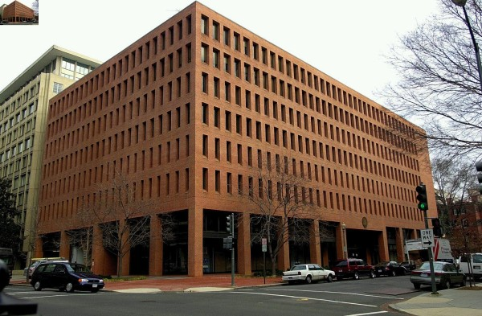
Commissione interamericana dei diritti umani – funzioni e poteri
(art. 41 Convenzione americana e artt. 18-20 Statuto)
art. 41 Convenzione: “The main function of the Commission shall be to promote respect for and defense of human rights. In the exercise of its mandate, it shall have the following functions and powers: […]
b. to make recommendations to the governments of the member states, when it considers such action advisable, for the adoption of progressive measures in favor of human rights within the framework of their domestic law and constitutional provisions as well as appropriate measures to further the observance of those rights; […]
d. to request the governments of the member states to supply it with information on the measures adopted by them in matters of human rights; […]
f. to take action on petitions and other communications pursuant to its authority under the provisions of Articles 44 through 51 of this Convention; […]”
art. 18 Statuto: “[…] g. to conduct on-site observations in a state, with the consent or at the invitation of the government in question”

Slide 10
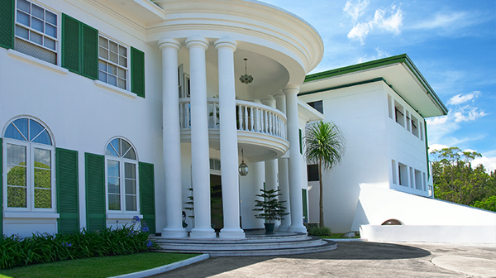
Corte interamericana dei diritti umani
Esercita due funzioni: contenziosa (artt. 61-63) e consultiva (art. 64)
art. 62: “1. A State Party may, upon depositing its instrument of ratification or adherence to this Convention, or at any subsequent time, declare that it recognizes as binding, ipso facto, and not requiring special agreement, the jurisdiction of the Court on all matters relating to the interpretation or application of this Convention.
2. Such declaration may be made unconditionally, on the condition of reciprocity, for a specified period, or for specific cases. […]
3. The jurisdiction of the Court shall comprise all cases concerning the interpretation and application of the provisions of this Convention that are submitted to it, provided that the States Parties to the case recognize or have recognized such jurisdiction, whether by special declaration pursuant to the preceding paragraphs, or by a special agreement”.

Slide 11
art. 64: “1. The member states of the Organization may consult the Court regarding the interpretation of this Convention or of other treaties concerning the protection of human rights in the American states. Within their spheres of competence, the organs listed in Chapter [VIII] of the Charter of the Organization of American States, as amended by the Protocol of Buenos Aires, may in like manner consult the Court.
2. The Court, at the request of a member state of the Organization, may provide that state with opinions regarding the compatibility of any of its domestic laws with the aforesaid international instruments.”
Fino ad oggi la Corte ha reso 26 pareri consultivi (l’ultimo in termini temporali: La denuncia de la Convención Americana sobre Derechos Humanos y de la Carta de la Organización de los Estados Americanos y sus efectos sobre las obligaciones estatales en materia de derechos humanos (OC-26/20 del 9 novembre 2020)

Slide 12
La questione venezuelana: alcune date
2014 – si intensifica una drammatica crisi socio-economica e prende avvio un notevole esodo di venezuelani (ad oggi più di 5 MLN)
Marzo 2015 – gli Stati Uniti iniziano ad adottare sanzioni unilaterali e ad imporre un embargo di armi nei confronti del governo di Maduro
Dicembre 2015 – vittoria alle elezioni parlamentari del partito «Unità nazionale» (Juan Guaidò Presidente dell’Assemblea nazionale)
Novembre 2017 – anche l’Ue impone misure restrittive (embargo armi e sanzioni nei confronti di individui appartenenti all’élite governativa)
20 maggio 2018 – le elezioni presidenziali vedono la conferma di Nicolas Maduro
23 gennaio 2019 – Guaidò si proclama Presidente ad interim del Venezuela (ex artt. 233, 333 e 350 della Costituzione venezuelana)

Slide 13
L’OSA e la crisi venezuelana
10 settembre 2013 – notifica di recesso del Venezuela dalla Convenzione americana dei diritti umani (ex art. 78 Convenzione)
27 aprile 2017 – notifica di recesso del Venezuela dall’OSA (ex art. 148 Carta)
Risoluzione del Consiglio permanente del 3 aprile 2017 condanna della decisione della Corte suprema venezuelana di sospendere i poteri dell’Assemblea nazionale
Risoluzione dell’Assemblea generale del 5 giugno 2018 nella votazione del 6 giugno 2018 mancanza della maggioranza necessaria per sospendere il Venezuela
Risoluzione 10 gennaio 2019 del Consiglio permanente non riconoscimento del governo di Maduro
Risoluzione 9 aprile 2019 del Consiglio permanente accreditamento di Gustavo Tarre Briceño come rappresentante permanente venezuelano in seno all’OSA

Slide 14
“THE PERMANENT COUNCIL OF THE ORGANIZATION OF AMERICAN STATES […] TAKING NOTE that through resolution CP/RES. 1117 (2200/19) of January 10, 2019, the OAS underscored the constitutional authority of the democratically elected National Assembly and resolved not to recognize the legitimacy of Nicolás Maduro’s new term of office; […] RESOLVES 1. To accept the appointment of Mr. Gustavo Tarre as the National Assembly’s designated Permanent Representative, pending new elections and the appointment of a democratically elected government”.
(CP/RES. 1124 (2217/19) RESOLUTION ON THE SITUATION IN VENEZUELA (Adopted by the Permanent Council at its special meeting of April 9, 2019), adottata con 18 voti favorevoli, 9 voti contrari, 6 astensioni e un assente).
Risoluzione del Consiglio permanente illegittima?
Accreditamento come forma di riconoscimento (collettivo) di governo?

Slide 15
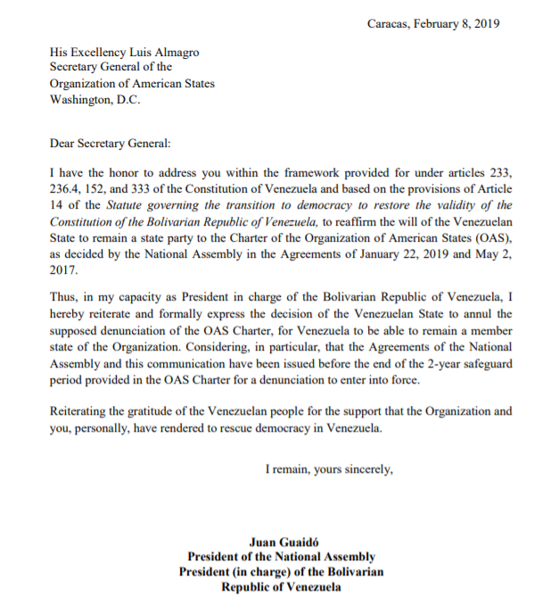

Slide 16
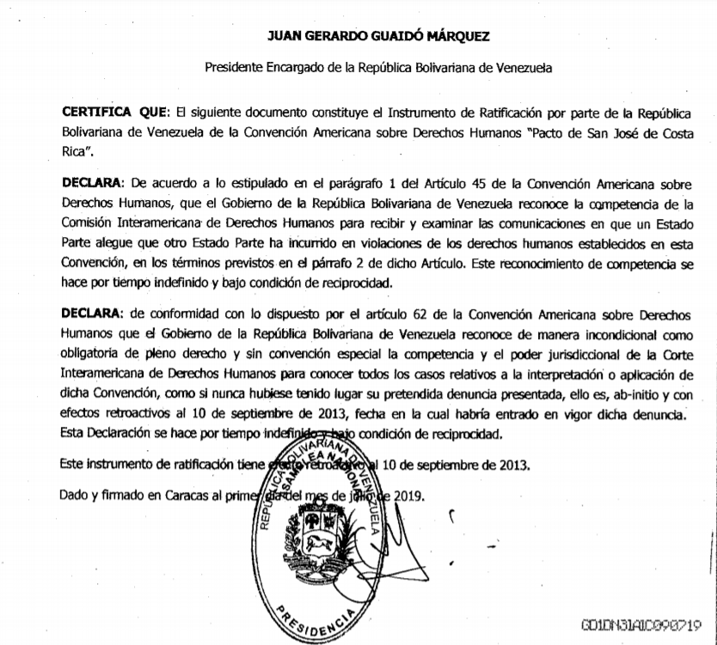

Slide 17
Il riconoscimento di governi
«The non-recognition by other nations of a government claiming to be a national personality, is usually appropriate evidence that it has not attained the independence and control entitling it by international law to be classed as such. But when recognition vel non of a government is by such nations determined by inquiry, not into its de facto sovereignty and complete governmental control, but into its illegitimacy or irregularity of origin, their non recognition loses something of evidential weight on the issue with which those applying the rules of international law are alone concerned. […] Such non-recognition for any reason, however, can not outweigh the evidence disclosed by this record before me as to the de facto character of Tinoco’s government, according to the standards set by International Law. […] The question is, has it really established itself in such a way that all within its influence recognize its control, and that there is no opposing force assuming to be a government in its place? ls it discharging its functions as a government usually does, respected within its own jurisdiction?»
(sentenza arbitrale del 18 ottobre 1923 sul caso delle Concessioni Tinoco (Regno Unito c. Costarica), pp. 381-382)

Slide 18
Il riconoscimento di governi
Quale ruolo per il principio di legittimità democratica (o della costituzionalità del governo che possiede il controllo effettivo)?
Prassi recente: Costa d’avorio (2011) e Gambia (2017)
Quali differenze rispetto alle vicende venezuelane? Incertezza sul titolo di governo e mancato appoggio uniforme della Comunità internazionale
Elezioni politiche del 6 dicembre 2020: larghissima maggioranza di seggi per il partito socialista e nuovo presidente dell’Assemblea nazionale (Jorge Rodríguez)

Slide 19
Riconoscimento prematuro come ingerenza negli affari interni e esterni del Venezuela?
«As regards the first problem - that of the content of the principle of non-intervention - the Court […] notes that, in view of the generally accepted formulations, the principle forbids all States or groups of States to intervene directly or indirectly in internal or external affairs of other States. A prohibited intervention must accordingly be one bearing on matters in which each State is permitted, by the principle of State sovereignty, to decide freely. One of these is the choice of a political, economic, social and cultural system, and the formulation of foreign policy. Intervention is wrongful when it uses methods of coercion in regard to such choices, which must remain free ones. The element of coercion, which defines, and indeed forms the very essence of, prohibited intervention, is particularly obvious in the case of an intervention which uses force, either in the direct form of military action, or in the indirect form of support for subversive or terrorist armed activities within another State. […]
It has to consider whether there might be indications of a practice illustrative of belief in a kind of general right for States to intervene, directly or indirectly, with or without armed force, in support of an internal opposition in another State, whose cause appeared particularly worthy by reason of the political and moral values with which it was identified. For such a general right to come into existence would involve a fundamental modification of the customary law principle of non-intervention».
(CIG, caso delle Attività militari e paramilitari in e contro il Nicaragua (Nicaragua c. Stati Uniti d’America), sentenza del 27 giugno 1986, parr. 205-206)

Slide 20
Questione venezuelana e sistema interamericano di tutela dei diritti umani
Organi di controllo come «strumento di politica estera» degli Stati membri dell’OSA?
Parere consultivo OC-26/20 sollecitato dalla Colombia duplice ruolo del potere di riformulazione dei quesiti esercitato dalla Corte interamericana
“When a situation of serious and systematic violations of human rights arises under the jurisdiction of a State in the Americas which has denounced the American Convention and the Charter of the Organization of American States,
1. What obligations do the remaining member States of the OAS have in matters of human rights?
2. What mechanisms are available to Member States of the OAS to enforce those obligations?
3. To what mechanisms of international protection of human rights can persons subject to the jurisdiction of the denouncing State have recourse?”

Slide 21
2) Quale impatto del «riconoscimento» di Guaidò sul sistema interamericano di tutela dei diritti umani?
Limiti pratici all’effettività dell’attività degli organi di controllo in assenza di cooperazione dello Stato territoriale perdurante rilevanza del principio di effettività di governo
«[…] En este sentido, manifestamos nuestro compromiso para que prontamente, una vez que cese la usurpación del régimen ilegítimo de Nicolás Maduro, el Estado venezolano cumpla con todas las decisiones de la Corte Interamericana y asimismo cumpla con las obligaciones convencionales de adoptar las medidas necesarias para respetar, garantizar, proteger y reparar integralmente a las violaciones de los derechos humanos en un marco de democracia constitucional y del Estado de derecho. [...] por lo que esperamos en breve contar con los medios necesarios para cooperar efectivamente con él y hacer realidad el ideal de todos los derechos para todos, en paz y en democracia» (Dichiarazione del Rappresentante permanente Tarre Briceño in seno al Consiglio permanente – 11 dicembre 2019).

Slide 22
La visita «in loco» della Commissione interamericana su invito del Rappresentante permanente (5-8 febbraio 2020)

Slide 23
Parere consultivo OC-26/20
«The Court emphasizes that, regardless of the different domestic procedures for denouncing treaties in the region, the denunciation of a human right treaty - particularly one that establishes a jurisdictional system for the protection of human rights, such as the American Convention - must be subject to a pluralistic, public and transparent debate within the States, as it is a matter of great public interest because it implies a possible curtailment of rights and, in turn, of access to international justice. In this regard, the Court considers it pertinent to have recourse to the principle of parallelism of forms, which implies that if a State has established a constitutional procedure for assuming international obligations it would it be appropriate to follow a similar procedure when it seeks to extricate itself from those obligations […]» (par. 64).
«Lastly […], the Court finds it pertinent to point out that the collective guarantee implies a duty by the States to act jointly and cooperate to protect the rights and freedoms which they have undertaken to uphold internationally through their membership of the regional Organization and, in particular, (1) to present in a timely manner their observations or objections regarding denunciations of the American Convention and/or of the OAS Charter that do not withstand scrutiny in light of democratic principle and that undermine the inter-American public interest […] (2) ensure that the denouncing State does not consider itself disengaged from the OAS until it has complied with the human rights obligations acquired through the various protection mechanisms within the framework of their respective competencies and, in particular, those related to compliance with the reparations ordered by the Inter-American Court until the conclusion of the proceedings» (par. 173).

