Slide 1
Mobile Robotics
Part II.3
a.a. 2020-2021
Robotics and Mechatronics

Slide 2
MAPPING
Mobile Robotics

Slide 3
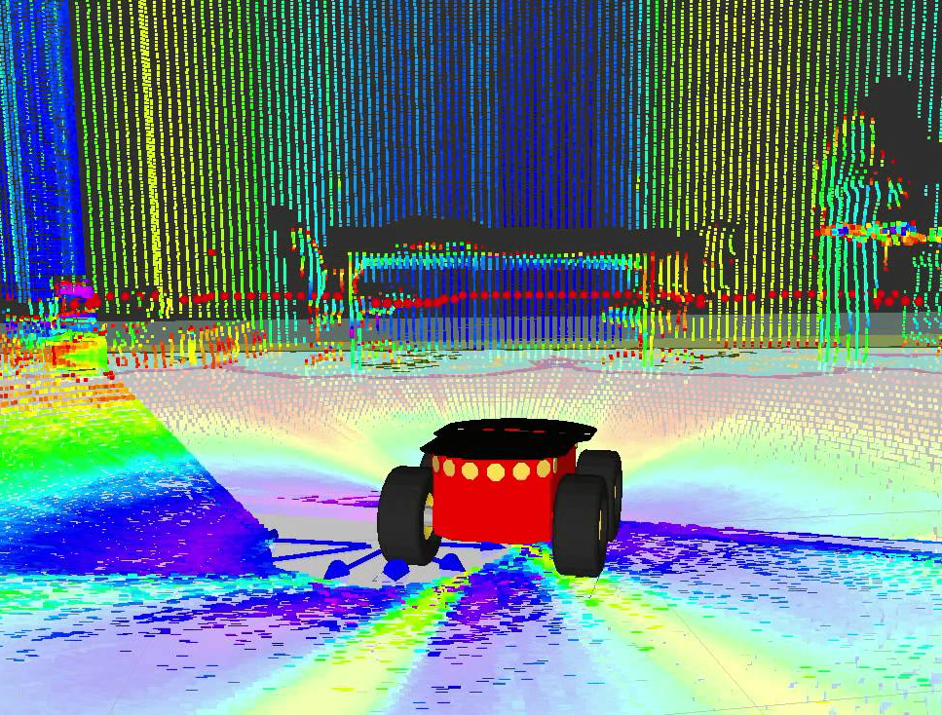
Environment mapping
Creation of a virtual map of the environment surrounding the robot
Contains information on:
  Obstacles
  Terrain geometry
  Locations and Points of
  Interest (POI) (e.g. goal)
  Position of the robot
  itself
Crucial for definition of traversability paths
Obstacles
POI
Terrain
geometry
Robot position

Slide 4
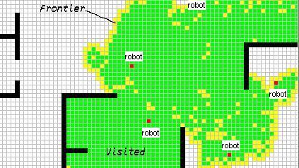
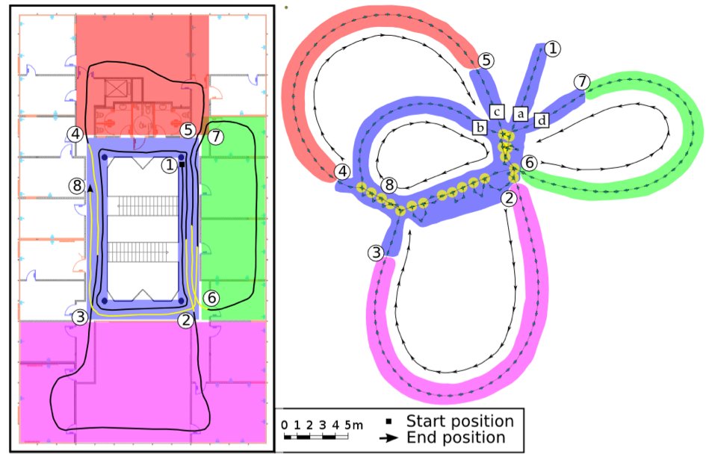
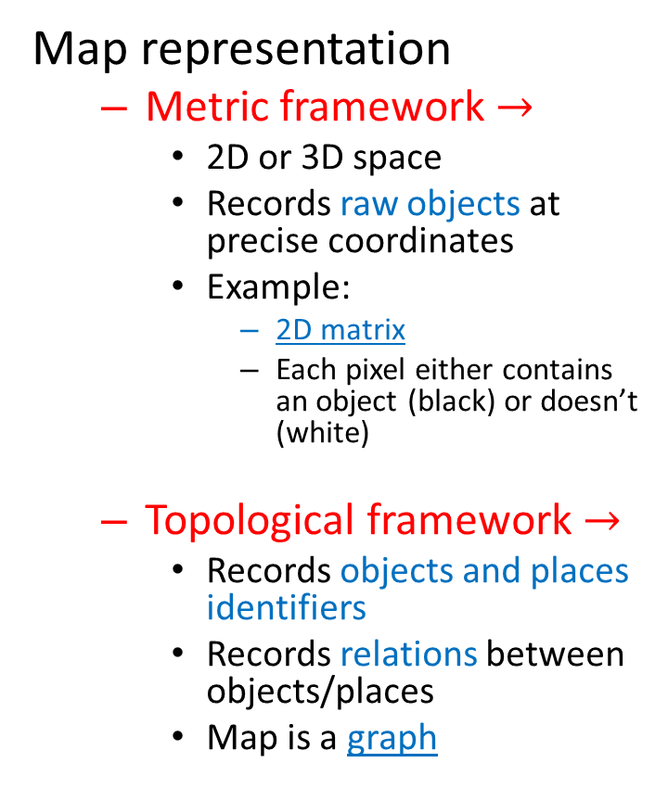
Environment mapping
Map representation
  Metric framework $→$
    2D or 3D space
    Records raw objects at precise coordinates
    Example:
      2D matrix
      Each pixel either contains an object (black) or doesn’t (white)
  Topological framework $→$
    Records objects and places identifiers
    Records relations between objects/places
    Map is a graph

Slide 5
Environment mapping
Type of map:
  Continuous
    Features are determined by mathematically defined objects
      Polygons, lines, points etc.
      High accuracy
      High computational cost
  Discrete
    Based on the decomposition of the environment in discrete elements
      Grids: occupancy grid
      Lower accuracy
      Large datasets

Slide 6
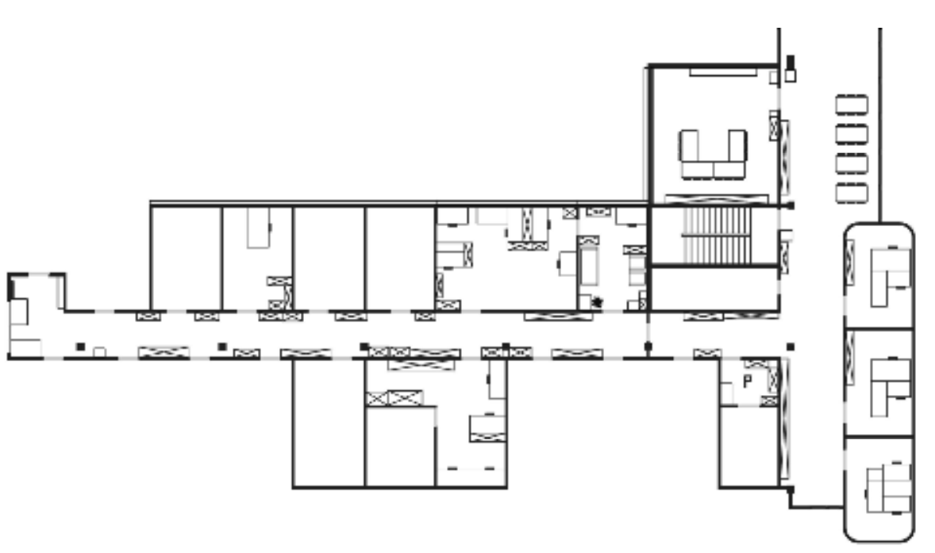
Continuous maps
Geometric map
2D
Polygons as objects/walls

Slide 7
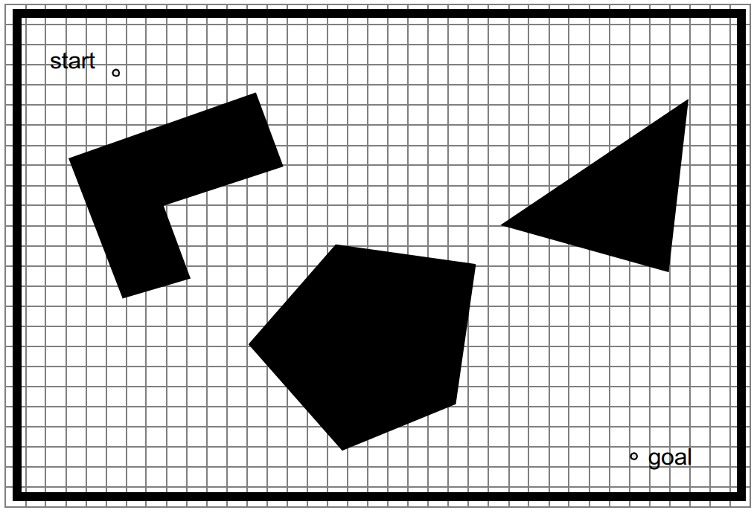
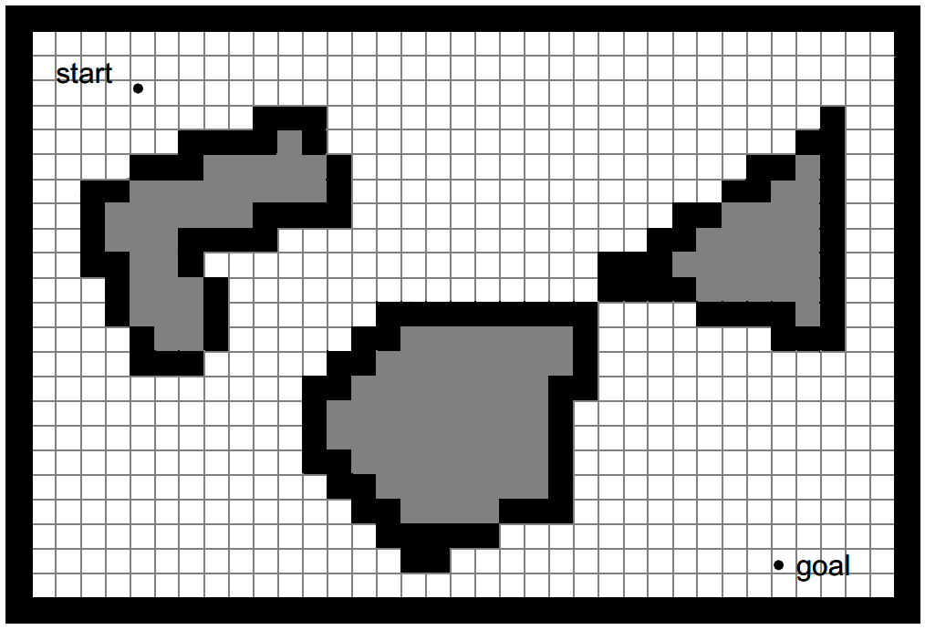
Discrete maps
Occupancy grid-based map

Slide 8
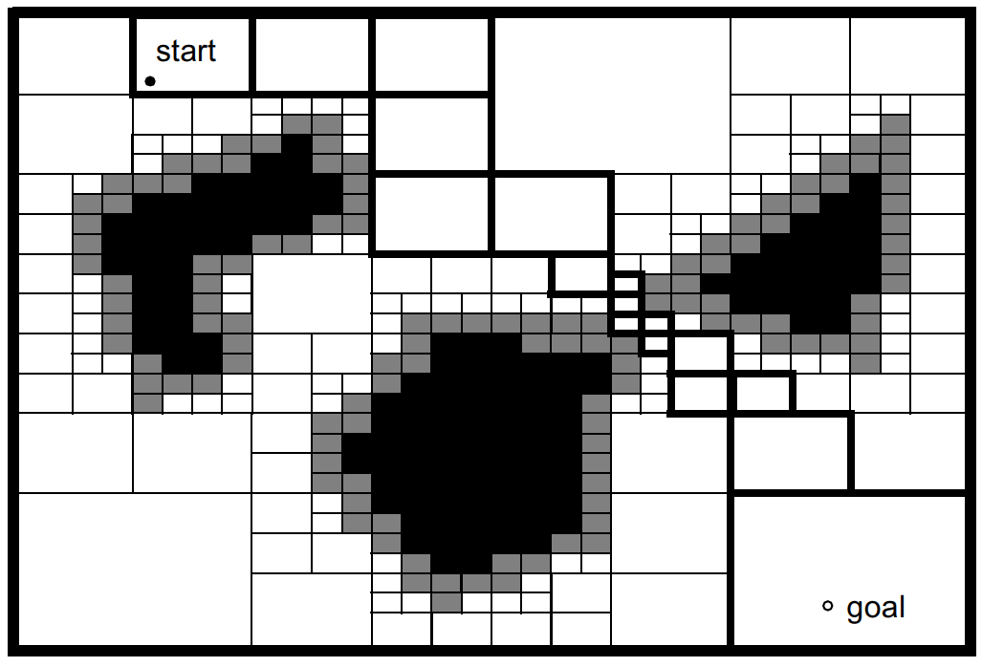
Discrete maps
Variable-cell occupancy grid-based map

Slide 9
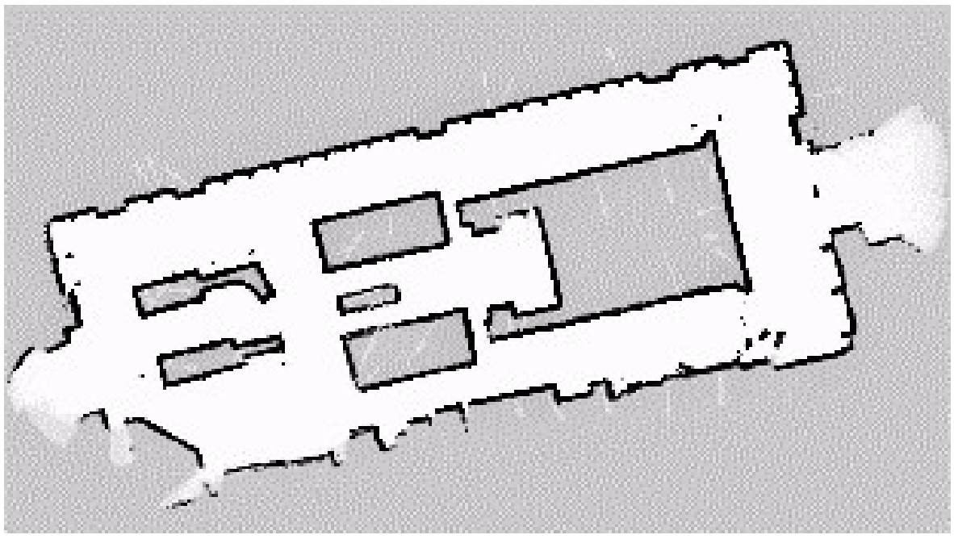
Discrete maps
Occupancy-grid

Slide 10
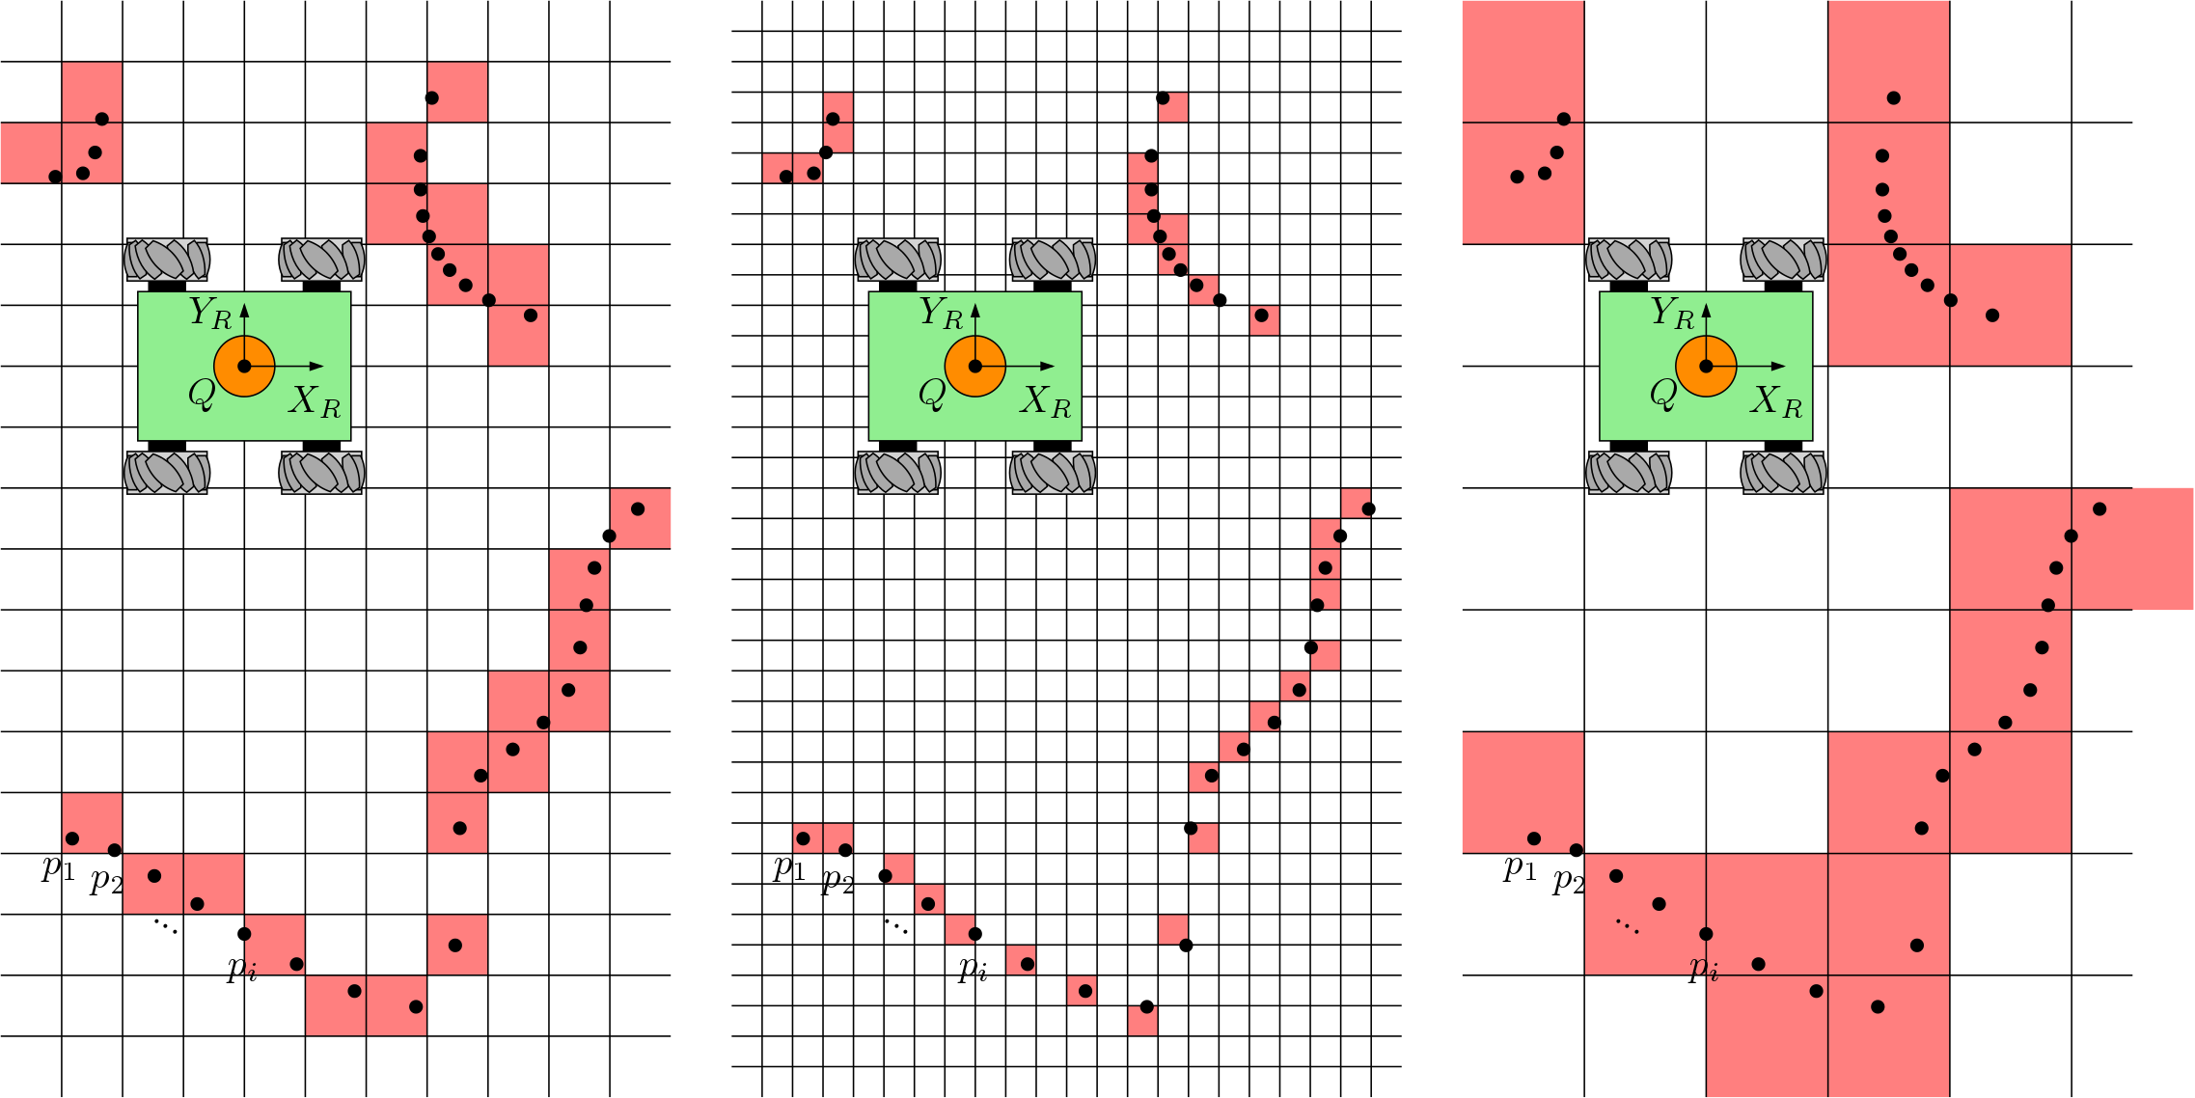
Example of occupancy grid mapping

Slide 11

Environment mapping
Rules:
  Precision of map $⇔$ precision of goals
  Precision of map $⇔$ accuracy of the sensors
  Complexity of map $⇒$ computational cost

Slide 12
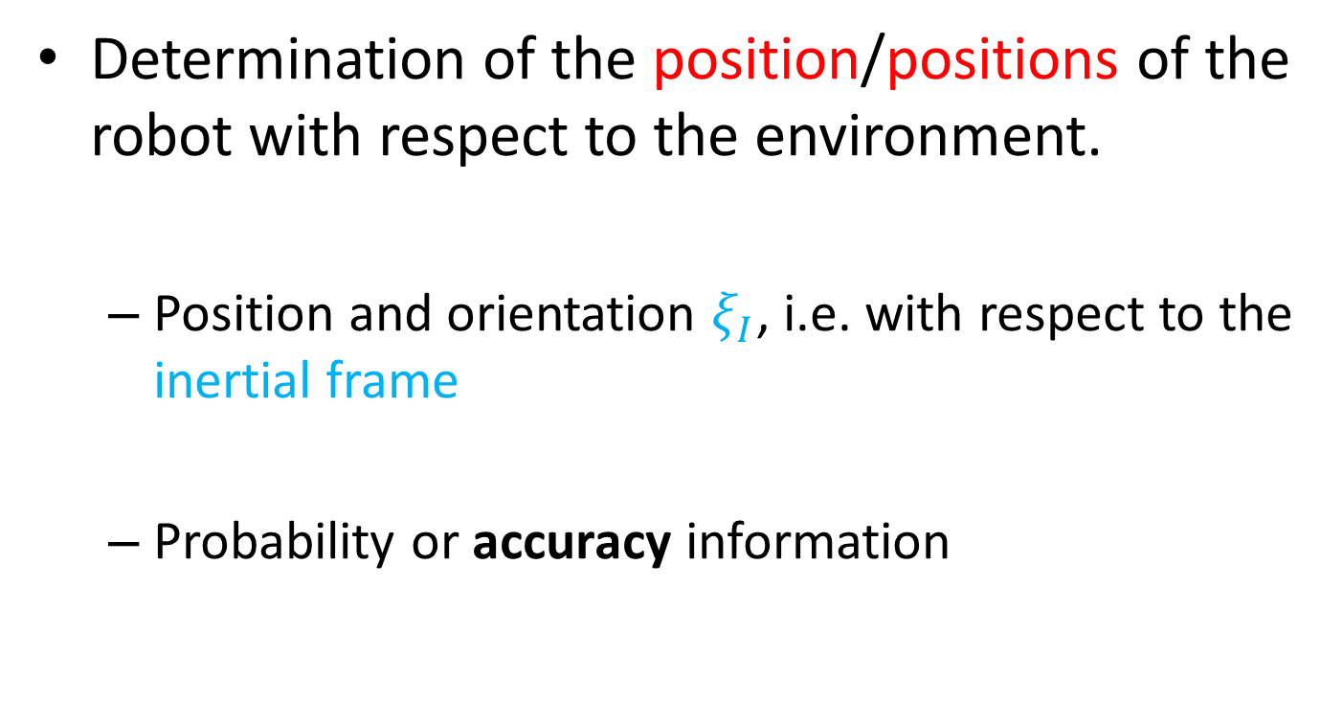
Position determination
Determination of the position/positions of the robot with respect to the environment.
  Position and orientation $ξ_{I}$, i.e. with respect to the inertial frame
  Probability or accuracy information

Slide 13
Position determination
Belief representation:
  Single unique position?
  Set of possible positions?
  How are they ranked?
Single-hypothesis
  The robot identifies one single unique position
  a certain probability distribution
Multiple-hypothesis
  The position is described in a fuzzy way
  This allows a better description of the degree of uncertainty

Slide 14
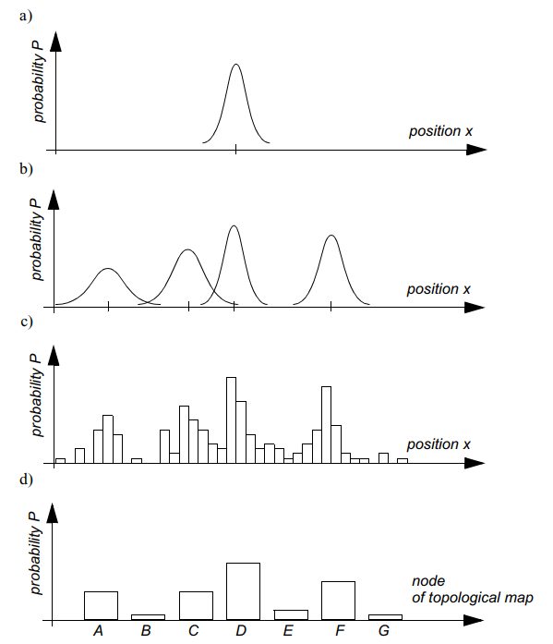
Position determination
Single-hypothesis
Continuous environment
Multiple-hypothesis
Discrete environment

Slide 15
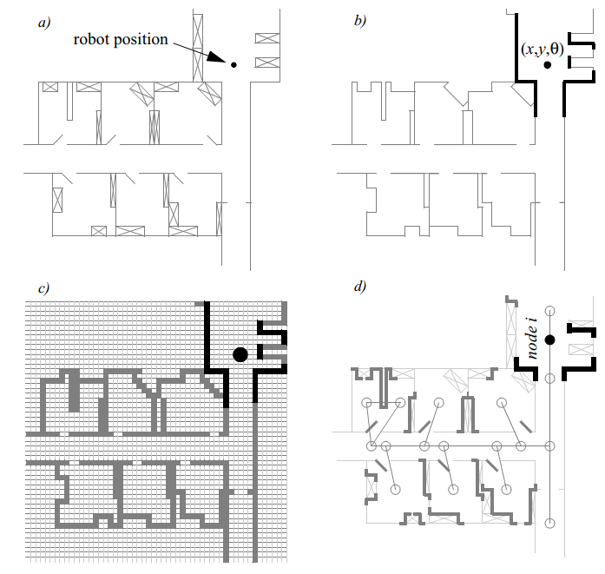
Position determination
Reality
Line-based map
Continuous geometric map
Occupancy grid-based map
Topological map
Discrete geometric map
Non-metric

Slide 16
Navigation
Mobile Robotics

Slide 17
Navigation
Definition
  Determination of position and orientation relative to the environment,
  The planning and execution of the maneuvers required to get from point A to point B.

Slide 18
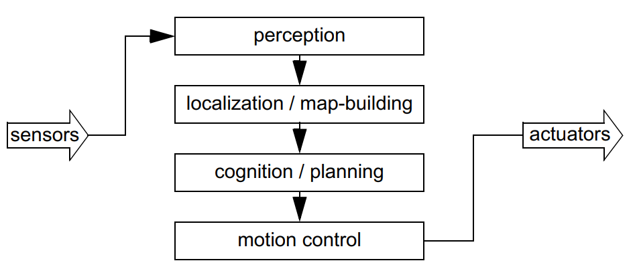
Map-based Navigation

Slide 19
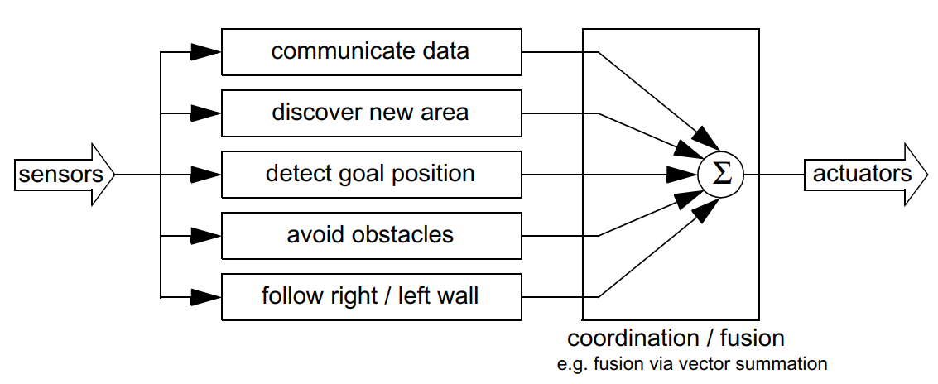
Behavior-based navigation

Slide 20
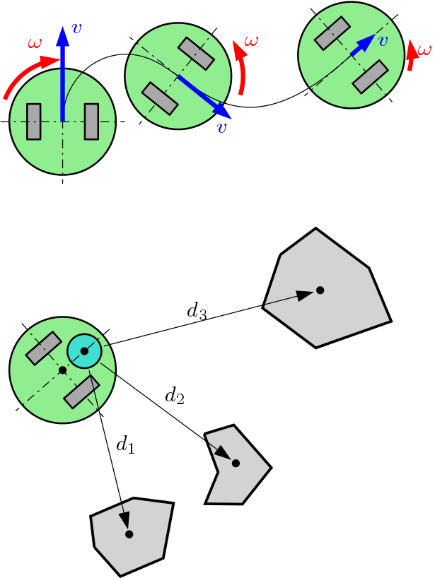
Position determination
Idiothetic sources
  Related to self-motion
  Uses proprioceptive sensors
    Number of wheel rotations,
    IMU
    Also called odometry or dead reckoning
Allothetic sources
  Related to external references
  Uses exteroceptive sensors
    Objects/obstacles
    Landmarks
    Terrain geometry
    Points of interest
Example: Odometry
Example: triangulation

Slide 21
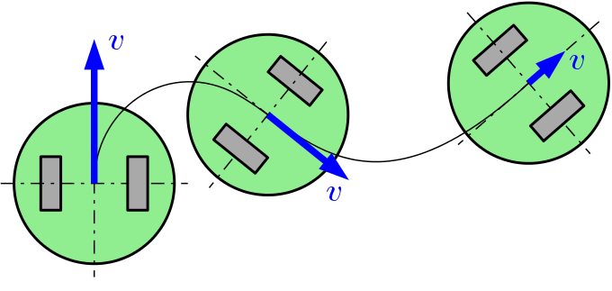

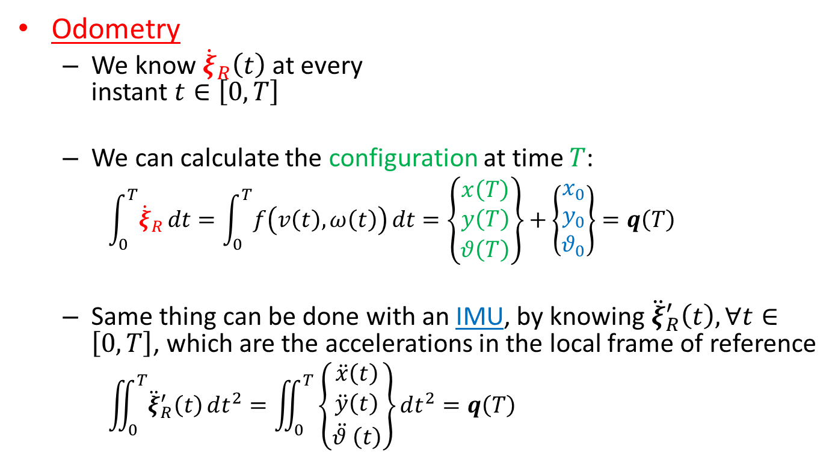


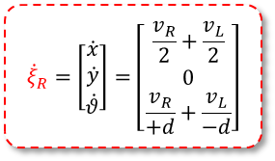

Example: odometry
$$y$$
$$x$$
$$y′$$
$${\dot{ξ}}_{R}=\left[\begin{aligned}\dot{x} \\ \dot{y} \\ \dot{θ}\end{aligned}\right]=\left[\begin{aligned}\frac{v_{R}}{2}+\frac{v_{L}}{2} \\ 0 \\ \frac{v_{R}}{+d}+\frac{v_{L}}{−d}\end{aligned}\right]$$
Odometry
  We know ${\dot{ξ}}_{R}\left(t\right)$ at every
  instant $t∈\left[0,T\right]$
  We can calculate the configuration at time $T$:
    $$\int_{0}^{T}{{\dot{ξ}}_{R}}dt=\int_{0}^{T}{f\left(v\left(t\right),ω\left(t\right)\right)}dt=\left\{\begin{aligned}x\left(T\right) \\ y\left(T\right) \\ θ\left(T\right)\end{aligned}\right\}+\left\{\begin{aligned}x_{0} \\ y_{0} \\ θ_{0}\end{aligned}\right\}=q\left(T\right)$$
  Same thing can be done with an IMU, by knowing${\ddot{ξ}}_{R}^{′}\left(t\right), ∀t∈\left[0,T\right]$, which are the accelerations in the local frame of reference
    $$\iint_{0}^{T}{{\ddot{ξ}}_{R}^{′}\left(t\right)}dt^{2}=\iint_{0}^{T}{\left\{\begin{aligned}\ddot{x}\left(t\right) \\ \ddot{y}\left(t\right) \\ \ddot{θ }\left(t\right)\end{aligned}\right\}}dt^{2}=q\left(T\right)$$
$$x′$$
Initial position

Slide 22
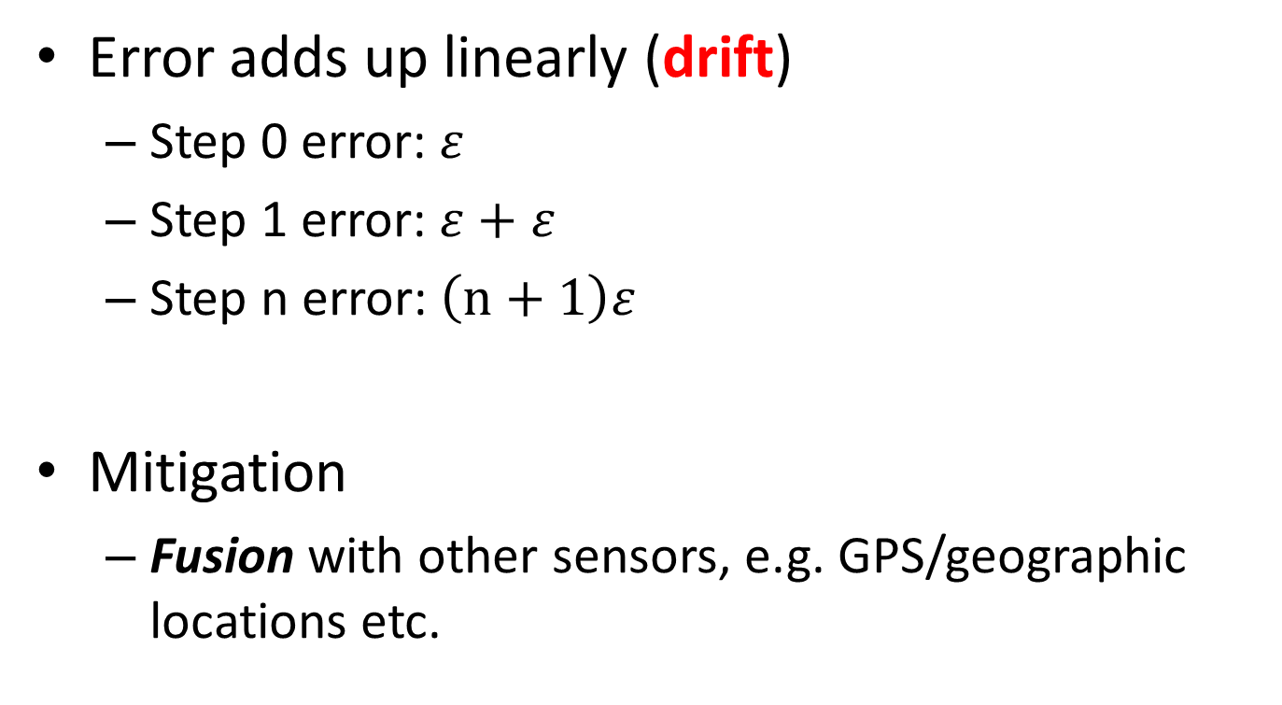
Odometric error
Error adds up linearly (drift)
  Step 0 error: $ε$
  Step 1 error: $ε+$ $ε$
  Step n error: $\left(n+1\right)ε$
Mitigation
  Fusion with other sensors, e.g. GPS/geographic locations etc.
Worst case scenario

Slide 23
S.L.A.M.
Simultaneous Localization and Mapping
The computational problem of simultaneously mapping the environment and localizing the robot within
Very computationally intensive
Implemented in varying ad-hoc architectures in the whole industry
  E.g. Autonomous cars

Slide 24
Reactive navigation
Line following
  A somewhat «legacy» technology
    No mapping required,
    Limited position determination required,
    Simple sensors (IR or magnetic if the line is magnetized)
    Virtually zero flexibility
  Can be coupled to other more advanced form of navigation
Video logistics
Video carts

Slide 25
Path planning
Aim: producing a continuous path between two points, A (start) and B (goal).
Several possible paths:
Approaches:
  Search algorithms
  Fields
Obstacles
B
A

Slide 26
Path planning
A path-planning or navigation problem can be represented as a graph
  Weights can be
  assigned to the single
  branches to account
  for distance, slope,
  terrain, …
The aim is to find the shortest or best path through the nodes, from A to B
B
B
Nodes
A
A

Slide 27
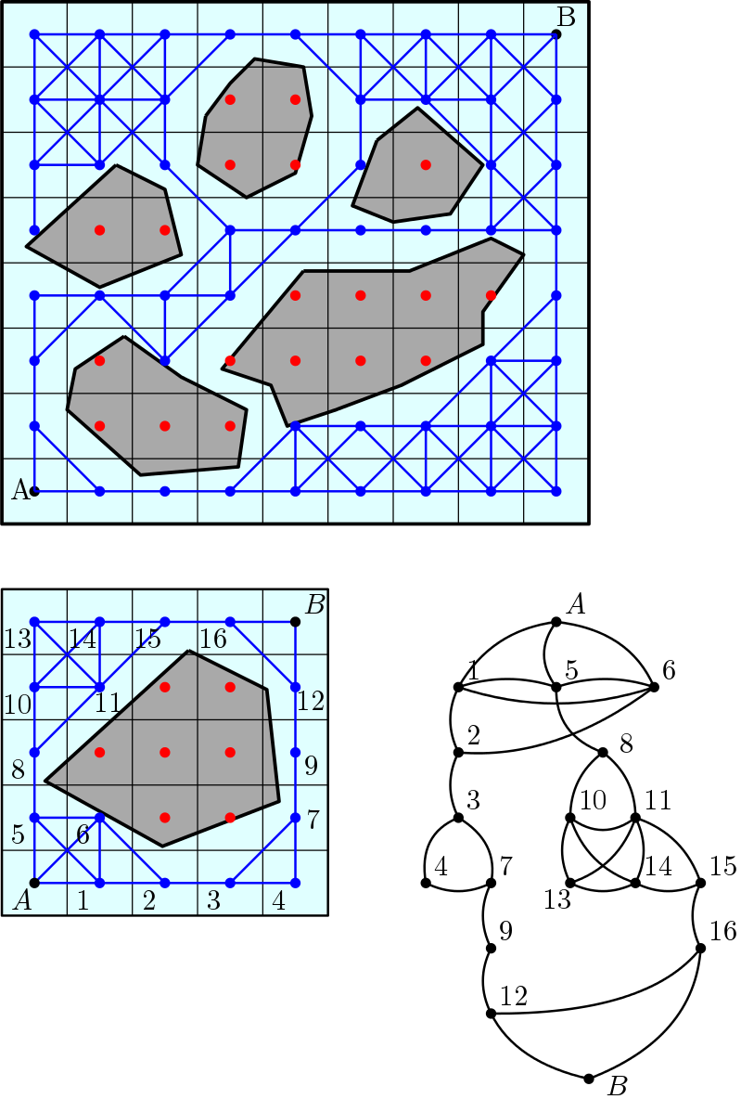
Path planning
Determination of the nodes
  Grid-based search
  Edge visibility graph
Search for optimal path
This is achieved by graph
exploration through efficient
search algorithms:
  Dijkstra, A*, ...

Slide 28
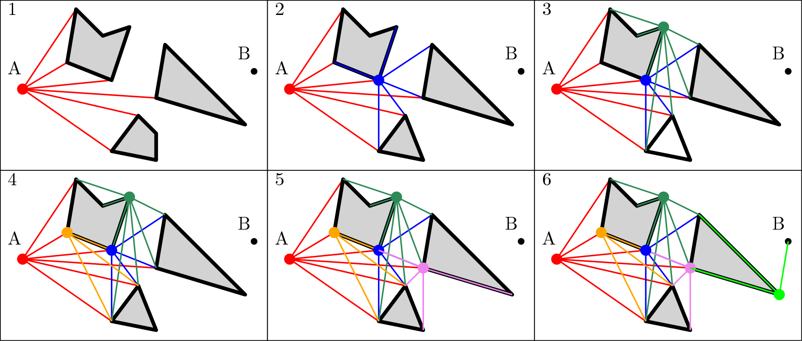
Edge visibility graph
The process is repeated for every visible edge
The result is a graph connecting point A to B

Slide 29
Path planning
Example of graph navigation in matrix form
B
Step 1
Define matrix
Step 2
Find minimum distance path by selecting the lowest neighbor
Exact
Optimal
4 | 3 | 2 | 1 | 0
5 |  |  | 2 | 1
6 | 5 | 4 | 3 | 2
 |  |  | 4 | 3
8 | 7 | 6 | 5 | 4
A
Distance matrix

Slide 30
Path planning
A larger example
  1000x1000 grid
  Long computation
A
B

Slide 31
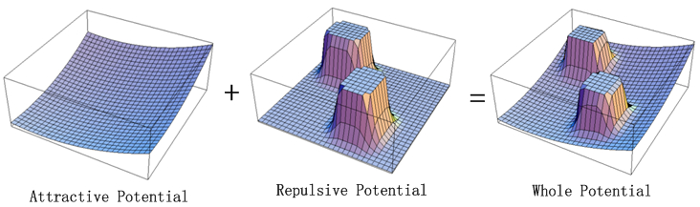
Path planning
Artificial potential fields
  Point A is starting point
  Obstacles are repulsors
  Goal B is an attractor
A
B

Slide 32
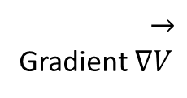
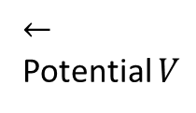
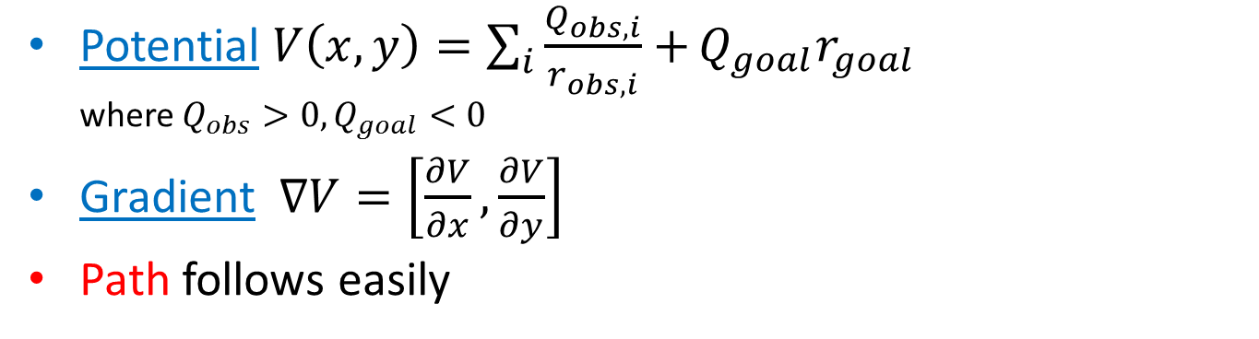
Path planning
Potential $V\left(x,y\right)=\sum_{i}{\frac{Q_{obs,i}}{r_{obs,i}}+}Q_{goal}r_{goal}$
where $Q_{obs}>0, Q_{goal}<0$
Gradient $∇V=\left[\frac{∂V}{∂x},\frac{∂V}{∂y}\right]$
Path follows easily
$$←$$
Potential $V$
$$→$$
Gradient $∇V$

Slide 33
Example of artificial potential fields

Slide 34
The “real world” issue
Mobile Robotics

Slide 35
«The Real World»
Issues in the real world
  Geometry of the terrain
    Loss of contact with the ground
    Slopes
  Terrain yield
    Traction loss
    Sinking
  Position determination accuracy

Slide 36
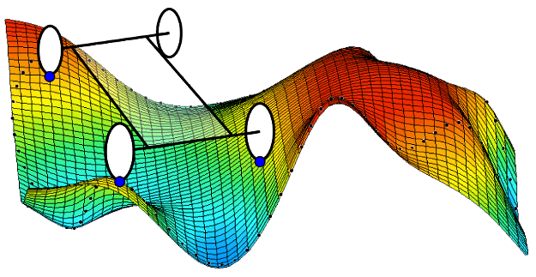
Terrain geometry
Loss of contact
  Up to this moment we have dealt with flat ground
    Simultaneous contact with all wheels
  Discontinuities $⇒$ loss of contact
  Possible solutions
    Three wheeled systems
    Suspension systems
    Rocker-bogie

Slide 37
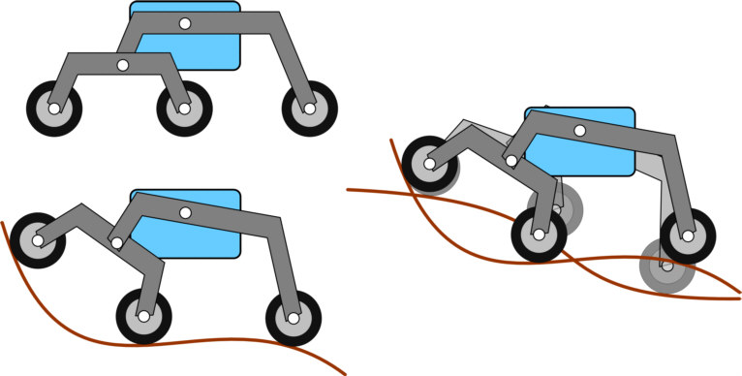
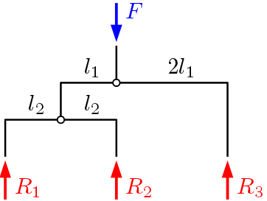
Terrain geometry
Rocker-bogie
  Based on the Whippletree mechanism
  Advantages:
    Distributes loads equally on the wheels
    Allows contact even on complex geometries

Slide 38
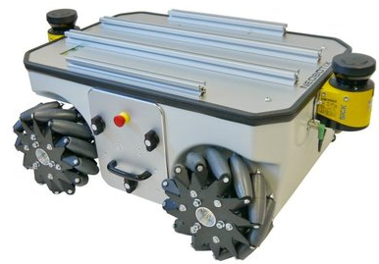
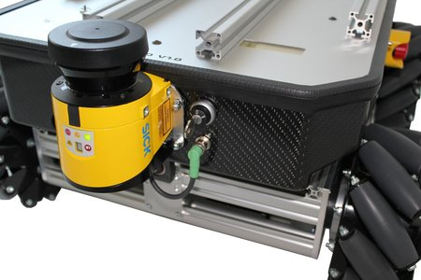
Bogie example

Slide 39
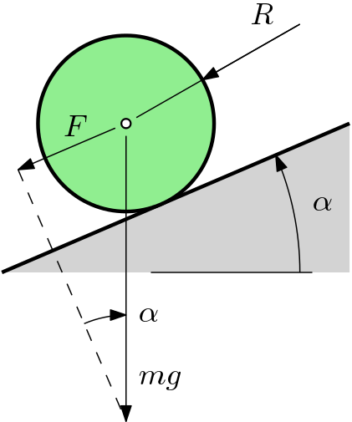
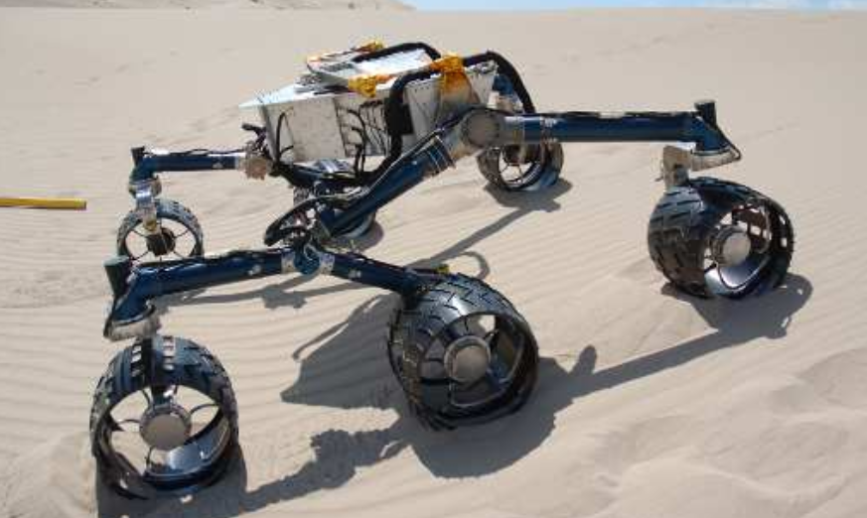
Terrain geometry
Slopes
  The actuation motors limit the maximum slope angle
    $F=mg\sin{α}$
    Thus:
    $τ=FR=mgR\sin{α}$
  The maximum slope angle is
    $$α=\operatorname{asin}\left(\frac{τ}{mgR}\right)$$

Slide 40
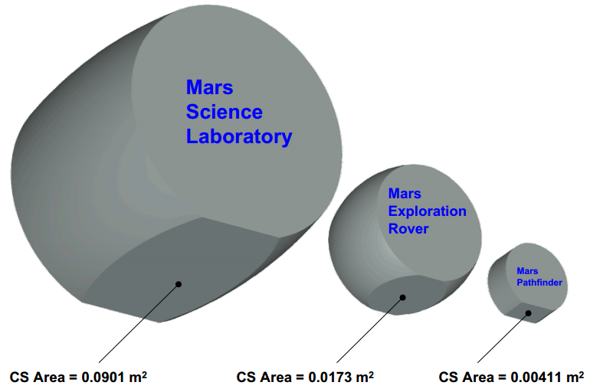
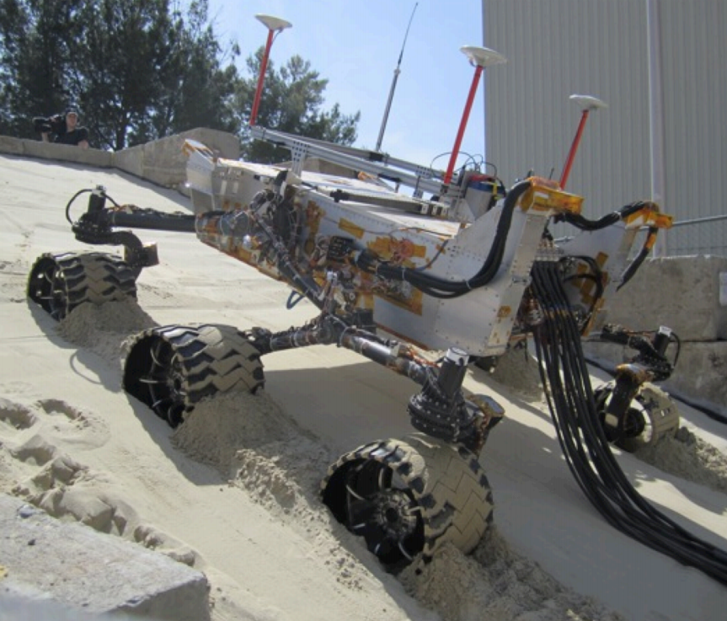
Terrain Yield
Traction loss
  Bad for odometry: introduces errors (drift)
    Consider using exteroceptive sensors
  Can prevent overcoming slopes
    Lower friction coefficient limits $F$ acting between wheels and ground
  Solutions:
    Keep ground pressure under control
      $σ_{ground}=\frac{mg}{CS}, CS$ contact surface

Slide 41
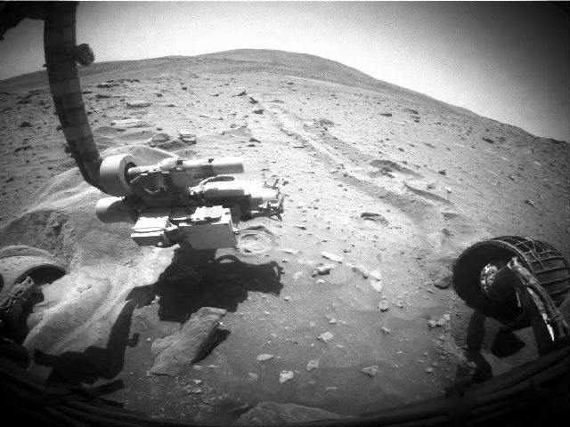
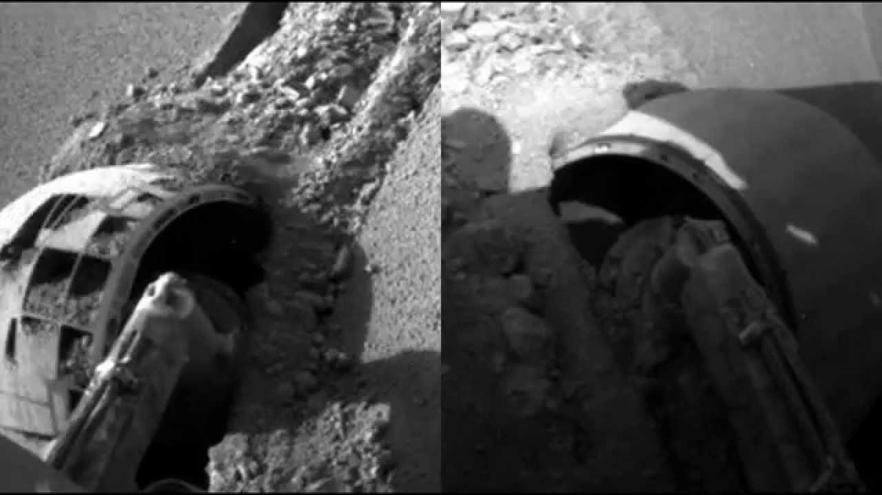
Terrain Yield
Sinking
  Can happen in 2 occasions
  Very high wheel pressure and/or very loose soil
  Due to digging by slipping wheels
The demise of JPL’s Spirit rover, in 2010

