Slide 1
Errata corrige
Applies to MobileRobots part 1.1
Slides 55-57
Published on 25/05/2021

Slide 2
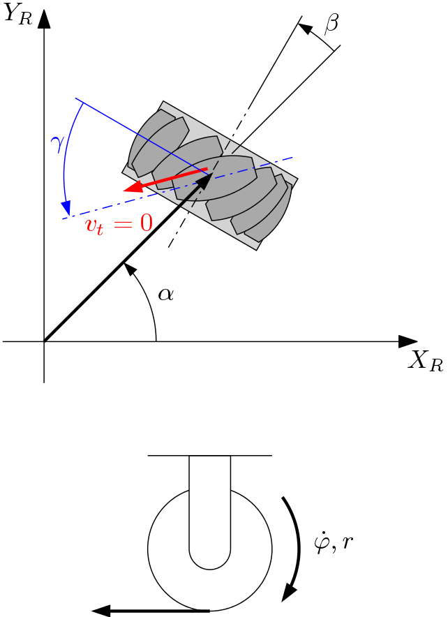
Swedish wheel model
The rolling constraint:
$${\left[\begin{matrix}\sin\left(α+β+γ\right) \\ −\cos\left(α+β+γ\right) \\ −l\cos\left(β+γ\right)\end{matrix}\right]}^{T}R\left(θ\right){\dot{ξ}}_{I}−r\dot{φ}\cos{γ}=0$$
The sliding constraint:
$${\left[\begin{matrix}\cos\left(α+β+γ\right) \\ \sin\left(α+β+γ\right) \\ l\sin\left(β+γ\right)\end{matrix}\right]}^{T}R\left(θ\right){\dot{ξ}}_{I}−r\dot{φ}\sin{γ}−r_{rl}{\dot{φ}}_{rl}=0$$
$$v$$
$$v$$
$$v_{t}$$
$$v$$
Rollers

Slide 3
Rolling constraint
$${\left[\begin{matrix}\sin\left(α+β+γ\right) \\ −\cos\left(α+β+γ\right) \\ −l\cos\left(β+γ\right)\end{matrix}\right]}^{T}R\left(θ\right){\dot{ξ}}_{I}−r\dot{φ}\cos{γ}=0$$

Slide 4
Sliding constraint
$${\left[\begin{matrix}\cos\left(α+β+γ\right) \\ \sin\left(α+β+γ\right) \\ l\sin\left(β+γ\right)\end{matrix}\right]}^{T}R\left(θ\right){\dot{ξ}}_{I}−r\dot{φ}\sin{γ}−r_{rl}{\dot{φ}}_{rl}=0$$

