Slide 1
Part I.1
a.a. 2020-2021
Mobile Robots

Slide 2
Robot
Definition
A machine capable of carrying out a complex task automatically.

Slide 3
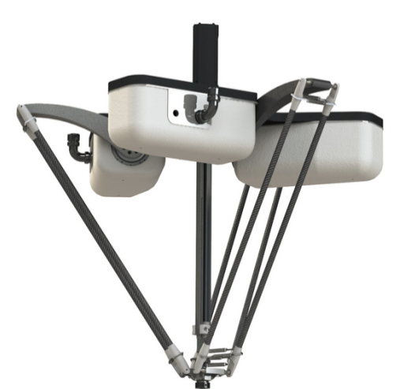
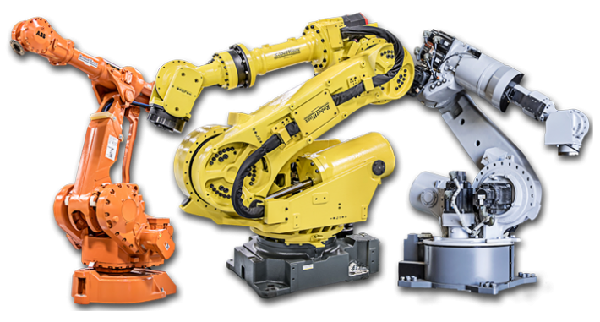
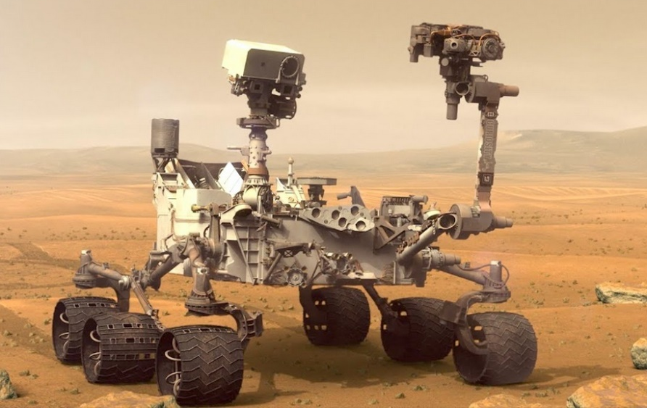
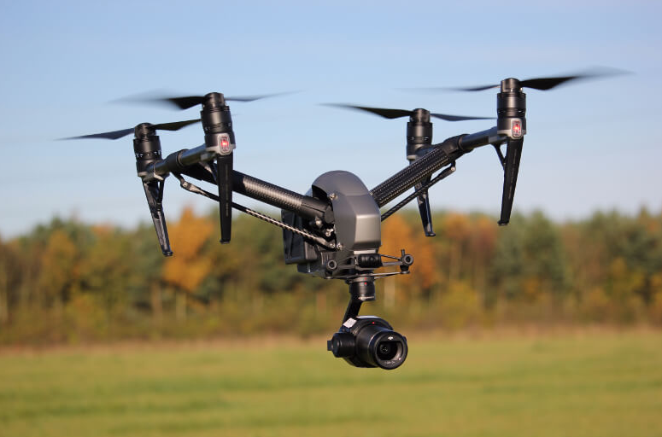
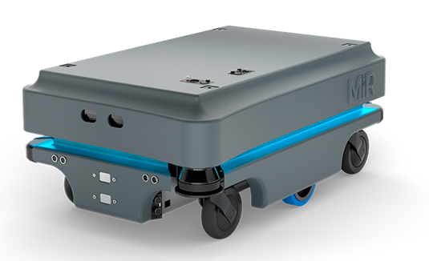
Robots
Classification
  Stationary
  Mobile
Industrial robots
Rovers
Flying
Mobile robots

Slide 4
Introduction to mobile robotics
Mobile Robotics

Slide 5
Mobile robots
... also called Automated Guided Vehicles, or Autonomous Ground Vehicles (AGV) (!)
... or Rovers when used on rough terrain
Features
  Base is not fixed
  Autonomy
  Most useful when
    Work has to be done on large spaces
    Environment does not allow large fixed structures

Slide 6
Mobile robots vs. AGV
Automated Guided Vehicles
  Autonomous but simple programming,
  Dependent on “fixed guides” (points of reference): magnetic, optical, etc.,
  Limited flexibility.
Mobile robots
  Full autonomy, complex programming,
  Less dependent on fixed points of reference,
  Flexible.
This distinction is not always clear

Slide 7
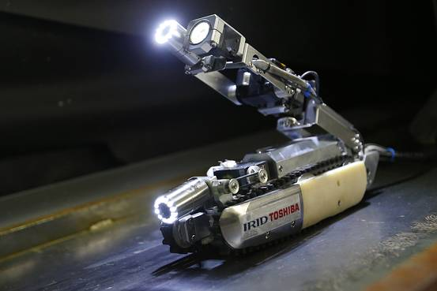
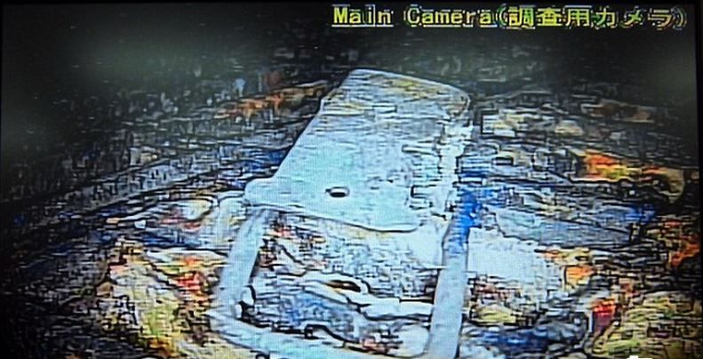
Application example
Fukushima nuclear plant 2011 disaster
  Hazarduous environment
  No infrastructure can be built
  Large space needs to be explored
Mobile robot

Slide 8
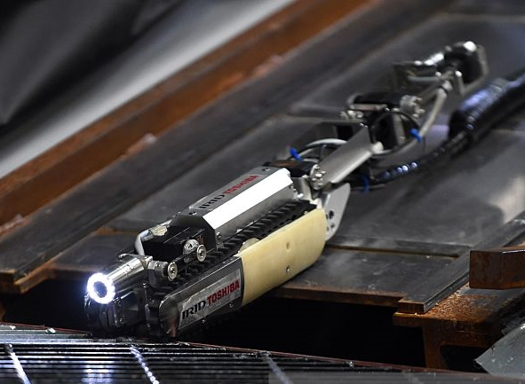
Rugged skid-steer robot
Differential steering (skid steering)
Good performance against uneven terrain
Bad accuracy
Low autonomy
Video skidSteer

Slide 9
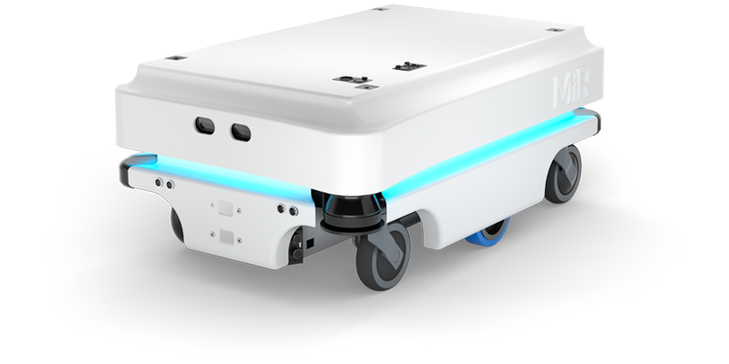
Differential drive robot
Differential steering
Good performance against uneven terrain
Video differentialDrive

Slide 10
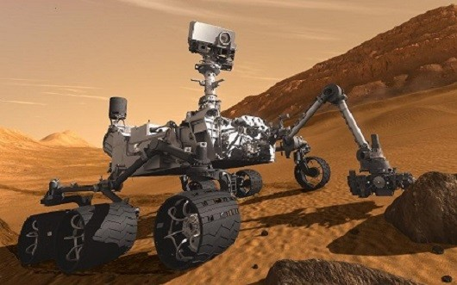
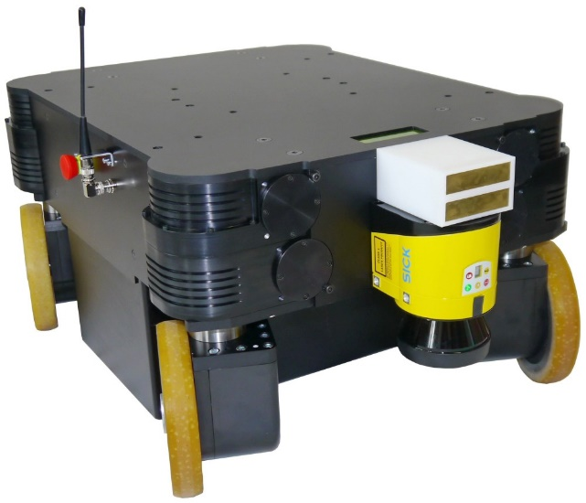
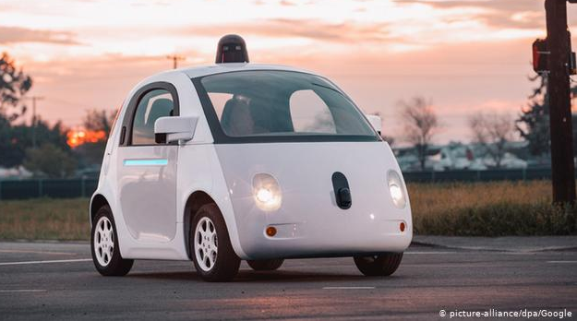
Steered-wheels platform
Fair degree of mobility
Stable driving
Applications:
  Autonomous cars
  Rovers
  Industrial high-load AGVs
Video Curiosity prototype
Video orientableWheels

Slide 11
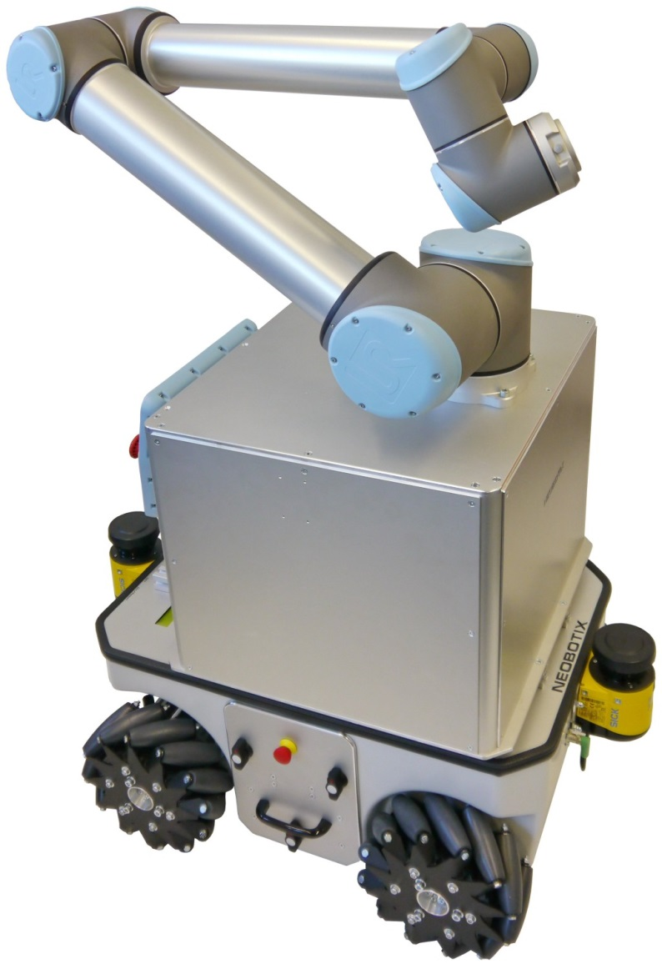
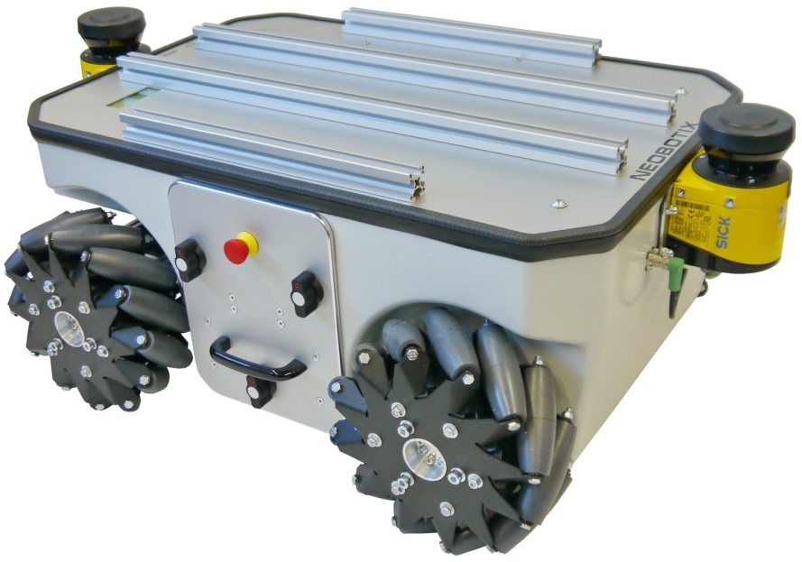
Omnidirectional platform
Can move in all directions
High loads
High positional accuracy
Is used mainly in the industry:
  In warehouse
  Transport and Handling
Bad with uneven terrain
Video mecanumWheels

Slide 12
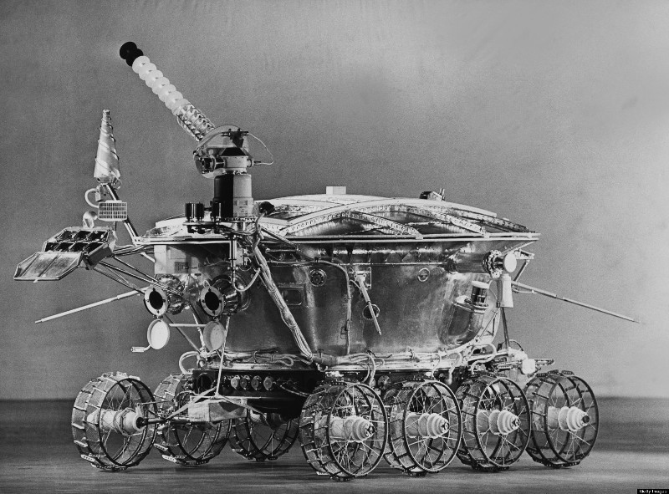
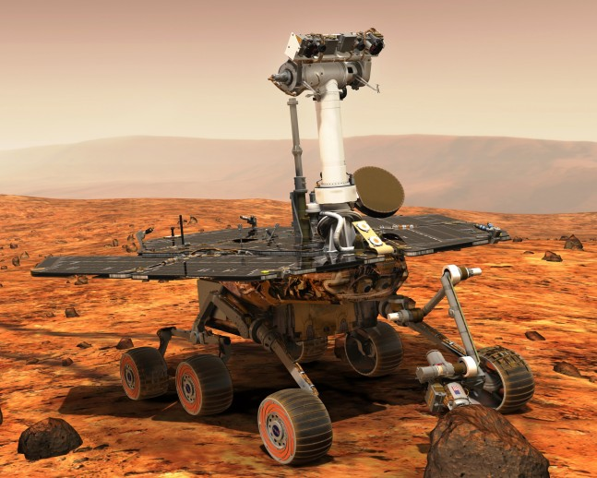
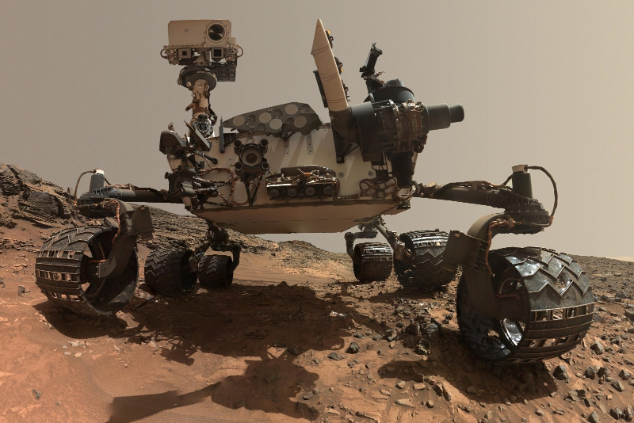
Space exploration rovers
Lunokhod (1970)
Steerable wheels
Exploration of extreme environments
High degree of autonomy
Good on rough terrain
Very expensive
MER A/B (2003)
MSL (2011)

Slide 13
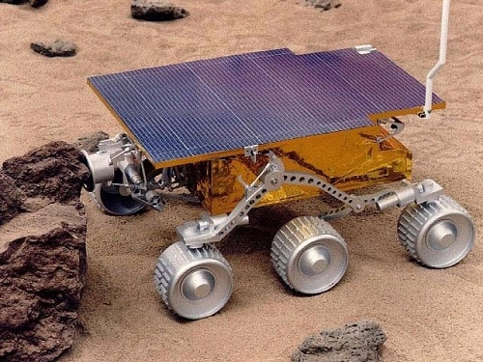
Rovers: Sojourner
Part of NASA/JPL Mars Pathfinder mission
1997
Operational life: 7 days
Mass: 11.5 Kg
Sojourner replica

Slide 14
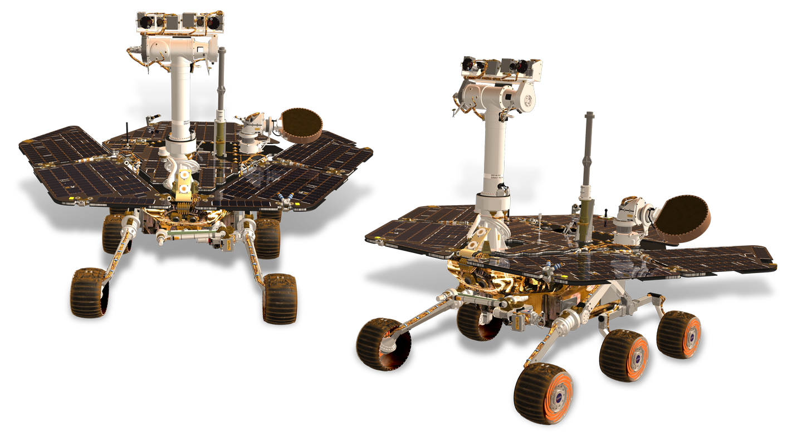
Rovers: MER A/B
Spirit and Opportunity
Part of NASA/JPL Mars Exploration Rover mission
2003
Operational life:
  2269 days (A/Spirit)
  5498 days (B/Opportunity)
Mass: 185 Kg
Simulation video

Slide 15
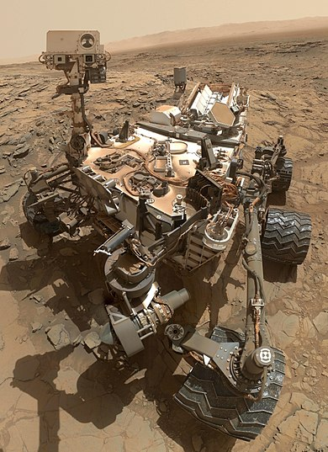
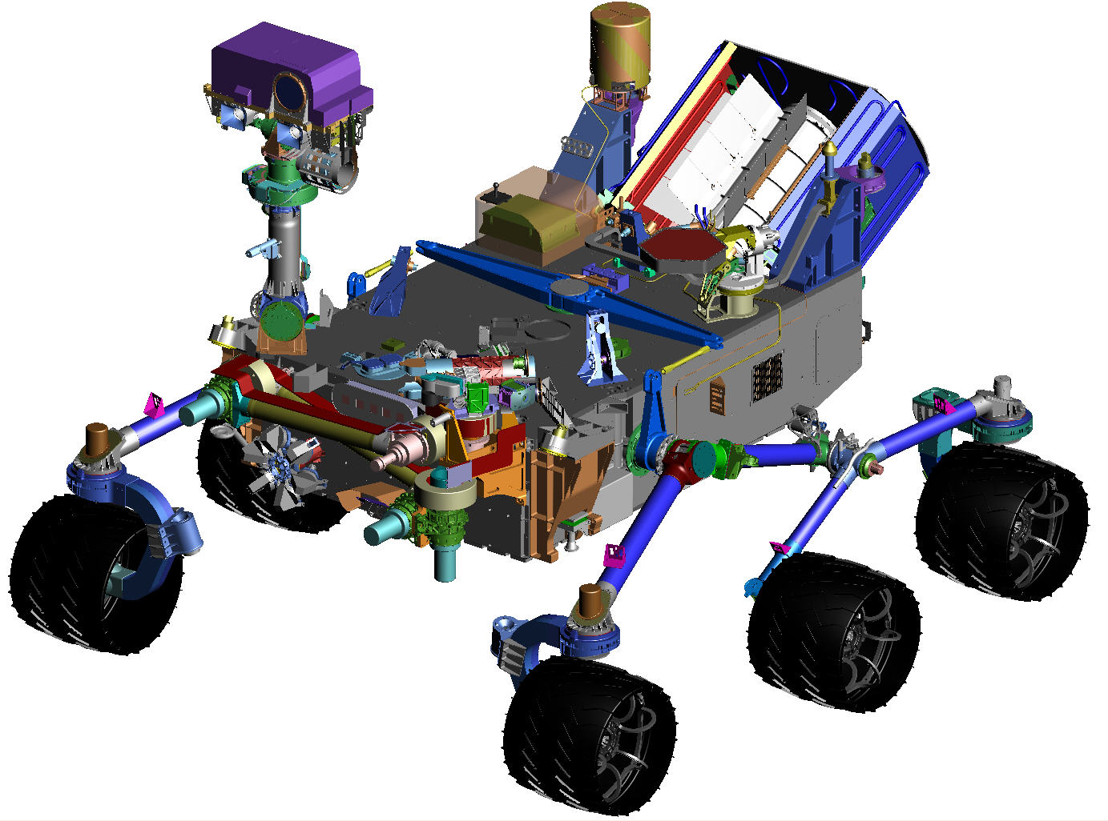
Rovers: Curiosity
Part of NASA/JPL Mars Science Laboratory mission
2012
Operational life:
  3152 days (still in operation)
Mass: 899 Kg

Slide 16
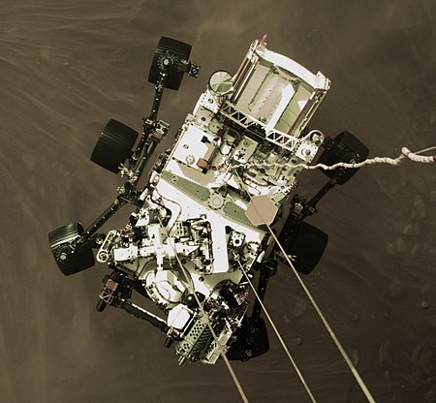
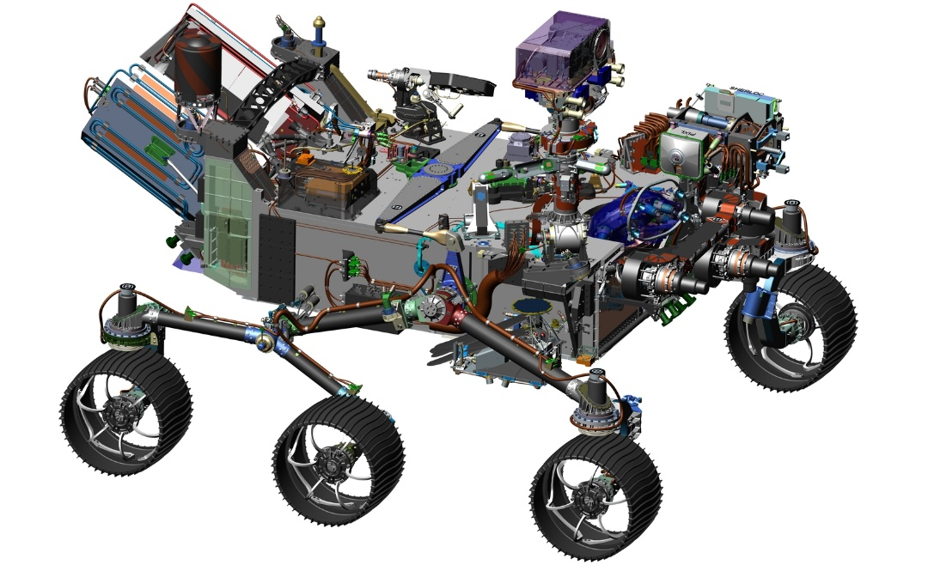
Rovers: Perseverance
Part of NASA’s/JPL Mars 2020 mission
2021
Operational life:
  35 days (still in operation)
Mass: 1,025 Kg

Slide 17
The problem
Go from point A to point B
Obstacles
  Static/dynamic
  Obstacle avoidance
Uneven terrain
  Requires mapping
  Yield
  Traction loss, slopes, etc...
Contamination, etc.
B
A

Slide 18
Issue 1: obstacles
Static obstacles
  Position is fixed in time
Dynamical obstacles
  Position varies with time
  Not always predictable
B
A
?
B
A

Slide 19
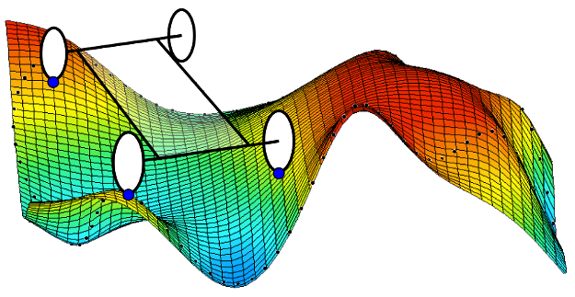
Issue 2: uneven terrain
Risks:
  Loss of contact with the ground
  Terrain yield and traction loss
  Slopes

Slide 20

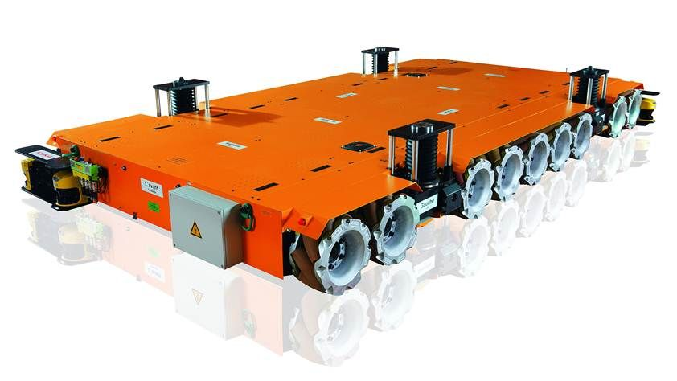
Purpose
Why go from A to B?
  Exploration
  Executing task at B
  Transporting something from A to B
This way we can define the robot’s accessories: solar panels, arms etc.

Slide 21
Features of mobile robots
Mobile Robotics

Slide 22
Elementary motions
Motion = combination of:
  Point-to-point motion
  Path following
  Trajectory tracking
  Reactive motion

Slide 23
Elementary motions
Point-to-point motion:
Path following:
Trajectory tracking:
B
A
x
The parameter is $x∈path$
$$t=4s$$
$$t=3s$$
The parameters are
$$t∈\left[0,T\right]$$
$$x∈path$$
$$t=1s$$
$$t=2s$$

Slide 24
Reactive motion
Online obstacle avoidance
Line/wall following
Target tracking
A
Original path
B
Alternative path

Slide 25
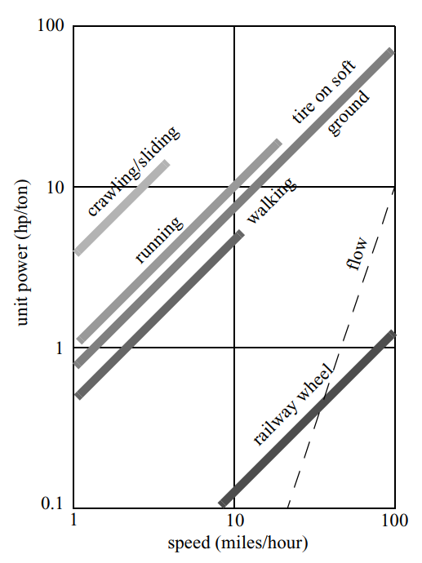
Wheel systems
Why use wheels?
  Legged systems are much more complicated
    Wheel: 2 DoF
    Leg: 6 DoF
  Wheels are efficient on hard terrains
  Legged systems on soft

Slide 26
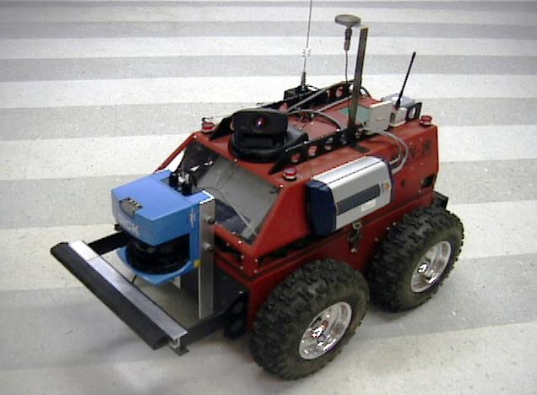
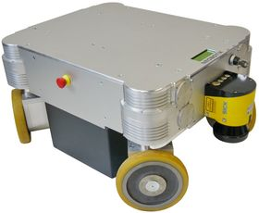

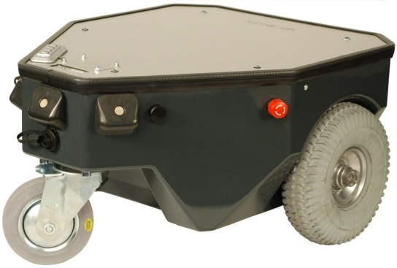
Wheel systems
Simple
Simple wheel
Orientable wheel
Omnidirectional wheel
  Omniwheel
  Mecanum wheel
Passive wheels
  Not actuated, generally used for stability
Omnidirectional
Orientable
Passive
Video differentialDrive

Slide 27
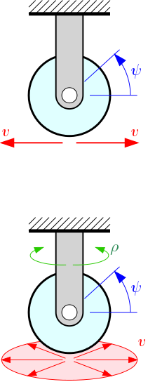
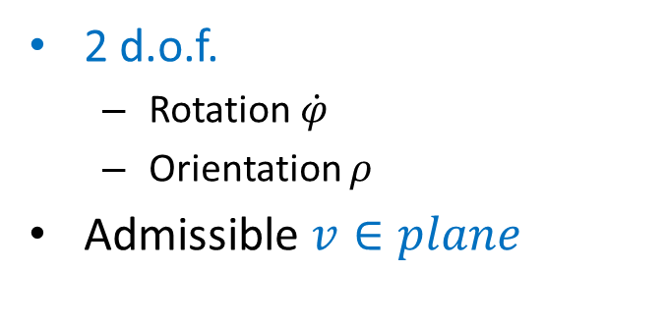
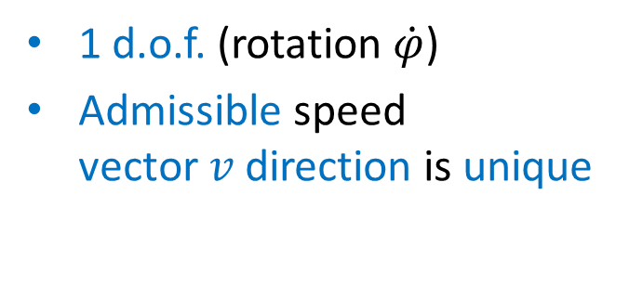


Wheel systems
Simple wheel
Orientable wheel
1 d.o.f. (rotation $\dot{φ}$)
Admissible speed vector$v$direction is unique
2 d.o.f.
  Rotation $\dot{φ}$
  Orientation $ρ$
Admissible $v∈plane$
No slip on the point of contact!
$$\dot{φ}$$
$$\dot{φ}$$

Slide 28
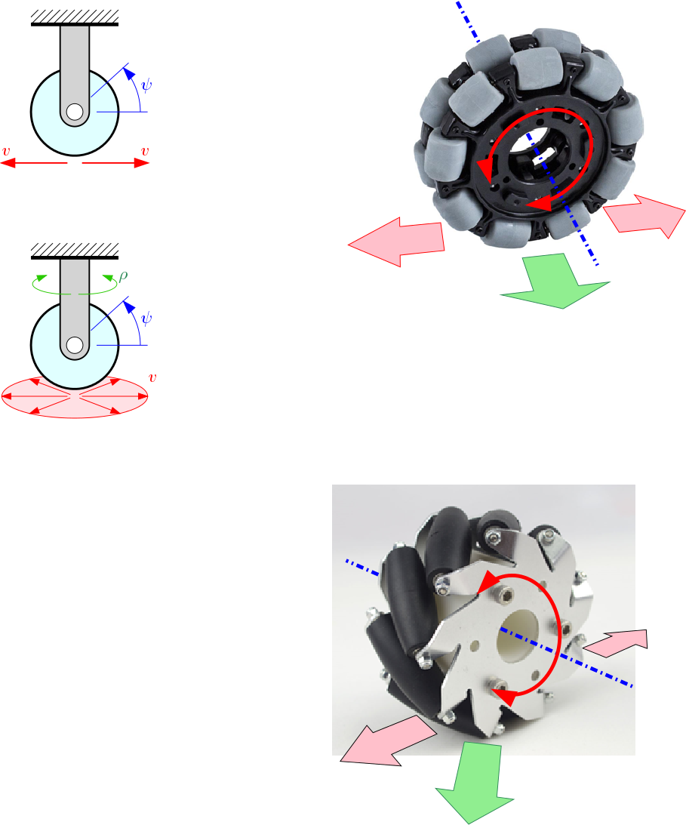
Wheel systems
Omnidirectional wheels (swedish wheels)
Omniwheel
Hint: Combining rotation $\dot{φ}$
of the wheels, the admissible velocity vector $v$ can be omnidirectional
$$\dot{φ}$$
$$v$$
Controlled motion
Lability
Video

Slide 29
Wheel systems
Omnidirectional wheels (swedish wheels)
  Mecanum wheel or Ilon wheel
Hint: Combining rotation $\dot{φ}$ of the wheels, the admissible velocity vector $v$ can be omnidirectional
$$\dot{φ}$$
$$γ$$
$$v$$
Video mecanum wheels

Slide 30
Question?
How many omni-directional wheels are required for a controllable robot?

Slide 32
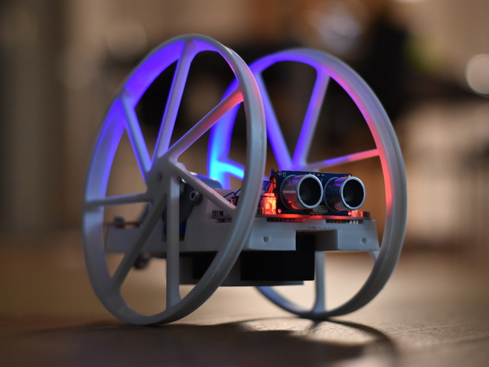
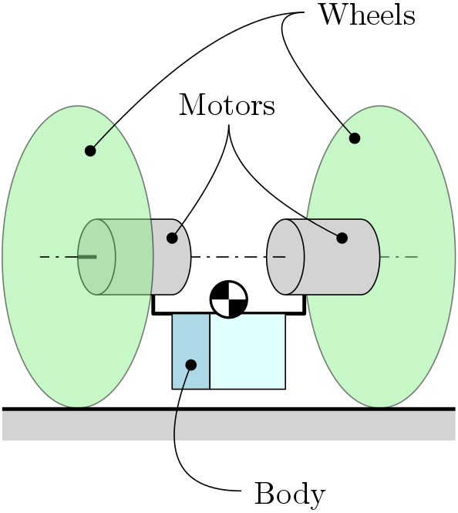
Stability
What is the minimum number of wheels for a stable system?

Slide 33
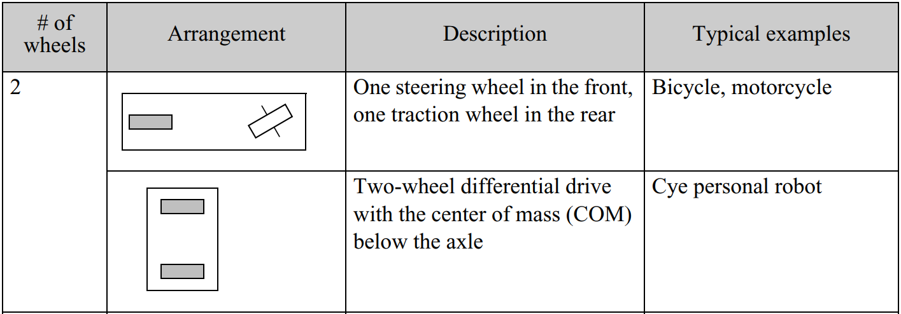
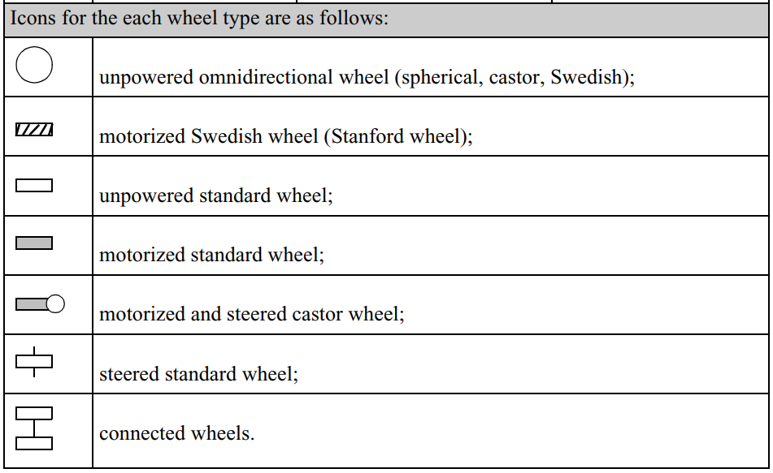
Wheel configurations
2 wheels

Slide 34
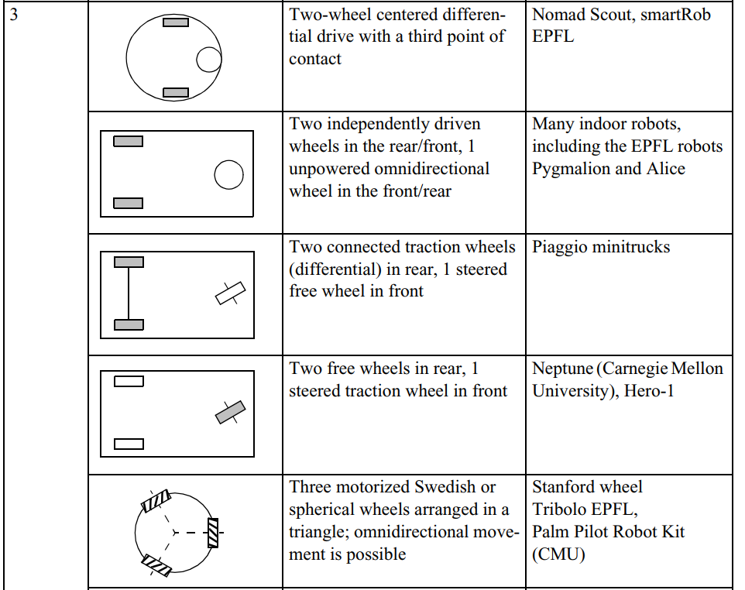
Wheel configurations
3 wheels

Slide 35
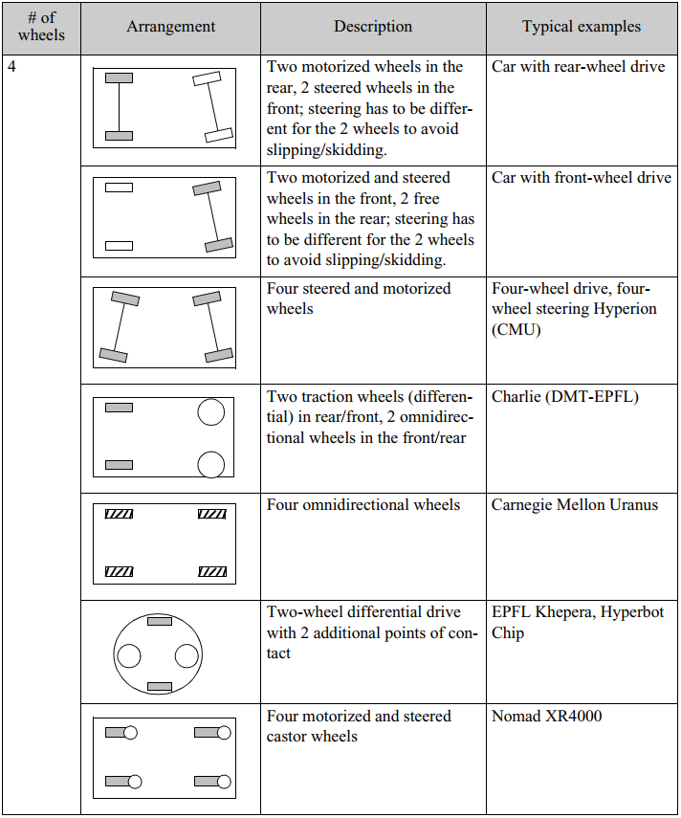
Wheel configurations
4 wheels

Slide 36
Introduction to the Theory
Mobile Robotics

Slide 37
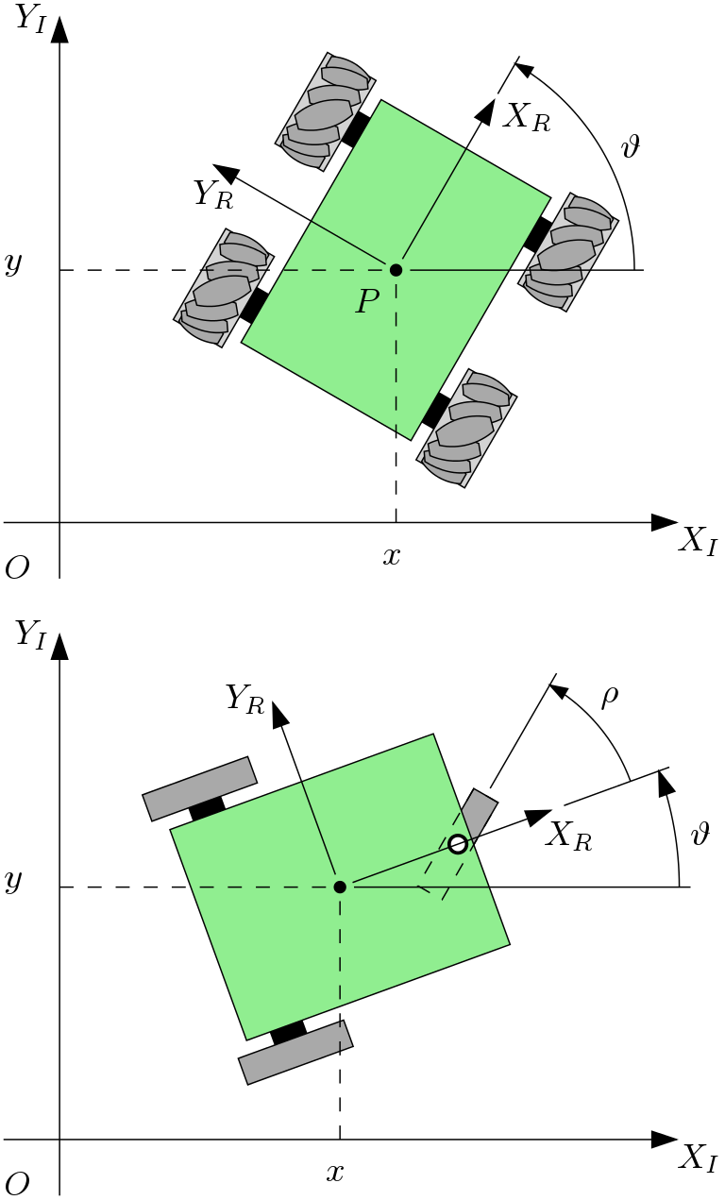
Frames of reference
Global inertial frame of reference:
  $$\left\langle X_{I},Y_{I}\right\rangle$$
Local frame of reference:
  $$\left\langle X_{R},Y_{R}\right\rangle$$

Slide 38
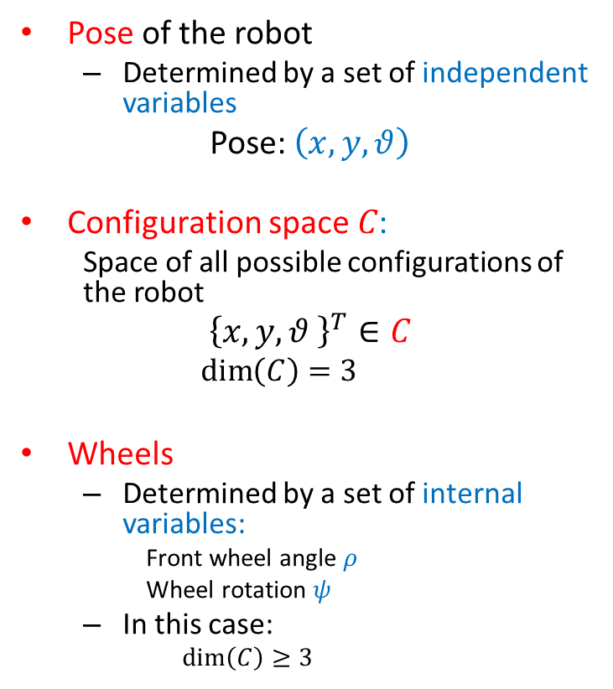
Pose and configuration space
Pose of the robot
  Determined by a set of independent variables
Pose: $\left(x,y,θ\right)$
Configuration space 𝐶:
  Space of all possible configurations of the robot
$${\left\{x,y,θ \right\}}^{T}∈C$$
  $$\dim\left(C\right)=3$$
Wheels
  Determined by a set of internal variables:
    Front wheel angle $ρ$
    Wheel rotation $ψ$
  In this case:
    $$\dim\left(C\right)≥3$$

Slide 39
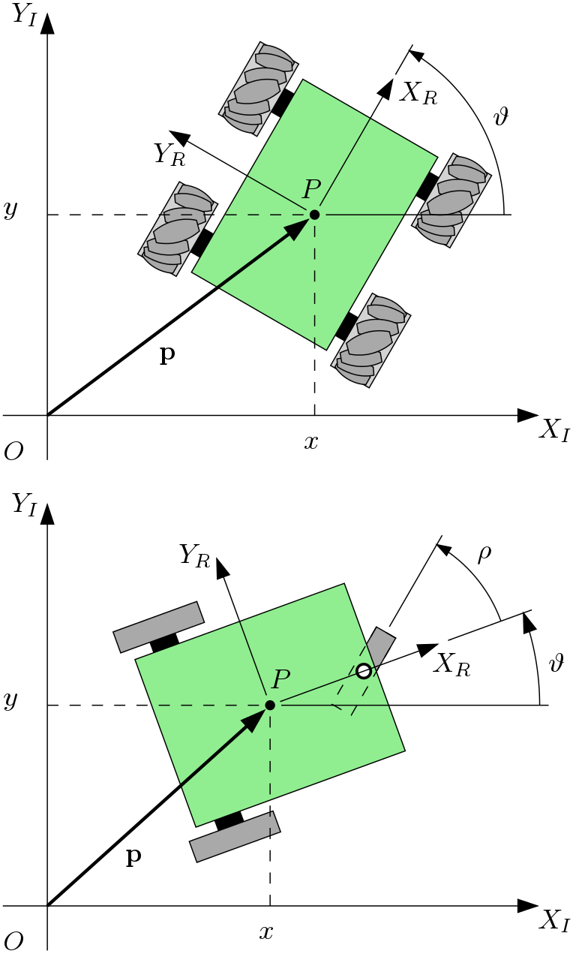
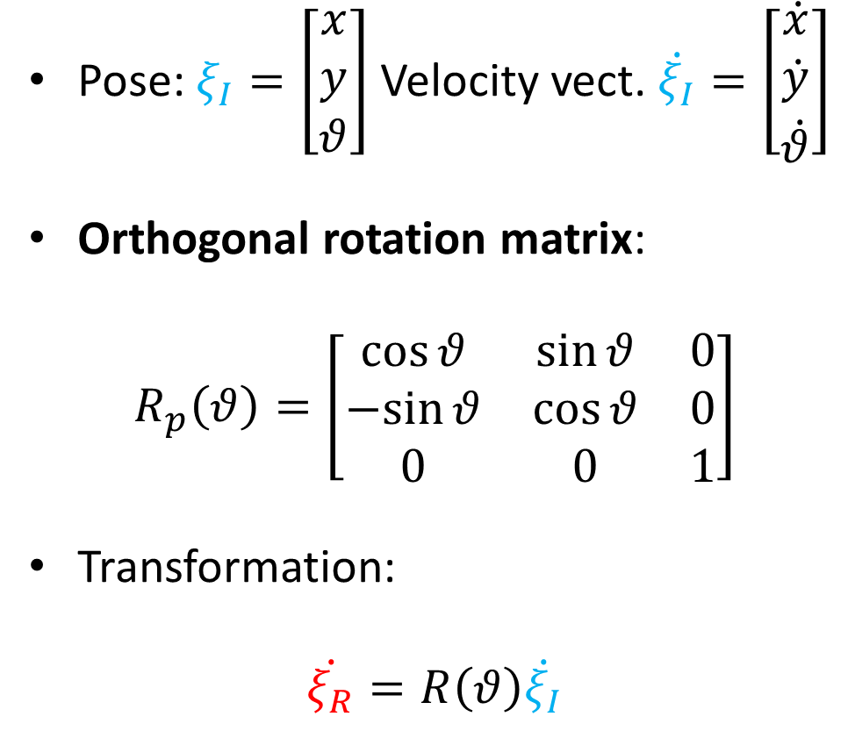

Pose transformation: global $→$ local
Pose: $ξ_{I}=\left[\begin{matrix}x \\ y \\ θ\end{matrix}\right]$ Velocity vect. $\dot{ξ_{I}}=\left[\begin{matrix}\dot{x} \\ \dot{y} \\ \dot{θ}\end{matrix}\right]$
Orthogonal rotation matrix:
$$R_{p}\left(θ\right)=\left[\begin{matrix}\cos{θ} & \sin{θ} & 0 \\ −sin{θ} & \cos{θ} & 0 \\ 0 & 0 & 1\end{matrix}\right]$$
Transformation:
$$\dot{ξ_{R}}=R\left(θ\right)\dot{ξ_{I}}$$

Slide 40
Velocity transformation: local $→$ global
Rotation matrix:
$$R\left(θ\right)=\left[\begin{matrix}\cos{θ} & \sin{θ} & 0 \\ −\sin{θ} & \cos{θ} & 0 \\ 0 & 0 & 1\end{matrix}\right]$$
Inverse transformation:
$${\dot{ξ}}_{R}=R\left(θ\right){\dot{ξ}}_{I}$$
$$⇓$$
$${\dot{ξ}}_{I}=R^{−1}\left(θ\right){\dot{ξ}}_{R}$$

Slide 41
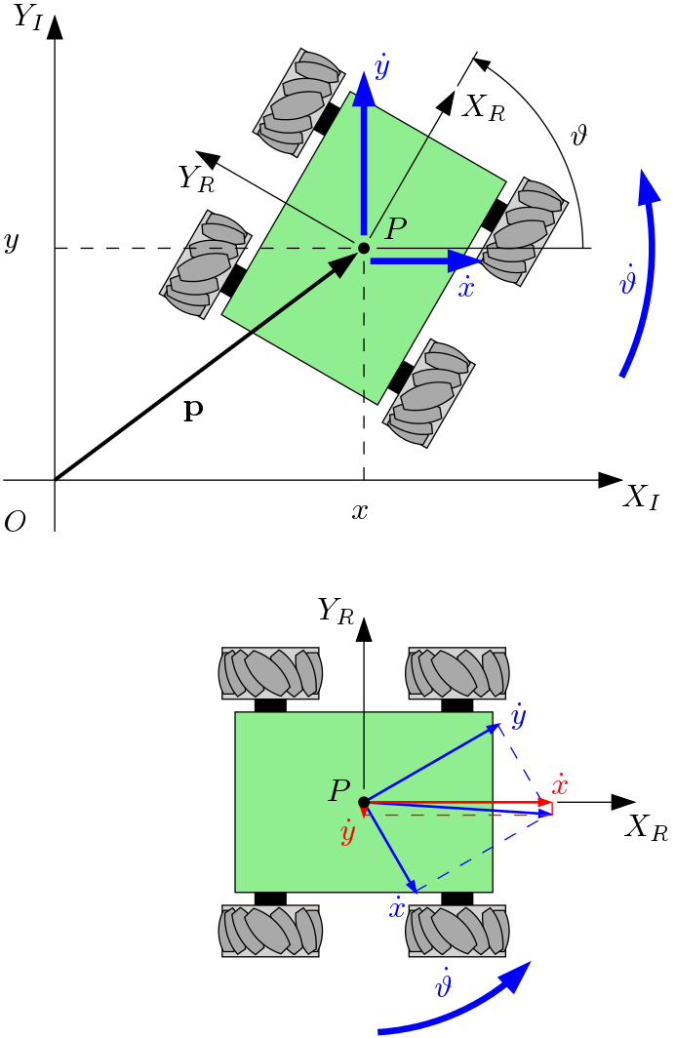
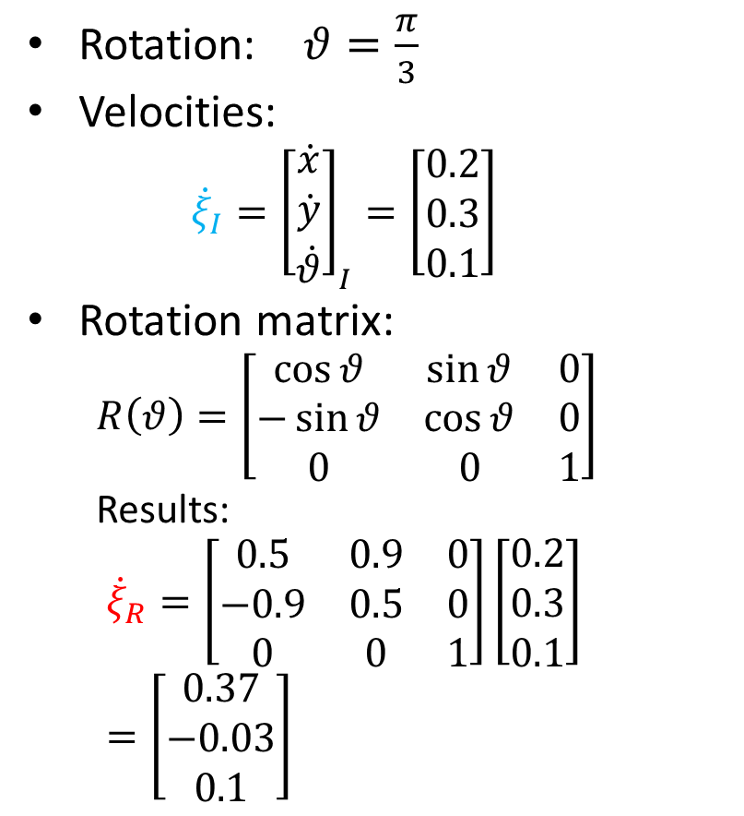
Example
$$\dot{y}$$
$$\dot{θ}$$
Rotation: $θ=\frac{π}{3}$
Velocities:
  $${\dot{ξ}}_{I}={\left[\begin{matrix}\dot{x} \\ \dot{y} \\ \dot{θ}\end{matrix}\right]}_{I}=\left[\begin{matrix}0.2 \\ 0.3 \\ 0.1\end{matrix}\right]$$
Rotation matrix:
  $$R\left(θ\right)=\left[\begin{matrix}\cos{θ} & \sin{θ} & 0 \\ −\sin{θ} & \cos{θ} & 0 \\ 0 & 0 & 1\end{matrix}\right]$$
  Results:
  $${\dot{ξ}}_{R}=\left[\begin{matrix}0.5 & 0.9 & 0 \\ −0.9 & 0.5 & 0 \\ 0 & 0 & 1\end{matrix}\right]\left[\begin{matrix}0.2 \\ 0.3 \\ 0.1\end{matrix}\right]=\left[\begin{aligned}0.37 \\ −0.03 \\ 0.1\end{aligned}\right]$$
$$\dot{x}$$

Slide 42
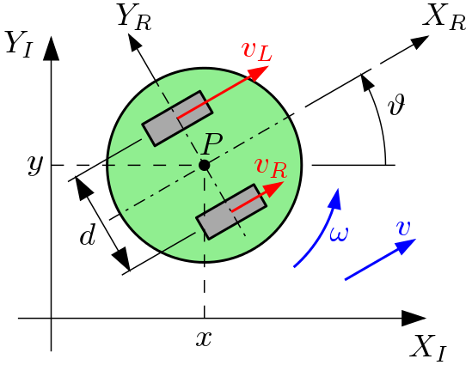
Forward kinematics
$$\dot{y}$$
$$\dot{θ}$$
$$\dot{x}$$
Local $→$ global
Transformation:
$${\dot{ξ}}_{I}=R^{−1}\left(θ\right){\dot{ξ}}_{R}$$
$${\dot{ξ}}_{R}={\left[\begin{matrix}\dot{x} \\ \dot{y} \\ \dot{θ}\end{matrix}\right]}_{R}=\left[\begin{aligned}v \\ 0 \\ ω\end{aligned}\right]=\left[\begin{aligned}\frac{v_{R}}{2}+\frac{v_{L}}{2} \\ 0 \\ \frac{v_{R}}{+d}+\frac{v_{L}}{−d}\end{aligned}\right]$$
$$R^{−1}\left(θ\right)=\left[\begin{matrix}\cos{θ} & −\sin{θ} & 0 \\ \sin{θ} & \cos{θ} & 0 \\ 0 & 0 & 1\end{matrix}\right]$$
Note:
The calculation is done separately for each wheel, considering the other wheel as stationary, followed by addition.

Slide 43
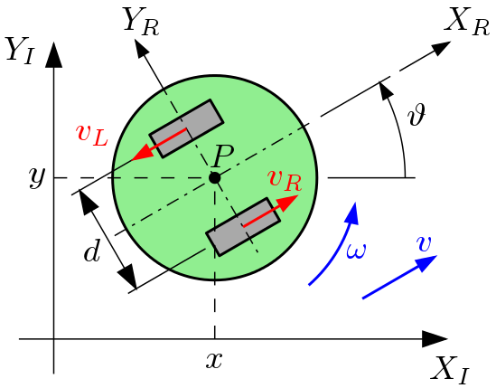
Example
$${\dot{ξ}}_{R}=\left[\begin{aligned}\dot{x} \\ \dot{y} \\ \dot{θ}\end{aligned}\right]=\left[\begin{aligned}\frac{v_{R}}{2}+\frac{v_{L}}{2} \\ 0 \\ \frac{v_{R}}{+d}+\frac{v_{L}}{−d}\end{aligned}\right]=\left[\begin{aligned}\frac{1}{2}−\frac{1}{2} \\ 0 \\ \frac{1}{3.3 }+\frac{−1}{−3.3}\end{aligned}\right]=\left[\begin{aligned}0 \\ 0 \\ 0.3+0.3\end{aligned}\right]=\left[\begin{aligned}0 \\ 0 \\ 0.6\end{aligned}\right]$$
Then:
$${\dot{ξ}}_{I}=R^{−1}\left(θ\right)\left[\begin{aligned}0 \\ 0 \\ 0.6\end{aligned}\right]$$
Parameters:
  $$v_{R}=1$$
  $$v_{L}=−1$$
  $$d=0.3$$
  $$θ=π/3$$

Slide 44
Example
$${\dot{ξ}}_{R}=\left[\begin{aligned}\dot{x} \\ \dot{y} \\ \dot{θ}\end{aligned}\right]=\left[\begin{aligned}\frac{v_{R}}{2}+\frac{v_{L}}{2} \\ 0 \\ \frac{v_{R}}{+d}+\frac{v_{L}}{−d}\end{aligned}\right]=\left[\begin{aligned}\frac{0.8}{2}+\frac{1}{2} \\ 0 \\ \frac{0.8}{0.3}+\frac{1}{−0.3}\end{aligned}\right]=\left[\begin{aligned}0.9 \\ 0 \\ 2.67−3.3\end{aligned}\right]=\left[\begin{aligned}0.9 \\ 0 \\ −0.67\end{aligned}\right]$$
Then:
$${\dot{ξ}}_{I}=R^{−1}\left(\frac{π}{3}\right){\dot{ξ}}_{R}=\left[\begin{aligned}0.45 \\ 0.78 \\ −0.67\end{aligned}\right]$$
Parameters:
  $$v_{R}=0.8$$
  $$v_{L}=1$$
  $$d=0.3$$
  $$θ=π/3$$
Time integration
$$x_{i}=x_{i−1}+\dot{x}dt$$
$$y_{i}=y_{i−1}+\dot{y}dt$$
$$θ_{i}=θ_{i−1}+\dot{θ}dt$$

Slide 45
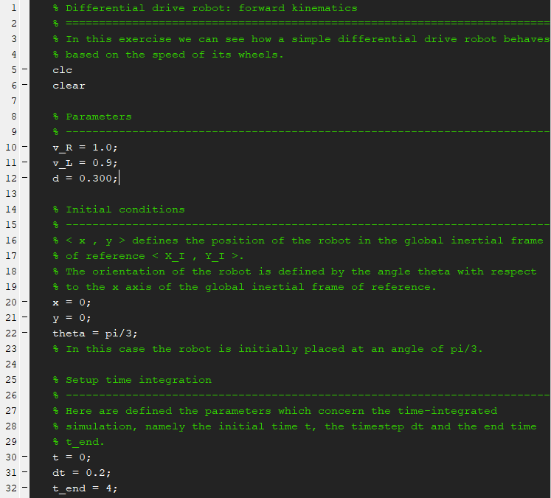
Exercise
Parameters
Initial conditions
Differential drive robot
Time integration parameters for the simulation

Slide 46
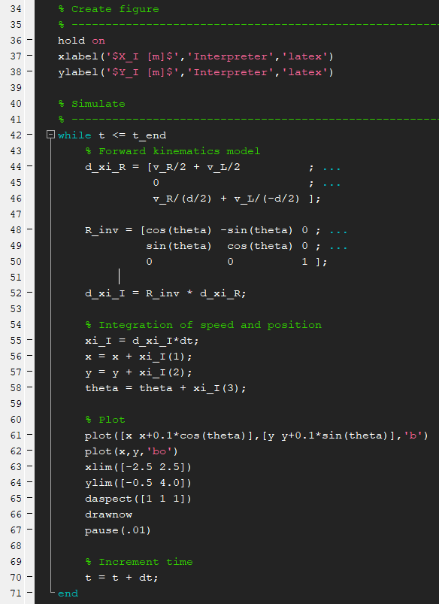
Exercise
$${\dot{ξ}}_{R}=\left[\begin{aligned}\dot{x} \\ \dot{y} \\ \dot{θ}\end{aligned}\right]=\left[\begin{aligned}\frac{v_{R}}{2}+\frac{v_{L}}{2} \\ 0 \\ \frac{v_{R}}{+d}+\frac{v_{L}}{−d}\end{aligned}\right]$$
Kinematic model
$$R^{−1}\left(θ\right)=\left[\begin{matrix}\cos{θ} & −\sin{θ} & 0 \\ \sin{θ} & \cos{θ} & 0 \\ 0 & 0 & 1\end{matrix}\right]$$
Time integration
$${\dot{ξ}}_{I}=R^{−1}\left(θ\right){\dot{ξ}}_{R}$$
Plot
Differential drive robot
Time increment

Slide 47
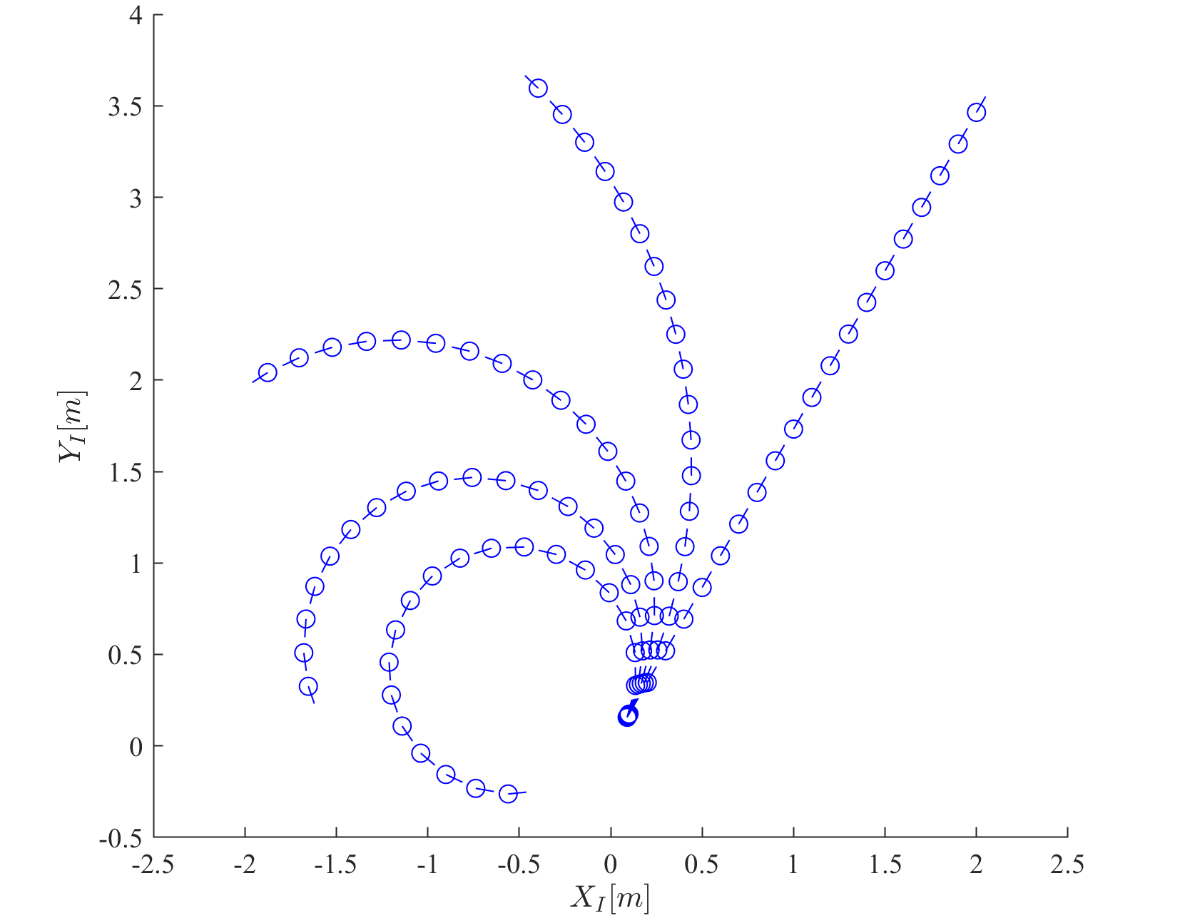
Results
$$v_{R}=1$$
$$v_{L}=0.95$$
$$v_{R}=1$$
$$v_{L}=1$$
$$v_{R}=1$$
$$v_{L}=0.90$$
$$v_{R}=1$$
$$v_{L}=0.85$$
$$v_{R}=1$$
$v_{L}=0.8$0

Slide 48
Wheel models
Mobile Robotics

Slide 49
Constraints
No-slip constraint causes:
  Two constraints for each wheel:
    Rolling constraint
    Sliding constraint
$$v_{t}$$
$$\dot{φ}$$
$$v$$

Slide 50

Fixed/steered wheel model
Wheel spin:
  $$v=\dot{φ}r$$
The motion of the wheel in local frame:
$$v=\dot{x}\sin\left(α+β\right)−\dot{y}\cos\left(α+β\right)−\dot{θ}l\cos{β}−r\dot{φ}=0$$
Thus the rolling constraint:
$${\left[\begin{matrix}\sin\left(α+β\right) \\ −\cos\left(α+β\right) \\ −l\cos\left(β\right)\end{matrix}\right]}^{T}R\left(θ\right){\dot{ξ}}_{I}−r\dot{φ}=0$$
Local reference frame
$${\dot{ξ}}_{R}$$
$$v$$

Slide 51

Rolling constraint
Local reference frame
$$\dot{x}$$
$$l\dot{θ}$$
$$\dot{y}$$
$$α+β$$
$$l\dot{θ}$$
$$β$$
$$\dot{x}$$
$$\dot{y}$$
$$v$$
$$α+β$$
$$v=\dot{x}\sin\left(α+β\right)−\dot{y}\cos\left(α+β\right)−\dot{θ}l\cos{β}=r\dot{φ}$$
Thus…
$$v=\dot{x}\sin\left(α+β\right)−\dot{y}\cos\left(α+β\right)−\dot{θ}l\cos{β}−r\dot{φ}=0$$

Slide 52
Fixed/steered wheel model
The constraint of the wheel in local frame:
$$v_{t}=\dot{x}\cos\left(α+β\right)+\dot{y}\sin\left(α+β\right)+\dot{θ}l\sin{β}=0$$
Thus the sliding constraint:
$${\left[\begin{matrix}\cos\left(α+β\right) \\ \sin\left(α+β\right) \\ l\sin\left(β\right)\end{matrix}\right]}^{T}R\left(θ\right){\dot{ξ}}_{I}=0$$
Local reference frame
Steering angle
$$v_{t}$$

Slide 53
Sliding constraint
$$v_{t}=\dot{x}\cos\left(α+β\right)+\dot{y}\sin\left(α+β\right)+\dot{θ}l\sin{β}=0$$
Local reference frame
$$\dot{y}$$
$$v_{t}$$
$$l\dot{θ}$$
$$v_{t}$$
$$\dot{x}$$
$$l\dot{θ}$$
$$β$$
$$α+β$$
$$α+β$$
$$\dot{y}$$
$$\dot{x}$$

Slide 54


Example
$$α=0°$$
$$β=0°$$
Assume $θ=0°$
Then the sliding constraint:
$$\left[\begin{matrix}1 & 0 & 0\end{matrix}\right]\left[\begin{matrix}1 & 0 & 0 \\ 0 & 1 & 0 \\ 0 & 0 & 1\end{matrix}\right]\left[\begin{aligned}\dot{x} \\ \dot{y} \\ \dot{θ}\end{aligned}\right]=\left[\begin{matrix}1 & 0 & 0\end{matrix}\right]\left[\begin{aligned}\dot{x} \\ \dot{y} \\ \dot{θ}\end{aligned}\right]=0$$

Slide 55




Swedish wheel model
The rolling constraint:
$${\left[\begin{matrix}\sin\left(α+β+γ\right) \\ −\cos\left(α+β+γ\right) \\ −l\cos\left(β+γ\right)\end{matrix}\right]}^{T}R\left(θ\right){\dot{ξ}}_{I}−r\dot{φ}\cos{γ}=0$$
The sliding constraint:
$${\left[\begin{matrix}\cos\left(α+β+γ\right) \\ \sin\left(α+β+γ\right) \\ l\sin\left(β+γ\right)\end{matrix}\right]}^{T}R\left(θ\right){\dot{ξ}}_{I}−r\dot{φ}\sin{γ}−r_{rl}{\dot{φ}}_{rl}=0$$
$$v$$
$$v$$
$$v_{t}$$
$$v$$
Rollers

Slide 56


Rolling constraint
$${\left[\begin{matrix}\sin\left(α+β+γ\right) \\ −\cos\left(α+β+γ\right) \\ −l\cos\left(β+γ\right)\end{matrix}\right]}^{T}R\left(θ\right){\dot{ξ}}_{I}−r\dot{φ}\cos{γ}=0$$

Slide 57

Sliding constraint
$${\left[\begin{matrix}\cos\left(α+β+γ\right) \\ \sin\left(α+β+γ\right) \\ l\sin\left(β+γ\right)\end{matrix}\right]}^{T}R\left(θ\right){\dot{ξ}}_{I}−r\dot{φ}\sin{γ}−r_{rl}{\dot{φ}}_{rl}=0$$

Slide 58
Example
Consider $γ=0$
The rolling constraint:
$${\left[\begin{matrix}\sin\left(α+β+γ\right) \\ −\cos\left(α+β+γ\right) \\ −l\cos\left(β+γ\right)\end{matrix}\right]}^{T}R\left(θ\right){\dot{ξ}}_{I}−r\dot{φ}\cos{γ}=0$$
The sliding constraint:
$${\left[\begin{matrix}\cos\left(α+β+γ\right) \\ \sin\left(α+β+γ\right) \\ l\sin\left(β+γ\right)\end{matrix}\right]}^{T}R\left(θ\right){\dot{ξ}}_{I}−r\dot{φ}\sin{γ}−r_{rl}{\dot{φ}}_{rl}=0$$
Equivalent to fixed wheel
The rolling constraint of the rollers!

Slide 59

Example
Consider $γ=\frac{π}{2}$
The rolling constraint:
$${\left[\begin{matrix}\sin\left(α+β+γ\right) \\ −\cos\left(α+β+γ\right) \\ −l\cos\left(β+γ\right)\end{matrix}\right]}^{T}R\left(θ\right){\dot{ξ}}_{I}−r\dot{φ}\cos{γ}=0$$
The sliding constraint:
$${\left[\begin{matrix}\cos\left(α+β+γ\right) \\ \sin\left(α+β+γ\right) \\ l\sin\left(β+γ\right)\end{matrix}\right]}^{T}R\left(θ\right){\dot{ξ}}_{I}−r\dot{φ}\sin{γ}−r_{rl}{\dot{φ}}_{rl}=0$$
Not related to $\dot{φ}$!
Degenerate form

