Slide 1

Robot Operating System
ROS
a.a. 2020-2021
Mobile Robots

Slide 2
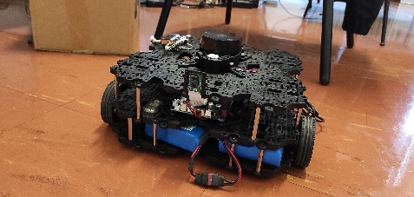
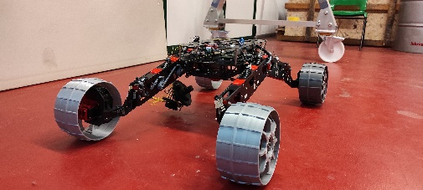
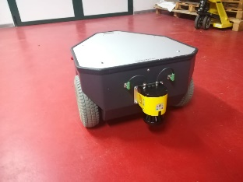
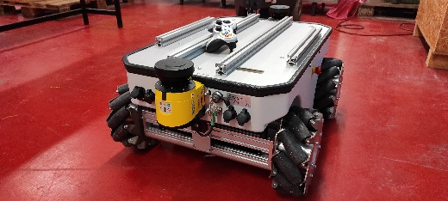
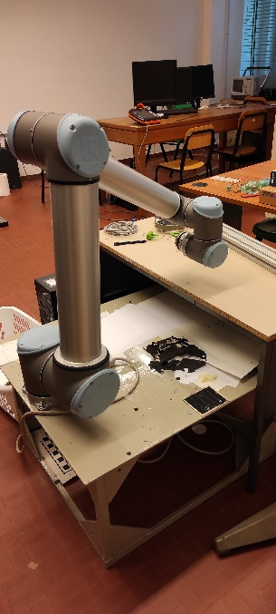
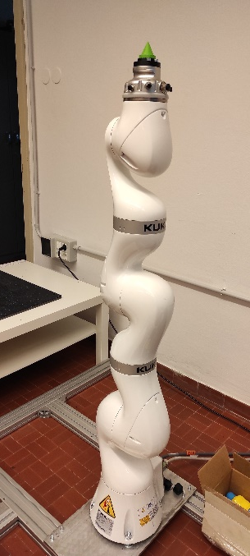
Our fleet
At the University of Trieste Robotics Laboratory all the mobile robots are ROS-Enabled
Turtlebot3 Waffle-Pi
Rover
MP-500
MPO-500
And eventually:
UR10
Kuka LBR

Slide 3
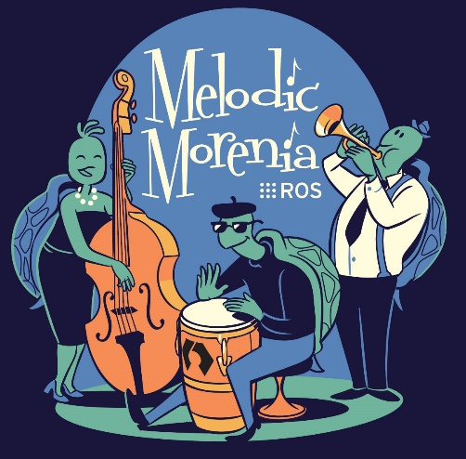
Introduction
ROS: Robot Operating System
A set of libraries to build robot applications
  Hardware control (actuators, sensors, ...)
  Software control (navigation, mapping, ...)
Features
  Wide variety of platforms
  Flexible
  Distributed
  Exploits Modularity
  Open Source

Slide 4
History
Originally developed in 2007 at the Stanford Artificial Intelligence Laboratory and continued at Willow Garage (now Clearpath Robotics)
Since 2013 managed by OSRF (Open Source Robotics Foundation)

Slide 5
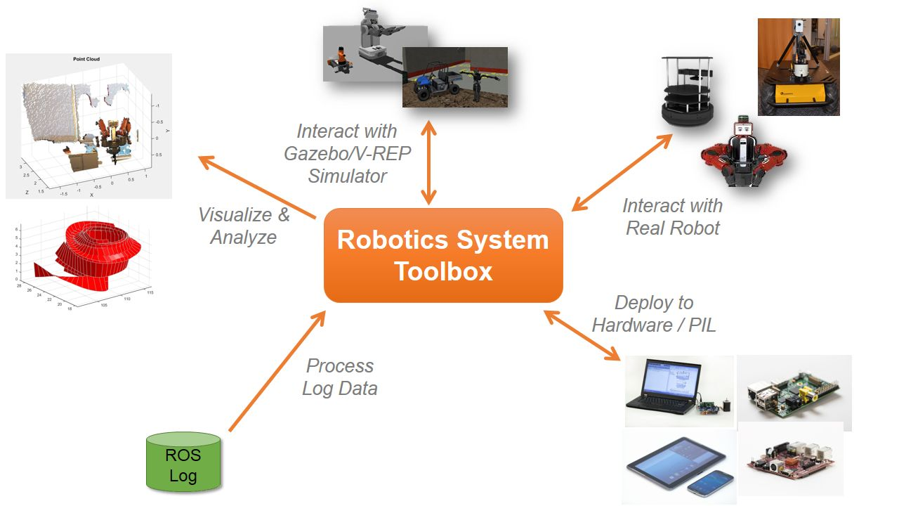
ROS Ecosystem

Slide 6
Main Features
Operating system side
  Provides core functionality
  Low-level hardware control
  Messaging between processes
Packages
  Contributed by the user base
  Implement common robot functionality:
  SLAM, path planning, perception, vision, manipulation, autonomous navigation, etc.

Slide 7
Philosophy
Distributed
  Peer-to-peer
  Numerous small programs which exchange messages
Package-based
  Packages provide all the specific functionalities.
  Client libraries: C++, Python, Java, C#, lisp, MATLAB, ...
Thin
  ROS itself is only a layer that wraps around stand-alone libraries
  It allows there to exchange information between them
Free and Open-source

Slide 8
ROS elements
Nodes
Messages and Topics
Services
ROS Master
Parameters

Slide 9
ROS Terminology
A ROS network comprises different parts of a robot system (such as a planner or a camera interface) that communicate over ROS. The network can be distributed over several machines.
A ROS master coordinates the different parts of a ROS network. It is identified by a Master URI (Uniform Resource Identifier) that specifies the hostname or IP address of the machine where the master is running.
A ROS node is an entity that contains a collection of related ROS capabilities (such as publishers, subscribers and services). A ROS network can have many ROS nodes.
Publishers, subscribers, and services are different kinds of ROS entities that process data. They exchange data using messages.
A publisher sends messages to a specific topic (such as "odometry"), and subscribers to that topic receive those messages. There can be multiple publishers and subscribers associated with a single topic.

Slide 10
Example
Nodes
Messages
Face detection
Image message
Camera
Image message
Obstacle detection
Point cloud
Bool message
Laser-scanner
Obstacle position/size
Point cloud
Velocity message
Motor Driver
Map building
Obstacle Avoidance

Slide 11
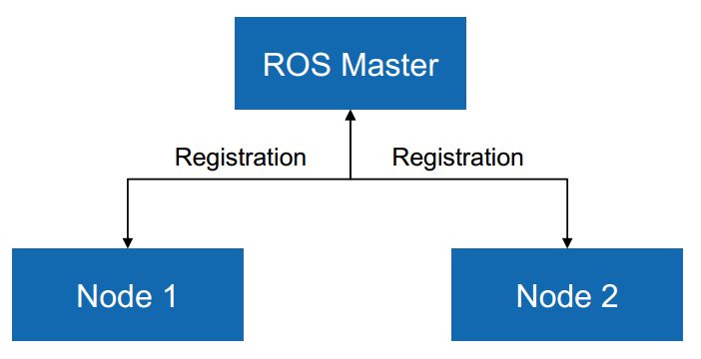
ROS structure
The master node coordinates all other nodes
All nodes register with the master at startup

Slide 12
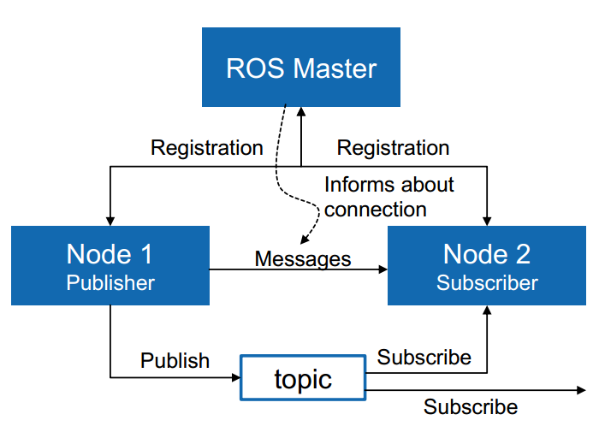
ROS structure

Slide 13
ROS nodes
Single-purposed executable programs
  Sensor drivers, actuator drivers, mapper, planner, User Interfaces, …
Individually compiled, executed, and managed
Nodes are written using a ROS client library
  roscpp – C++ client library
  rospy – python client library
Nodes can publish or subscribe to a Topic
Nodes can also provide or use a Service

Slide 14
ROS Topics
A stream of messages with a defined type
  Example:
  Laser range-finder sends data on a topic called scan, with message type: “LaserScan”
Nodes communicate with each other by publishing messages to topics
Publish/Subscribe model:
  N-to-N broadcasting

Slide 15
ROS Topics
Example:
Camera nodes publish image data to topic /vision
Left camera
Right camera
Topic: /vision
Stereo node subscribes to topic /vision
Stereoscopy
3D Processing
Topic: /map
Path-planner
Stereo node publishes 3D data of map to topic /map
Path-planner node subscribes to topic /map
Eventually, the path-planner commands the motors...

Slide 16
Messages
Many kind of different messages;
They represent the data structure of the passed data;
Defined in a file .msg;
Compiled togheter with the parent package or as standalone msg package
Standard
e.g. Bool, float, int, char, etc.
Message
Derived
e.g. Vector, Twist, Odometry, etc.
Custom
e.g. pippo, pluto, etc.

Slide 17
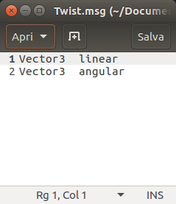
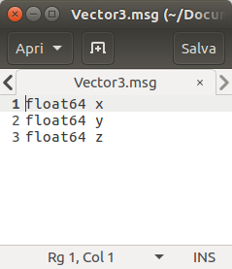
Message - Example
The topic /cmd_vel, common to every mobile platform, uses Twist as message type.
Twist is derived

Slide 18
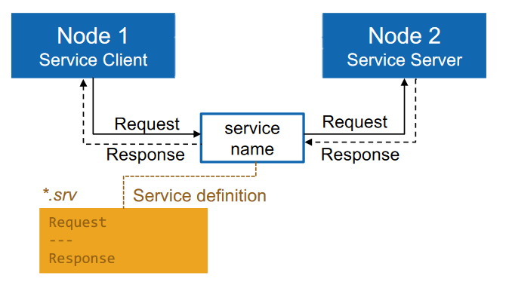
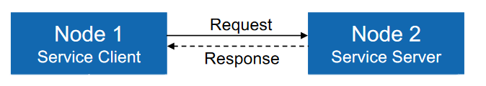
ROS Services
Used for request/response communication
1 to 1 communication

Slide 19
ROS Services - Usage
Perform small tasks once in a while: e.g. reset sensors, perform calibration, taking pictures of something of interest;
Save collected data;
Emergengy stop.

Slide 20
Topics / Services
Comparison:
Client-server communication
Node
Service
Node
N-N broadcast communication
Node
Node
Topic
Publication
Subscription
Node
Node

Slide 21
Actions
Used as services but for very large demanding tasks/actions.
Uses 3 messages: Goal Message, Feedback Message, Result Message.
Example:
Planner
Go to pose
Progress
Robot
Final pose

Slide 22
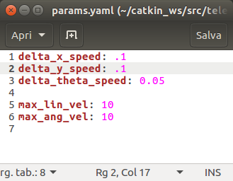
Parameter Server
Shared dictionary in the ROS network.
Nodes store and load parameters at runtime
Runs inside the ROS Master
Mainly used for systems configuration.
Possible to start the Nodes by passing parameters one by one;
Possible to load a configuration file loading multiple parameters

Slide 23
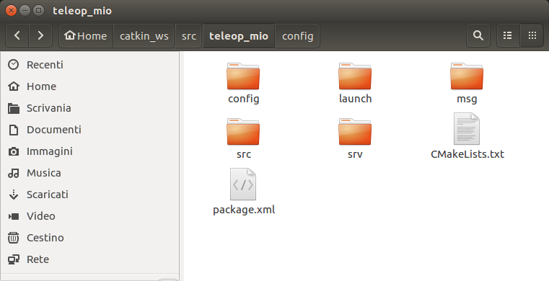
Ros Package
Main unit of how the software is organized in ROS;
Extensive use of C++, Python and XML language;
Contains:
  Nodes;
  Messages/Services/Actions definitions;
  Configuration files;
  Launch files;
  Instructions for the compiler;
  Package Manifest (metadata, version, dependecies etc.).

Slide 24
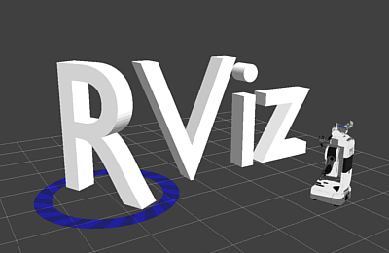
Rviz
3D visualization tool for ROS
  Allows visualization of robot frame
  Frames of reference
  Maps
  Path/trajectories
  Objects
  Sensor data
  Vision output
Video RVIZ

Slide 25
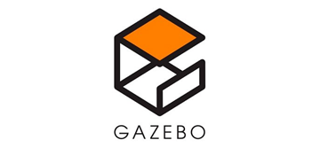
Gazebo
Dynamic simulator for robotic systems in general;
Allows modeling of the robot and the scenario either in its GUI or via code;
Modeling of the robot through URDF and SDF files (files describing how the robot is composed – Links, Joints, Bodies, Sensors etc.);
Explicit definition of physical properties: friction, gravity, contacts etc;
Extendable with custom plugins, for example extend robot model with additional sensors.

Slide 26
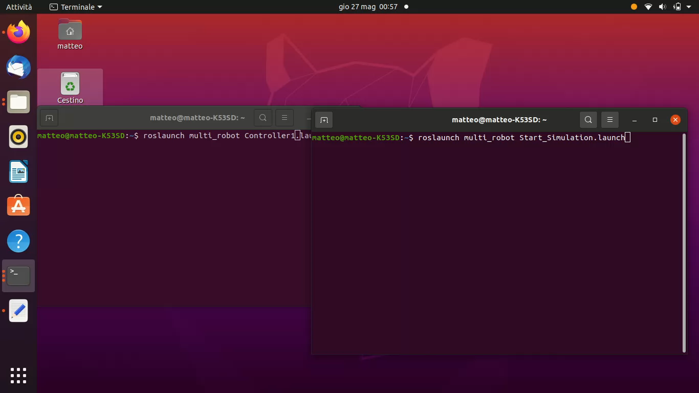
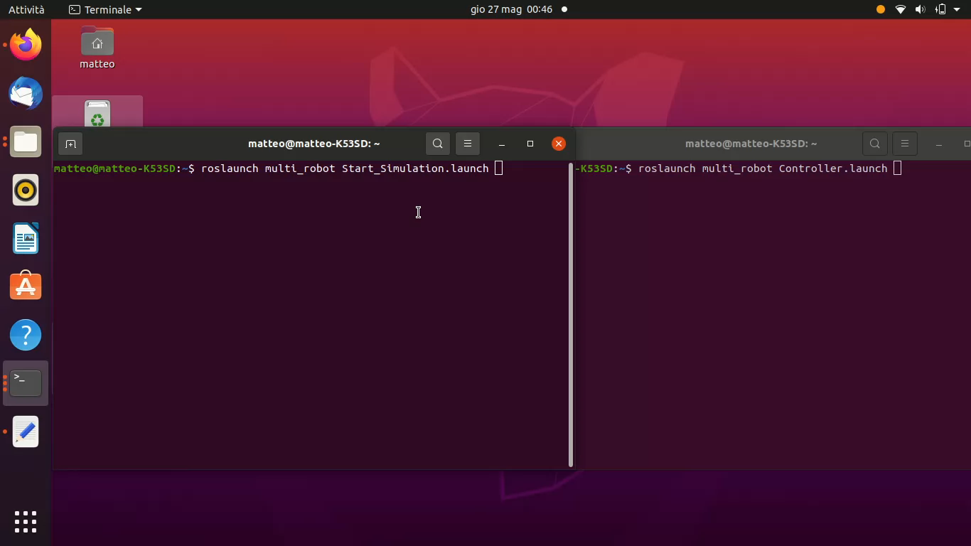
Gazebo - Example
Trajectory tracking with one and a fleet of mobile robots in a custom and cluttered environment;
Simulation/world setup and robots spawning
Two ROS Package created
Trajectory Tracking Controller

Slide 27
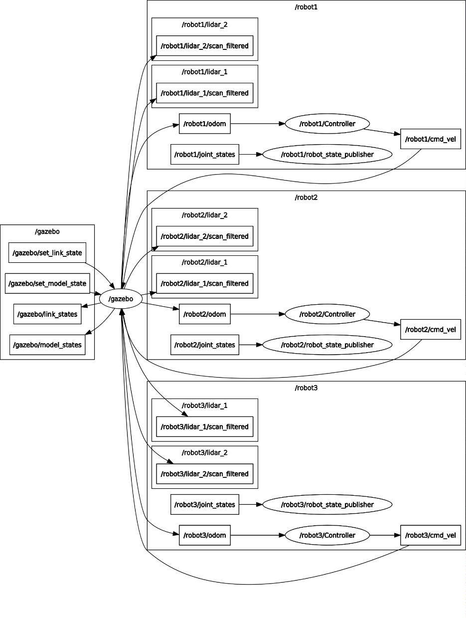
Gazebo – Example (Rosgraph)
Case of multiple robots
Use of namespaces (prefix) makes the script scalable to n independent robots.

Slide 28
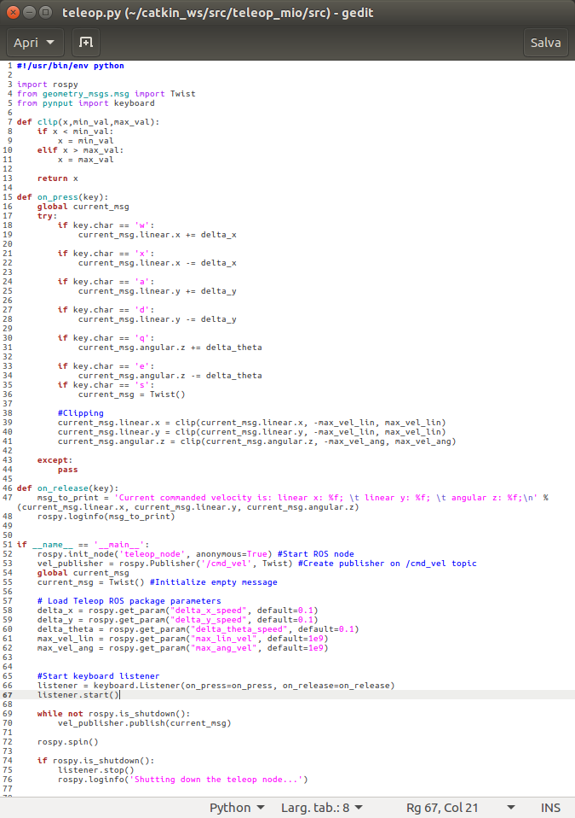
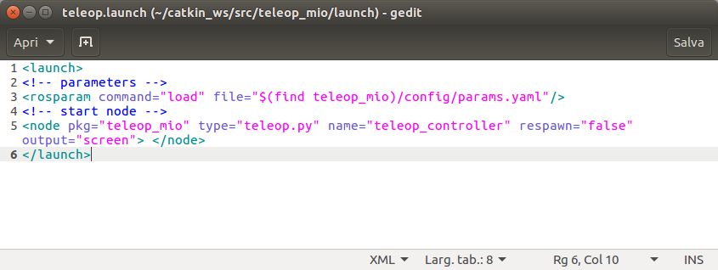
ROS Package Example
Custom Teleop Node
Use of rospy client
Control a mobile platform using the keyword;
Usable on any kind of mobile platform;
Can control either simulated ones or real ones
Source Code
Launch File

Slide 29
Summary Example
Based on the Turtlebot3, the navigation stack, mapping (Gmapping), SLAM
roslaunch turtlebot3_gazebo turtlebot3_world_mio.launch #Simulation environment
roslaunch teleop_mio teleop.launch #Teleop
rosservice call /gazebo/reset_simulation #Reset simulation
roslaunch turtlebot3_slam turtlebot3_slam.launch #SLAM & Mapping
rosrun map_server map_saver -f test_map/test_map #Save map
roslaunch turtlebot3_gazebo turtlebot3_world_mio.launch #Simulation environment
roslaunch turtlebot3_navigation turtlebot3_navigation.launch map_file:=$HOME/test_map/test_map.yaml #Planner

Slide 30

Rover
Developed a ROS-Enabled prototype of a 4 wheel steering rover.
Main Nodes:
  Robot Core Node: compute odometry, update motors command, receive and apply teleoperating commands after applying inverse kinematics, receive motors operating modes, extract and update IMU, provide informations about sensors, motors and joint state.
  Lidar Node: Aquire readings in form of distance and angles and publish them on /scan topic.
  Matlab Remote Node: Contains teleop, SLAM, mapping, planning, inverse kinematics and many other features.
  Camera Node: takes images from the camera and publish them in the corresponding topic.
  Diagnosis Node: Collect states of different systems and publish them on its topic.

Slide 31
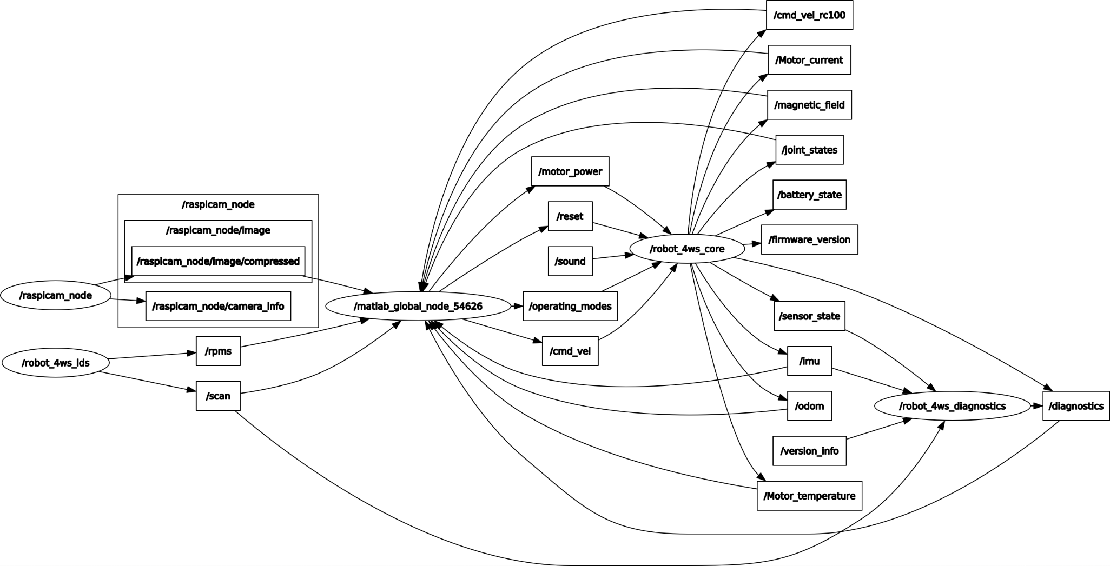
Rover - Rosgraph
Rover Core Node
Camera Node
Master Node
LiDar Scanner Node

Slide 32
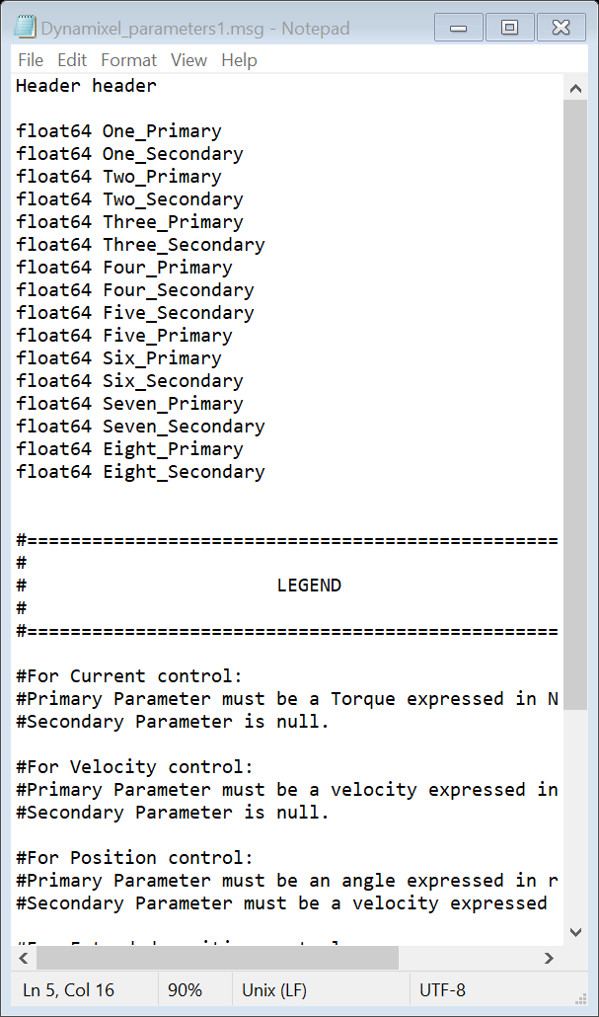
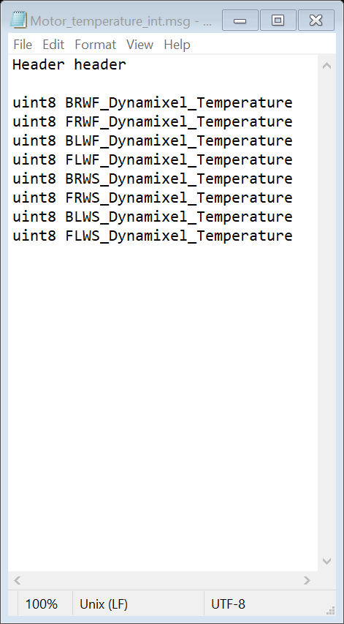
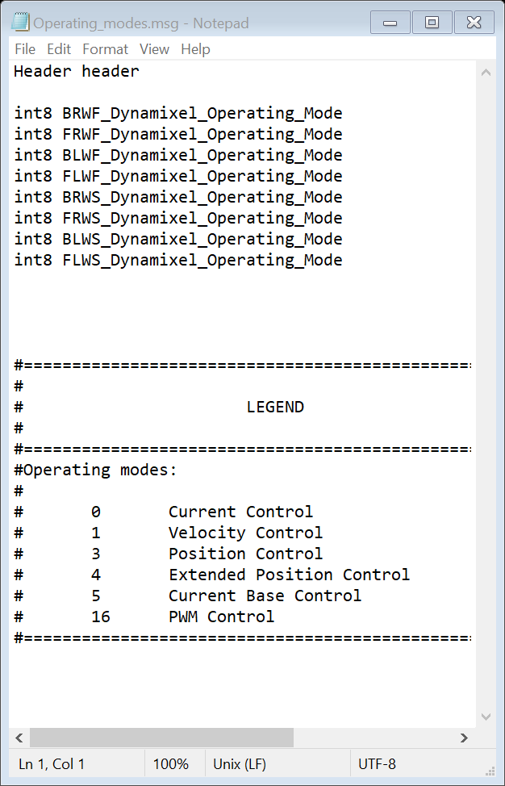
Rover – Custom Message Definition

Slide 33
How to start - Solutions
If you are courious and you want to start on developing ROS applications:
ROS Developement Studio: online programming and testing. No installation required link;
Create a virtual machine on your Windows laptop and install Ubuntu in it. Oracle VM Virtual Box. Then refer to the next step;
ROS: installation of the software required. Better to use Ubuntu
  Homepage: descriptions, tutorials etc.
  Installation guide: last ROS version ROS Noetic Ninjemys.
Enjoy and have fun!

Slide 34
Thank you for your attention
For any question feel free to contact us.
Contacts:
sseriani@units.it
matteo.caruso@phd.units.it

