Slide 1
Farmacogenetica
Gabriele Stocco
Professore Associato in Farmacologia (BIO/14)
Dipartimento di Scienze della Vita
Edificio FC – “Fondazione Callerio”
Email: stoccog@units.it
Telefono: 0405588634

Slide 2
Pharmacogenomics
Identification of genes variants that influence drug effects.
Is it possible to predict the effect of a drug in a certain patient?
Pharmacogenetics/genomics associate to a certain phenotype (specific therapeutic outcome) a certain genotype.
The promise of pharmacogenomics is that by knowing the genotype in a patient it will be possible to predict the therapeutic outcome.

Slide 3
For some diseases the percentage of drug response is still unsatisfactory
US Food and Drug Administration

Slide 4
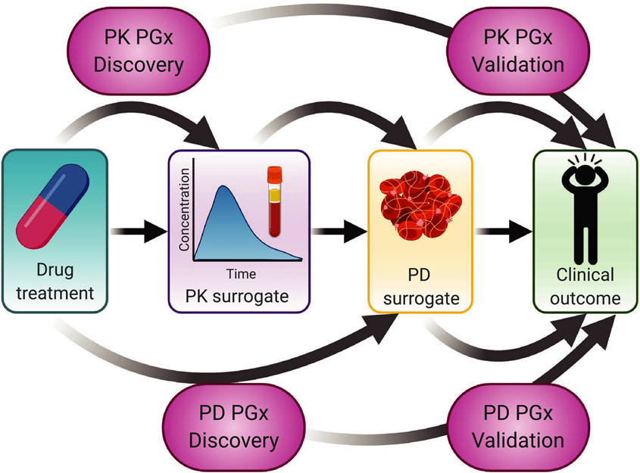
Mechanistic chain of pharmacogenetics associations. It may be easiest to identify a pharmacogenetic (PGx) effect on a proximal surrogate, such as the effect of pharmacokinetic pharmacogenetics (PK PGx) on a PK surrogate of drug concentrations. A similar process can be used to test for pharmacodynamic pharmacogenetics (PD PGx) on a PD surrogate of biochemical response. If genetics affects one of these surrogate endophenotypes, it can then be tested for an effect on a clinically relevant treatment outcome in validation studies in preparation for potential clinical translation.
Hinks et al., CPT 2021

Slide 5
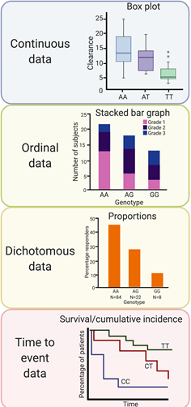
Examples of visual representations for different types of data acquired during a PGx association study. Continuous phenotype data such as for drug clearance are often summarized in box plots by patient genotype. Ordinal and dichotomous phenotype data are often represented by proportions of patients by genotype in histograms. Time‐to‐event data are plotted by genotype in Kaplan‐Meier plots which summarize the proportions of patients at risk for an event at a given timepoint after study enrollment. Genome‐wide association study data are generally represented in a Manhattan plot, which plots the chromosomal location of SNP variation along the x‐axis and the −log(P value) for each SNP along the y‐axis. GWAS, genome‐wide association study; PGx, pharmacogenetics; SNP, single‐nucleotide polymorphism..
Hinks et al., CPT 2021

Slide 6
Interindividual variability in drug response
Treatment outcome
(same dose)
Response
No effect
Adverse effect

























Slide 7
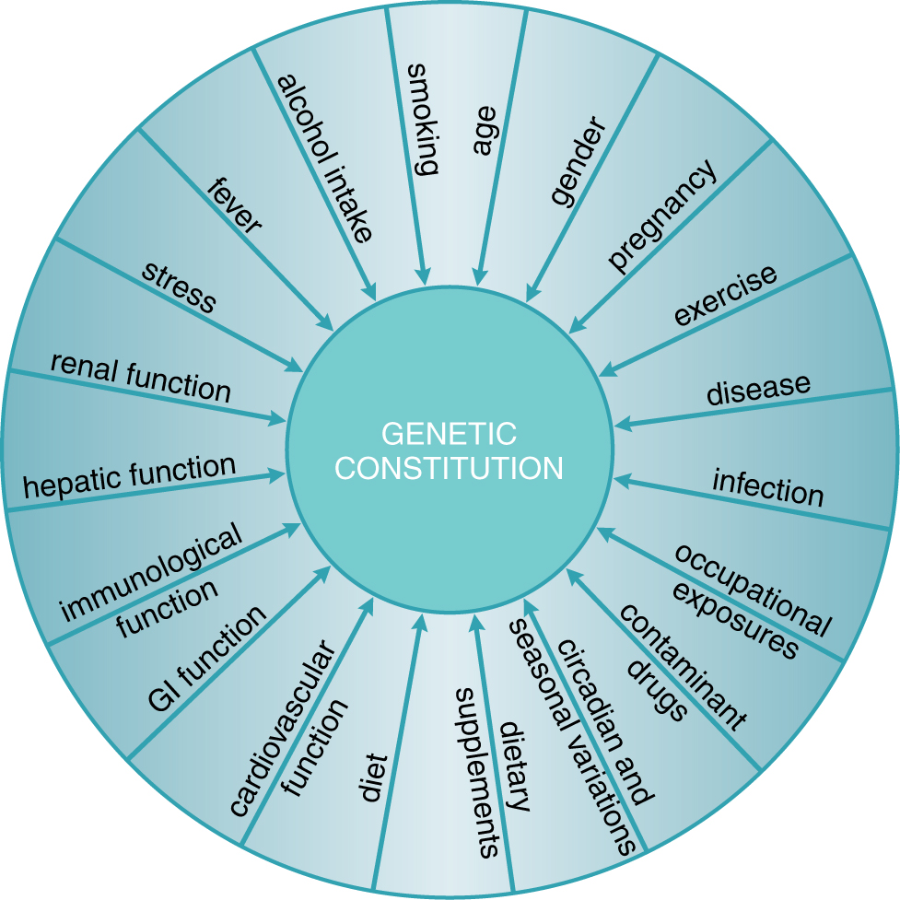
Exogenous and endogenous factors that contribute to interindividual variability in drug response
Physiological
Pathological
Genetic
Goodman and Gilman, 2011

Slide 8
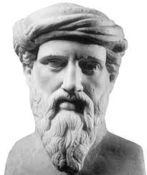
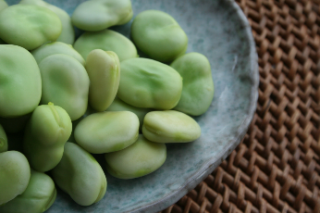
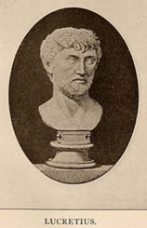
Genetic characteristics predispose to the response to substances
Pitagora
(Samo?, 570 b.C. – Metaponto, 495 b.C.)
He forbade his disciples to eat broad beans
(for the risk of favism?).
Lucrezio
(Campania, 98 /96 b.C. – Roma 55 /53 b.C.)
Quod ali cibus est aliis fuat acre venenum.
What is food for a man, it is poison for another.
«De rerum natura» Libro IV, linea 637
Pirmohamed, Br J Clin Pharmacol 2001
Ventura

Slide 9
Relling & Evans, Nature 2015

Slide 10
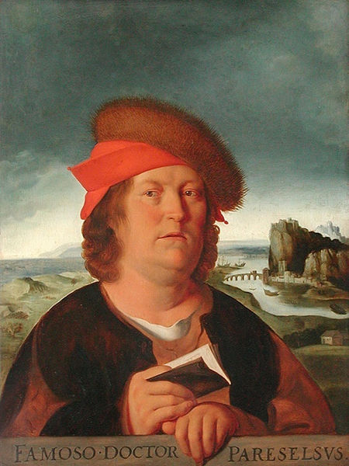
Modulation of the dose and drug effects
Paracelso (Philip Theophrastus Bombastus von Hohenheim)
(Einsiedeln 1493 – Salisburgo 1541)
“Omnia venenum sunt: nec sine veneno quicquam existit. Dosis sola facit, ut venenum non fit”
“All things are poison and nothing is without poison; only the dose makes a thing not a poison”
Yip et al., Clin Pharm Ther 2015

Slide 11
Il 10% della codeina somministrata per os è O-demetilata dal CYP2D6 a morfina, che è responsabile dell’effetto analgesico

Slide 12
History of pharmacogenetics and pharmacogenomics
Pirmohamed, Br J Clin Pharmacol 2001

Slide 13
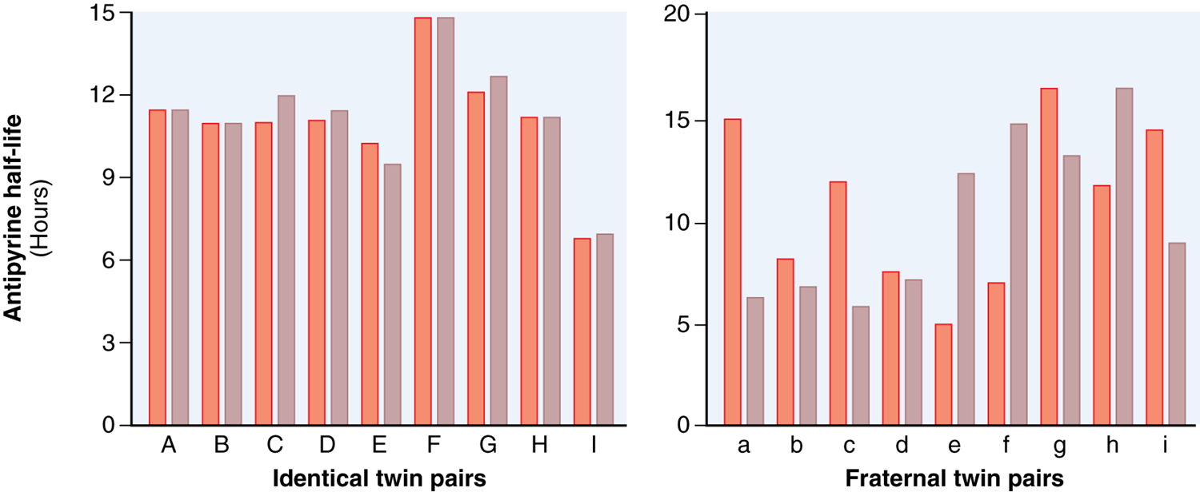
L’emivita dell’antipirina ha una concordanza maggiore nei gemelli identici che nei gemelli non identici.
Vessel & Page, Science 1968
Goodman and Gilman, 2011

Slide 14
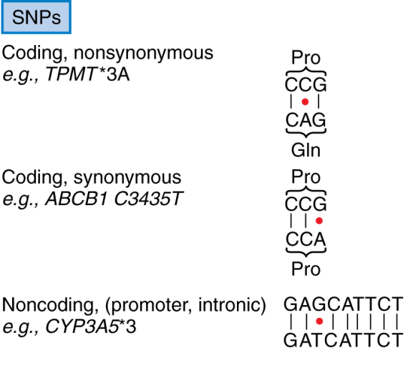

Genetic variants
Single nucleotide polymorphism (SNP)
Transition (pur→pur, pir→pir)
Transversion (pur↔ pir)
~ 1 nucleotide every 300-1000 bp
~ 17.000.000 SNPs
Deletion
Insertion
Sequence repeat
Gene copy number variation
~ 8.000 CNV
Notes:
Polimorfismo:
differenze genetiche ereditate non individuali
Differenze interindividuali e inter-etniche nel metabolismo dei farmaci

Slide 15
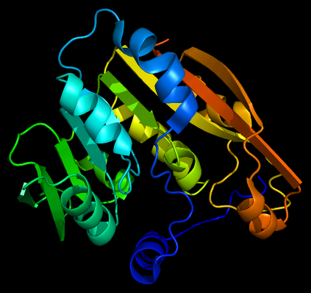
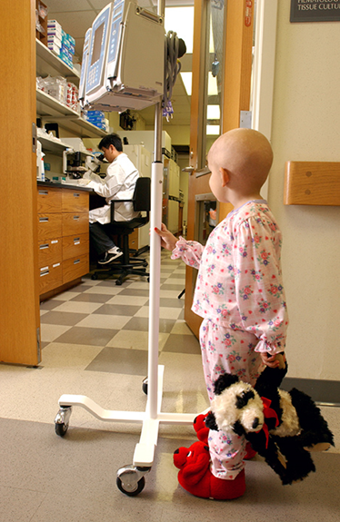
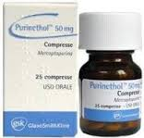
Exemple of pharmacogenetic trait
Enzyme thiopurine- S-methyltransferase
Thiopurine-S-methyltransferase enzymatic activity
Stocco et al., Human Mol Genet 2012

Slide 16
Cheok & Evans, 2006

Slide 17
Cheok & Evans, 2006

Slide 18
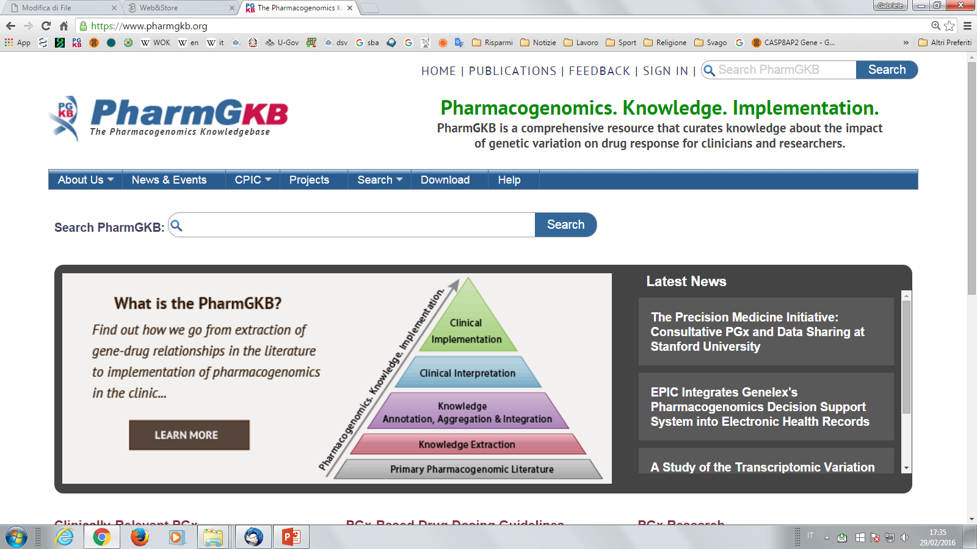
Risorsa online
www.pharmgkb.org
Linee guida farmacogenetiche mercaptopurina: https://www.pharmgkb.org/guidelineAnnotation/PA166104945

Slide 19
Hertz et al., CPT 2021

