Slide 1
Genetics of IL28B and HCV – response to infection and treatment
An example of genetic contribute to modify natural history and treatment
Agnese FERESIN – 26.08.2021

Slide 2
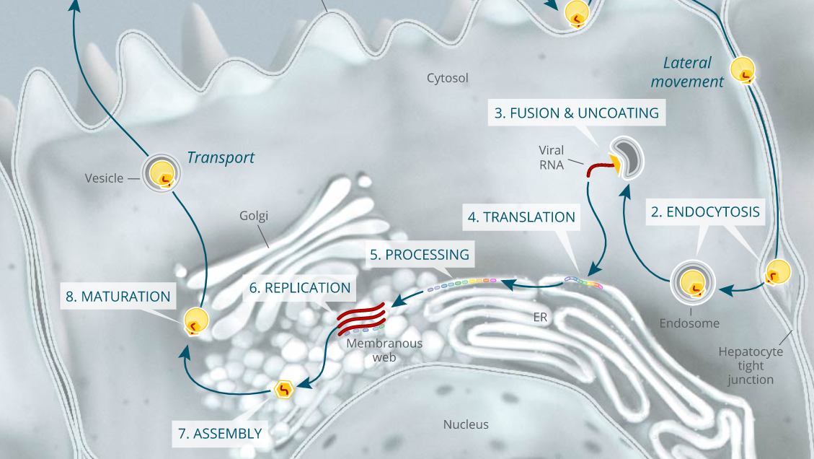
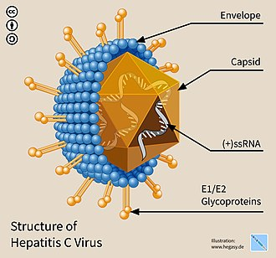
HCV
Scoperta 1989
Fam. Flaviviridae
6 genotipi

Slide 3
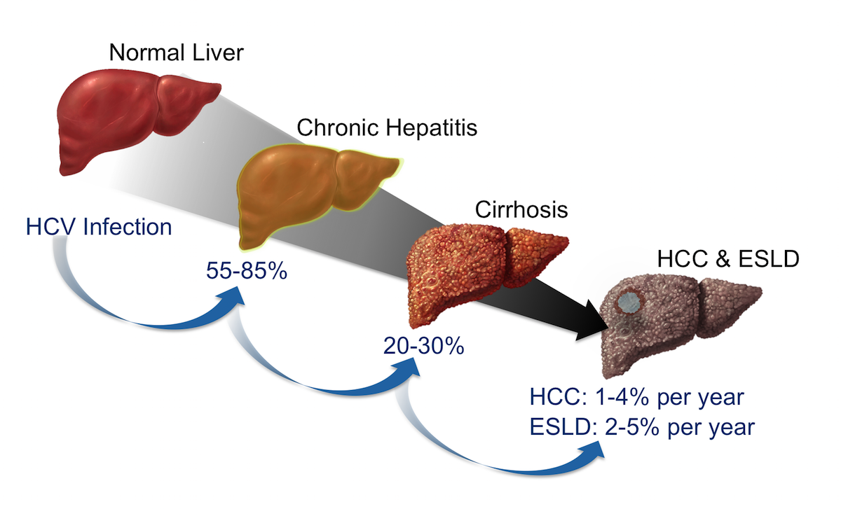
HCV: burden of disease
WHO estimates that 71 million people have chronic HCV infection (2020)

Slide 4
Pegylated interferon (PEG-IFN-α) plus ribavirin therapy remains the standard of care in many areas where direct antiviral agents are poorly accessible.
Fewer than half of treated patients achieve a sustained virological response SVR.
Identification of factors affecting response to IFN-α therapy remains an important goal.

Slide 5
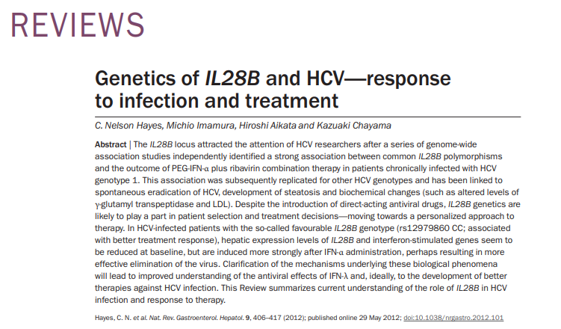
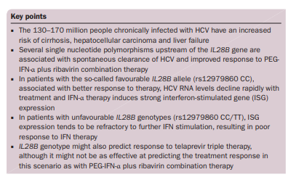

Slide 6
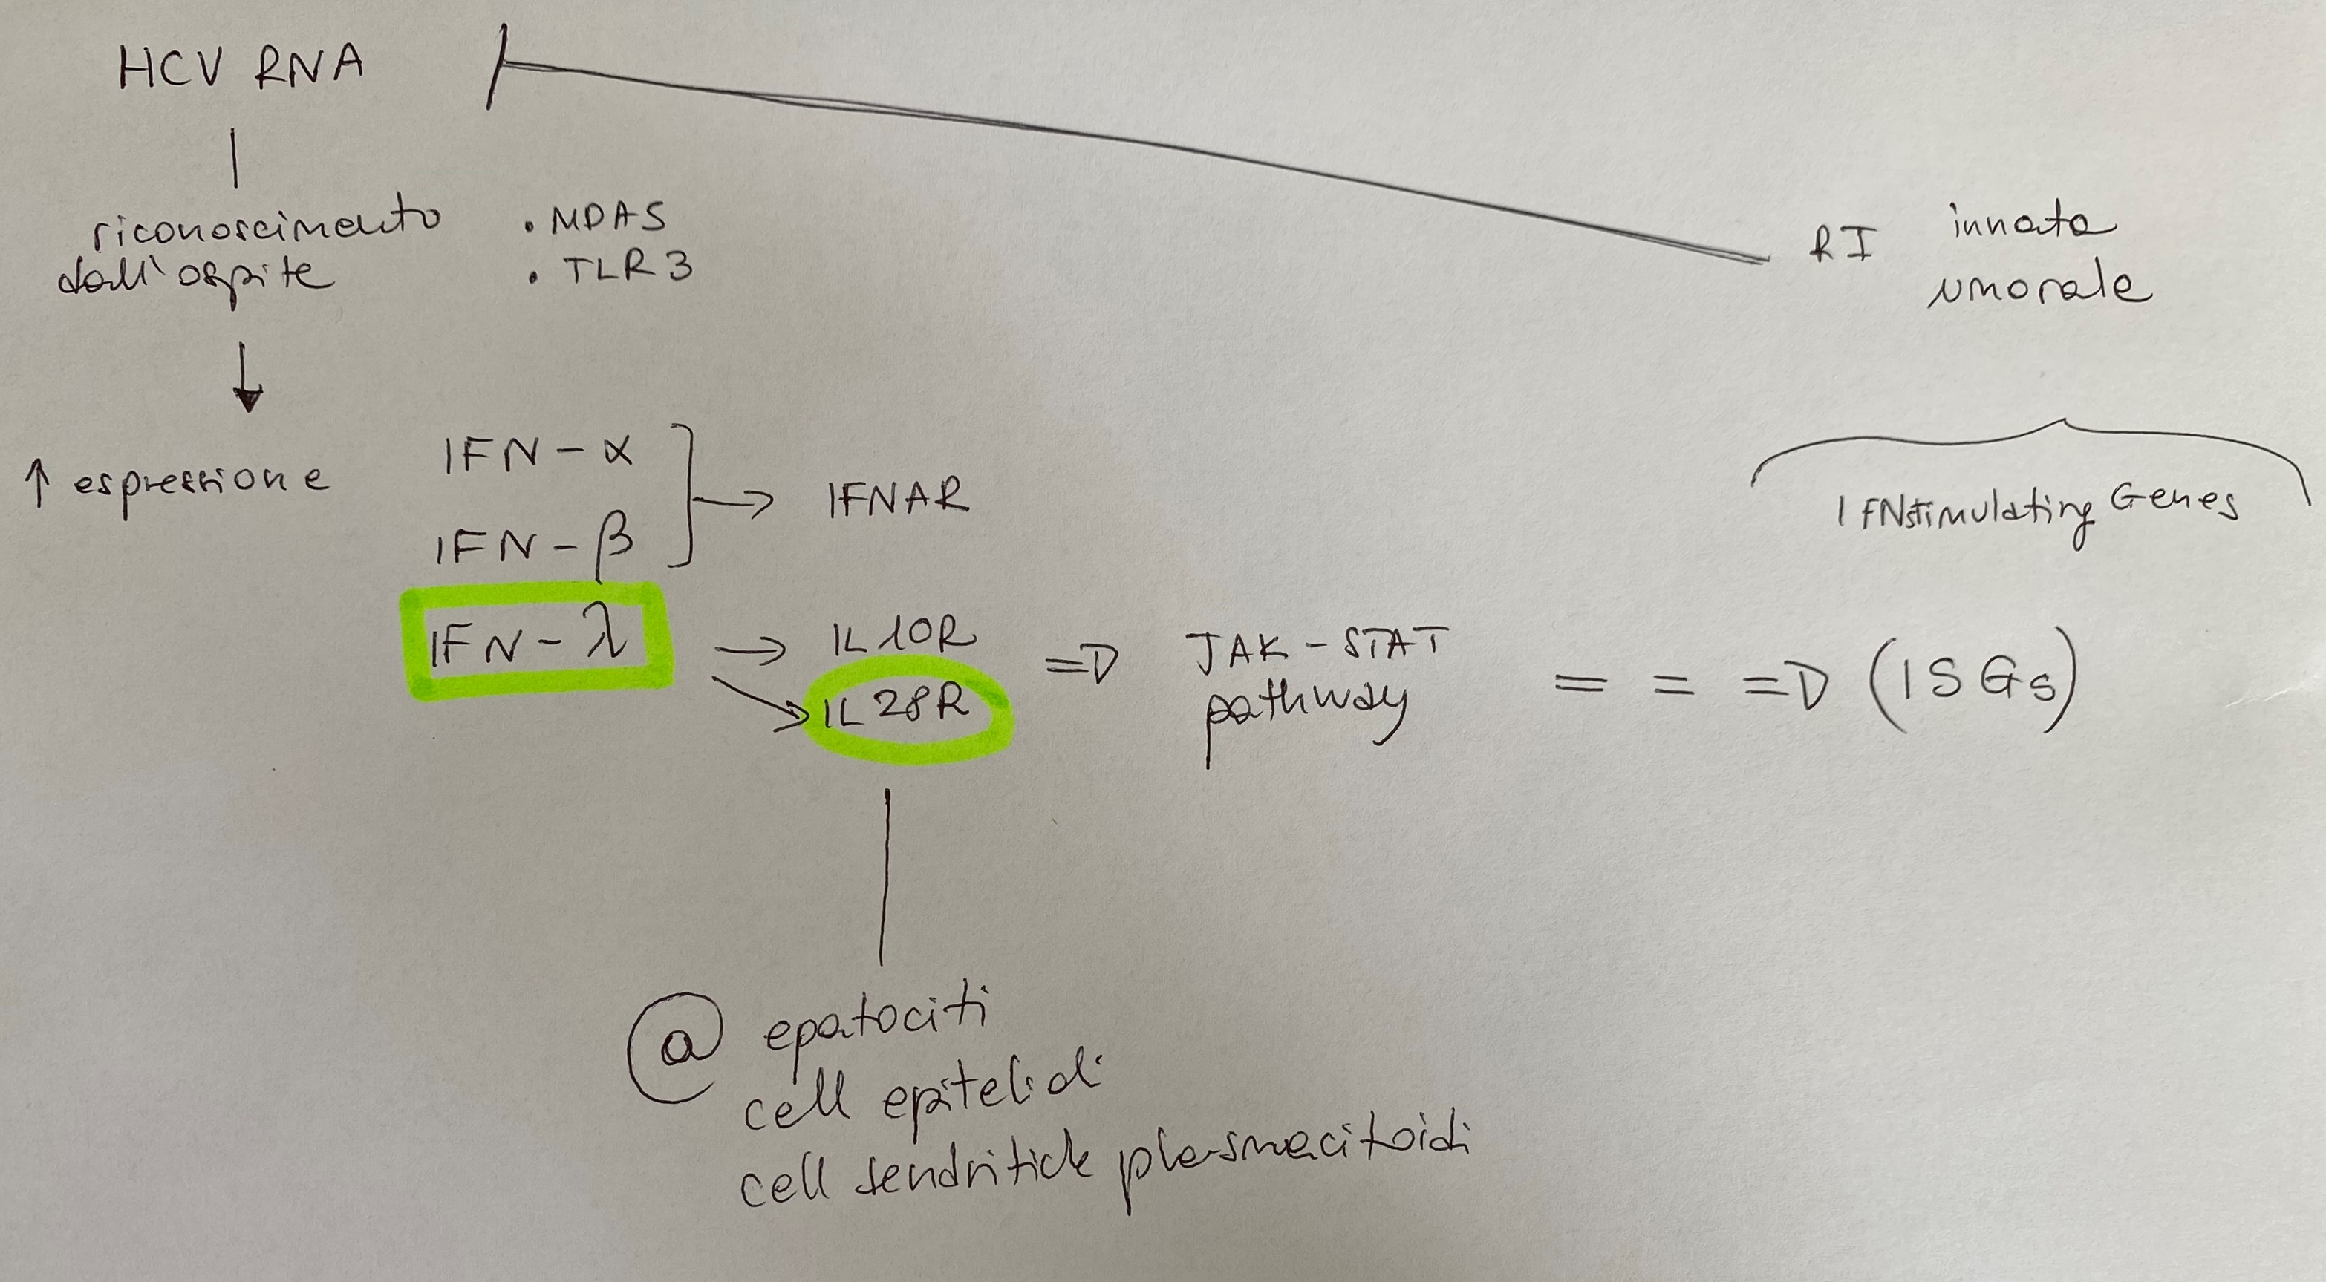
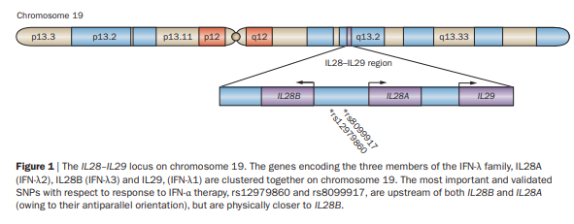
GWAS studies:
IL28BCC, considerato favorevole
IL28BCT, considerato meno favorevole
IL 28BTT , considerato il più sfavorevole dei 3

Slide 7
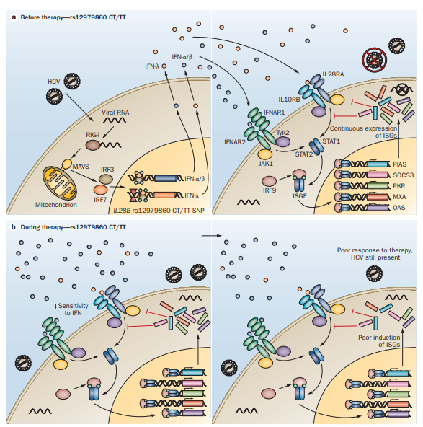
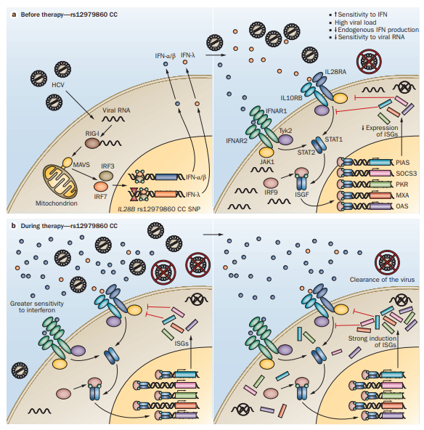

Slide 8
UNFAVORABLE RESPONSE
FAVORABLE RESPONSE
Hepatocyte are unable to clear the virus before therapy
// lower viral load
Hepatocyte remains more sensitive to IFN
// higher viral laod
Hepatocyte are unable to induce stronger ISGs expression during IFN therapy
Hepatocyte induce a stronger ISG expression during IFN therapy

Slide 9
UNFAVORABLE RESPONSE
FAVORABLE RESPONSE
Not all pts with the favourable genotype achieve SVR
Some pts with the unfavourable genotype have a mild response
? Personal cofactors (HIV, dose, other complications, ..)
? Other genomic regulators

Slide 10
KEY POINTS
The predictive role of IL28B SNPs is based on PEGIFN-α plus ribavirin combination therapy.
Initial data suggest that the favourable IL28B allele also predicts response to triple therapy but its predictive effect might not be as strong as for PEG-IFN-α plus ribavirin combination therapy.
Patients who fail to respond to IFN-α could also be more susceptible to antiviral resistance, and IL28B genotyping could help identify those patients who are poor candidates for triple therapy.
IL28B genotyping could also be useful in helping to predict and control recurrent HCV infection after liver transplantation, as re-infection with HCV following liver transplantation is common and requires post-transplant antiviral therapy: the unfavourable IL28B genotype in recipients is associated with more severe recurrence of HCV infection, and IL28B genotypes of donors and recipients are independently associated with post-­transplant treatment response, suggesting that donors with the favourable IL28B genotype might be preferentially allocated to HCV-infected patients

