Slide 1
The role of transport for economic and human development. An historical overview
Adapted from: Paolo Beria
Course in Transport Economics, Economic history of
transport technologies

Slide 3
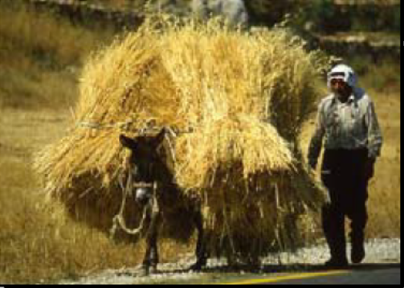
Exchange surpluses
Increased productivity and specialization generate surpluses that need to be transported between communities

Slide 4
Other motives to move people and goods
Product specialization linked to natural resources (fish, cotton, ..)
Cities: concentration of non self-sufficient people
Demand for luxury goods (vases, amber, spices, carpets, textile, glass)
Wars: army logistics
Sightseeing: travelers

Slide 5
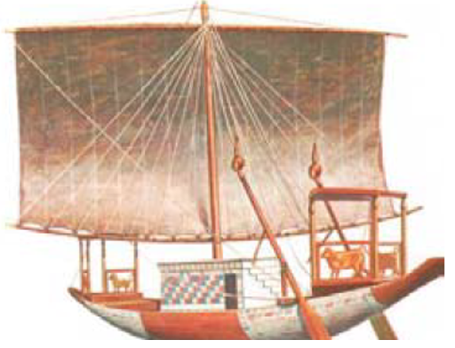
Main obstacle: friction
Moving goods from one location to another locations requires vehicles and infrastructure
Relevant attributes: costs, time, reliability, safety
In ancient times transport on water had an advantage over transport over land: less friction!

Slide 6
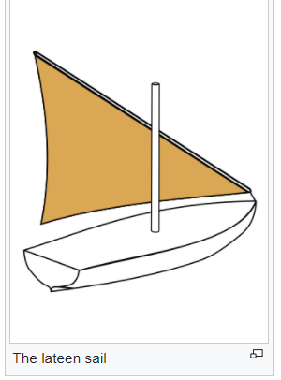
Square rig is a generic type of sail and rigging arrangement in which the primary driving sails are carried on horizontal spars which are perpendicular, or square, to the keel of the vessel and to the masts.
A lateen (from French latine, meaning "Latin") or latin-rig is a triangular sail set on a long yard mounted at an angle on the mast, and running in a fore-and-aft direction.

Slide 7
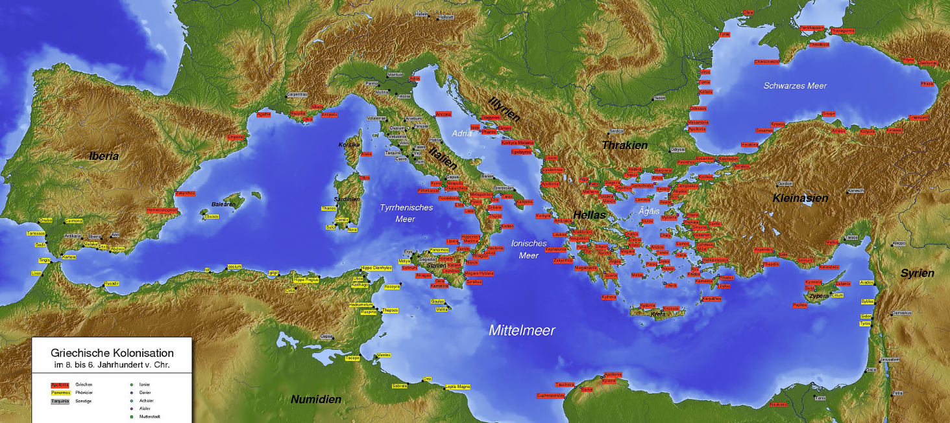
Sea and river transport in ancient times
Cities are mainly located along the coasts
Sea transport was mostly cabotage:
Cabotage or coasting trade: shipping along coastal routes, port to port
Cabotaggio: navigazione da cabo a cabo, da porto a porto

Slide 8
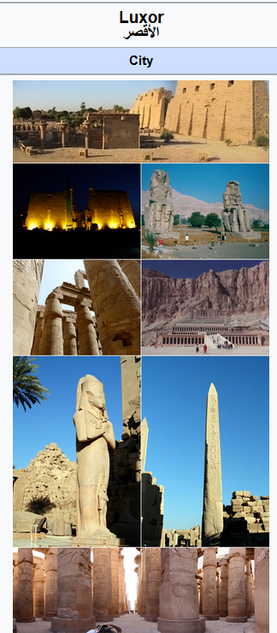
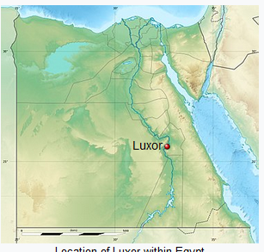
Waterways are very important
Luxor was the ancient city of Thebes, the great capital of (Upper) Egypt during the New Kingdom
The importance of the city started as early as the 11th Dynasty, when the town grew into a thriving city, by native Nubi Egyptian, it was renowned for its high social status and luxury, but also as a center for wisdom, art, religious and political supremacy.

Slide 10
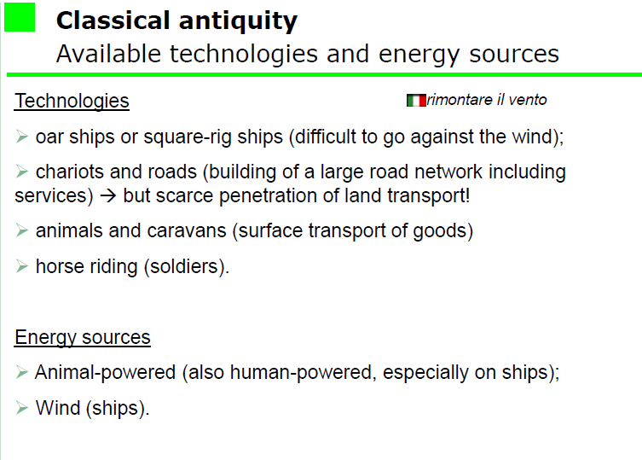

Slide 11
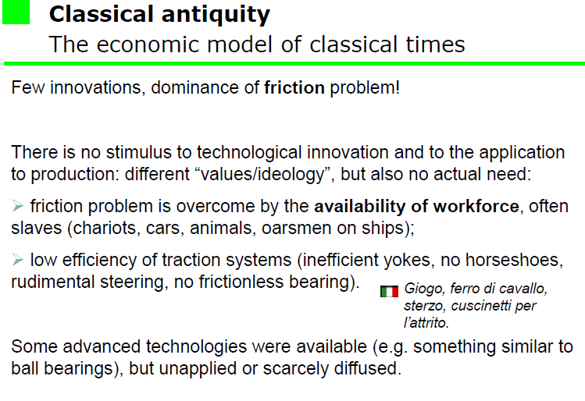
cuscinetto

Slide 12
Road transport

Slide 15
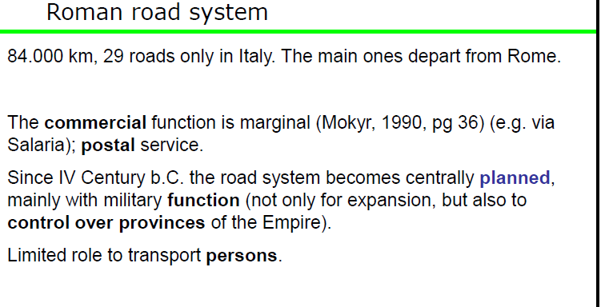

Slide 16
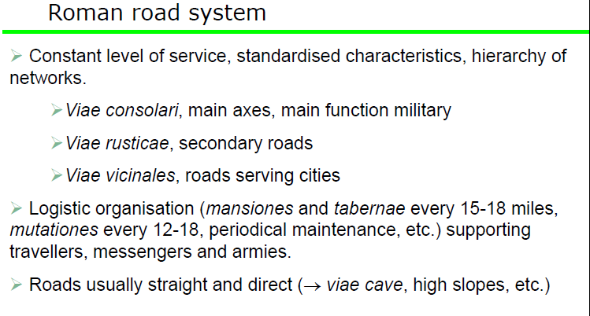

Slide 17
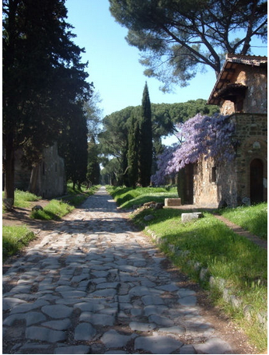
Roman roads
Roman Road (Appian Way) The Appian Way was completed around 312 BC, linking Rome to the port city of Brundisium (Brindisi). It played a fundamental role in helping expanding the Roman hegemony which was then in its early stages and also set the engineering standards which would be applied to most of the roads subsequently built. A road was typically surfaced with stone paving blocks, had a drainage ditch on each side and were built upon a foundation of laid rock which was constructed from a large ditch.

Slide 18
A technology to build roads

Slide 19
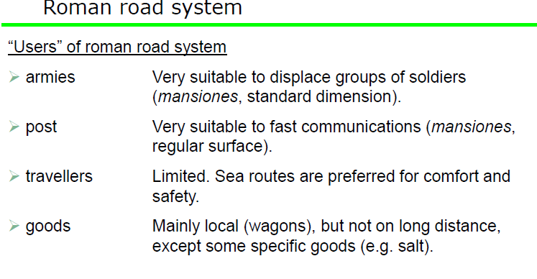

Slide 20
To summarize: Ancient Times technologies
Technologies
Sea transport: oar ships, square-rig ships
Road transport: chariots and roman roads, animals (horses and cows) and caravans
Energy sources
Animal traction
Wind

Slide 21
Middle Ages
The Middle Ages or Medieval Period might be subdivides into three periods:
Early Middle Ages: fall of the Western Roman Empire to the year 1000)
High Middle Ages: year 1000 to year 1300
Late Middle Ages: up to Christopher Columbus's first voyage to the Americas in 1492, the conquest of Constantinople by the Turks in 1453, or the Protestant Reformation in 1517

Slide 22
Transport developments
Early middle ages: population decline, counter-urbanization, invasion, and movement of people. Consequently, limited exchange of goods and people.
High Middle Ages: the population of Europe increased greatly (from 35 to 80 million between 1000 and 1347) as technological and agricultural innovations allowed trade to flourish and the Medieval Warm Period climate change allowed crop yields to increase
Late Middle Ages: marked by difficulties and calamities including famine, plague, and war, which significantly diminished the population of Europe
Notes:
Christopher Columbus's first voyage to the Americas in 1492, the conquest of Constantinople by the Turks in 1453, or the Protestant Reformation in 1517

Slide 23
High Middle Ages
In central and northern Italy and in Flanders, the rise of towns that were to a degree self-governing stimulated economic growth and created an environment for new types of trade associations. Commercial cities on the shores of the Baltic entered into agreements known as the Hanseatic League, and the Italian Maritime republics such as Venice, Genoa, Amalfi and Pisa expanded their trade throughout the Mediterranean.
Trading fairs were established and flourished in northern France during the period, allowing Italian and German merchants to trade with each other as well as local merchants.
In the late 13th century new land and sea routes to the Far East were pioneered, famously described in The Travels of Marco Polo written by one of the traders, Marco Polo (d. 1324).
Besides new trading opportunities, agricultural and technological improvements enabled an increase in crop yields, which in turn allowed the trade networks to expand.

Slide 24
Ship technology
the Middle Ages produced a decisive technological achievement: the creation of a reliable oceangoing ship depending entirely on wind power instead of a combination of wind and muscle.

Slide 25
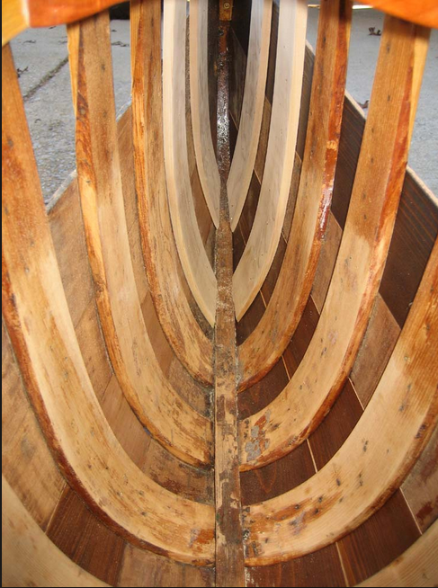
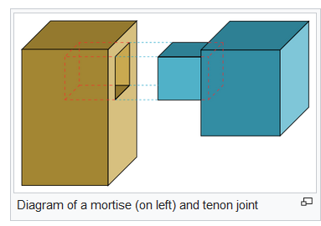
The rib and plank method
Shipbuilding improved with the use of the rib and plank method rather than the old Roman system of mortise and tenon.

Slide 26
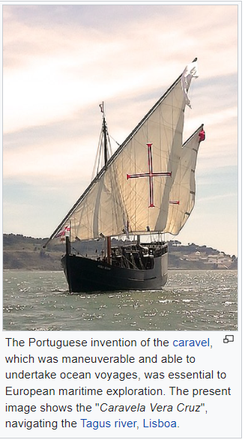
The lateen sail
the combination of the traditional square sail, used with little modification from Egyptian times through the Roman Empire to the Viking long boats, with the triangular lateen sail developed in the Arab world and adopted in the Mediterranean, which gave it the “lateen” (Latin) association attributed to it by the northern seafarers. This combination allowed ships so equipped to tack "against the wind"
Dating back to Roman navigation, the lateen became the favorite sail of the Age of Discovery. The Age of Discovery (or the Age of Exploration) is an informal and loosely defined term for the early modern period, largely overlapping with the Age of Sail, approximately from the 15th century to the 18th century in European history, in which seafaring Europeans explored regions across the globe, most of which were already inhabited.

Slide 27
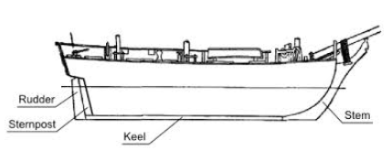
The sternpost rudder
the adoption of the sternpost rudder gave greatly increased maneuverability, allowing ships to take full advantage of their improved sail power in tacking into a contrary wind.

Slide 28
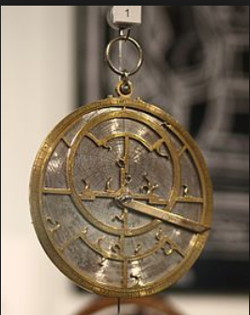
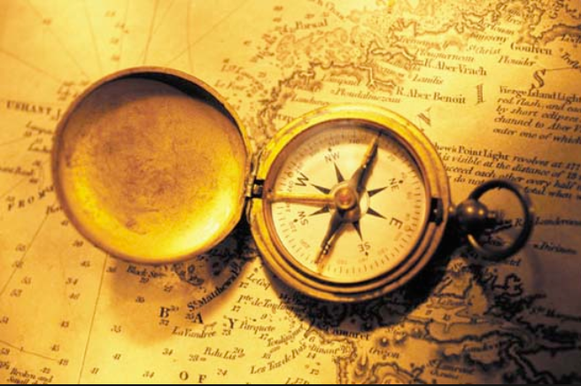
The magnetic compass, the astrolabe
Third, the introduction of the magnetic compass provided a means of checking navigation on the open seas in any weather.
The convergence of these improvements in the ships of the later Middle Ages, together with other improvements in construction and equipment—such as better barrels for carrying water, more reliable ropes, sails, and anchors, the availability of navigational charts (first recorded in use on board ship in 1270), and the astrolabe (for measuring the angle of the Sun or a star above the horizon)—lent confidence to adventurous mariners and thus led directly to the voyages of discovery that marked the end of the Middle Ages and the beginning of the expansion of Europe that has characterized modern times.

Slide 31
To summarize: medieval technologies
Technologies
Sea transport: oar ships, square-rig ships, lateen sail (against the wind)
Road transport: chariots and Roman roads, animals (horses and cows) and caravans
Energy sources
Animal traction
Wind
Innovation
Postal service

Slide 32
Early Modern Period or pre-industrial period
Although the chronological limits of the period are open to debate, the timeframe spans the period after the late portion of the post-classical age (c. 1500), known as the Middle Ages, through the beginning of the Age of Revolutions (c. 1800) and is variously demarcated by historians as beginning with the Fall of Constantinople in 1453, with the Renaissance period, and with the Age of Discovery
The Renaissance was a period in European history, from the 14th to the 17th century, regarded as the cultural bridge between the Middle Ages and modern history. It started as a cultural movement in Italy in the Medieval period and later spread to the rest of Europe, marking the beginning of the Modern age.
Notable trends of the early modern period include the development of experimental science, accelerated travel due to improvements in mapping and ship design, increasingly rapid technological progress, secularized civic politics, and the emergence of Nation states. Historians typically date the end of the early modern period when the French Revolution of the 1790s began the "modern" period.

Slide 33
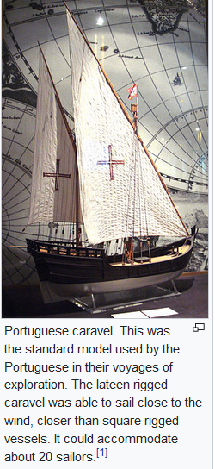
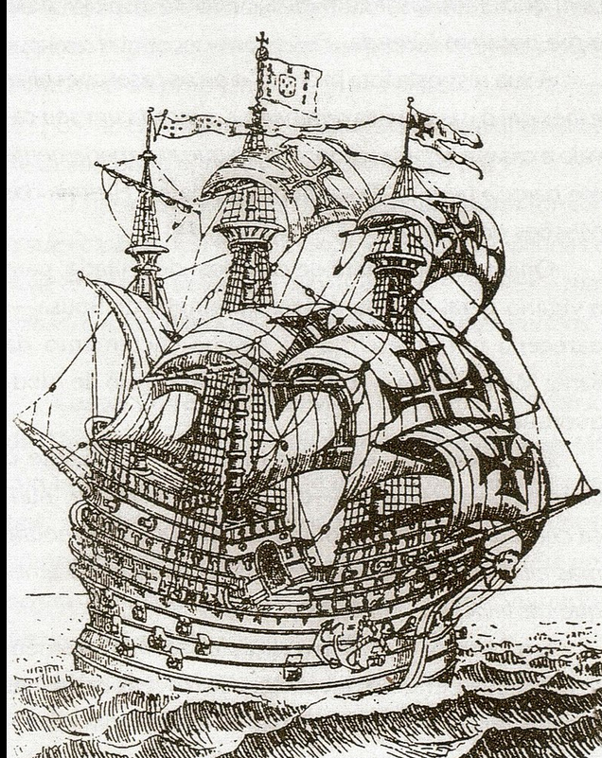
Innovations in sea transport
In terms of shipping advances, the most important developments were the creation of the carrack and caravel designs in Portugal. These vessels evolved from medieval European designs from the North Sea and both the Christian and Islamic Mediterranean. They were the first ships that could leave the relatively placid and calm Mediterranean, Baltic or North Sea and sail safely on the open Atlantic.
A carrack was a three- or four-masted ocean-going sailing ship
A caravel is a small, highly maneuverable sailing ship

Slide 34
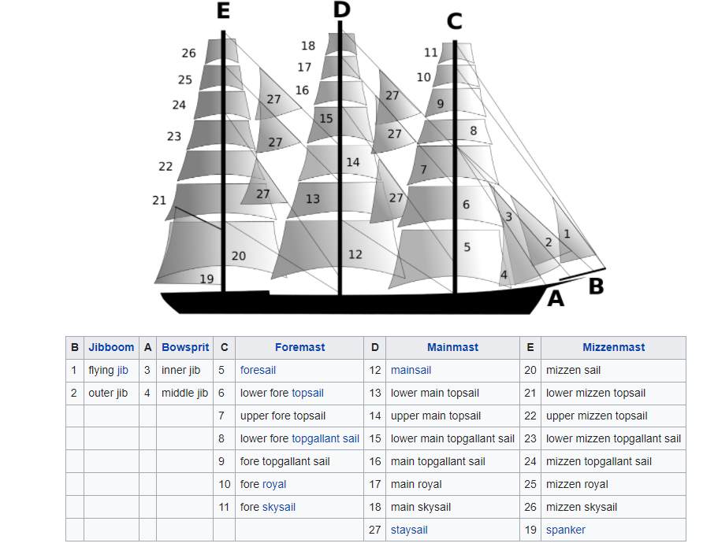

Slide 35
Roads since the XVII Century
Road renaissance
More mature economics (pre-industrial productions and increase in traffic)
Political control over territory of the new national States
Support for economic development via public works
Functions
Military
Postal
Short distance goods
Passangers on coaches

Slide 39
To summarize: Renaissance to Early Modern times technology
Technologies
Sea transport: oar ships, square-rig ships, lateen sail (against the wind), carracks and caravels for ocean navigation
Road transport: chariots and better roads, animals (horses and cows) and caravans
Energy sources
Animal traction
Wind
Innovation
Gun powder, bronze and metallurgy

Slide 41
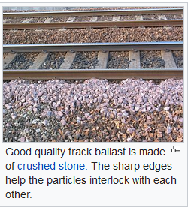
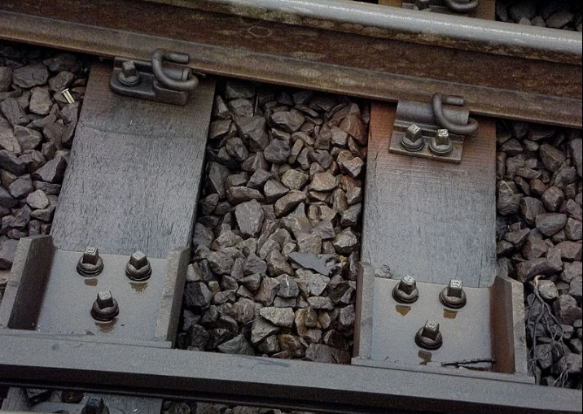
Technical features
rail vehicles (rolling stock)
Track ballast forms the trackbed upon which railroad ties (sleepers) are laid.
Friction is much reduced!
Track ballast (close up) between railway sleepers and under railway track

Slide 42
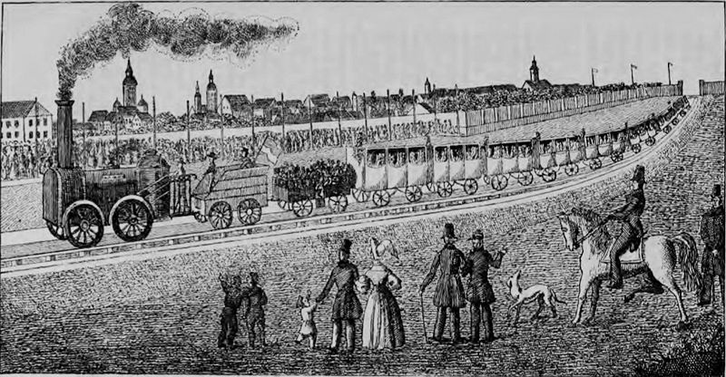
Although primitive rail systems existed by the 17th century to move materials in quarries and mines, it is not until the early 19th century that the first real rail transportation systems came into existence.

Slide 43
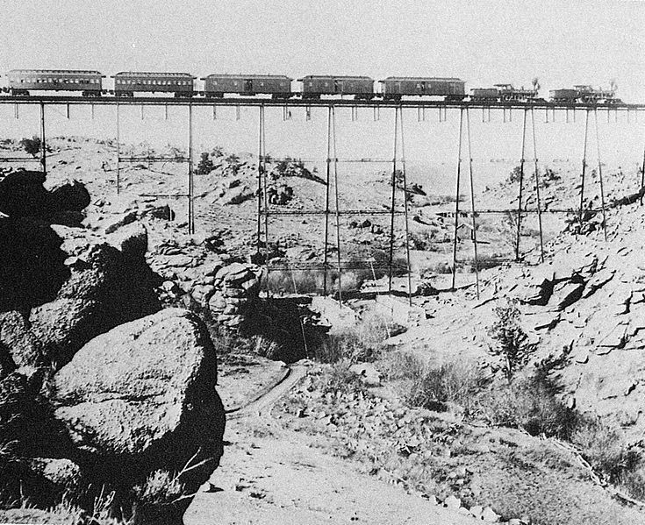
Un treno attraversa un ponte sulla linea transamericana, trainato da due locomotive di tipo 4-4-0 American (rodiggio Whyte) e con al seguito alcune carrozze Pullman. È il 1860.

Slide 45
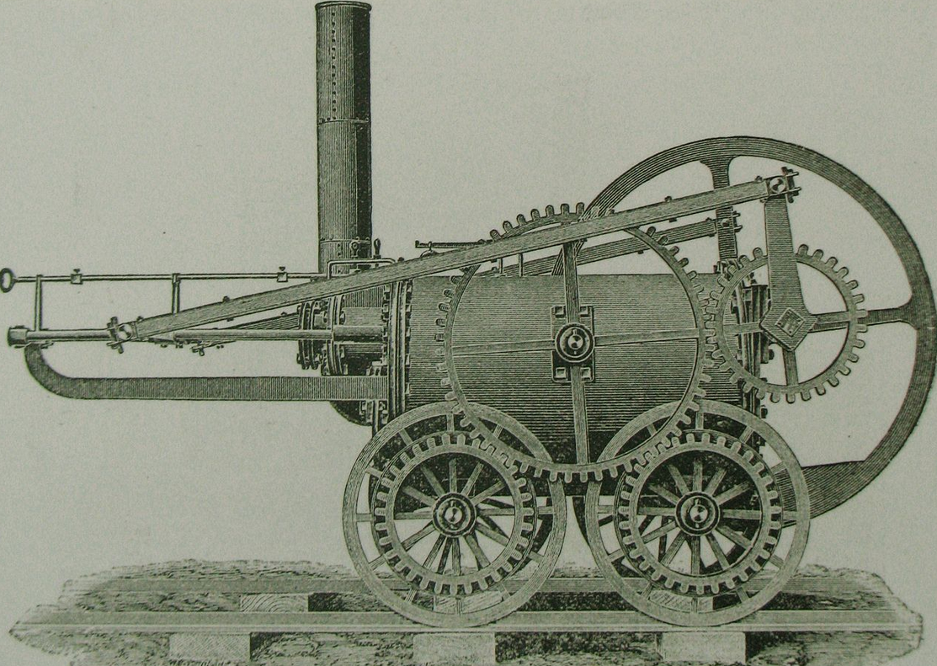
The locomotive
A locomotive or engine is a rail transport vehicle that provides the motive power for a train. A locomotive has no payload capacity of its own, and its sole purpose is to move the train along the tracks.
The first successful locomotives were built by Cornish inventor Richard Trevithick. In 1804 his unnamed steam locomotive hauled a train along the tramway of the Penydarren ironworks, near Merthyr Tydfil in Wales.

Slide 46
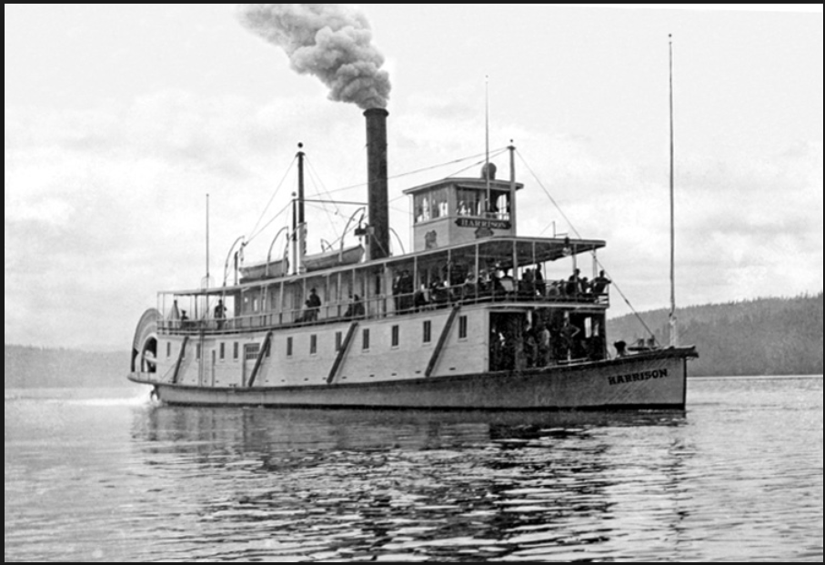
The steamboat
A steamboat is a boat that is propelled primarily by steam power. The term steamboat is used to refer to smaller, insular, steam-powered boats working on lakes and rivers, particularly riverboats. As using steam became more reliable, steam power became applied to larger, ocean-going vessels.
The first steam-powered ship Pyroscaphe was a paddle steamer powered by a Newcomen steam engine; it was built in France in 1783 by Marquis Claude de Jouffroy and his colleagues

Slide 48
To summarize: industrial revolution
Technologies
Rail transport: locomotives, trains, rails
Sea transport: steamboats
Road transport: bridges and tunnels
Energy sources
Animal traction
Wind
Coal
Innovation
Steel, cast-iron and other metals

Slide 49
Modern innovations: the car and the airplane

Slide 50
New engines
An electric motor is an electrical machine that converts electrical energy into mechanical energy. Most electric motors operate through the interaction between an electric motor's magnetic field and winding currents to generate force.
An Otto cycle is an idealized thermodynamic cycle that describes the functioning of a typical spark ignition piston engine. It is the thermodynamic cycle most commonly found in automobile engines.
the Diesel cycle is a combustion process of a reciprocating internal combustion engine. In it, fuel is ignited by heat generated during the compression of air in the combustion chamber, into which fuel is then injected. This is in contrast to igniting the fuel-air mixture with a spark plug as in the Otto cycle (four-stroke/petrol) engine. Diesel engines are used in aircraft, automobiles, power generation, diesel-electric locomotives, and both surface ships and submarines.

Slide 51
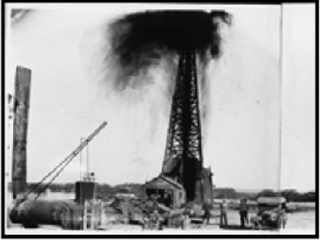
Oil
Oil as a fuel instead of coal and the oil industry (extraction, refinery, distribution)
Rubber tires
New roads: bituminous asphalt concrete paving

Slide 52
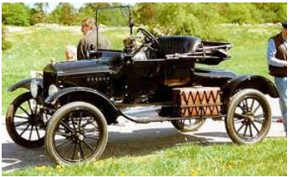
The car
The Ford Model T is an automobile produced by Ford Motor Company from October 1, 1908, to May 26, 1927. It is generally regarded as the first affordable automobile, the car that opened travel to the common middle-class American; some of this was because of Ford's efficient fabrication, including assembly line production instead of individual hand crafting.
Friction is not a problem: it is necessary for driving!

Slide 53
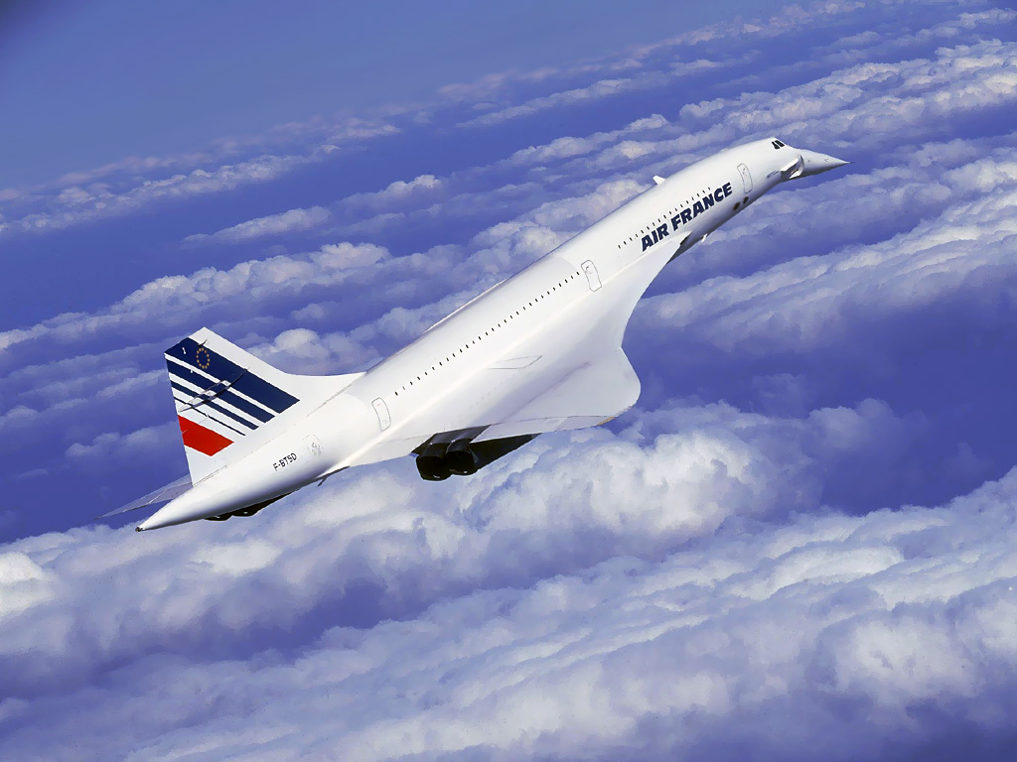
The airplane
Almost no friction!

Slide 54
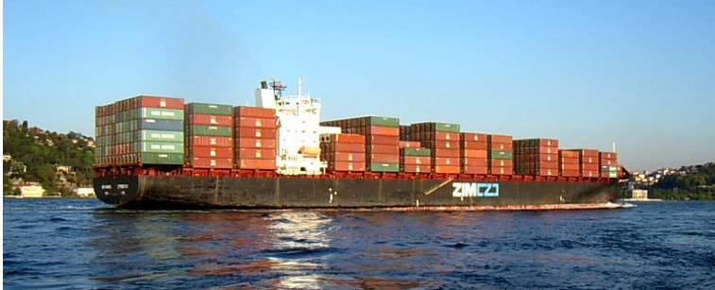
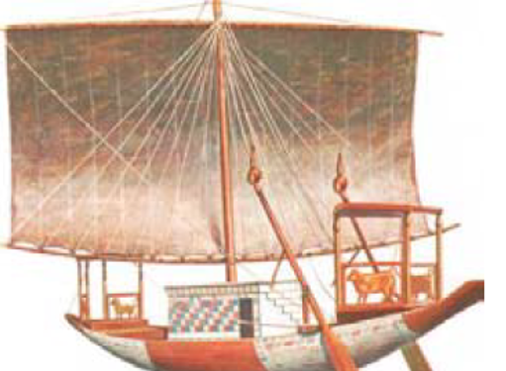
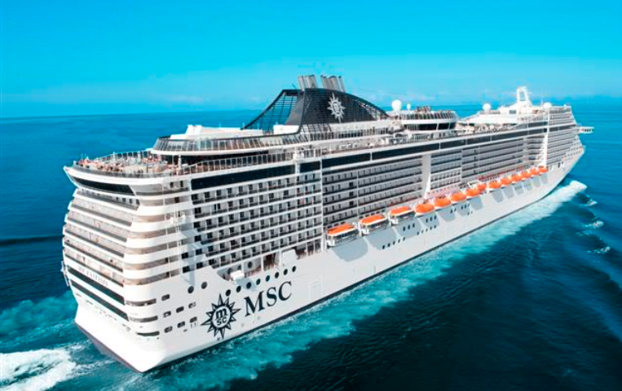
Tecnological evolution: see trasport

Slide 55
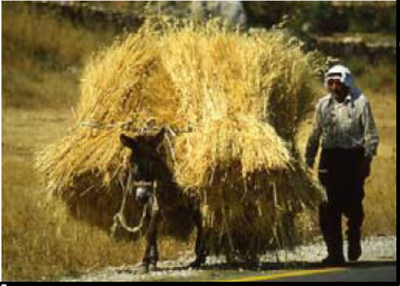
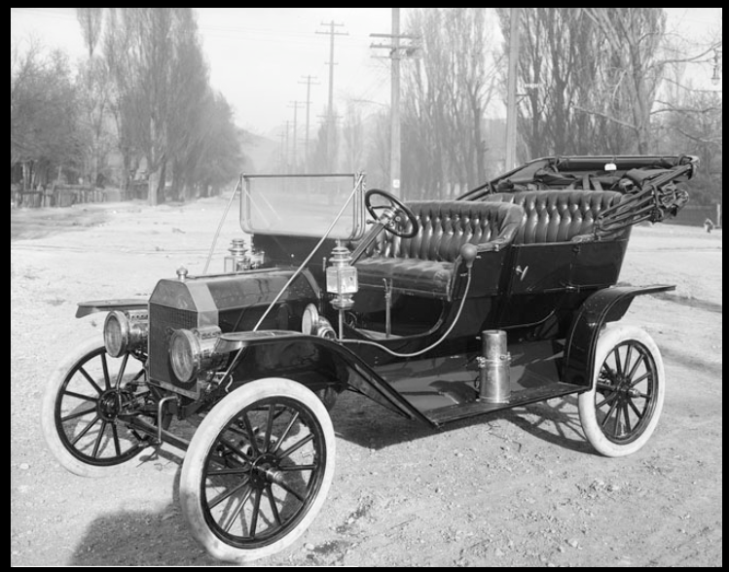
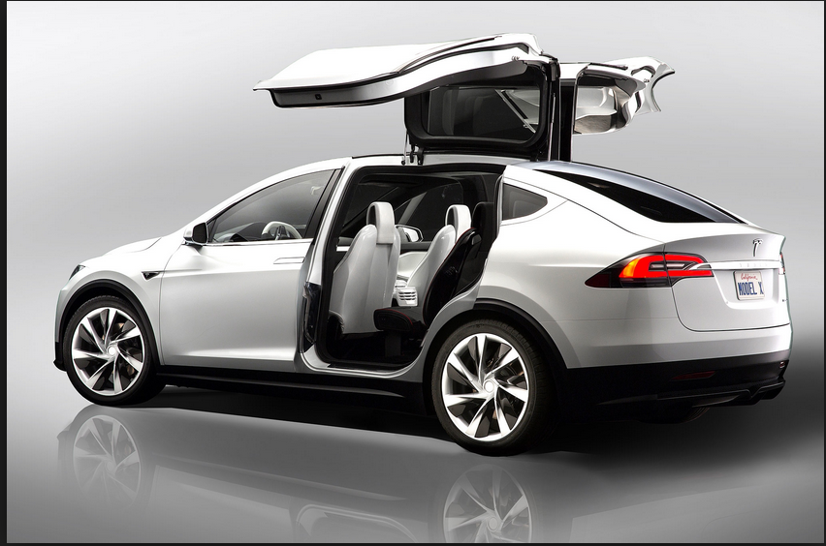
Tecnological evolution: road trasport

Slide 56
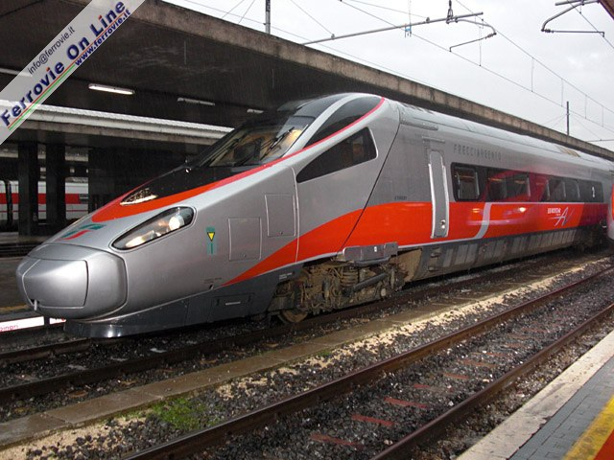
Tecnological evolution: rail trasport

Slide 57
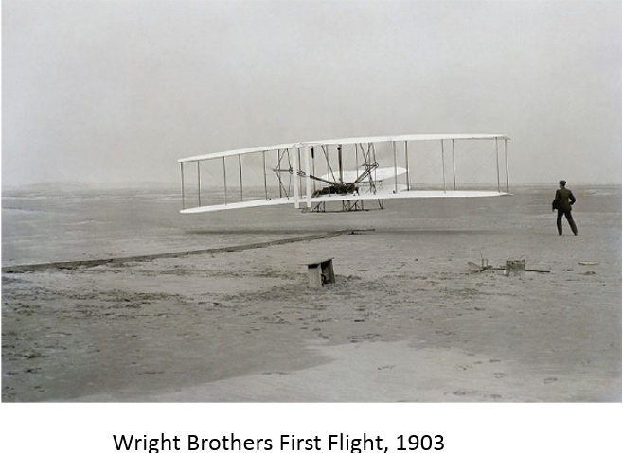
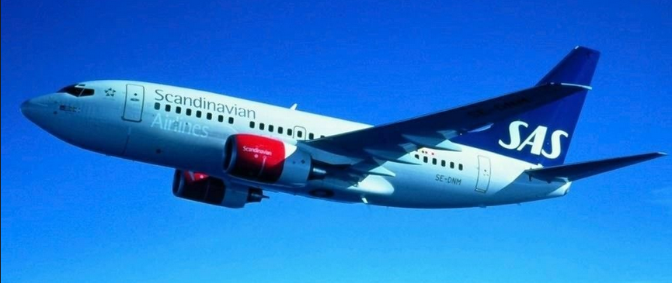
Tecnological evolution: air trasport

Slide 58
To summarize: modern times
Technologies
Rail transport: locomotives, high speed trains, magnetic trains
Sea transport: tankers, containerships
Road transport: cars and trucks
Air transport: airplanes
Energy sources
Oil (petrol, diesel)
Electricity (oil, coal, water, wind, solar, biomasses,..)
Innovation
Numerous in chemicals, metals, electronics, informatics

Slide 59
Major impacts
On land use:
Peoples’ and firms’ localization is not determined mainly by transport costs
Manufacturing activities, commercial activities and residential activities can be spatially separated
On the economy
Vehicles and infrastructure construction as a leading industrial sectors
People and goods mobility as determinants of economic change
On the society
People mobility as determinants of cultural change

Slide 60
Transport and industrial development
Means of transport
Infrastructure
Mining and chemicals
Construction
Mechanical, iron and steel industry
Elettrotechnics, elettronics, informatic industry

Slide 61
Transport and economic development
Transport activities
Market size and trade
Mobility of people
Globalization and product specialization
Economic development and transport costs reduction

Slide 62
Have a nice day!

