Slide 1
Rail transportation

Slide 2
Importance
Rail transportation refers to the movement on guideways (rails, also known as tracks), monorails, magnetic levitation).
Rail transportation has been the product of the industrial era, playing a major role in the economic development of Western Europe, North America and Japan
It represents a major improvement in land transport technology
This was not necessarily because of its capacity to carry heavy loads, since maritime transportation excelled at doing so, but because of its higher level of ubiquity and its speed.
Rail transport systems dramatically improved travel time as well as the possibility to offer reliable and consistent schedules that could be included in the planning of economic activities such as production and distribution.

Slide 3
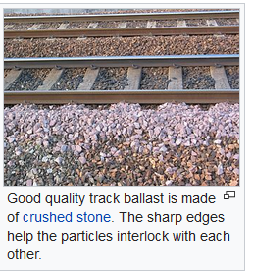
Technical features
rail vehicles (rolling stock)
Track ballast forms the trackbed upon which railroad ties (sleepers) are laid.

Slide 4
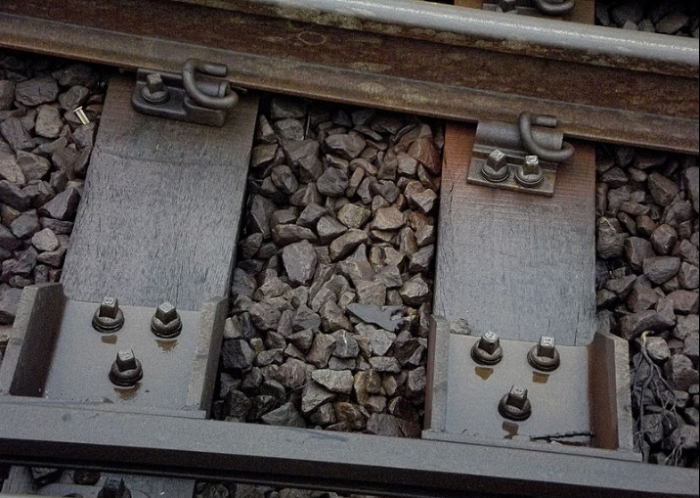
Track ballast
Track ballast (close up) between railway sleepers and under railway track

Slide 5
Passengers

Slide 6
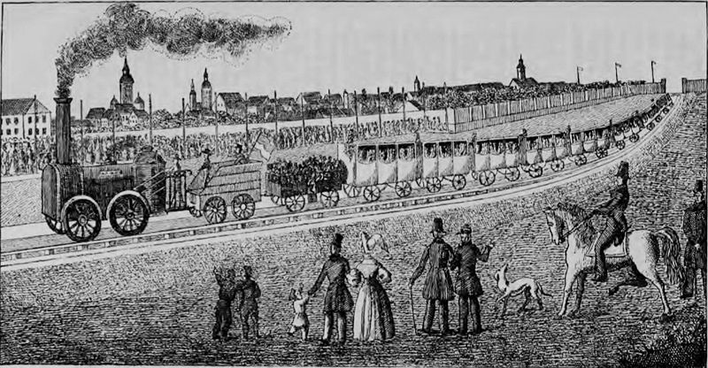
Although primitive rail systems existed by the 17th century to move materials in quarries and mines, it is not until the early 19th century that the first real rail transportation systems came into existence.

Slide 7
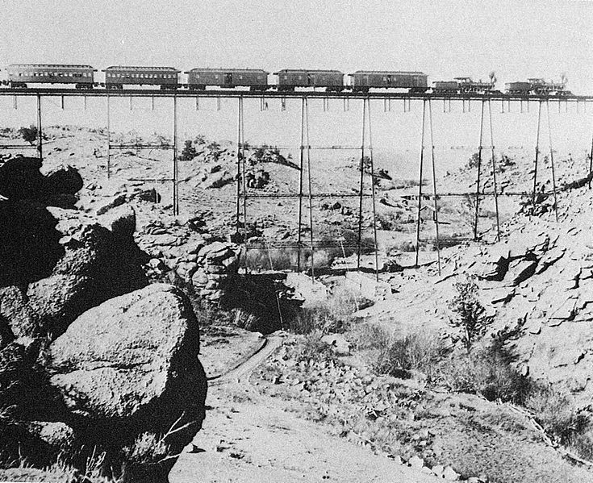
Un treno attraversa un ponte sulla linea transamericana, trainato da due locomotive di tipo 4-4-0 American (rodiggio Whyte) e con al seguito alcune carrozze Pullman. È il 1860.

Slide 8
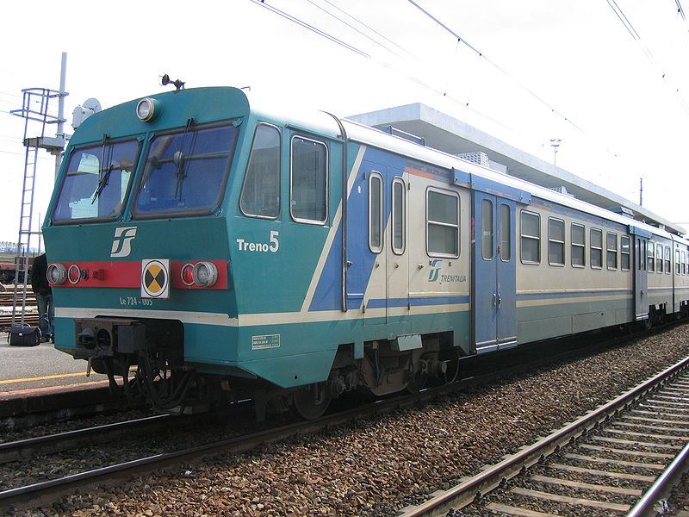

Slide 9
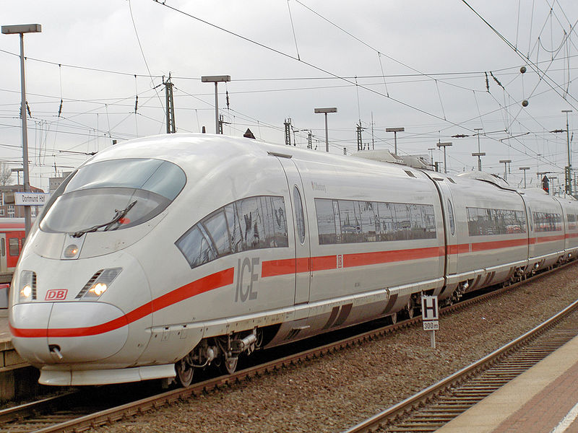
InterCityExpress - Germania

Slide 10
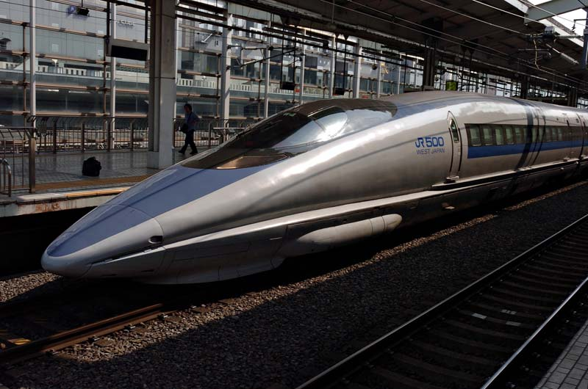
Shinkansen 500 series at Kyoto Station taken by Nick Coutts on 2005-03-19

Slide 11
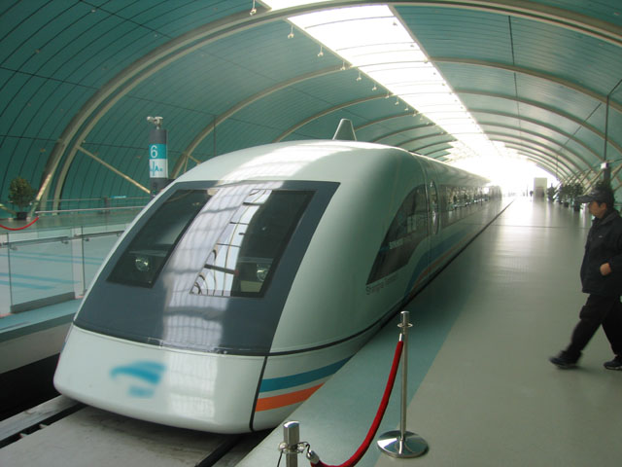
magnetic levitation train

Slide 12
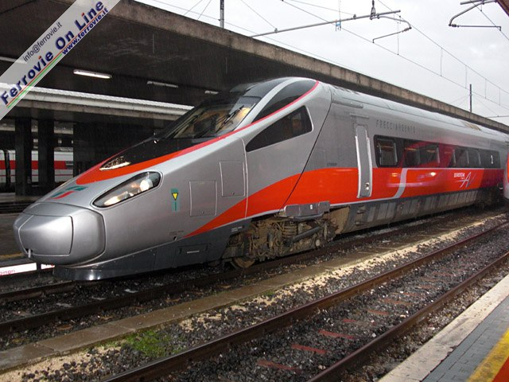
ETR 610

Slide 13
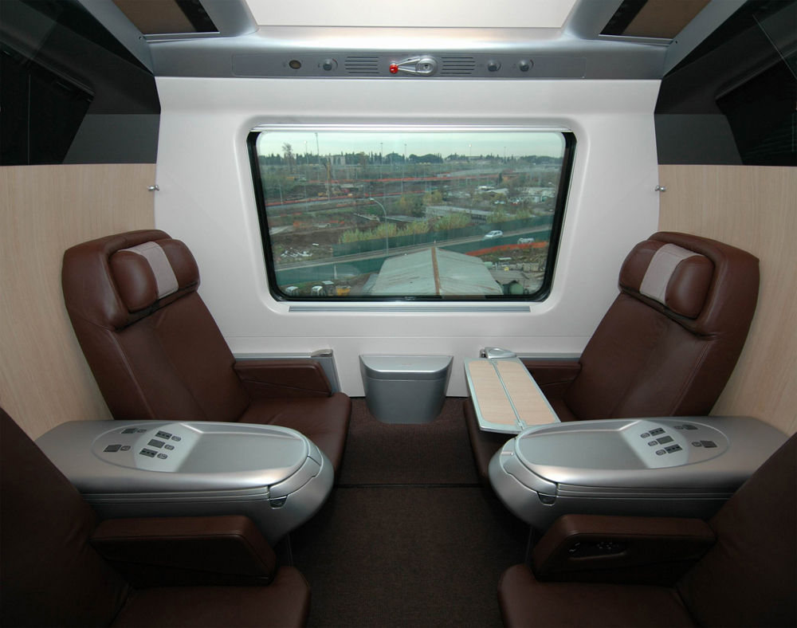

Slide 14
Freight

Slide 15
Freight railways structure
Factors that influence the capacity of the freight rail system:
ownership of tracks and rolling stock (private vs. public)
maximum train length
signaling equipment (level of automatization)
maintenance schedule
traffic mix (freight vs passenger)

Slide 16
Track gauge
The track gauge is the spacing of the rails on a railway track and is measured between the inner faces of the load-bearing rails.
They are heterogeneous across jurisdictions since because of historical and political reasons, different nations and regions have adopted different gauges. The standard gauge of 1.435 meters has been adopted in many parts of the world, across North America and most of Western Europe for example. It accounts for about 60% of the railways. But other gauges have been adopted in other areas, such as the broad gauge (1.520 meters) in Russia and Eastern Europe accounting for about 17% of the railways. This makes the integration of rail services complex, since both freight and passengers are required to change from one railway system to the other. As attempts are being made to extend rail services across continents and regions, this is an important obstacle, as for example between France and Spain, Eastern and Western Europe, and between Russia and China. The potential of the Eurasian land bridge is impaired in part by these gauge differences.

Slide 17
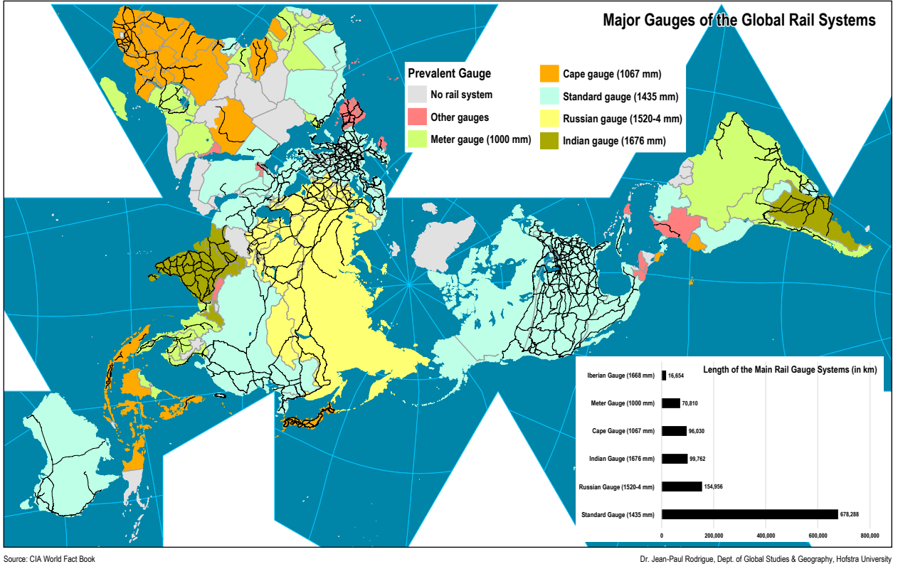
https://transportgeography.org/?page_id=1771

Slide 18
Traction
The locomotion technology ranges from steam (almost abandoned), to diesel (mainly for freight in the United States) and electric (mainly for passengers in Europe). More recently, hydrogen is used to fuel trains.

Slide 19
Vehicles
Rail transportation is very flexible in terms of vehicles and there is a wide variety of them filling different purposes.
Among the most common vehicle assets are open wagons (hopper cars) used for bulk cargo (e.g. minerals), box cars to carry general and refrigerated goods, and tank cars to carry liquids.
Intermodal transportation has also permitted the development of a new class of flat railcars that can carry containers and trailers (less common).
The recent trend has been towards a specialization of freight wagons, such as hopper wagons (grain, potash and fertilizers), triple hopper wagons (sand, gravel, sulfur and coal), flat wagons (wood, agricultural equipment, manufactured goods, containers), tanker wagons (petrochemical products), box wagons (livestock, paper, manufactured goods, refrigerated goods), car wagons.

Slide 20
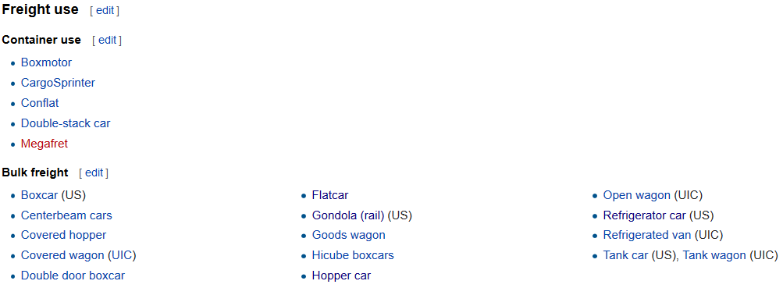
List of railway vehicles
https://en.wikipedia.org/wiki/List_of_railway_vehicles

Slide 21
Carri per il trasporto di merci
Esistono normalmente nelle versioni a 2, a 3 e a 4 assi con la stessa tipologia ma portata diversa.
Carro per merce varia
Carro aperto tipo K
Carro per merce lunga, aperto in alto, eventualmente accessoriato con sponde di varia altezza o con piantoni fermacarico.
Carro a temperatura controllata tipo "INTERFRIGO".
Carro a tramoggia.
Carro cisterna
Carro silo. Come per il precedente ma per merci polverose e granulari, anche in questo caso, per la maggior parte, di proprietà privata.
Carro bisarca
Carro porta-container
Carro ultrabasso.
Carro siluro o carro siviera. Contenitori a forma allungata rivestiti internamente di materiale refrattario, all’interno dei quali viene colata la ghisa fusa per il trasferimento in acciaieria.

Slide 22
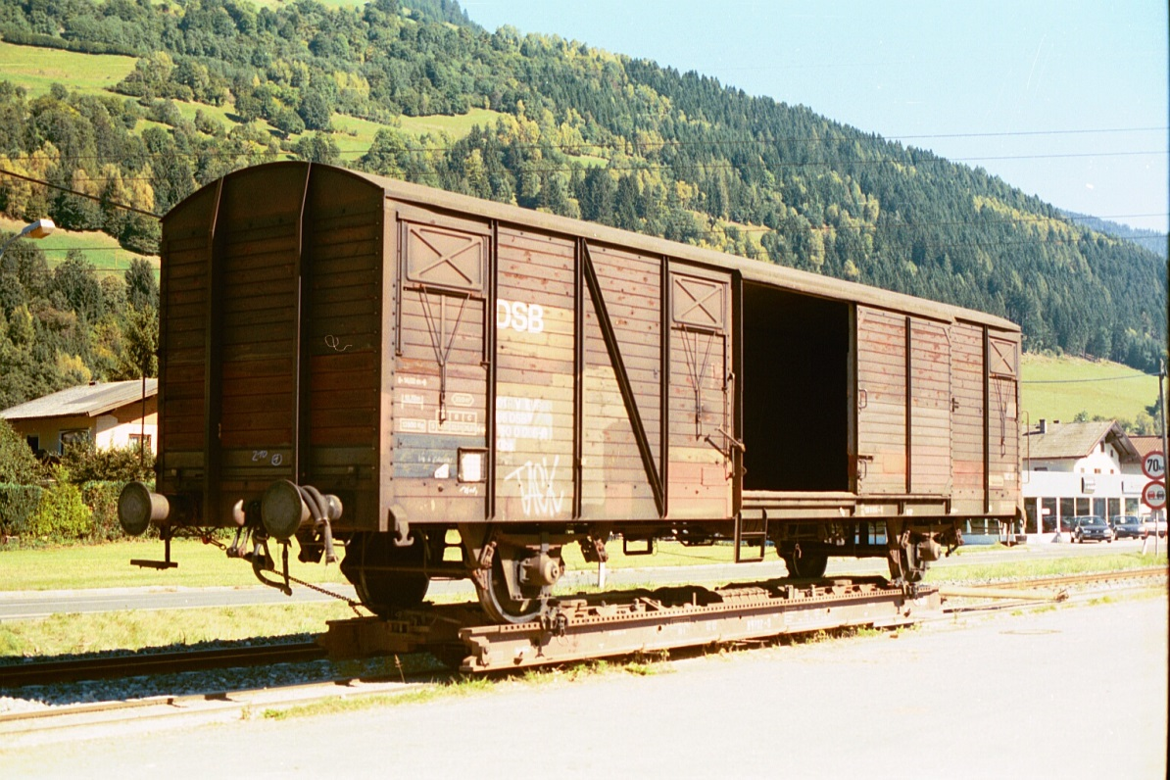
Boxcar
A boxcar is a North American railroad car that is enclosed and generally used to carry freight. The boxcar, while not the simplest freight car design, is probably the most versatile, since it can carry most loads. Boxcars have side doors of varying size and operation, and some include end doors and adjustable bulkheads to load very large items.
Carro per merce varia, chiuso, con porte laterali di carico e scarico. È il carro ferroviario per antonomasia e contemporaneamente quello da più tempo in circolazione; nella sua versione più grande a 4 assi ha una lunghezza di circa 20 m, una superficie di carico utile di 53 m², un volume che raggiunge i 135 m³ ed una portata netta che può arrivare ai 50.000 kg. Recentemente hanno cominciato a diffondersi anche i vagoni con pareti laterali scorrevoli in sostituzione delle porte centrali fisse, migliorando la capacità di carico e scarico delle merci su pallet.

Slide 23
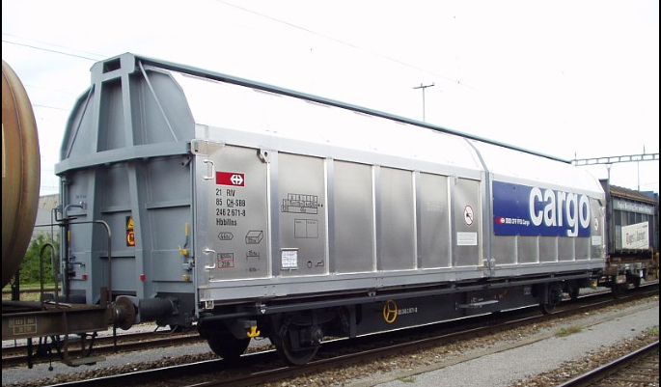
Covered goods wagon
Swiss (SBB) Hbbillns sliding wall wagon, a present-day standard for palettised goods with lockable and movable partitions

Slide 24
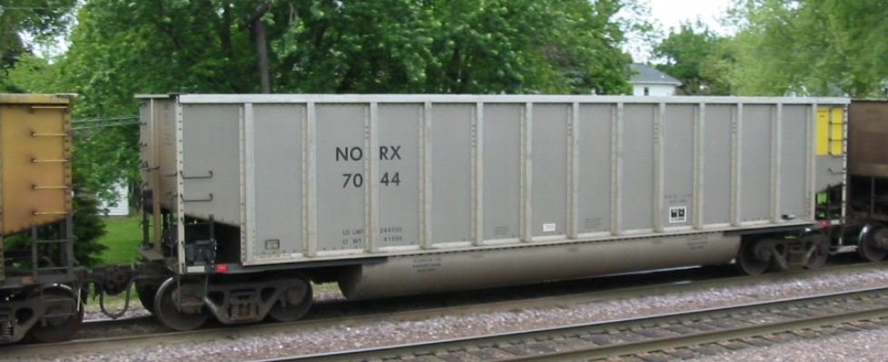
Gondola Car
A gondola is an open-topped rail vehicle used for transporting loose bulk materials. Because of their low side walls gondolas are also suitable for the carriage of such high-density cargos as steel plates or coils, or of bulky items such as prefabricated sections of rail track.

Slide 25
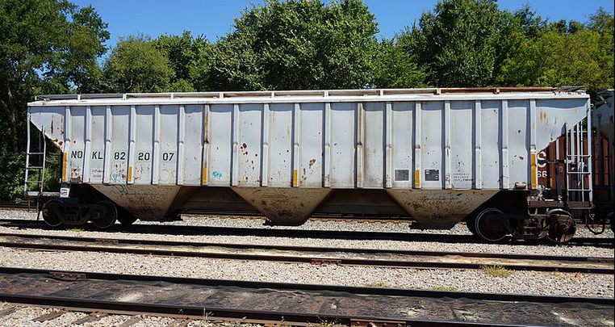
Hopper car
A hopper car is a type of railroad freight car used to transport loose bulk commodities such as coal, ore, grain, and track ballast. Two main types of hopper car exist: covered hopper cars, which are equipped with a roof, and open hopper cars, which do not have a roof. This type of car is distinguished from a gondola car in that it has opening doors on the underside or on the sides to discharge its cargo. The development of the hopper car went along with the development of automated handling of such commodities, with automated loading and unloading facilities.
Covered hopper cars are used for bulk cargo such as grain, sugar, and fertilizer that must be protected from exposure to the weather. Open hopper cars are used for commodities such as coal, which can suffer exposure with less detrimental effect. Hopper cars have been used by railways worldwide whenever automated cargo handling has been desired.

Slide 26
covered hopper
A covered hopper is a railroad freight car designed for carrying dry bulk loads, varying from grain to products such as sand and clay.

Slide 27
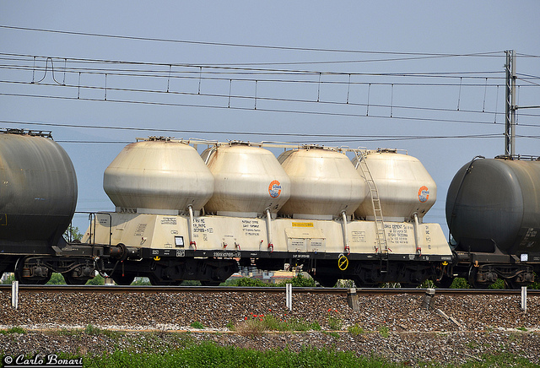
Carro silo. Come per il precedente ma per merci polverose e granulari, anche in questo caso, per la maggior parte, di proprietà privata.

Slide 28
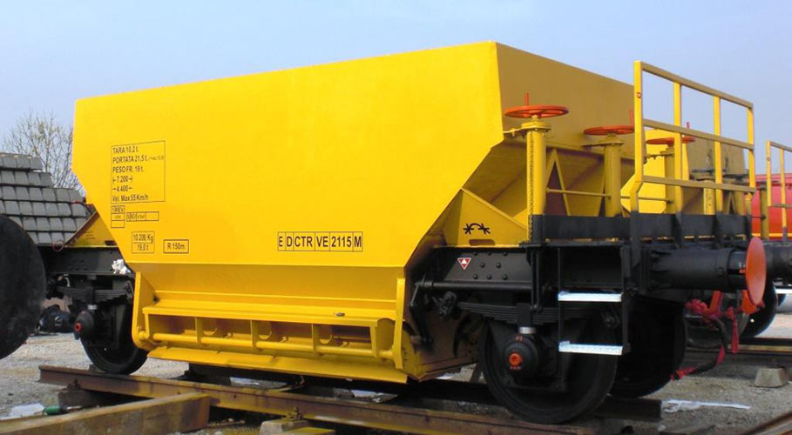
Carro a tramoggia. Consente il carico di merci sfuse dall'alto e il loro scarico tramite ribaltamento laterale del vagone stesso. Viene utilizzato per il trasporto di materie prime come ad esempio il carbone.

Slide 29
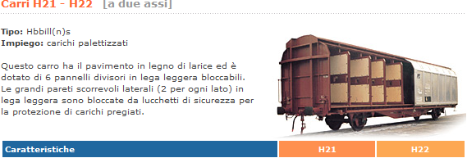

Slide 30
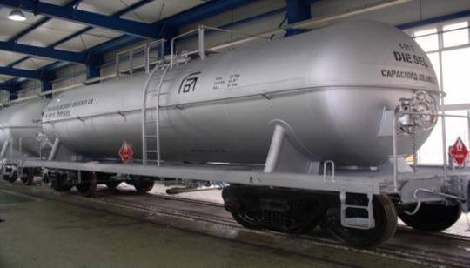
Tank car
A tank car (International Union of Railways (UIC): tank wagon) is a type of railroad car (UIC: railway car) or rolling stock designed to transport liquid and gaseous commodities.
Carro cisterna. Adatto al trasporto di merci liquide, il cui esempio più classico è quello relativo ai derivati del petrolio, è fornito di appositi bocchettoni per il carico nella parte superiore e di uno o più scomparti divisori interni. La maggior parte dei vagoni di questo tipo è di proprietà privata essendo progettati per il trasporto di uno specifico tipo di materiale difficilmente compatibile con altri.

Slide 31
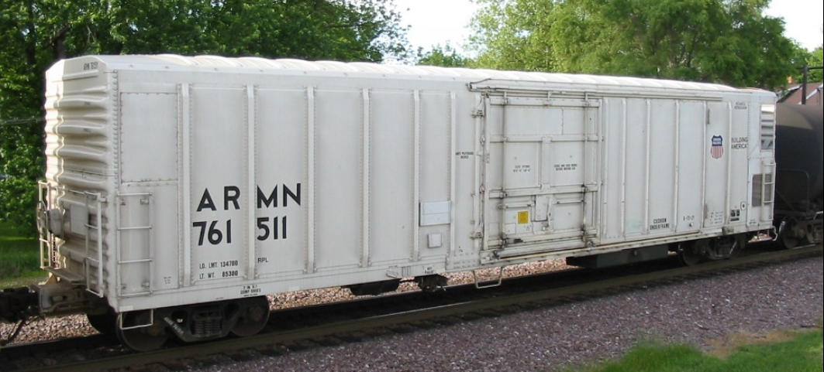
Refrigerator car
A refrigerator car (or "reefer") is a refrigerated boxcar (U.S.), a piece of railroad rolling stock designed to carry perishable freight at specific temperatures. Refrigerator cars differ from simple insulated boxcars and ventilated boxcars (commonly used for transporting fruit), neither of which are fitted with cooling apparatus.

Slide 32
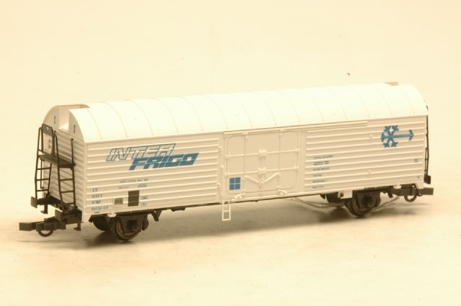
Carro a temperatura controllata tipo "INTERFRIGO". Fornito di appositi compressori e grazie alle pareti coibentate consente di controllare la temperatura interna durante il trasporto, evitando di interrompere la catena del freddo nel caso di trasporti alimentari, oppure di evitare il gelo ai materiali ad esso sensibili durante i mesi più freddi dell'anno.

Slide 33
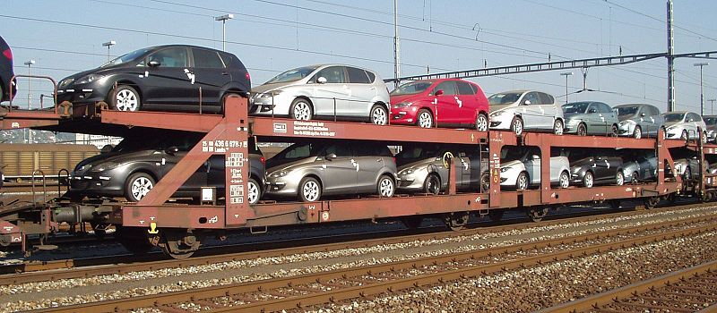
Autorack
An autorack, also known as an auto carrier (also car transporter outside the US), is a specialized piece of railroad rolling stock used to transport automobiles and light trucks. Autoracks are used to transport new vehicles from factories to automotive distributors, and to transport passengers' vehicles in car shuttles and motorail services
Carro bisarca (per trasporto di auto). È in genere a 3 assi e formato da due livelli di carico, accessoriato con rampe alle estremità per consentire un agevole carico e scarico. Anche questo tipo di vagoni è normalmente posseduto da aziende specializzate in questo tipo di trasporto.

Slide 34
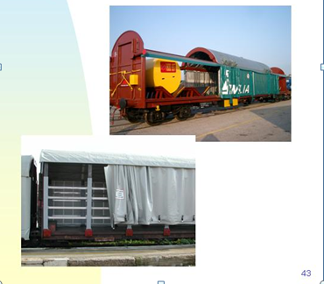
Rail cars for pallets

Slide 35
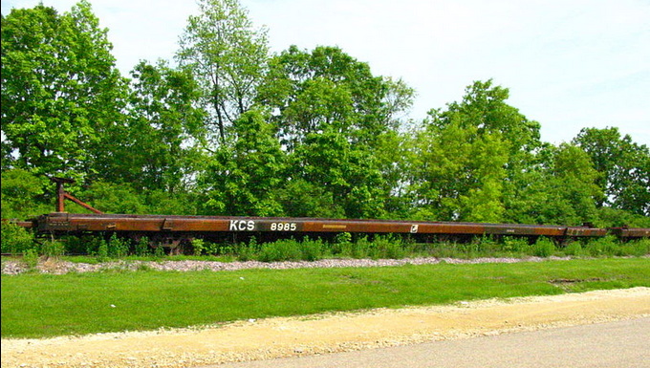
Flatcar
A Florida East Coast Railway flatcar carries two shipping containers
Flatcars are used for loads that are too large or cumbersome to load in enclosed cars such as boxcars. They are also often used to transport intermodal containers (shipping containers) or trailers as part of intermodal freight transport shipping.
Carro porta-container. È un vagone fornito di semplice piano di appoggio ma con agganci specifici per i container. Utilizzato per il trasporto intermodale.

Slide 36
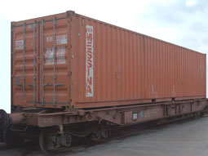
Flatcar

Slide 37
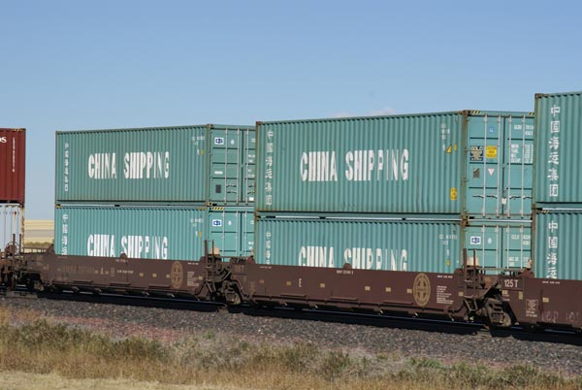
A well car, also known as a double-stack car or stack car
the usage of double-stack cars has revolutionized rail transportation with additional fuel efficiency and cost reductions of about 40%.

Slide 38
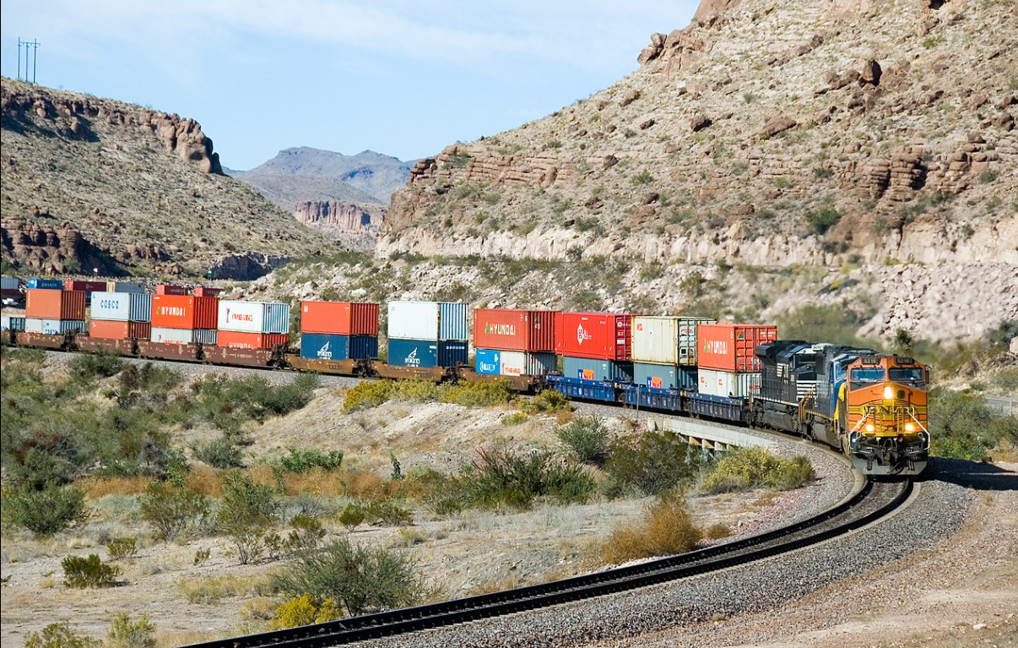
Train in Arizona, with 20-, 40- and-53 foot containers double stacked in well cars

Slide 39
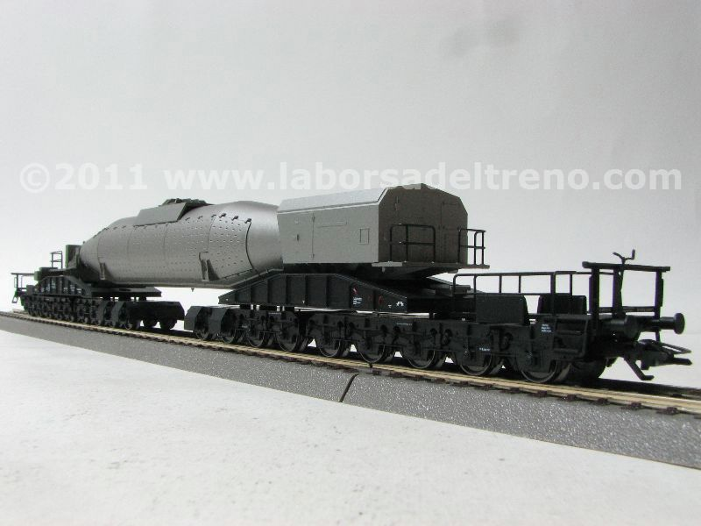
A car to carry special weapons (DB Krupp)

Slide 40
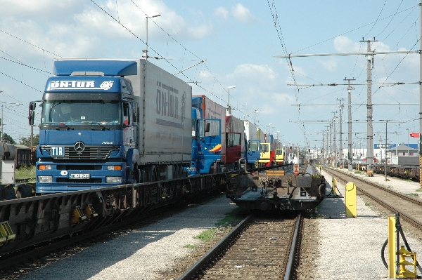
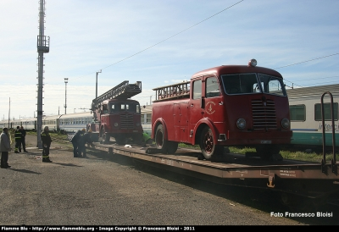
Rolling highway
In rail transportation, a rolling highway, or rolling road is a form of combined transport involving the conveying of road trucks by rail, referred to as Ro-La trains. The concept is a form of piggyback transportation.
Carro ultrabasso. Utilizzato per il trasporto di autosnodati, o autotreni con rimorchio, le cosiddette autostrade viaggianti, ha carrelli di 4 assi ciascuno ed è equipaggiato con ruote di diametro ridotto onde ottenere un piano di carico molto più basso rispetto agli altri tipi di vagoni il che permette di trasportare gli autocarri rientrando nei limiti di sagoma prescritti.

Slide 41
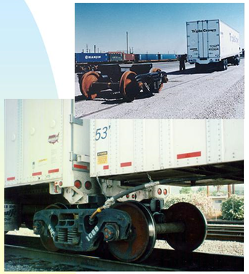
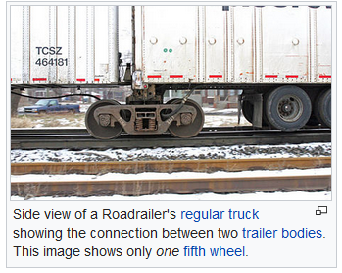
RoadRailer
In railroad terminology a Roadrailer or RoadRailer is a highway trailer, or semi-trailer, that is specially equipped for use in railroad intermodal service.

Slide 42
Block train
A block train is a freight train that runs as a unit from the loading point to the unloading point without intermediate stops. This is referred to as a point-to-point traction service.
Un treno blocco è un treno merci che viaggia dal punto di carico a quello di scarico come unità senza fermate intermedie, in questo caso si parla di servizio di trazione da punto a punto.

Slide 43
Statistical evidence of freight rail transport use and competiveness

Slide 44
Evidence from Italian data: rail transportation is mostly used to transport heavy, bulky, low value goods

Slide 45
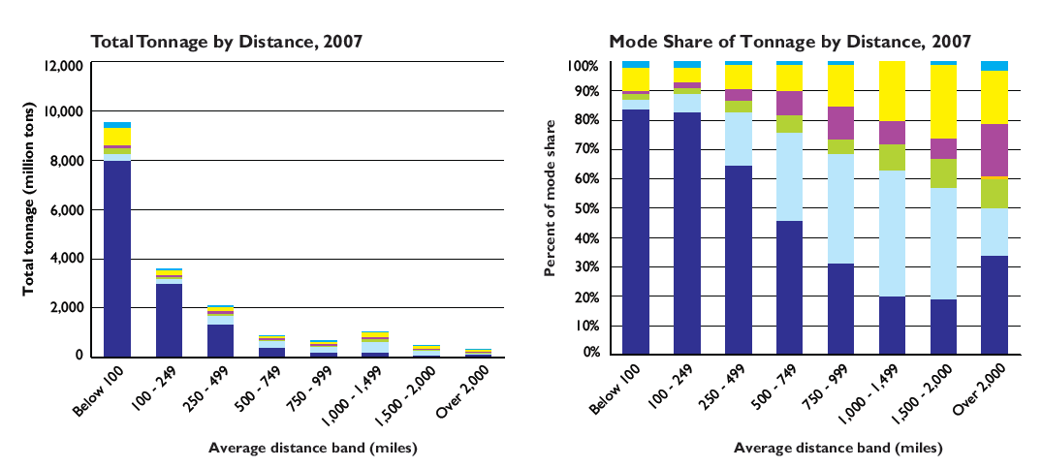
Freight railway transport in the USA
US statistics: Rail’s share increases with distance

Slide 46
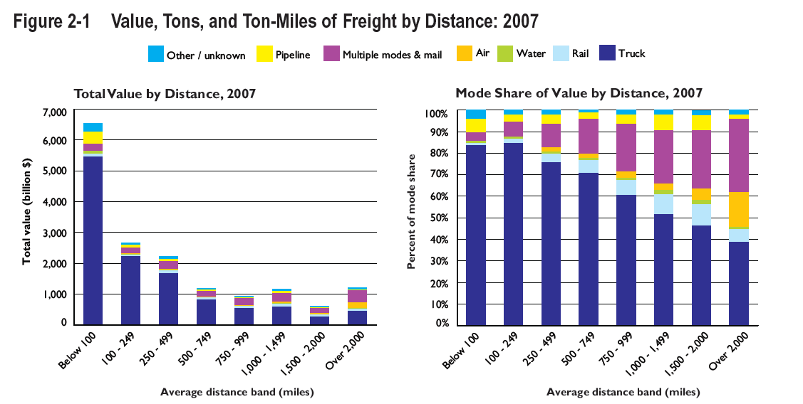
Freight railway transport in the USA
US statistics: Rail’s share increases with distance, but it carries lower value goods

Slide 47
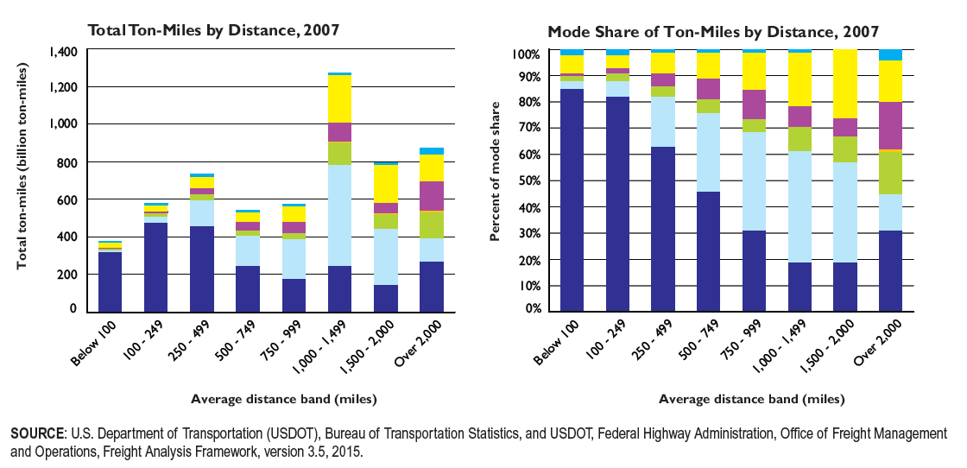
Freight railway transport in the USA
US statistics: Rail’s share increases with distance and it carries heavier goods

Slide 48
Advantages and disadvantages of rail transport relative to road transport for inland shipments: a discussion

Slide 49
Rail’s technical advantages: energy efficiency, loading capacity, safety
Rail transport is capital-intensive but very energy-efficient. The tracks provide smooth and hard surfaces on which the wheels of the train can roll with a minimum of friction.
Metal wheels on metal rails have a significant advantage of overcoming resistance (in pounds or Newtons) compared to rubber-tired wheels on any road surface: railway - 0.001g at 10 mph and 0.024g at 60 mph; truck - 0.009g at 10 mph and 0.090 at 60 mph.
In terms of motion power (horsepower/weight ratio), a slow-moving barge requires 0.2 hp/net ton,a railway and pipeline require 2.5 hp/net ton, while a truck requires 10 hp/net ton. However, at higher speeds, a railway overcomes the barge and proves most economical.
Trains have a small frontal area in relation to the load they are carrying, which reduces air resistance and thus energy usage.
Other technical advantages:
The track distributes the weight of the train evenly, allowing significantly greater loads per axle and wheel than in road transport, leading to less wear and tear on the permanent way.
In addition, the presence of track guiding the wheels allows for very long trains to be pulled by one or a few engines and driven by a single operator, even around curves, which allows for economies of scale in both manpower and energy use; by contrast, in road transport, more than two articulations causes fishtailing and makes the vehicle unsafe.

Slide 50
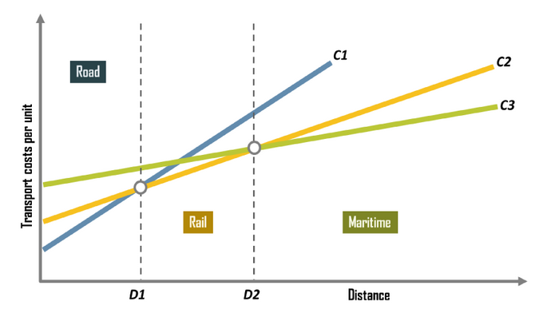
The traditional Hoover diagram: fixed and variable cost difference among modes
Rail is supposed to have higher fixed costs than road but lower than maritime transport.
Rail is supposed to have lower variable costs with distance than road but higher than maritime transport.
As a results, rail is competitive for shipments longer than D1 and shorter than D2.
Note that costs are assumed to vary with distance only, disregarding the type of good transported, potential transshipment costs, the time and punctuality dimension, flexibility, social costs and so on.

Slide 51
Rail freight vs road freight transport: pros, cons and undecided aspects

Slide 52
Rail Freigt Transport: Pros
Historical role. Rail transportation accelerated the industrialization process. The construction of the rail infrastructure and the rolling stock spur industrial activities. Rail transportation had also multiplier effects on industrial activities. It spurred economic development and the diffusion of human settlements in inland locations.
Long distance shipments. Rail transportation is particularly competitive for long distance inland shipments. The average length of a domestic rail freight haul was 1,300 km in the United States, compared with 700 km for trucks.
Heavy, bulky and low value commodities. Due to its technical characteristics (energy efficiency, large number of railroad cars in a train, reasonable speed), Rail transportation enables the transport of raw materials (paper, wood, grain, chemicals, metallic products, cars, agricultural equipment, etc.). No other land transportation mode has the capacity of rail as a wagon can carry up to 100 tons of freight, more than three times that of a truck. Intermodal integration. Rail transportation loads\unload the large numbers of containers arriving at a port via container ships using services such as RO-LA\piggy back trains, container trains, block trains, double-stack trains.
Ports’ connection. Rail transportation provides an important link between ports and the hinterland (inland ports, logistic centers, intermodal centers).
Safety. Rail transportation is one of the more safest modes of transport, both for freight and passengers

Slide 53
Rail Freight Transporta: Cons
Construction and maintenance costs. Rail transport has high construction and maintenance costs.
Fixed and limited origin-destination point, instead of door-to-door service. The rail network is fixed and connects a limited number of points (stations). A road leg by truck might be needed from the location of the manufacturing firm to the departing station and from the arriving train station to the final destination. That adds cost and transport time.
Transshipments costs and time. Often goods need to be loaded and unloaded onto the train from\to another mode of transport (ship or truck). This not only increase costs and time, but also increases the risk of damage during the transshipment.
Flexibility (time to organize a shipment). Firms might require last minute, unplanned transport services. Road transport is believe to be easier and faster to organize than road transport.

Slide 54
Rail Freight Transportation: undecided, but crucial aspects for mode competition
Overall travel time of a shipment. Relative to road freight transport, the overall travel time of freight rail transport is usually higher on short to median distances, but it might be lower for long distance shipments (the truck driver is allowed to drive only a given number of hours than take a rest; he must sleep; the trucks are not allowed on week-ends). The road transport regulation impact the overall travel time for long distance trips.
Empty returns. It is generally be more difficult to avoid “empty returns” for road freight transport than for rail freight transport. It depends on the markets, type of goods and origin-destination pairs. Empty returns add to the overall transport costs.
Overall transport costs of a shipment:
a train need one (max two) train operator for a large number of train wagons; a truck carries a more limited load. Labor cost are an important cost component. Freight rail transport enjoys economies of scale, while road transport does not. As a result, for some goods and over longer distances, the cost of a freight rail transport service might be lower than that of a truck service.
over short to medium distance trips and for small-size shipments, the cost of using the service of a truck is usually lower.
The strong competition among road transport providers drives the price down. Freight transport operates in much less competitive environment (monopoly, oligopoly)

Slide 55
Statistics on rail freight modal share

Slide 56
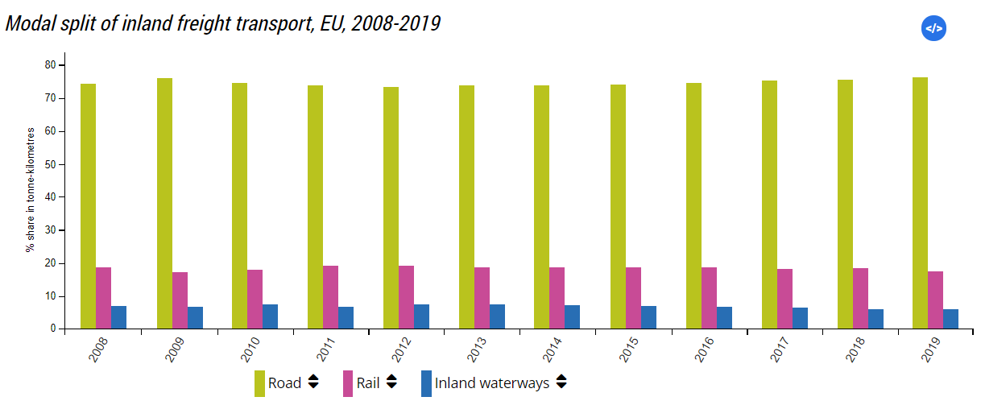
Rail’s modal share in Europe: less than 20 percent
In 2019, road freight transport accounted for 76.3 % of the total inland freight transport, followed by rail and inland waterways transport (17.6 % and 6.1 % respectively).
In 2019, Lithuania had the highest share of rail freight transport in total inland freight transport, with 74 %.
In 2019, the Netherlands had the highest share of inland waterways freight transport in total inland freight transport, with 43 %.
Road is the leading mode of freight transport at intra-EU level (53 %) followed by maritime transport (30 %) and rail transport (12 %).

Slide 57
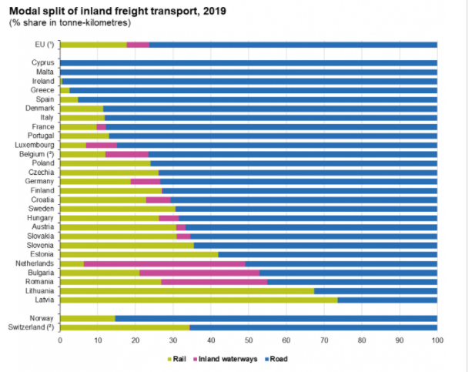
Rail’s modal share in European countries
Rail’s modal share varies by country: it is higher in Eastern European countries for historical reasons and depending on truck availability…

Slide 58
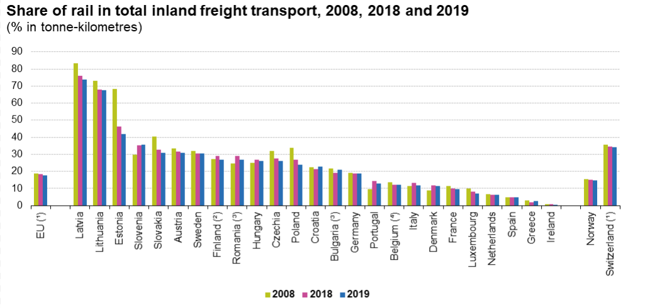
….but loosing market share also and especially in Eastern European countries

Slide 59
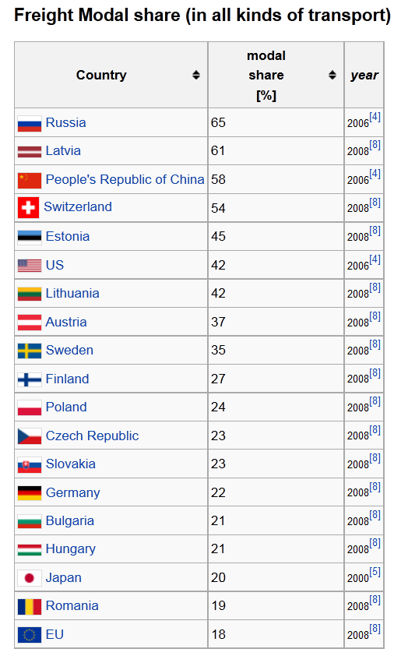
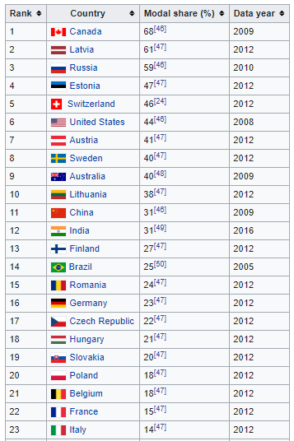
International statistics

Slide 60
Rail treight transport modal split in selected countries based on OECD statistics (my estimates based on the indicator tonnes-kilometres)
The size of the country matters!
The larger the country, the longer the shipment distances, the more convenient rail transport becomes, especially for heavy goods!
Tonnes-kilometres, Millions
PS. The estimates for Italy and the US coincide with other statistical sources. The estimate for the Russian Federation might be overestimated

Slide 61
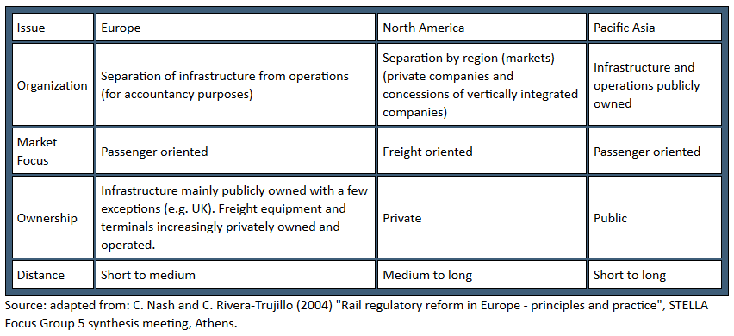
The institutional arrangement of the rail sector varies by country: comparison between European, North American and Pacific Asian Railways

Slide 62
Impact of road competition on the economics of rail
Since the end of the 1950s, railway systems in advanced economies have faced an increasing competition from road transport, with varying results.
In most instances, the breakeven distance (that is a threshold above which rail becomes competitive with respect to road), changed to the advantage of road transport.
Currently, the breakeven distance between intermodal rail and truck is estimated between 600 and 800 miles (950 and 1,300 km). Under 500 miles (800 km), drayage costs from the terminal usually account for 70% of total costs.
The rail’s loss of market share lead many rail freight operators to financial distress. Governments had to step in to save the rail freight operators from bankruptcy.

Slide 63
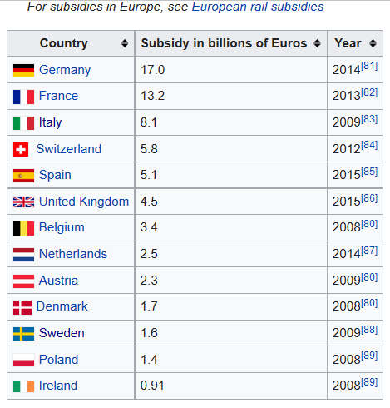
State subsidies
Rail transportation used to be highly dependent from government subsidies in several countries. Governments funded most rail projects, mainly for the sake of national economic imperatives. This has created several rail monopolies with an integrated management of infrastructure, but with several imposed routes. However, many rail systems underwent deregulation with private operators since it became harder and harder to sustain the subsidies weight in the public budgets.

Slide 64
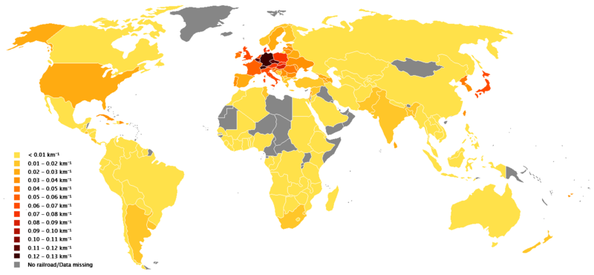
Rail network divided by area of country: not all countries have a dense rail network!

Slide 65
Passenger rail transport: an international comparison Video on China’ high speed trains https://www.youtube.com/watch?v=0JDoll8OEFE

Slide 66
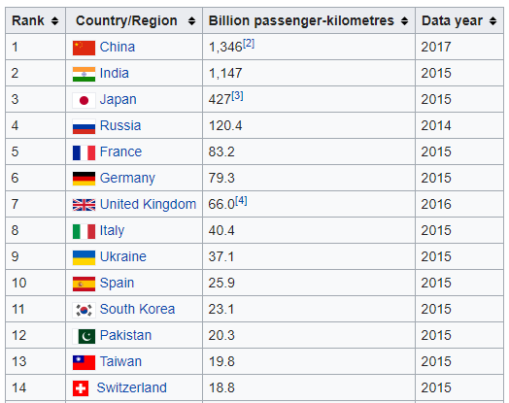
Passenger-kilometres of rail transport per year

Slide 67
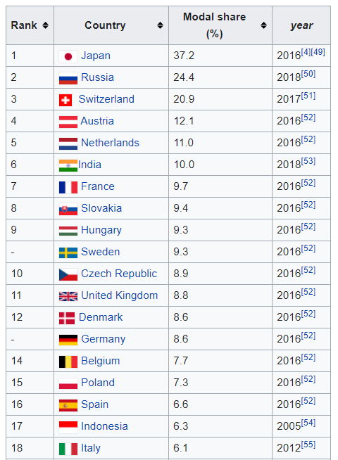
Passenger modal share for rail
https://en.wikipedia.org/wiki/List_of_countries_by_rail_usage

Slide 68
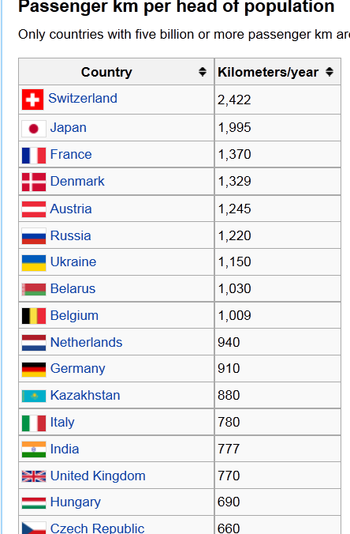
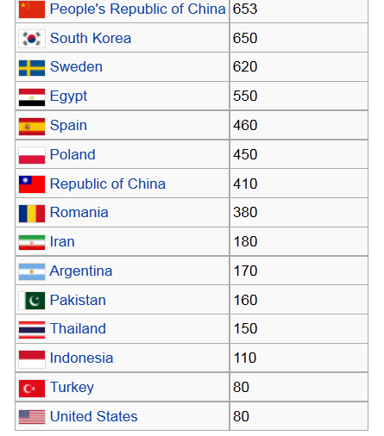

Slide 69
Modal split of rail passenger transport in Europe in 2019
Country | %
Switzerland | 20
Austria | 12.9
Netherlands | 11.3
Sweden | 10.5
France | 10.4
Slovakia | 10.2
Czechia | 9.9
Germany | 9.4
United Kingdom | 8.5
Belgium | 8.4
Hungary | 8.3
Denmark | 8.2
European Union - 28 countries (2013-2020) | 8.1
European Union - 27 countries (from 2020) | 8
Poland | 7.3
Spain | 7.1
Italy | 6.3
Finland | 6.2
Norway | 4.9
Luxembourg | 4.8
Portugal | 4.6
Romania | 4.2
Latvia | 3.4
Ireland | 3.3
Turkey | 3.3
Croatia | 2.4
Bulgaria | 2.2
Estonia | 2.2
Slovenia | 1.8
Montenegro | 1.2
Greece | 1
Lithuania | 1
Serbia | 0.7
North Macedonia | 0.6
Cyprus | na
Malta | na
Iceland | na
Switzerland stands out with 20%. Austria follows at a distance

Slide 70
Rail transport in Italy
The rail network
Passengers
Freight

Slide 71
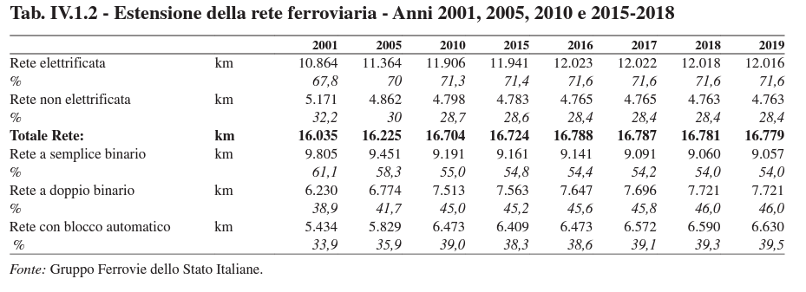
The rail network in Italy: stable

Slide 72
Rail’s traffic: declining

Slide 73
Do people use more the bus or the train for the intercity travel? Bus

Slide 74
The large majority of the trains compete in the market

Slide 75
Public investments per mode of transport: mostly to road construction and maintenance

Slide 76
The Ferrovie dello Stato Italiane (FSI) group

Slide 78
History
Ferrovie dello Stato Italiane S.p.A. (previously Ferrovie dello Stato, FS) (in English Italian State Railways) is a government-owned holding company that manages infrastructure and services on the Italian rail network. One of the subsidiaries of the company, Trenitalia, is the main rail operator in Italy.
Ferrovie dello Stato (State Railway) was instituted by an act on 22 April 1905, taking control over the majority of the national railways, which were private until then. The president was nominated by the government.

Slide 79
History
With the rise of Fascism, a centralization policy was carried out. The board of directors and chief administrator office were abolished at the end of 1922. The institution was administered by a commissioner, appointed by the King until April 1924. Since then, Ferrovie dello Stato was managed by the newly born Ministry of Communications (including rail transport), under Costanzo Ciano.
At the end of 1944, the Ministry of Communications was split and the new Ministry of Transport was created, including the general management of Ferrovie dello Stato, and in 1945, the company was renamed Azienda Autonoma delle Ferrovie dello Stato.

Slide 80
History
The period after World War II was particularly tough for Ferrovie dello Stato, since most of the Italian rail network was severely damaged and the rolling stock was obsolete. The network was rebuilt almost entirely by 1952. Since then, a period of renewal started. New trains were introduced, among them the ETR 300, and many sections of the national network were electrified and sometimes doubled.
The newly born Ferrovie dello Stato underwent major structural transformations between 1986 and 1992. The workforce was reduced to half: from 216,310 employees in 1988 to 112,018 in 1999. Divisions were created to rationalize the management.
The company was privatized in 1992 with the creation of the new Ferrovie dello Stato SpA, a joint-stock company, following a European guideline. However, the privatization was only formal, since shares were still owned by the Italian Government.

Slide 82
the mission statement
With the new 2017-2026 Industrial Plan, the FS Group has renewed and strengthened its ambition to carry out works and transport services which can create value for the community in a lasting way, redefining the sector in an intermodal way.
The new strategy which looks to invest 94 billion euros in ten years, works on the basis of five key areas:
integrated mobility, including the involvement of all sector operators;
integrated logistics, with a radical reorganisation of the goods area;
integration between both rail and road infrastructure;
international development;
digitalisation.
the company is seeking to become an all-around player in mobility.
…new, more comfortable and technologically advanced trains, modern stations which are increasingly integrated into the urban fabric, with road/rail integration. …

Slide 83
2020
Notes:
TrainOse S.A., fondata nel 2005, dal 2017 è al 100% del Gruppo FS Italiane. La società di trasporto ferroviario passeggeri e merci ha sede ad Atene, Grecia.
Netinera Deutschland, Oltre 3.600 dipendenti, una flotta di circa 346 treni e 682 bus. Il Gruppo FS, in partnership con Cube Infrastructure, il 25 febbraio 2011, ha perfezionato l’acquisto da Deutsche Bahn della proprietà di Arriva Deutschland, oggi NETINERA Deutschland, e dell’articolato gruppo societario facente capo a quest’ultima. Con questa acquisizione, il nostro Gruppo consolida e sviluppa la sua presenza sul mercato internazionale, dotandosi di una import
Busitalia Sita Nord è la società del Gruppo Ferrovie dello Stato Italiane che si occupa di trasporto persone con autobus, oltre ad altre modalità di trasporto. ante base operativa in Germania - dove già opera con TX Logistik nel trasporto merci e nella logistica, anche nel settore del trasporto passeggeri. L’offerta di trasporto del gruppo Busitalia copre attualmente circa 100 milioni di bus km annui, 2,7 milioni di treni km* e 41mila miglia nautiche, con circa 2300 autobus, 46 treni, 18 tram e 7 motonavi. I dipendenti sono oltre 4000.
Anas è la società del Gruppo Ferrovie dello Stato Italiane che si occupa di infrastrutture stradali. Da quasi un secolo costruisce le strade che connettono ogni località del Paese, le gestisce e le mantiene efficienti nel corso del tempo. La società è protagonista nel mondo della progettazione, della costruzione e della manutenzione stradale e tra i leader riconosciuti a livello internazionale. Gestisce la rete viaria di interesse nazionale, con oltre 26mila km di strade statali, autostrade e raccordi autostradali.

Slide 84
2021

Slide 85
Polo Mercitalia
Il Polo Mercitalia è il raggruppamento delle società del Gruppo FS Italiane che operano nel business del trasporto merci e nella logistica.
Il Polo Mercitalia nasce nel 2017 ed è oggi composto da sette società.
Mercitalia Logistics, la capogruppo specializzata nella valorizzazione degli asset immobiliari a destinazione logistica e in attività di logistica integrata;
Mercitalia Rail, la maggiore impresa ferroviaria merci in Italia e una delle principali in Europa;
TX Logistik, la terza più grande impresa ferroviaria merci in Germania, operativa in diversi paesi europei;
Mercitalia Intermodal, il più grande operatore di trasporto combinato strada/rotaia in Italia e il terzo in Europa;
Mercitalia Shunting & Terminal, il “champion” italiano nelle attività di primo e ultimo miglio ferroviario e uno dei maggiori gestori di inland terminal in Italia;
Mercitalia Maintenance, specializzata nella manutenzione di carri ferroviari;
TERALP (Terminal AlpTransit), specializzata nella realizzazione di infrastrutture terminalistiche all’avanguardia.
La creazione di un Polo unico per le merci e la logistica ha permesso di ottimizzare i servizi, con un modello operativo coordinato e sinergico che consente al Gruppo FS Italiane di essere competitivo, avere una posizione più rilevante sul mercato e contribuire così allo sviluppo sostenibile del Paese.
Il Polo Mercitalia sviluppa un fatturato di un miliardo di euro all’anno, occupa circa 5mila addetti e dispone di una flotta di circa 26mila vagoni e quasi 700 locomotori. Le strategie che il Polo Mercitalia metterà in campo per competere sul mercato europeo della logistica e del trasporto merci scaturiscono da un’accurata analisi delle criticità che hanno caratterizzato il comparto merci del Gruppo FS Italiane. La componente ferroviaria del business – razionalizzata, efficientata e migliorata nella qualità del servizio – sarà una delle competenze distintive del Polo Mercitalia che concentrerà attenzione e risorse sui grandi Corridoi ferroviari di traffico transalpino da/per l’Italia, le principali dorsali ferroviarie che collegano il Nord e il Sud dell’Italia, le interconnessioni tra le principali aree economiche e i maggiori porti, alcune importanti relazioni di traffico tra poli industriali e commerciali del nostro Paese e dei Paesi europei in cui si deciderà di operare, l’allargamento della presenza lungo la catena del valore, a monte e a valle della trazione ferroviaria.

Slide 86
Busitalia - Sita Nord
è attiva nei servizi di trasporto locale in Veneto, Toscana, Umbria e Campania, che gestisce direttamente o attraverso società controllate.
La società ha acquisito Qbuzz, terzo operatore di trasporto pubblico locale in Olanda, attivo nelle aree di Utrecht e Groningen-Drenthe.
Oltre ai collegamenti in ambito urbano, sub-urbano ed extraurbano su gomma, Busitalia gestisce altre modalità di trasporto, tra cui la tramvia di Padova, la ex Ferrovia Centrale Umbra, la navigazione sul lago Trasimeno, la mobilità alternativa nelle città dell’Umbria, nonché alcune linee a libero mercato.
Busitalia partecipa inoltre alla gestione dei City Sightseeing di Firenze, Venezia e Napoli e, tramite la controllata Busitalia Rail Service, organizza, per conto di Trenitalia, servizi sostitutivi e integrativi di corse ferroviarie su tutto il territorio nazionale, compresi collegamenti FrecciaLink.

Slide 87
Ferrovie del Sud Est e Servizi Automobilistici Srl
Ferrovie del Sud Est e Servizi Automobilistici Srl è un operatore di servizi di trasporto di persone e merci su ferrovie, autolinee, tranvie, funivie ed altri veicoli. Nata nel 1931 in Puglia, FSE si serve di una rete ferroviaria che conta 474 km di linea: dopo le Ferrovie dello Stato Italiane (cui è interconnessa), si tratta della rete omogenea più estesa del Paese.
Attraverso le quattro province meridionali della regione, collegando fra loro i capoluoghi di Bari, Taranto e Lecce, nonché 85 comuni del circondario, FSE da più di 80 anni è sinonimo di viaggio in Puglia, in treno o in autobus, per lavoro, studio o turismo. Il servizio di trasporto pubblico viene assicurato anche su gomma, ad integrazione di quello su rotaia, a servizio di oltre 130 comuni, da Bari sino a Gagliano del Capo.
Nel corso del 2016, Ferrovie del Sud Est è entrata a far parte del Gruppo FS Italiane. Confidando nella necessaria collaborazione di tutti gli stakeholder, stiamo esprimendo il nostro massimo sforzo per assicurare ai cittadini pugliesi il progressivo allineamento ai livelli di qualità, di sicurezza e di trasparenza amministrativa che applichiamo ovunque siamo chiamati ad operare.

Slide 88
Metro5 S.p.A.
Metro5 S.p.A. è la società Concessionaria per la progettazione, costruzione e gestione della Linea.
Costituita in data 5 giugno 2006, ai sensi dell’art. 37 quinques della Legge 109/94. Metro 5 S.p.A., quale Società di progetto, è subentrata a tutti gli effetti all’A.T.I. aggiudicataria.
La nuova Linea M5 è la prima grande infrastruttura di trasporto urbano in Italia realizzata in project financing, strumento che permette la partecipazione finanziaria di privati.
Oltre il 40% dell’opera è stato finanziato con il contributo di Metro 5 S.p.A che ha curato la progettazione, la costruzione e curerà la gestione fino al 2040 attraverso i suoi soci.
Metro5 è costituita da: Alstom Ferroviaria S.p.A., Astaldi S.p.A., ATM S.p.A., Ferrovie dello Stato Italiane S.p.A., Hitachi Rail S.p.A. E Hitachi Rail STSS.p.A.

Slide 89
Anas
Anas è la società del Gruppo Ferrovie dello Stato Italiane che si occupa di infrastrutture stradali. Da quasi un secolo costruisce le strade che connettono ogni località del Paese, le gestisce e le mantiene efficienti nel corso del tempo.
La società è protagonista nel mondo della progettazione, della costruzione e della manutenzione stradale e tra i leader riconosciuti a livello internazionale. Gestisce la rete viaria di interesse nazionale, con circa 32 mila km di strade statali, autostrade e raccordi autostradali.
Anas progetta costantemente nuove soluzioni ad alta specializzazione ingegneristica che consentono di risolvere i problemi di connessione su un territorio geologicamente complesso come quello italiano, con oltre 15.500 ponti e viadotti e 2.000 gallerie che rappresentano la metà delle gallerie presenti sull’intero panorama europeo.
Grazie alla sala situazioni nazionale, alle 21 sale operative compartimentali e a una flotta di oltre mille veicoli dotati di localizzatori satellitari e di telecamere, monitora costantemente l’intera infrastruttura stradale del Paese.
Il piano investimenti prevede nel quinquennio interventi per circa 36 miliardi di euro su tutto il territorio nazionale. L’azienda conta circa 6mila dipendenti nelle 38 sedi territoriali ed è presente all’estero attraverso la controllata Anas International Enterprise.

Slide 90
Recent developments (from the FSI website)
Another important stage in the renewal process has been the introduction of the new Busitalia Fast service. It offers competitive transport services at a domestic and European level, with high levels of safety and innovation. Created with the aim of becoming the main European player in long-distance mobility by bus, the service runs daily service to 15 Italian regions and over 90 cities in Italy and Germany, with a fleet of 60 latest-generation buses.
And then during 2017, the FS Italiane group's rail freight transport and logistics services changed radically with the launch of the Polo Mercitalia, a single, large hub that brings together the group companies that operate in this area (Mercitalia Logistics, Mercitalia Rail, Gruppo TX Logistik, Cemat, Mercitalia Transport & Services, Mercitalia Terminal, TerAlp and TLF).

Slide 91
International development
The Group exports domestic production to 60 countries in the five continents, where it generates revenues of over a billion euros, developing projects for high-speed trains and conventional lines, through Transport Master Plans, feasibility studies, preliminary and implementation design, work supervision and testing. It also carries out maintenance and network improvement, security (homeland security for railway infrastructure), training and operation and maintenance work.

Slide 92
Il consorzio Ilsa, composto da Trenitalia e Air Nostrum, selezionato come primo operatore privato ad accedere al mercato iberico
Fs sbarca in Spagna. Il consorzio Ilsa, composto da Trenitalia e Air Nostrum, si è aggiudicato i servizi alta velocità Madrid - Barcellona, Madrid - Valencia/Alicante e Madrid - Malaga/Siviglia. L'inizio del servizio commerciale è previsto per gennaio 2022 e avrà una durata decennale.
Gianfranco Battisti, amministratore delegato e direttore generale di Fs Italiane.
"Siamo orgogliosi di mettere a disposizione anche in Spagna il know-how sviluppato in 10 anni di alta velocità con 350 milioni di passeggeri trasportati in Italia, unici in Europa in un mercato competitivo. Il Gruppo Fs Italiane è un player internazionale primario, pronto ad affrontare le sfide per le gare nel mercato americano dopo l'aggiudicazione sia dei servizi ferroviari fra Londra ed Edimburgo, operativi dal 9 dicembre in Gran Bretagna, sia del progetto per l'alta velocità in Thailandia", ha aggiunto il manager.
Il consorzio Ilsa offrirà 32 collegamenti giornalieri sulla rotta Madrid - Barcellona (16 in ciascuna direzione). La rotta Madrid - Valencia avrà otto collegamenti al giorno, sette saranno quelli sia fra Madrid e Malaga sia fra la capitale e Siviglia. Da Madrid ad Alicante, invece, ci saranno quattro collegamenti giornalieri, che potranno pero' aumentare durante le settimane estive di punta. Il treno scelto da Ilsa è il Frecciarossa 1000. Le cinque rotte aggiudicate saranno servite grazie a una flotta di 23 treni.
La gara per l'alta velocità spagnola vinta oggi è solo l'ultima di un più ampio piano di sviluppo internazionale del Gruppo Fs che impiega già l'8,6% della propria forza lavoro fuori dall'Italia, con una quota pari al 15% dei propri ricavi conseguita nei mercati esteri, pari a 1,4 miliardi di euro. Dall'Arabia Saudita alla Turchia, dagli Stati Uniti all'Algeria, passando per Sud Africa, Russia, Germania e Thailandia: sono una sessantina i Paesi dove le Ferrovie dello Stato operano tramite partnership, joint venture e la business unit Fs International, creata a giugno 2018 con l'obiettivo di promuovere la vendita del know-how professionale e tecnologico del gruppo all'estero.
Un successo legato anche al Frecciarossa 1000, il treno di punta della flotta di Trenitalia e il più veloce d'Europa, progettato e costruito secondo le specifiche tecniche di interoperabilità internazionali che gli consentono di poter circolare su più reti europee.

Slide 93
International growth: 13% of total revenue in 2017
Three main directions:
The first consists in putting itself forward as a general contractor, with the capacity to build railways, especially in countries with a large gap in infrastructure. There are 200 railway companies around the world, but only seven with high-speed lines. FS Italiane thus has a real chance of exporting its know how. The priority areas for international expansion are the Middle East (Iran, Saudi Arabia, Oman), India and South-East Asia (Malaysia, Thailand, Singapore, Vietnam), the Americas (Brazil, Argentina, Colombia, Peru, the US, and Canada) and Africa (Ivory Coast, Congo and South Africa).
The second looks to the growth of the market for rail services abroad. Trenitalia can export the very high-quality level of travel that it now has on its high-velocity network. As well a strengthening of existing cross-border relationships (for example the Thello services to France, the Venice – Ljubljana – Belgrade service or new traffic with Switzerland following the opening of the Gotthard and Ceneri base tunnels) there will be a focus on the most interesting European routes: Paris – Brussels, Paris, Paris – Bordeaux, Hamburg – Cologne, Milan – Zurich – Frankfurt (a link that will start at the end of 2017 and will cross three countries), Athens – Salonica (thanks to the purchase of Trainose) and London – Edinburgh. All of this is because of the liberalisation of European railways which will start in 2020 because of the Fourth Railway Package.
The last involves the international development of TPL, which will be mainly achieved using the group’s presence abroad. The aim is to find rail/road integration opportunities for passenger transport in the cities served by the infrastructure work done by the group.

Slide 94
International actitivities: details
Europa
In Francia il Gruppo Ferrovie dello Stato, tramite la controllata Trenitalia, possiede il 100% di Trenitalia-Veolia Transdev che opera con il servizio Thello nel settore dei treni notturni tra la Francia e l'Italia. Obiettivo della società italo-francese è quello di espandersi nei servizi ad alta velocità in Europa.
In Germania il Gruppo FS possiede Netinera la seconda impresa ferroviaria privata dopo Veolia Verkehr. Sempre nel paese tedesco Trenitalia (una controllata del Gruppo FS) ha comprato l'impresa ferroviaria TX Logistik che opera nel trasporto merci a lunga percorrenza.
In Grecia a partire dal 14 luglio 2016 è in corso la trattativa per l'acquisizione da parte del Gruppo FS della società di trasporto ferroviario TrainOSE, il corrispettivo greco di Trenitalia
In Repubblica Ceca, Grandi Stazioni si occupa della ristrutturazione e della valorizzazione delle stazioni di Praga, Karlovy Vary e Mariánské Lázně.
In Romania, Italferr sta fornendo i suoi servizi di ingegneria alle ferrovie rumene- Trenitalia invece sta aiutando le Căile Ferate Române a redigere i contratti di servizio con lo Stato.
In Serbia e Montenegro, Italferr, insieme alla società di ingegneria ferroviaria Serba CIP, ha intrapreso uno studio per l'ammodernamento di oltre 450 km di linea ferroviaria, di cui 290 in Serbia e 165 in Montenegro.
In Serbia, Italferr ed un'associazione temporanea di imprese sta realizzando un sistema informatizzato (RMS – Railway Management System) per la gestione, la diagnosi e la manutenzione dell'infrastruttura ferroviaria.
In Polonia, Trenitalia, possiede per il 50% Pol-rail una società operante nel trasporto di merci su rotaia che negli ultimi anni si è espansa molto diventando una delle principali aziende del settore nel centro Europa. La crescita dell'azienda ha spinto gli azionisti a creare una società in Romania denominata Rom-Rail.
Africa
In Egitto, Italferr, si è aggiudicata dal Ministero dei trasporti egiziano lo studio di prefattibilità di una linea ad Alta Velocità della lunghezza di circa 220 km per collegare Cairo e Alessandria. Inoltre sempre Italferr sta aiutando il difficile risanamento delle ferrovie egiziane.
In Algeria, Italferr, è stata incaricata dal ministero dei trasporti algerino di riorganizzare l'intero settore ferroviario del Paese
In Marocco, il Gruppo FS, collabora con le ferrovie locali nella programmazione degli investimenti per la modernizzazione della rete ed aiuta a formare il personale sia tecnico che amministrativo.
In Libia, il Gruppo FS Ha firmato un accordo di cooperazione con le Ferrovie libiche per lo sviluppo dell'infrastruttura e dell'impresa ferroviaria.
Asia
In Turchia, il Gruppo FS, fornisce supporti tecnici ed ingegneristici alle ferrovie turche (Türkiye Cumhuriyeti Develet Demiryollari) per lo sviluppo delle infrastrutture ferroviarie nel Paese e svolge le analisi di mercato nel settore delle merci. per la progettazione di due impianti di manutenzione per i treni alta velocità. FS ha anche collaborato per la realizzazione della ferrovia ad alta velocità Istanbul–Ankara.
In Siria, Italferr sta lavorando ad uno studio di fattibilità per il potenziamento infrastrutturale e tecnologico della linea Aleppo – Damasco, principale asse ferroviario della Siria
In Iraq, il Gruppo Ferrovie dello Stato, è stato incaricato di redigere il Piano Nazionale dei Trasporti.
In India, Grandi Stazioni insieme a Tata Group, ha vinto la gara per la ristrutturazione della stazione di Nuova Delhi
In Kazakistan, il Gruppo FS insieme ad Ansaldo STS, ha firmato un memorandum d'intesa sulla ristrutturazione delle ferrovie kazake.
America del Sud
In Venezuela, Italferr, sta lavorando per la progettazione di nuove linee ferroviarie destinate prevalentemente al servizio merci.
In Uruguay, FS, collabora nella ristrutturazione della rete e del materiale rotabile.

Slide 95
FS group: struggling to make a profit

Slide 96
Recent Balance sheets: a profitable group
2016
In 2016 FS Italiane closed the balance sheet with a net profit of 772 million euros and achieved revenues of 8.93 billion euros. EBITDA amounts to 2.3 billion euros, while EBIT amounts to 892 million euros. The economic value distributed amounts to € 6.83 billion. Investments of € 5.95 billion were made, of which € 1.64 billion in self-financing. Approximately 71% of the investments concern the infrastructure sector, in which the interventions carried out by RFI amount to 4.17 billion euro. Approximately 27% of investments are related to the transport sector, for interventions dedicated to passenger transport by rail and by road, both in Italy and abroad, and to freight transport. Trenitalia recorded investments for € 1.55 billion, Netinera Deutschland for around € 53 million and the companies of the Busitalia group, operating in road transport in Italy, for € 24 million.
2018
The Group achieved revenues of 12.1 billion euros (+ 30% compared to 2017), with an overall increase of 2.8 billions of euros (of which 2.4 attributable to the entry of ANAS), and very positive levels of EBITDA (equal to 2.5 billion euros) and of EBIT (€ 0.7 billion). The net result, equal to 559 million euros, increased by 32% compared to the 2017 figure, calculated net of the non-recurring positive components generated by the new regulated energy tariff scheme
electric for railway traction.

Slide 99
High speed rail: a new entrant NTV
5 main routes, 56 daily trains serving 13 cities and 18 stations:
Torino - Milano - Bologna - Firenze - Roma - Napoli – Salerno
Venezia - Padova - Ferrara - Bologna - Firenze - Roma - Napoli - Salerno
Brescia - Verona - Bologna - Firenze - Roma - Napoli
Torino - Milano - Brescia - Verona - Vicenza - Padova – Venezia
Bolzano - Trento - Verona - Bologna - Firenze – Roma.
On 7 february 2018 Italo is sold to the American Global Infrastructure Partners for 1,98 billion euros.

Slide 100
Impact of HS rail competion
Da «Concorrenza ad alta velocità», di Ugo Arrigo, 17.04.18, La voce.info
Increase supply of rail services
Increased demand and load factor (76% almost equal to low cost air carriers)
Lower ticket prices (average revenue per passenger lower than European conterparts)

Slide 101
Freight rail transport: many operating companies

Slide 102
A European perspective

Slide 103
Rail transport in Europe
Rail transport in Europe is characterized by its diversity, both technical and infrastructural.
The European Union aims to make cross-border operations easier as well as to introduce competition to national rail networks.

Slide 104
Differences in guage
While most railways in Europe use 1,435 mm (4 ft 8 1⁄2 in) standard gauge, in some other countries, like Spain or countries which territories used to be a part of Russian Empire and Soviet Union, widespread broad gauge exists. For instance in Spain it is 1,668 mm (5 ft 5 21⁄32 in) (also known as Iberian gauge), while in Russia, Ukraine, Belarus, Finland, Baltic states gauge width is 1,520 mm (4 ft 11 27⁄32 in) or 1,524 mm (5 ft) (also known as Russian gauge). Ireland uses the somewhat unusual 5 ft 3 in (1600mm) gauge, which is referred to in Ireland as "Irish Gauge".

Slide 105
Differences in electrification
Likewise, electrification of lines varies between countries. 15 kV AC has been used in Germany, Austria, Switzerland, Norway and Sweden since 1912, while the Netherlands uses 1500 V DC, France uses 1500 V DC and 25 kV AC, and so on. All this makes the construction of truly pan-European vehicles a challenging task and, until recent developments in locomotive construction, was mostly ruled out as being impractical and too expensive.

Slide 106
European railway packages
The First Railway Directive 91/440/EC (with amendments, also called the "First Railway Package") is an EU directive that sets out an EU law framework and requirements for railways in the EU to allow open access operations on railway lines by companies other than those that own the rail infrastructure. The legislation was further extended by further directives to include cross border transit of freight.
The Second Railway Package is a group of European Union legislation which promote common standards and open access, working towards an integrated European railway area. Regulation 881/2004 created the European Railway Agency, to coordinate safety and interoperability efforts.

Slide 107
European railway packages
The third railway package intended to revitalize railways across Europe and open up passenger services to competition. (harmonized licenses for train drivers, open access, and subsidized public services, rail passengers rights)
The fourth railway package covers standards and authorization for rolling stock; workforce skills; independent management of infrastructure; and the liberalization of domestic passenger services in an attempt to reduce European rail subsidies. The package is another attempt at reforming a rail sector still dominated by state-owned railway businesses that control both the tracks and the trains. It has been watered down: instead of requiring infrastructure and train operations to be completely separate businesses, it permits them to be owned by a single holding company. Responsibility for authorizing rolling stock to use a network would be shifted towards the European Railway Agency.

Slide 108
Vertical integration or separation of tracks from trains?
The Separated Model.
complete separation of infrastructure and transportation services, i.e. institutional and factual separation of infrastructure and transportation services into separate legal persons that are not interrelated (Sweden, Great Britain).
As a separate option of this model should be mentioned the structure when railway transportation activity is completely separated from railway infrastructure management, but the infrastructure is managed and administered not by one company but by several independent companies, which ensure e.g. infrastructure planning, infrastructure maintenance, infrastructure capacity distribution and collection of charges (Holland).
The Integrated Model
A vertically integrated model, i.e. a holding structure, when railway infrastructure is managed by a separate legal person holding its own accounts, budget and independent financial results, but which together with the companies providing communication services belongs to one group of companies (Germany, Italy, France, Austria).
One should note that although companies belong to the same group of companies, infrastructure manager does not have a right to provide advantage to the companies of the group over other companies providing railway transportation services

Slide 109
Vertical integration or separation of tracks from trains?
Different countries have taken different approaches, and they have yielded different results.
Japan and the U.S. have both found success with a vertically integrated model. The U.S. freight sector has prospered since deregulation 30 years ago, with freight companies owning their own tracks and running their own trains, while Japan split its national railway company into six different companies, each with their own regions.
The opinion of Fumitoshi Mizutani and Shuji Uranishi in the Journal of Regulatory Economics “If a rail organization has lower train density, the vertical separation policy is reasonable,” they conclude. “However, a rail organization with higher train density” — with networks in Germany, Switzerland, Japan, South Korea and the Netherlands qualifying — “should take a vertical integration policy.”
“In the case of lower train density, as trains are operated on tracks, the coordination cost is low between the operation company and the infrastructure company. “

Slide 110
Numero di imprese ferroviarie nel settore passeggeri e merci, 2018
SETTIMO RAPPORTO ANNUALE AL PARLAMENTO ART (2020)

Slide 114
Recent data

Slide 115
Conclusions
An important and complex sector
Market structure: monopoly or oligopoly
Passengers: it satifies the short to medium range mobility needs
Freight: bulk, low value cargo over long distances
High public investments
Tendency of the national monopolies to explore other areas of business (buses, logistics)
Still many obstacles to a European competition or integration, but the competetion among «the national champions» (former monopolists) is increasing

