Slide 1
Maritime Transport
Some of the content is from: Jean-Paul Rodrigue, Claude Comtois and Brian Slack (2009), THE GEOGRAPHY OF TRANSPORT SYSTEMS, New York: Routledge, 352 pages. ISBN 978-0-415-48324-7 - http://people.hofstra.edu/geotrans/

Slide 2
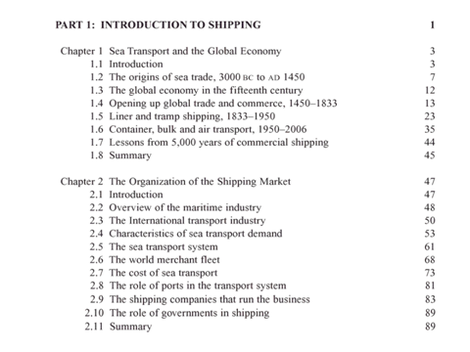
Maritime Economics, Martin Stopford, 2009\

Slide 3
Transport by water
Market Segments
Passengers (travel, cruise, river tourism)
Freight
Market Segments
Internal and international cabotage
River transport
Maritime transport
Ports
Sea ports
River ports

Slide 4
Outline
Transport volumes
Routes
Ships
Services
Shipping companies
Ports

Slide 5
Traffic Volume

Slide 6
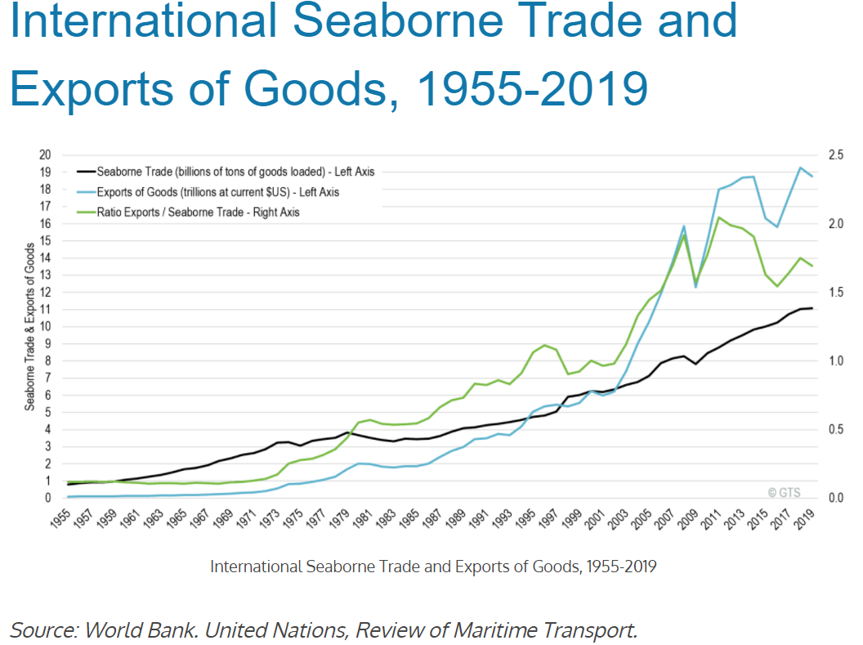
The growth of maritime transportation is strongly correlated with the growth of international trade since maritime shipping and ports are the main physical support for international trade flows.
https://transportgeography.org/contents/chapter5/maritime-transportation/international-seaborne-trade/

Slide 7
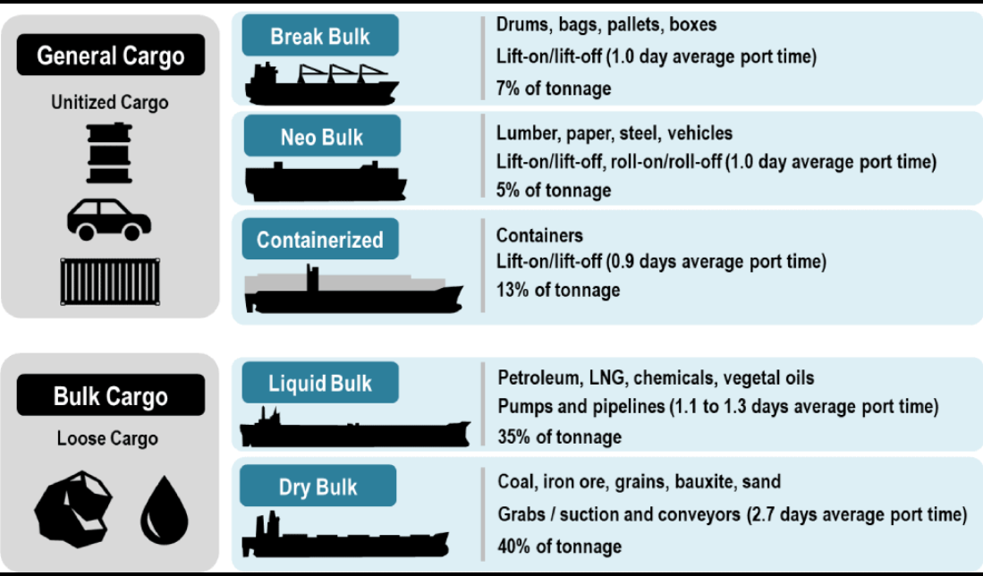
Types of Maritime Cargo

Slide 8
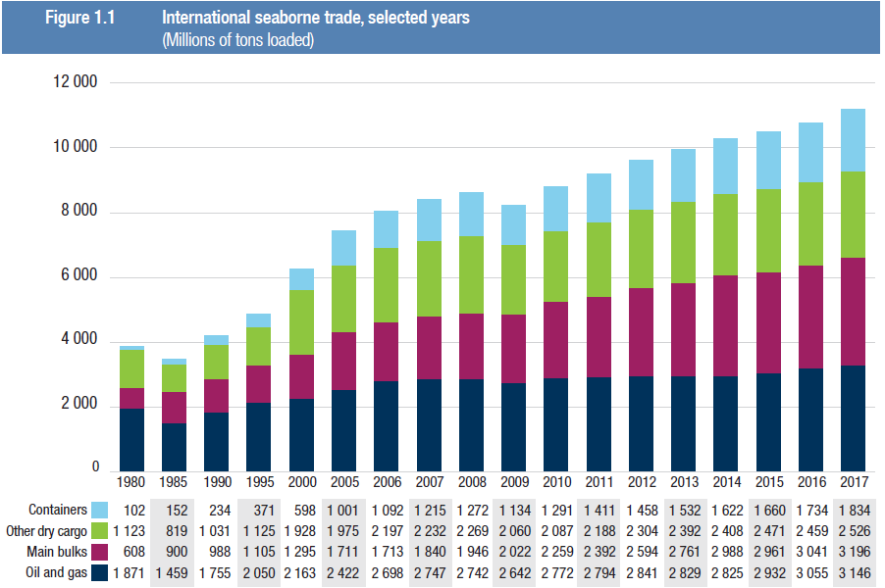
main bulks include data on iron ore, grain, coal, bauxite/alumina and phosphate. Starting in 2006, they include data on iron ore, grain and coal only. Data relating to bauxite/alumina and phosphate are included under “other dry cargo”.
https://unctad.org/en/PublicationsLibrary/rmt2018_en.pdf

Slide 9
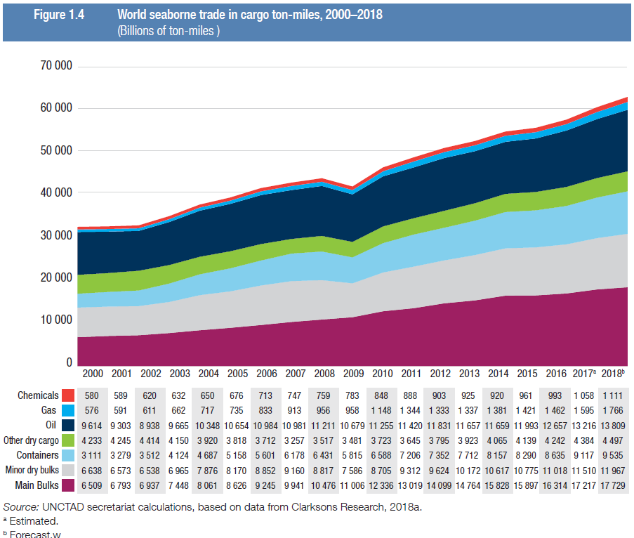

Slide 10
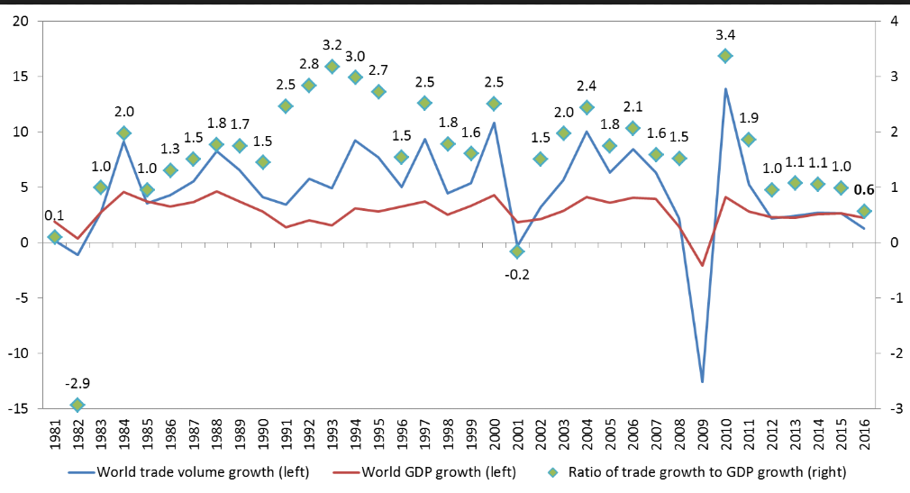
Trade volume and GDP: trade rises faster than GDP

Slide 11
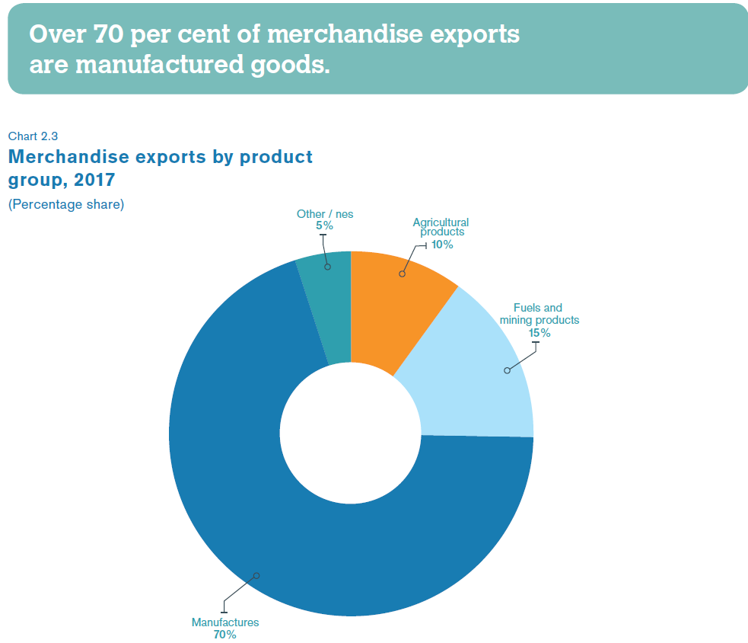

Slide 12
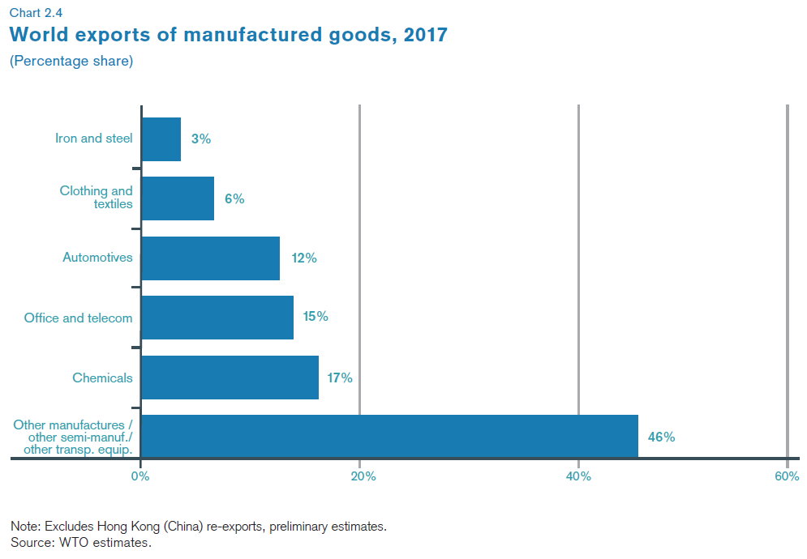

Slide 13
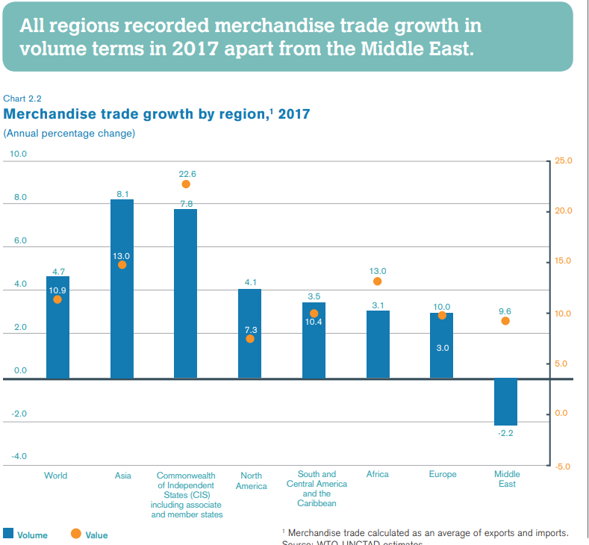

Slide 14
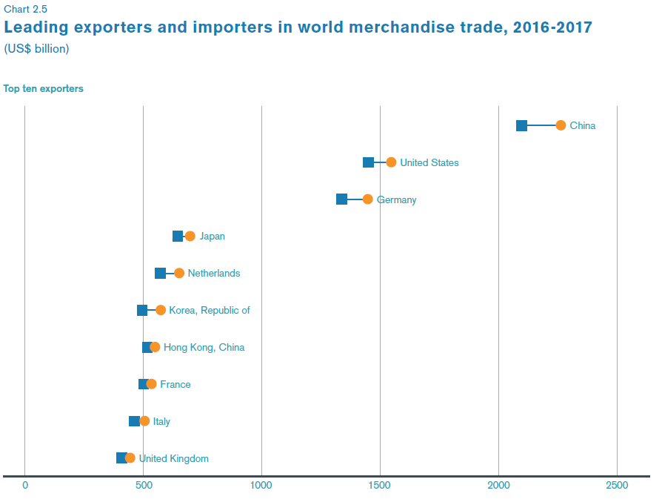

Slide 15
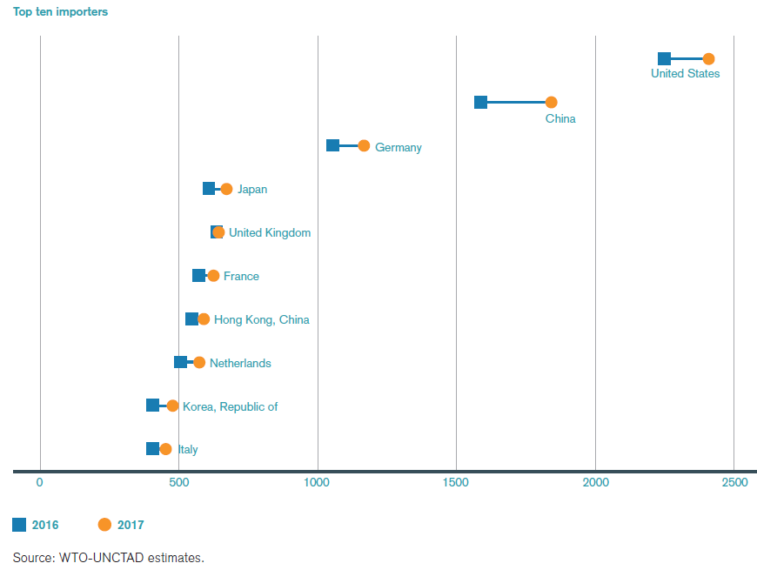

Slide 16
Traffic volumes
Maritime traffic is dominantly focused on freight. Before the era of intercontinental air transportation, transcontinental passenger services were assumed by liner passenger ships, dominantly over the North Atlantic. Long distance passenger movements are now a marginal leisure function solely serviced by cruise shipping. Several oceanic ferry services are also in operation over short distances, namely in Western Europe (Channel; Baltic Sea), Japan and Southeast Asia (Indonesia).
The systematic growth of maritime freight traffic has been fueled by:
Increase in energy and mineral cargoes derived from a growing demand from industrialized economies of North America, Europe, China and Japan. For instance, coal is mainly used for energy generation and steel-making.
Globalization that went on with an international division of the production and trade liberalization.
Technical improvements in ship and maritime terminals have facilitated the flows of freight.
Economies of scale permitted maritime transportation to remain a low cost mode, a trend which has been strengthened by containerization.

Slide 17
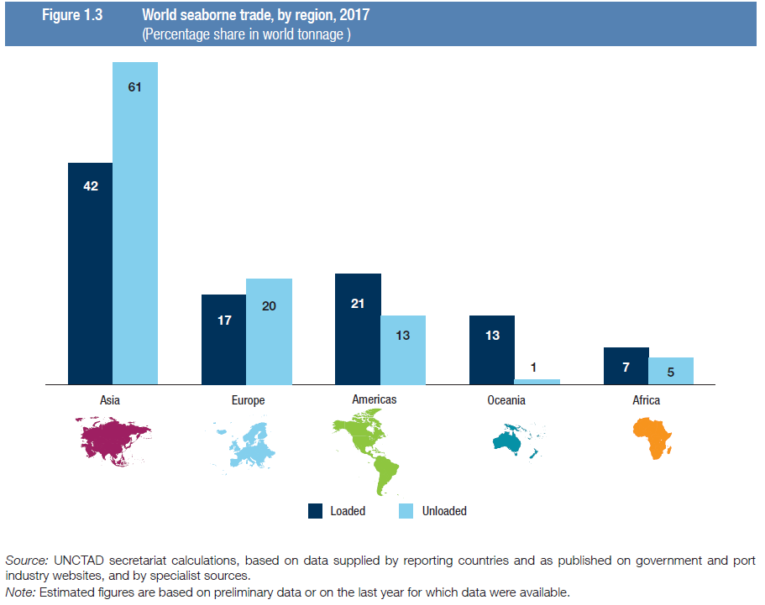
Risk of trade unbalance

Slide 18
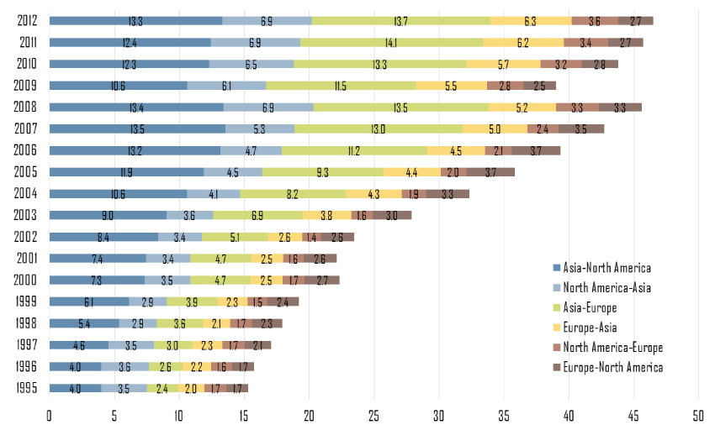
Containerized Cargo Flows along Major Trade Routes, 1995-2012 (in million TEUs)

Slide 19
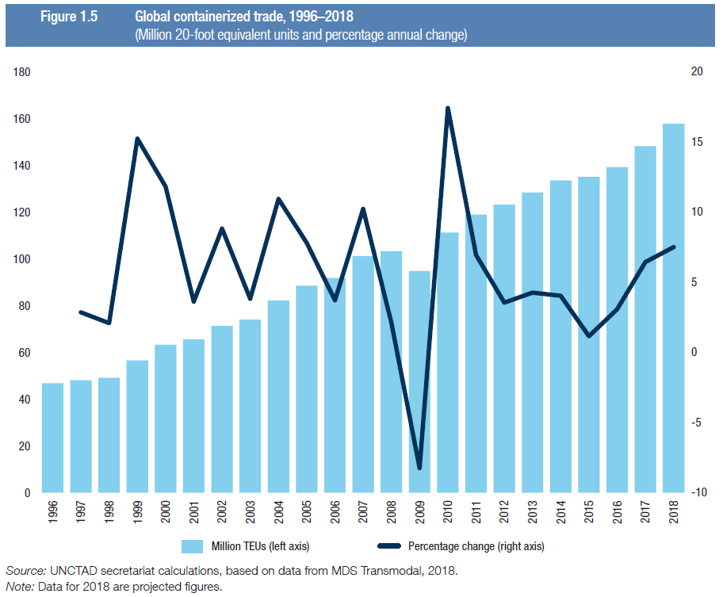
Containers

Slide 20
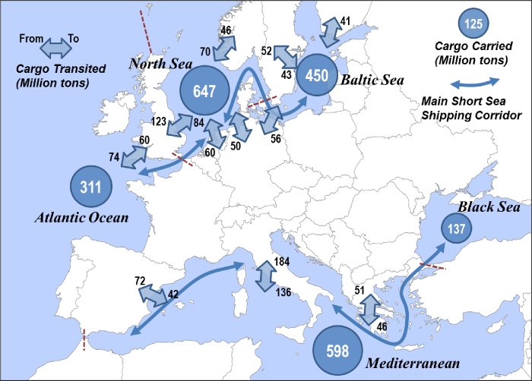
The European Short Sea Shipping Market
In 2007 total freight transport by short sea shipping in the EU-27 amounted to 1.86 billion tons or 61% of total EU-27 maritime goods transport. The most important short sea countries are the United Kingdom (366 million tons), Italy (325 million tons) and the Netherlands (259 million tons). The majority of short sea flows take place between partner ports situated in the Mediterranean (28%) and the North Sea (27%). Liquid bulk (including liquefied gas, crude oil and oil products) is the most important cargo type with almost half the total tonnage or 896 million tons. Shortsea traffic of dry bulk amounted to 364 million tons. Containers accounted for 210 million tons, roro for 250 million tons and other cargo for 142 million tons. Rotterdam was the largest European short sea port overall with 186 million tons of shortsea traffic. Antwerp was the largest European short sea port for containers with 30.5 million tons closely followed by Rotterdam with 30.2 million tons. For roll-on/roll-off transport (roro), Dover in the UK and Calais in France remained the top two short sea ports with 24.6 and 18.3 million tons of roro short sea traffic respectively.

Slide 21
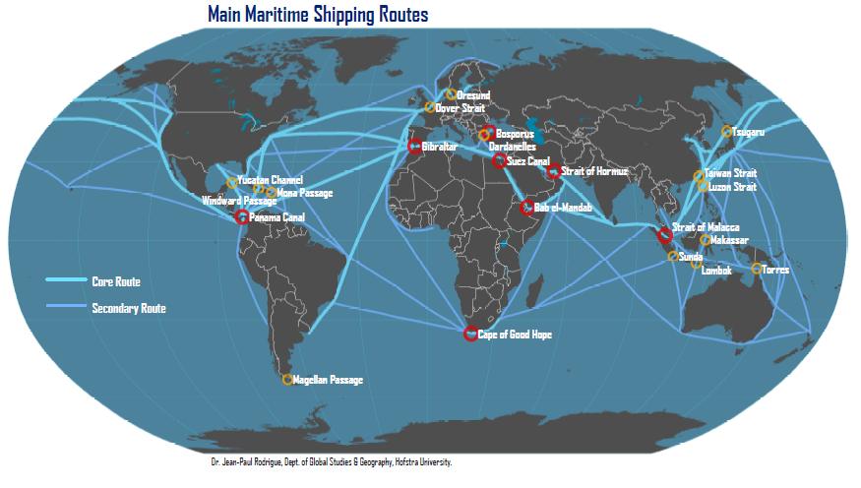
Routes

Slide 22
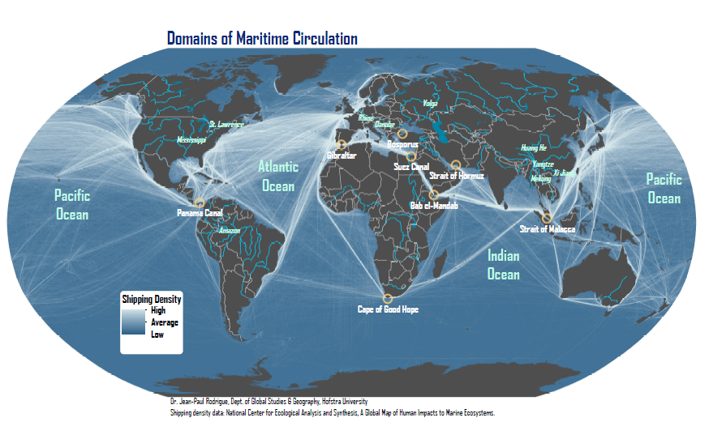
Routes

Slide 23
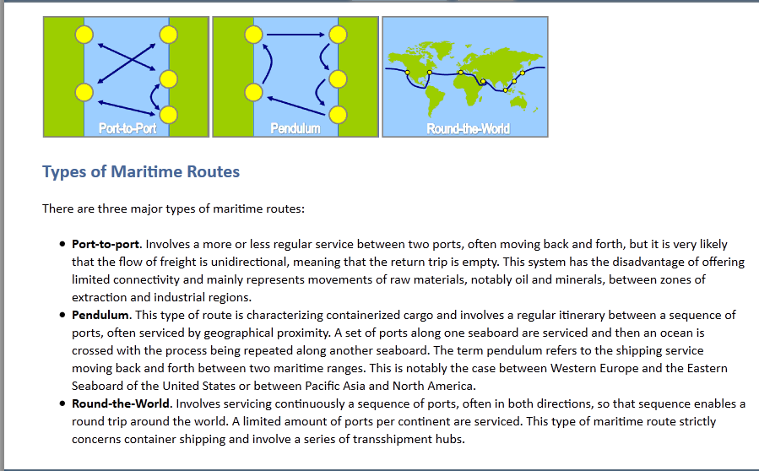
Jean-Paul Rodrigue, Claude Comtois and Brian Slack (2009), THE GEOGRAPHY OF TRANSPORT SYSTEMS, New York: Routledge, 352 pages. ISBN 978-0-415-48324-7

Slide 24
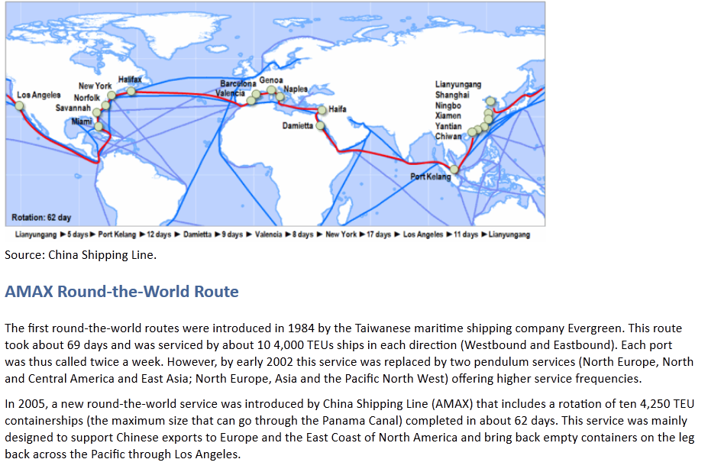

Slide 25
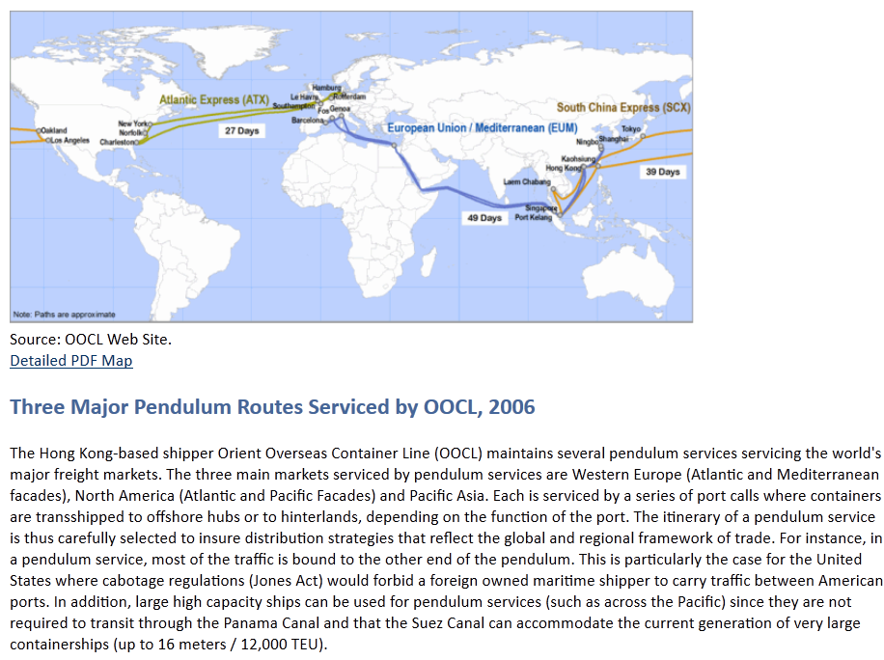

Slide 26
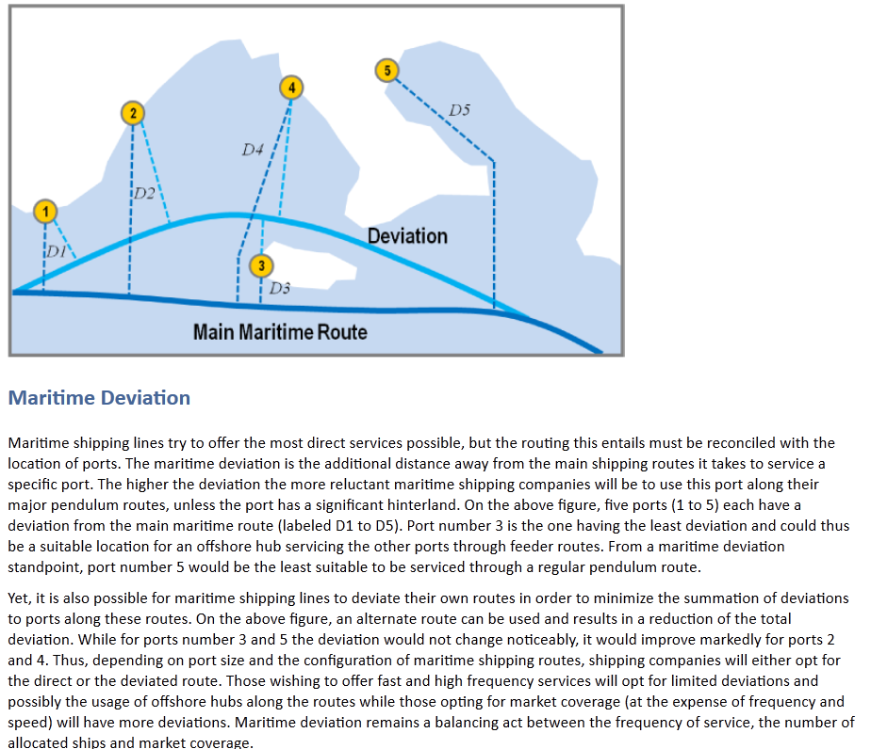

Slide 27
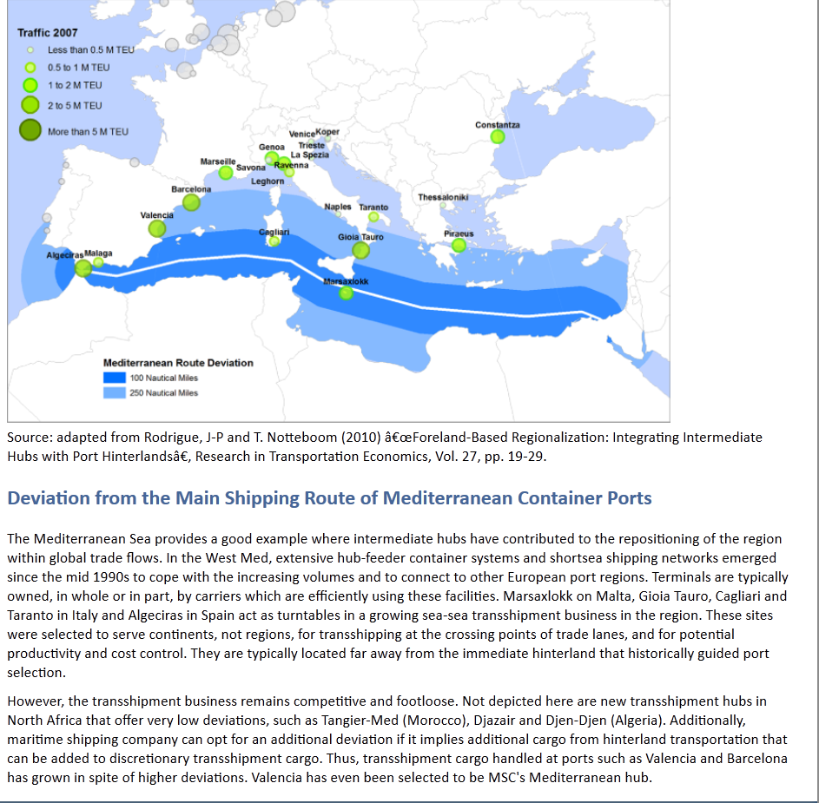

Slide 28
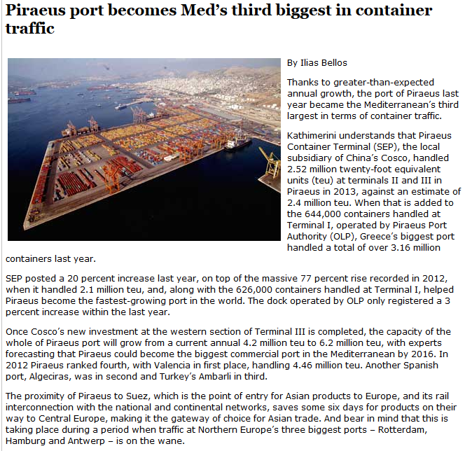

Slide 29
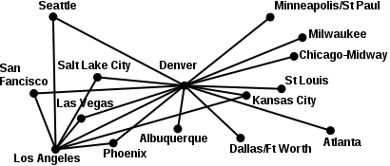
The hub-and-spoke system

Slide 30
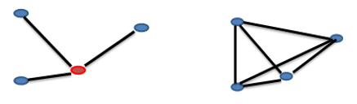
Pros of the hub-and-spoke system
For a network of n nodes, only n - 1 spokes are needed to connect all nodes instead of n*(n-1)/2.
Fewer spokes (routes) allow the possibility to use larger vehicles (ships, airlines, ..) and to load them more (higher efficiency, lower costs).
Complex operations such as handling and accounting are managed in less locations.
When necessary, a newer node is easily added to the network

Slide 31
Cons of the hub-and-spoke system
Since the model is centralized, it is not flexible. Any problem at the hub, or on single routes, could have unexpected consequences across the network. It can be difficult or impossible to handle occasional high demand periods between two routes.
Changes to timetables are complex. Accurate traffic analysis and timely programming are needed to keep the hub running smoothly.
The hub is a bottleneck and a critical point in the network. The total capacity of the network is limited by the capacity of the hub. Delays at the hub (caused, for example, by bad weather) can cause delays across the network. Delays in one spoke can be transmitted to the entire network.
Since you need to cross the hub before reaching your destination, travel times are longer than direct connections. Going through the hub may be desirable in the case of goods, which can be sorted out and consolidated, but not for passengers or for goods that are time constraint.
To reach most destinations a vehicle change (airplane, ship) is needed. Any loss of connection is difficult to make up.

Slide 32
Types of vessel
The global maritime shipping industry is serviced by about 22,000 vessels falling into four broad types:
Passenger vessels can be further divided into two categories: passenger ferries, where people are carried across relatively short bodies of water in a shuttle-type service, and cruise ships, where passengers are taken on vacation trips of various durations, usually over several days. The former tend to be smaller and faster vessels, the latter are usually very large capacity ships having a full range of amenities. In 2011, about 19 million passengers were serviced by cruise ships, underlining an industry with much growth potential since it services several seasonal markets where the fleet is redeployed to during the year.
Bulk carriers are ships designed to carry specific commodities, and are differentiated into liquid bulk and dry bulk vessels. They include the largest vessels afloat. The largest tankers, the Ultra Large Crude Carriers (ULCC) are up to 500,000 deadweight tons (dwt), with the more typical size being between 250,000 and 350,000 dwt; the largest dry bulk carriers are around 350,000 dwt, while the more typical size is between 100,000 and 150,000 dwt. The emergence of liquefied natural gas technology enabled the maritime trade of natural gas with specialized ships.
General cargo ships are vessels designed to carry non-bulk cargoes. The traditional ships were less than 10,000 dwt, because of extremely slow loading and off-loading. Since the 1960s these vessels have been replaced by container ships because they can be loaded more rapidly and efficiently, permitting a better application of economies of scale. Like any other ship class, larger containerships require larger drafts with the current largest ships requiring a draft of 15.5 meters.
Roll on-Roll off (RORO) vessels, which are designed to allow cars, trucks and trains to be loaded directly on board. Originally appearing as ferries, these vessels are used on deep-sea trades and are much larger than the typical a ferry. The largest are the car carriers that transport vehicles from assembly plants to the main markets.
Notes:
Specialization of ships. Economies of scales are often linked with specialization. Both processes have considerably modified maritime transportation. In time, ships became increasingly specialized to include general cargo ships, tankers, grain carriers, barges, mineral carriers, bulk carriers, Liquefied Natural Gas (LNG) carriers, RO-RO ships (roll-on roll off; for vehicles) and container ships.

Slide 33
Passengers

Slide 34
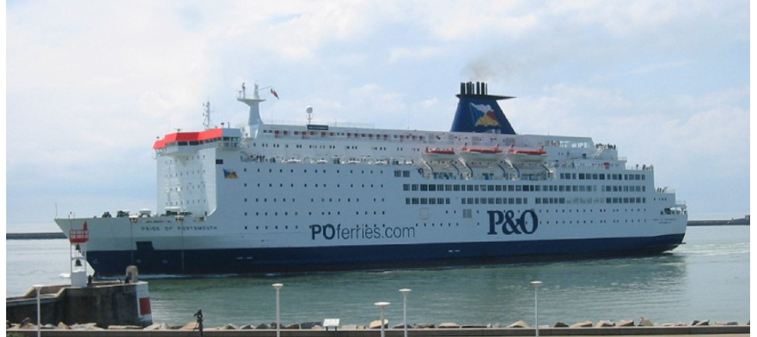
Channel Ferry Ship Entering the Port of Le Havre, France
Ferries are a form of transport, usually a boat or ship, but also other forms, carrying (or ferrying) passengers and sometimes their vehicles. Ferries are also used to transport freight (in lorries and sometimes unpowered freight containers) and even railroad cars. Most ferries operate on regular, frequent, return services. A foot-passenger ferry with many stops, such as in Venice, is sometimes called a waterbus or water taxi. Ferries form a part of the public transport systems of many waterside cities and islands, allowing direct transit between points at a capital cost much lower than bridges or tunnels. Many of the ferries operating in Northern European waters are ro/ro ships.

Slide 35
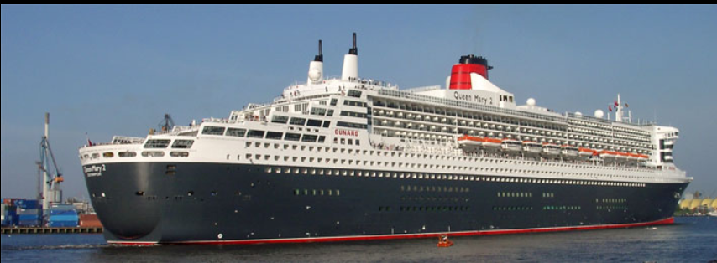
Ocean liner
Ocean liner is a passenger ship designed to transport people from one seaport to another along regular long-distance maritime routes according to a schedule. Ocean liners may also carry cargo or mail, and may sometimes be used for other purposes. Due to the growth of air travel, the passenger ships saw a steady decline.

Slide 36
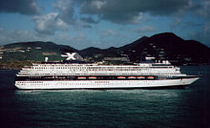
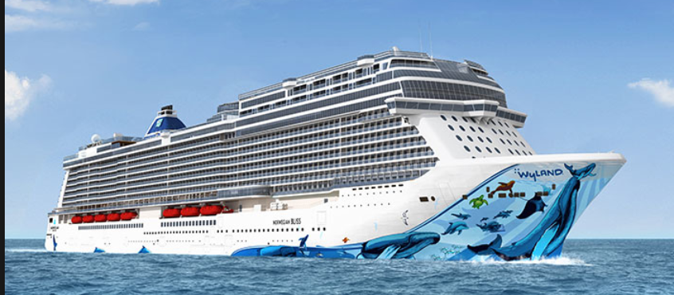
Cruise ships
Cruise ships are passenger ships used for pleasure voyages, where the voyage itself and the ship's amenities are considered an essential part of the experience. Cruising has become a major part of the tourism industry, with millions of passengers each year as of 2006. The industry's rapid growth has seen nine or more newly built ships catering to a North American clientele added every year since 2001, as well as others servicing European clientele.

Slide 37
Freight

Slide 38
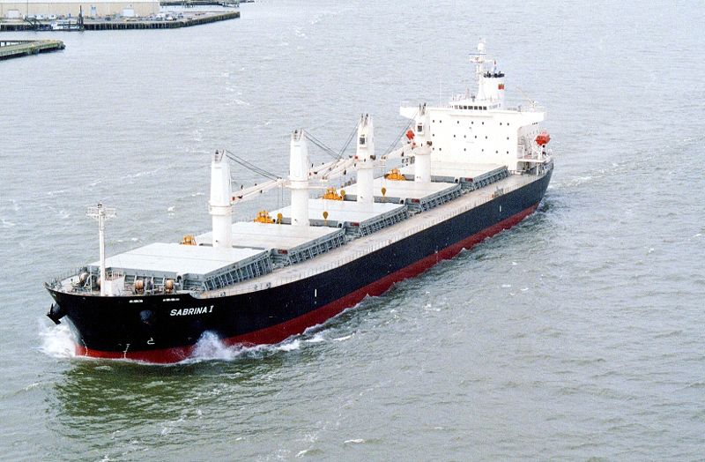
Bulk carriers
Bulk carriers are cargo ships used to transport bulk cargo items such as ore or food staples (rice, grain, etc.) and similar cargo. They can be recognized by the large box-like hatches on their deck, designed to slide outboard for loading. A bulk carrier could be either dry or wet.

Slide 39
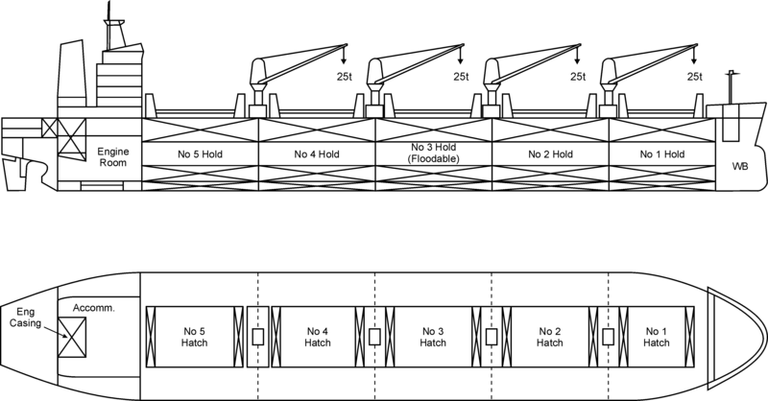
Type: Cargo ship
Propulsion: 2-stroke diesel engine and 1 propeller
Capacity: up to 364,000 DWT
Notes: Rear house, full hull, series of large hatches

Slide 40
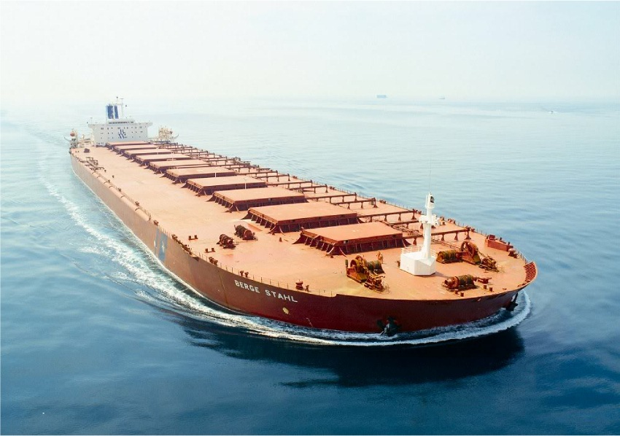
World's Largest Dry-Bulk Carrier, the Berge Stahl, carrying iron ore between Brazil (Ponta da Madeira in Itaqui) and Rotterdam (Europoort), which it calls once every 5 weeks.

Slide 41
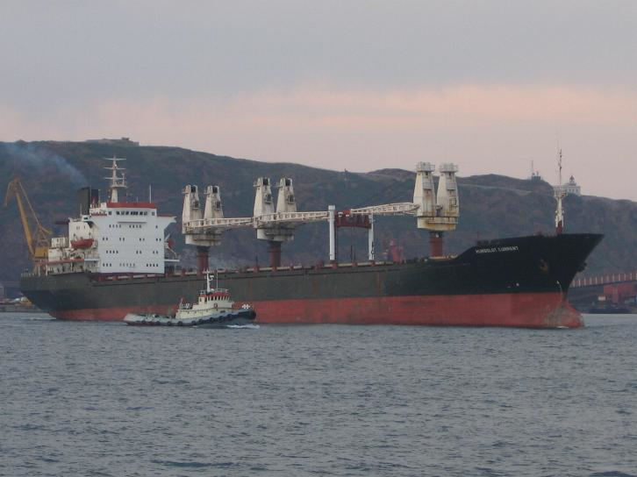
Geared bulk carriers are typically in the handysize to handymax size range although there are a small number of geared panamax vessels, like all bulkers they feature a series of holds covered by prominent hatch covers. They have cranes, derricks or conveyors that allow them to load or discharge cargo in ports without shore-based equipment. This gives geared bulkers flexibility in the cargoes they can carry and the routes they can travel. (Photo: A typical geared handysize bulk carrier.)
Handysize is a naval architecture term for smaller bulk carriers or oil tanker with deadweight of up to 50,000 tonnes
Deadweight: portata lorda
cranes, derricks or conveyors = gru, torri o trasportatori

Slide 42
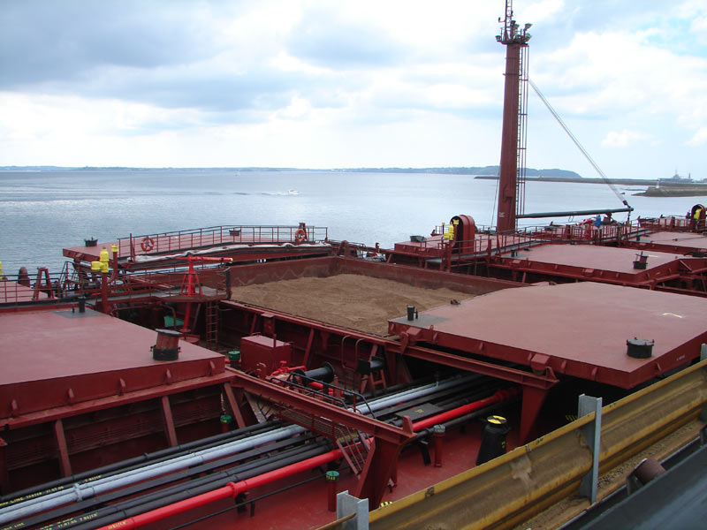
Combined carriers are designed to transport both liquid and dry bulk cargoes. If both are carried simultaneously, they are segregated in separate holds and tanks. Combined carriers require special design and are expensive. They were prevalent in the 1970s, but their numbers have dwindled since 1990.

Slide 43
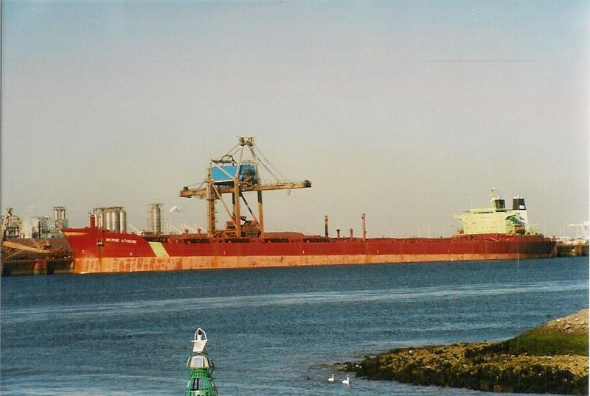
Gearless carriers are bulkers without cranes or conveyors. These ships depend on shore-based equipment at their ports of call for loading and discharging. They range across all sizes, the larger bulk carriers (VLOCs) can only dock at the largest ports, some of these are designed with a single port-to-port trade in mind. The use of gearless bulkers avoids the costs of installing, operating, and maintaining cranes.

Slide 44
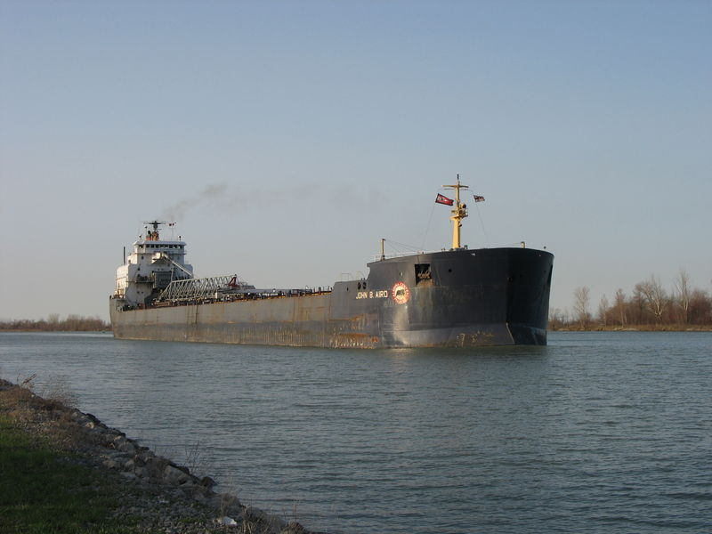
Self-dischargers are bulkers with conveyor belts which allow them to discharge their cargo quickly and efficiently.

Slide 45
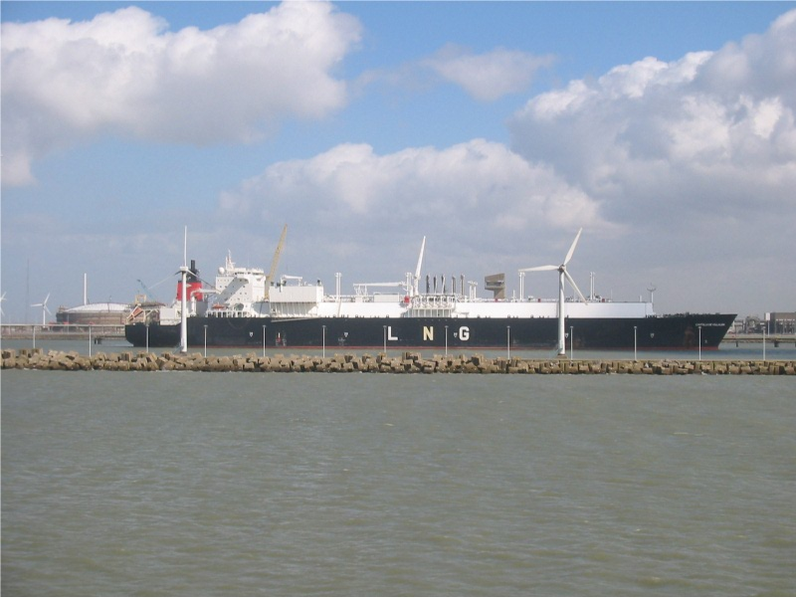
LNG (liquified natural gas) Ship, Port of Zeebrugge

Slide 46
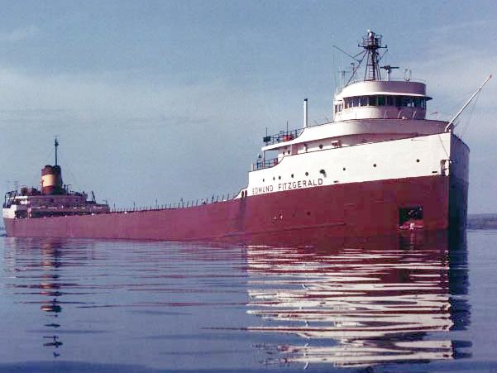
Lakers are the bulkers prominent on the Great Lakes, often identifiable by having a forward house which helps in transiting locks. Operating in fresh water, these ships suffer much less corrosion damage and have a much longer lifespan than saltwater ships.
Locks = chiuse

Slide 47
Container ships
Container ships are cargo ships that carry their entire load in truck-size containers, in a technique called containerization. They form a common means of commercial intermodal freight transport. Informally known as "box boats," they carry the majority of the world's dry cargo. Most container ships are propelled by diesel engines, and have crews of between 10 and 30 people. They generally have a large accommodation block at the stern (poppa), directly above the engine room.

Slide 48
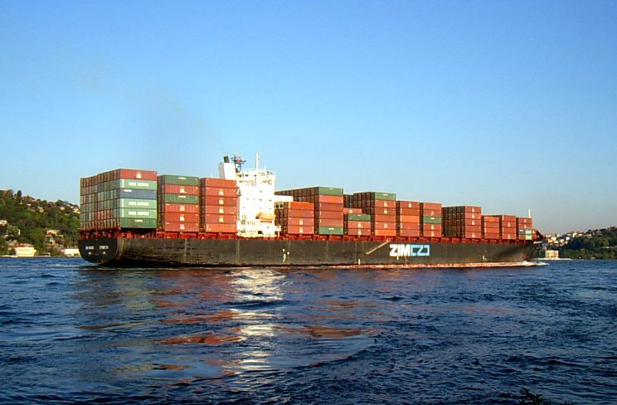

Slide 49
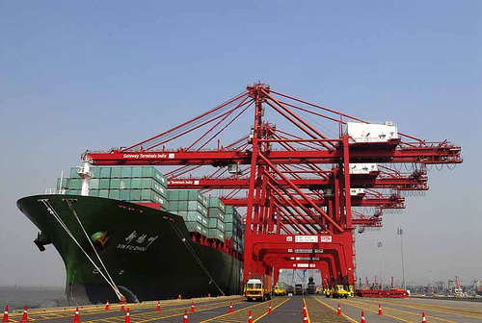

Slide 50
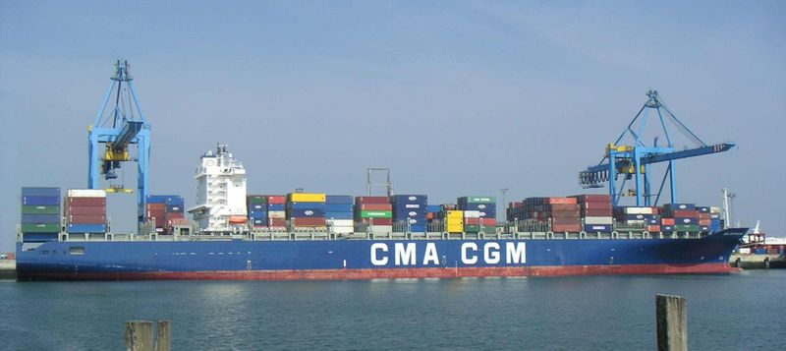

Slide 51
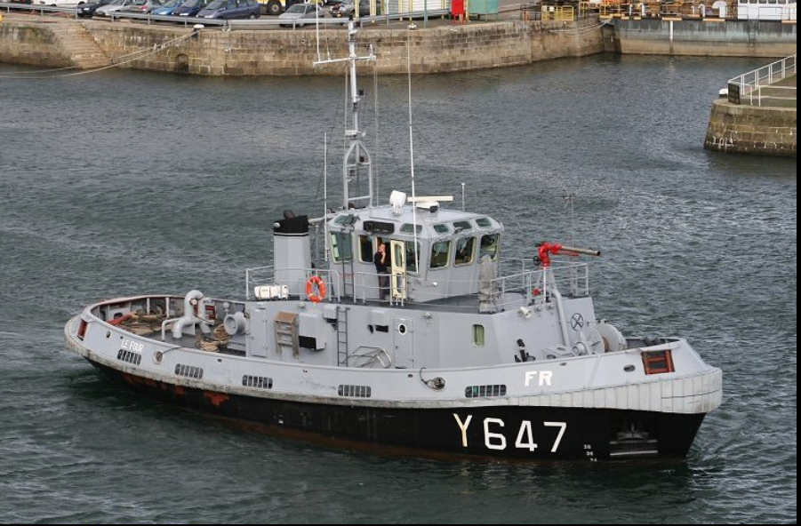
Tugboat
A tugboat is a boat used to manoeuvre, primarily by towing or pushing other vessels (see shipping) in harbours, over the open sea or through rivers and canals. They are also used to tow barges, disabled ships, or other equipment like towboats.

Slide 52
History
The earliest container ships were converted tankers, built up from surplus T2 tankers after World War II. In 1951 the first purpose-built container vessels began operating in Denmark, and between Seattle and Alaska. On November 26, 1955 the purpose-built container ship Clifford J. Rodgers, carried 600 containers between North Vancouver, British Columbia and Skagway, Alaska.
The first purpose-built container ship in the United States was the Ideal-X , a converted T2, owned by Malcom McLean, which carried 58 metal containers between Newark, New Jersey and Houston, Texas on its first voyage, in April 1956.
Today, approximately 90% of non-bulk cargo worldwide is transported by container, and modern container ships can carry up to 15,000 twenty-foot equivalent units (TEU). As a class, container ships now rival crude oil tankers and bulk carriers as the largest commercial vessels on the ocean.

Slide 53
Construction
Container ships are designed so that no space is wasted. Capacity is measured in Twenty-foot equivalent unit (TEU), the number of standard 20-foot containers measuring 20 × 8.0 × 8.5 feet (6.1 × 2.4 × 2.6 metres) a vessel can carry. This not withstanding, most containers used today measure 40 feet (12 metres) in length. Above a certain size, container ships do not carry their own loading gear, so loading and unloading can only be done at ports with the necessary cranes. However, smaller ships with capacities up to 2,900 TEU are often equipped with their own cranes.

Slide 54
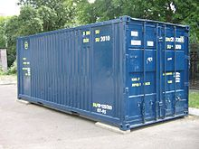
TEU - Twenty-foot equivalent unit
A 20-foot-long (6.1 m) ISO container equals 1 TEU.
The twenty-foot equivalent unit (often TEU or teu) is an inexact unit of cargo capacity often used to describe the capacity of container ships and container terminals. It is based on the volume of a 20-foot-long (6.1 m) intermodal container, a standard-sized metal box which can be easily transferred between different modes of transportation, such as ships, trains and trucks.
One TEU represents the cargo capacity of a standard intermodal container, 20 feet (6.1 m) long and 8 feet (2.44 m) wide. There is a lack of standardisation in regards to height, ranging between 4 feet 3 inches (1.30 m) and 9 feet 6 inches (2.90 m), with the most common height being 8 feet 6 inches (2.59 m). Also, it is common to designate 45-foot (13.7 m) containers as 2 TEU, rather than 2.25 TEU.
A 20-foot-long (6.1 m) ISO container equals 1 TEU.

Slide 55
Construction
Informally known as "box boats," they carry the majority of the world's dry cargo, meaning manufactured goods. There are large main line vessels that ply the deep sea routes, then many small "feeder" ships that supply the large ships at centralized hub ports. Most container ships are propelled by diesel engines, and have crews of between 20 and 40 people. They generally have a large accommodation block at the stern, near the engine room. Container ships now carry up to 15,000 TEU (approximately equivalent to 35 100-car double-stack intermodal freight trains) on a voyage.
The world's largest container ship: 21,000 OOCL
Notes:
55

Slide 56
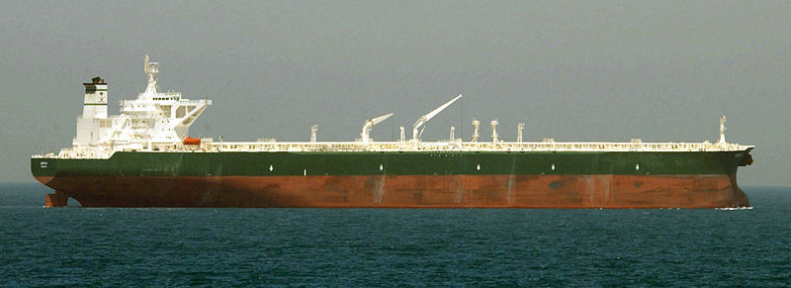
Tankers
Tankers are cargo ships for the transport of fluids, such as crude oil, petroleum products, liquefied petroleum gas, liquefied natural gas and chemicals, also vegetable oils, wine and other food - the tanker sector comprises one third of the world tonnage.
Notes:
56

Slide 57
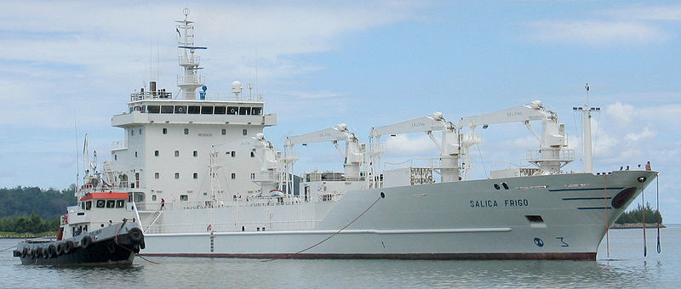
Reefer ships are cargo ships typically used to transport perishable commodities which require temperature-controlled transportation, mostly fruits, meat, fish, vegetables, dairy products and other foodstuffs.

Slide 58
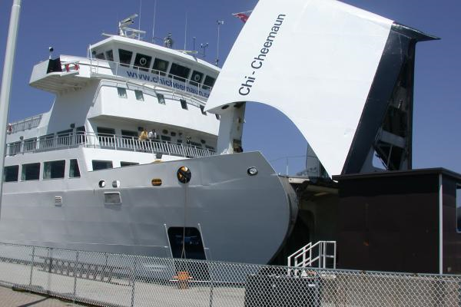
Roll-on/roll-off ships are cargo ships designed to carry wheeled cargo such as automobiles, trailers or railway carriages. RORO (or ro/ro) vessels have built-in ramps which allow the cargo to be efficiently "rolled on" and "rolled off" the vessel when in port. While smaller ferries that operate across rivers and other short distances still often have built-in ramps, the term RORO is generally reserved for larger ocean-going vessels.

Slide 59
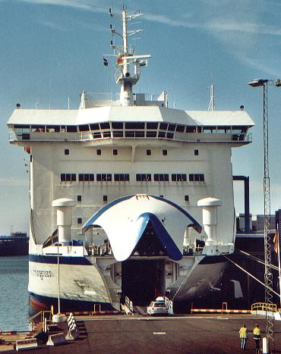

Slide 60
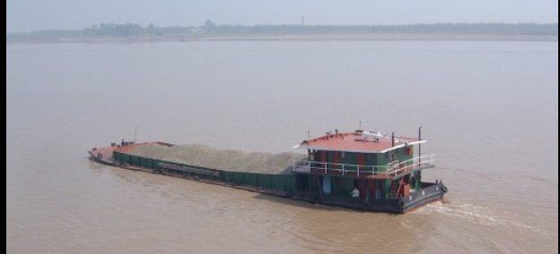
Barge
A barge is a flat-bottomed boat, built mainly for river and canal transport of heavy goods. Most barges are not self-propelled and need to be moved by tugboats towing or towboats pushing them. Barges on canals (towed by draft animals on an adjacent towpath) established the conditions supporting the early industrial revolution in both Europe and the American Northeast. Carriage of bulk goods gradually lost ground to freight railways as train capacity and speeds continued to climb.

Slide 61
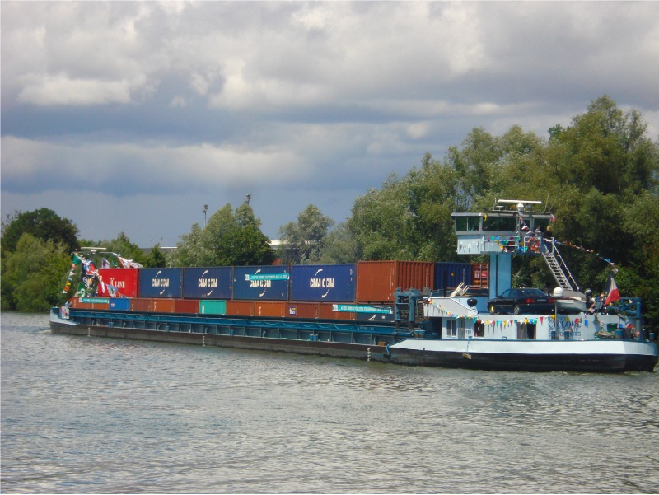
Container Barge

Slide 62
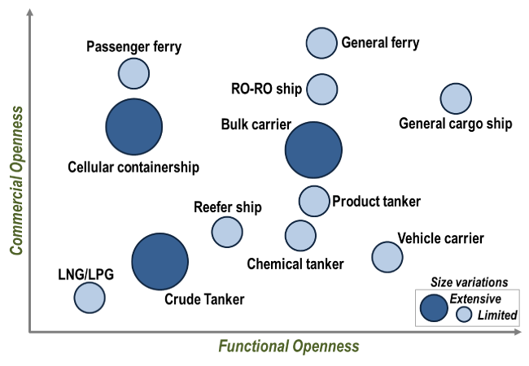
Source: Adapted from J. Woxenius (2010) "Flexibility vs. Specialisation in European Short Sea Shipping", International Association of Maritime Economists, Lisbon, Portugal.
Commercial openness: the range of customers accepted for a specific transport service.
Functional openness: the scope of cargoes or cargo containment technologies accepted by a transport system.

Slide 63

Registered World Fleet, 1910-2010

Slide 64

https://transportgeography.org/?page_id=2169

Slide 65
Classification
Class | Length (lung.) | Beam (largh.) | Draft (pescaggio) | Typical Min DWT | Typical Max DWT
Seawaymax | 226 m | 24 m | 7.92 m | 10,000 DWT | 60,000 DWT
Panamax | 294.1 m | 32.3 m | 12 m | 60,000 DWT | 80,000 DWT
Aframax |  |  |  | 80,000 DWT | 120,000 DWT
Suezmax |  |  | 16 m | 120,000 DWT | 200,000 DWT
VLCC (Malaccamax) | 470 m | 60 m | 20 m | 200,000 DWT | 315,000 DWT
ULCC |  |  |  | 320,000 DWT | 550,000 DWT
DWT=Deadweight tonnage: tonnellate di portata lorda
Notes:
Le chiuse del Canale di Panama consentono, attualmente, il transito di navi di lunghezza inferiore a 294,1 metri,
larghezza inferiore a 32,3 metri e pescaggio massimo di 12 metri; l’ampliamento consentirà il passaggio di navi post-Panamax con un massimo di 399 metri di lunghezza, 49 di larghezza e profonde 15/16 metri. I lavori sono iniziati nel 2007 e dovrebbero terminare nel 2014
Ultra Large Crude Carrier

Slide 66

Six Generations of Containerships
Notes:
Six Generations of Containerships Since the beginning of containerization in the mid 1950s, containerships undertook six general waves of changes, each representing a generation of containership: The first generation of containerships was composed of modified bulk vessels or tankers that could transport up 1,000 TEUs. The first containership, the "Ideal-X" was a converted World War II T2 tanker. The container was at the beginning of the 1960s an untested transport technology and reconverting existing ships proved out to be the least expensive and risky solution. These ships were carrying onboard cranes since most port terminals were not equipped to handle containers and were relatively slow, with speeds of about 18 to 20 knots.
Once the container began to be massively adopted at the beginning of the 1970s, the construction of the first cellular containerships (second generation) entirely dedicated for handling containers started. All containerships are composed of cells lodging containers in stacks of different height depending on the ship capacity. Cranes were removed from the ship design so that more containers could be carried. The ability of ports to handle containership ceased to be a major concern with the setting of specialized container terminals around the world. These ships were also much faster with speeds of 20-24 knots that would become the speed of reference in containerized shipping.
Economies of scale rapidly pushed for the construction of larger containerships in the 1980s. The larger the number of containers being carried the lower the costs per TEU. The process became a virtuous circle compounding larger volumes and lower costs. The size limit of the Panama Canal, which came to be known as the panamax standard, was achieved in 1985 with a capacity of about 4,000 TEUs (third generation). Once this limit was achieved, a decade passed before a new generation of containerships was designed. The APL C10 class containerships were introduced in 1988 and was the first containership class to exceeded the 32.2 m width limit of the Panama Canal. At the same time panamax container ship designs were evolving to take maximum advantage of the limitation in beam.
By 1996 full fledged fourth generation of containerships were introduced and capacities reached 6,600 TEUs. This represented a market risk since a ship above the panamax size required a substantial amount of cargo to be used profitably along a service loop and by the late 1990s the rapid growth of global trade made such a ship class a marketable proposition.
Once the panamax threshold was breached, ship size quickly went to the fifth generation (Post Panamax Plus) with capacities reaching 8,000 TEUs ("S Class"). Going beyond panamax was perceived as a risk in terms of the configuration of the networks, additional handling infrastructure as well as draft limitations at ports. Each subsequent generation of containership is facing a shrinking number of harbors able to handle them. Containerships above the third generation require deep water ports (at least 43 feet of draft) and highly efficient, but costly, transshipment infrastructures. This is placing pressures for ports to dredge to accommodate these draft constraints.
By 2006, sixth generation containerships came online when the maritime shipper Maersk introduced a new class having a capacity in the range of 11,000 to 14,500 TEUs, the Emma Maersk, (E Class). This generation will take two specifications. The first will take the shape of "New Panamax", with ships designed to fit exactly in the locks of the expanded Panama Canal, expected to open in 2014, and which confers capacity of up to 12,500 TEU. The second can be dubbed "Post New Panamax" since these ships are bigger than the expanded Panama Canal specifications and can handle up to about 18,000 TEU (Triple E Class). It remains to be seen which routes and ports these ships would service, but they are limited.
Containership speeds have peaked to an average of 20 to 25 knots and it is unlikely that speeds will increase due to energy consumption; many shippers are opting for slow steaming to cope with higher bunker fuel prices and overcapacity. The deployment of a class of fast containerships has remained on the drawing boards because the speed advantages they would confer would not compensate for the much higher shipping costs. Supply chains have simply been synchronized with container shipping speeds. Although economies of scale would favor the construction and allocation of larger containerships on more shipping routes, there are operational limitations to deploy ships bigger than 8,000 TEU. Containerships in the range of 5,500 to 6,500 TEU appear to be the most flexible in terms of number of port calls since using larger ships along trade routes would require fewer calls and thus be less convenient to service specific markets.

Slide 67



Atlanta
Orient Overseas Container Line
https://www.youtube.com/watch?v=fzbNkdtSqrQ
A ballast tank is a compartment within a boat, ship or other floating structure that holds water, which is used as ballast to provide stability for a vessel.

Slide 68


Ship gigantism
OOCL Hong Kong
This 20,000 TEU container ship is currently titled as the world’s largest container ship ever built. She was delivered for service May 2017 after being established at the Samsung Heavy Industries, Geoje shipyard. She has a carrying capacity of 21,413 TEU. And, she will be serving the destination to North Europe from these following countries, which covers a voyage of seventy seven days.
Notes:
Speed. The average speed of ships is about 15 knots (1 knot = 1 marine mile = 1,853 meters), which is 28 km per hour. Under such circumstances, a ship would travel about 575 km per day. More recent ships can travel at speeds between 25 to 30 knots (45 to 55 km per hour),

Slide 69

List of largest container ships

Slide 70

Annual cost | TEU | $/TEU
9.000.000 | 4.000 | 2.250
12.000.000 | 6.000 | 2.000
14.200.000 | 10.000 | 1.420

Slide 71


Slide 72
Final comments on ships
Size. The last century has seen a growth of the number of ships as well as their average size. Each time the size of a ship is doubled, its capacity is cubed (tripled). Although the minimum size for cost effective bulk handling is estimated to be around 1,000 deadweight tons, economies of scale have pushed for larger ship sizes to service transportation demand. For ship owners, the rationale for larger ships implies reduced crew, fuel, berthing (ormeggio), insurance and maintenance costs.
Speed. The average speed of ships is about 15 knots (1 knot = 1 marine mile = 1,853 meters), which is 28 km per hour. Under such circumstances, a ship would travel about 575 km per day. More recent ships can travel at speeds between 25 to 30 knots (45 to 55 km per hour), but it is uncommon that a commercial ship will travel faster than 25 knots due to energy requirements. To cope with speed requirements, the propulsion and engine technology has improved from sailing to steam, to diesel, to gas turbines and to nuclear (only for military ships; civilian attempts were abandoned in the early 1980s).

Slide 73

Speed and fuel consumption

Slide 74
Specialization of ships. Economies of scales are often linked with specialization. Both processes have considerably modified maritime transportation. In time, ships became increasingly specialized to include general cargo ships, tankers, grain carriers, barges, mineral carriers, bulk carriers, Liquefied Natural Gas (LNG) carriers, RO-RO ships (roll-on roll off; for vehicles) and container ships.
Ship design. Ship design has significantly improved from wood hulls (scafi), to wood hulls with steel armatures, to steel hulls (the first were warships) and to steel, aluminum and composite materials hulls. The hulls of today’s ships are the result of considerable efforts to minimize energy consumption, construction costs and improve safety. Depending on its complexity, a ship can take between 4 months (container and crude carriers) and 1 year to build (cruise ship).
Automation. Different automation technologies are possible including self-unloading ships, computer assisted navigation (crew needs are reduced and safety is increased) and global positioning systems. The general outcome of automation has been smaller crews being required to operate larger ships.

Slide 75
Type of service
With respect to the organization:
Regular schedule (liner services): the vessels are employed on a regular scheduled service between fixed ports of call. These maritime shipping services are available to any freight importer of exporter, implying that the cargo being carried on any given ship belongs to different interests. A growing share of liner services is containerized.
On voyage basis (tramp ships or charter services): the vessels have no schedule and move between ports based on cargo availability.
With respect to the destination:
Feeder services from transshipment hubs to feeder ports and vice versa. These services can be arranged on a direct hub port to feeder port base or can follow a line bundling set-up with several feeder ports of call per vessel rotation. They tend to use regular containerships, but of smaller size (often aptly called feeder ships).
Cabotage services between ports of the same economic region, as for instance within Europe or North America.

Slide 76

Bulk versus containarized transportation

Slide 77
Financing and regulation
The operation of the maritime transport system requires financing that can come from two sources:
Public. The public sector is commonly responsible for guidance infrastructures (beacons and charts), public piers, dredging, security and in several cases of the administration of ports (under the umbrella of port authorities).
Private. The private sector is mostly concerned about specific facilities such as piers, transshipment infrastructures and ships, which are commonly owned by private maritime companies.
In the past, governments have intervened, often massively, in the maritime sector to fulfill different goals such as economic development, national defense, prestige, balance of payments, and the protection of the national industry. To reach those goals, governments relied on methods such as regulations, subsidies, national fleets, preference of cargo and ports of entry. Cabotage regulations have been one of the privileged measures to protect the national maritime transportation industry.

Slide 78
The Biggest Shipping Companies in the World – 2018
1. A.P. Moller – Maersk Group
A.P. Moller–Maersk Group is a Danish business conglomerate with activities in the transport and logistics and energy sectors. Maersk has been the largest container ship and supply vessel operator in the world since 1996. The company is based in Copenhagen, Denmark with subsidiaries and offices across 130 countries and around 88,000 employees. In September 2016, Maersk Group announced splitting into two separate divisions: transport & logistics and energy. The company market capitalization is US$ 35 billion (2017).
2. Mediterranean Shipping Company S.A.
MSC Mediterranean Shipping Company S.A. (MSC) is the world’s second-largest shipping line in terms of container vessel capacity. As of the end of December 2014, MSC was operating 471 container vessels with an intake capacity of 2,435,000 twenty-foot equivalent units (TEU). The Geneva-headquarteres company operates in all major ports of the world. MSC’s most important port is Antwerp in Belgium. MSC Cruises is a division of the company focused on holiday cruises.
3. CMA CGM S.A.
CMA CGM S.A. is a French container transportation and shipping company. It is a leading worldwide shipping group, using 200 shipping routes between 420 ports in 150 different countries. Its headquarters are in Marseille and its North American headquarters are in Norfolk, Virginia, United States. The name is an acronym, which, spelled out, would translate as “Maritime Freighting Company – General Maritime Company”.
4. COSCO Shipping Co. Ltd.
COSCO Shipping Corporation Limited, also referred to as the China COSCO Shipping Group or China COSCO Shipping, is a Chinese business conglomerate and state-owned enterprise headquartered in Shanghai. The group is engaged in a variety of business sectors, with a focus on integrated logistics, shipping, finance services, and equipment manufacturing. Its core business cluster is container, dry-bulk, and petroleum transport services. As of 2016, the group’s total fleet size ranks first globally, comprising 1114 merchant vessels and a total capacity of 85.32 million DWT.
5. Hapag-Lloyd
Hapag-Lloyd is a multinational German based transportation company. It is composed of a cargo container shipping line, Hapag-Lloyd AG, which in turn owns other subsidiaries such as Hapag-Lloyd Cruises. The company was formed in 1970 by the merger of two German transportation/maritime companies, Hamburg America Line (HAPAG), which dated from 1847, and Norddeutscher Lloyd (NDL) or North German Lloyd (NGL), which was formed in 1856.

Slide 79
6. Evergreen Marine Corp.
Evergreen Marine Corporation is a Taiwanese container transportation and shipping company. Headquartered in Luzhu District, Taoyuan City, Taiwan, Evergreen Marine is a global containerized-freight shipping company. With over 150 container ships it is part of the Evergreen Group conglomerate of transportation firms and associated companies. Evergreen calls on 240 ports worldwide in about 80 countries. The company’s activities include: shipping, construction of containers and ships, management of ports, and engineering and real estate development. Subsidiaries and divisions include Uniglory Marine Corp. (Taiwan), Evergreen UK Ltd. (UK), and shipping company Italia Marittima S.p.A. (Italy). In 2007, Hatsu, Italia Maritima, and Evergreen were merged into the single “Evergreen Line.”
7. OOCL
OOCL is one of the world’s largest integrated international container transportation, logistics and terminal companies with more than 320 offices in 70 countries around the world. OOCL has 57 vessels of different classes, with capacity varying from 2,992 twenty-foot equivalent units (TEU) to 21,413 TEU, including two ice-class vessels for extreme weather conditions.
8. Yang Ming Marine Transport Corp.
Yang Ming Marine Transport Corporation is an ocean shipping company based in Keelung, Taiwan (ROC). This shipping line was founded in 1972, but has historical links through its merger with the China Merchants Steam Navigation Company, which dates back to the Qing Dynasty (1872–1995). Yang Ming currently operates 84 container ships up to 8,250 twenty-foot equivalent units (TEU) and 17 bulk carriers.
9. MOL
MOL (Mitsui O.S.K. Lines, Ltd.) (Kabushiki-gaisha Shōsen Mitsui) is a Japanese transport company headquartered in Toranomon, Minato, Tokyo, Japan. The company’s main area of operations is international shipping. Its alligator logo can be seen on containers in ports around the world.
10. NYK Line
Nippon Yusen Kabushiki Kaisha is one of the oldest and largest shipping companies in the world. It is a member of the Mitsubishi keiretsu. The company has its headquarters in Chiyoda, Tokyo, Japan and a fleet of about 800 ships, that includes container ships, tankers, bulk and woodchip carriers, Ro-Ro car carriers, reefer vessels, LNG and cruise ships.

Slide 80
Top ten by TEU capacity
2018
2020
1. P. Moller–Maersk – 4.1m TEU
2. Mediterranean Shipping Company – 3.8m TEU
3. COSCO Shipping Lines – 3.1m TEU
4. CMA CGM Group – 2.7m TEU
5. Hapag-Lloyd – 1.7m TEU
6. Ocean Network Express – 1.5m TEU
7. Evergreen Line – 1.2m TEU
8. Orient Overseas Container Line – 733,580 TEU
9. HMM – 728,416 TEU
10. Yang Ming – 616,000 TEU
1. A.P. Moller – Maersk Group
2. Mediterranean Shipping Company S.A.
3. CMA CGM S.A.
4. COSCO Shipping Co. Ltd.
5. Hapag-Lloyd
6. Evergreen Marine Corp.
7. OOCL
8. Yang Ming Marine Transport Corp.
9. MOL
10. NYK Line

Slide 81


Slide 82


Slide 83

From a cargo value/transport cost per TEU proposition, the containerized shipping of commodities has become more advantageous, and this even after the sharp correction that took place in late 2008 due to the unfolding financial crisis. This correction also had a deflationary impact on container shipping rates, so the spread between the evolution of the price of commodities and container shipping rates remains significant.

Slide 84


Slide 85


Slide 86

Baltic Dry Index: an important index
The Baltic Dry Index (BDI) is an economic indicator issued daily by the London-based Baltic Exchange. Not restricted to Baltic Sea countries, the index provides "an assessment" of the price of moving the major raw materials by sea. Taking in 23 shipping routes measured on a time charter basis, the index covers Handysize, Supramax, Panamax, and Capesize dry bulk carriers carrying a range of commodities including coal, iron ore and grain.“
Most directly, the index measures the demand for shipping capacity versus the supply of dry bulk carriers. The demand for shipping varies with the amount of cargo that is being traded or moved in various markets (supply and demand).
Because dry bulk primarily consists of materials that function as raw material inputs to the production of intermediate or finished goods, such as concrete, electricity, steel, and food; the index is also seen as an efficient economic indicator of future economic growth and production. The BDI is considered by some people as a leading economic indicator because it predicts future economic activity.

Slide 87


Slide 88
The Economist explains
Why the Baltic Dry Index is at an all-time low
China’s rip-roaring economy, the destination for well over half the world’s ship-borne iron ore and 25% of coal, has cooled.
The reason that the BDI has taken such a precipitous dive is that it is a measure both of demand for shipping and of the supply of vessels. Sliding charter rates are more a reflection of the eternal optimism of shipowners than a calamitous foundering of the world economy.
The supply of ships is inelastic; it takes around two to three years between ordering a new vessel and its launch so the response to shifts in demand is slow and conditions can change while additions to the fleet are under construction. Even the location of ships can play a big role. If the number of cargoes on a particular route outweighs the available hold space on that route the index can soar, just as it can plummet if the opposite is true—even if worldwide the total of cargoes and ships is in balance.
as the world economy boomed and rates hit new heights, shipowners ordered a huge tonnage of bulk carriers. But China’s policy of weaning itself off dirty energy (ripulirsi, ristrutturarsi) has contributed to a rapid decline in imports, leaving another glut of new vessels and rock-bottom rates for their owners.

Slide 89

https://www.bloomberg.com/quote/BDIY:IND

Slide 90

Significant imbalances in containerized maritime freight rates have emerged along major trading routes. Prior to 1998, the "spread" between eastbound and westbound rates used to be relatively narrow, a couple of hundred USD per TEU. From 1999, the rate spread increased to about a thousand USD per TEU, a reflection of the substantial global trade imbalances. On one hand, the Asian financial crisis of 1997 created a substantial devaluation of their respective currencies (with the exception of the Chinese Yuan which was pegged to the USD until 2005), which made exports cheaper. On the other hand, the same period was characterized by significant economic growth in North America with its associated consumption and a level of deindustrialization. American imports thus increased at a rate which was significantly faster than exports.
While rates between Europe and Asia and between the United States and Asia have steadily declined and then remained constant, rates in the opposite direction (from Asia) have increased and are subject to some volatility, which is mainly lined with export-oriented business cycles. As many Asian exports are consumer goods, their demand is impacted by cycles of growth (e.g. 1996-1999) and recession (e.g. 2001-2002 and 2008-2010).

Slide 91

Shipping cycles

Slide 92


Slide 93


Slide 94


Slide 95


Slide 96



Slide 97

From Maurizio Cociancig, Adriafer

Slide 98
Interesting videos
Ship demand, Shipping Industry Expert - JOHN KIRKLAND: https://www.youtube.com/watch?v=IpnAs0pV6uU from 8.41-14.30
Port congestion, https://www.youtube.com/watch?v=1wdSVm2x6Zg, from 7.30- 18.30
Big Ships & Heavy Load - Hard Work At The PORT OF HAMBURG, https://www.youtube.com/watch?v=WIlTa50rhvI

Slide 99
Conferences
An important historic feature of oceanic liner transport is the operation of "conferences". These are formal agreements between companies engaged on particular trading routes. They fix the rates charged by the individual lines, operating for example between Northern Europe and the East Coast of North America, or eastbound between Northern Asia and the West Coast of North America. Over the years in excess of 100 such conference arrangements have been established. While they may be seen as anti-competitive, the conference system has always escaped prosecution from national anti-trust agencies. This is because they are seen as a mechanism to stabilize rates in an industry that is inherently unstable, with significant variations in supply of ship capacity and market demand. By fixing rates exporters are given protection from swings in prices, and are guaranteed a regular level of service provision. Firms compete on the basis of service provision rather than price.

Slide 100
Strategic alliances
A new form of inter-firm organization has emerged in the container shipping industry since the mid-1990s. Because of the costs of providing ship capacity to more and more markets are escalating beyond the means of many carriers, many of the largest shipping lines have come together by forming strategic alliances with erstwhile competitors. They offer joint services by pooling vessels on the main commercial routes. In this way they are each able to commit fewer ships to a particular service route, and deploy the extra ships on other routes that are maintained outside the alliance. The alliance services are marketed separately, but operationally involve close cooperation in selecting ports of call and in establishing schedules. The alliance structure has led to significant developments in route alignments and the economies of scale of container shipping. The consequences have been a concentration of ownership, particularly in container shipping. The 20 largest carriers controlled 26% of the world slot capacity in 1980, 42% cent in 1992 and about 58% in 2003. Those carriers have the responsibility to establish and maintain profitable routes in a competitive environment. This involves three major decisions about how such a maritime network takes shape: frequency of service, fleet and vessel size, number of port calls.

Slide 101


Slide 102


Slide 103


Slide 104
Next: Shipping and port competition

