Slide 1
Magnetic Surveying
The purpose of magnetic surveying is to identify and describe regions of the Earth’s crust that have unusual (anomalous) magnetizations.
In the realm of applied geophysics the anomalous magnetizations might be associated with local mineralization that is potentially of commercial interest, or they could be due to subsurface structures that have a bearing on the location of oil deposits.
In global geophysics, magnetic surveying over oceanic ridges provided vital clues that led to the theory of plate tectonics and revealed the polarity history of the Earth’s magnetic field since the Early Jurassic.

Slide 2
Magnetic Surveying
Magnetic surveying consists of:
1) measuring the terrestrial magnetic field at predetermined points;
2) correcting the measurements for known changes;
3) Comparing the resultant value of the field with the expected value at each measurement station.
The expected value of the field at any place is taken to be that of the International Geomagnetic Reference Field (IGRF)
The difference between the observed and expected values is a magnetic anomaly.

Slide 3
Magnetic Surveying: ground survey
The surveying of magnetic anomalies can be carried out on land, at sea and in the air. In a simple land survey an operator might use a portable magnetometer to measure the field at the surface of the Earth at selected points that form a grid over a suspected geological structure.
This method is slow but it yields a detailed pattern of the magnetic field anomaly over the structure, because the measurements are made close to the source of the anomaly

Slide 4
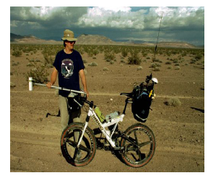
Magnetic Surveying: ground survey
Ground magnetic surveys: The operator carrying the sensor should be free of magnetic objects, including keys, knives, zips, internal surgical pins…
It is advisable to check for ‘personal magnetism’ by keeping the magnetometer still and taking readings with the user facing successively north, east, . . . and seeing that any differences are small compared to those expected in the survey.
The sensor is often mounted on a pole, with height selectable up to about 2 m. Raising the sensor makes it less affected by shallow magnetic bodies, particularly small ferrous objects, which are common in our throwaway society
However, this will not eliminate the unwanted effects of motor vehicles, railway lines, steel gates, barbed wire fences, and so on, so they should be passed at a distance, if possible, and a note made.
Readings are taken along a profile or sometimes over a grid, as described, sometimes at closer intervals when the field is varying rapidly, to record the shape of the anomaly in more detail.

Slide 5
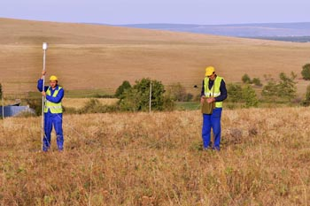
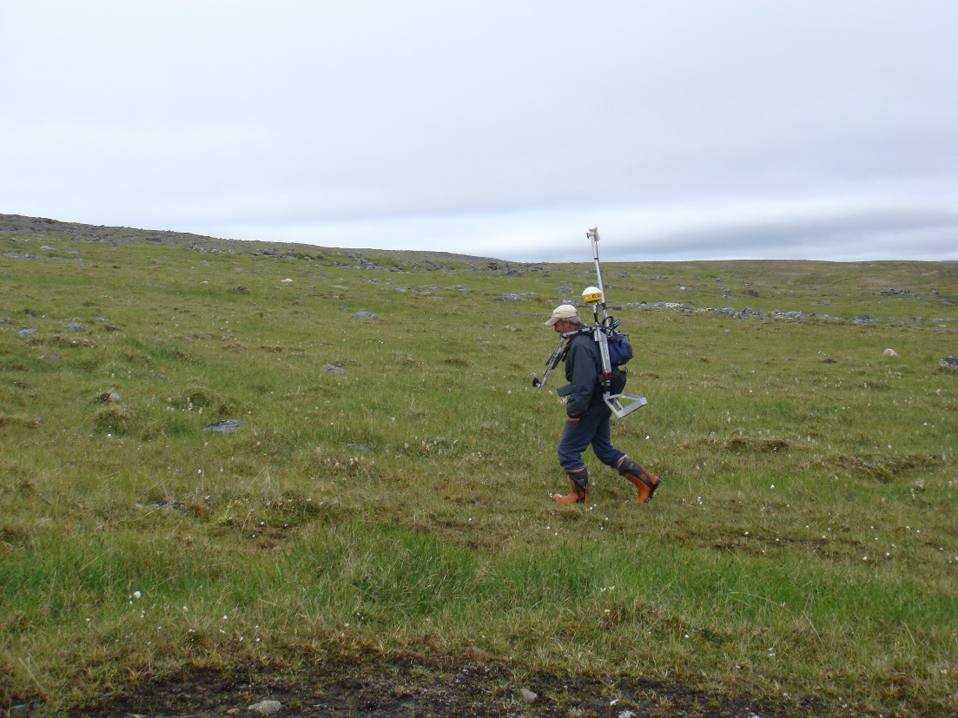
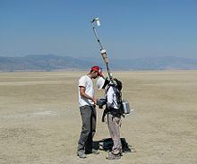

Slide 6
Magnetic Surveying: ground survey
Magnetic surveying therefore offers a convenient way of mapping the contacts. The variation within the ultrabasics (due to inhomogeneity and varying amounts of alteration of the rock) illustrates how the character of the anomaly can sometimes be used as a preliminary identification of lithology, useful in the interpretation of aeromagnetic maps

Slide 7
Magnetic Surveying: aireborne survey
In practice, the surveying of magnetic anomalies is most efficiently carried out from an aircraft. The magnetometer must be removed as far as possible from the magnetic environment of the aircraft.
This may be achieved by mounting the instrument on a fixed boom, several meters long. Alternatively, the device may be towed behind the aircraft in an aerodynamic housing, at the end of a cable 30–150m long. The “bird” containing the magnetometer then flies behind and below the aircraft.
Airborne magnetometers generally have higher sensitivity (≈ 0.01 nT) than those used in ground-based surveying (sensitivity ≈ 1 nT).

Slide 8
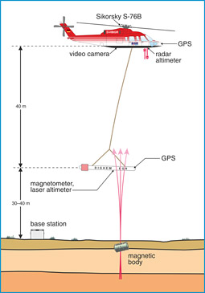

Slide 9
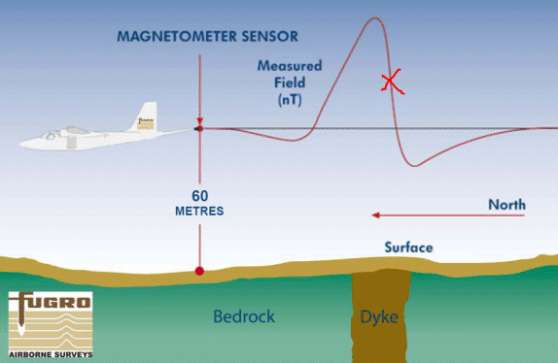

Slide 10
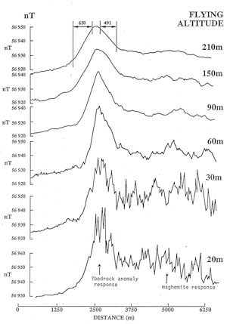
Magnetic Surveying: aireborne survey

Slide 11

Magnetic Surveying: shipborne survey
Airborne magnetic surveying is an economical way to reconnoitre a large territory in a short time. It has become a routine part of the initial phases of the geophysical exploration of an uncharted territory.
The magnetic field over the oceans may also be surveyed from the air. However, most of the marine magnetic record has been obtained by shipborne surveying. In the marine application a proton-precession magnetometer mounted in a waterproof “fish” is towed behind the ship at the end of a long cable.
Considering that most research vessels consist of several hundred to several thousand tons of steel, the ship causes a large magnetic disturbance. For example, a research ship of about 1000 tons deadweight causes an anomaly of about 10 nT at a distance of 150 m: to minimize the disturbance of the ship the tow-cable must be about 100–300 m in length. At this distance the “fish” in fact “swims” well below the water surface. At a typical survey speed of 10 km h⁻¹ its operational depth is about 10–20 m.

Slide 12
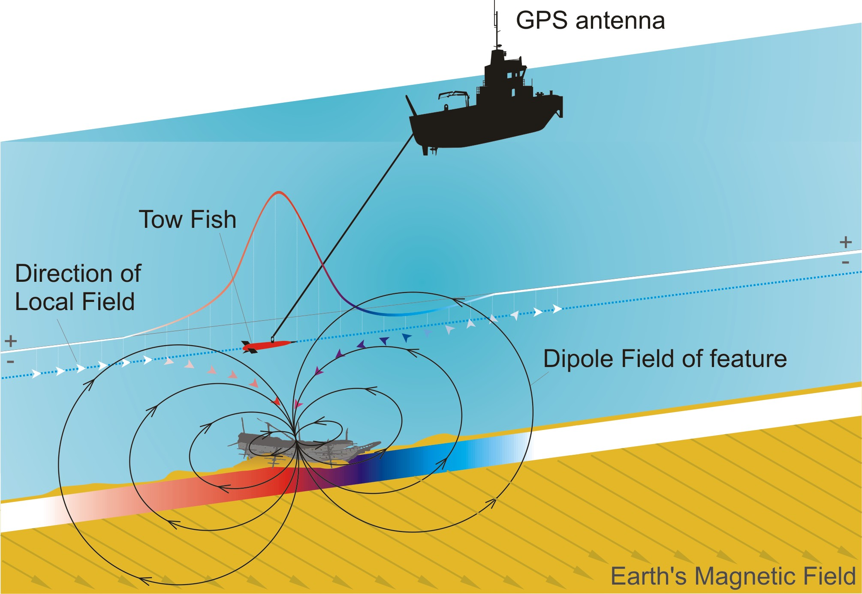

Slide 13
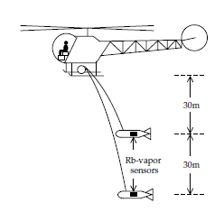
Magnetic Surveying: magnetic gradiometers
The magnetic gradiometer consists of a pair of alkali-vapor magnetometers maintained at a fixed distance from each other
In ground-based surveying the instruments are mounted at opposite ends of a rigid vertical bar. In airborne usage two magnetometers are flown at a vertical spacing of about 30 m. The difference in outputs of the two instruments is recorded. If no anomalous body is present, both magnetometers register the Earth’s field equally strongly and the difference in output signals is zero. If a magnetic contrast is present in the subsurface rocks, the magnetometer closest to the structure will detect a stronger signal than the more remote instrument, and there will be a difference in the combined output.
The gradiometer emphasizes anomalies from local shallow sources at the expense of large-scale regional variation due to deep-seated sources. Moreover, because the gradiometer registers the difference in signals from theindividual magnetometers, there is no need to compensate the measurements for diurnal variation, which affects each individual magnetometer equally

Slide 14
Magnetic Surveying: survey patterns
In a systematic regional airborne (or marine) magnetic survey the measurements are usually made according to a predetermined pattern. In surveys made with fixed-wing aircraft the survey is usually flown at a constant flight elevation above sea-level.
The survey focuses on the depth to the magnetic basement, which often underlies less magnetic sedimentary surface rocks at considerable depth This method would be suitable over ancient shield areas, where the goal of the survey is to detect local mineralizations with potential commercial value
If a helicopter is being employed, the distance from the magnetic sources may be kept as small as possible by flying at a constant height above the ground surface.

Slide 15
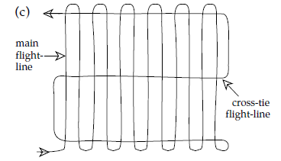
Magnetic Surveying: survey patterns
The usual method is to survey a region along parallel flight-lines, which may be spaced anywhere from 100 m to a few kilometers apart, depending on the flight elevation used, the intensity of coverage, and the quality of detail desired.
The orientation of the flightlines is selected to be more or less normal to the trend of suspected or known subsurface features.
Additional tielines are flown at right angles to the main pattern. Their separation is about 5–6 times that of the main flight-lines. The repeatability of the measurements at the intersections of the tie-lines and the main flight-lines provides a check on the reliability of the survey.

Slide 16
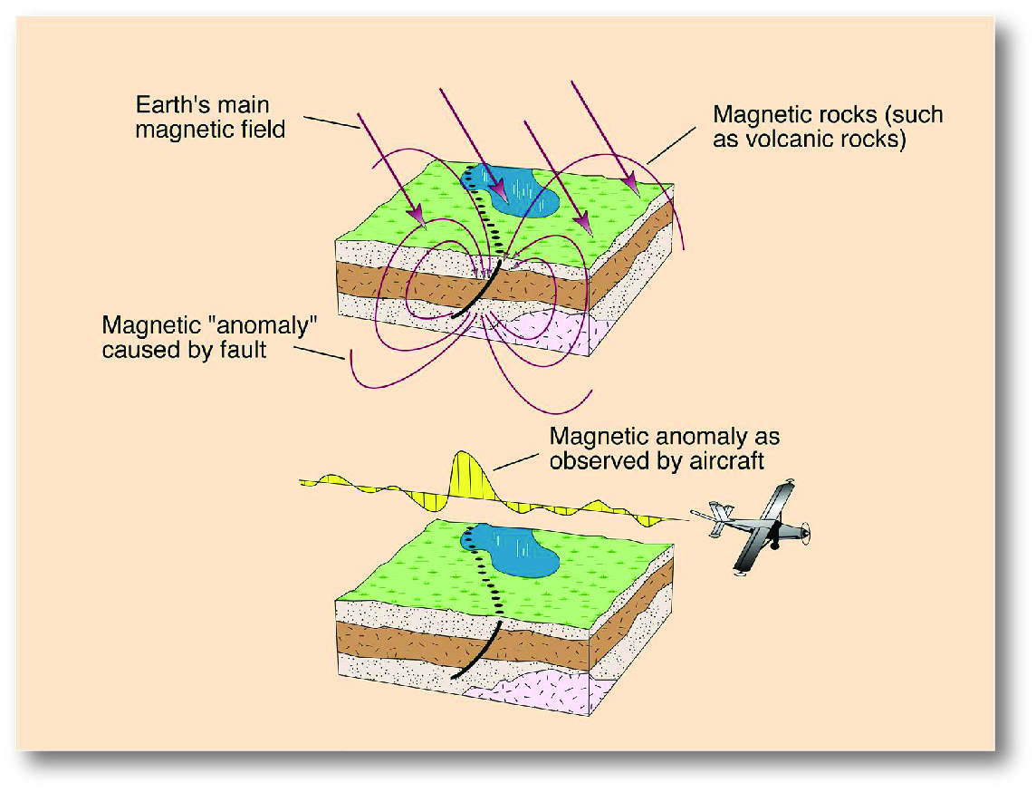

Slide 17
Magnetic Surveying: data reduction
Corrections needed for magnetic surveys are fewer than for gravity surveys and generally are of less importance.
Diurnal variations.
The strength of the Earth’s field changes over the course of a day, called diurnal variation. Variation seldom reaches as much as 100 nT over 24 hrs, but during occasional magnetic ‘storms’ it can exceed 1000 nT. As the diurnal variation changes smoothly (unlike storms), it can be measured by returning periodically to the base station, in the manner of drift correction of a gravimeter
Alternatively, a magnetometer that records values at regular intervals can be left at the base station and is more convenient. To correct survey readings for diurnal variation, first some time is adopted as a reference – here it’s the time the recording began – and then diurnal changes from this time are read off at the times of survey readings and added to (or subtracted from) the survey readings. If the anomaly is large or the time spent recording it is short, correcting for diurnal variation may make little difference to the anomaly, but recording it provides a check that the instrument is functioning correctly. It will also detect if a magnetic storm is occurring;

Slide 18
Magnetic Surveying: data reduction
Altitude variations.
The variation of magnetic field with altitude is dominated by the vertical variations of the dipole field. The total intensity B_{t} of the field is obtained by computing the resultant of the radial component B_{r} and the tangential component B_{θ}
The altitude correction is given by the vertical gradient of the magnetic field, obtained by differentiating the intensity B_{t} with respect to radius, r. This gives:
The vertical gradient of the field clearly depends on the latitude of the measurement site. At the magnetic equator (B_{t}≈30,000 nT) the altitude correction is about 0.015 nT m⁻¹; near the magnetic poles (Bt≈60,000 nT) it is about 0.030 nT m⁻¹. The correction is so small that it is often ignored.

Slide 19
Magnetic Surveying: data reduction
Regional variations
The IGRF expresses the undisturbed geomagnetic field in terms of a large number of harmonics and includes temporal terms to correct for secular variation. The complexity of the IGRF requires the calculation of the reference field by computer.
It must be realized, however, that the IGRF is imperfect as the harmonics employed are based on observations at relatively few, scattered, magnetic observatories.
The IGRF in areas remote from observatories can be substantially in error
A method of removing the regional gradient over a relatively small survey area is by use of trend analysis. A trend line (for profile data) or trend surface (for areal data) is fitted to the observations using the least squares criterion, and subsequently subtracted from the observed data to leave the local anomalies as positive and negative residuals

Slide 20
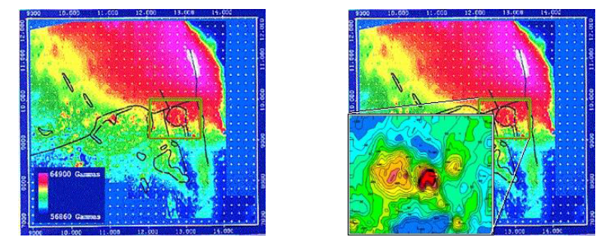
Magnetic Surveying: data reduction
Example: regional field removal
Airborne magnetic data gathered over a 25 square km area around a mineral deposit in central British Columbia. Some geological structural information is shown as black lines. The monzonite stock in the centre of the boxed region is a magnetic body, but this is not very clear in the data before removing the regional trend

Slide 21
Magnetic Surveying: aeromagnetic map construction

Slide 22
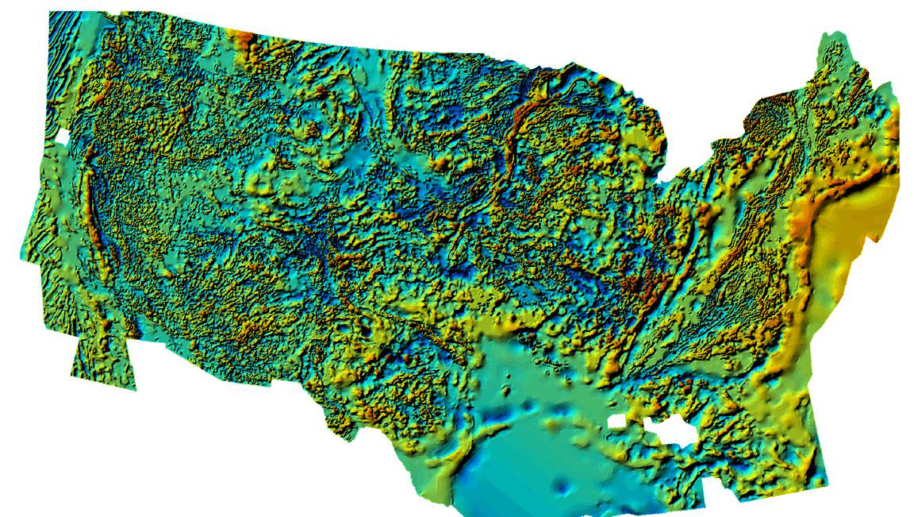
Magnetic Surveying: aeromagentic map

Slide 23
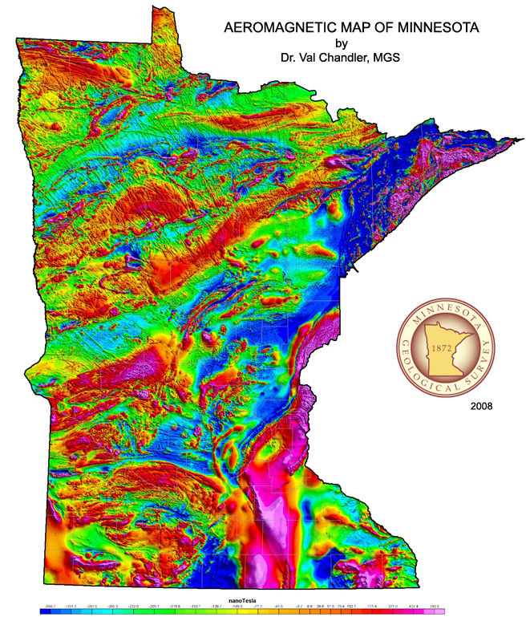
Magnetic Surveying: aeromagentic map

Slide 24
Magnetic Surveying: magnetic anomaly
Unlike gravity, the magnetic field varies markedly over the Earth’s surface, being roughly twice as strong at the Earth’s magnetic poles as the equator. This variation does not matter for surveys of small areas, but is corrected for on regional ones. The field subtracted is the IGRF – International Geomagnetic Reference Field.
The IGRF is considerably more complicated than the International Gravity Formula used for latitude corrections in gravity surveys. It is revised every five years to take account of secular variation.
A magnetic anomaly originates in the magnetization contrast (ΔM) between rocks with different magnetic properties.
The shape of the anomaly depends not only on the shape and depth of the source object but also on its orientation to the profile and to the inducing magnetic field, which itself varies in intensity and direction with geographical location

Slide 25
Magnetic Surveying: magnetic anomaly
In oceanic magnetic surveying the magnetization contrast results from differences in the remanent magnetizations of crustal rocks
Commercial geophysical prospecting is carried out largely in continental crustal rocks, for which the magnetization M may be assumed to be induced by the present geomagnetic field.
The magnetization contrast is then due to susceptibility contrast in the crustal rocks. If k represents the susceptibility of an body, k₀ the susceptibility of the host rocks and F the strength of the inducing magnetic field, we can write:

Slide 26
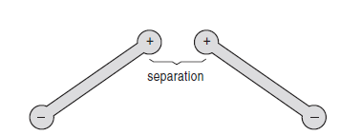
Magnetic Surveying: magnetic anomaly
To understand the anomaly shapes we will use the concept of magnetic pole distributions. A magnetic body can be thought of as being made of magnetic poles. Poles always occur as positive and negative pairs, but magnets can be made so long and thin that the effect of a single pole can be isolated.
Poles repel each other if they are both positive or both negative but attract if of opposite polarity. In either case, the force is proportional to the inverse square of their separation, like gravitational attraction between small masses.
When calculating the magnetic field due to a body we usually have to add the fields of one or more pairs of opposite poles. The simplest body is a dipole

Slide 27
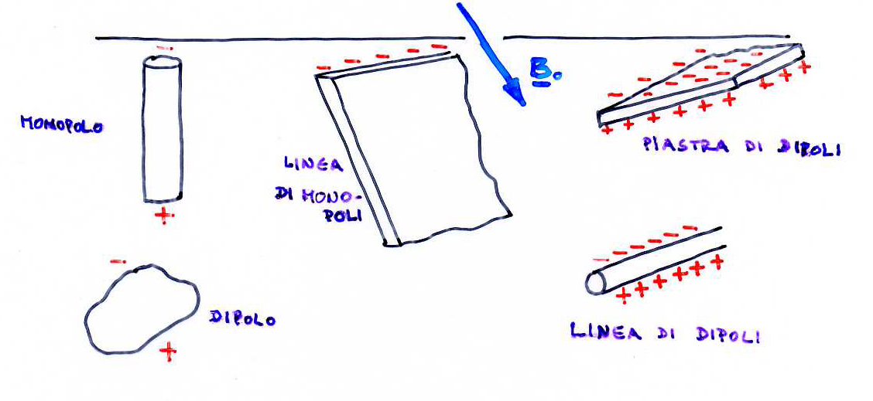
Anomalie magnetiche
Un’anomalia magnetica rappresenta un disturbo locale del CMT dovuto ad una variazione locale nella magnetizzazione – contrasto di magnetizzazione.
L’anomalia osservata esprime l’effetto complessivo della magnetizzazione indotta e quella residua – che possono avere intensità e direzioni diverse. Poichè la magnetizzazione residua è altamente variabile e poco misurata, le anomalie vengono interpretate come se la magnetizzazione indotta fosse l’unica sorgente dell’anomalia.
Le anomalie magnetiche vengono di solito interpretate in termini di dipoli e monopoli (singoli, linee, piastre) a seconda dell’estensione geometrica dei corpi geologici a cui sono associate.

Slide 28
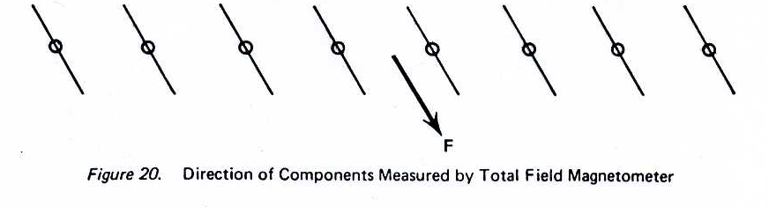
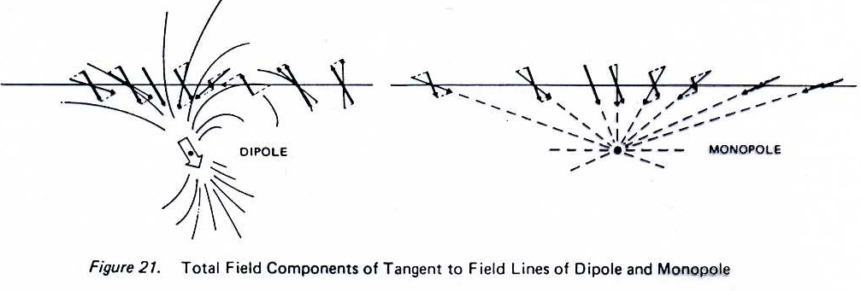
L’anomalia magnetica dipende dalla direzione del campo esterno

Slide 29
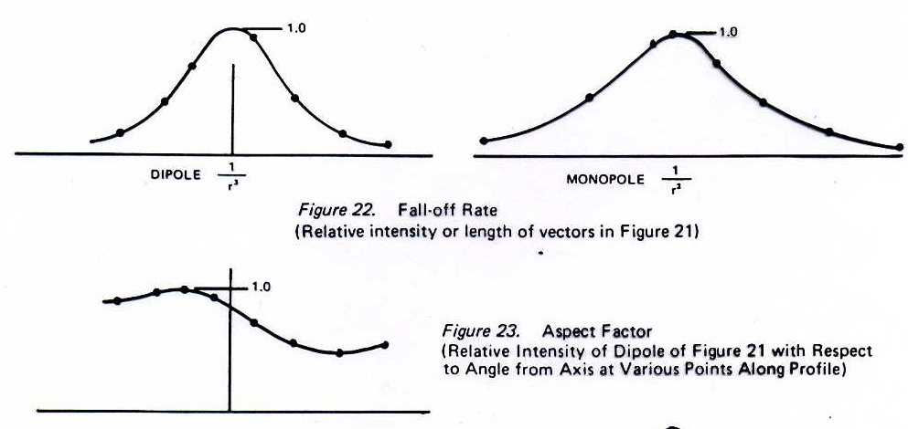
L’anomalia magnetica dipende dalla direzione del campo esterno

Slide 30
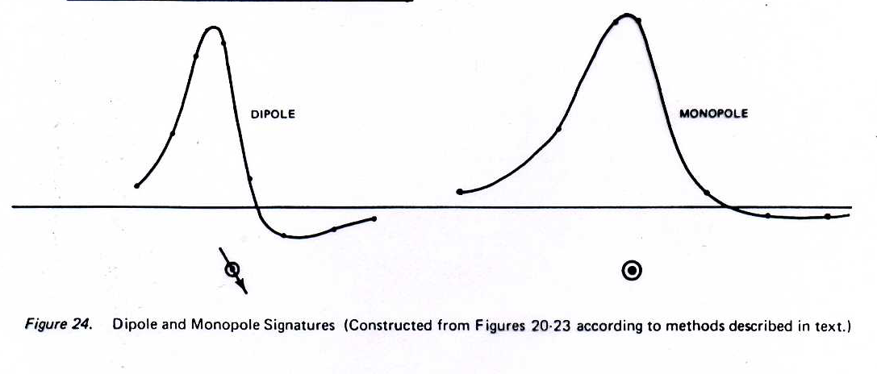
L’anomalia magnetica dipende dalla direzione del campo esterno

Slide 31
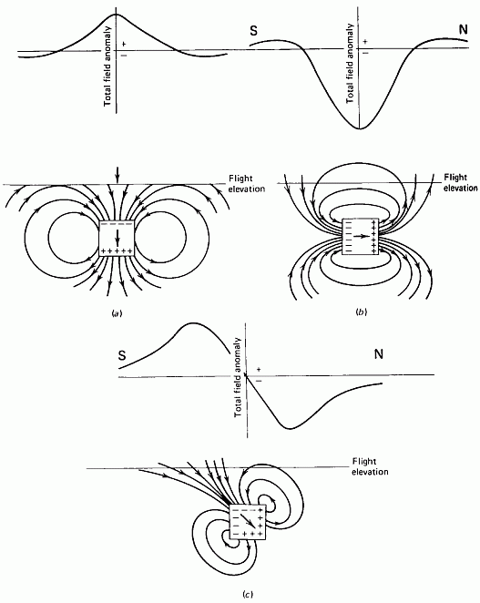
The anomalies are different because a susceptible body will be magnetized in the direction of the Earth's field. The body then produces its own field around it which is similar to a dipole field. That induced field adds vectorially to the ambient field

Slide 32
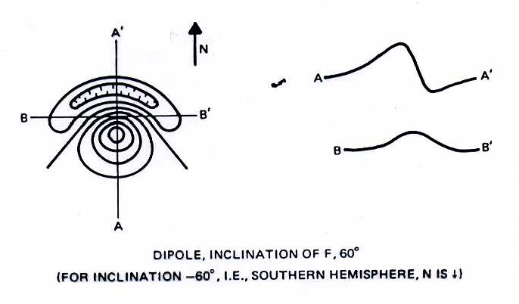
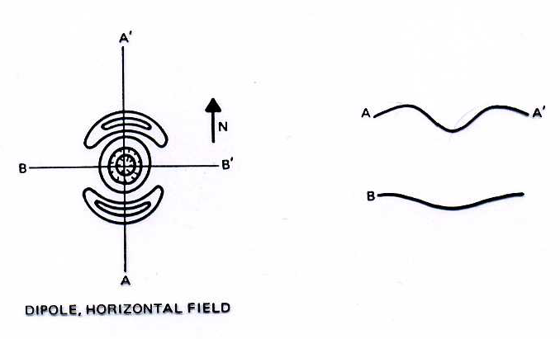
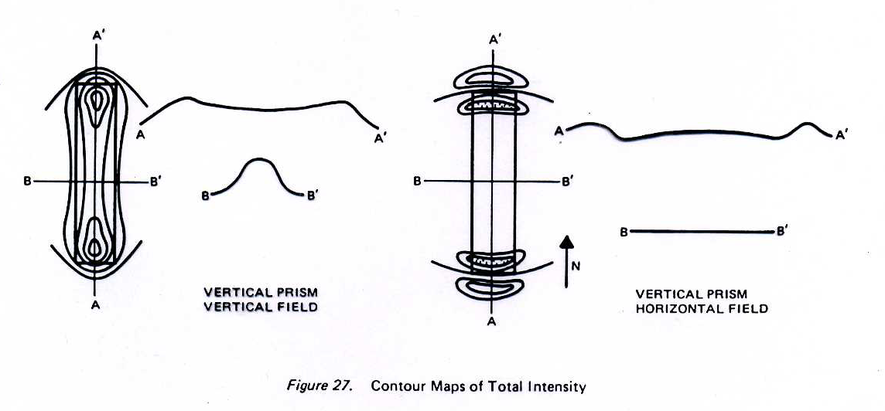

Slide 33
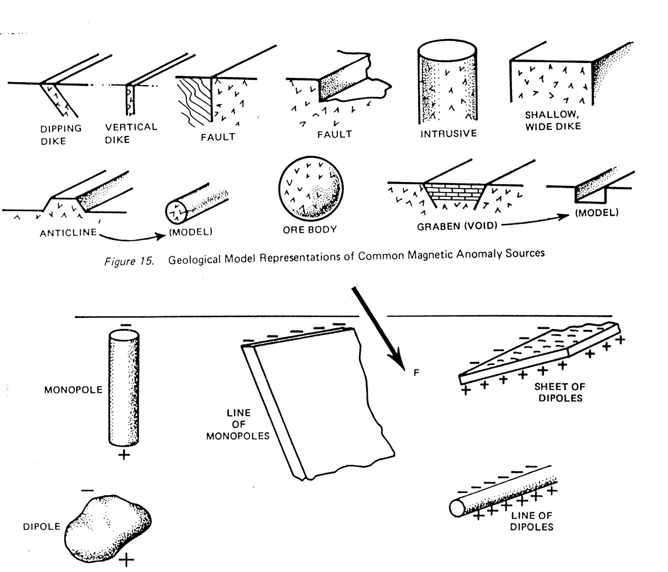

Slide 34
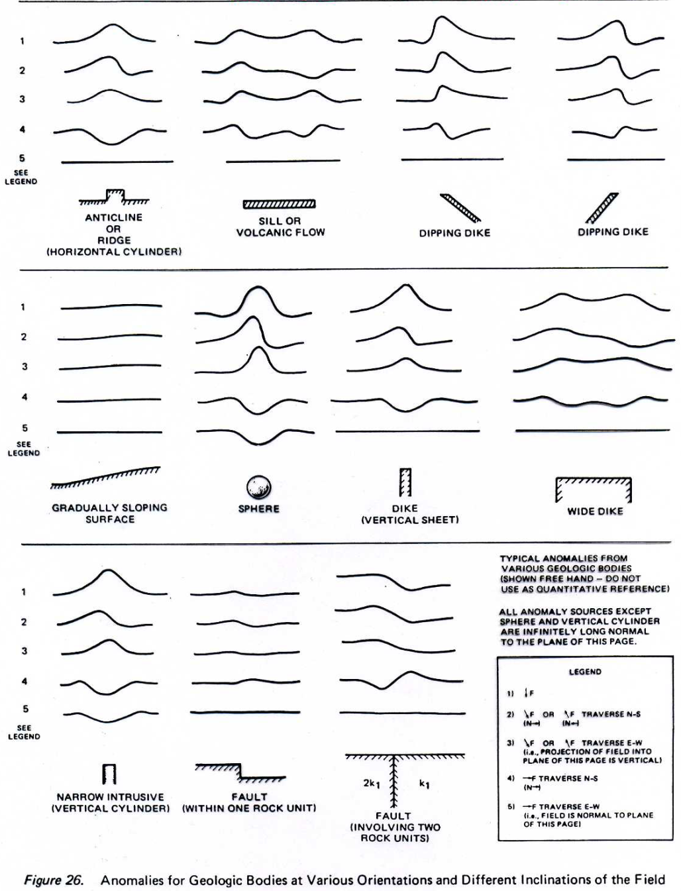
Anomalie magnetiche per corpi geologici diversi

Slide 35
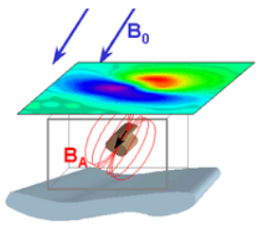
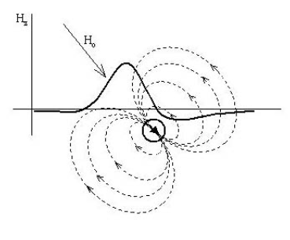

Slide 36
Magnetic Surveying: magnetic anomaly
Some insight into the physical processes that give rise to a magnetic anomaly can be obtained from the case of a vertically sided body that is magnetized by a vertical magnetic field.
N.B This is a simplified situation because in practice both the body and the field will be inclined, probably at different angles
Example: vertical dike
N.B we will assume a two-dimensional situation, where the horizontal length of the dike is infinite. We assume that the dike extends to very great depths so that we can ignore the small effects associated with its remote lower end. The vertical sides of the dike are parallel to the magnetization and no magnetic poles are distributed on these faces.
However, the horizontal top face is normal to the magnetization and a distribution of magnetic poles can be imagined on this surface. The direction of magnetization is parallel to the field, so the pole distribution will consist of “south” poles. The magnetized dike behaves like a magnetic monopole. At any point above the dike we measure both the inducing field and the anomalous “stray field” of the dike, which is directed toward its top

Slide 37
Magnetic Surveying: magnetic anomaly
Example: vertical dike
The anomalous field has a component parallel to the Earth’s field and so the total magnetic field will be everywhere stronger than if the dike were not present. The magnetic anomaly is everywhere positive, increasing from zero far from the dike to a maximum value directly over it

Slide 38
Magnetic Surveying: magnetic anomaly
Example vertical dike
If the vertical extent of the dike is finite, the distribution of north poles on the bottom of the dike may be close enough to the ground surface to produce a measurable stray field. The upper distribution of south poles causes a positive magnetic anomaly, as in the previous example. The lower distribution of north poles causes a negative anomaly.
The north poles are further from the magnetometer than the south poles, so their negative anomaly over the dike is weaker. However, farther along the profile the deeper distribution of poles subtends a larger angle than the upper one does.

Slide 39
Magnetic Surveying: magnetic anomaly
Example: vertical dike
Beyond a certain lateral distance from the dike (to the left of L and to the right of R) the negative anomaly of the lower pole distribution is stronger than the positive anomaly of the upper one. This causes the magnetic anomaly to have negative side lobes, which asymptotically approach zero with increasing distance from the dike
The magnetized dike in this example resembles a bar magnet and can be modelled crudely by a dipole. Far from the dike, along a lateral profile, the dipole field lines have a component opposed to the inducing field, which results in the weak negative side lobes of the anomaly. Closer to the dike, the dipole field has a component that reinforces the inducing field, causing a positive central anomaly

Slide 40
Magnetic Surveying: magnetic anomaly
Example: inclined magnetization
When an infinitely long dike is magnetized obliquely rather than vertically, its anomaly can be modelled either by an inclined dipole or by pole distributions. The magnetization has both horizontal and vertical components, which produce magnetic pole distributions on the vertical sides of the dike as well as on its top and bottom.

Slide 41
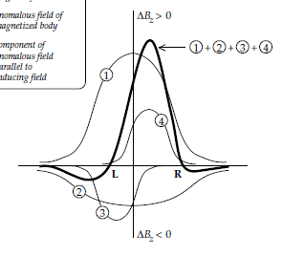
Magnetic Surveying: magnetic anomaly
Example: inclined magnetization
The symmetry of the anomaly is changed so that the negative lobe of the anomaly is enhanced on the side towards which the horizontal component of magnetization points; the other negative lobe decreases and may disappear.
The shape of a magnetic anomaly also depends on the angle at which the measurement profile crosses the dike, and on the strike and dip of the dike

Slide 42
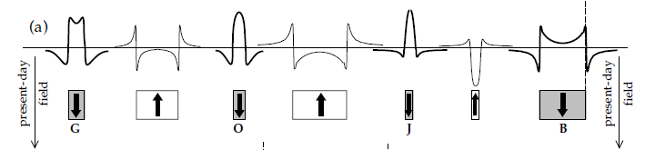
Magnetic Surveying: oceanic magnetic anomalies
The concept of magnetic pole distributions can be applied individually to each block of the oceanic crust individually to determine the shape of its magnetic anomaly.
If the blocks are contiguous, as is the case when they form by a continuous process such as sea-floor spreading, their individual anomalies will overlap
If the two sets of crustal blocks are brought together at the spreading axis, a magnetic anomaly sequence ensues that exhibits a symmetric pattern with respect to the ridge axis

Slide 43
Magnetic Surveying: magnetic anomaly
N.B: to deduce the anomaly it produces we also need to take account of its orientation and the Earth’s field!
Anomaly of a dipole at different latitudes
At the equator the anomaly is symmetrical, with a trough between two peaks Immediately above the dipole at A the field is opposite to the Earth’s field, so the total intensity is reduced, while at B and C it increases the total field, though by a lesser amount, because of the greater distance from the dipole.

Slide 44
Magnetic Surveying: magnetic anomaly
Example: anomaly of a sphere
The field of a uniformly magnetised sphere–approximating to, for example, a compact ore body is the same as that of a dipole at its centre (regardless of whether it is deep compared to its radius)
Magnetic anomaly map
Anomaly contours over the Marmora ore body in Canada, found by an aeromagnetic survey
That an S–N profile through the map is similar to that of a buried sphere at the same

Slide 45
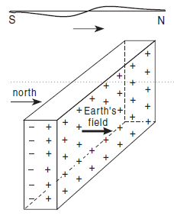
Magnetic Surveying: magnetic anomaly
Example: sheet striking E–W
If the field is horizontal the poles are formed on opposite vertical faces of the sheet, like dipoles stacked one above the other. Each dipole produces an anomaly field except that the deeper the dipole, the lower and broader its anomaly. Together, they add to an anomaly somewhat broader than that of the top one alone
At the north magnetic pole, where the field is vertically downwards, poles are formed along the upper and lower edges of the sheet. If the sheet extends to great depths, the field of the lower poles will be negligible because of their distance from the surface, so only the top edge need be considered. It produces a symmetrical, positive anomaly

Slide 46
Magnetic Surveying: magnetic anomaly
Example: sheet striking E–W
At intermediate latitudes poles form on top, base, and sides.

Slide 47
Magnetic Surveying: magnetic anomaly
Example: sheet striking N–S
At the magnetic equator, these are the vertical ends; if the sheet is long with its ends remote from the survey area, these will produce little field, so, surprisingly, it would not be detectable magnetically
At the magnetic north pole, the poles form only along the top and base; this is the same as for a E–W striking sheet, because at the poles strike direction has no significance
At intermediate latitudes, poles along the top dominate producing a symmetrical though reduced anomaly.

Slide 48
Magnetic Surveying: magnetic anomaly
Example: horizontal crustal block
Let the width of the block be 2m, and let the horizontal position be measured from the mid point of the block, so that x₁=x-m and x₂=x+m. The top of the block is at depth z₁ and its base at depth z₂
The vertical magnetic field anomaly over the block is:
ΔM_{z} is the magnetization contrast and the angles (α₁ –α₂) and (α₃ –α₄) are the planar angles subtended at the point of measurement by the top and bottom edges of the vertically magnetized crustal block respectively.
NB: Magnetic profiles normal to the strike of elongate bodies may be regarded as two-dimensional, as long as the third dimension of the body is large enough for variations normal to the profile to be negligible.

Slide 49
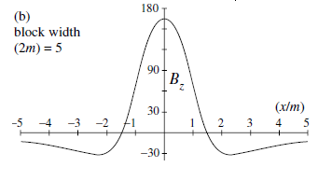
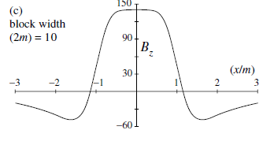
Magnetic Surveying: magnetic anomaly
Example: horizontal crustal block
2m=5
Effect of block width on anomaly shape: The block is effectively a thin magnetized layer, similar to the source of oceanic magnetic anomalies: vertically magnetized block with its top at depth 2.5 km and base at depth 3 km
The narrowest block gives a sharp, positive central anomaly with negative side lobes
As the block widens with respect to its depth, the top of the central anomaly flattens its amplitude over the middle of the block decreases, and the negative side lobes grow. When the block is much wider than the depth to its top a dip develops over the center of the block.
The positive anomalies are steep sided and are maximum just within the edges of the block, while the null values occur close to the edges of the block.
The negative side anomalies are almost as large as the positive anomalies. The pronounced central dip in the anomaly is due to the limited vertical thickness of the layer.
If the layer is very wide relative to its thickness, the central anomaly may diminish almost to zero
2m=10
2m=40

Slide 50
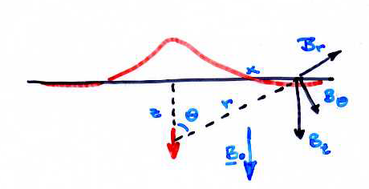
Anomalia dovuta ad un dipolo
Le componenti radiale e tangenziale di un dipolo sono:
In aree in cui il CMT è verticale o quasi verticale (I da 70° a 90°) il dipolo indotto sarà anche verticale ed il magnetometro misurerà la componente B_{z}
L’anomalia avrà valore

Slide 51
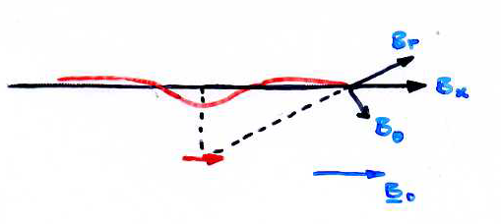
Anomalia dovuta ad un dipolo
Analogamente per un campo orizzontale:

Slide 52
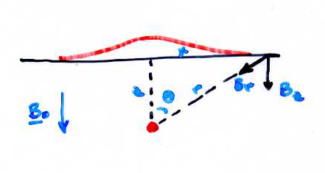
Anomalia dovuta ad un monopolo
Il monopolo ha solo la componente radiale
Per cui
Ed avremo

Slide 53
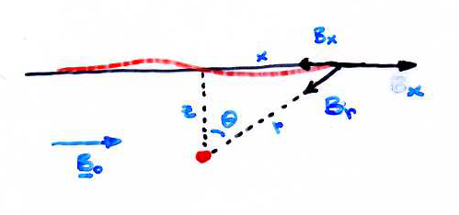
Anomalia dovuta ad un monopolo
Analogamente per un campo orizzontale avremo:

Slide 54
Sfera
Un dipolo può essere sempre assunto per una sorgente le cui dimensioni sono piccole rispetto alla distanza di misura (meno di 1/5 o 1/10).
Campo al polo
Per una sfera di raggio a avremo
Lungo l’asse del dipolo
Notiamo che la formula non dipende dalle unità di lunghezza, per cui l’anomalia dovuta ad una sfera di 1 km raggio e 2 km di distanza è uguale a quella di una sfera di 1 m di raggio a 2 m di distanza. Pertanto piccoli oggetti locali possono dar luogo ad anomalie confrontabili con quelle di corpi geologici che vogliamo scoprire!

Slide 55
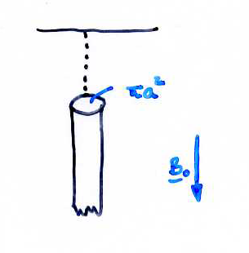
Per un monopolo, la cui dipendenza da r è di 1/r², avremo che

Slide 56
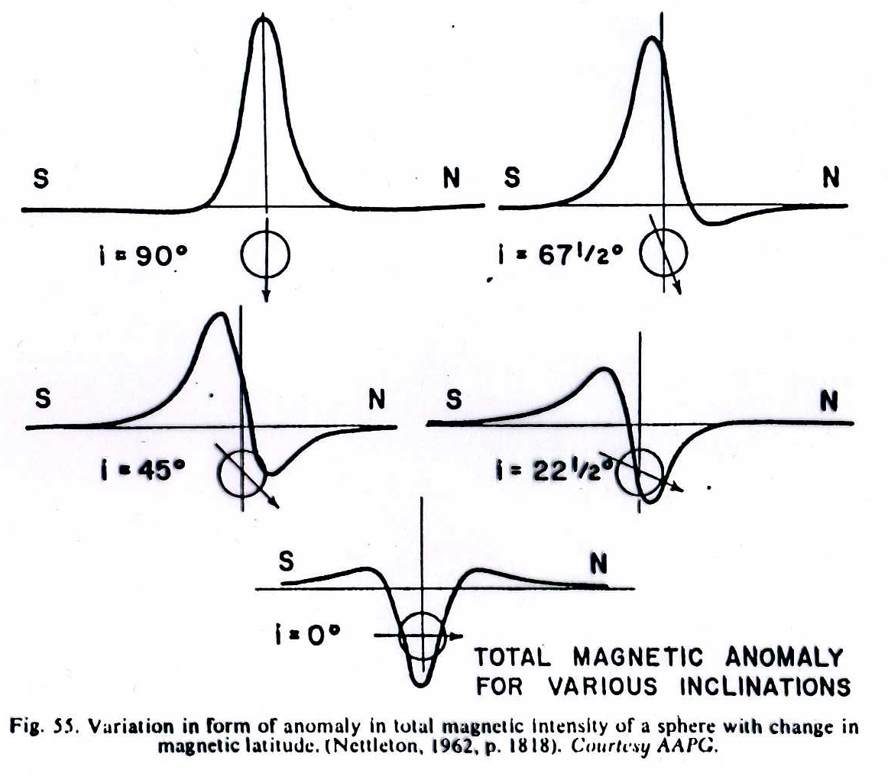
Anomalia dovuta ad una sfera magnetizzata a diverse latitudini

Slide 57
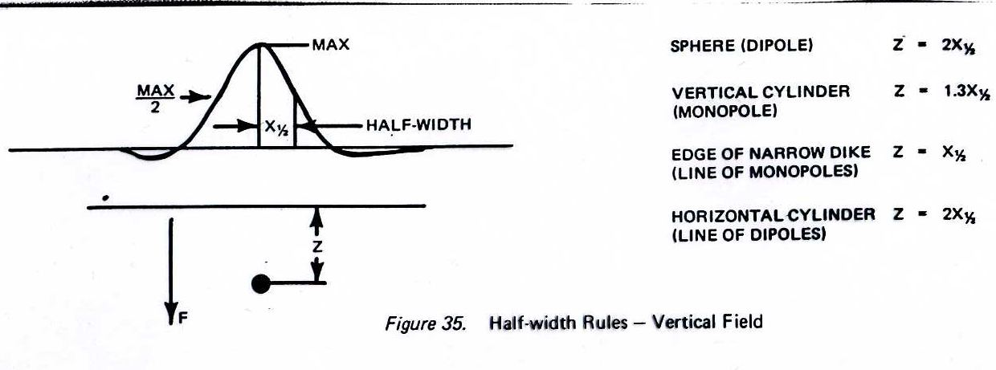

Slide 58
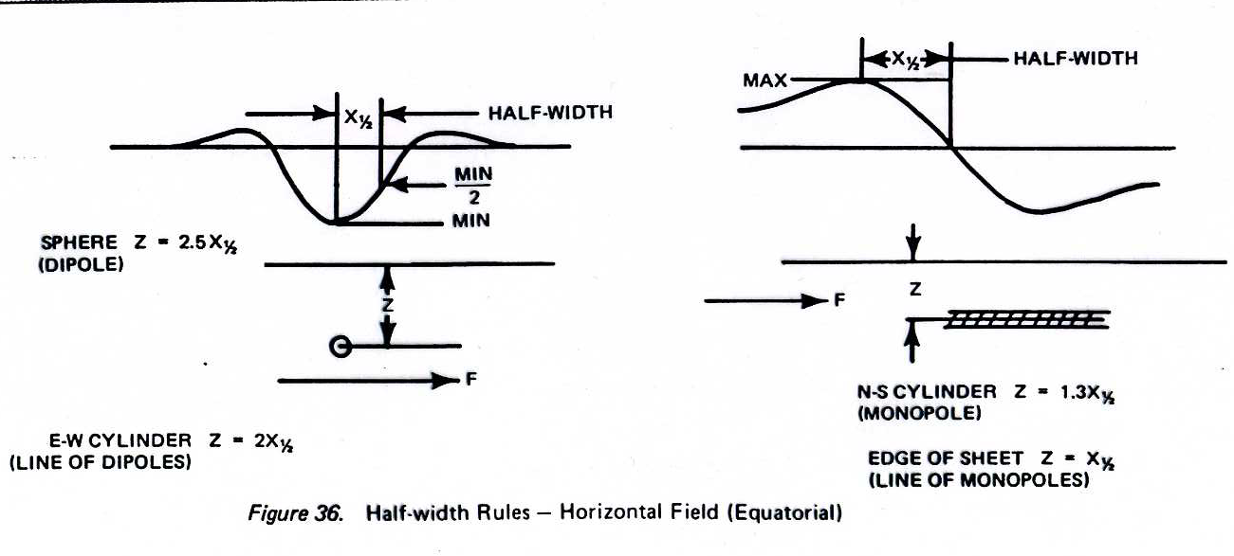

Slide 59
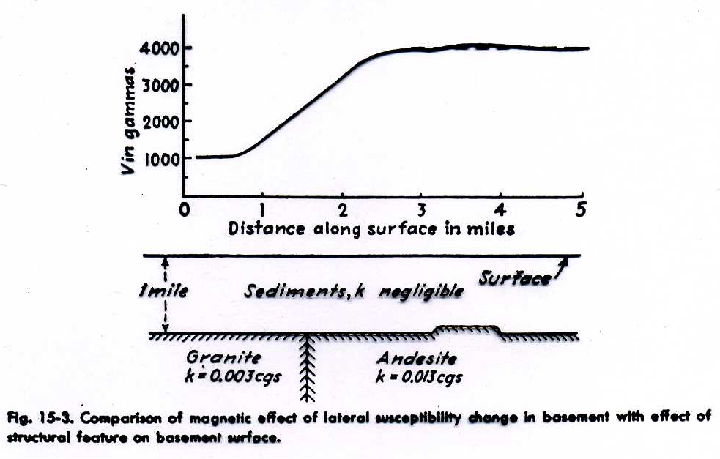
Anomalia di una piastra semiinfinita:

Slide 60
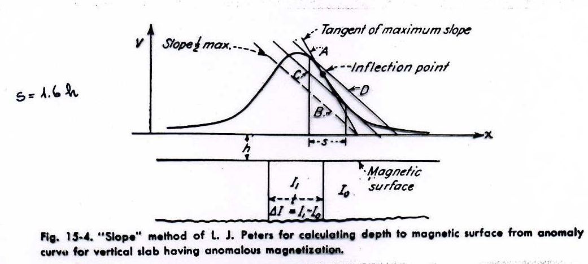
Anomalia di una piastra semiinfinita:

Slide 61
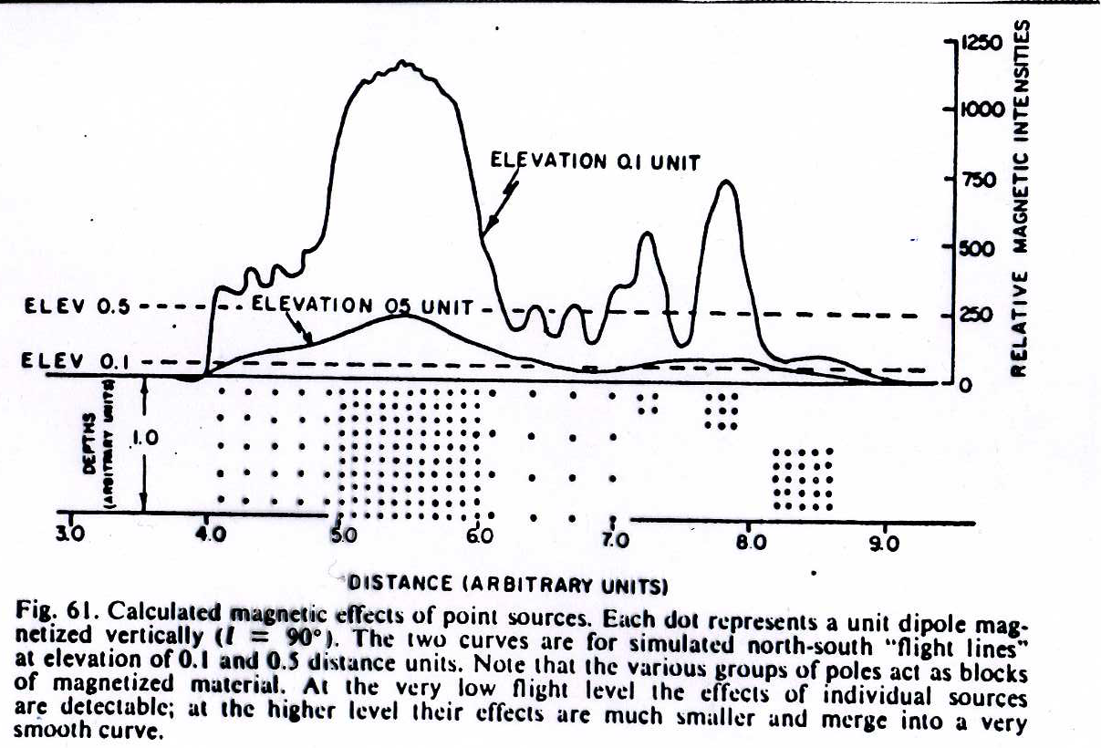

Slide 62
Magnetic Surveying: interpretation
Simply shaped bodies, allows simple interpretations. Often, though, bodies have complicated shapes, and they have both induced and remanent magnetisations at an angle, and then forward modellingis a more useful approach.
Forward modelling: guessing a model, computing its anomaly, and comparing it with the observed one
“Guess” geology
Calculate result - Compare to data
Iterate.

Slide 63
Magnetic Surveying: forward modeling
Example: forward modeling

Slide 64
Magnetic Surveying: magnetic anomaly
Example: non uniqueness
Non-uniqueness of the interpretation: it is particularly important that models be constrained by all available information and the remanent magnetisation and susceptibilities of samples measured if possible.

Slide 65
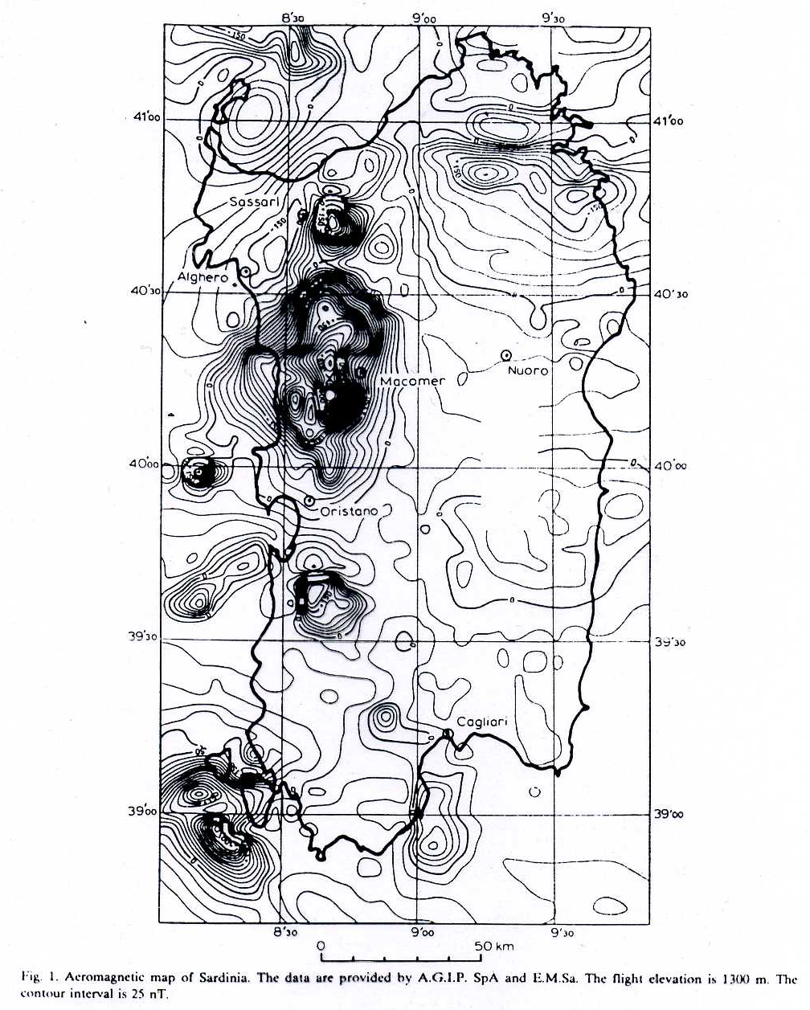
Interpretazione anomali magnetica complessa

Slide 66
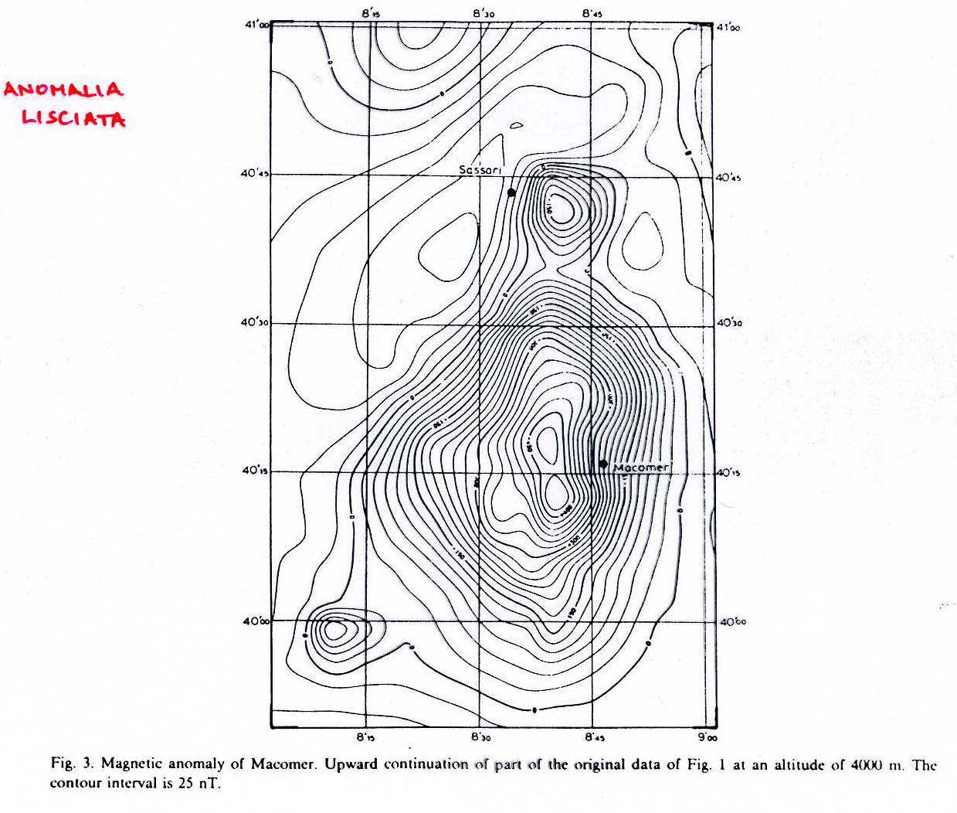

Slide 67
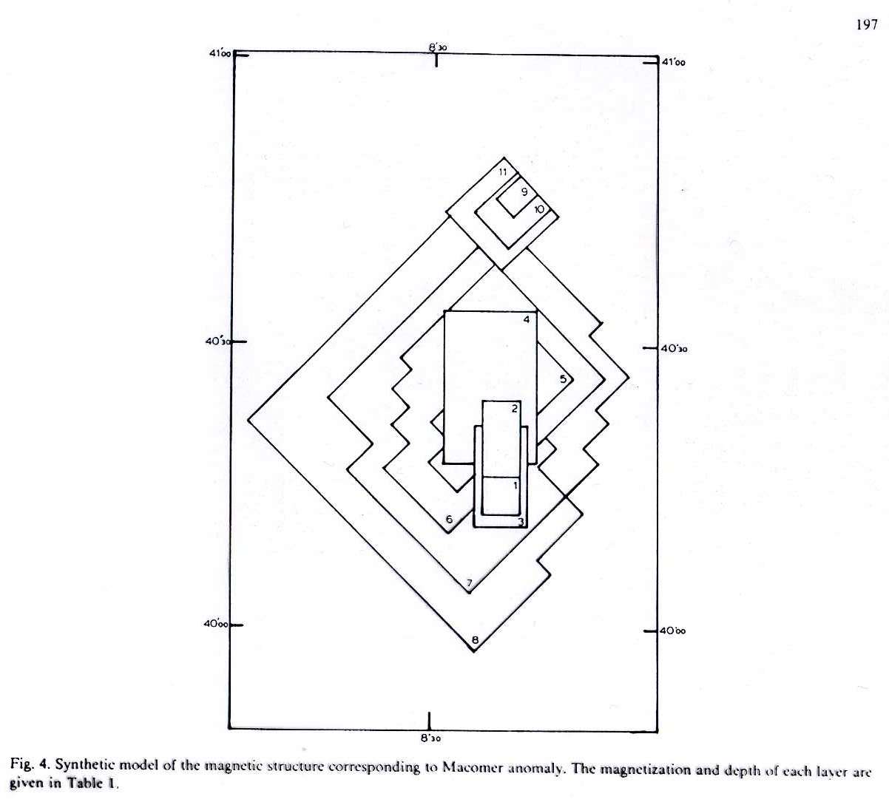
Modello sintetico

Slide 68
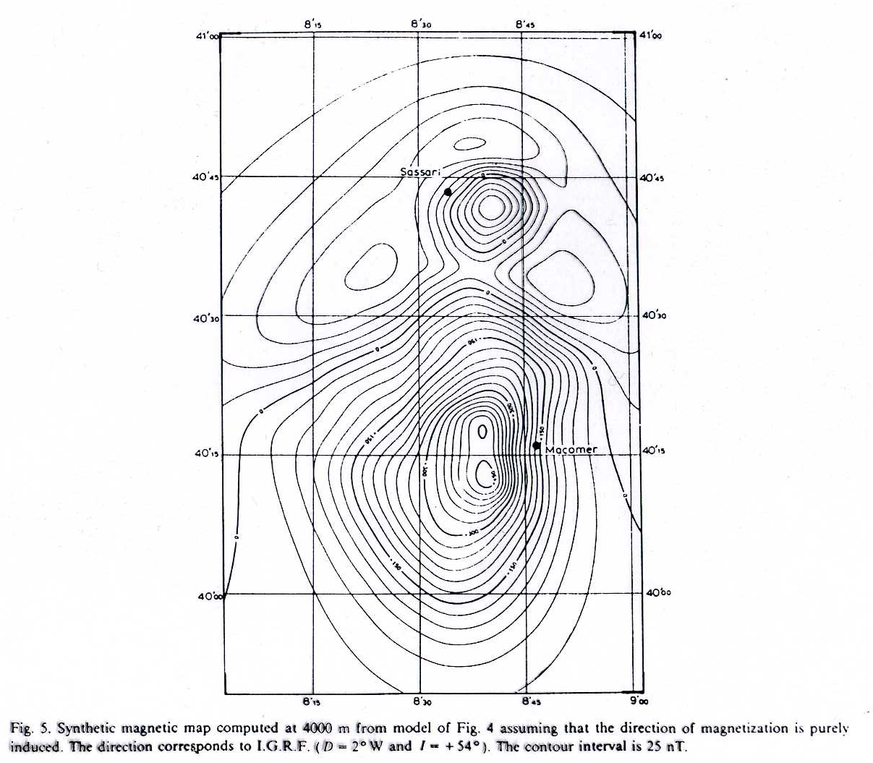
Anomalia risultante dal modello

Slide 69
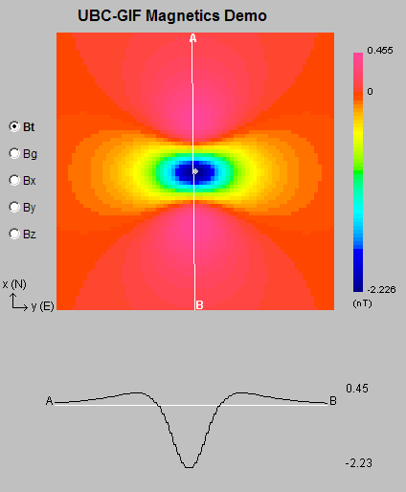
Magnetic Surveying: reduction to the pole.
Objects buried at different locations on the earth yields different total field anomalies
Inclination=0°
Inclination=45°
Inclination=90°

Slide 70
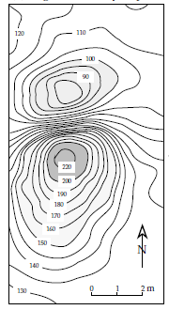
Magnetic Surveying: reduction to the pole.
The asymmetry (or skewness) of a magnetic anomaly can be compensated by the method of reduction to the pole.
This consists of recalculating the observed anomaly for the case that the magnetization is vertical. The method involves sophisticated data-processing.
The reduction to the pole removes the asymmetry of an anomaly and allows a better location of the margins of the disturbing body. Among other applications, the procedure has proved to be important for detailed interpretation of the oceanic crustal magnetizations responsible for lineated oceanic magnetic anomalies..

