Slide 1
Scalar-Vector-Tensor
A quantity described by only one number is called scalar, like as temperature.
A quantity described by three numbers, intensity (magnitude), direction, is called vector like as velocity v = [V_{x} ,V_{y} , V_{z}]
A quantity described by more one number i.e. 3 directions and 3 intensities is called tensor, like as strains in a continuous medium
Strain tensor

Slide 2
A scalar, a vector and a tensor quantity can be constant or depend on a variable (scalar, vector, tensor). When depend on a variable, the quantity is called field (scalar vectorial, tensorial).
If the coordinate system changes, the scalar is the same, instead the vector and the tensor have to be ricalculated.
So we define a quantity which “physical” proprieties are indipendent by the coordinate system (i.e. Intensity and direction of the vector).

Slide 3
Tensors are simply mathematical objects that can be used to describe physical properties, just like scalars and vectors. In fact tensors are merely a generalization of scalars and vectors; a scalar is a zero rank tensor, and a vector is a first rank tensor.
The rank (or order) of a tensor is defined by the number of directions (and hence the dimensionality of the array) required to describe it. For example, properties that require one direction (first rank) can be fully described by a 3×1 column vector, and properties that require two directions (second rank tensors), can be described by 9 numbers, as a 3×3 matrix. As such, in general an n^{th} rank tensor can be described by 3^{n} coefficients.
The need for second rank tensors comes when we need to consider more than one direction to describe one of these physical properties.

Slide 4
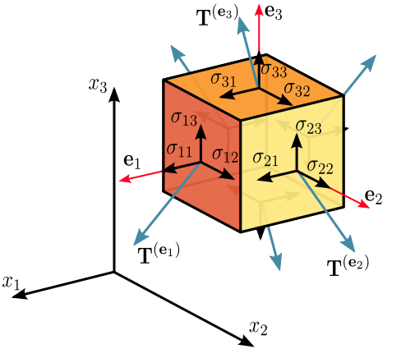
Tensors are geometric objects that describe linear relations between vectors, scalars, and other tensors.
Stress tensor

Slide 5
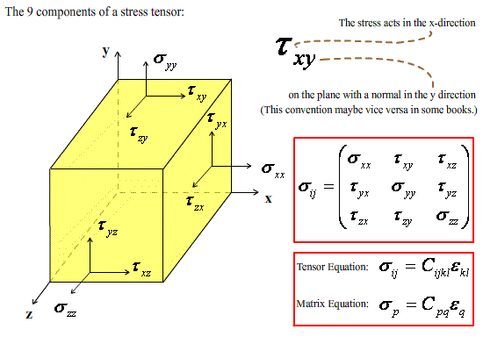

Slide 6
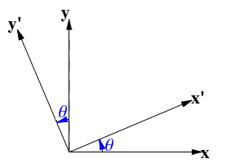

COORDINATE TRASFORMATIONS 2-D
and

Slide 7
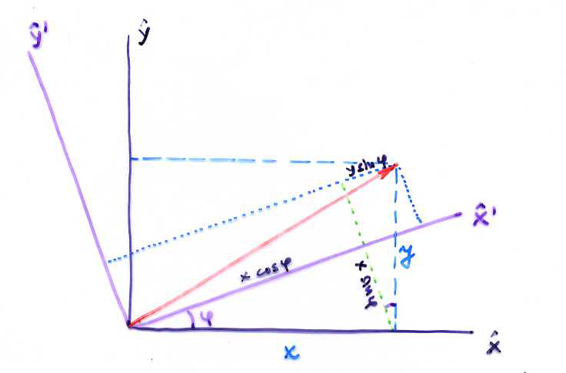
COORDINATE TRASFORMATIONS 2-D
NB: implied summation over repeated indices!

Slide 8
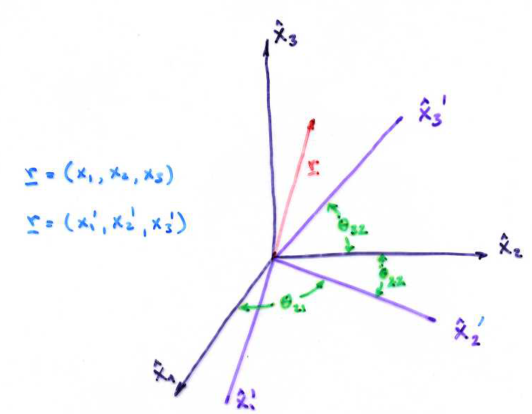
COORDINATE TRASFORMATIONS 3-D
NB:

Slide 9
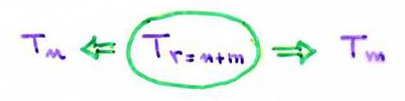

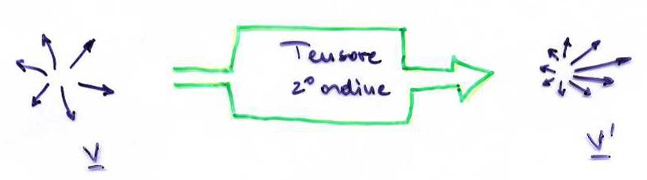
TENSORS
The tensor of r^{th} put in relation two tensors with rank m and n ( m+n=r)
Example: a vector is a trasformation of one point in an other one.
A tensor of second rank transfrom a vector (vectorial field) in an other one ( vectorial field).

Slide 10
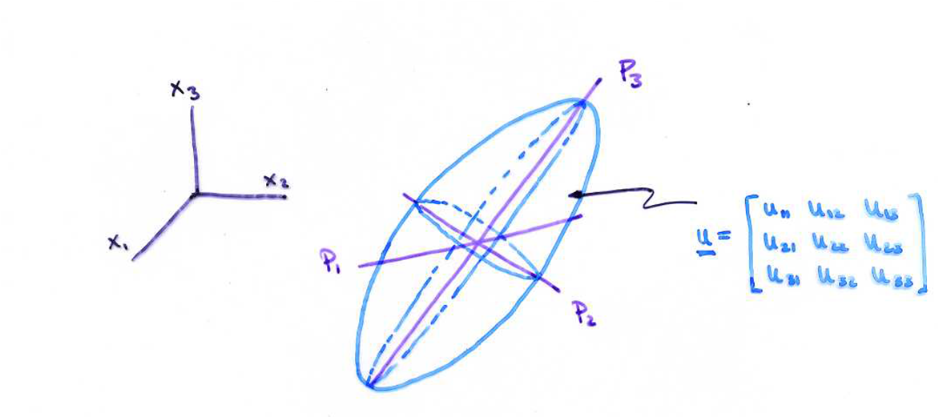
In almost all cases, the tensors of second rank are:
Symmetric
have positive eingenvalues
These tensors can be represented by ellisoidal surfaces.
6 indipendent components
The intersection of the main axes, P1, P2, P3, correspond to
where λ₁, λ₂, λ₃ are the eigenvalues ​​(major, intermediate, minor).

Slide 11
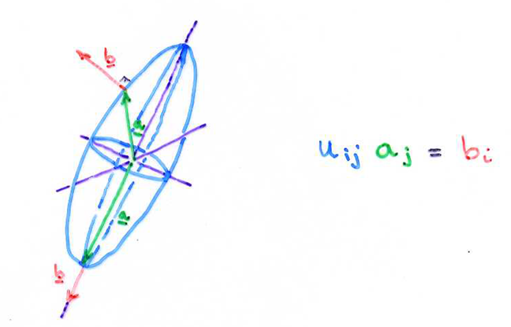
A tensor acting on a vector transforms it into another vector. The b direction is perpendicular to the a intersection with the ellipsoid u.
If a is parallel to one of the three main axes, then b || a .

Slide 12
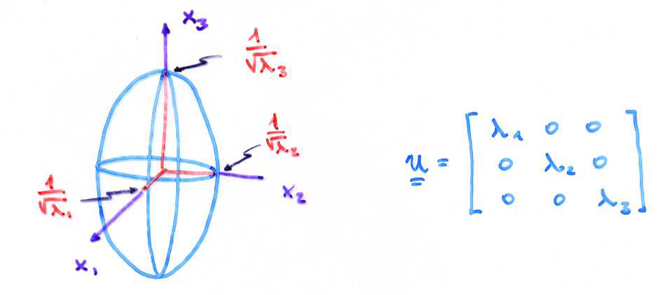
The representation ellipsoid surface oriented along the main axes is:

Slide 13
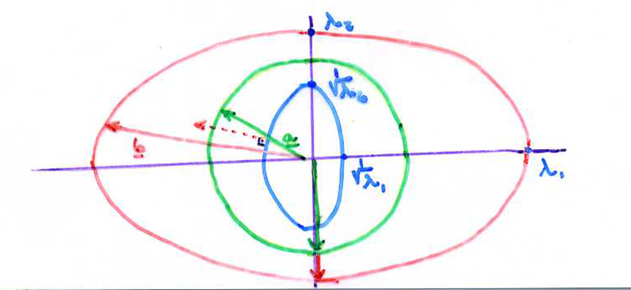
​​The length of the major, the intermediate and minor axis is
The intensity ellipsoid gives the b vector intensity that is (from ua)

Slide 14
CONTENTS:
Stress definition
Stress in two dimensions
Stress in three dimensions
Translations and rotations
Deviatoric stress
Mohr’s circle

Slide 15
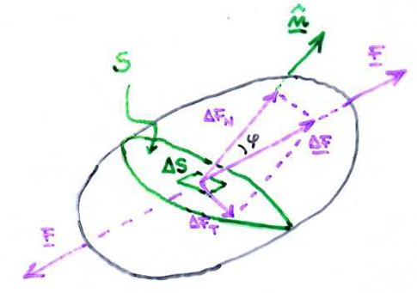
When on a solid body act external force (i.e. pressure, traction), the body is deformed changing shape and/or volume. The body that returns to its inizial condition when the external forces stopped, is called elastic body. For small deformation and small time scale (minutes not million years), the rocks can be consider elastic.
The elasticity theory links the forces applied on external surface of a body to its shape and volume changes. This relationship is expressed in term of stresses and strains.
Stresses are forces per unit area that are transmitted through a material by interatomic force fields. Stresses that are transmitted perpendicular to a surface are normal stresses; those that are transmitted parallel to a surface are shear stresses. The mean value of the normal stresses is the pressure.
We consider a body subjected to a traction force F and ΔS a surface element of a generic section S of the body of which the normal n makes an angle ϕ with F. If we named ΔF the force that acts on ΔS, the stress is:
Its unit in SI system is Pascal: 1Pa=1Nm⁻²

Slide 16
Consider the force that must act at the base of the column of rock at a depth y beneath the surface to support the weight of the column: the weight of the column of cross-sectional area δA, is ρgyδA.
This weight must be balanced by an upward surface force σ_{yy}δA distributed on the horizontal surface of area δA at depth y.
We are assuming that no vertical forces are acting on the lateral surfaces of the column and that the density ρ is constant:
σ_{yy} is thus the surface force per unit area acting perpendicular to a horizontal surface, that is, stress
Since the forces on the column of rock must be equal if the column is in equilibrium, we find:
The normal force per unit area on horizontal planes increases linearly with depth. The normal stress due to the weight of the overlying rock or overburden is known as the lithostatic stress or pressure.

Slide 17
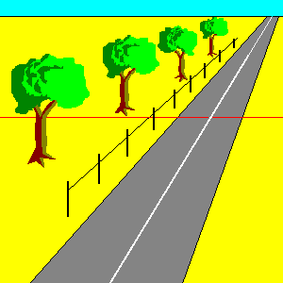
Surface forces can act parallel as well as perpendicular to a surface. An example is provided by the forces acting on the area element δA lying in the plane of a strike–slip fault:
The normal compressive force σ_{xx}δA acting on the fault face is the consequence of the weight of the overburden and the tectonic forces tending to press the two sides of the fault together. The tangential or shear force on the element σ_{xz}δA opposes the tectonic forces driving the left-lateral motion on the fault.
This shear force is the result of the frictional resistance to motion on the fault. The quantity σ_{xz} is the tangential surface force per unit area or the shear stress: the first subscript refers to the direction normal to the surface element and the second subscript to the direction of the shear force.

Slide 18
Sign convention
The tension stress (directed outwards the body) is positive.
The compressional stress (directed inwards the body) is negative.
The component along the positive direction of an axis is positive.
The component along the negative direction of an axis is negative.
The sign of the stress is the product of these signs (above).
Example: the component of a compressional stress directed along the negative axis is positive:
- x - = +
The horizontal tensile stress is a force per unit area acting on vertical planes and tending to pull on such planes. A compressive stress is a normal force per unit area tending to push on a plane. We consider compressive stresses positive and tensile stresses negative, a convention generally adopted in the geological literature. This is opposite to the sign convention used in most elasticity textbooks in which positive stress is tensional

Slide 20
Stress in two dimensions
In this section we will consider a two-dimensional state of stress; the state is two-dimensional in the sense that there are no surface forces in the z direction and none of the surface forces shown vary in the z direction. The normal stresses are σ_{xx} and σ_{yy}, and the shear stresses are σ_{xy} and σ_{yx}. The notation adopted in labeling the stress components allows immediate identification of the associated surface forces. The second subscript on σ gives the direction of the force, and the first subscript gives the direction of the normal to the surface on which the force acts.
The tangential or shear stresses σ_{xy} and σ_{yx} have associated surface forces that tend to rotate the element in Figure about the z axis. The moment exerted by the surface force σ_{xy}δyδz is the product of the force and the moment arm δx; that is, it is σ_{xy}δxδyδz. This couple is counteracted by the moment σ_{yx}δxδyδz exerted by the surface force σ_{yx}δxδz with a moment arm δy.

Slide 21
Because the element cannot rotate if it is in equilibrium:
Thus the shear stresses are symmetric in that their value is independent of the order of the subscripts. Three independent components of stress σ_{xx}, σ_{yy}, and σ_{xy} must be specified in order to prescribe the two-dimensional state of stress.

Slide 22
Stress in three dimensions
Stress components can be defined at any point in a material. In order to illustrate this point, it is appropriate to consider a small rectangular element with dimensions δx, δy, and δz defined in accordance with a cartesian x, y, z coordinate system, as illustrated in Figure:
In order that the parallelepiped is in static equilibrium (not in motion), is need to be null the resultants of the internal and external forces act on it and also the resultant of the moments.
Both the normal and shear stress are function of the coordinates of the point to which they relate; so that we should consider the stress changes that are expressed by partial differentials of the stresses.

Slide 23
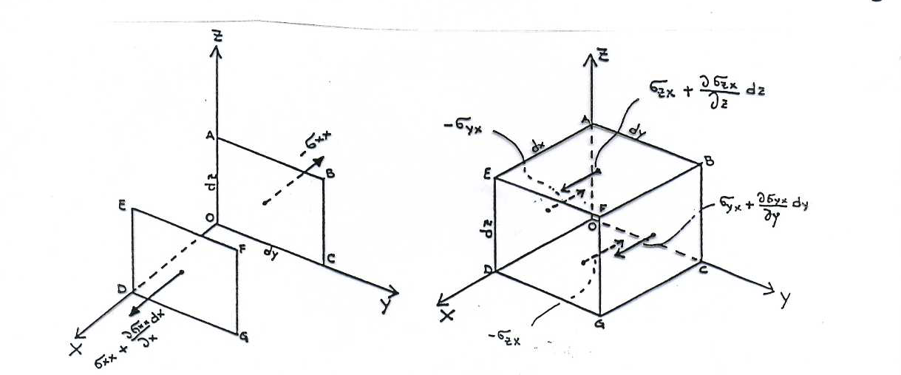
Translation:
We consider the internal forces acting alon x axis. The contribution of normal stresses is the one related to the two faces perpendicular to the x axis.
On the DEFG face the stress is σ_{xx} plus its increment along x axis. So the force acts on the DEFG is:
Instead the force on the face ABCO is (the negative sign is because the negative direction along x axis):
The sum of the forces due to the normal stresses is:

Slide 24
The contribution due to the shear stresses is related to the two faces pairs parallel to x axis. For the sides perpendicular to y axis:
Instead for the sides perpedicular to z axis:
The resultant of the forces act along x axis is:

Slide 25
The same for the y and z axis:
The external forces acting on the parallelepiped are due to gravity, with acceleration g. If the density of parallelepiped is ρ, the gravity force act along x axis is:
The equilibrium conditions to avoid translations can be expressed as:
These equation can be easilyexpressed in tensorial or vectorial form as

Slide 26
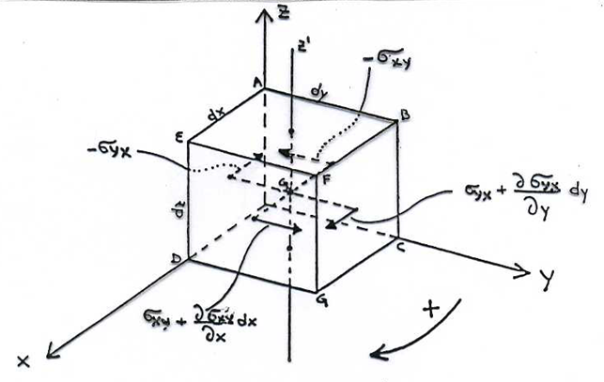
Rotations:
We consider the components of rotations around axes passing for the barycenter of the parallelepiped and parallel to the axes x, y, z. For a axis parallel to z, the stresses that cause rotations, are those acting along x and y.
Considering positive the moments that cause a clockwise rotation, the moment related to the shear stresses parallel to x axis is
(moment = stress x surface x arm):
The same for the stresses parallel to axis y:

Slide 27
To not have rotations, the sum of moments must be null. Ignoring the terms of fourth order
(dx²dydz), we obtain:
from which we have:
The same results are obtained for the other axes, so that we have:
The stress tensor is a simmetric tensor and has only six indipendent components.

Slide 28
Deviatoric stress
Deep in the Earth there is great compression stress due to the gravitational load of the overlying rocks. Is sometimes appropriate to remove the effect of the load and consider only the remaining effort which we call “deviatoric”. We define the average stress
as the third part of the normal stresses sum, that is the trace of the stresses tensor which is invariant. So the average stress is also equal to the trace of diagonalized tensor divided three:
The deviatoric stress is defined removing the effect of average stress:

Slide 29
So that the main stresses are big and almost equal, the deviatoric stress tensor removes this effect and indicates the state of residual stress. The deviatorio stress tenson can be diagonalized and has the same axes of the main stresses as the stress tensor.
The deviatoric stress tensor is the result of tectonic force and provide faulting and sometimes produces anisotropy in the propagation of seismic waves.
For depth bigger than few km, it frequently assume that exist a state of lithostatic stress, for which the normal stress are equal to the pressure due to the gravitational load of the overlying rocks with minus sign, and the deviatoric stresses are equal to zero.
Because the weight of a column of rock high z and with density ρ is equal to ρgz, the pressure P at a depth of 3 km below a column of rock with density 3 g/cm^3 is:
The pressure at a depth of 3 km is about 1 kbar o 100Mpa. Because exist the deviatori stresses (small) the relationship is only a good approximation.

Slide 30
In almost all cases, the tensors of second rank are:
Symmetric
have positive eingenvalues
These tensors can be represented by ellisoidal surfaces.
6 indipendent components
The intersection of the main axes, P1, P2, P3 (eigenvalues​​), correspond to
where λ₁, λ₂, λ₃ are the eigenvalues ​​(major, intermediate, minor).

Slide 31
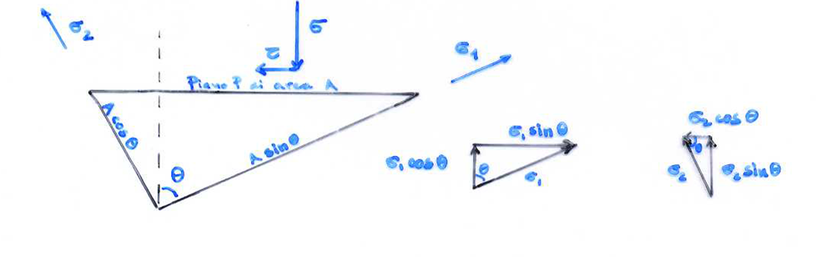
MOHR’S CIRCLE
A means by which two stresses acting on a plane of known orientation can be plotted as the components of normal and shear stresses (derived separately from each of the two stresses). Mohr’s circle is a geometric representation of the 2-D transformation of tridimensional state of stresses and this graphical representation is extremely useful because it enables you to visualize the relationships between the normal and shear stresses acting on various inclined planes at a point in a stressed body.
Using Mohr’s Circle you can also calculate principal stresses, maximum shear stresses and stresses on inclined planes.
To derive the tangential stress and normal on a plane, consider a prismatic element with two sides parallel to the main stress σ1 and σ2 (σ1<σ2 ) and with the third face P with area A, which normal forms an angle θ with the direction of σ1

Slide 32
Consider the equilibrium of the prisma in the two directions, parallel and perpendicular, at plane P!. For the equilibrium along the parallel direction:
From which

Slide 33
The same for the perpendicolar direction
From which
From these equations we can calculate the normal σ and shear τ components on any plane,
given ϑ, σ1 and σ2.
These equations represent the Mohr’ circle.

Slide 34
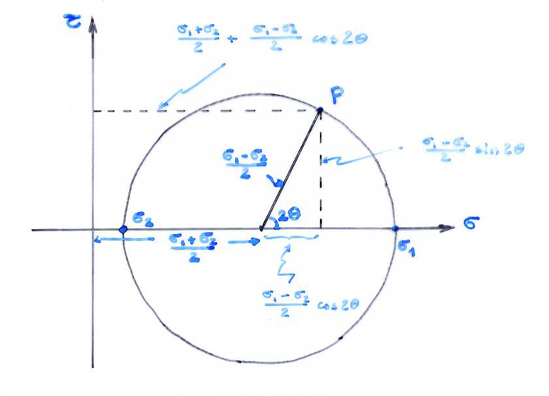
The compressional stress is positive (on the right of the origin), the tensional ones negative.
The shear stress downward is positive, the others negative. The angles measured counterclockwise from the σ1 are positive.

Slide 35
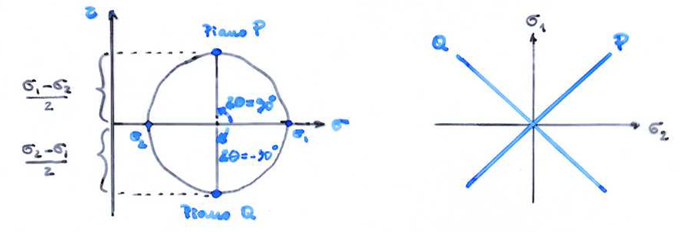
The shear stress is the biggest on two perpendicular planes : the first one is at ϑ= 45° from σ1, the second one is at ϑ= -45° from σ1.

Slide 36
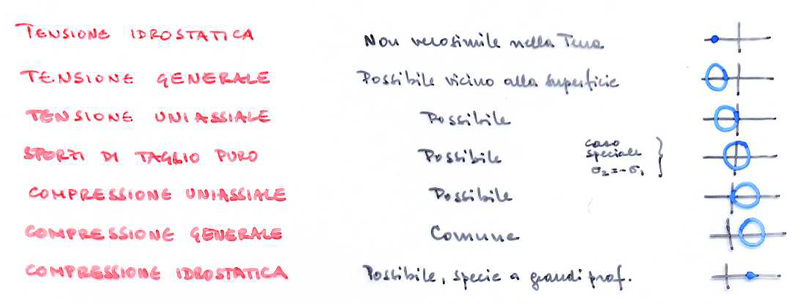
Until now we have considered one surface/plane stress (one of the main stress is null), so
the stress tensor (assuming σ3=0) is:
Possible bidimensional stress and their representation

Slide 37
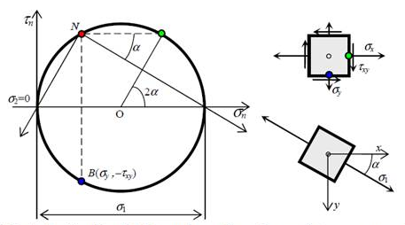
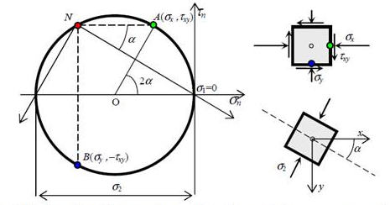
Esempi cerchio di Mohr
Cerchio di Mohr nel caso di
Cerchio di Mohr nel caso di
(tensione monoassiale)
(compressione monoassiale)
37
Notes:
37

Slide 38
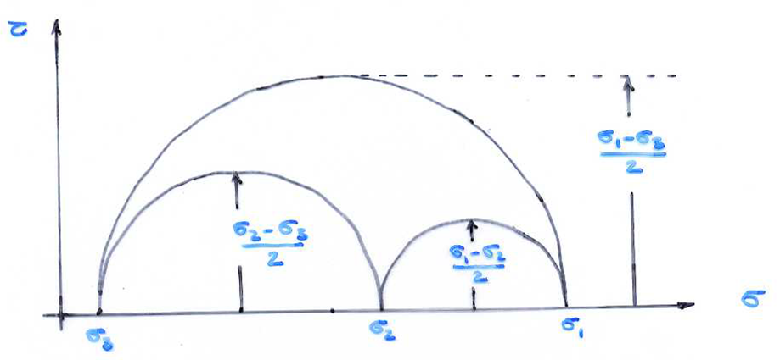
Passing from surface stress to tridimensional one, there will be three couples of main stress with which to build three Mohr’s circles, each of ones represent the stress state on the plane containing the main corresponding axes.

Slide 39
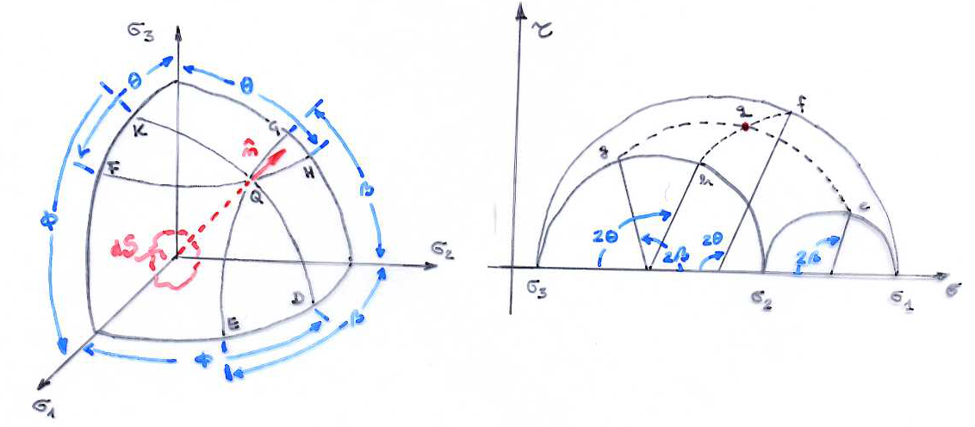
By symmetry we have represented only the part of the graphyc corresponding to τ > 0. it can be shown that any point lying between the three circles can represents the normal and shear stress on a plane oriented with normal n̂=(cos φ, cosβ, cosϑ). For the palane dS the point is q!

Slide 40
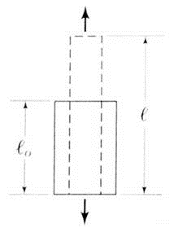
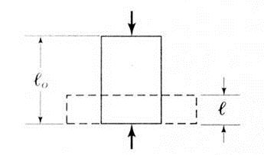
Solid bodies are never completely rigid; under the action of forces applied these bodies are deformed. The strain are said to be elastic if they disappear when stopped the forces that have produced them, and the body on which these forces acted, it will be said elastic body otherwise deformations are said to be permanent. Consider the purely geometrical study of the distribution of displacements and deformations of an elastic body, without caring to consider the forces that caused these changes.
Small deformations:
Elongation:
Linear deformation:
40
Notes:
40

Slide 41
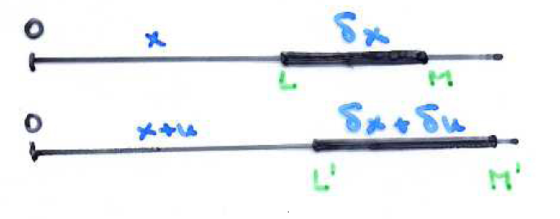
Consider a stress acting in the x direction on an elastic thread. The point L on the thread moves of a distance u to the point L’ when the stress is applied, instead the point M moves to the point M’ at the distance u+δu. The strain in the x direction and indicate with e_{xx} is defined by the ratio between the elongation and the original length of the elastic thread:
Implicit in our discussion is the assumption that the deformations are small.
41
Notes:
Oggi analizziamo come sotto l’azione di forze questi corpi si deformano
41

Slide 42
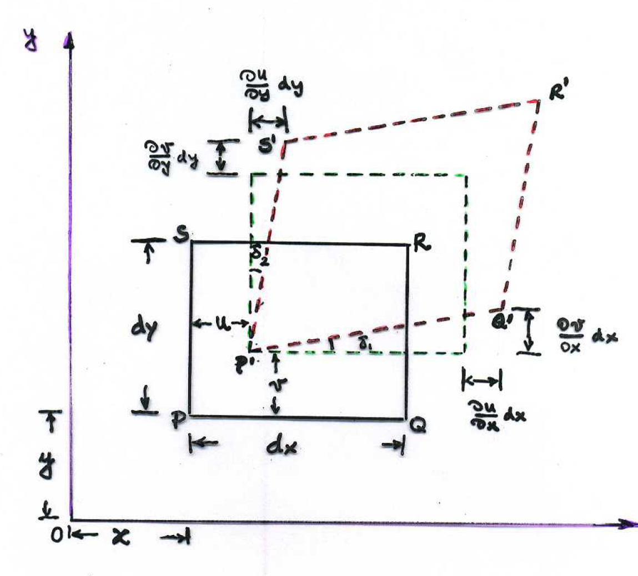
In the bidimensional case, we consider the deformations of the rectangle PQRT in the plane x-y. The P, Q,S points moves to P’, Q’, S’.
The deformation in the x direction:
The same in the y direction:
42
Notes:
Oggi analizziamo come sotto l’azione di forze questi corpi si deformano
42

Slide 43

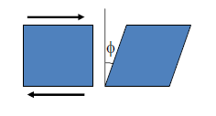
We have so far considered strains or deformations that do not alter the right angles between line elements that are mutually perpendicular in the unstrained state. Shear strains, however, can distort the shapes of small elements. For example, Figure shows a rectangular element in two dimensions that has been distorted into a parallelogram. The shear strain e_{xy} is defined to be one half of the decrease in the angle SPQ:
where φ₁ and φ₂ are the angles through which the sides of the original rectangular element are rotated.. The angle δ₁ + δ₂ is called shear angle:
43
Notes:
43

Slide 44
In the three dimensions only six shear strains (e_{ij} with i≠j), but e_{ij}=e_{ji} so only three are independent:
So the shear angle is double of shear deformation
44
Notes:
44

Slide 45
If the amount of solid-body rotation is zero, the distortion is known as pure shear. In this case, illustrated in Figure:
and the shear strain is:
If δ₁ ≠ δ₂ there is a rotation around the z axes of the angle:
Notes:
45

Slide 46
In three dimensions. Prior to deformation it has sides δx, δy, and δz. The element may be deformed by changing the dimensions of its sides while maintaining its shape in the form of a rectangular parallelepiped. After deformation, the sides of the element are δx−ε_{xx}δx, δy−ε_{yy}δy, and δz−ε_{zz}δz.
The quantity e_{xx}, e_{yy} ,e_{zz} are called normal components of strain. The normal components of strain e_{xx}, e_{yy}, and e_{zz} are assumed, by convention, to be positive if the deformation shortens the length of a side. This is consistent with the convention that treats compressive stresses as positive.
46
Notes:
Oggi analizziamo come sotto l’azione di forze questi corpi si deformano
46

Slide 47
In three dimensions:
47
Notes:
47

Slide 48
The elongation (δu, δv, δw) of any point (δx, δy, δz) can be expressed – at the first order – by:
The equations can be written in vectorial form (matrices) dividing a symmetric part (strains)from an antisymmetric one (rotations):
The strain is an a-dimensional quantity! Generally, in seismology, the strain due to a seismic wave is about 10⁻⁶.
48
Notes:
48

Slide 49
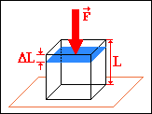
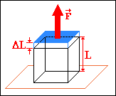
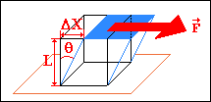
Normal strain:
Length changes
Shear strain:
Shape changes
49
Notes:
Oggi analizziamo come sotto l’azione di forze questi corpi si deformano
49

Slide 50
The fractional change in volume (volume change divided by original volume) due to strain is known as the dilatation Δ; it is positive if the volume of the element is decreased by compression. The original volume of parallelepiped is V=δxδyδz. After deformation (at first approximation) the volume is:
The dilatation is:
If the deformation of the element is so small that squares and higher order products of the strain components can be neglected in computing the change in volume of the element, we obtain:
The dilatation is equal to the divergence of displacement.
50
Notes:
50

Slide 51
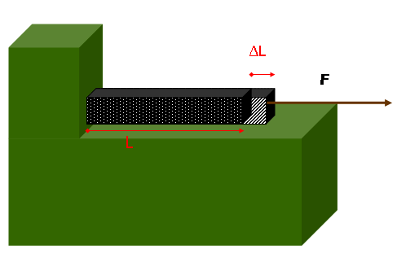
Usually you want to calculate the deformation having the known stress. Hooke proposed that, for small deformations, each deformation is proportional to the stress that the causes: this is the Hooke's law that is the basis of the theory of elasticity. In other words, the Hooke's Law is the relationship of proportionality between stress and strain.
If is applied a traction (compression) to a body, the body itself is subject to an elongation (shortening). By Hooke’s law:
The proportionality constant depend on the material, temperature, geometrical characteristic of the object (body).
51
Notes:
51

Slide 52
In a one dimension the Hooke’s law can be written:
Where c the constant depending on the medium.
In three dimensions each of six components of the stress tensor can be linearly dependent on the six components of the strain tensor
………………………….
We have 36 constants. By the symmetry of the stress and strain tensors and by a thermodynamic condition, the number of independent constants is 21.
52
Notes:
52

Slide 53
If we consider an isotropic medium ( that is its properties not change with the direction), the number of constants decreases to two:
Or in tensorial form:
With δ_{ij} unit tensor (δ_{ij} =1 per i=j ; δ_{ij} =0 per i≠j).
The constants λ and μ are known as Lamè’s parameters. The constant μ (μ=σ_{xy}/2e_{xx}) give a measurement of the resistence of a body to a shear stress, and is calles shear modulus or rigidity modulus. Obviously the shear modulus for a liquid or gas is null. There are also other constants: Young modulus, Poisson modulus, Poisson ratio and Bulk’ modulus.
53
Notes:
53

Slide 54
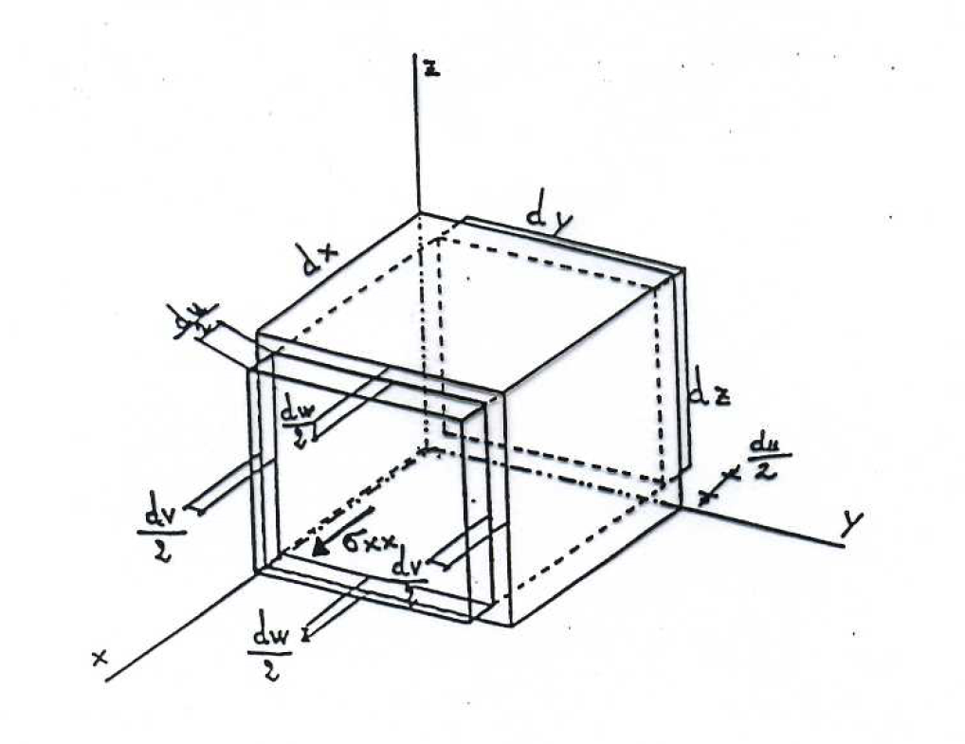
According to Hooke’s law, when a body deforms elastically, there is a linear relationship between stress and strain. The ratio of stress to strain defines an elastic constant (or elastic modulus) of the body. The elastic moduli, defined for different types of deformation, are Young’s modulus, the rigidity modulus, the bulk modulus and the Poisson’s ratio
MODULO DI YOUNG
Young’s modulus is defined from the extensional deformations. Each longitudinal strain is proportional to the corresponding stress component. If we apply a stress σ_{xx} we have elongation du along the x axis and shortenings dv and dw along y and z. The extension is proportional to σ_{xx} and to length dx ; is inversely proportional to the resistance of the material:
To obtaine the relationship between E and the Lame costants λ and μ we write σ_{xx} and e_{xx} using λ and μ. Because only σ_{xx} is different by zero:
54
Notes:
54

Slide 55
MODULO DI YOUNG
Summing the first three equations:
And replacing this last equation in the first one:
So the Young’s modul is
The Young’s modul, as Lame’ parameters, is dimensionally like a stress and has large value , as 10¹⁰ Pa.
55
Notes:
55

Slide 56
POISSON RATIO
In an elastic body the transverse strains e_{yy} and e_{zz} are not independent of the strain e_{xx.} Consider the change of shape of the bar in Figure. When it is stretched parallel to the x-axis, it becomes thinner parallel to the y-axis and parallel to the z-axis. The transverse longitudinal strains e_{yy} and e_{zz} are of opposite sign but proportional to the extension e_{xx} and can be expressed as:
The constant of proportionality ν is called Poisson’s ratio. The values of the elastic constants of a material constrain ν to lie between 0 (no lateral contraction) and a maximum value of 0.5 (no volume change) for an incompressible fluid. In very hard, rigid rocks like granite n is about 0.45, while in soft, poorly consolidated sediments it is about 0.05. In the interior of the Earth, ν commonly has a value around 0.24–0.27. A body for which the value of ν equals 0.25 is sometimes called an ideal Poisson body.
56
Notes:
56

Slide 57
INCOMPRESSIBILITY MODULUS (BULK’ MODULUS)
Consider a body subject to a hydrostatic pressure (e.g. Body immersed in a liquid): the ratio between the pressure and the compression (= negative cubic dilatation) is named Bulk’ modulus K. For a hydrostatic pressure:
That is
Adding these three equations
So we have
K represents the resistance opposed by a medium to an increasing of hydrostatic pressure.
The Young’ and Bulk’ modulus, the Lamè parameters are all positive. They are measured in Nm⁻²=Pa and their values for rocks are usually ranged from 20 to 120 Gpa.
57
Notes:
57

Slide 58
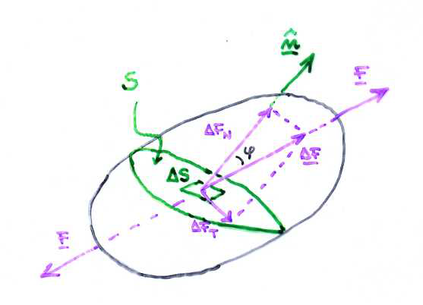
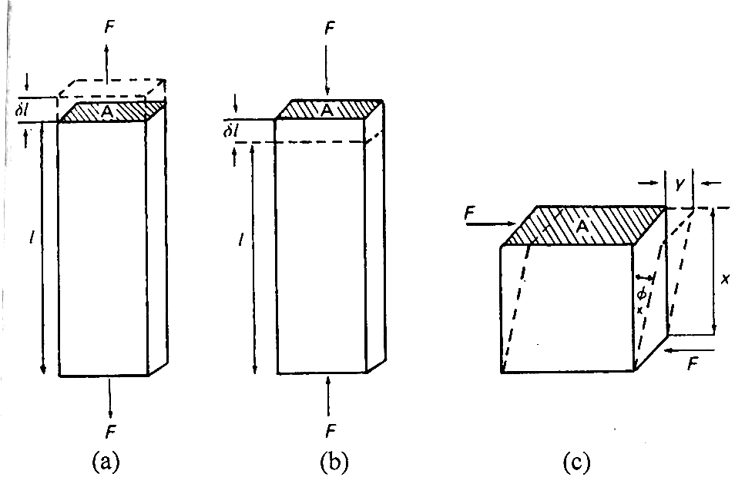
SUMMARIZING...
The application of a force creates a state of stress which causes a deformation in the structure of the body. The stress is the relationship between the force and the surface on which it acts
There are three kind of stress: traction (a), compression (b) and shear (c).
When the force acts normal to surface causes the traction or the compression. Instead if the force acts parallel to the surface causes a shear stress.
The unit is Pascal (1Pa=1Nm⁻²).
58
Notes:
58

Slide 59
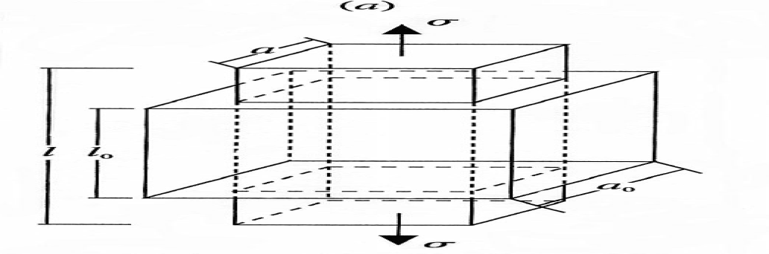
A stress that acts on a body causes a change in dimensions and shape of the body itself.
Traction or compression
Normal deformation
where l and l₀ are the body dimension in stress direction first and after its action.
Δl is the dimentional variation due to the stress. The deformation is adimensional!
59
Notes:
59

Slide 60
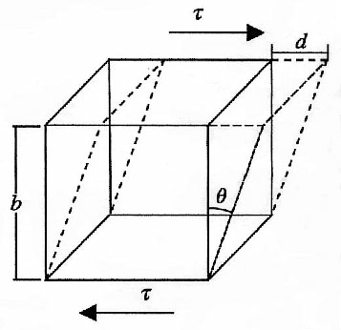
A stress that acts on a body causes a change in dimensions and shape of the body itself.
Shear stress
Shear strain
Both the normal and shear strain depend on the derivative of displacement field.
Convention of the σ_{ij} sign:
POSITIVE | NEGATIVE
TENSIVE STRESS (direct to the outside of the body) | COMPRESSIONAL STRESS (direct to the inside of the body)
Componet along the positive axis direction | Componet along the negative axis direction
The sign of the σ_{ij} component is equal to the product of the sign above.
Example: the compressional stress component along the negative axis direction is positive because is equal to - x - = +!
60
Notes:
60

Slide 61
The Hooke’s law define a relationship between stress and strain. For a isotropic body:
where μ and λ are di Lame’s parameters, Θ is the cubic dilation and δ_{ij} is the Kronecker delta.
The Lame’s parameters have the stress dimensions (Mpa).
The dilation is the divergence of the displacement:
The Kronecker delta is a unit tensor: δ_{ij} =1 per i=j ; δ_{ij} =0 per i≠j.
61
Notes:
61

Slide 62
ELASTIC PARAMETERS
Rigidity:
resistance of the medium to shear (N/m²)
Young modulus:
Stress dimension (MPa)
Poisson ratio:
Is adimensional and ranged between 0 and 0.5. For liquid (μ=0) σ=0.5, for compact rocks σ=0.05. the average value for rocks is 0.25 that corrispond to λ=μ that is Poisson ratio.
Bulk Modulus (or imcopressibility):
is the relationship between applied pressure and volume variation.
62
Notes:
62

Slide 63
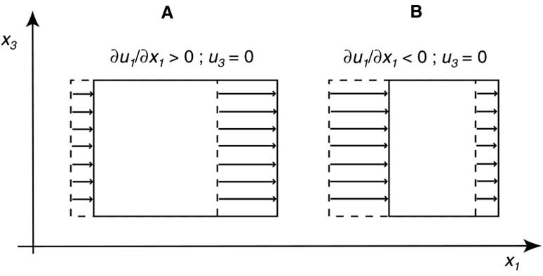
Quali sono le deformazioni?

Slide 64
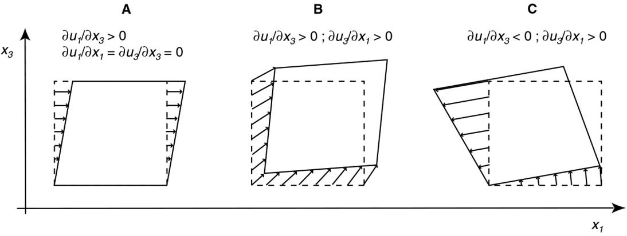
Quali sono le deformazioni?

Slide 65
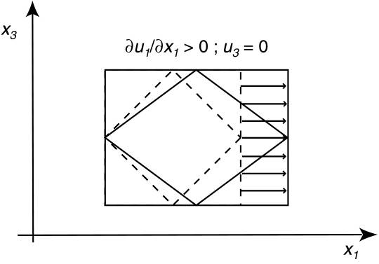
Quali sono le deformazioni?

