Slide 1
Trigger
A soglia: il trigger viene attivato quando
l’ampiezza del segnale supera una predefinita
soglia
RMS (root-mean-square): viene considerata
l’ampiezza del segnale in una breve finestra
temporale al posto dell’ampiezza istantanea.
STA/LTA: viene considerato il rapporto della
media del segnale relativo ad una finestra
temporale corta (STA, short time average)
rispetto ad una finestra temporale lunga (LTA,
long time average).

Slide 2
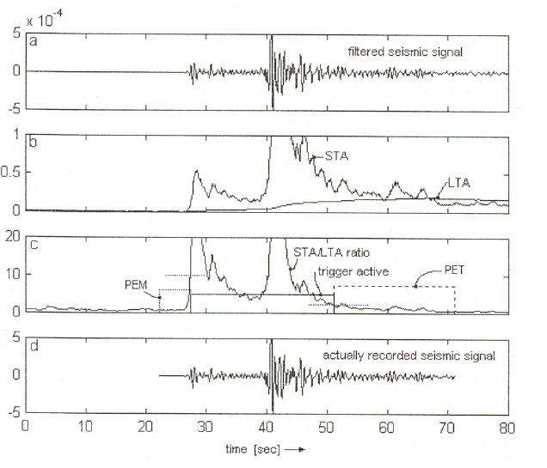
STA – short time average PEM – Pre-event time
LTA – long time average PET - post event time

Slide 3
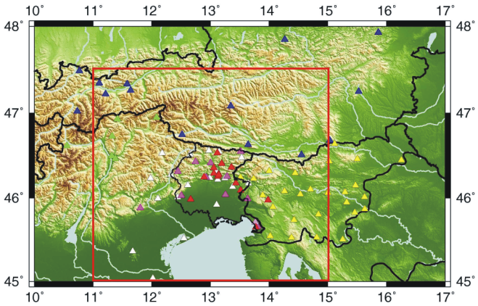


Notes:
3

Slide 4
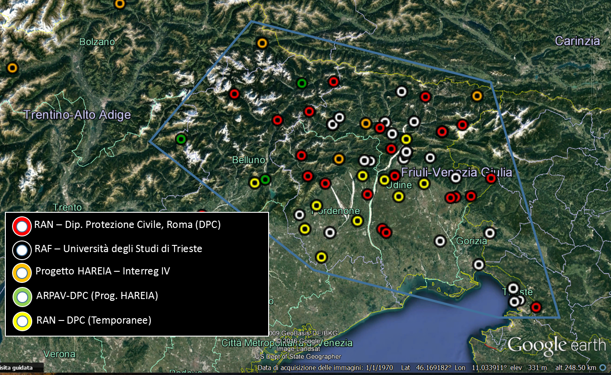

Slide 5
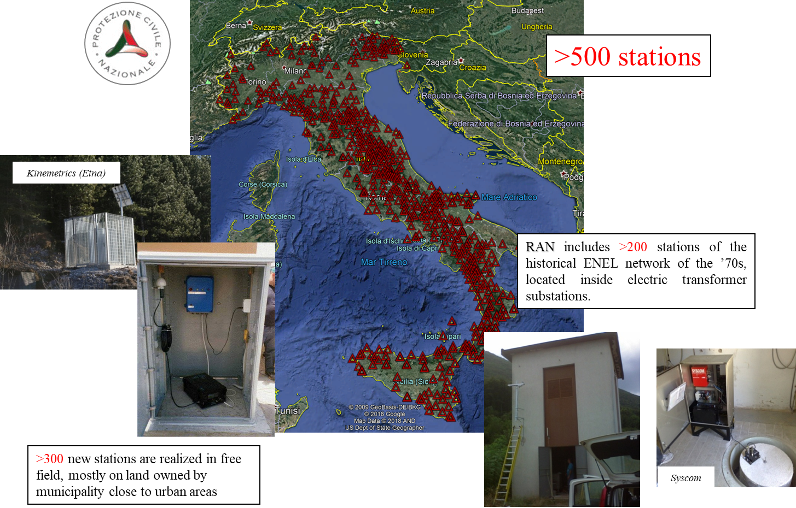

Slide 6
Earthquake: introduction
Most of the earthquakes which shake the Earth each year are so weak that they are only registered by sensitive seismographs, but some are strong enough to have serious, even catastrophic, consequences for mankind and the environment.
About 90% of all earthquakes result from tectonic events, primarily movements on faults. The remaining 10% are related to volcanism, collapse of subterranean cavities, or man-made effects.
Our understanding of the processes that lead to earthquakes derives to a large extent from observations of seismic events on the San Andreas fault in California.
The average relative motion of the plates adjacent to the San Andreas fault is about 5 cm yr⁻¹, with the block to the west of the fault moving northward.
On the fault-plane itself, this motion is not continuous but takes place spasmodically. According to modern plate tectonic theory this extensively studied fault system is a transform fault. This is a rather special type, so it cannot be assumed that the observations related to the San Andreas fault are applicable without reservation to all other faults. However, the elastic rebound model, proposed by H. F. Reid after the 1906 San Francisco quake, is a useful guide to how an earthquake may occur.

Slide 7
SORGENTI SISMICHE
NATURALI ARTIFICIALI
CONTROLLATE INDOTTE
TERREMOTI TETTONICI ESPLOSIONI TERREMOTI INDOTTI DA DIGHE
TERREMOTI VULCANICI RUMORE CULTURALE TREMORI DI MINIERA
IMPLOSIONI, COLLASSI TERREMOTI INDOTTI DA MICROSISMI OCEANICI INIEZIONE DI FLUIDI
Notes:
7

Slide 9
The model is illustrated in Figure by the changes to five parallel lines, drawn normal to the trace of the fault in the unstrained state and intersecting it at the points A–E.
Strain due to relative motion of the blocks adjacent to the fault accumulates over several years. Far from the trace of the fault the five lines remain straight and parallel, but close to it they are bent.
When the breaking point of the crustal rocks at C is exceeded, rupture occurs and there is a violent displacement on the fault-plane. The relative displacement that has been taking place progressively between the adjacent plates during years or decades is achieved on the fault-plane in a few seconds.
The strained rocks adjacent to the fault “rebound” suddenly. The accumulated strain energy is released with the seismic speed of the ruptured rocks, which is several kilometers per second.
The segments BC and C’D undergo compression, while CD and BC’ experience dilatation. The points A and E do not move; the stored strain energy at these points is not released. The entire length of the fault-plane is not displaced, only the region in which the breaking point has been exceeded. The greater the length of the fault-plane that is activated, the larger is the ensuing earthquake.

Slide 10
The occurrence of a large earthquake is not necessarily as abrupt as described in the preceding paragraph although it can be very sudden. In 1976 a major earthquake with magnitude 7.8 struck a heavily populated area of northern China near the city of Tangshan.
Although there were known faults in the area, they had long been seismically inactive, and the large earthquake struck without warning. It completely devastated the industrial region and caused an estimated 243,000 fatalities.
However, in many instances the accumulating strain is partially released locally as small earthquakes, or foreshocks. This is an indicator that strain energy is building up to the rupture level and is sometimes a premonition that a larger earthquake is imminent.
When an earthquake occurs, most of the stored energy is released in the main shock. However, for weeks or months after a large earthquake there may be numerous lesser shocks, known as aftershocks, some of which can be comparable in size to the main earthquake. Structures weakened by the main event often collapse in large aftershocks, which can cause physical damage as severe as the main shock. The death toll from aftershocks is likely to be less, because people have evacuated damaged structures.

Slide 11
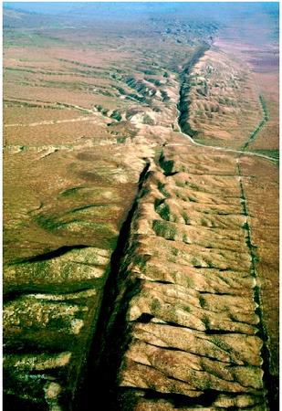
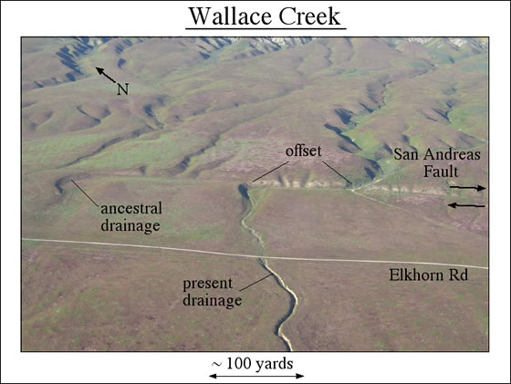
San Andreas Fault

Slide 12
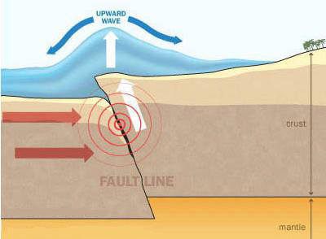
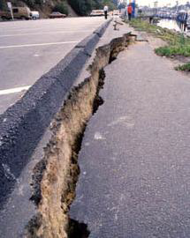
Earthquake: elastic rebound theory
There are three different causes types of earthquakes: tectonic, volcanic, and explosion. The type of earthquake depends on the region where it occurs and the geological make-up of that region. The most common are tectonic earthquakes. These occur when rocks in the Earth's crust break due to geological forces created by movement of tectonic plates. Another type, volcanic earthquakes occur in conjunction with volcanic activity. Collapse earthquakes are small earthquakes in underground caverns and mines, and explosion earthquakes result from the explosion of nuclear and chemical devices.
Volcanic earthquake
Explosion earthquake

Slide 13
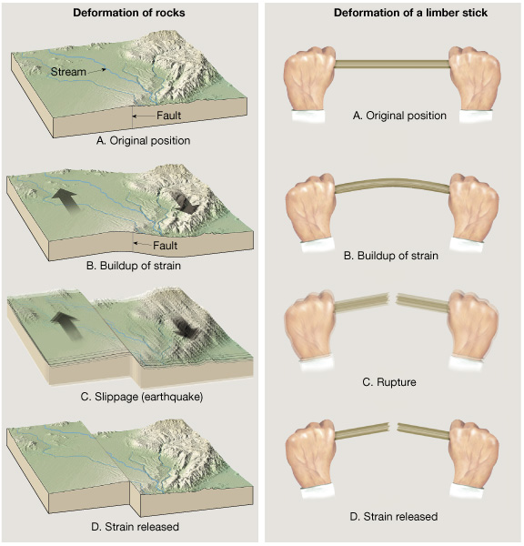
Tectonic earthquakes are explained by the so-called elastic rebound theory, formulated by the American geologist Harry Fielding Reid after the San Andreas Fault ruptured in 1906, generating the great San Francisco earthquake.

Slide 14
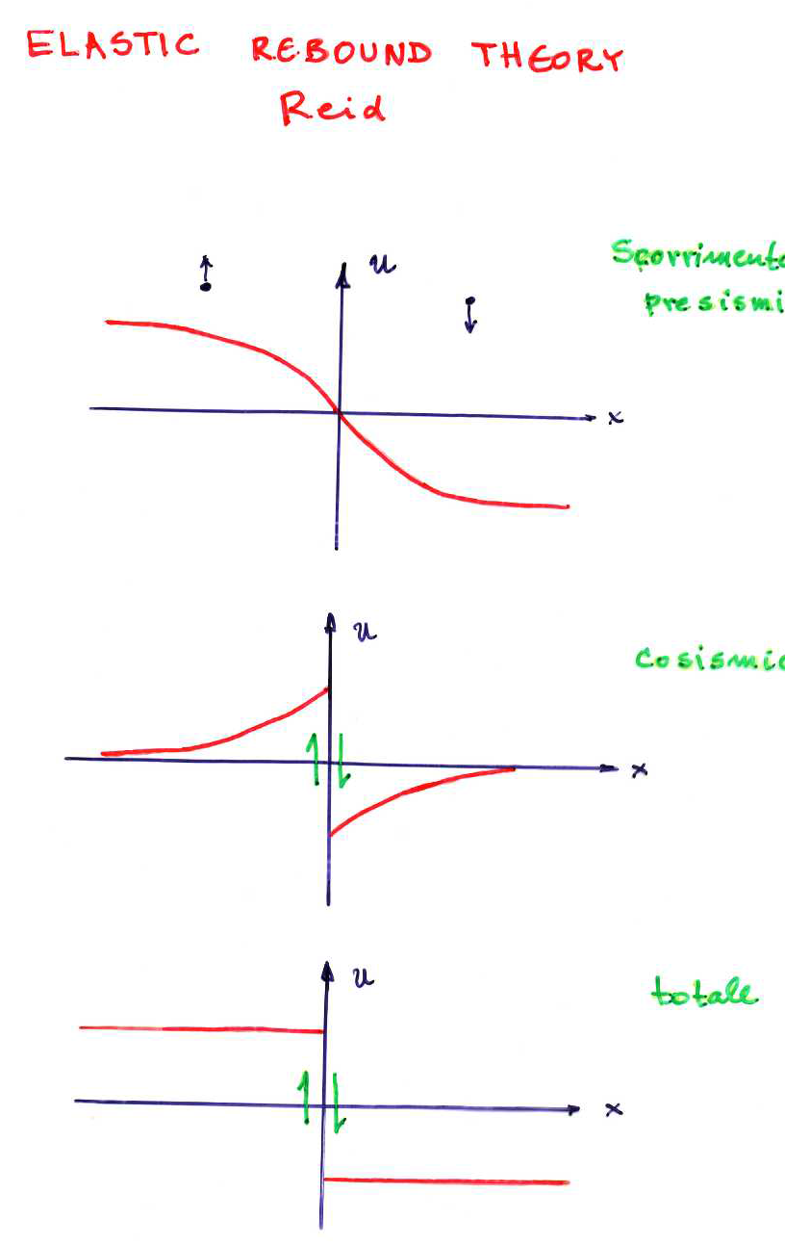
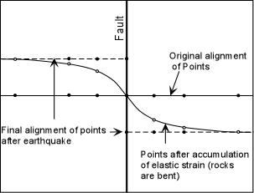
Notes:
14

Slide 15
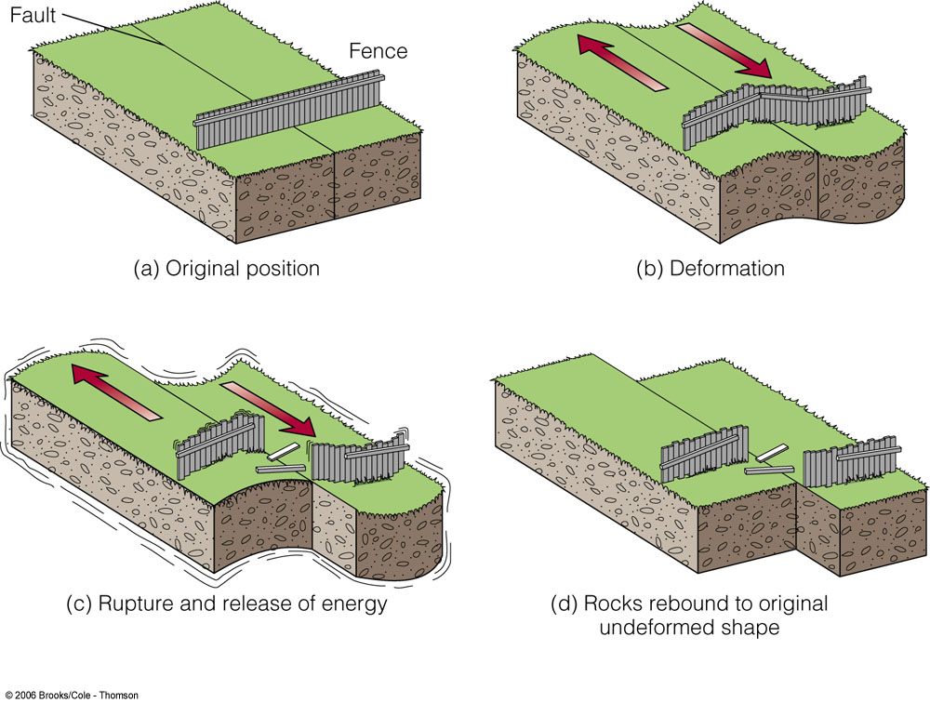
Elastic Rebound Theory
1. Stress on a fault slowly accumulates
2. During an earthquake, stress on the fault is released
3. After an earthquake, stress begins to re-accumulate

Slide 16
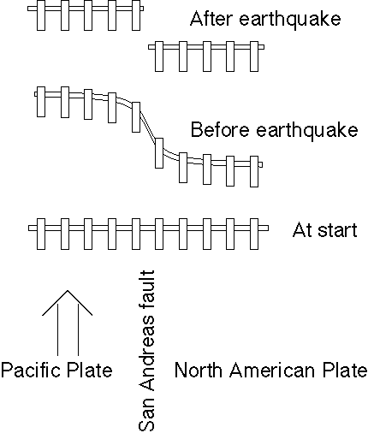
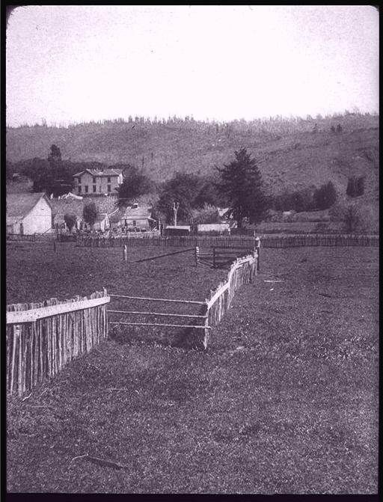

Slide 17
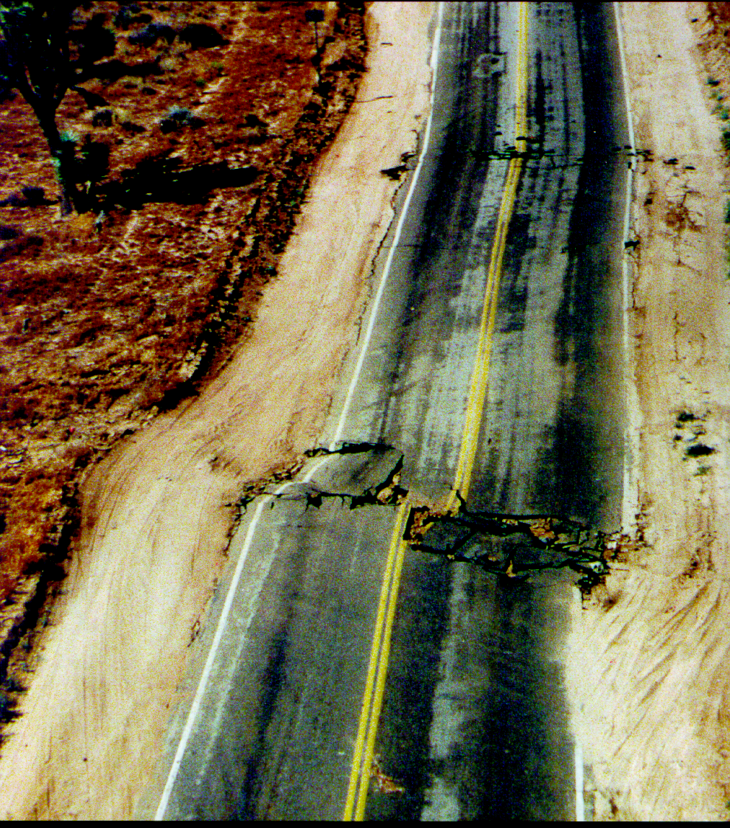
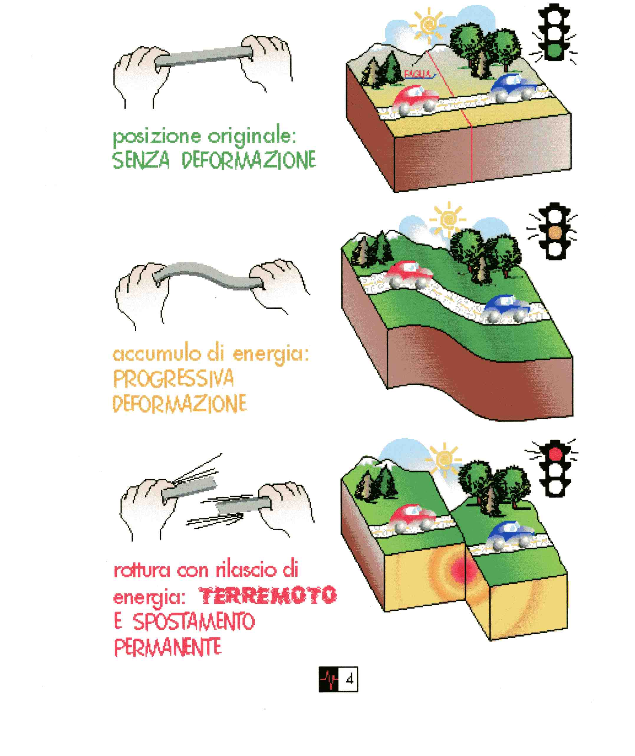
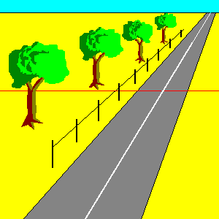
La faglia

