Slide 1
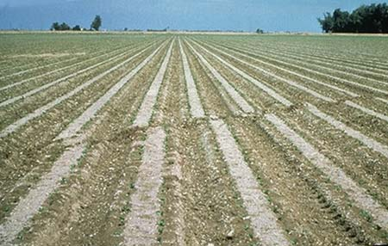

Slide 2
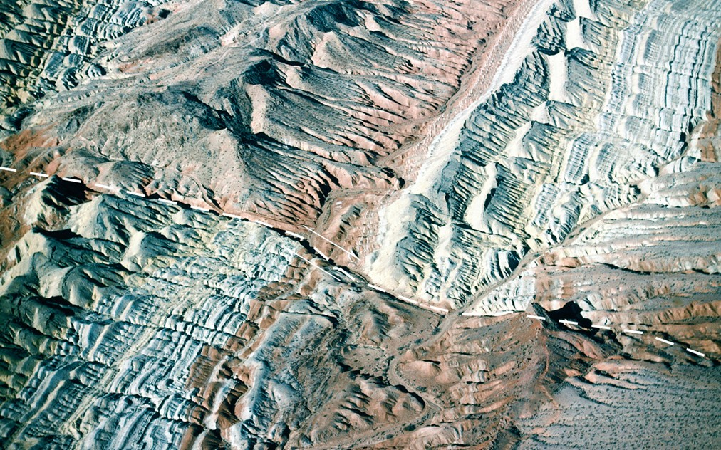

Slide 3
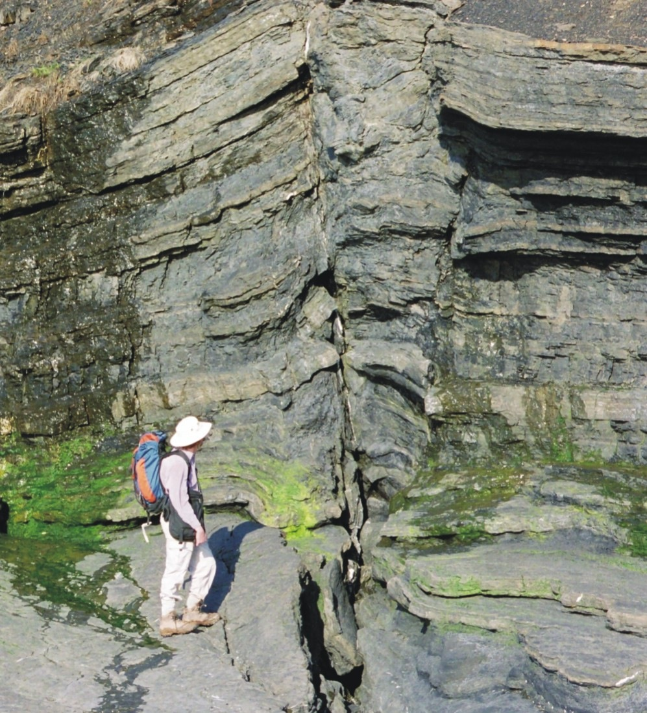

Slide 4
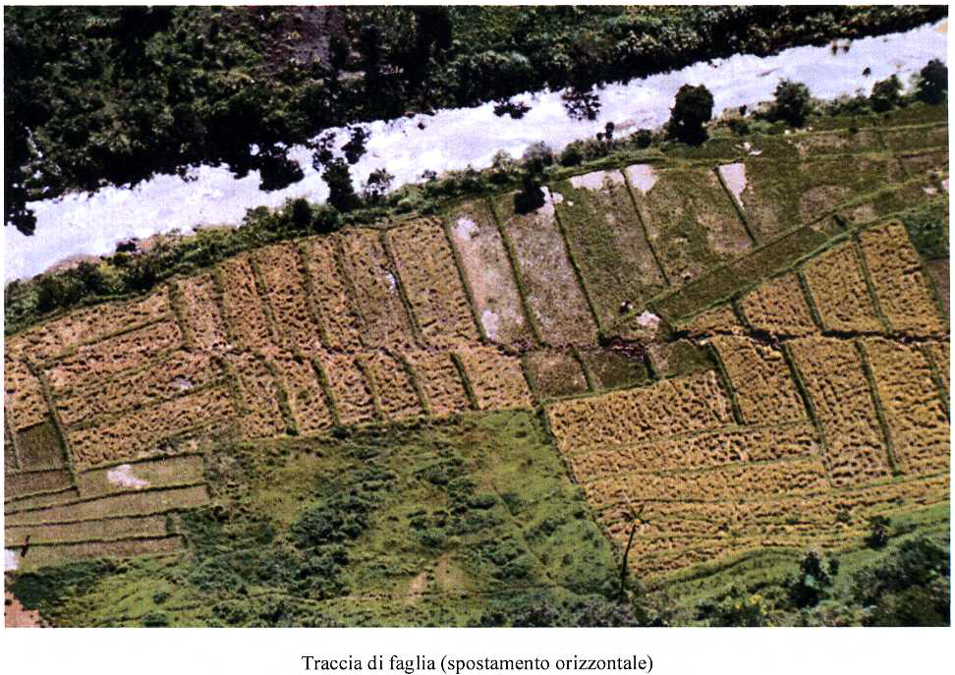

Slide 5
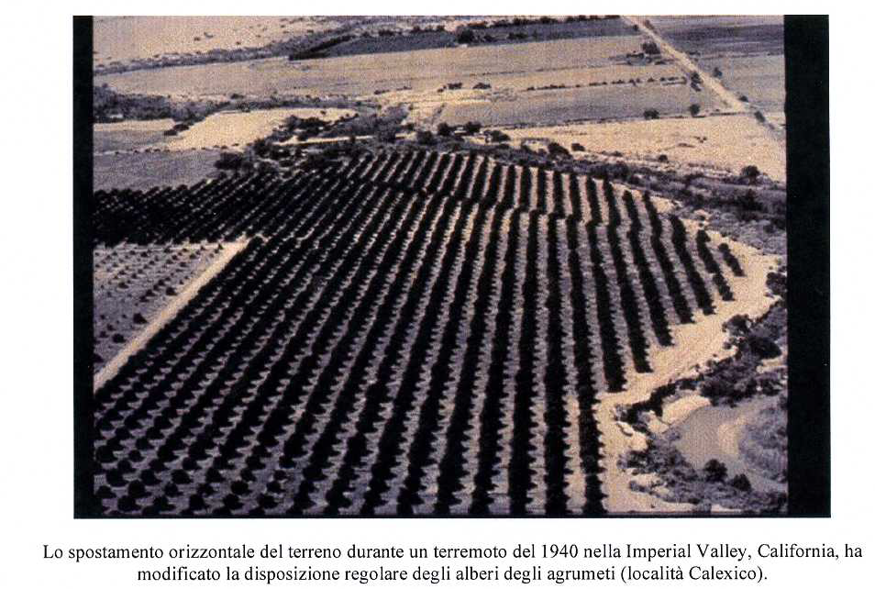

Slide 7
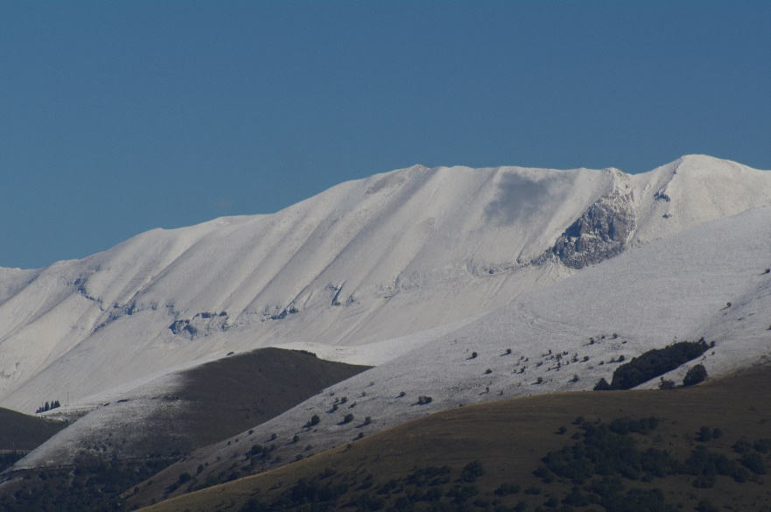
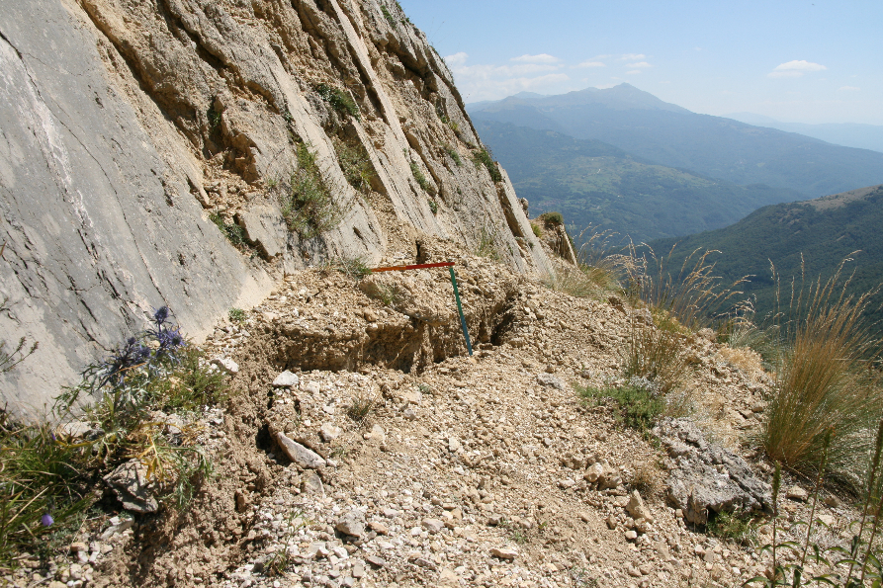
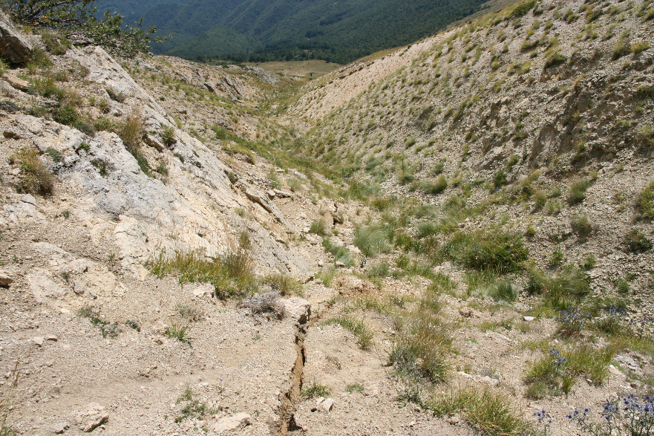
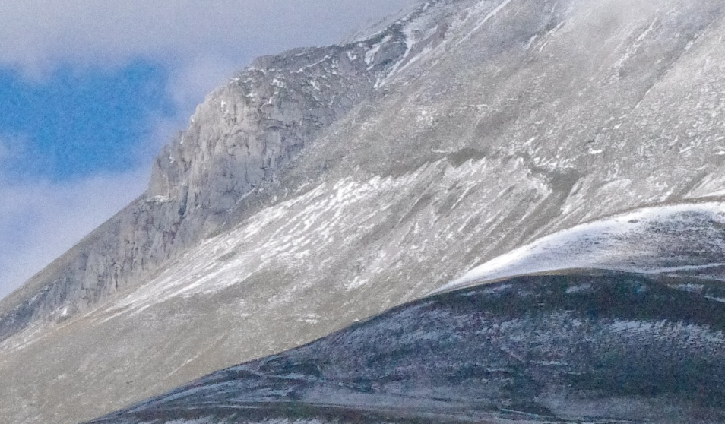
Monte Vettore
Terremoto Amatrice 24 agosto 2016

Slide 8
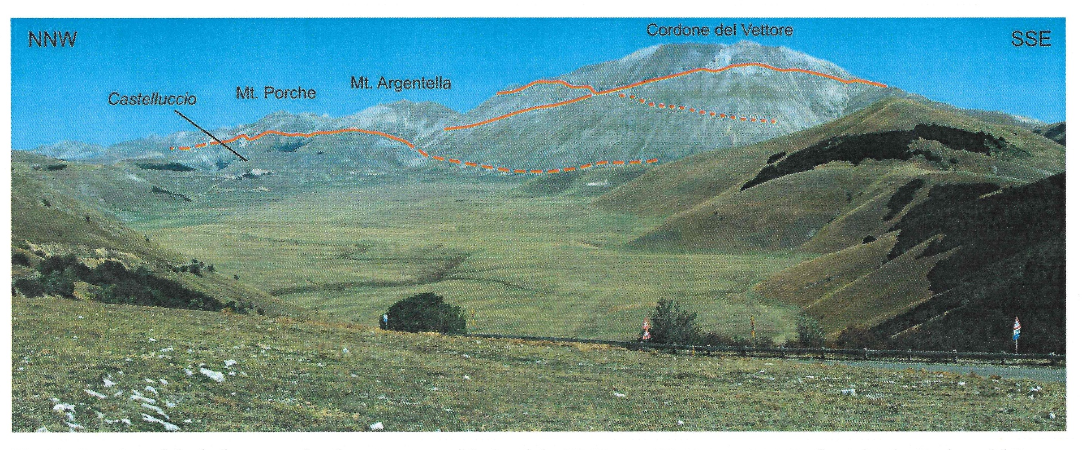
Terremoto Amatrice 24 agosto 2016

Slide 9
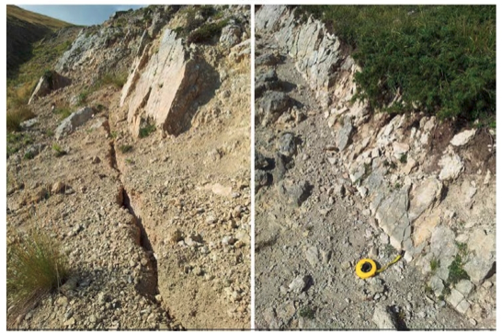
Terremoto Amatrice 24 agosto 2016
Esempi di nastrini bianchi di neoformazione alla base del piano di faglia in roccia del Monte Vettore.

Slide 10
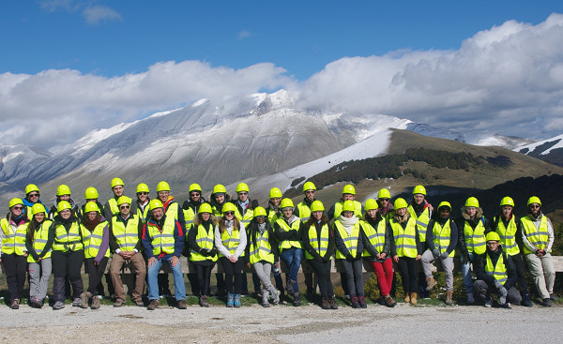

Slide 11
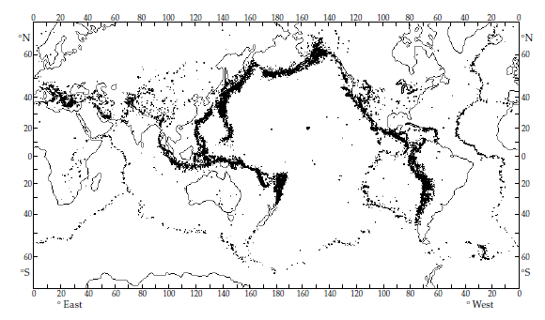

Slide 12
Earthquake: seismicity
The circum-Pacific zone, in which about 75–80% of the annual release of seismic energy takes place, forms a girdle that encompasses the mountain ranges on the west coast of the Americas and the island arcs along the east coast of Asia and Australasia.
The Mediterranean-transasiatic zone responsible for about 15–20% of the annual seismic energy release, begins at the Azores triple junction in the Atlantic Ocean and extends along the Azores–Gibraltar ridge; after passing through North Africa it makes a loop through the Italian peninsula, the Alps and the Dinarides; it then runs through Turkey, Iran, the Himalayan mountain chain and the island arcs of southeast Asia, where it terminates at the circum-Pacific zone.
The system of oceanic ridges and rises forms the third most active zone of seismicity, with about 3–7% of the annually released seismic energy. In addition to their seismicity, each of these zones is also characterized by active volcanism.
The remainder of the Earth is considered to be aseismic
However, no region of the Earth can be regarded as completely earthquake-free. About 1% of the global seismicity is due to intraplate earthquakes, which occur remote from the major seismic zones. These are not necessarily insignificant: some very large and damaging earthquakes (e.g. the New Madrid, Missouri, earthquakes of 1811 and 1812 in the Mississippi river valley) have been of the intraplate variety.

Slide 13
Earthquakes can also be classified according to their focal depths. Earthquakes with shallow focal depths, less than 70 km, occur in all the seismically active zones; only shallow earthquakes occur on the oceanic ridge systems.
The largest proportion (about 85%) of the annual releas of seismic energy is liberated in shallow-focus earthquakes.
The remainder is set free by earthquakes with intermediate focal depths of 70–300 km (about 12%) and by earthquakes with deep focal depths greater than 300 km (about 3%).
These occur only in the circum-Pacific and Mediterranean-transasiatic seismic zones, and accompany the process of plate subduction.
The distributions of epicentral locations and focal depths of intermediate and deep earthquakes give important evidence for the processes at a subduction zone.
When the earthquake foci along a subduction zone are projected onto a cross-section normal to the strike of the plate margin, they are seen to define a zone of seismicity about 30–40 km thick in the upper part of the 80–100 km thick subducting oceanic plate, which plunges at roughly 30–60° beneath the overriding plate
For many years the inclined seismic zone was referred to in Western literature as a Benioff zone in recognition of the Californian scientist, Hugo Benioff.

Slide 14
In the years following World War II Benioff carried out important pioneering studies that described the distribution of deep earthquakes on steeply dipping surfaces of seismicity
Many characteristics of the occurrence of deep earthquakes had been described in the late 1920s by a Japanese seismologist, Kiyoo Wadati. He discovered that the closer the epicenters of earthquakes lay to the Asian continent, the greater were their focal depths; the deep seismicity appeared to lie on an inclined plane.
It was Benioff, however, who in 1954 proposed as an explanation of the phenomenon that the ocean floor was being “subducted” underneath the adjacent land. This was a bold proposal well in advance of the advent of plate tectonic theory.
Today the zone of active seismicity is called a Wadati–Benioff zone in recognition of both discoverers.

Slide 16
In three dimensions the Wadati–Benioff zone constitutes an inclined slab dipping underneath the overriding plate. It marks the location and orientation of the upper surface of the subducting plate. The dip-angle of the zone varies between about 30° and 60°, becoming steeper with increasing depth, and it can extend to depths of several hundred kilometers into the Earth. The deepest reliably located focal depths extend down to about 680 km.
The structure of a subducting plate is not always as simple as described: Pacific plate revealed a double Wadati–Benioff zone under northeast Honshu, Japan. The seismicity at depths below 100 km defines two parallel planes about 30–40 km apart. The upper plane, identified with the top of the subducting plate, is in a state of compression; the lower plane, in the middle of the slab, is in a state of extension.
These stress states are the result of unbending of the subducting plate, which had previously undergone sharp bending at shallow depth below the trench axis. This information is inferred from analysis of the mechanisms by which the earthquakes occur.

