Slide 1
Earthquake: magnitude
Magnitude is an experimentally determined measure of the “size” of an earthquake. In 1935 C. F. Richter attempted to grade the sizes of local earthquakes in Southern California on the basis of the amplitude of the ground vibrations they produced at a known distance from the epicenter. The vibrations were recorded by seismographs, which were standardized to have the same response to a given stimulus.
Richter’s original definition of magnitude was based on surface-wave amplitudes (As) recorded by seismographs at an epicentral distance of 100 km.
Because seismographs were located at various distance from the earthquake, an extra term was added to compensate for attenuation of the signal with increasing epicentral distance.

Slide 2
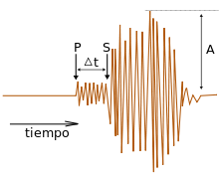
Magnitudo
La magnitudo, più propriamente, è un parametro atto a rappresentare l’energia sprigionata da un terremoto. Viene calcolata sulla base di misure effettuate sul sismogramma, maggiore è l’energia liberata dal sisma maggiori sono le ampiezze delle oscillazioni registrate. Misurata per molti anni (simbolo M) tramite la Scala Richter, oggi esistono diverse scale di magnitudo. Tutte le scale, a differenza della Scala Mercalli, non sono decimali ma logaritmiche perciò la differenza di un’unità implica un potenziale energetico di circa 30 volte maggiore o minore.
.
A = ampiezza massima delle oscillazioni del terremoto che si sta osservando
A0 = ampiezza massima delle oscillazioni causate da un terremoto di riferimento
ɛ = fattore di correzione (distanza reale dall’epicentro, profondità dell’ipocentro)

Slide 3
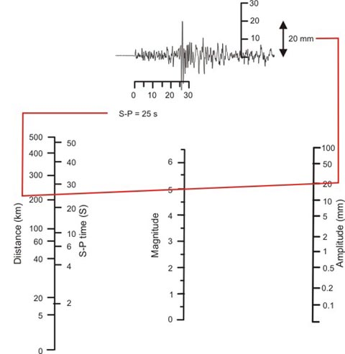
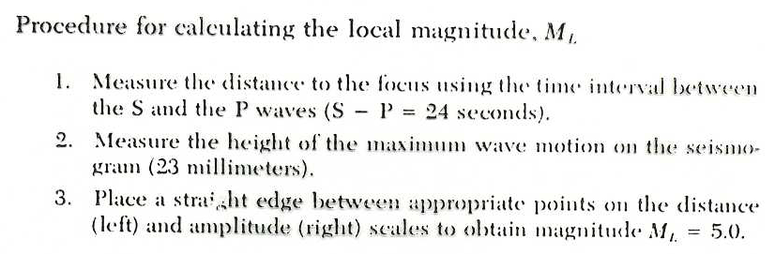
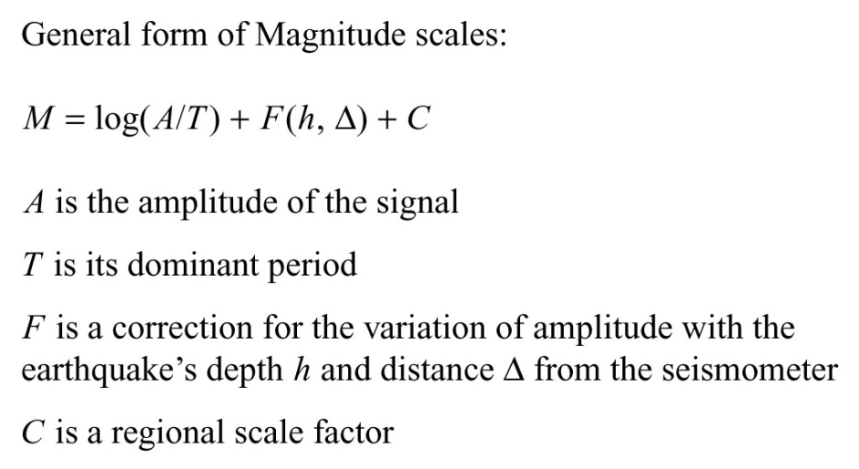

Slide 4
Increasingly sensitive instruments allowed the recording of signals from distant earthquakes; those from events with epicentral distances greater than 20° are known as teleseismic signals. Originally, the magnitude was determined from the horizontal ground motion, because seismological stations were equipped mainly with horizontal-motion seismometers. However, the surface waves recorded by these instruments consist of superposed Love and Rayleigh waves, which complicates the theoretical interpretation of the records.
Vertical-motion seismometers record only the Rayleigh waves (together with P- and SV-waves), and so progressively the definition of surface-wave magnitude has come to be based on the vertical component of motion. The majority of surface-wave magnitudes assigned to earthquakes worldwide are now based on vertical-motion records.
The International Association for Seismology and Physics of the Earth’s Interior (IASPEI) has adopted the following definition of the surface-wave magnitude (Ms) of an earthquake:

Slide 5
where A_{s} is the vertical component of the ground motion in micrometers (μm) determined from the maximum Rayleigh-wave amplitude, T is the period of the wave (18–22 seconds), Δ is the epicentral distance in degrees (20°< Δ < 160°), and where the earthquake has a focal depth of less than 50 km.
The depth of the source affects the nature of the seismic wave train, even when the same energy is released. An earthquake with a deep focus may generate only a small surface-wave train, while shallow earthquakes cause very strong surface waves. Equation 4 for Ms was derived from the study of shallow earthquakes, observed at a distance greater than 20°. Therefore, corrections must be made to the computed value of Ms to compensate for the effects of a focal depth greater than 50 km or epicentral distance less than 20°
The amplitude of body waves is not sensitive to the focal depth. As a result, earthquake magnitude scales have also been developed for use with body waves. An equation, proposed by B. Gutenberg in 1945, can be used to calculate a body-wave magnitude (m_{b}) from the maximum amplitude (A_{p}) of the ground motion associated with P-waves having a period (T) of less than 3 s:

Slide 6
Where Q(Δ, h) is an empirical correction for signal attenuation due to epicentral distance (Δ) and focal depth (h) that is made by reading directly from a graph or table of values.

Slide 7
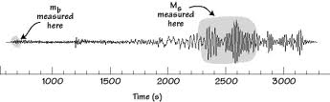
For some earthquakes both Ms and m_{b} can be calculated. Unfortunately, the different estimates of magnitude often do not agree well, except for small earthquakes. This is due to the way the ground responds to a seismic event, and to the different natures of body waves and surface waves. Body waves have a different dependence of amplitude on frequency than do surface waves. m_{b} is estimated from a highfrequency (1 Hz) phase whereas Ms is determined from low-frequency (0.05 Hz) vibrations.

Slide 8
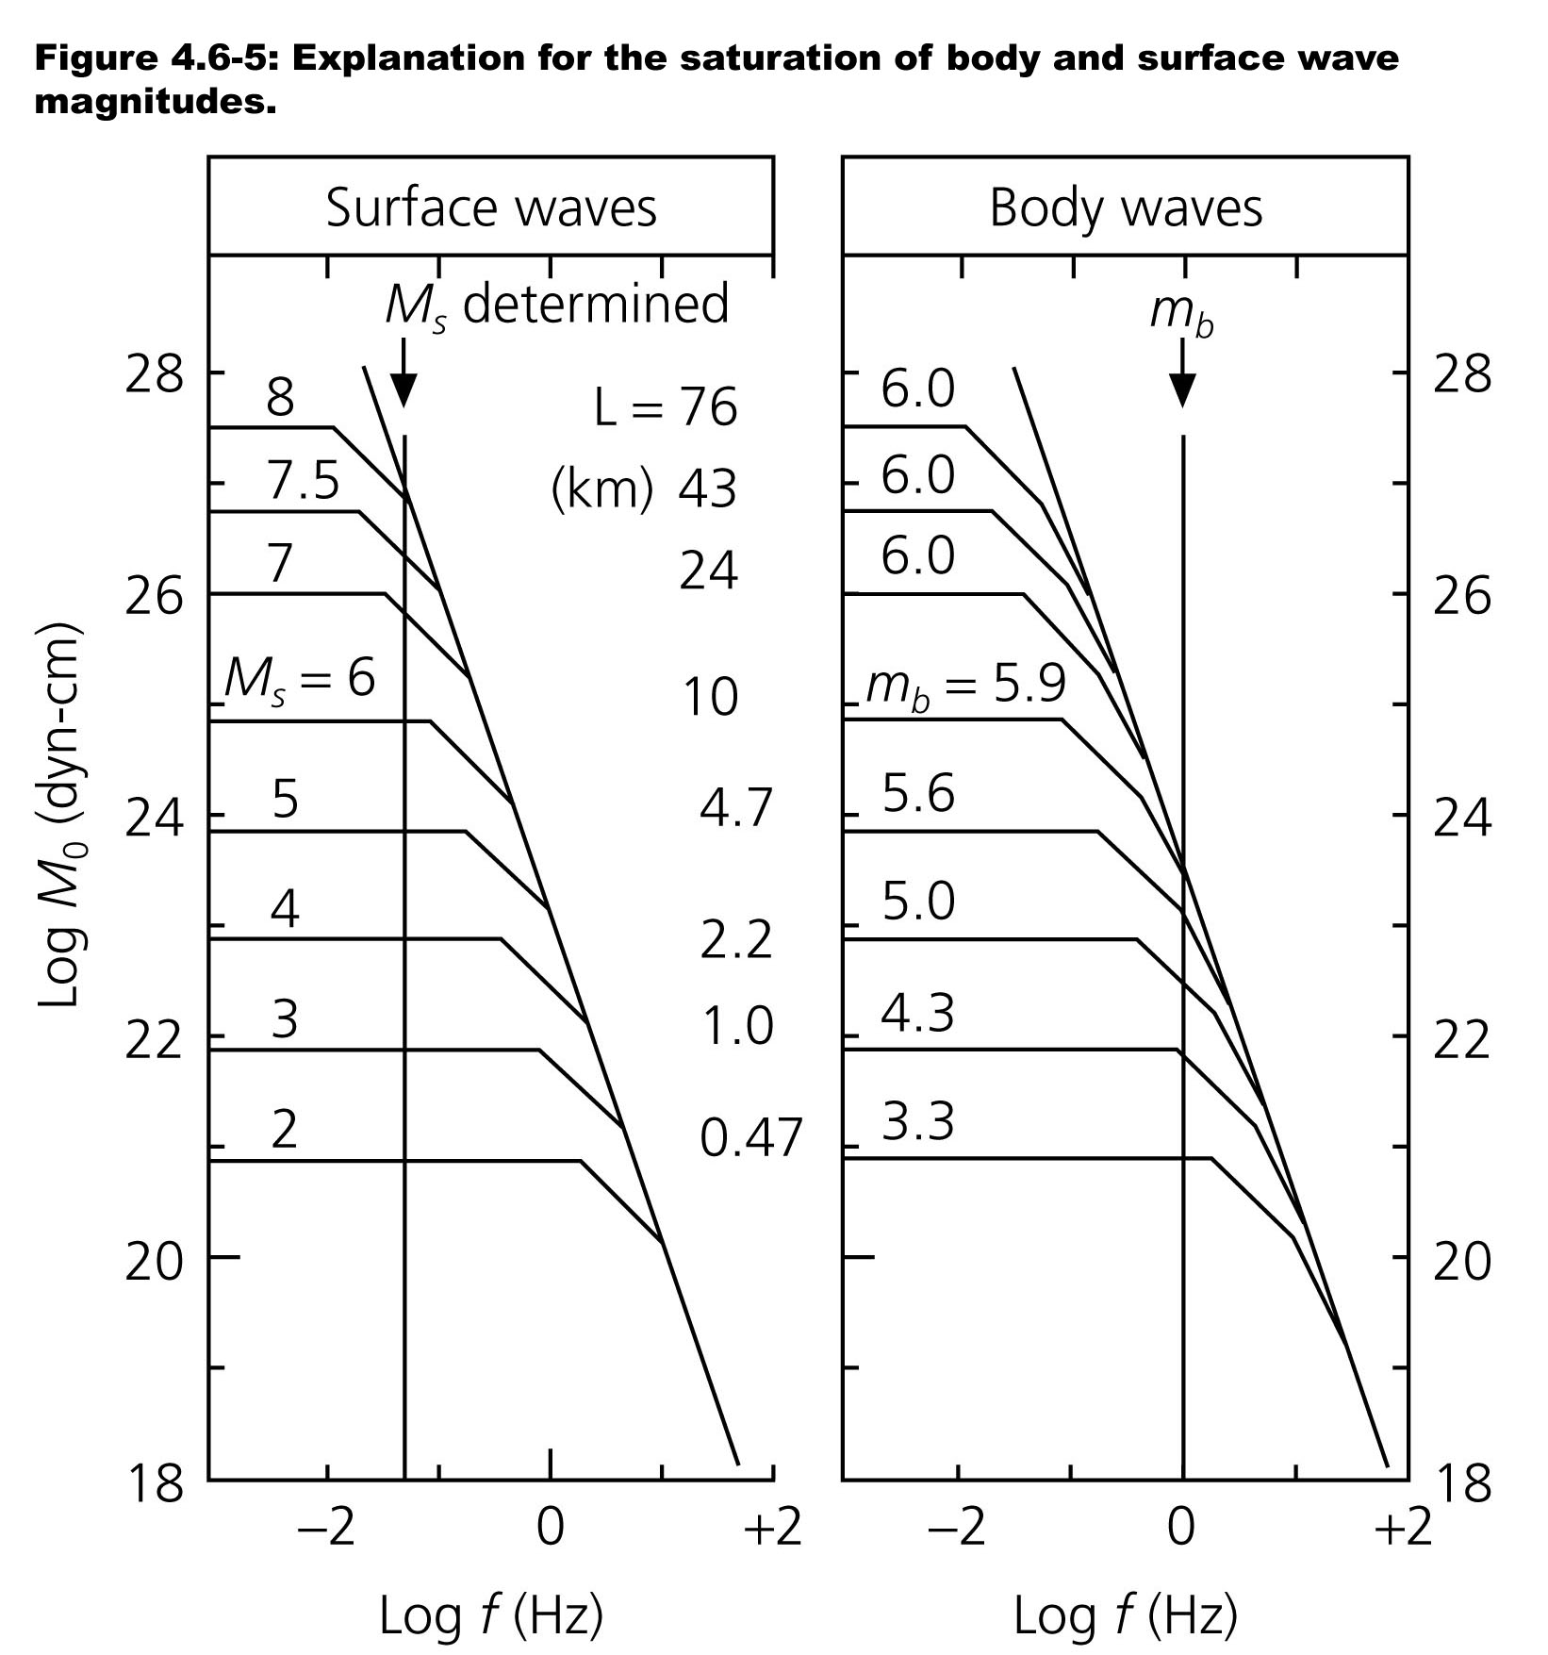
DIFFERENT MAGNITUDES REFLECT ENERGY RELEASE AT DIFFERENT PERIODS
1 s - Body wave magnitude m_{b}
20 s - Surface wave magnitude M_{s}
Long period - moment magnitude M_{w} derived from moment M₀

Slide 9
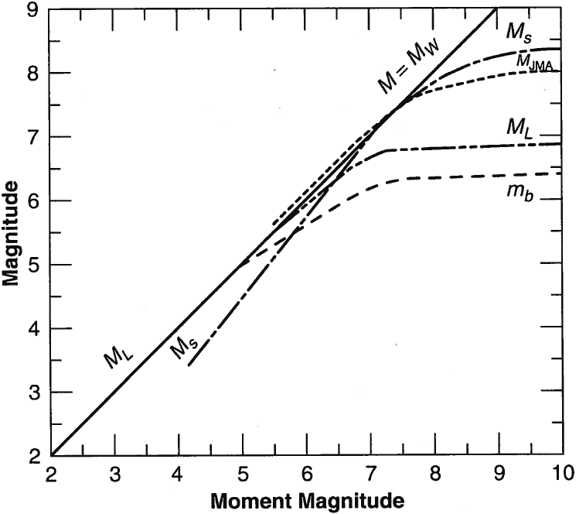
Earthquake: magnitude saturation
Above a certain size, each method becomes insensitive to the size of the earthquake, and exhibits magnitude saturation. This occurs for body-wave estimates at around m_{b}>6; all larger earthquakes give the same body-wave magnitude. Similarly, surface-wave estimates of magnitude saturate at M_{s}>8.
Thus, for very large earthquakes, M_{s} and m_{b} underestimate the energy released. An alternative definition of magnitude, based upon the long-period spectrum (M_{w} ) of the seismic wave, is preferred for very large earthquakes. It makes use of the physical dimensions of the focus.

Slide 10
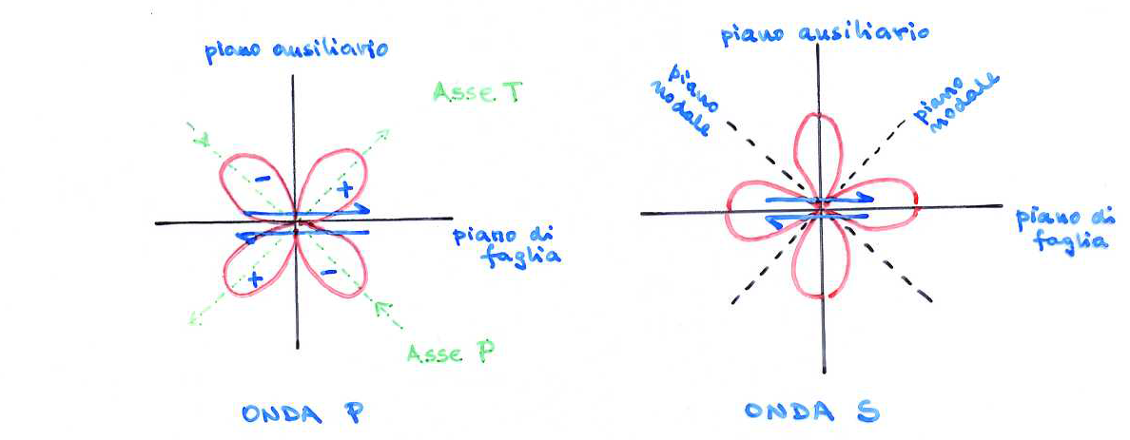
PROFILI RADIAZIONE
Sia M_{s} che M_{s} tendono a saturare (non danno valori abbastanza alti) per terremoti molto grandi e dipendono dalla frequenza. Inoltre, I terremoti non irradiano onde sismiche uniformemente in tutte le direzioni, ma hanno profili di radiazione caratteristici:
Notes:
10

Slide 11
Il terremoto non irradia onde P lungo la faglia e lungo la direzione perpendicolare ad essa (piani nodali), mentre per le onde S tali direzioni hanno il Massimo di radiazione. Per le onde P il Massimo di radiazione avviene nella direzione di massima compressione (con polarità primo impulso negativa) e di massima tensione (con polarità primo impulso positiva).
L’ampiezza dell’onda che arriva alla stazione dipende fortemente dall’azimuth della stazione rispetto alla faglia.
Una certa distribuzione di stazioni potrà quindi sovrastimare oppure sottostimare la magnitude.
Per le ragioni sopra esposte si preferisce caratterizzare la entità del terremoto mediante un parametron più fisico, il momento sismico e con una magnitude legata ad esso.
Notes:
11

Slide 12
As discussed in the elastic rebound model, a tectonic earthquake arises from abrupt displacement of a segment of a fault. The area S of the fractured segment and the amount by which it slipped D can be inferred.
Together with the rigidity modulus m of the rocks adjacent to the fault, these quantities define the seismic moment M₀ of the earthquake. Assuming that the displacement and rigidity are constant over the area of the rupture:
The seismic moment can be used to define a moment magnitude (M_{w}). The definition adopted by the responsible commission of IASPEI is:
In this equation M₀ is in N m
Mw is more appropriate for describing the magnitudes of very large earthquakes. It has largely replaced M_{s} in scientific evaluation of earthquake size, although M_{s} is often quoted in reports in the media.

Slide 13
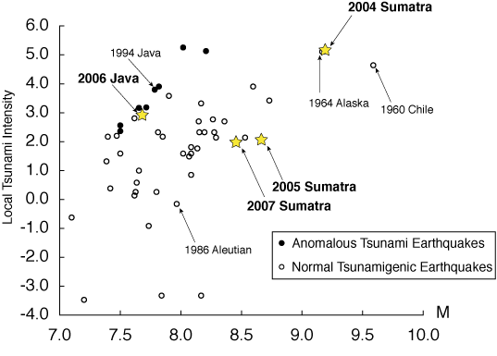
The magnitude scale is, in principle, open ended. Negative Richter magnitudes are possible, but the limit of sensitivity of seismographs is around -2. The maximum possible magnitude is limited by the shear strength of the crust and upper mantle, and since the beginning of instrumental recording none has been observed with a surface wave magnitude M_{s} as high as 9. However, this is largely due to a saturation effect resulting from the method by which surface-wave magnitudes M_{s} are computed.
Seismic moment magnitudes Mw of 9 and larger have been computed for some giant earthquakes. The largest in recorded history was the 1960 Chile earthquake with M_{w}=9.5.

Slide 14
When an earthquake occurs on a fault, the ruptured area spreads in size from the point of initial failure, akin to opening a zip fastener. If the fault ruptures along a length L, and the fractured segment has a down-dip dimension w (referred to as the width of the faulted zone), the area S is equal to wL.
This inference is supported by the correlation between seismic moment and the ruptured area S for many shallow earthquakes

Slide 15
The length L of the rupture zone determines how long the ground motion lasts in an earthquake. This factor has a significant bearing on the extent of damage to structures during moderate to strong earthquakes. Theory gives the speed of propagation of the rupture as 75–95% of the shear wave velocity.
Assuming that the rupture propagates along the fault at about 2.5–3.0 km s⁻¹, the duration of the ground motion can be estimated for an earthquake of a given magnitude or seismic moment
For example, close to the epicenter of a magnitude 5 earthquake the vibration may last a few seconds, whereas in a magnitude 8 earthquake it might last about 50 s. However, there is a lot of scatter about the ideal correlation.
In the great Sumatra earthquake, with magnitude 9.0, the rupture continued for some 500 s!.

Slide 16
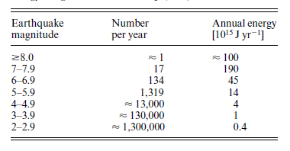
Earthquake: energy
The definition of earthquake magnitude relates it to the logarithm of the amplitude of a seismic disturbance. Noting that the energy of a wave is proportional to the square of its amplitude it should be no surprise that the magnitude is also related to the logarithm of the energy. Several equations have been proposed for this relationship.
An empirical formula worked out by Gutenberg relates the energy release E to the surface-wave magnitude Ms:
The logarithmic nature of the formula means that the energy release increases very rapidly with increasing magnitude. For example, when the magnitudes of two earthquakes differ by 1, their corresponding energies differ by a factor 32 (=10^{1.5}). Hence, a magnitude 7 earthquake releases about 1000 times the energy of a magnitude 5 earthquake. Another way of regarding this observation is that it takes 1000 magnitude 5 earthquakes to release the same amount of energy as a single large earthquake with magnitude 7.

Slide 17
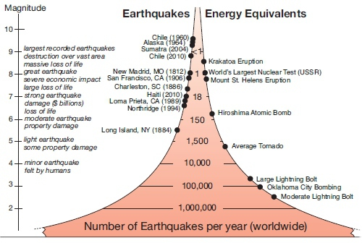
Multiplying the mean number of earthquakes per year by their estimated energy (using one of the energy–magnitude equations) gives an impression of the importance of very large earthquakes.
Ms > 7 are responsible for most of the annual seismic energy. In a year in which a very large earthquake (Ms>8) occurs, most of the annual seismic energy is released in that single event.
It is rather difficult to appreciate the amount of energy released in an earthquake from the numerical magnitude alone. A few examples help illustrate the amounts of energy involved. Earthquakes with M_{s}=1 are so weak that they can only be recorded instrumentally; they are referred to as micro earthquakes. The energy associated with one of these events is equivalent to the kinetic energy of a medium sized automobile weighing 1.5 tons which is travelling at 130 km h⁻¹ (80 m.p.h.).
The energy released by explosives provides another means of comparison, although the conversion of energy into heat, light and shock waves is proportionately different in the two phenomena. One ton of the explosive trinitrotoluene (TNT) releases about 4.2x10⁹ joules of energy. Equation 8 shows that the 11 kiloton atomic bomb which destroyed Hiroshima released about the same amount of energy as an earthquake with magnitude 5.9. The energy released in a 1 megaton nuclear explosion is equivalent to an earthquake with magnitude 7.2; the 2004 Sumatra earthquake (magnitude 9.0) released an amount of energy equivalent to the detonation of 475 megaton bombs.

Slide 18
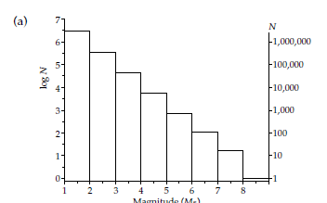
Earthquake: frequency
Every year there are many small earthquakes, and only a few large ones. According to a compilation published by Gutenberg and Richter in 1954, the mean annual number of earthquakes in the years 1918–1945 with magnitudes 4–4.9 was around 6000, while there were only an average of about 100 earthquakes per year with magnitudes 6–6.9. The relationship between annual frequency (N) and magnitude (M_{s}) is logarithmic and is given by an equation of the form:
The value of a varies between about 8 and 9 from one region to another, while b is approximately unity for regional and global seismicity.
Low values of b indicate area less fracturated and characterize continental rift and deep earthquakes.
High values of b indicate area highly fractured and are typical of oceanic ridges.
The b value is determined with the method of maximum likelihood:
The Gutenberg Richter law characterize a seismic area and is important for seismic hazard

Slide 19
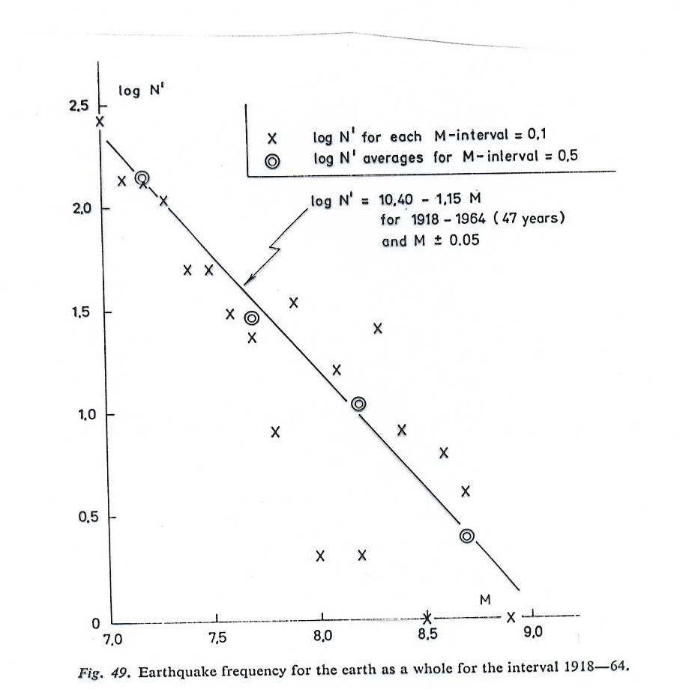
Notes:
19

Slide 20
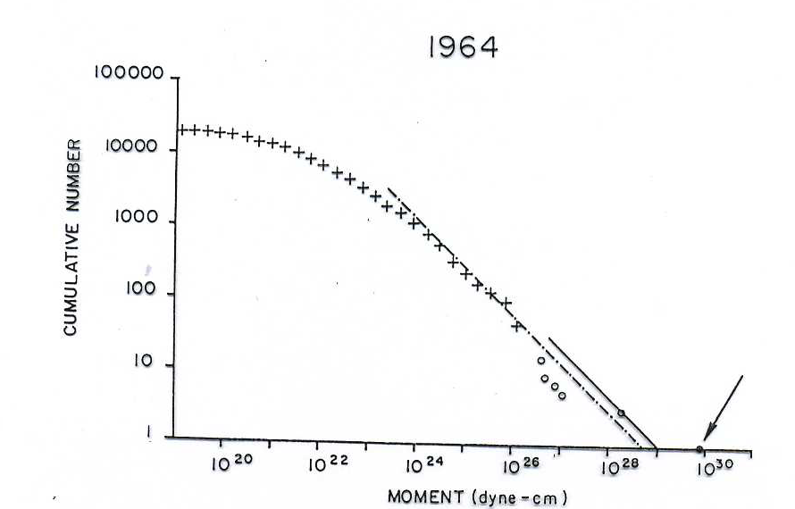
Notes:
20

Slide 21
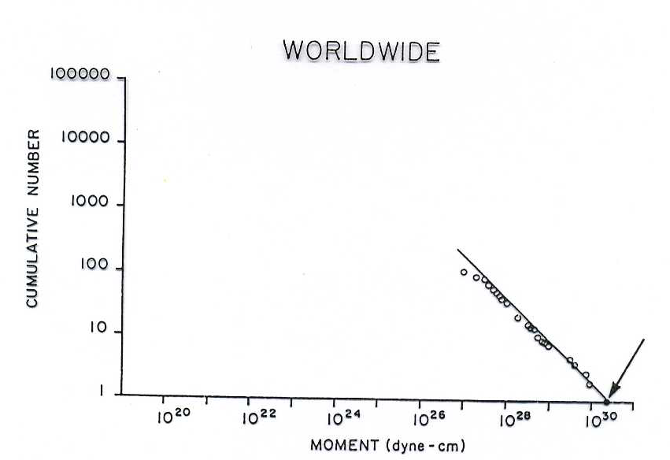
Notes:
21

Slide 22
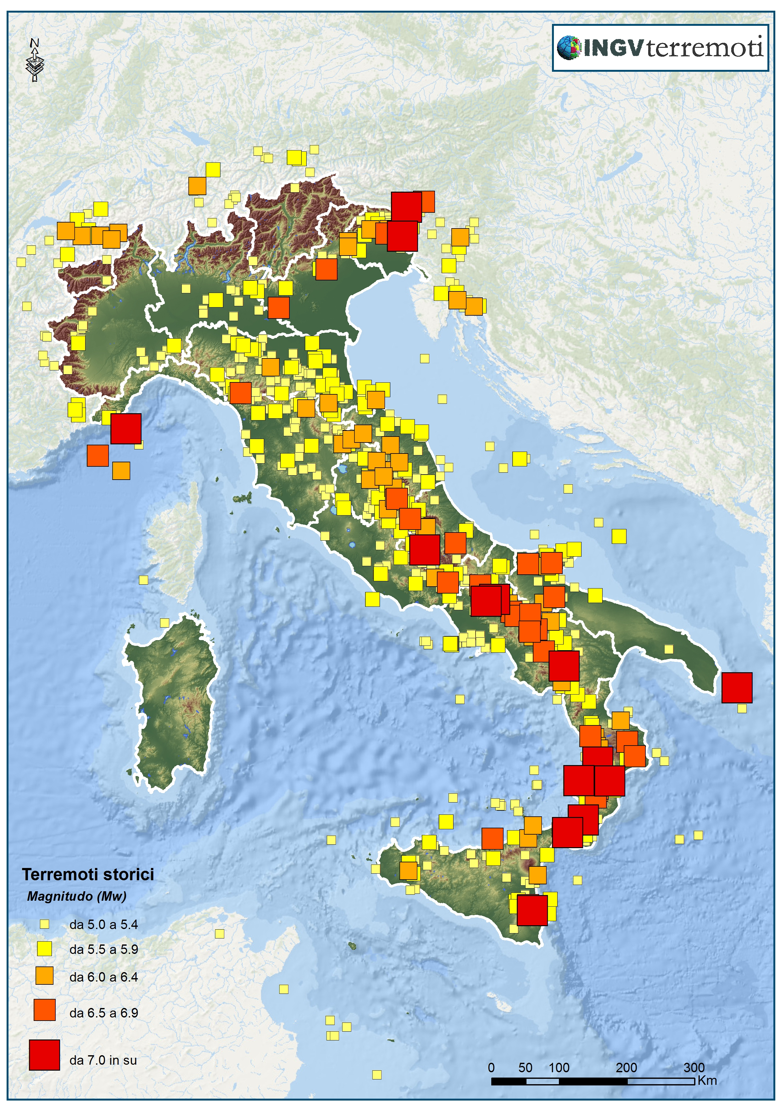
Terremoti passati
La sismicità dall’anno 1000 al 2006 by INGV
Guardando la mappa dei terremoti italiani dall’anno 1000 al 2006, è facile notare che i terremoti spesso avvengono in zone già colpite in passato. Gli eventi storici più forti si sono verificati in Sicilia, nelle Alpi orientali e lungo gli Appennini centro-meridionali, dall’Abruzzo alla Calabria. Ma ci sono stati terremoti importanti anche nell’Appennino centro-settentrionale e nel Gargano. In particolare, dal 1900 ad oggi si sono verificati 30 terremoti molto forti (Mw≥5.8), alcuni dei quali sono stati catastrofici. Qui di seguito li riportiamo in ordine cronologico. Il più forte tra questi è il terremoto che nel 1908 distrusse Messina e Reggio Calabria.

Slide 23
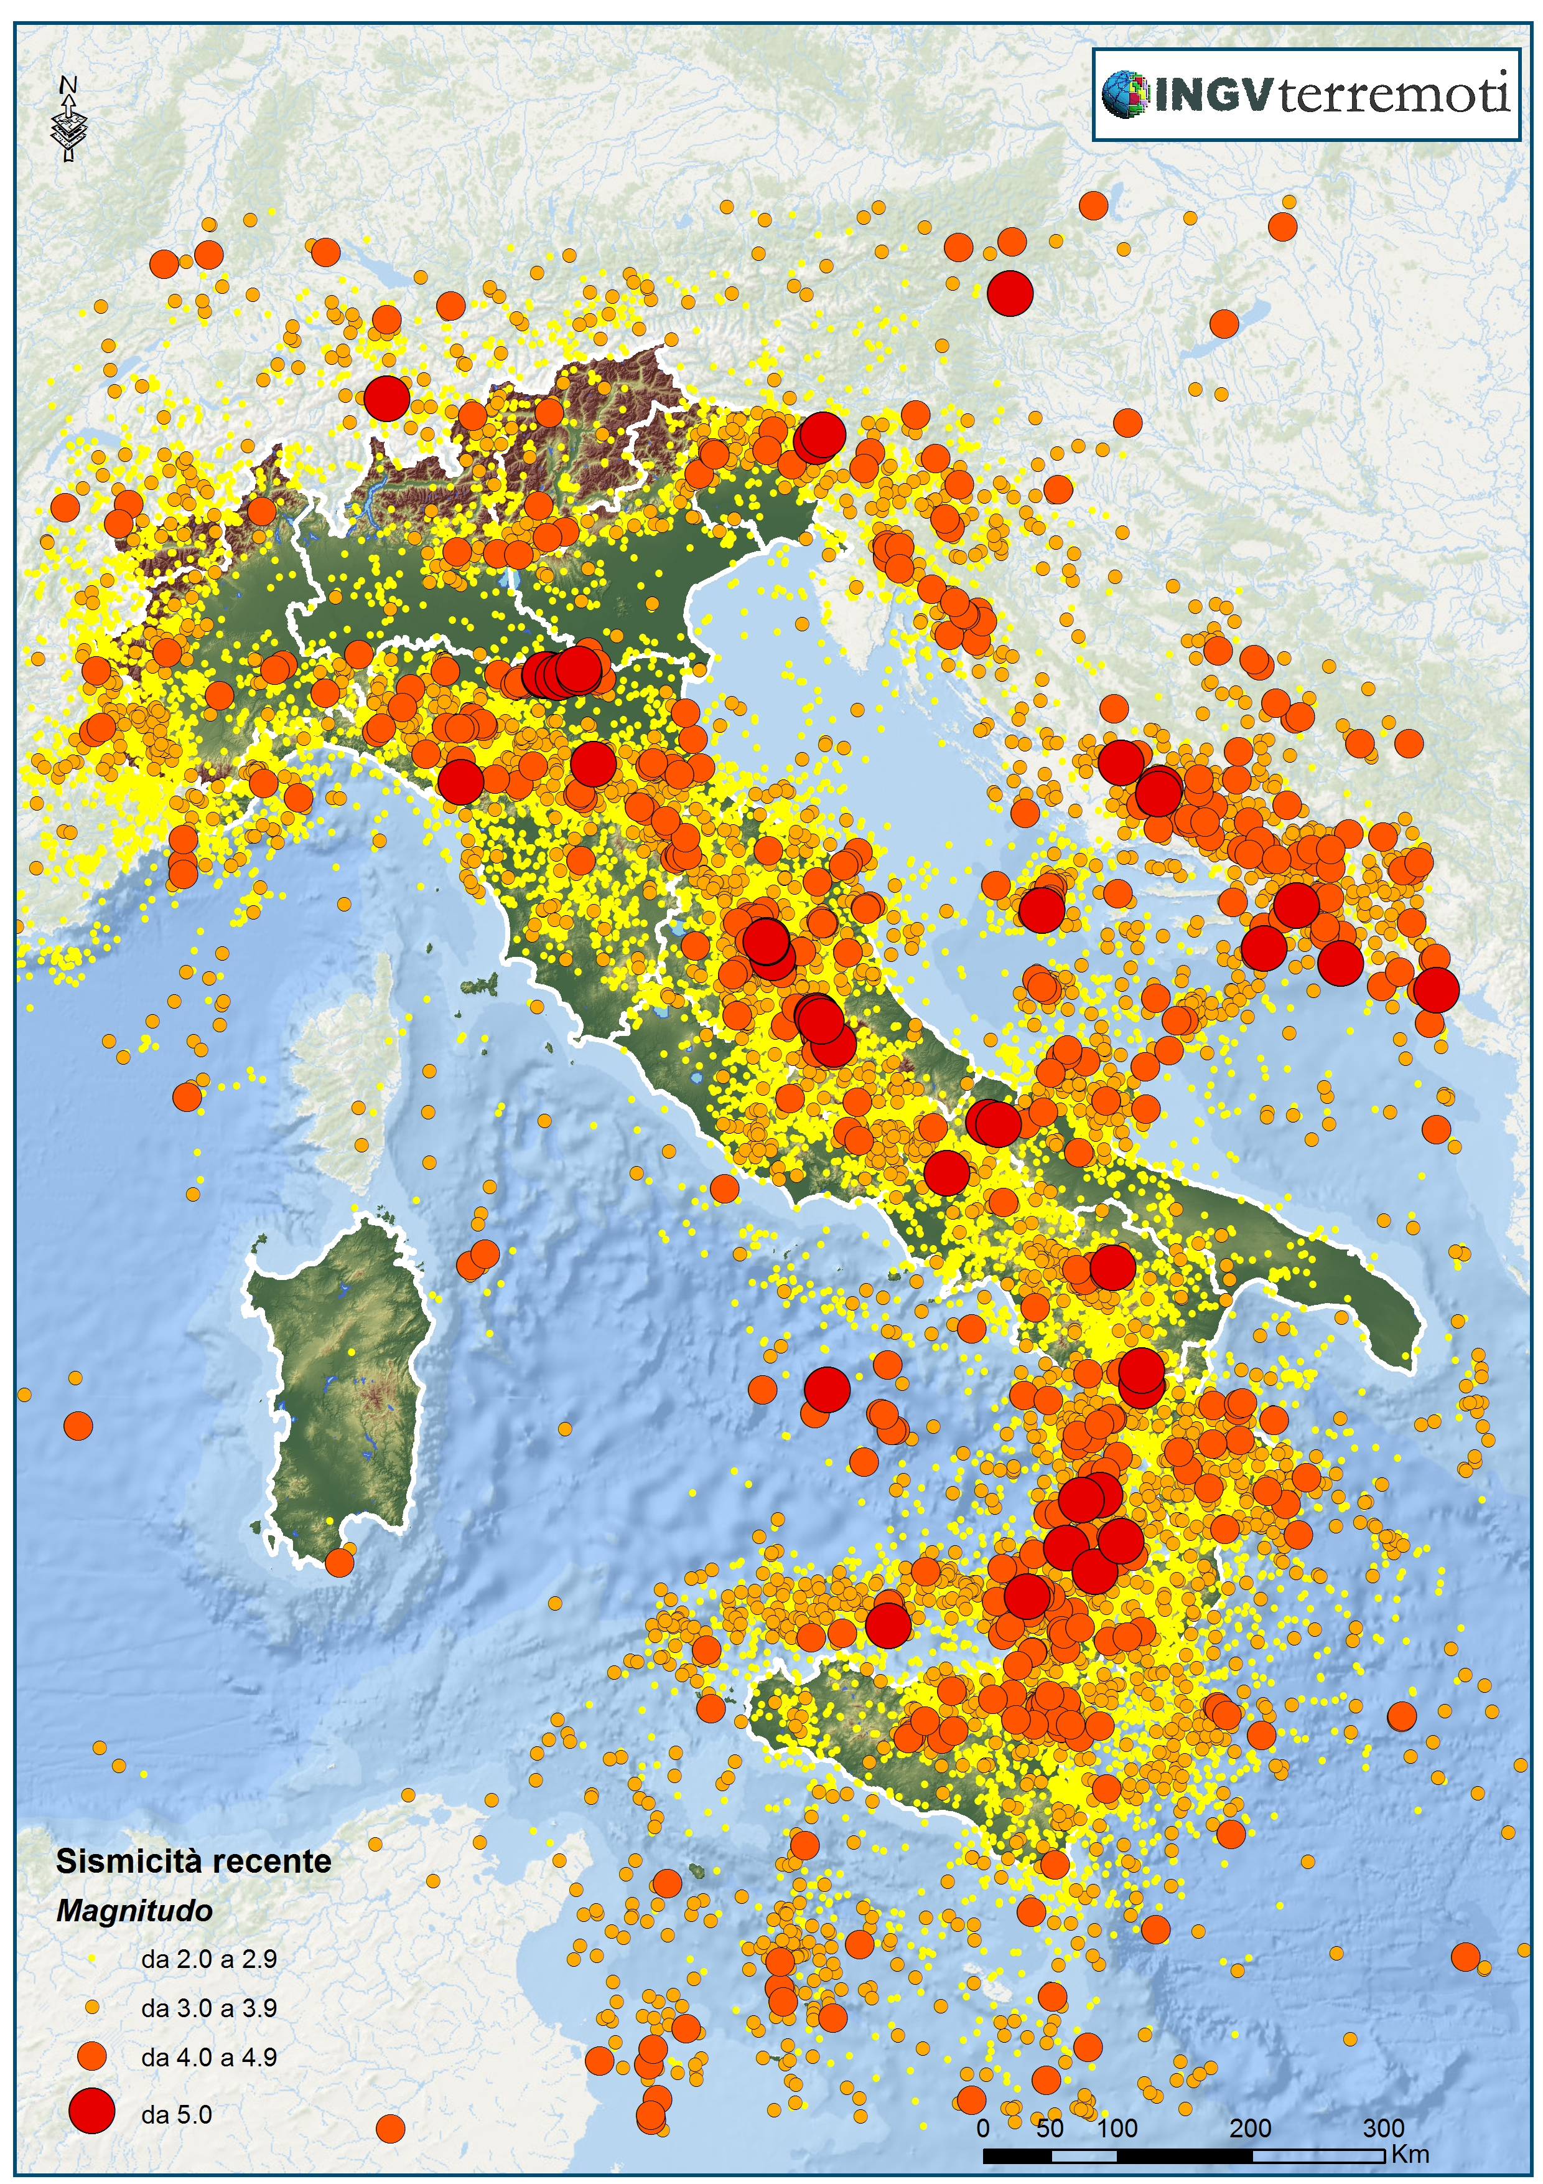
Terremoti recenti
Guardando la mappa degli ultimi 30 anni (1985-2014) di sismicità si nota che i terremoti recenti sono localizzati in aree distribuite principalmente lungo la fascia al di sotto degli Appennini, dell’arco Calabro e delle Alpi.
La sismicità dal 1985 al 2014. Sono mostrati i terremoti di magnitudo ML≥2.0 registrati dalla Rete Sismica Nazionale

Slide 24
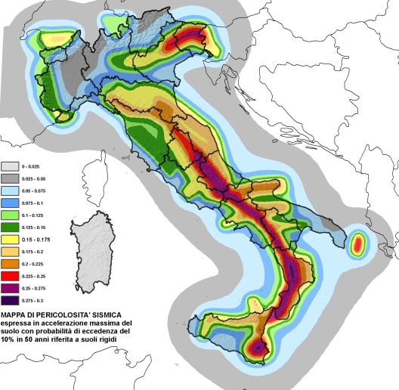
Pericolosità sismica del territorio nazionale
Per questo l’INGV ha realizzato la mappa della pericolosità sismica (zonesismiche.mi.ingv.it). Questa mappa si basa sull’analisi dei terremoti del passato, sulle informazioni geologiche disponibili e sulle conoscenze che si hanno sul modo in cui si propagano le onde (e quindi l’energia) dall’ipocentro all’area in esame. Confrontando tutte queste informazioni è possibile ottenere i valori di scuotimento del terreno in un dato luogo a causa di un probabile terremoto, vicino o lontano che sia: tali valori sono espressi in termini di accelerazione massima orizzontale del suolo rispetto a g (l’accelerazione di gravità). La stima della pericolosità sismica fornisce l’accelerazione massima attesa su suolo rigido con una probabilità di superamento del 10% in 50 anni. Questa mappa, in continuo aggiornamento, mostra la pericolosità delle varie zone dal minimo (colore grigio) al massimo (colore viola).

Slide 25
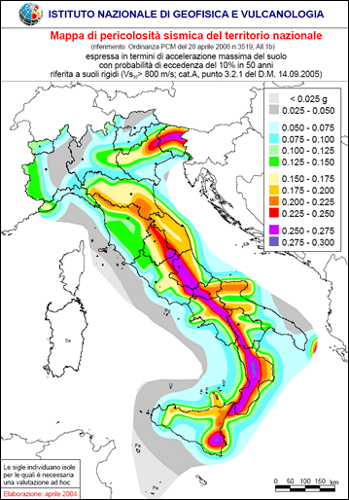
Pericolosità sismica del territorio nazionale
La mappa di pericolosità è uno strumento fondamentale per la realizzazione di misure di prevenzione che consentano di ridurre gli effetti dei terremoti, per esempio costruendo edifici resistenti alle vibrazioni dei terremoti più forti che possiamo aspettarci in una determinata zona. Sulla base della mappa di pericolosità sismica, infatti, la legge italiana ha classificato il territorio nazionale in 4 zone: dalla zona 1, dove potrebbero verificarsi terremoti molto forti, alla zona 4, a bassa pericolosità ma comunque a rischio per la presenza di edifici vulnerabili.
Circa il 60% dei comuni italiani è classificato nelle prime tre zone. I comuni devono rispettare precise norme sulla progettazione e realizzazione delle costruzioni nuove e sull’adeguamento di quelle vecchie. Tali norme, aggiornate nel luglio 2009, stabiliscono cosa deve essere fatto, in ogni punto del territorio nazionale, in fase di progettazione delle strutture e contengono inoltre nuove regole per il rafforzamento delle strutture esistenti.

Slide 26
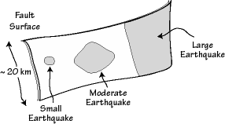
The size of the area that slips during an earthquake is increases with earthquake size.
The largest earthquakes generally rupture the entire depth of the fault, which is controlled by temperature.
The temperature increases with depth to a point where the rocks become plastic and no longer store the elastic strain energy necessary to fail suddenly.
The shaded regions on the fault surface are the areas that rupture during different size events

Slide 27
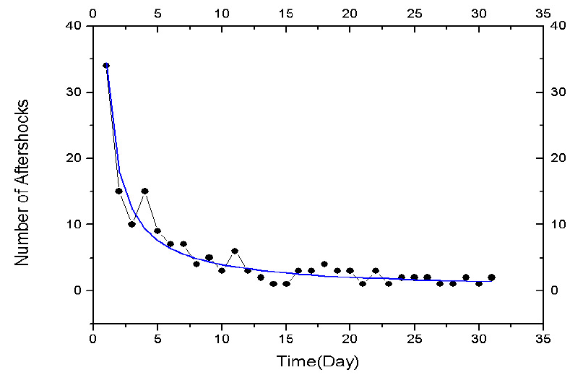
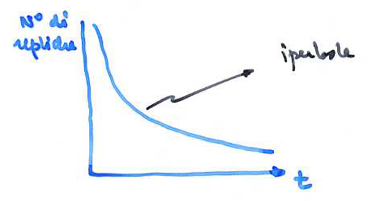
Earthquake: aftershock
Occur after each strong earthquake
The biggest replica is typically at least one unit of magnitude smaller than the main event
The sum of the energy associated with the sequence of aftershocks is usually 5-10% of that released from the main event is a secondary process
By studying the Japanese earthquakes (1981) OMORI showed that the number of replicas decreases with time after the main event and follows the law of OMORI

Slide 28
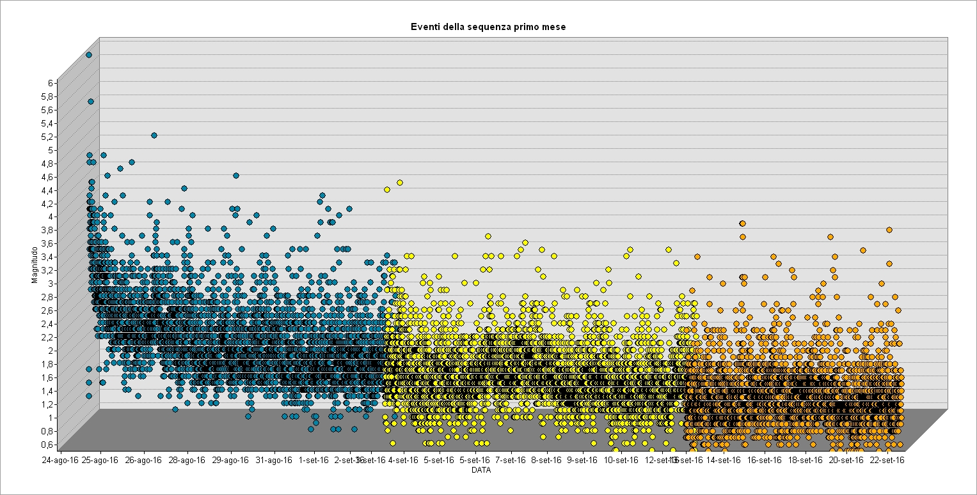

Slide 29
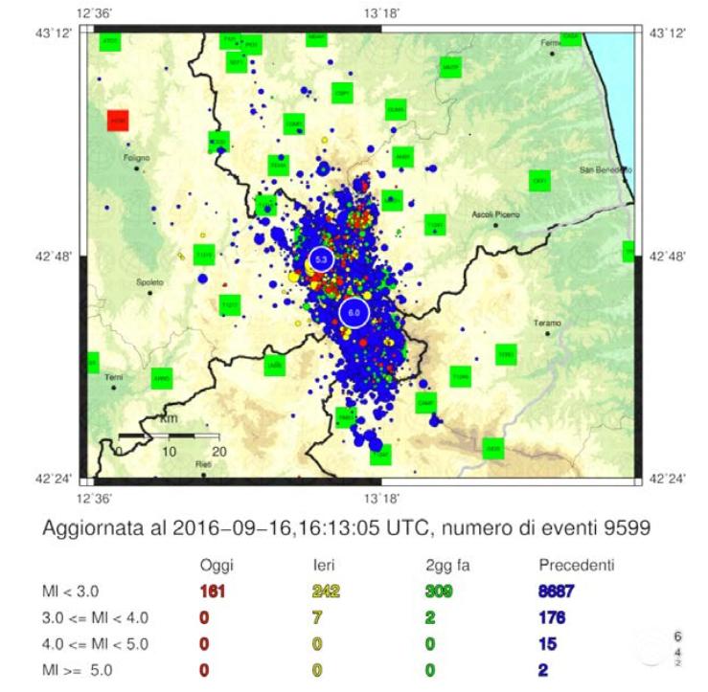

Slide 30
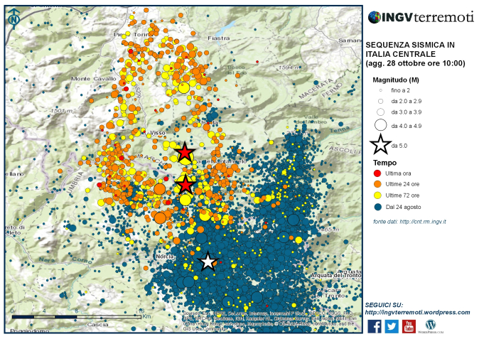

Slide 31
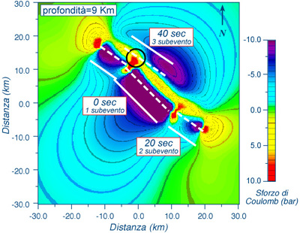
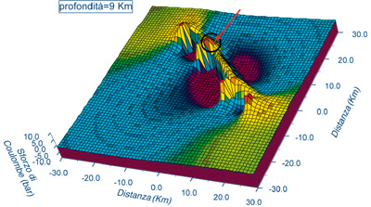

Terremoto Irpinia 1980

Slide 32
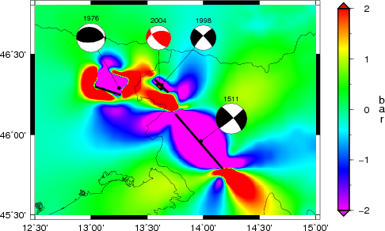
Visco-elastic modeling and stress evolution since 1511 up to 2004 accounting for coseismic and postseismic deformation
of each past major event
(Borghi, Aoudia- Tectonophysics, 2009)
3-D Finite Elements Method
domain boundaries extending 100 km away from the most external point of each fault
an Earth model comprised by a 16-km-thick elastic upper curst, a viscoelastic lower crust with viscosity 10¹⁹ Pa s between a depth of 16 km and the Moho at 37 km and a viscoelastic lithospheric mantle with viscosity 10²¹ Pa s.

Slide 33
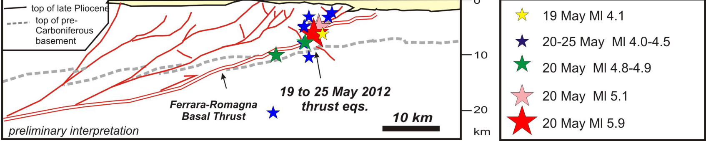
The aftershocks occur:
    On a fault
        On the fault plane
        At the end of the fault where stress to increase due to the major earthquake
    Around the fault
Sezione schematica strutturale dell’area ipocentrale dell’Emilia ritracciata da Toscani et al., 2009 (Da THE FERRARA ARC THRUST EARTHQUAKES OF MAY-JUNE 2012 (NORTHERN ITALY):STRONG-MOTION AND GEOLOGICAL OBSERVATIONS-– REPORT I)

Slide 34
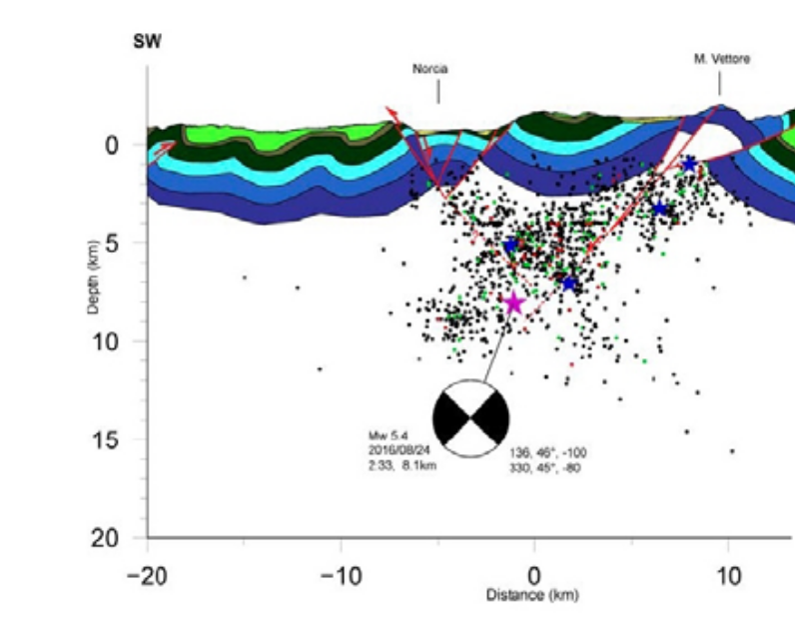
Terremoto Amatrice 24 agosto 2016
NORCIA
MONTE VETTORE
EVENTO PRINCIPALE

Slide 35
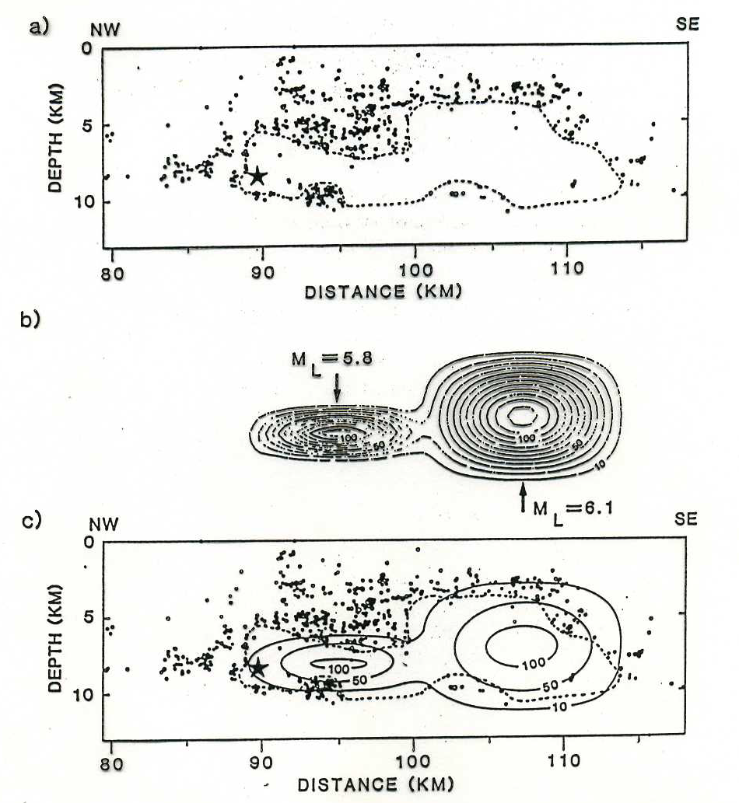
Aftershocks and slip of the earthquake in Morgan Hill (California) in 1984, a strike-slip earthquake on the Hayward let him. (a) the distribution of the aftershocks on the fault, which shows the hypocenter of the main event (star) and the bounds of rupture as reported by Cockerham and Eaton (1984). (b) slip distrubution of the two major earthquakes in the sequence. (c) the two overlapping figures (from Bakun, King and Cockerham, 1986).

