Slide 1
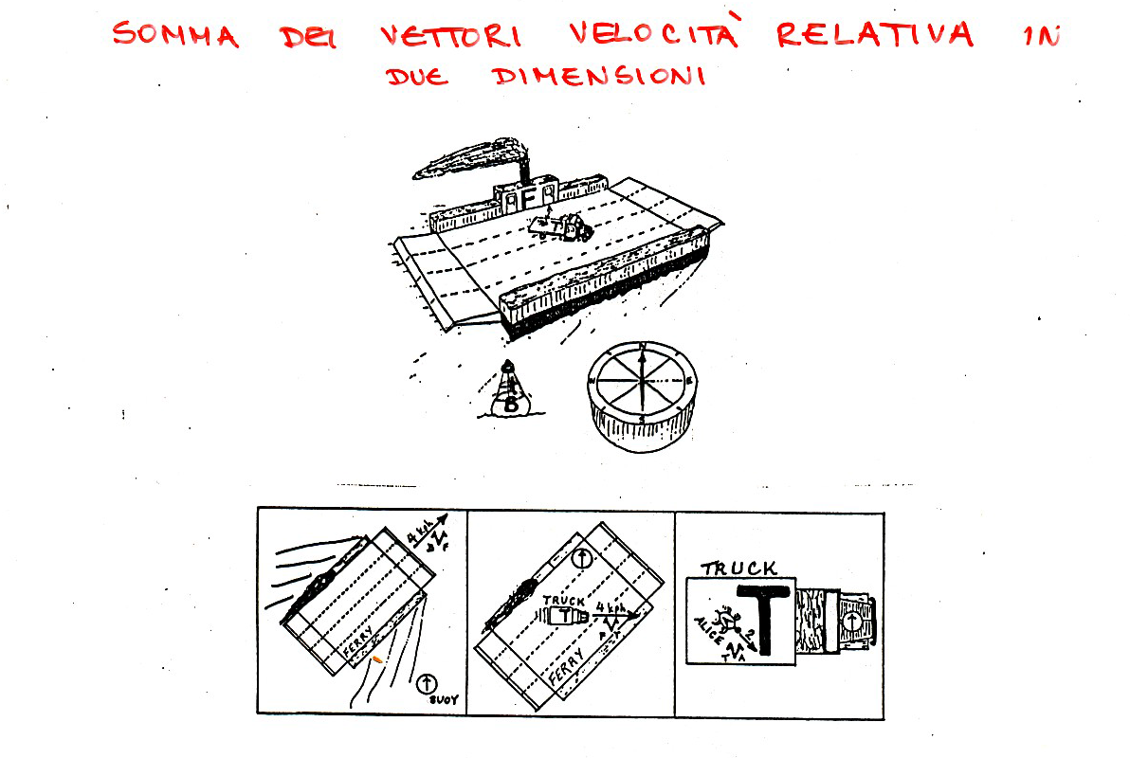

Slide 2
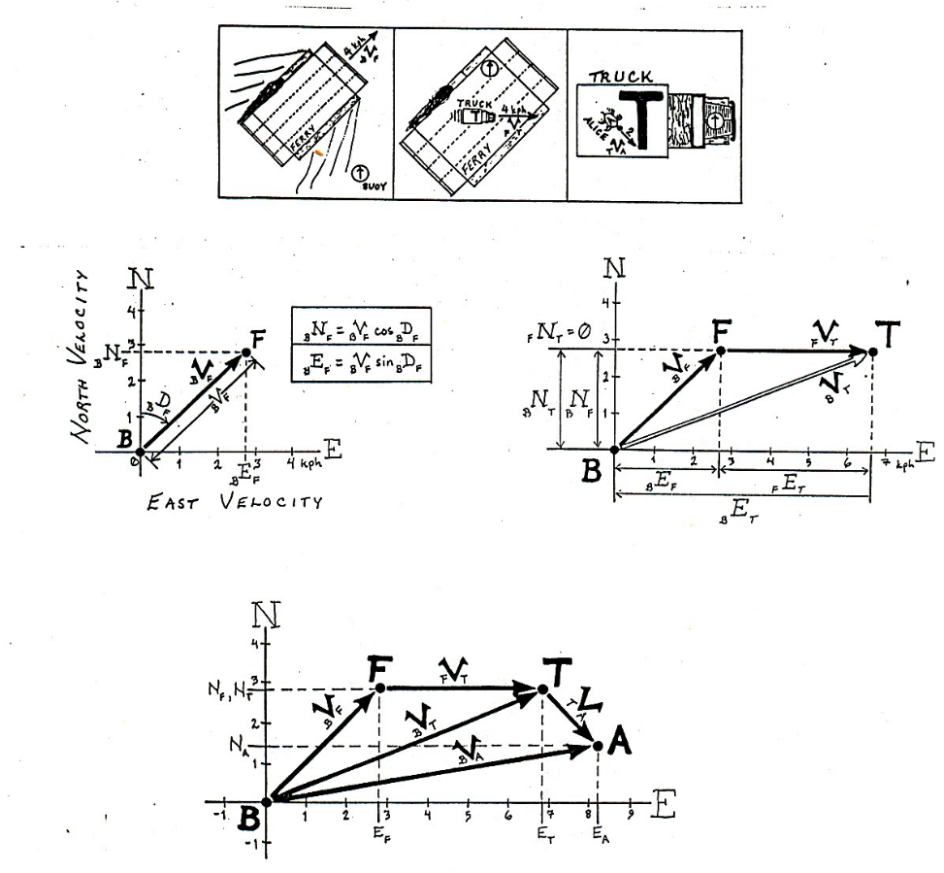

Slide 3
Plate tectonics on a flat earth: Relative velocity between two plates
a) Constructive boundary
b) Destructive boundary
c) Conservative boundary

Slide 4
Plate tectonics on a flat earth: Relative velocity between two plates
The velocity of plate A with respect to plate B is written: _{B}V_{A}.
Conversely, The velocity of plate B with respect to plate A is written: _{A}V_{B}.

Slide 5
The key principles: Types of plate boundaries
Transform faults can be grouped into six basic classes. By far the most common type of transform fault is the ridge-ridge fault.

Slide 6
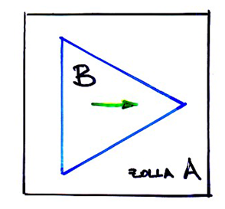



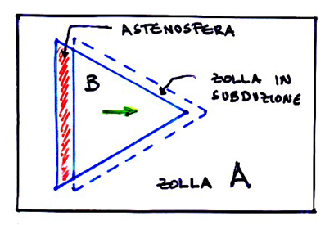
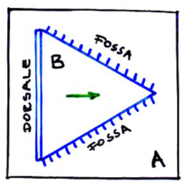
RELATIVE VELOCITY BETWEEN PLATES
“ FLAT EARTH”
From a paper cut a triangle and move it relative to the paper itself
Symbol of edges:
Ridge
Trench
Transform fault

Slide 7
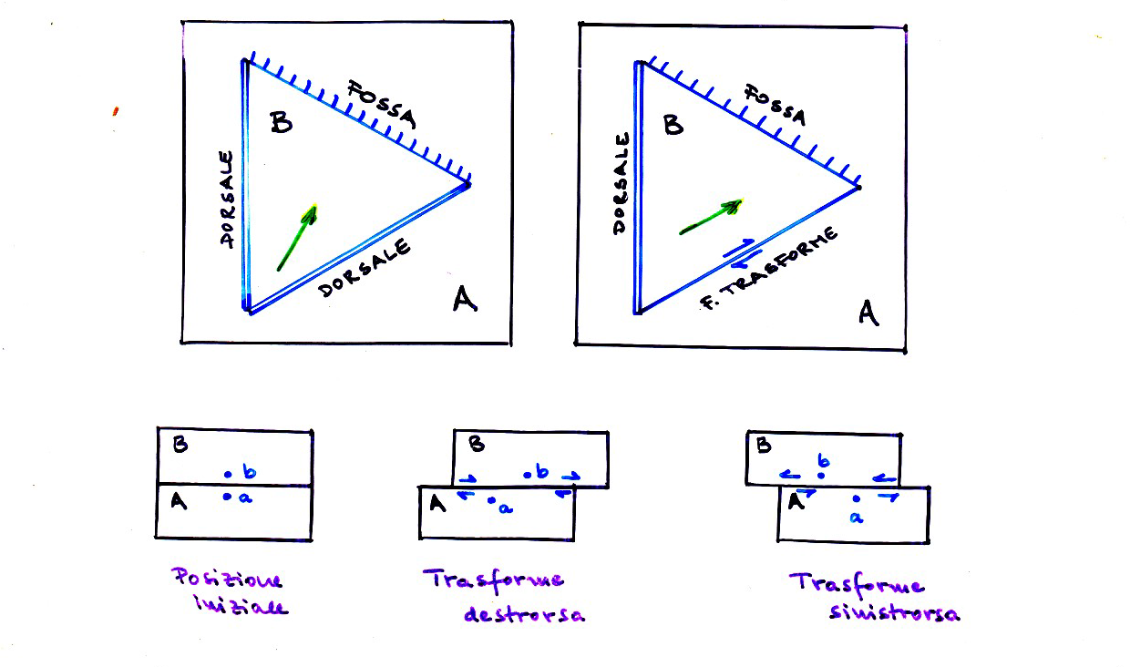

Slide 8
Plate tectonics on a flat earth: Two plates
The western boundary of plate B is a ridge, which is spreading at a half-rate of 2 cm yr⁻¹.
Since _{A}V_{B} is equal to 4 cm yr⁻¹, the eastern boundary is a subduction zone. Either plate A is subducting underneath plate B and the length of plate B increases by 2 cm yr⁻¹, or plate B is subducting underneath plate A and plate B is being destroyed at a rate of 2 cm yr⁻¹.

Slide 9
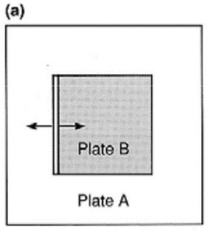
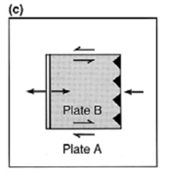
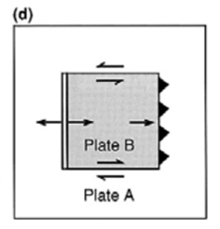
Constructive bundary: its velocity equal to 2 cm/yr.
What is the relative velocity _{A}v_{B} ?
What happen to the other three bundary of the B plate?
Case 1: _{A}v_{B} =4cm/yr (to right)
The superior and inferior bundaries are conservative
There are two possibility for the subduction: A to B or B to A
What are the velocity in the two case?
What happen to the plates?

Slide 10
Case 1: _{A}v_{B} =4cm/yr (to right)
The western boundary of plate B is a ridge, which is spreading at a half-rate of 2 cm yr⁻¹.
Since _{A}V_{B} is equal to 4 cm yr⁻¹, the eastern boundary is a subduction zone. Either plate A is subducting underneath plate B and the length of plate B increases by 2 cm yr⁻¹(c) or plate B is subducting underneath plate A and plate B is being destroyed at a rate of 2 cm yr⁻¹(d).

Slide 11
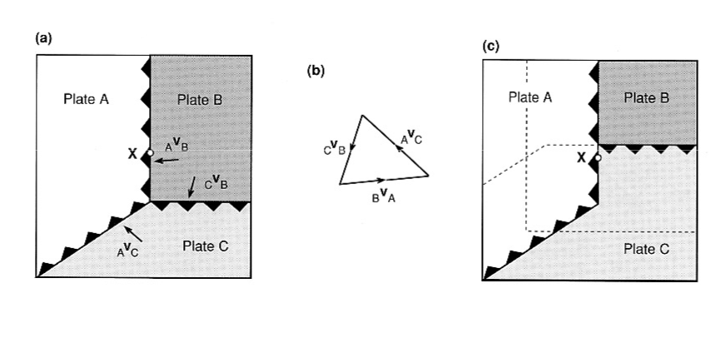

Slide 12
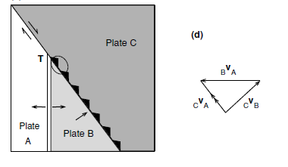
Plate boundaries can change with time
Both formation and distruction of the plates are the clear reason of the change of the plate bundary and thei relative velocity. Also the variation of the rotation pole modifies the status quo completely.
Parts of the plate bundary can also change locally without these events.
Point T, where plates A, B and C meet, is the triple junction. The boundary between plates A and B is a ridge, that between plates A and C is a transform fault and that between plates B and C is a subduction zone. The circled part of the boundary changes with time.

Slide 13
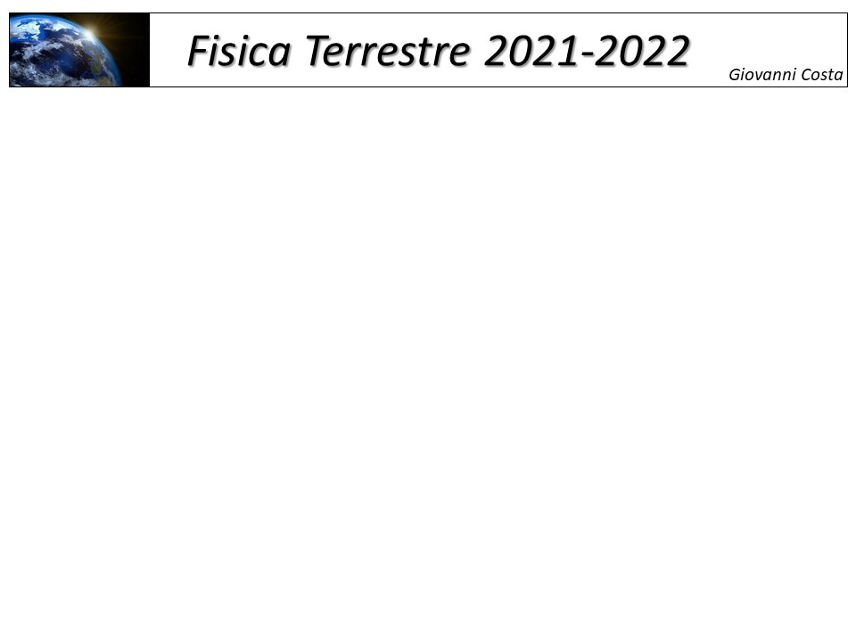
Plate tectonics on a flat earth: Three plates
Plates A and B are spreading away at a half-rate of 2 cm /yr.
Plate A being subducted underneath plate C at a rate of 6 cm/yr.
To determine the relative rate between plate B and C we use vector addition:
The northern and southern boundaries of plate B are transform faults, and the eastern boundary is a subduction zone with plate C overriding plate B at 10cm/yr

Slide 14
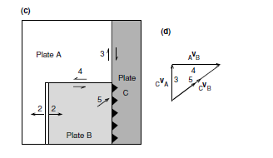
Plate tectonics on a flat earth: Two plates
Plates A and B are spreading away at a half-rate of 2 cm /yr.
The boundary between between plates A and C is a transform fault with a relative motion of 3 cm/yr.
Plate B undergoes oblique subduction beneath plate C at 5 cm yr/1.
The other possible solution is for plate C to be subducted beneath plate B at 5 cm yr/1. In that case, the boundary between plates C and B would not remain collinear with the boundary between plates B and C but would move steadily to the east.

Slide 15
Present-Day Plate Motions

Slide 16
Plate boundaries can change with time
A three-plate model. Point T, where plates A, B and C meet, is the triple junction. The western boundary of plate C consists of transform faults. Plate B is overriding plate A at 4 cm/yr. The circled part of the boundary of plate C changes with time.
Point T, where plates A, B and C meet, is the triple junction. The boundary between plates A and B is a ridge, that between plates A and C is a transform fault and that between plates B and C is a subduction zone. The circled part of the boundary changes with time.

Slide 17
Triple junctions
1) RRR: E. Pacific Rise- Galapagos
2) TTT: Central Japan
3) TTF: Peru-Chile trench\and West Chile Rise
4) FFR: Owen Fracture Zone– Sheba Ridge
5) FFT: California
6) RTF: Gulf of California

Slide 18
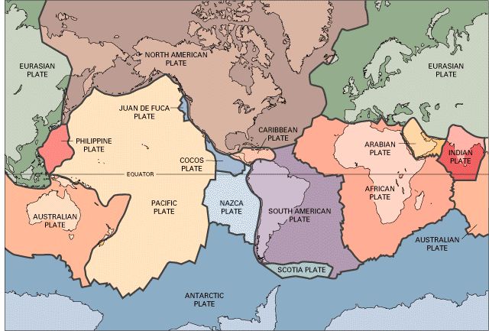
Triple junctions
Triple junction: A special type of plate boundary where three plates meet at a single point.
There are three types of plate boundaries:
Ridge (R)
Transform fault (F)
Subduction zone or trench (T)

Slide 19
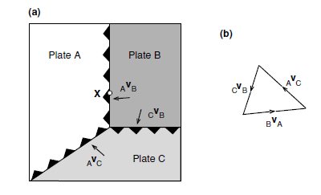
Triple junctions
A triple junction is said to be ‘stable’ when the relative motions of the three plates and the azimuth of their boundaries are such that the configuration of the junction does not change with time.
An ‘unstable’ triple junction exists only momentarily before evolving to a different geometry.
If four or more plates meet at one point, the configuration is always unstable, and the system will evolve into two or more triple junctions.
Plate A is overriding plates B and C, and plate C is overriding plate B.
the original triple junction was unstable; however, the new triple junction is stable (meaning that its geometry and the relative velocities of the plates are unchanging), though the triple junction itself continues to move northwards along the north–south edge of plate A.

Slide 20
Triple junctions
It can be seen that, although the original triple junction is not stable, it would be stable if _{A}v_{c} were parallel to the boundary between plates B and C. Then the boundary between B and C would not move in a north–south direction relative to A, so the geometry of the triple junction would be unchanging with time.
The other configuration in which the triple junction would be stable occurs when the edge of the plate either side of the triple junction is straight.
There are sixteen possible types of triple junction, all shown in of these sixteen triple junctions, one is always stable (the ridge–ridge–ridge junction), and two are always unstable (the fault–fault–fault and fault–ridge–ridge junctions). The other thirteen junctions are stable under certain conditions. In the notation used to classify the types of triple junction, a ridge is written as R, a transform fault as F and a subduction zone (or trench) as T. Thus, a ridge–ridge–ridge junction is RRR, a fault–fault– ridge junction is FFR, and so on.

Slide 21
Triple junctions
It can be seen that, although the original triple junction is not stable, it would be stable if _{A}v_{c} were parallel to the
boundary between plates B and C. Then the boundary between B and C would not move in a north–south direction relative to A, so the geometry of the triple junction would be unchanging with time.
The other configuration in which the triple junction would be stable occurs when the edge of the plate either side of the triple junction is straight.
There are sixteen possible types of triple junction, all shown in Of these sixteen triple junctions, one is always stable (the ridge–ridge–ridge junction), and two are always unstable (the fault–fault–fault and fault–ridge–ridge junctions). The other thirteen junctions are stable under certain conditions. In the notation used to classify the types of triple junction, a ridge is written as R, a transform fault as F and a subduction zone (or trench) as T. Thus, a ridge–ridge–ridge junction is RRR, a fault–fault– ridge junction is FFR, and so on.

Slide 22
TTT Triple junctions
FFR Triple junctions

Slide 23
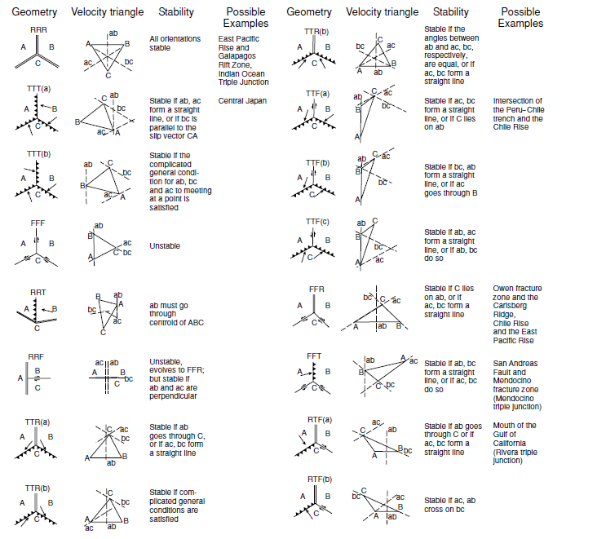
Triple junctions

Slide 24
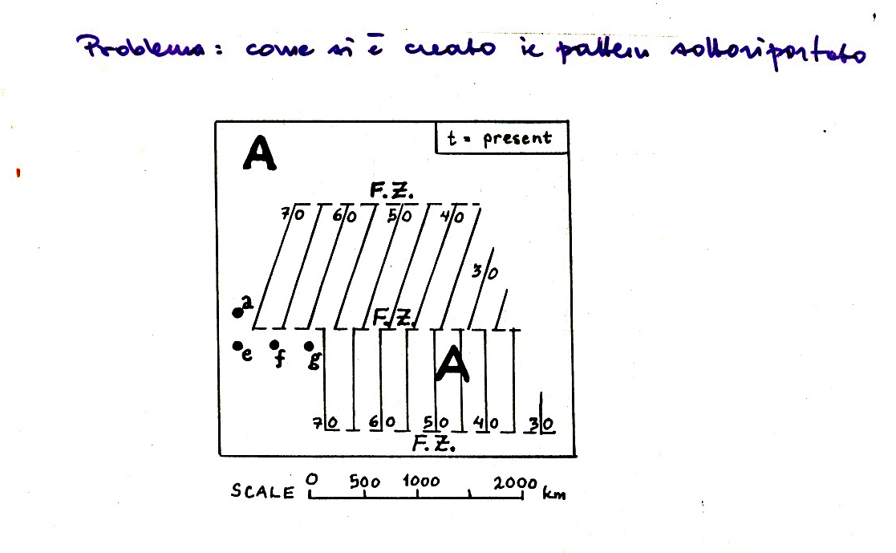

Slide 25
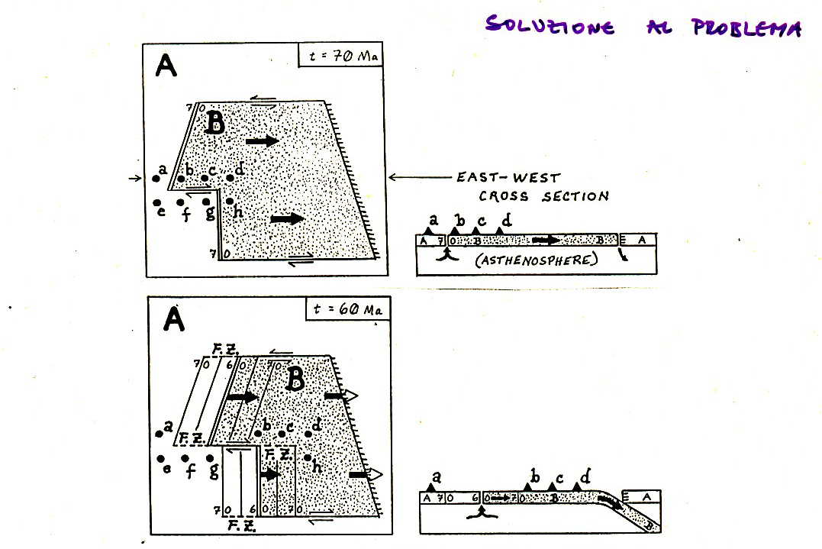

Slide 26
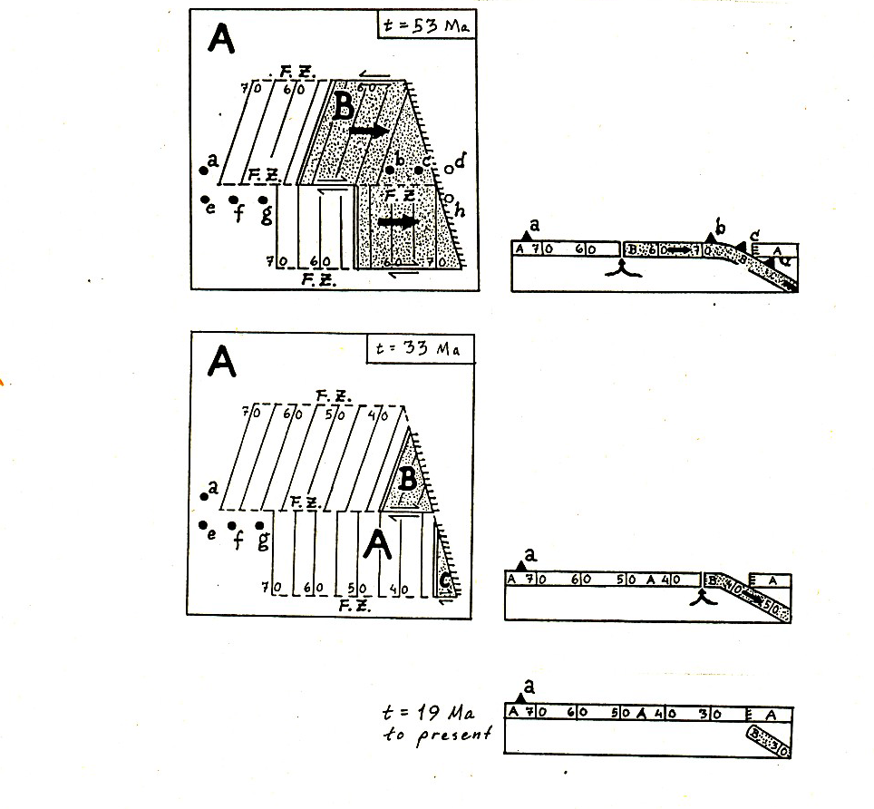

Slide 27
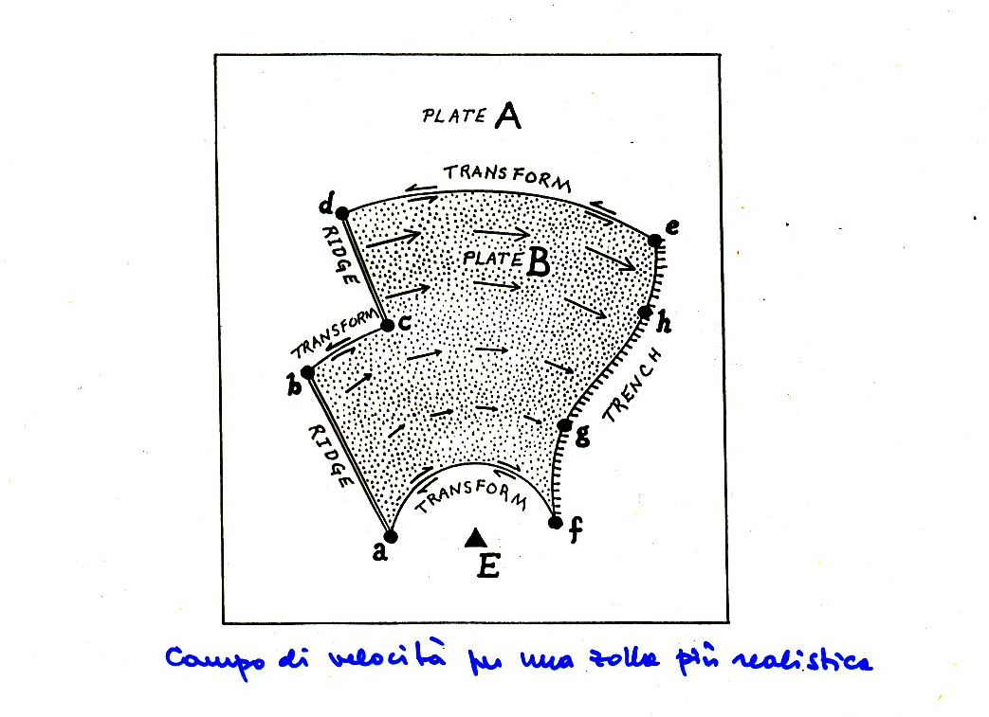

Slide 28
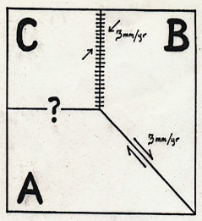
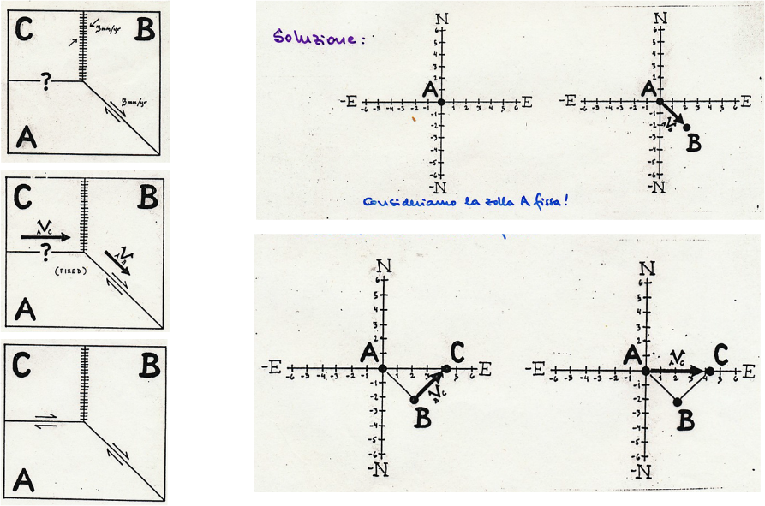
Velocity diagram
Which is the type of margin between the plates A and C?

Slide 29
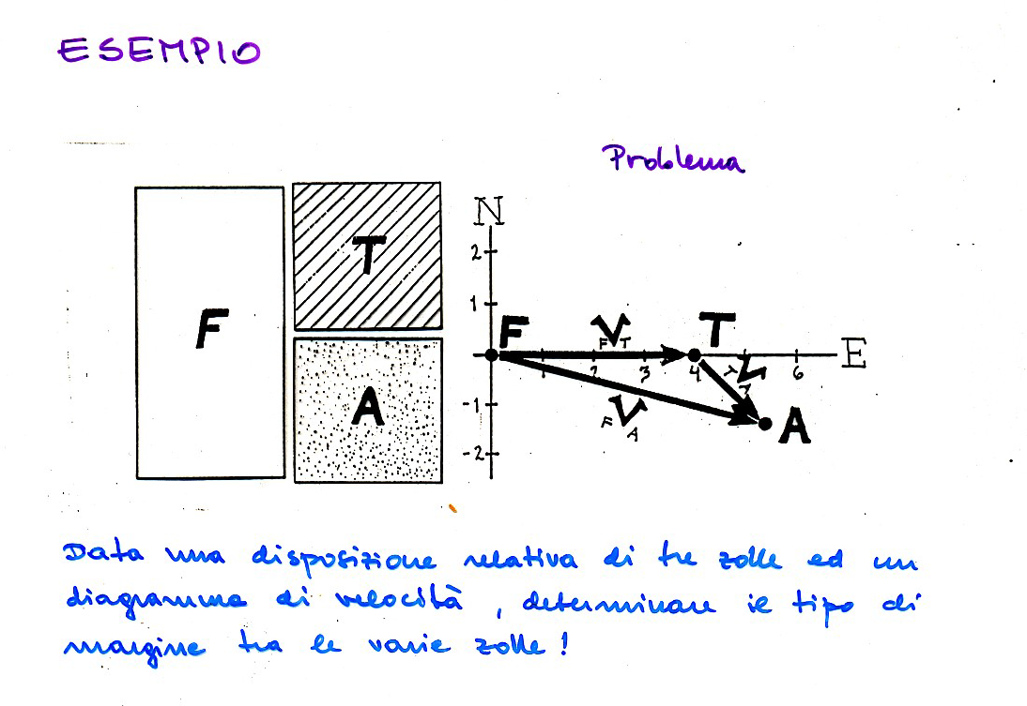
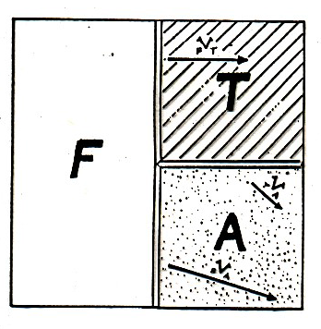

Slide 30
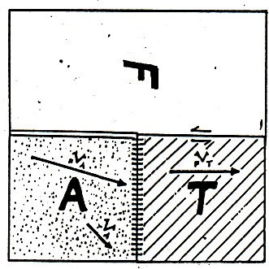
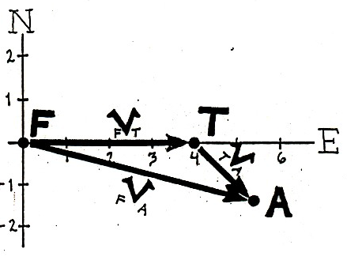
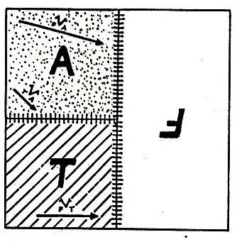
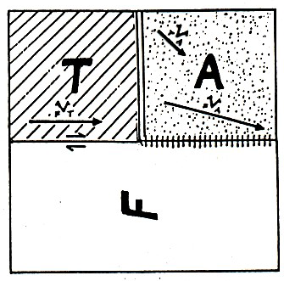

Slide 31
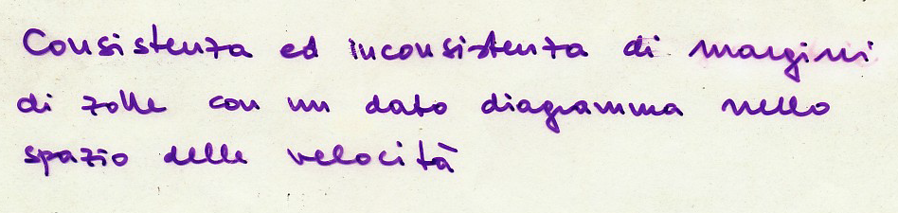
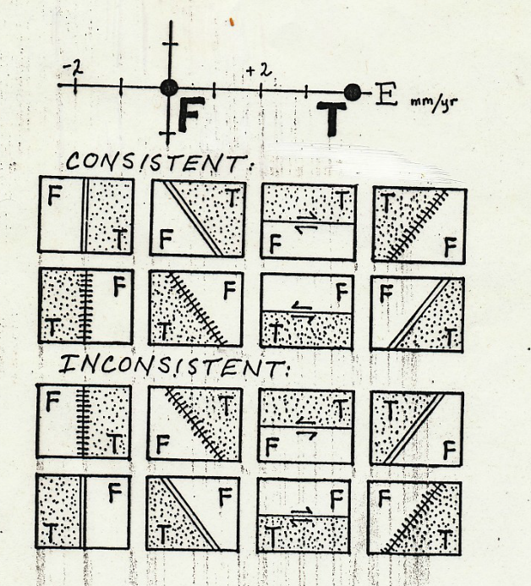

Slide 32
Present-Day Plate Motions

Slide 33
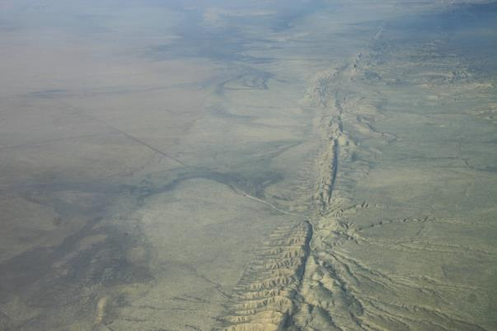
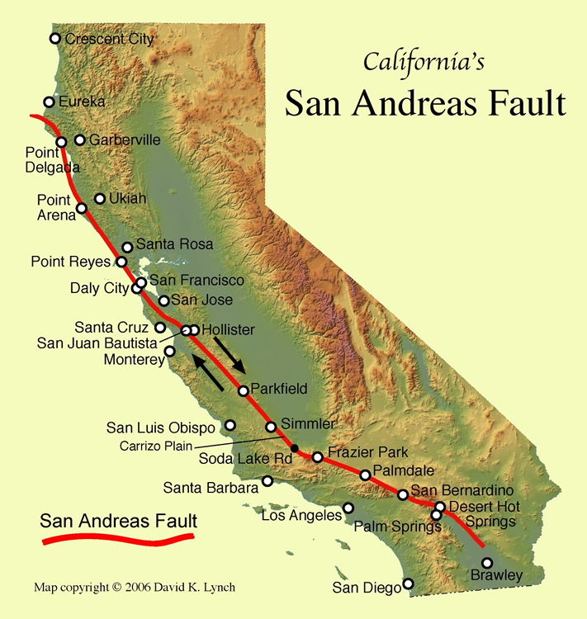
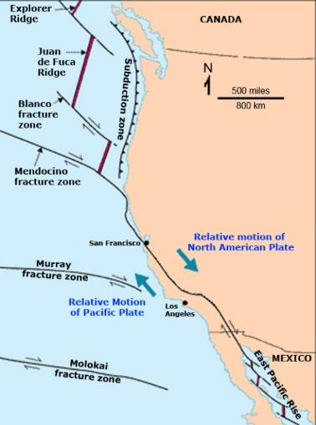

Slide 34
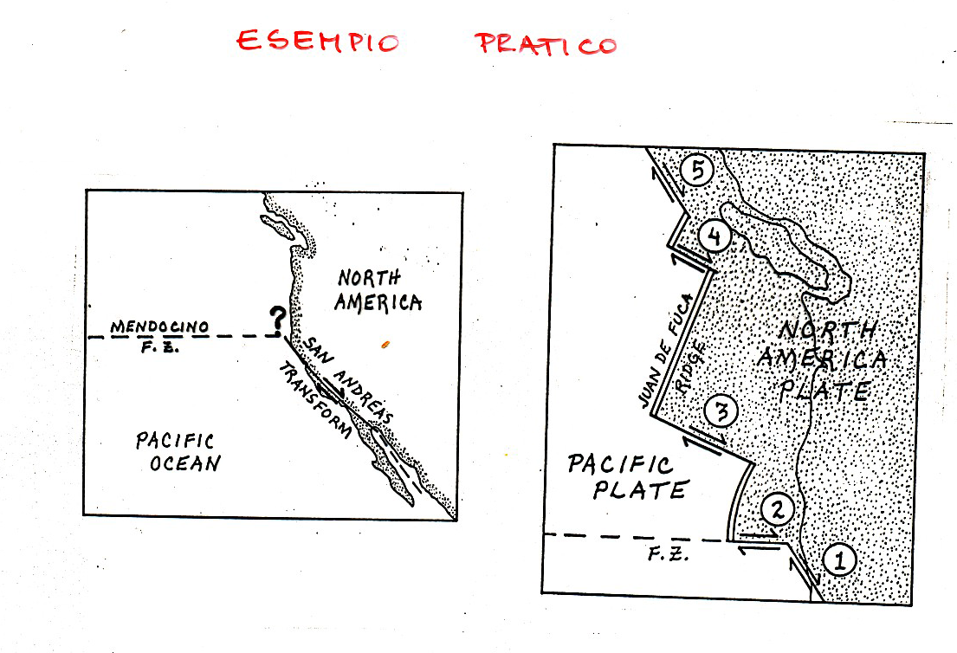

Slide 35
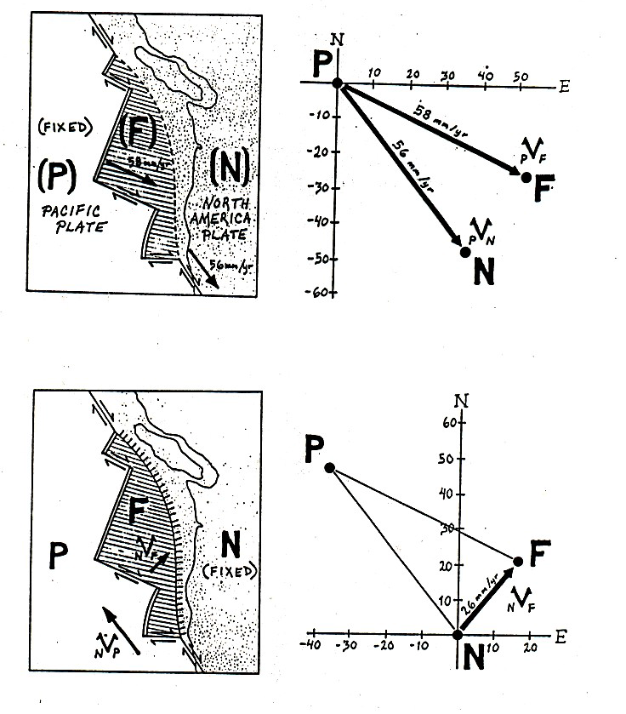

Slide 36
TRIPLE JUNCTION
A special type of plate boundary where three plates meet at a single point. There are three types of plate boundaries:
- Ridge (R)
- Transform fault (F)
- Subduction zone or trench (T)
A triple junction is said to be ‘stable’ when the relative motions of the three plates and the azimuth of their boundaries are such that the configuration of the junction does not change with time. An ‘unstable’ triple junction exists only momentarily before evolving to a different geometry. If four or more plates meet at one point, the configuration is always unstable, and the system will evolve into two or more triple junctions.
To find the velocity of a triple junction enough to recognize that it remains simultaneously on all three plate margins. Therefore its velocity is given by the point of intersection of the three straight lines (lines) speed relative to the three margins.
If the three velocity lines do not intersect the speed of the triple junction it is not defined and is a triple junction unstable

Slide 37
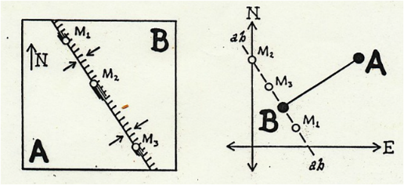
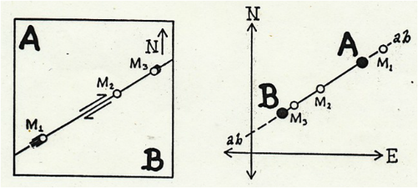
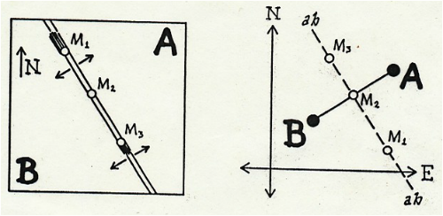
Velocity lines
For a subduction zone the velocity line is parallel to trench and it moves with the overriding plate.
For a transform fault the velocity line is parallel to the fault and it passes both for A and B
For a ridge, the velocity line is parallel to it, and if the expansion is symmetric, is perpendicular and is its bisection the segment AB which represents the relative velocity both of A and B

Slide 38
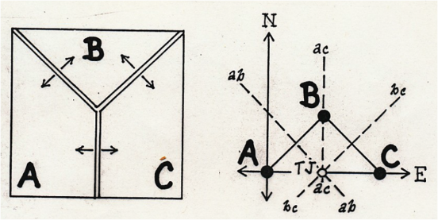
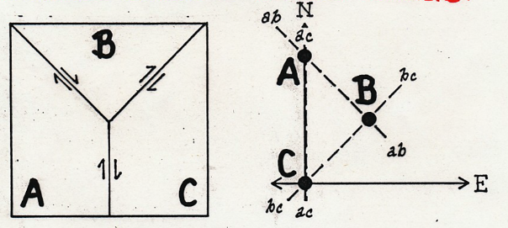
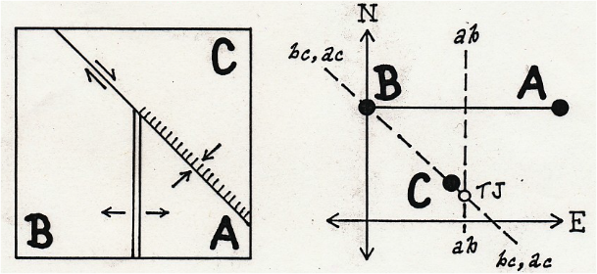
EXAMPLE
RIDGE – RIDGE – RIDGE is always stable (the bisectors perpendicular to the side of the triangle always intersect at a point).
Transform transform transform is always unstable (sides of the triangle never intersect in a point).
Ridge trench trasform is stable only if ab passes for c or if ac coincide with bc

Slide 39
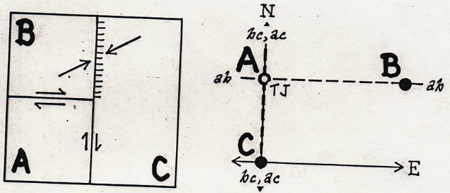
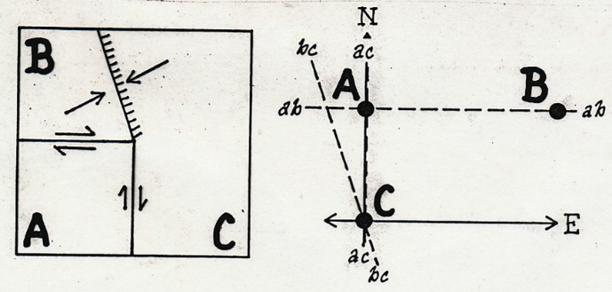
Trench-trasform-traform is stable because ab and ac pass to A and also bc (that have to pass for C) pass for A. Therefore, such junction is stable if the trench have the same direction of one of the transforms.
If the trench has not the same direction of one of the trasforms, the triple junction is always unstable.

Slide 40
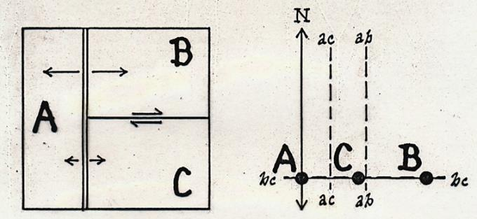
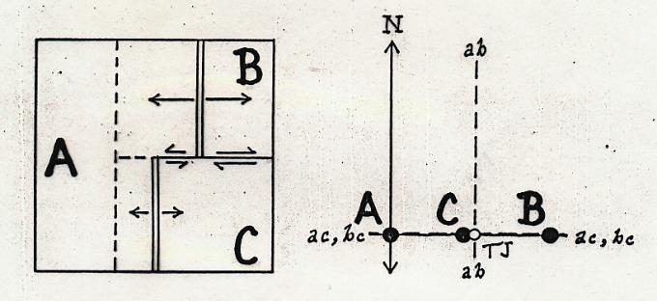
The triple junction ridge - trasform – ridge is unstable because the velocity line ac and ab do not intersect.
Therefore, after a lapse of time the configuration evolves towards a stable geometry trasform – ridge – trasform (the velocity line ab, ac and bc intersect in the point TJ and so that the triple junction will migrate estward).

Slide 41
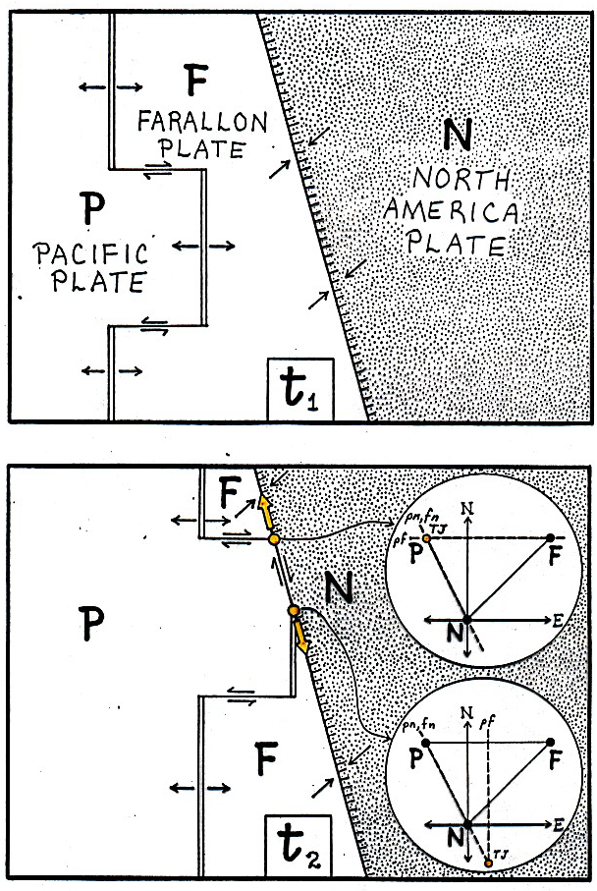
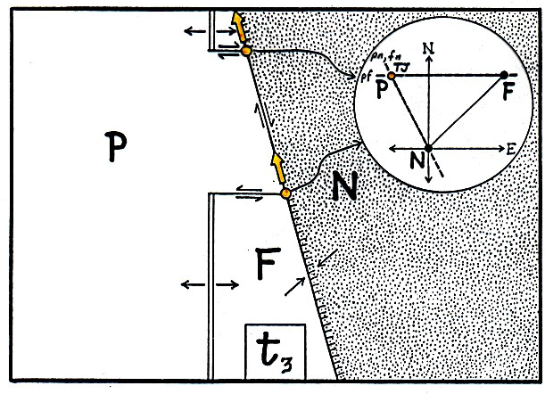

Slide 42
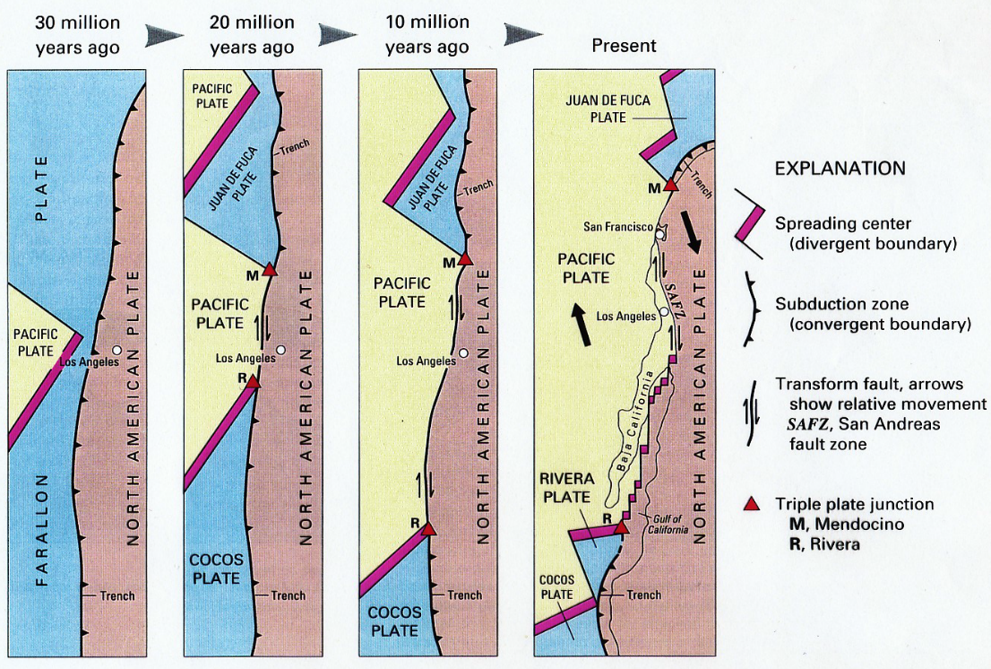
RTF: Gulf of California

Slide 43
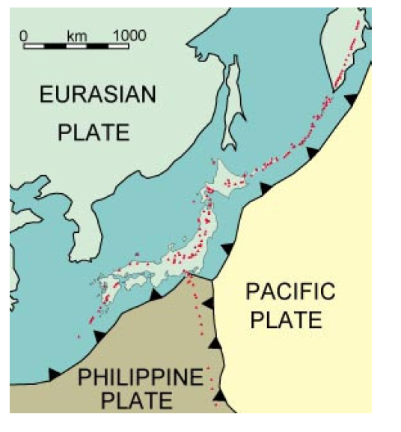
TTT Central Japan

Slide 44
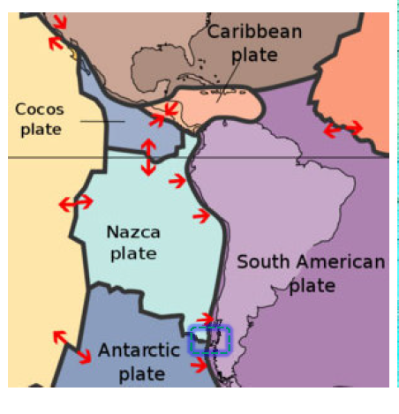
TTF Peru’ Chile Trench and West Chile Rise

Slide 45

FFT: California

Slide 46



Slide 47


Slide 48


Slide 49




Slide 50


Slide 51

Triple junctions
Many research papers discuss the stability or instability of the Mendocino and Queen Charlotte triple junctions that lie off western North America. These are the junctions (at the south and north ends, respectively) of the Juan de Fuca plate with the Pacific and North American plates and so are subjects of particular interest to North Americans because they involve the San Andreas Fault in California and the Queen Charlotte Fault in British Columbia,

Slide 52

Western N. America Tectonics
From 80 to 30 My Farallon plate subducted under west coast
Juan de Fuca & Cocos plates are remnants of Farallon plate

Slide 53

Notes:
53

Slide 54

Notes:
54

Slide 55

RRR Triple junctions

Slide 56


Slide 57

Absolute Plate motion
Although most of the volcanism on the Earth’s surface is associated with the boundaries of plates, along the mid-ocean ridges and subduction zones, some isolated volcanic island chains occur in the oceans (Fig. 2.19(a)). These chains of oceanic islands are unusual in several respects: they occur well away from the plate boundaries (i.e., they are intraplate volcanoes); the chemistry of the erupted lavas is significantly different from that of both mid-ocean ridge and subductionzone lavas; the active volcano may be at one end of the island chain, with the islands ageing with distance from that active volcano; and the island chains appear to be arcs of small circles. These features, taken together, are consistent with the volcanic islands having formed as the plate moved over what is colloquially called a hotspot, a place where melt rises from deep in the mantle.

Slide 58
Hot Spots
Hot Spots are places in the world where molten material from a source near the mantle-core boundary works its way up to the surface of the Earth
The molten material is not derived from the subduction of plates
Hawaii
Yellowstone
Galapagos Islands (pacific off South America)
Iceland
Azores Atlantic (at junction between NA, Europe and African plate)

Slide 59

Hot Spots
There is an active volcano at the southeastern end of each of the island chains. The Emperor– Hawaiian seamount chain is the best defined and most studied. The ages of the seamounts increase steadily from Loihi (the youngest and at present active) a submarine volcano off the southeast coast of the main island of Hawaii, northwestwards through the Hawaiian chain.
There is a pronounced change in strike of the chain where the volcanic rocks are about forty-three million years (43 Ma) old. The northern end of the Emperor seamount chain near the Kamchatka peninsula of Russia is 78 Ma old. The change in strike at 43 Ma can most simply be explained by a change in th direction of movement of the Pacific plate over the hotspot at that time.

Slide 60


Slide 61

Model HS3-NUVEL-1A
Combine multiple observations and solve for best-fitting rigid plate motions
277 ridge spreading rates
121 ocean transform-fault azimuths
724 earthquake slip vectors

Slide 62

Plate tectonics on a spherical earth: Rotation axes and rotation poles
Euler’s fixed point theorem: “The most general displacement of a rigid body with a fixed point is equivalent to a rotation about an axis trought that fixed”
Euler’s fixed point theorem: “Every displacement from one position to another on the surface earth can be regarded as a rotation about a suitably chosen axis passing through the center of the earth.”
The axis of rotation is the suitably chosen axis passing through the center of the earth.
The poles of rotation or the Euler’s poles are the two points where the axis of rotation cuts through the earth surface.
The magnitude of the angular velocity about the axis then define the magnitude of the relative motion between the two plates. Angular velocity behave as a vector, the relative motion between two plates can be written as: ω=ωk , where k is unit vector along the rotation axis and ω is the angular velocity

Slide 63
Plate tectonics on a spherical earth: Angular velocity and relative velocity
The movement of plates on the surface of the Earth. (a) The lines of latitude of rotation around the rotation poles are small circles (shown dashed) whereas the lines of longitude of rotation are great circles (i.e., circles with the same diameter as the Earth). (b) Constructive, destructive and conservative boundaries between plates A and B. Plate B is assumed to be fixed so that the motion of plate A is relative to plate B. The visible rotation pole is positive (motion is anticlockwise when viewed from outside the Earth). Note that the spreading and subduction rates increase with distance from the rotation pole. The transform fault is an arc of a small circle (shown dashed) and thus is perpendicular to the ridge axis. As the plate boundary passes the rotation pole, the boundary changes from constructive to destructive, i.e. from ridge to subduction zone. (c) A cross section through the centre of the Earth O. P and N are the positive and negative rotation poles, and X is a point on the plate boundary.

Slide 64
Plate tectonics on a spherical earth: Angular velocity and relative velocity
The relative velocity, ν, of a certain point on the earth surface is a function of the angular velocity, ω, according to:
where R is the earth radius and θ is the angular distance between the pole of rotation and point in question.
Thus, the relative velocity is equal to zero at the poles, where θ=0 degrees, and is a maximum at the equator, where θ=90 degrees.
The relative velocity is constant along small circles defined by θ=constant.
Note that large angular velocity does not mean large relative velocity.

Slide 65


Present-Day Plate Motions
After the instantaneous rotation pole and angular velocity have been determined for a pair of adjacent plates, they can be used to calculate the direction and relative motion at any point along the plate boundary.
N= North Pole
P= Rotation Pole
X= Point on the plate boundary.
The azimuth of the velocity β is given by:

Slide 66

Present-Day Plate Motions
To find angles a and C to substitute into Eq 3 and Eq 4 we use
spherical geometry (see Appendix) :
This can be simplified to yield the angle a, which is needed to calculate the velocity
from:
Substituting Eq1 and Eq 2 in Eq 6 gives:

Slide 67
Problem
Calculate the present day relative motion at 28°S, 71°W on the Perù-Chile Trench using the Nazca-South American rotation pole. Assume the radius of the earth to be 6371 km…..

Slide 68

Problem

Slide 69
Present-Day Plate Motions
Several methods can be used to find the present-day instantaneous poles of rotation and relative angular velocities between pairs of plates. Instantaneous refers to a geological instant; it means a value averaged over a period of time ranging from a few years to a few million years, depending on the method used.
1) A local determination of the direction of relative motion between two plates can be made from the strike of active transform faults. Since transform faults on ridges are much easier to recognize and more common than transform faults along destructive boundaries, this method is used primarily to find rotation poles for plates on either side of a mid-ocean ridge. The relative motion at transform faults is parallel to the fault and is of constant value along the fault. This means that the faults are arcs of small circles about the rotation pole. The rotation pole must therefore lie somewhere on the great circle which is perpendicular to that small circle. So, if two or more transform faults can be used, the intersection of the great circles is the position of the rotation pole

Slide 70
Present-Day Plate Motions
On a spherical Earth the motion of plate A relative to plate B must be a rotation about some pole. All the transform faults on the boundary between plates A and B must be small circles about that pole. Transform faults can be used to locate the pole: it lies at the intersection of the great circles which are perpendicular

Slide 71
Present-Day Plate Motions
2) The spreading rate along a constructive plate boundary changes as the sine of the angular distance θ from the rotation pole. So, if the spreading rate at various locations along the ridge can be determined (from spacing of oceanic magnetic anomalies), the rotation pole and angular velocity can then be estimated.
3) The analysis of data from an earthquake can give the direction of motion and the plane of the fault on which the earthquake occurred. This is known as a fault-plane solution or a focal mechanism. Fault-plane solutions for earthquakes along a plate boundary can give the direction of relative motion between the two plates.
4) Where plate boundaries cross land, surveys of displacements can be used (over large distances and long periods of time) to determine the local relative motion. For example, stream channels and even roads, field boundaries and buildings may be displaced

Slide 72
Present-Day Plate Motions
5) Satellites have made it possible to measure instantaneous plate motions with some accuracy. One method uses a satellite laser-ranging system (SLR) to determine differences in distance between two sites on the Earth’s surface over a period of years. Another method, very-long-baseline interferometry (VLBI), uses quasars for the signal source and terrestrial radio telescopes as the receivers. Again, the difference in distance between two telescope sites measured over a period of. A third method of measuring plate motions utilizes the Global Positioning System. A worldwide network of GPS receivers with a precision suitable for geodynamics has been established (1 cm in positioning and<10−3 arcsec in pole-position estimates). It is called the International GPS Service for Geodynamics (IGS), and is a permanent global network of receivers. Analysis of data from 1991–1996 shows that the agreement of GPS velocities with the geologically determined velocities for all but a few locations is to better than 95% confidence.

Slide 73
Appendix : spherical trigonometry
The sides of a triangle on a plane surface are straight lines and the sum of its internal angles is 180°(or π radians). Let the angles be A, B and C and the lengths of the sides opposite each of these angles be a, b and c. The sizes of the angles and the lengths of the sides are governed by the sine law:
The length of any side is related to the lengths of the other two sides and to the angle they include by the cosine law, which for the side a is:
The sides of a triangle on a spherical surface are great circle arcs and the sum of the internal angles is greater than 180°. The angle between two great circles at their point of intersection is defined by the tangents to the great circles at that point. Let the angles of a spherical triangle be A, B and C, and let the lengths of the sides opposite each of these angles be a, b and c, respectively. The lengths of the sides may be converted to the angles they subtend at the center of the Earth. For example, the distance from pole to equator on the Earth’s surface may be considered as 10,007 km or as 90 degrees of arc. Expressing the sides of the spherical triangle as angles of arc, the sine law is:
And the law of cosines is:

