Slide 1
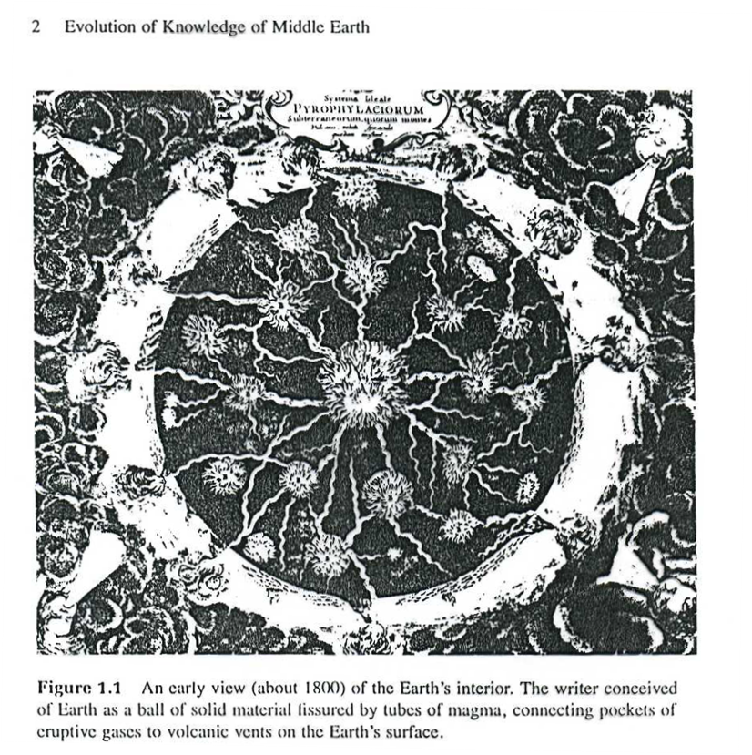

Slide 2
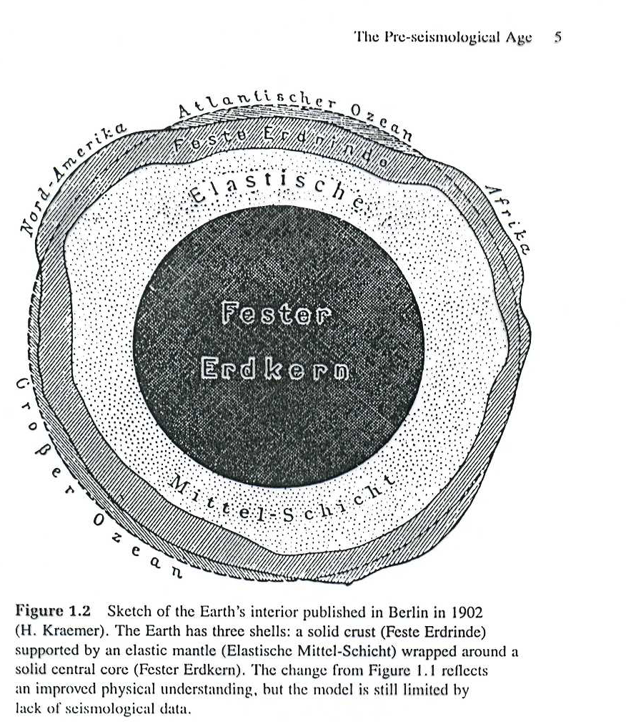

Slide 3
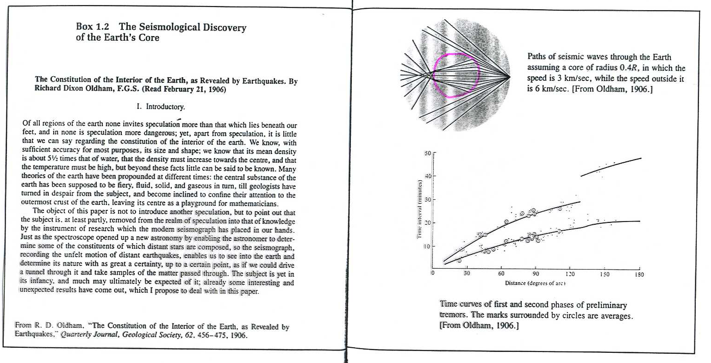

Slide 4
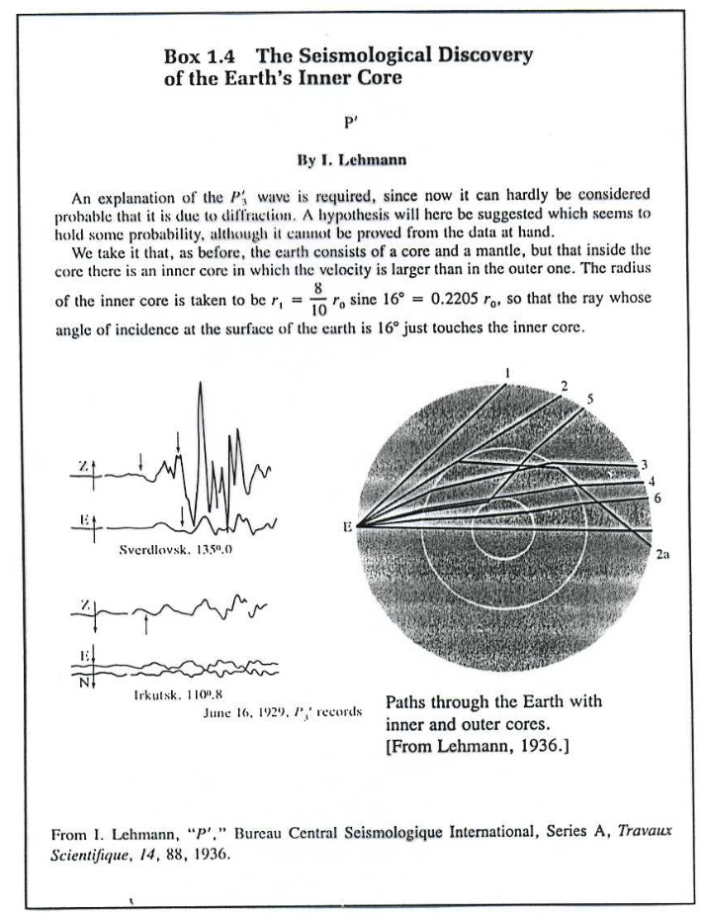

Slide 5
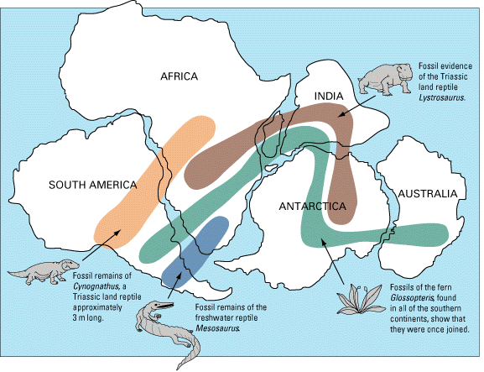
Fossil Record
There are matching fossil records that span across all of the continents
Without plate tectonics, this is hard to explain

Slide 6
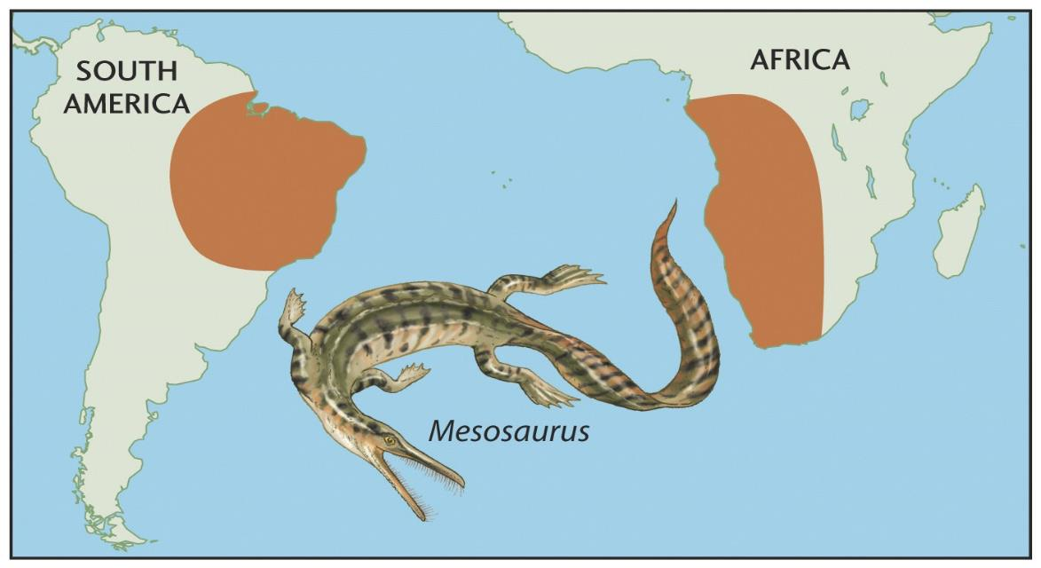
Fossil Record
The fossil record had revealed that the geology and paleontology match on opposite sides of the Atlantic Ocean

Slide 7
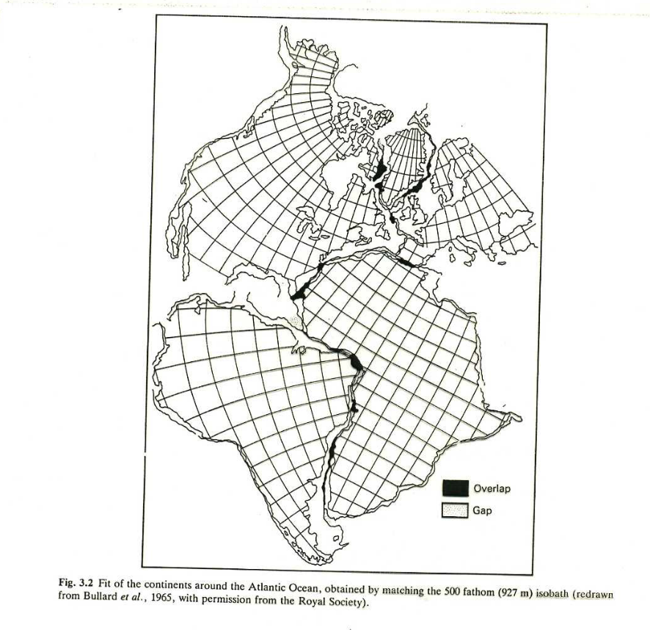

Slide 8
Wegener’s Evidence for Continental Drift
Rock sequences (meaning he looked at the order of rock layers) in South America, Africa, India, Antarctica, and Australia show remarkable similarities.
Wegener showed that the same three layers occur at each of these places.

Slide 9
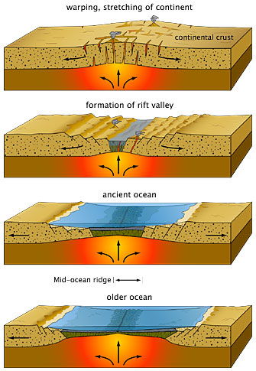
Accumulating Evidence
Fossil record
Magnetism and the Earth’s magnetic field
Paleomagnetism
Magnetic reversals
The topography of the seafloor
Age of the seafloor
Seafloor spreading

Slide 10
All’inizio del secolo si pensava che la Terra si fosse rafreddata dal suo stato fuso e che la contrazione avesse originato la topografia: montagne e fosse oceaniche.
Il fatto che fossili, piante ed animali simili (quindi con origini comuni) venissero ritrovati su diversi continenti , veniva spiegato con l’ipotesi di ponti di terra tra i continenti successivamente sommersi dagli oceani.
Nel 1915 A. WEGENER propose il movimento dei continenti. La sua teoria della DERIVA DEI CONTINENTI (coste continentali complementari, evidenze botaniche, ecc.) fu accettata da pochi. I geofisici correttamente osservavano che i continenti non potevano navigare attraverso le rocce solide dei fondali oceanici.
Negli anni ‘50 evidenze magnetiche provarono che i continenti si erano mossi uno relativamente all’altro, si scoprirono le dorsali oceaniche.
Nel 1962 H.H. HESS propose che la deriva dei continenti era avvenuta attraverso il processo dell’ espansione dei fondali oceanici.
Nacque così la teoria della TETTONICA A ZOLLE, un fattore unificante degli studi geologici e geofisici. La differenza con la teoria di Wegener è che ora sono i continenti e gli oceani a muoversi assieme spra l’interno della Terra.

Slide 11
At the beginning of the century it was thought that the Earth had cooled from its molten state and that the contraction had originated topography: mountains and ocean trenches. The fact that fossils, plants and animals alike (having common origins) were found on different continents, was explained with the hypothesis of land bridges between continents later submerged by oceans.
In 1915 A. WEGENER proposed movement of the continents. His theory of CONTINENTAL DRIFT (continental coasts complementary botanical evidence, etc.) was accepted by few. Geophysicists correctly observed that the continents could not navigate through the solid rocks of the ocean floor.
In the ’50s magnetic evidence proved that the continents had moved relative to each other, they discovered the OCEANIC RIDGES.
In 1962 H.H. HESS proposed that continental drift had occurred through the process of expansion of the ocean floor.
Thus was born the theory of PLATE TECTONICS, that unify geological and geophysical studies. The difference with Wegener's theory is that now the continents and oceans move together over the Earth's interior.

Slide 12
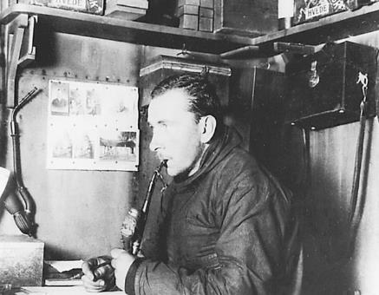
Continental drift
Alfred Wegener in the early 1900’s proposed the hypothesis that continents were once joined together in a single large land mass he called Pangea (meaning “all land” in Greek).
He proposed that Pangea had split apart and the continents had moved gradually to their present positions - a process that became known as continental drift.
According to the hypothesis of continental drift, continents have moved slowly to their current locations.

Slide 13
Continental drift: historical aspects
Key events
mapping of seafloor topography
measuring the seafloor’s magnetic field
timing the north-south flips of earth’s magnetic field
accurate location of earthquakes (indicate present-day plate boundaries)

Slide 14
Continental drift: key papers
Wegener (1912) – Continental drift: continents rafting through the upper mantle.
Menard (1952), Dietz (1952) – fracture zones
Irving (1956), Runcorn (1956) – used paleomagnetic data to show polar wandering and motion between plates.
Ewing and Heezen (1956) – presence of a rift valley at crest of most mid-ocean ridges.
Dietz (1961) – coined the term “sea-floor spreading”
Hess (1962) – Plate tectonics: convecting mantle passively carries the continents.
Vine and Matthews (1963) – magnetic stripes of the ocean sea floor are created by the
magnetization of oceanic crust as it is formed at the mid-ocean ridges. The older crust moves away
from the ridge as new crust forms.

Slide 15
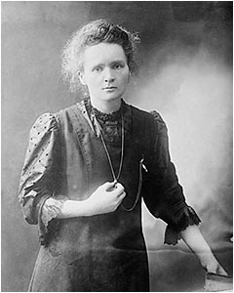
Magnetism
Most iron-bearing minerals are at least weakly magnetic
Each magnetic mineral has a Curie temperature, the temperature below which it remains magnetic
Above the Curie temperature the mineral is not magnetic
The Curie temperature varies from mineral to mineral, but it is always below the melting temperature of the mineral

Slide 16
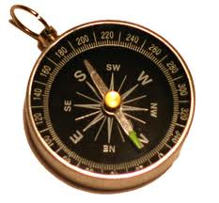
Earth’s Magnetic Field
The Earth has a magnetic field
This why a compass points to the north
The simple presence of iron in the Earth’s core is not enough to account for the Earth’s magnetic field
The high temperatures in the Earth’s core are far above the Curie temperature for any magnetic mineral

Slide 17
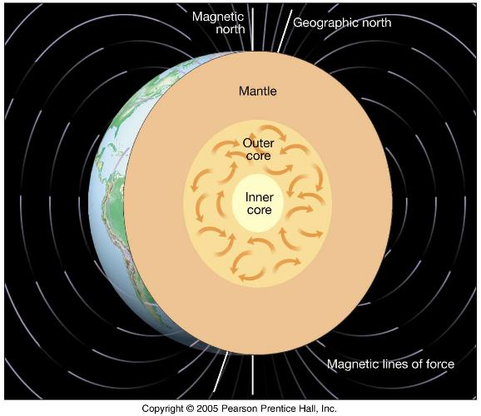
Earth’s Magnetic Field
It is believed that the Earth’s magnetic field originates in a layer called the outer core
The outer core is a metallic fluid consisting mainly of iron
This metallic fluid is in motion and the convection currents act like a giant dynamo, converting mechanical energy into magnetic energy

Slide 18
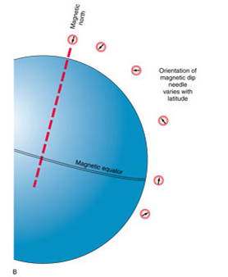
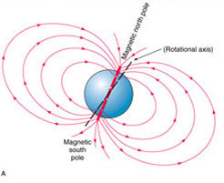
Paleomagnetism
A hot magma is not magnetic
As a magma cools and solidifies, the iron-bearing minerals (such as ferromagnesian silicates) crystallize
Eventually, the minerals cool below the Curie temperature and the iron-bearing minerals become magnetic

Slide 19
Paleomagnetism
Like tiny compass needles, these magnetic minerals align themselves parallel to the lines of force of the Earth’s magnetic field
This remnant magnetism, which is also called paleomagnetism, points to the north pole like a sign post
But...

Slide 20
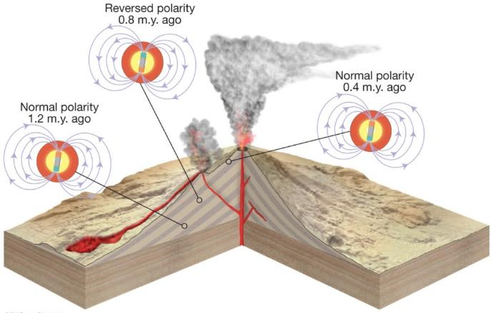
Magnetic Reversals
About a century ago, a sequence of lava flows were found in France where some of the flows had the north and south poles reversed
Therefore, the north pole and south pole must have repeatedly swapped positions

Slide 21
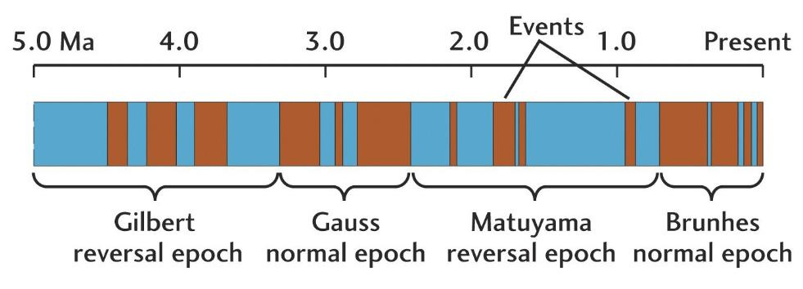
Magnetic Reversals
These magnetic reversals have occurred though out the history of the Earth
They occur on an irregular basis ranging in time from tens of thousands of years to millions of years

Slide 22
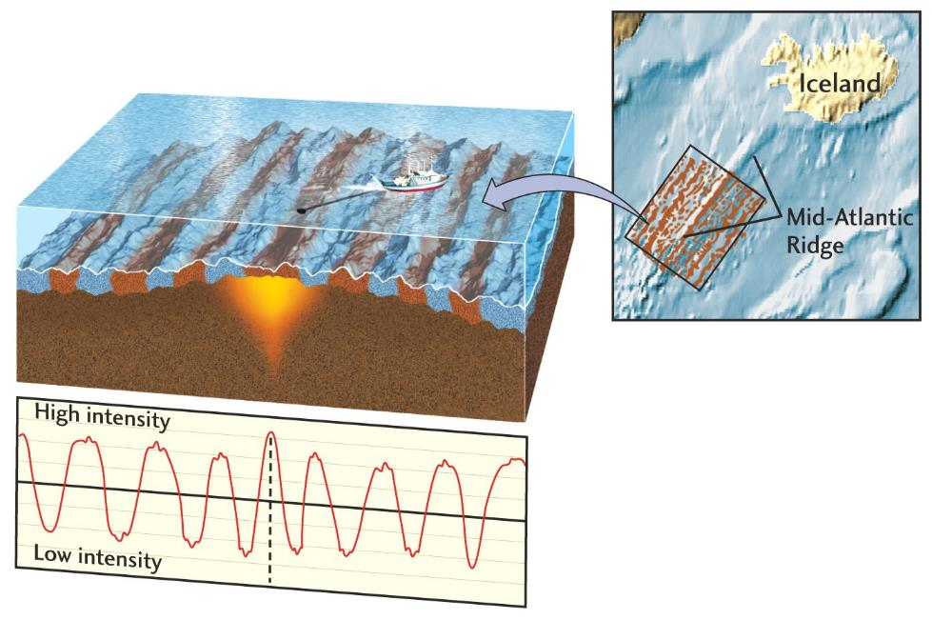
Magnetic Striping on Seafloor
In the 1950s, the Atlantic Ocean seafloor was found to consist of alternating stripes of normal and reversely magnetized rocks

Slide 23
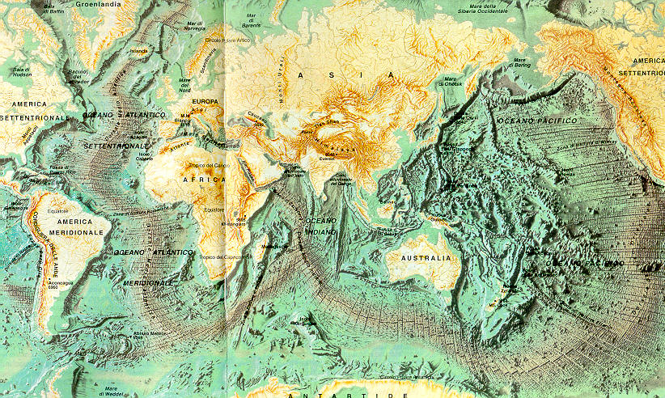

Slide 24
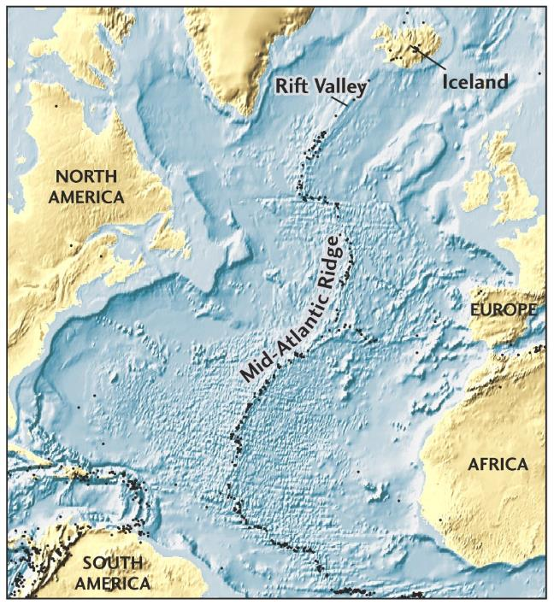
Topography of the Atlantic
Also, in the 1950s, it was discovered that an underwater mountain range ran north-south in the middle of the Atlantic Ocean
The Mid-Atlantic Ridge rises as high as 2 kilometers above the abyssal plain

Slide 25
Atlantic Ocean Sea Floor
In the 1960s, samples were collected from the Atlantic seafloor using special ships with drill rigs
The rocks of the Atlantic seafloor were discovered to be basalt
Basalt contains radioactive isotopes (such as U²³⁵) which can be dated

Slide 26
Atlantic Ocean Sea Floor
It was discovered that the youngest rocks of the Atlantic Ocean seafloor are found along the mid-oceanic ridge
And that farther you move away from the ridge, the older the rocks become on either side of the ridge
The oldest rocks are along the continental boundaries

Slide 27
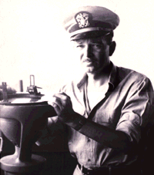
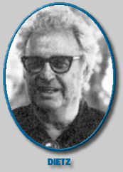
Seafloor Spreading
By 1962, Harry Hess at Princeton University and a Naval Reserve Rear Admiral, and Robert S. Dietz had coined the term “seafloor spreading”
And in 1963, the team of F. J. Vine and D. H. Matthews (and independently L. W. Morley) proposed that seafloor spreading could explain the observed magnetic reversal striping on the Atlantic and Pacific seafloors

Slide 28
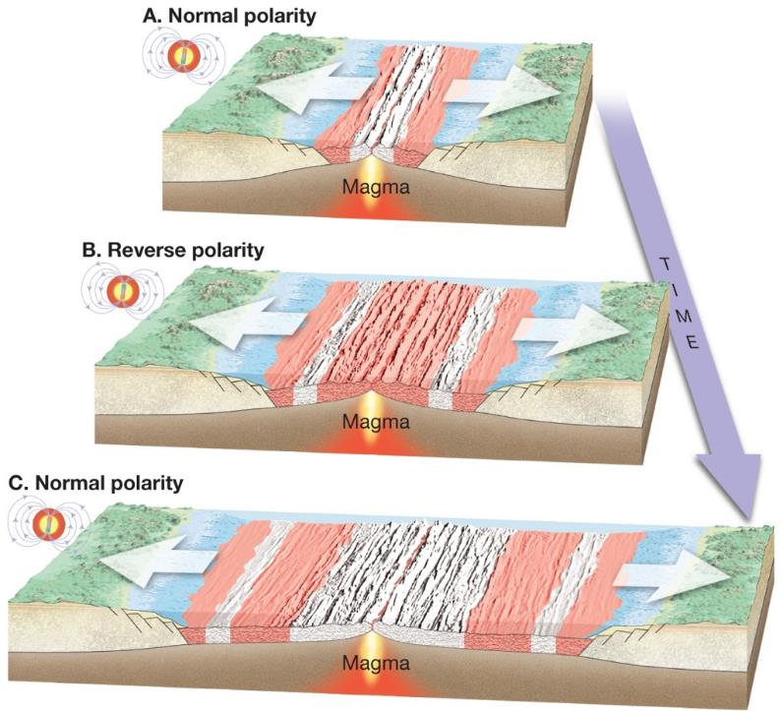
Seafloor Spreading
The Mid-Atlantic Ridge is a great fault zone where hot magma rises up, cools and solidifies, forming new basalt

Slide 29
Seafloor Spreading
The iron minerals in the basalt become magnetized in the prevailing direction of the Earth’s magnetic field

Slide 30
But what drives plate tectonics?
Two main hypotheses:
1. Convection Cells within the upper mantle (first postulated by Arthur Holmes a year before Wegener died).
2. Ridge push and slab pull.

Slide 31
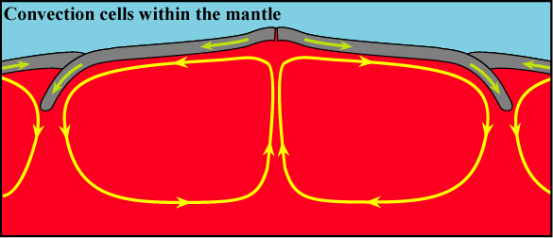
Mantle Convection
Giant convection cells within the upper mantle drag the plates along laterally.
Where convection rises sea floor spreading takes place.
Where the convection cells descend they drag crust down, causing subduction.
http://web.gps.caltech.edu/~gurnis/Movies/movies-more.html

Slide 32
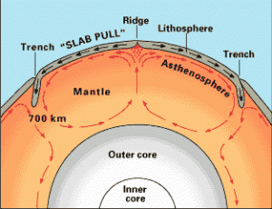
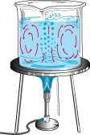

Slide 33
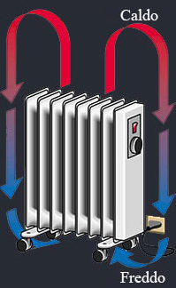
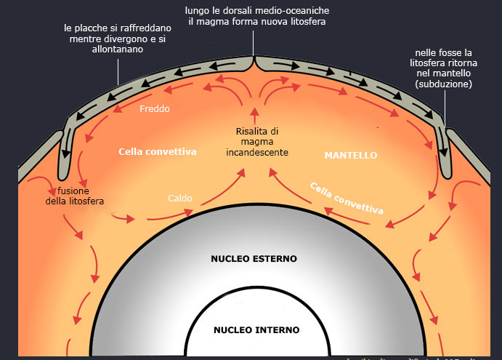
Placche tettoniche
La Terra è ritagliata in numerosi frammenti, chiamati placche litosferiche, la si può paragonare a un grande puzzle sferico. Le “tessere” di questo mosaico, dai contorni irregolari, non sono immobili ma si muovono. Le placche litosferiche, come zattere affiancate l’una all’altra, galleggiano sul sottostante mantello sospinte dai moti convettivi prodotti dal calore interno del pianeta.

Slide 34
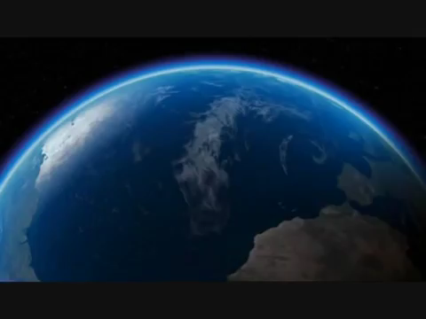

Slide 35
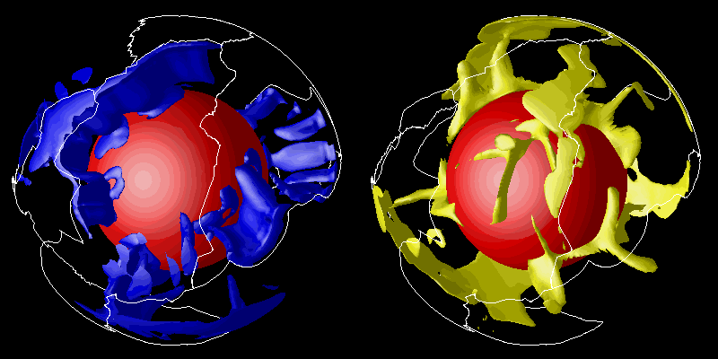
Mantle Convection

Slide 36
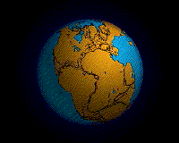

Slide 37
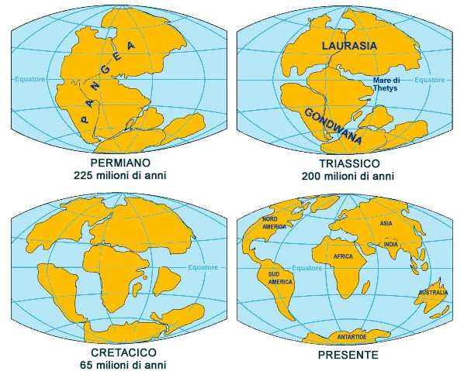

Slide 38
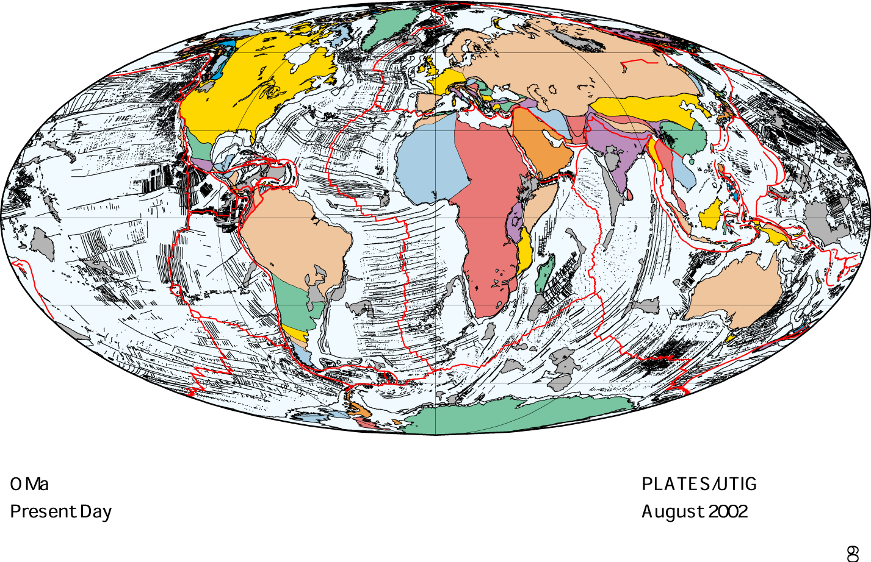

Slide 39
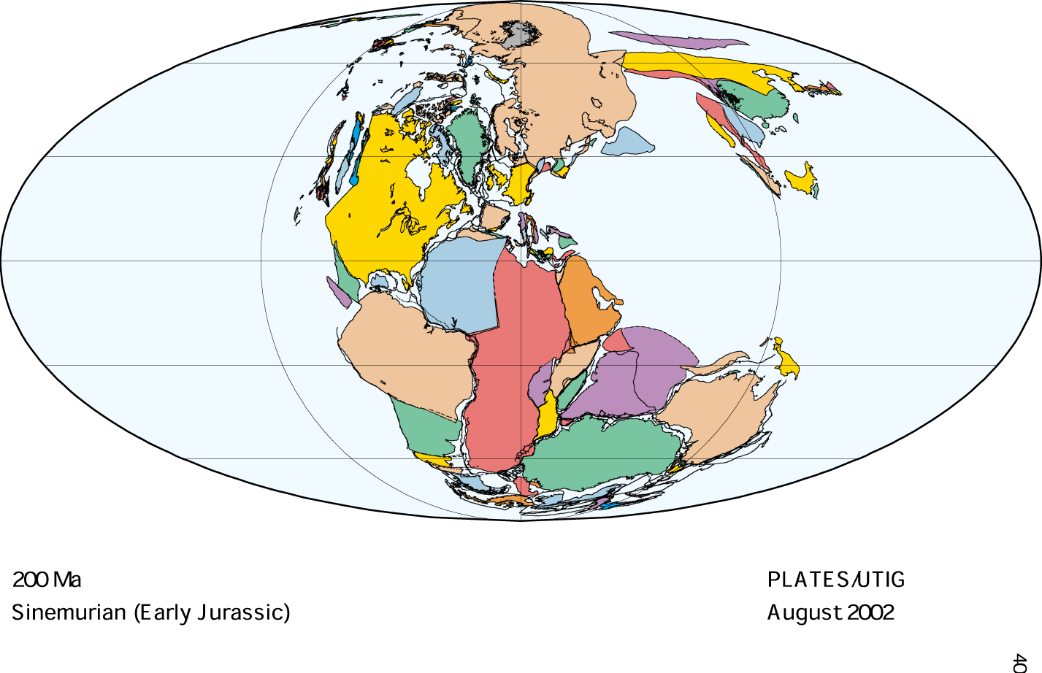

Slide 40
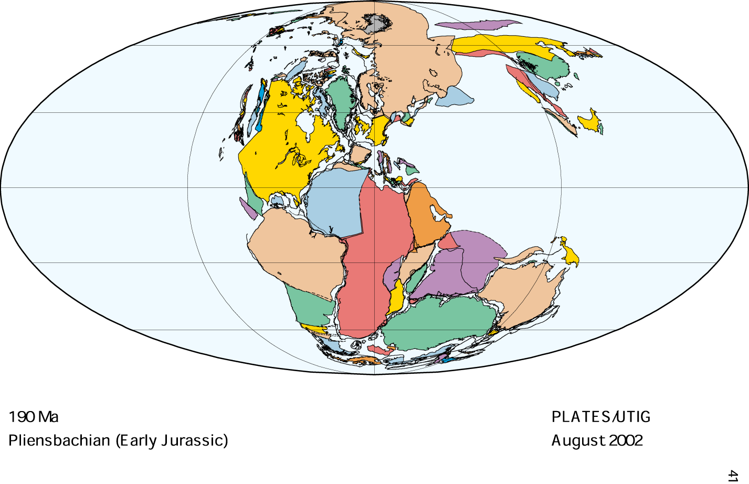

Slide 41
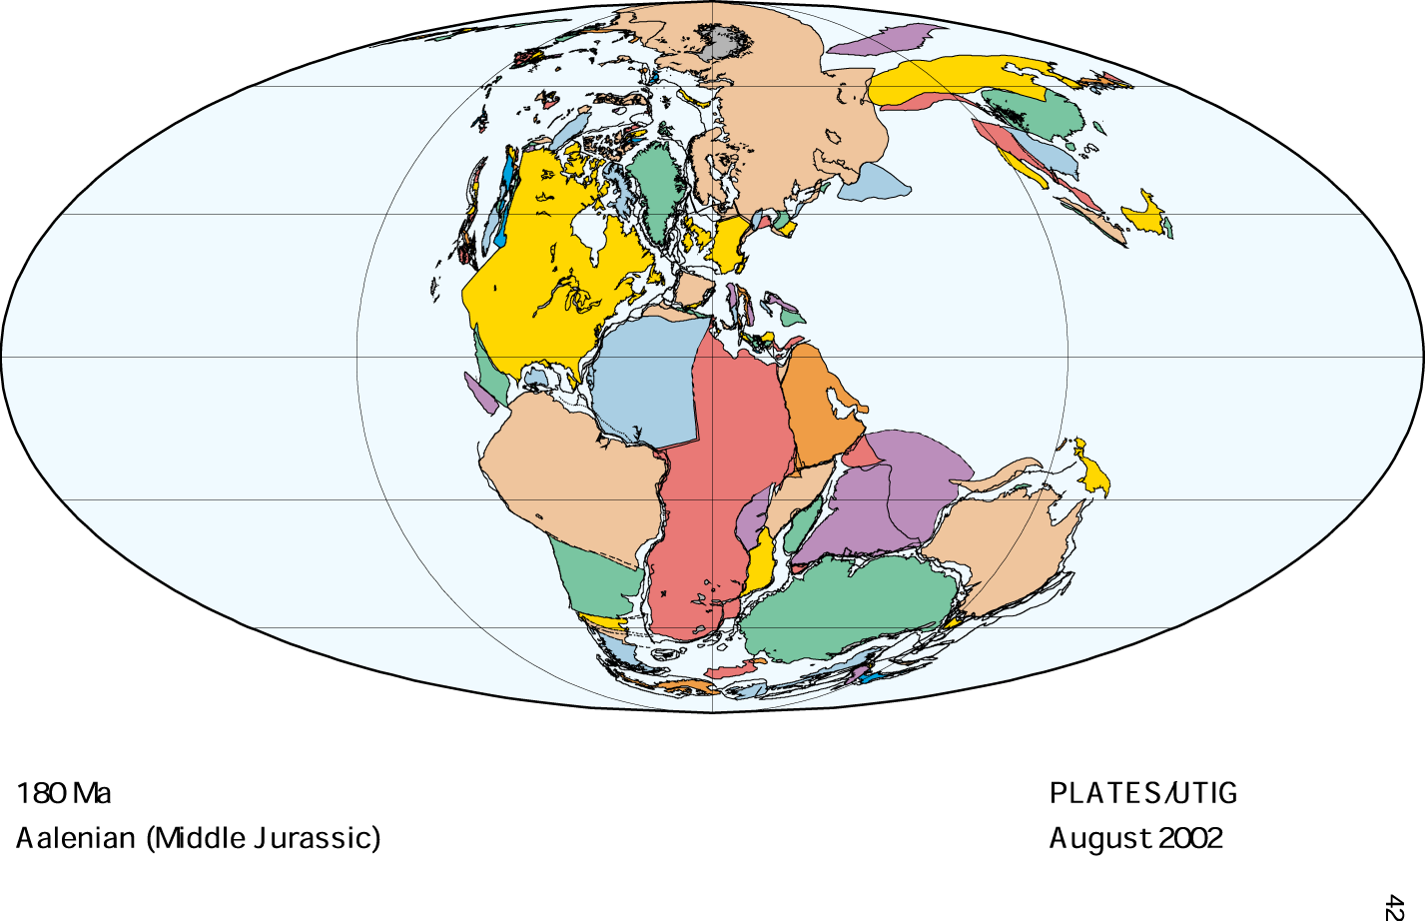

Slide 42
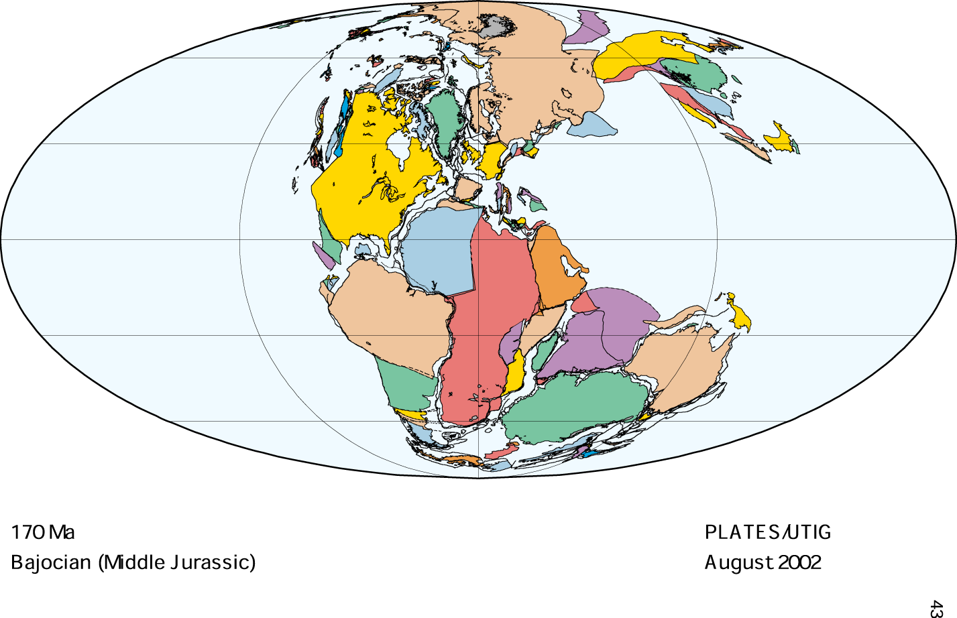

Slide 43
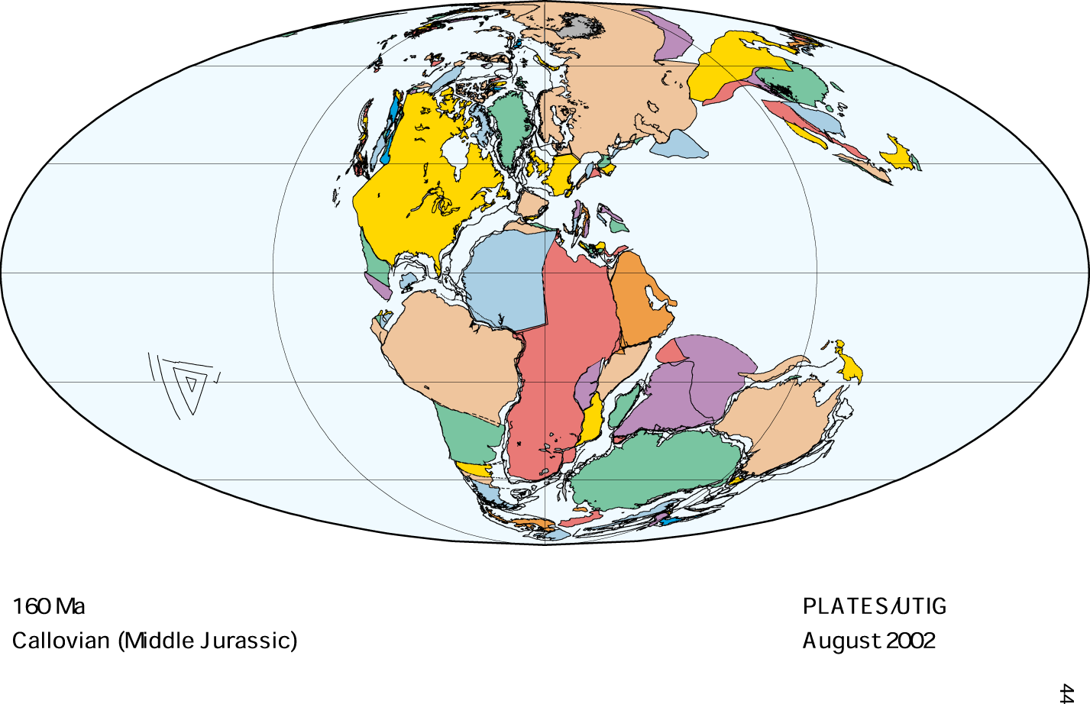

Slide 44
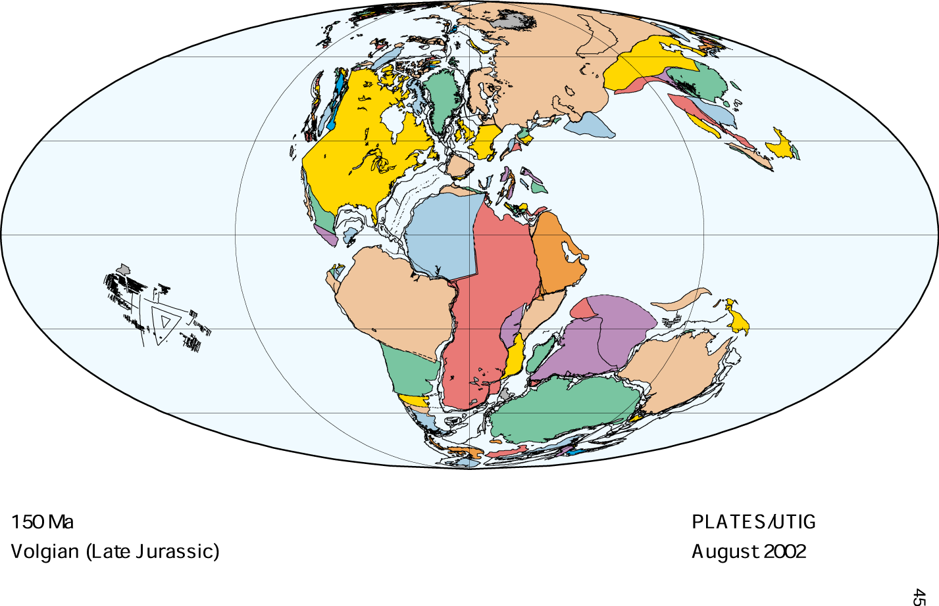

Slide 45
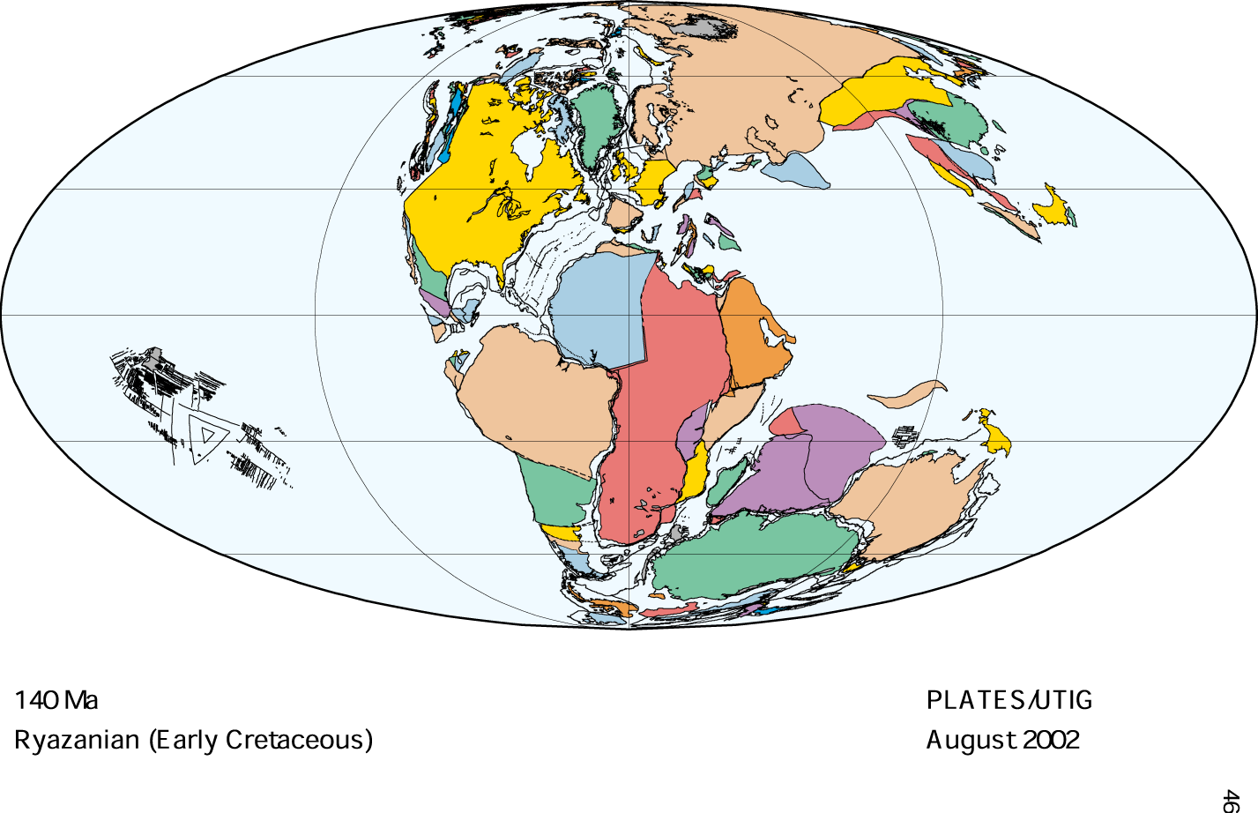

Slide 46
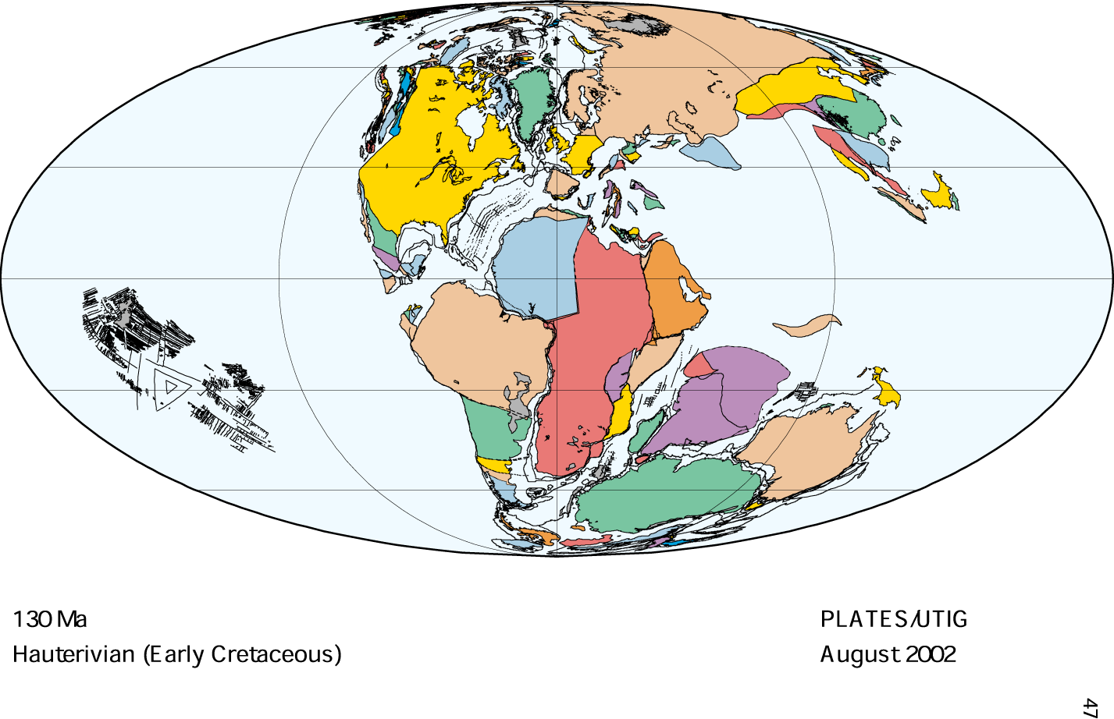

Slide 47
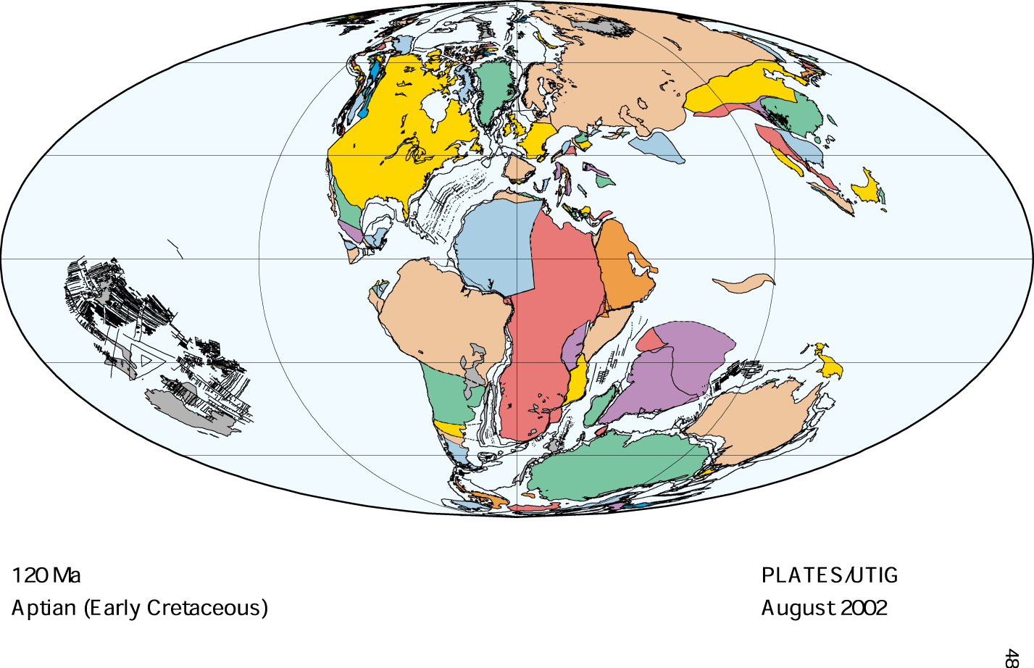

Slide 48
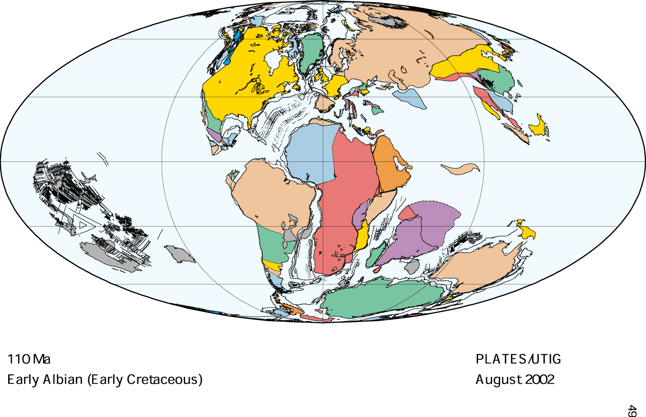

Slide 49
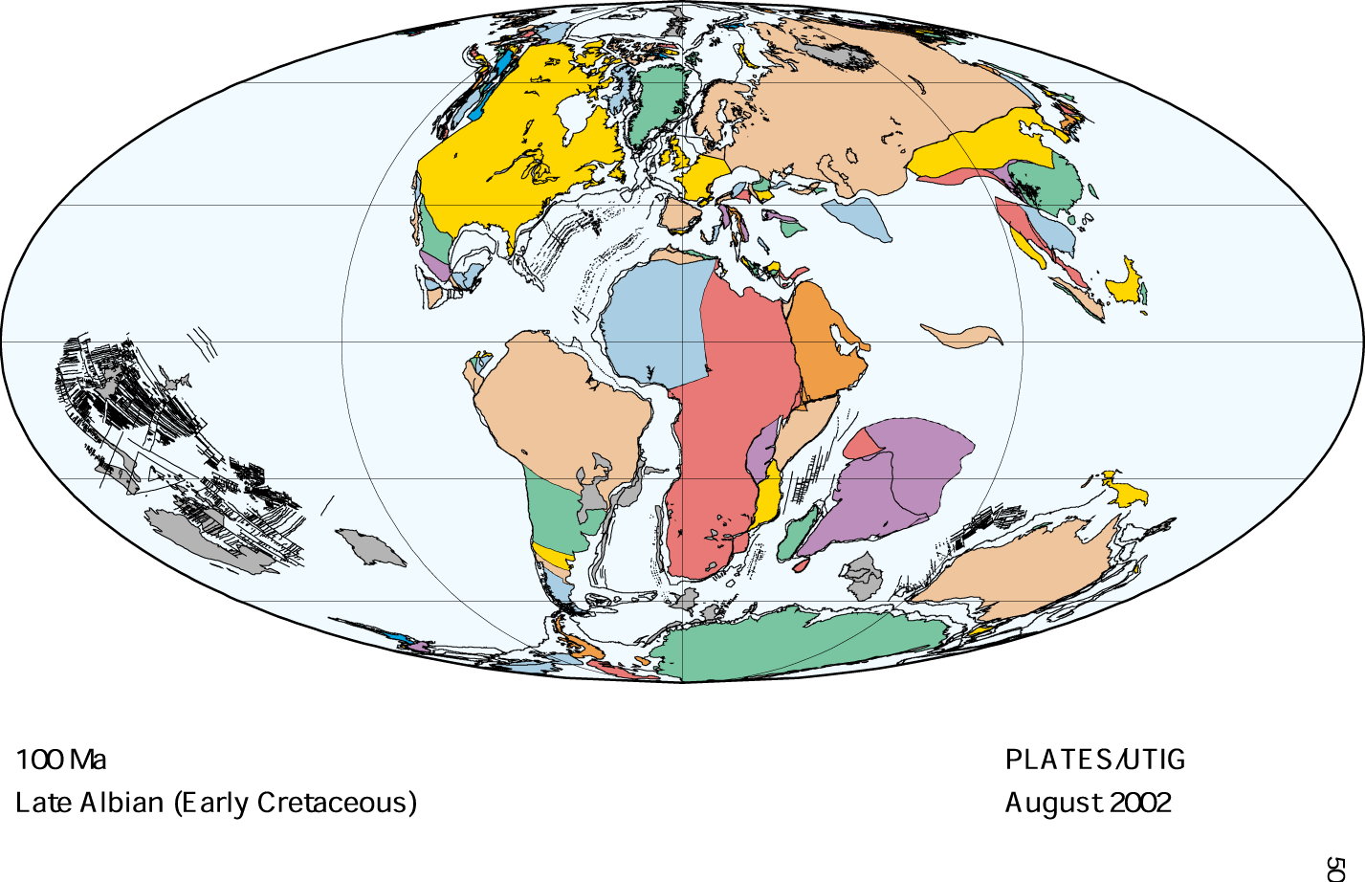

Slide 50
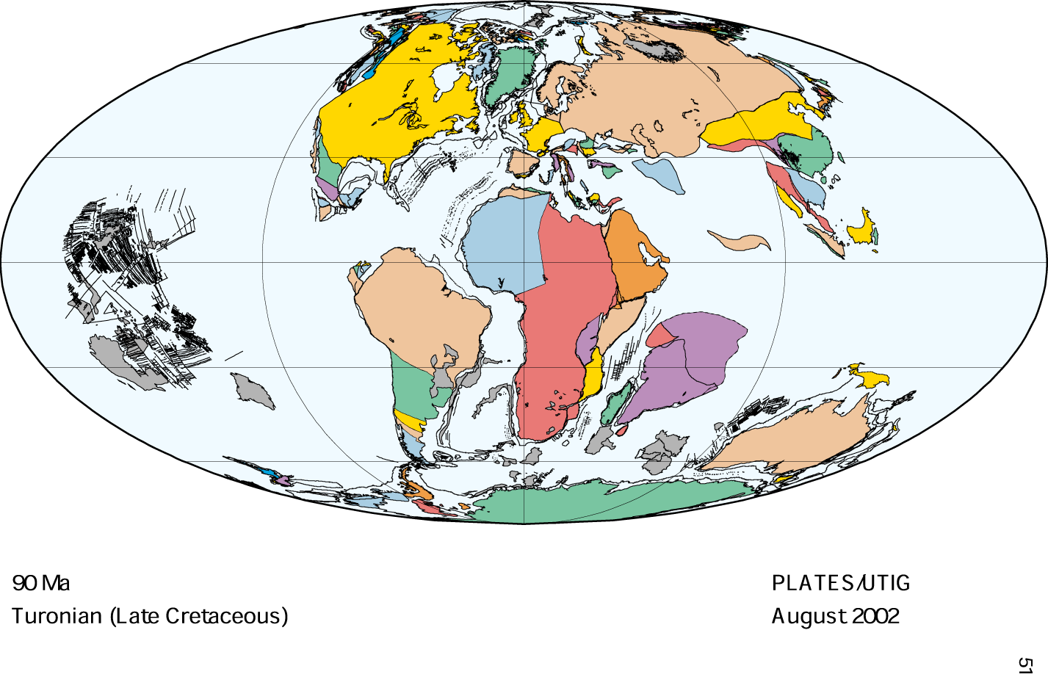

Slide 51
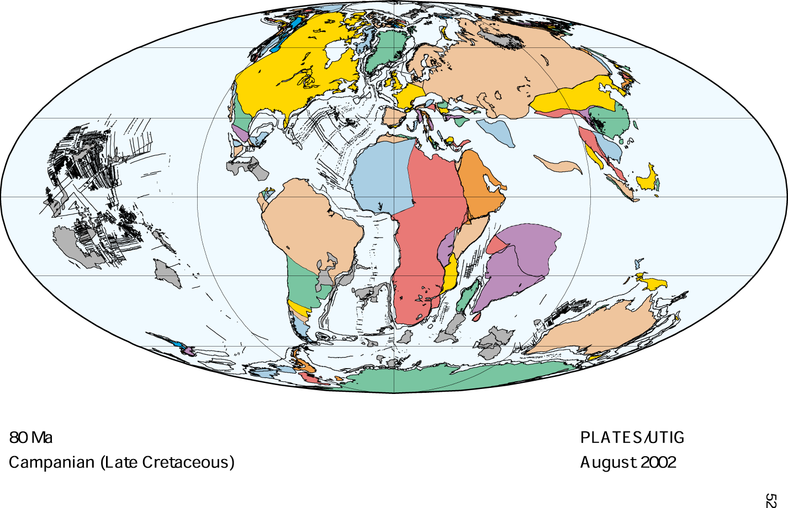

Slide 52
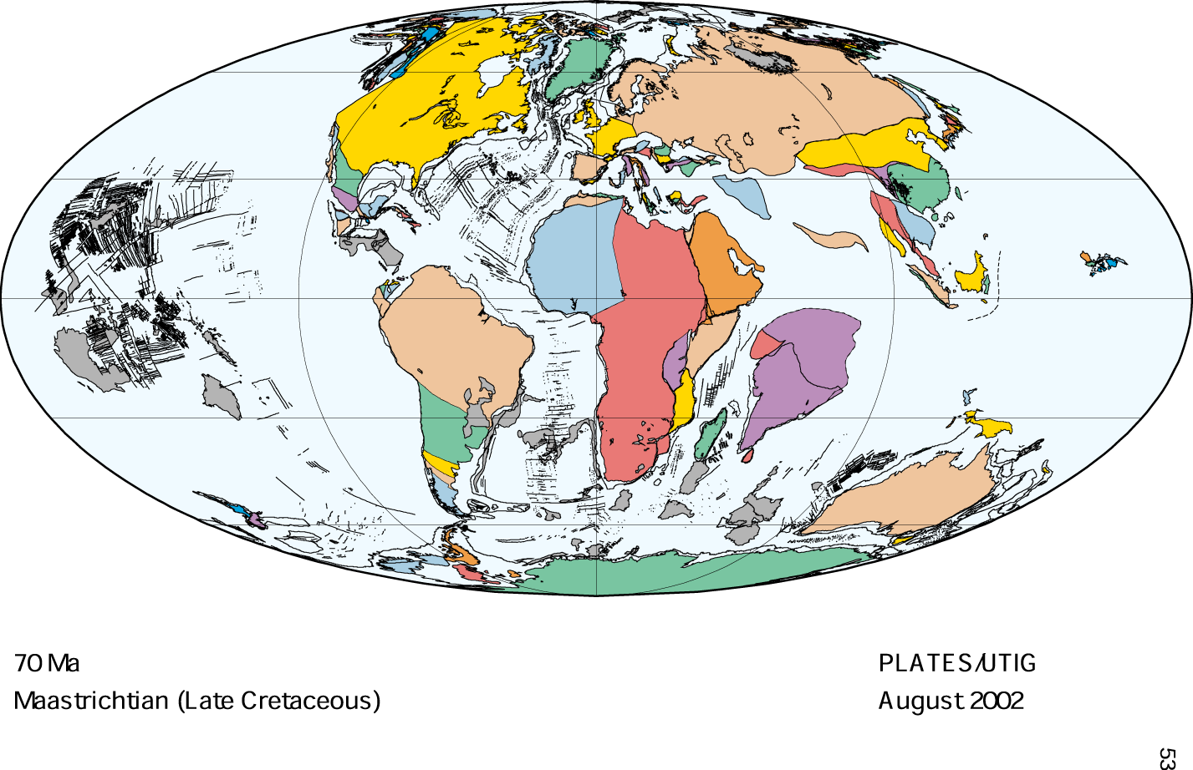

Slide 53
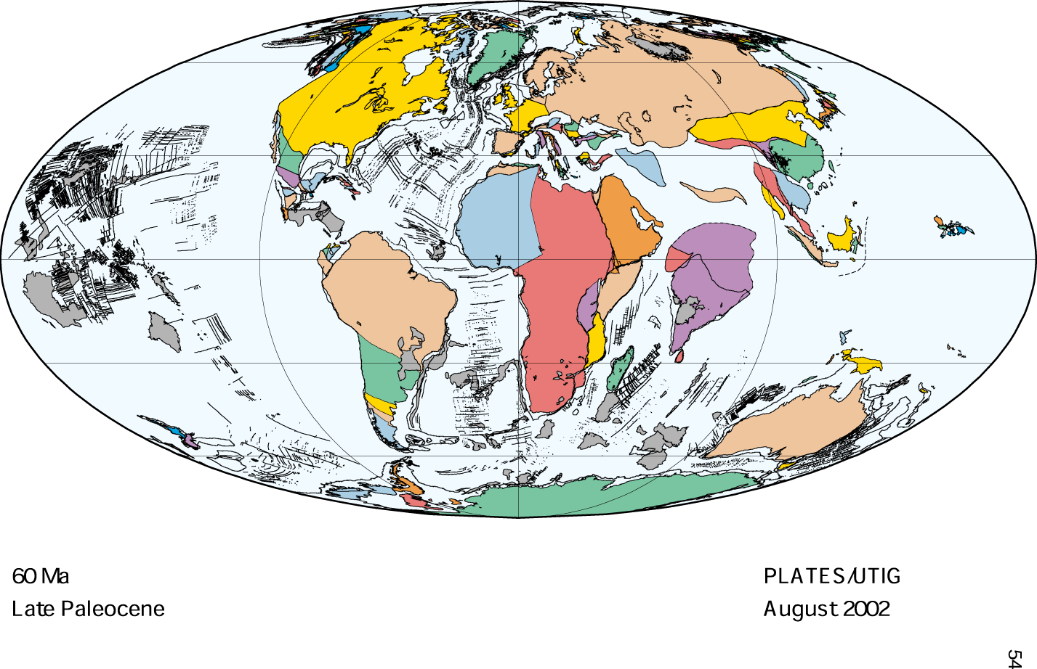

Slide 54
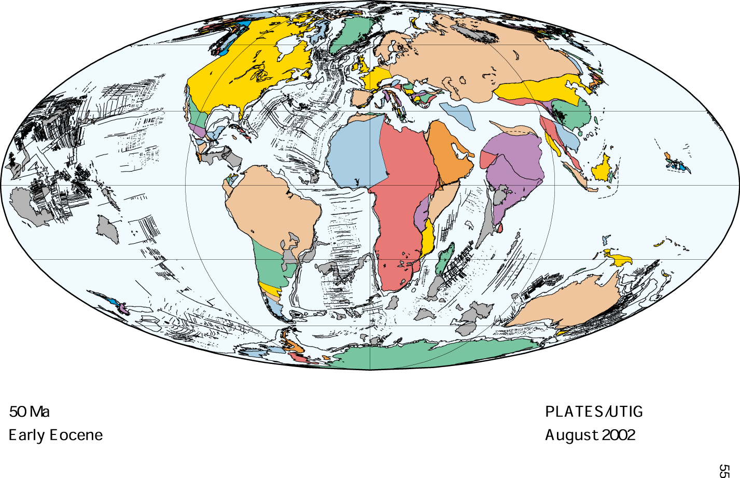

Slide 55
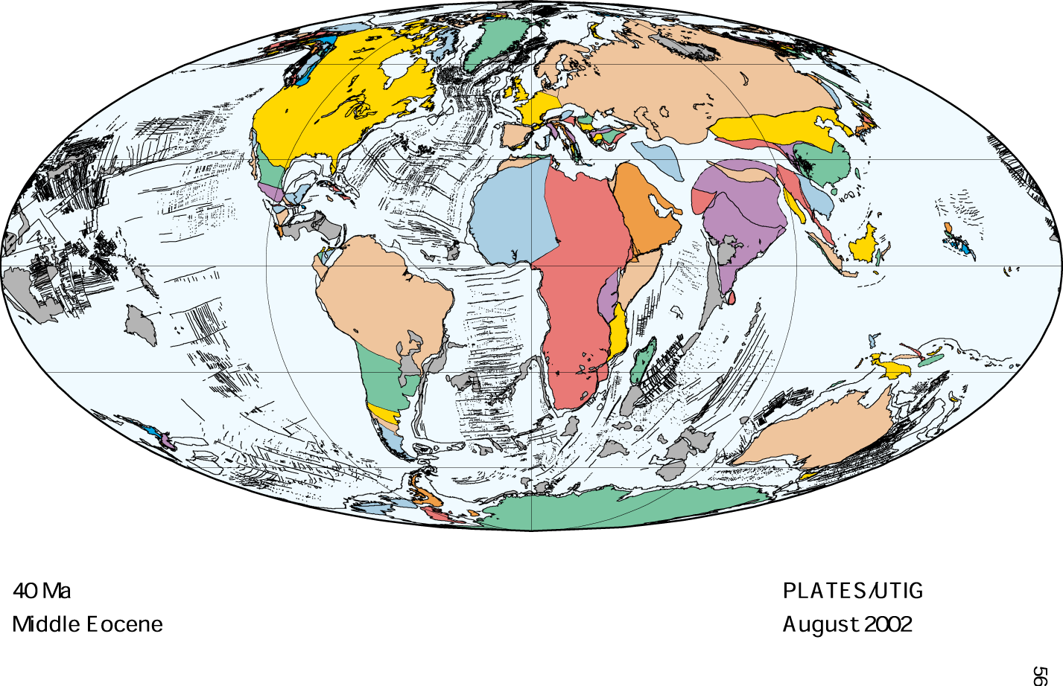

Slide 56
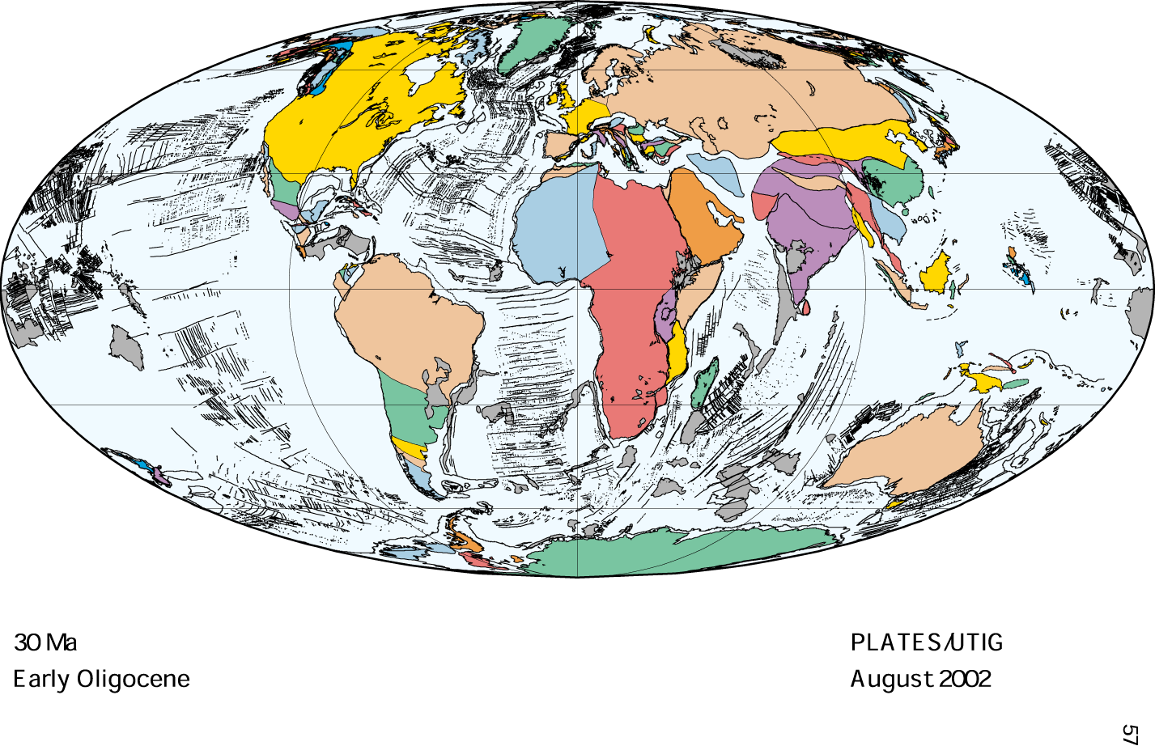

Slide 60
Plate tectonics: Earth structure and plate geometry
Plate tectonics - a theory that explains the function of the upper most layer of the planet.
Earth structure: The main units
Compositional:
Crust
Mantle
Core
Rheological:
Lithosphere
Asthenosphere
Mesosphere

Slide 61
The rocks we see on the surface are part of the Earth's CRUST, rich in silicon. It was identified by J.MILNE, LORD REYLEIG, LORD RUTHERFORD.
Below the crust there is the MANTLE so called by E. WIECHER (1897); physically and chemically different from the crust, rich in silicates and magnesium.
The boundary between the crust and mantle was identified by A. MOHOROVICIC (1909) and is called MOHOROVICIC DISCONTINUITY (MOHO)

Slide 62
The CORE of the Earth was discovered by R.D OLDHAM (1906) and correctly defined by B. GUTEMBERG (1912). It is mainly composed of iron and nickel. SIR H.JEFFREYS (1926) discovered that the core is liquid through work on tides.
The solid inner CORE was discovered by I. LEHMANN (1936).

Slide 64
Earth structure: the main units

