Slide 1
Relling & Evans, Nature 2015

Slide 2

Modulation of the dose and drug effects
Paracelso (Philip Theophrastus Bombastus von Hohenheim)
(Einsiedeln 1493 – Salisburgo 1541)
“Omnia venenum sunt: nec sine veneno quicquam existit. Dosis sola facit, ut venenum non fit”
“All things are poison and nothing is without poison; only the dose makes a thing not a poison”
Yip et al., Clin Pharm Ther 2015

Slide 3
History of pharmacogenetics and pharmacogenomics
Pirmohamed, Br J Clin Pharmacol 2001

Slide 4
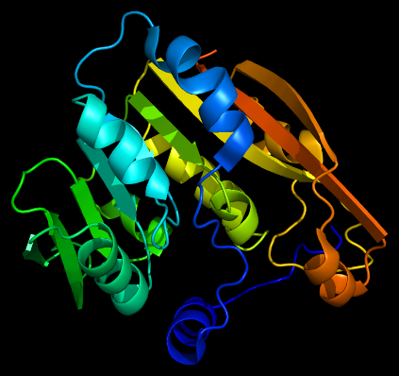

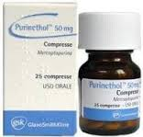
Exemple of pharmacogenetic trait
Enzyme thiopurine- S-methyltransferase
Thiopurine-S-methyltransferase enzymatic activity
Stocco et al., Human Mol Genet 2012

Slide 5
Cheok & Evans, 2006

Slide 6
Cheok & Evans, 2006

Slide 7

Definitions of genetic terms
Gene: fundamental unit, physical and functional, of heritability, that transmits biological information from a generation to the next.
Phenotype: morphological and functional characteristic of an organism determined by its genotype and modulated by the environment.
Genetic polymorphism: presence in the population of more variants of the same phenotype determined by different alleles with a frequency higher than 1%.
Allele: alternative form of a specific gene.

Slide 8
Fenotipi farmacologici di tipo farmacocinetico hanno una componente genetica di fenotipi più complessi (clinici)
+
- Emivita
- Concentrazione allo steady state
Farmacocinetico
Variabilità spiegabile in termini genetici
Fenotipi di risposta ai farmaci
Farmacodinamico
- Sensibilità ai farmaci in vitro
- Risposta clinica ai farmaci
- Tossicità clinica dei farmaci
Clinico
-

Slide 9
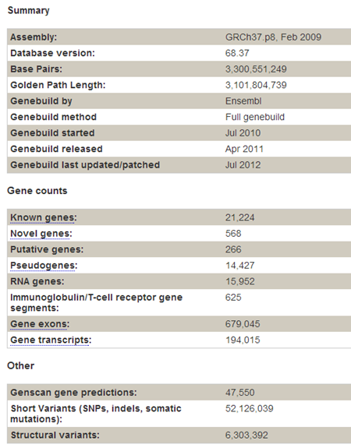
How big is the genome? How many genes does it contain?
http://jul2012.archive.ensembl.org/Homo_sapiens/Location/Genome?r=1:1-1000000

Slide 10
Objective of pharmacogenetic research
To associate to a certain PHENOTYPE (therapetuic response, adverse effects, resistance) a particular GENOTYPE
GENOTYPE
Single Nucleotide Variants (SNPs)
Deletions
Repeated sequences
Expression profiles (mRNA)
PHENOTYPE
Therapeutic response
Adverse effects
Lack of efficacy

Slide 11
Methods of pharmacogenetic research
The most critical step is to define and measure the drug-response phenotype.
Discovery model can be based on candidate gene studies or agnostic genome-wide analyses.
Pharmacogenetic discoveries require independent validation before they can be translated into clinical diagnostics.
The validation process can be facilitated by elucidating the mechanisms that determine how the variation alters drug responses.
Relling & Evans, Nature 2015

