Slide 1
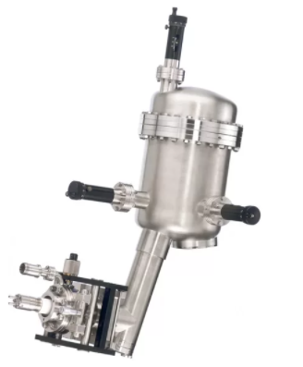
Sorgente X di laboratorio

Slide 2
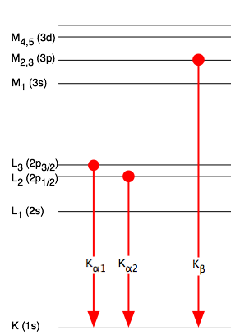
Target (Al, Cu, Mg)
Filamento (W, tungsteno)
I_{fil}~5 A
I_{em} ~ 20 mA
15 kV

Slide 3
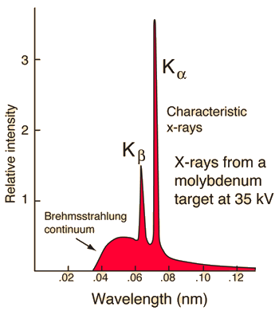
Notes:
Il supporto in Ag o Cu. Di solito Cu ma Ag è meglio.
Il problema è avere linee aggiuntive quando l’anodo inizia a deteriorarsi.

Slide 4
https://xdb.lbl.gov/

Slide 6
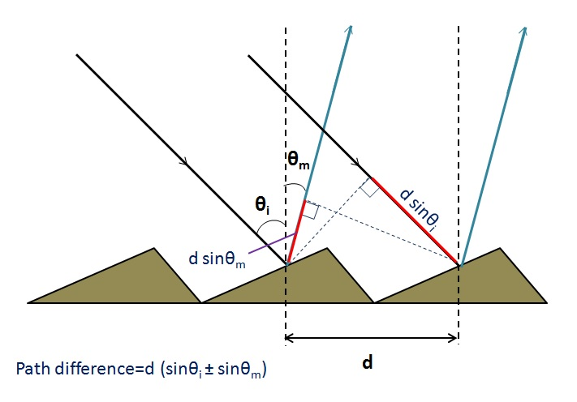

Slide 8
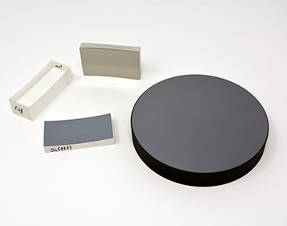

Slide 9
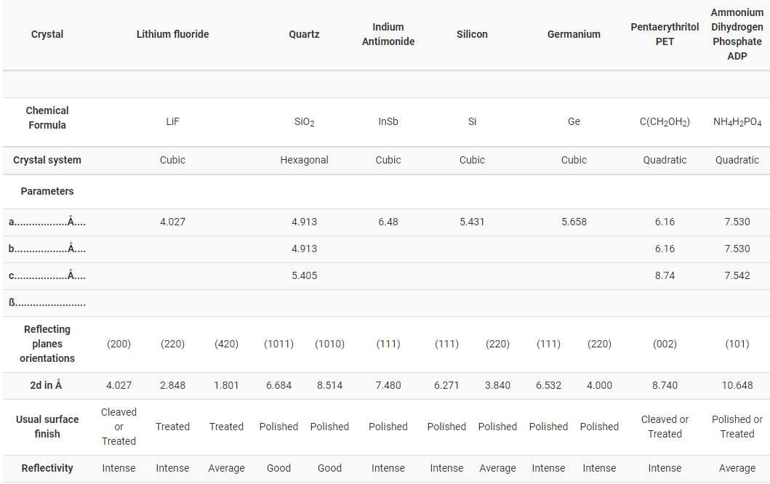
https://www.crystals.saint-gobain.com/products/x-ray-monochromators

Slide 11
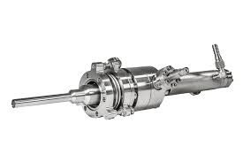
Lampada di Elio
(Discharge Helium Lamp)

Slide 16
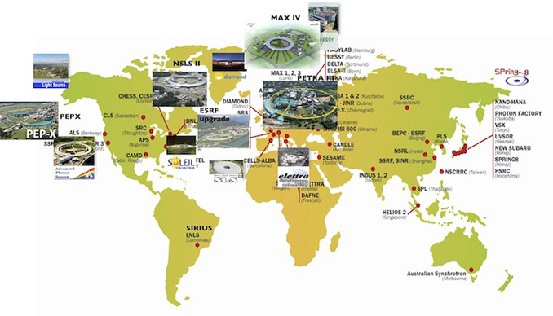
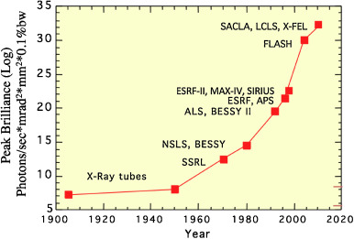
X-Ray Sources
Lab Sources
Synchrotrons
FELs
M. E. Couprie, J. Elect. Spec. Rel. Phen. 196 (2014) 3
W. Eberhardt, J. Elect Spec. Rel Phen. 200 (2015) 31

Slide 17
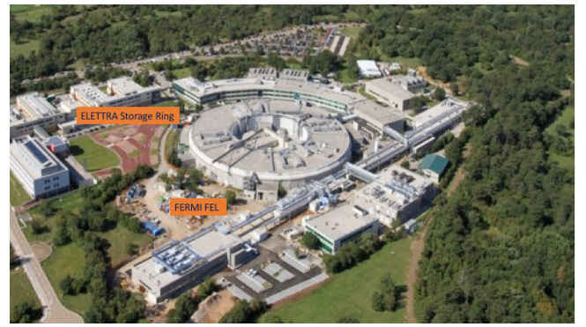
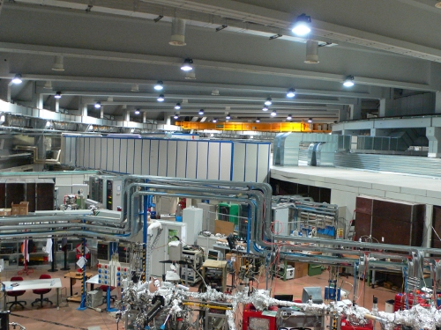
Elettra Synchrotron
USER FACILITY
ELETTRA: 28 beamlines in cooperation with national and international institutions

Slide 20
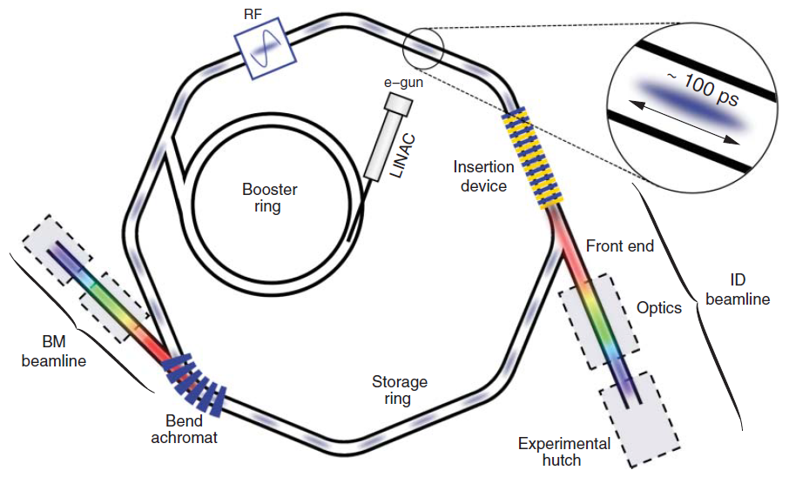

Slide 21
Mobilio-Boscherini-Meneghini, Synchrotron Radiation, Springer 2015

Slide 22
Elettra

Slide 23
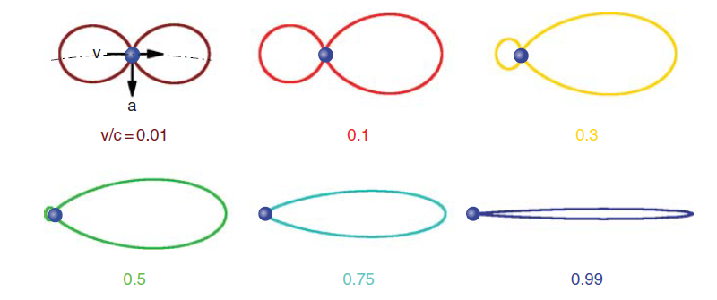
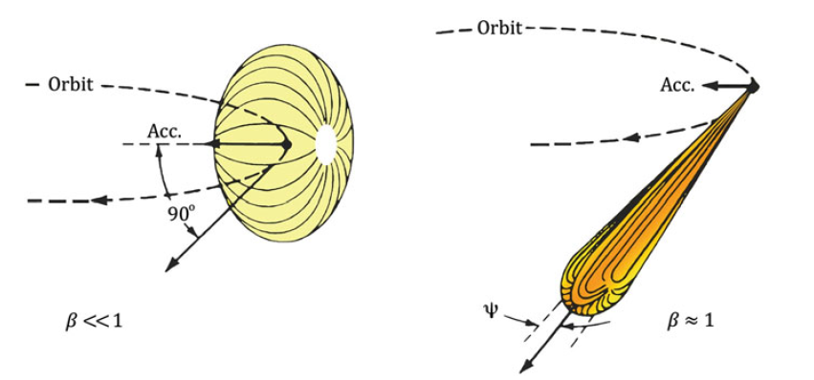

Slide 24
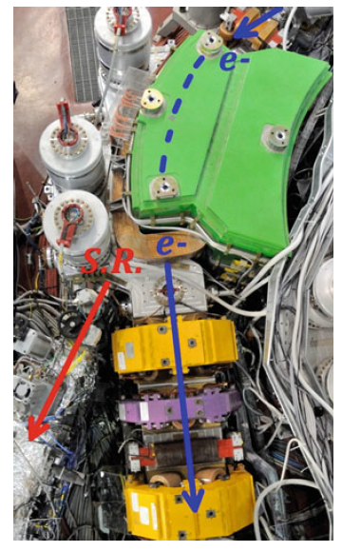

Slide 25
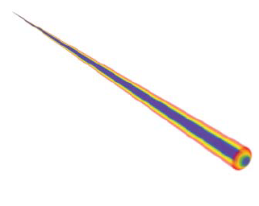
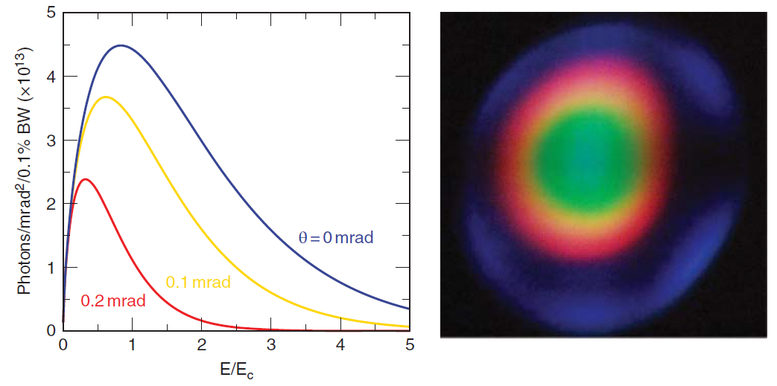
Energia critica del magnete curvante
Elettra

Slide 26
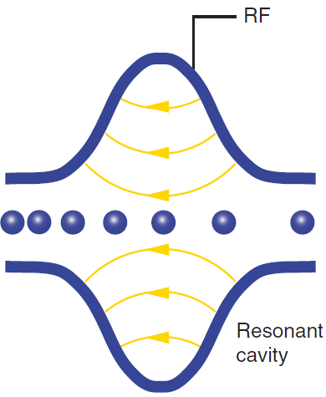
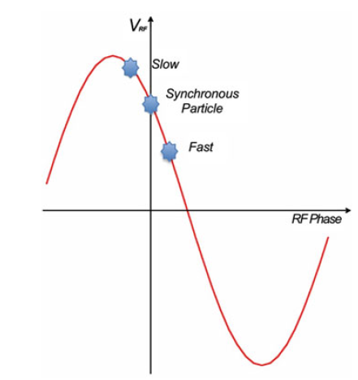
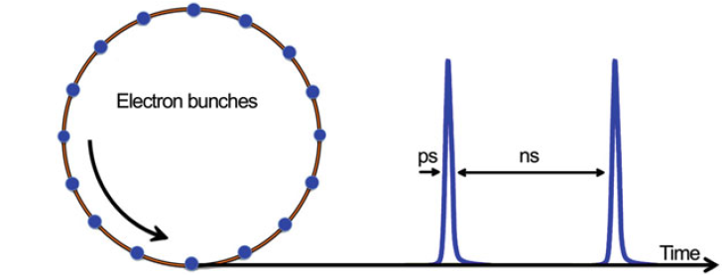
Mobilio-Boscherini-Meneghini, Synchrotron Radiation, Springer 2015

Slide 27
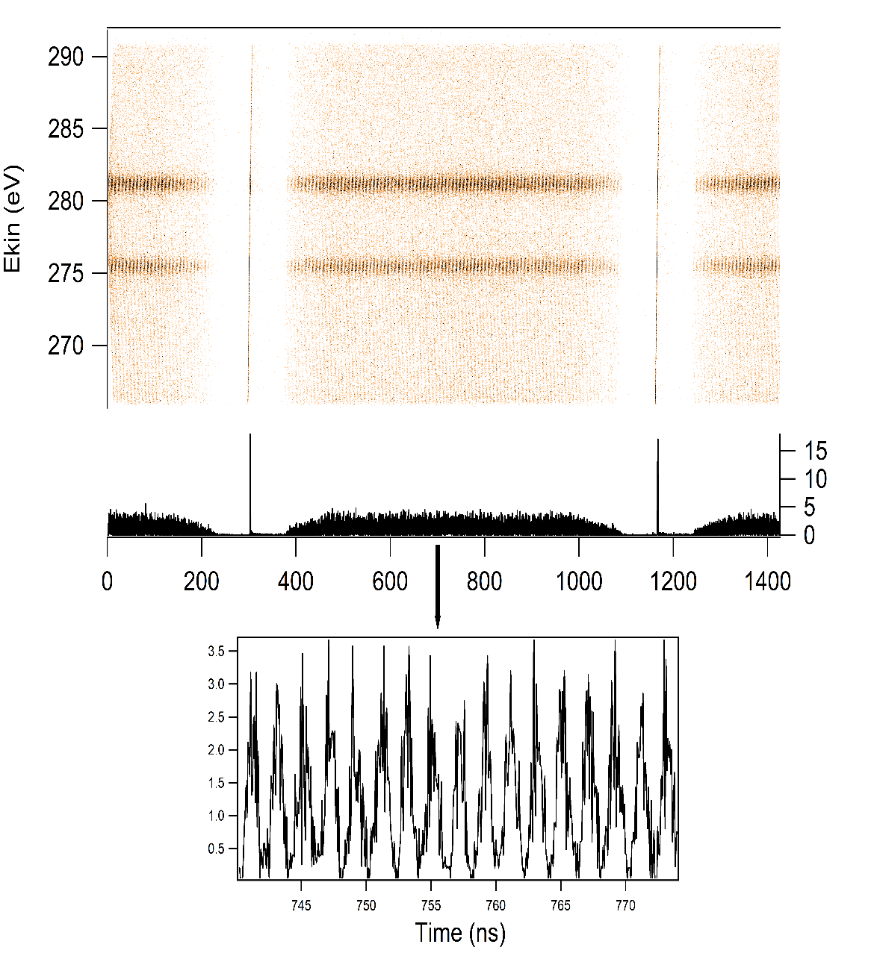
Synchrotron X-ray pulses
Elettra filling pattern
Electron bunches
864 ns
X-rays
100 ps X-ray pulses

Slide 28
Elettra

Slide 29
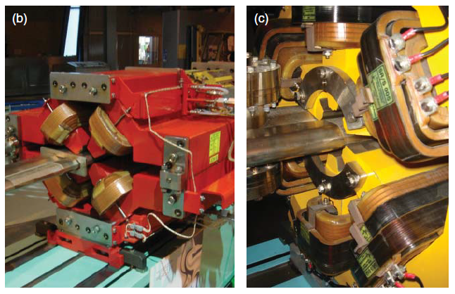

Slide 30
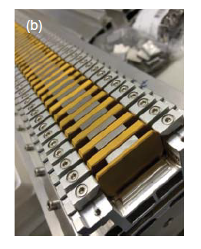
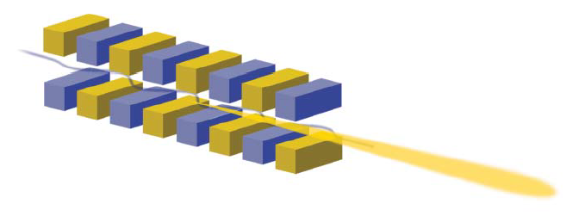

Slide 31
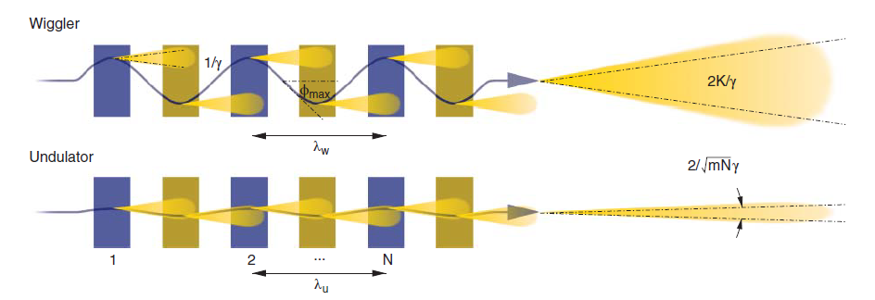

Slide 32
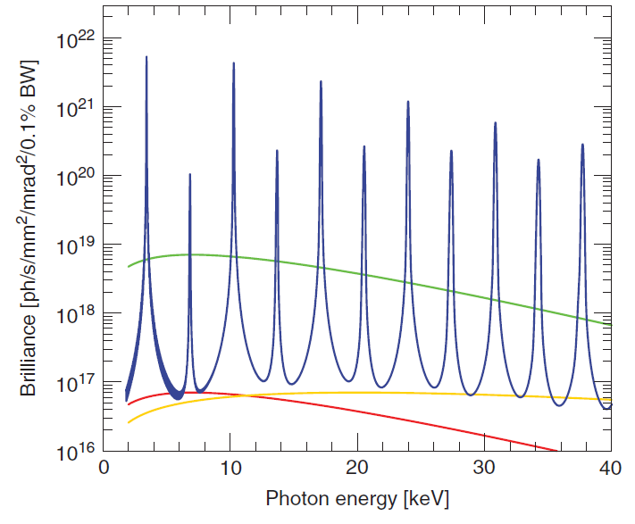
ondulatore
wiggler
Bending 4 gen (superbend)
Bending

Slide 33
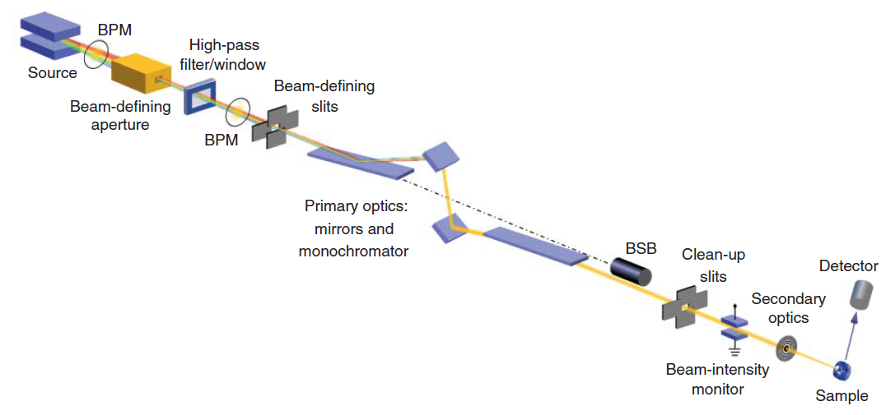
Beamlines

