Slide 2
Simple Past
The simple past tense describes an event that occurred at one particular time in the past.
Most simple past verbs add –ed to the base form, but some verbs have irregular past tense forms.
It snowed yesterday
Tom watched TV last night
Jack went to work early
I came to work late
We saw a great movie last night
The simple past forms of be are was and were:
Emily was at the office this morning
You were tired yesterday

Slide 3
Simple Past
When describing a series of actions that all happened in the past, the verbs are in same tense.
Andrew caught the ball, ran down the field, and scored a point.
In general, the simple past is used when:
the event is in the past
the event is completely finished
we say (or understand) the time and/or place of the event
Note that when we tell a story, we usually use the simple past. We may start with the past progressive to "set the scene", but we almost always use the simple past for the action:
"The wind was howling around the hotel and the rain was pouring down. It was cold. The door opened and James Bond entered. He took off his coat, which was very wet, and ordered a drink at the bar. He sat down in the corner of the lounge and quietly drank his..."

Slide 4
Simple Past: affirmative, negative, question forms
Regular verb forms
AFFIRMATIVE | NEGATIVE | QUESTION
I You He/She/It helped We They | I You He/She/It did not help We They | Did I Did You Did He/She/It help? Did We Did They
Irregular verb forms
AFFIRMATIVE | NEGATIVE | QUESTION
I You He/She/It ate We They | I You He/She/It did not eat We They | Did I Did You Did He/She/It eat? Did We Did They
Be verb forms
AFFIRMATIVE | NEGATIVE | QUESTION
I, He/She/It was here You, We, They were here | I, He/She/It was not here You, We, They were not here | Was I, He/She/It here? Were You, We, They here?

Slide 5
Exercise: Complete the sentences with the correct simple past form of the verb
An online order:
Tom (order) _________________ printer ink online last Monday.
The next morning he (realize) ___________ he (need) ___________ colored ink too.
He (try) ____________ to call the company to add more, but no one (answer)_____________, and there (be) ____________ no voicemail.
Tom (worry) _______________ that the website (be) _____________ fake.
He (email) _____________ the company and (explain) ____________ his situation.
The manager (respond) _____________ a few hours later and (fix) ___________ the order quickly.
Tom (relax) ______________ when he (receive) _____________ a confirmation email from the company.

Slide 6
Exercise: Complete the sentences with the correct forms of verbs that make sense. More than one verb may be appropriate. Some answers are negative.
Situation 1: Maria visited a friend at the hospital. A woman in the elevator had a cold and sneezed several times. The next day…
Maria _______________ in the morning with a fever and headache.
She ________________ well.
Her entire body _____________.
She ____________ her temperature with a thermometer.
She ____________ a high fever.
She ____________ the house all day.
She ____________ a few spoonfuls of chicken soup.
She ____________ to the nurse at the doctor’s office.
She ____________ an appointment for the following day.
ache feel leave schedule take eat have make speak to wake up

Slide 7
Exercise: Complete the sentences with the correct forms of verbs that make sense. More than one verb may be appropriate. Some answers are negative.
Situation 2: Professor Moore is our new math teacher. He is very hard to follow.
Yesterday, he…
______________ too fast.
______________ the material to us quickly.
______________ the board with examples.
______________ time for questions, unfortunately.
______________ everyone in the class.
confuse fill introduce leave speak

Slide 8
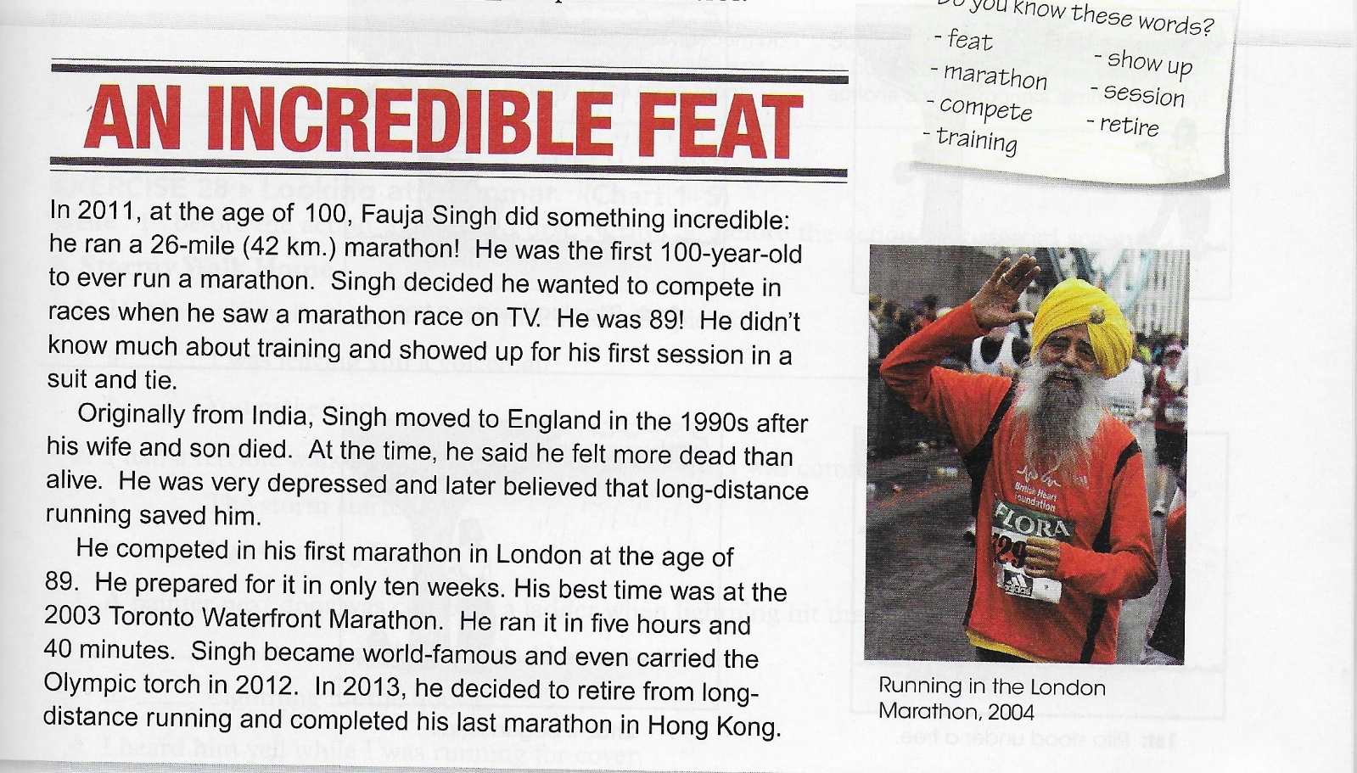
An incredible feat Read the passage. Point out the past tense verbs

Slide 9
Exercise: Complete the sentences with the verbs in the box.
Fauja Singh _______________ a marathon runner when he was depressed.
He _______________ a suit and tie to his first training.
He _______________ India after the death of his wife and son.
At the age of 89, he ______________ his first marathon.
Before he began training, he said that he _____________ more dead than alive.
His best running time __________________ five hours and 40 minutes.
He _______________ the Olympic torch in 2012.
He _______________ from marathon running in 2013.
be carry leave run become feel retire wear

Slide 10
Simple Past and Past Progressive
Simple Past
now
past X future
Past Progressive
X
start - finish
X---------------X
…in progress…

Slide 11
Simple Past vs. Past Progressive
The simple past indicates that an activity or situation began and ended at a particular time in the past.
I walked to school yesterday.
John lived in Paris for ten years, but now he lives in Rome.
I bought a new car three days ago.
If a sentence contains when (adverb clause) and has the simple past in both clauses, the action in the when-clause happens first.
Rita stood under a tree when it began to rain.
When Mrs. Taylor heard a strange noise, she got up to investigate.
When I dropped my cup, the coffee spilled on my lap.

Slide 12
Simple Past vs. Past Progressive
The past progressive is used to describe an action at a particular moment in the past. The action started before that moment but is not over at that moment.
When we use the past progressive, our listener usually knows or understands what time we are talking about:
I was working at 10pm last night.
They were not playing football at 9am this morning.
What were you doing at 10pm last night?
What were you doing when he arrived?
She was cooking when I called her.
We were having dinner when it started to rain.
John went home early because it was snowing.

Slide 13
Simple Past vs. Past Progressive
In the past progressive two actions occur at the same time in the past, but one action begins earlier and is in progress when the other action occurs.
I was walking down the street when it began to rain
While I was walking down the street, it began to rain.
Rita was standing under a tree when it began to rain.
The past progressive can also describe an action that began in the past and continued for an indefinite period of time.
At eight o’clock last night I was studying = “My studying began before 8:00 pm, was in progress at that time, and probably continued”.
Sometimes the past progressive is used in both parts of a sentence when two actions are in progress simultaneously.
While I was studying in one room of our apartment, my roommate was having a party in the other room.

Slide 14
Past Progressive + Simple Past
We often use the past progressive with the simple past. We use the past progressive to express a long action.
And we use the simple past to express a short action that happens in the middle of the long action.
We can join the two ideas with when or while:
Long action:
I was watching TV from 7pm to 9pm.
Short action:
You called at 8pm.

Slide 15
Past Progressive + Simple Past
Long action (watching TV): expressed with past progressive
Short action (called): expressed with simple past
We can join these two actions with when:
I was watching TV when you called.
Notice that "when you called" is also a way of defining the time (8pm).
But also:
While I was watching TV, you called.
We use:
when + short action (Simple Past)
while + long action (Past Progressive)

Slide 16
Exercise: Complete the sentences. Use the simple past or the past progressive of the verbs in parentheses.
Last night
Between 5:00 and 7:00 pm, I (sit) __________________ in class. I had a lot of things on my mind. I (think) _____________ about some family issues. I (listen, not) _____________ to the teacher.
It was a beautiful evening when I walked home. The moon (shine) ____________ over the water , and warm breeze (blow) _______________.
I (stop) _______________ by a friend’s apartment, but he (be, not) _____________ home. He (sit) ________________ in heavy traffic. He (get, not) _____________ home until 10:00.
My neighbors (argue) ______________ about something when I (walk) __________ by them outside my apartment building.
A package (wait) _______________ for me at home. I (open) _____________ it and (find) _____________ an early birthday present.
While I (read) _______________ to my nephew, he (fall) _______________ asleep, so I (cover) ______________ him up and (sneak) _______________ out of the room.

Slide 17
Exercise: correct the errors

Slide 18
Read and translate

