Slide 1
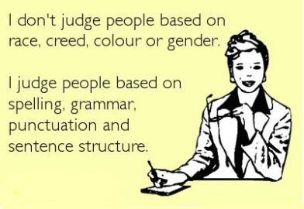

Slide 2
Table of English tenses
Tense | Affirmative/Negative/Question | Use | Signal Words
Simple Present | A: He speaks. N: He does not speak. Q: Does he speak? | action in the present taking place regularly, never or several times facts actions taking place one after another action set by a timetable or schedule | Always, every …, never, normally, often, seldom, sometimes, usually…
Present Progressive | A: He is speaking. N: He is not speaking. Q: Is he speaking? | action taking place in the moment of speaking action taking place only for a limited period of time action arranged for the future | At the moment, just, just now, Listen!, Look!, now, right now…
Simple Past | A: He spoke. N: He did not speak. Q: Did he speak? | action in the past taking place once, never or several times actions taking place one after another action taking place in the middle of another action | Yesterday, 2 minutes ago, in 1990, the other day, last Friday…

Slide 3
Tense | Affirmative/Negative/Question | Use | Signal Words
Past Progressive | A: He was speaking. N: He was not speaking. Q: Was he speaking? | action going on at a certain time in the past actions taking place at the same time action in the past that is interrupted by another action | While, as long as…
Present Perfect Simple | A: He has spoken. N: He has not spoken. Q: Has he spoken? | putting emphasis on the result action that is still going on action that stopped recently finished action that has an influence on the present action that has taken place once, never or several times before the moment of speaking | Already, ever, just, never, not yet, so far, till now, up to now…
Present Perfect Progressive | A: He has been speaking. N: He has not been speaking. Q: Has he been speaking? | putting emphasis on the course or duration (not the result) action that recently stopped or is still going on finished action that influenced the present | All day, for 4 years, since 1993, how long…?, the whole week…
Past Perfect Simple | A: He had spoken. N: He had not spoken. Q: Had he spoken? | action taking place before a certain time in the past sometimes interchangeable with past perfect progressive putting emphasis only on the fact (not the duration) | Already, just, never, not yet, once, until that day…

Slide 4
Tense | Affirmative/Negative/Question | Use | Signal Words
Past Perfect Progressive | A: He had been speaking. N: He had not been speaking. Q: Had he been speaking? | action taking place before a certain time in the past sometimes interchangeable with past perfect simple putting emphasis on the duration or course of an action | For, since, the whole day, all day…
Simple Future (will) | A: He will speak. N: He will not speak. Q: Will he speak? | action in the future that cannot be influenced spontaneous decision assumption with regard to the future | In a year, next …, tomorrow… assumption: I think, probably, perhaps
Simple Future (going to) | A: He is going to speak. N: He is not going to speak. Q: Is he going to speak? | decision made for the future conclusion with regard to the future | In one year, next week, tomorrow…
Future Progressive | A: He will be speaking. N: He will not be speaking. Q: Will he be speaking? | action that is going on at a certain time in the future action that is sure to happen in the near future | In one year, next week, tomorrow…
Future Perfect | A: He will have spoken. N: He will not have spoken. Q: Will he have spoken? | action that will be finished at a certain time in the future | By Monday, in a week…
Future Perfect Progressive | A: He will have been speaking. N: He will not have been speaking. Q: Will he have been speaking? | action taking place before a certain time in the future putting emphasis on the course of an action | For …, the last couple of hours, all day long…

Slide 5
Conditionals: if
There are different types of conditions.
Some are possible or likely, others are unlikely, and others are impossible.
If the weather improves, we’ll go for a walk.
(It is possible or likely that the weather will improve).
If the weather improved, we could go for a walk.
(It is not likely that the weather will improve).
If the weather had improved, we could have gone for a walk.
(The weather did not improve – fine weather is therefore an impossible condition).
These types of conditions are used in three types of sentences, called first, second and third conditional sentences.

Slide 6
Conditionals: if
Imagined conditions: the first conditional
We use the first conditional to talk about the result of an imagined future situation, when we believe the imagined situation is quite likely:
[imagined future situation] [future result]
If the taxi doesn’t come soon, I’ll drive you myself.
First conditional: form
conditional clause | main clause
if + present simple | modal verb with future meaning (shall/should/will/would/can/could/may/might)
If he gets a job in Liverpool, | he’ll have to get up early. It’s a long drive.
If Sheila rings, | I might ask her to come over for dinner.
We use the modal verb in the main clause, not in the conditional clause. If a lawyer reads the document, we will see if we’ve missed anything important. Not: If a lawyer will read the document

Slide 7
Conditionals: if
Imagined conditions: the second conditional
We use the second conditional to talk about the possible result of an imagined situation in the present or future. We say what the conditions must be for the present or future situation to be different.
If people complained, things would change.
(People don’t complain at the moment)
Second conditional: form
conditional clause | main clause
if + past simple | modal verb with future-in-the-past meaning (should/would/might/could)
If you asked her nicely, | she would say yes, I’m sure.
We use would in the main clause, not in the conditional clause: If you decided to take the exam, you would have to register by 31 March. Not: If you would decide to take the exam…

Slide 8
Conditionals: if
We use a past form in the conditional clause to indicate a distance from reality, rather than indicating past time. Past forms are often used in this way in English.
First and second conditional compared
When we use the first conditional, we think the imagined situation is more likely to happen than when we use the second conditional.
Compare
First conditional | Second conditional
If the flight’s late, we’ll miss our connection. (it’s possible or likely that the flight will be late) | If there were more buses, we would leave the car at home. (it is unlikely that there will be more buses)
I’ll come and give a hand if you need help moving your stuff. (it is possible or likely that you will need help) | He would buy a flat if he had the money for a deposit. (it is unlikely that he will have the money)

Slide 9
Conditionals: if
Imagined conditions: the third conditional
We use the third conditional when we imagine a different past, where something did or did not happen, and we imagine, therefore, a different result:
If I had played better, I would have won.
(I didn’t play well and I didn’t win).
It would have been easier if George had brought his own car.
(George didn’t bring his own car, so the situation was difficult).
If the dog hadn’t barked, we wouldn’t have known there was someone in the garden.
(The dog barked, so we knew there was someone in the garden).

Slide 10
Conditionals: if
Third conditional: form
Conditional clause | Main clause
if + past perfect | modal verb with future-in-the-past meaning (should/would/might/could) + have + -ed form
If they had left earlier, | they would have arrived on time.
We use would have + -ed in the main clause, not in the conditional clause: If he had stayed in the same room as Dave, it would have been a disaster. Not: If he would have stayed … it would have been a disaster.
People do sometimes use the form with would have in the conditional clause (in informal speaking), but many speakers consider it incorrect.

Slide 11
Conditionals: if
Real conditionals
Some conditions seem more real to us than others. Real conditionals refer to things that are true, that have happened, or are very likely to happen:
If you park here, they clamp your wheels.
(It is always true that they clamp your wheels if, or every time, you park here).
If I can’t sleep, I listen to the radio.
(It is often true that I can’t sleep, so I listen to the radio).
In real conditional sentences, we can use the simple present or present progressive in both clauses for present situations, and the simple past or past progressive in both clauses for past situations.
We can use these in various different combinations:

Slide 12
Conditionals: if
Simple present + simple present
If the weather is fine, we eat outside on the terrace.
(Every time this happens, this is what we do).
Present progressive + simple present
If the kids are enjoying themselves, we just let them go on playing till they’re ready for bed.
(Every time this happens, this is what we do).
Present progressive + present progressive
If the economy is growing by 6%, then it is growing too fast.
(If it is true that the economy is growing by 6%, then it is true that it is growing too fast).
Simple past + simple past
If my father had a day off, we always went to see my granddad.
(Every time that happened in the past, that is what we did).
Simple past + past progressive
Kevin always came in to say hello if he was going past our house.
(Every time he was going past our house, that is what he did).

Slide 13
Conditionals: if
We can also use modal verbs in the main clause:
If we go out, we can usually get a baby sitter.
(Every time we go out, it is usually possible/easy to get a babysitter).
If we wanted someone to fix something, we would ask our neighbor. He was always ready to help.
(Every time we needed something fixed, we would ask our neighbor).

Slide 14
Conditionals: if
Types of conditional: summary
The table shows how the main types of conditionals relate to one another:
true | likely/possible | less likely/less possible | impossible
REAL | FIRST | SECOND | THIRD
If babies are hungry, they cry. (babies do this every time they’re hungry) | If she gets the job, we’ll celebrate. (It is possible or likely she will get the job). | If we had more students, we would run the course. (It is less likely or unlikely that we will get more students). | If the rent had been lower, I would have taken the flat. (The rent was not low enough).

Slide 15
Conditionals: if
If + should
We can use if with should to refer to events which might happen by chance or by accident:
If you should bump into Carol, can you tell her I’m looking for her?
(If by chance you bump into Carol).
If the government should ever find itself in this situation again, it is to be hoped it would act more quickly.
Conditional clauses with will or would
Will and would can be used in conditional clauses, either with the meaning of ‘being willing to do something’, or to refer to later results:
If Clare will meet us at the airport, it will save us a lot of time.
(if Clare is willing to meet us).
If you would all stop shouting, I will try and explain the situation!
If it will make you happy, I’ll stay at home tonight.
(If it is true that you will be happy as a result, I’ll stay at home tonight).

Slide 16
Conditionals: if
We sometimes stress the will or would, especially if we doubt that the result will be the one mentioned:
If it really would save the planet, I’d stop using my car tomorrow.
(If it really is true that the planet would be saved as a result, I would stop using my car, but I doubt it is true).
Mixed conditionals
Often, things that did or did not happen in the past have results which continue or are still important in the present. We can emphasize this by using if with a past perfect verb, and would in the main clause:
If I hadn’t met Charles, I wouldn’t be here now.
(I met Charles so I’m here now).
She wouldn’t still be working for us if we hadn’t given her a pay-rise.
(We gave her a pay-rise so she is still working for us now).

Slide 17
Exercises
CONDITIONAL EXERCISE (FIRST / SECOND / THIRD CONDITIONALS)
(First conditional) If we __________________ (not / work) harder, we __________________ (not pass) the exam.
(Third conditional) If the students ____________ (not be) late for the exam, they ____________ (pass).
(Third conditional) If the weather __________________ (not be) so cold, we __________________ (go) to the beach.
(Second conditional) If she __________________ (have) her laptop with her, she __________________ (email) me.
(First conditional) If she _______________ (not go) to the meeting, I ________________ (not go) either.
(Third conditional) If the baby __________________ (sleep) better last night, I __________________ (not be) so tired.
(First conditional) If the teacher ________________ (give) us lots of homework this weekend, I __________________ (not be) happy.
(Second conditional) If Lucy __________________ (have) enough time, she __________________ (travel) more.
(First conditional) If the children __________________ (not eat) soon, they __________________ (be) grumpy.
(First conditional) If I __________________ (not go) to bed soon, I __________________ (be) tired in the morning.

Slide 18
Exercises
(Second conditional) If I _________________ (want) a new car, I ________________ (buy) one.
(Second conditional) If José ___________ (not speak) good French, he __________ (not move) to Paris.
(First conditional) If John ________________ (drink) too much coffee, he _____________ (get) ill.
(Third conditional) If we ________________ (tidy) our flat, we __________________ (not lose) our keys.
(Third conditional) If Luke __________ (not send) flowers to his mother, she _________ (not be) happy.
(Second conditional) If the children ____________ (be) in bed, I___________ (be able to) have a bath.
(Second conditional) If you ________________ (not be) so stubborn, we ________________ (not have) so many arguments!
(Third conditional) If Julie _______________ (not go) to Sweden, she ______________ (go) to Germany.
(First conditional) If she ________________ (go) to the library, she __________________ (study) more.
(Third conditional) If we _______________ (not have) an argument, we _______________ (not be) late.

Slide 19
Exercises
(Second conditional) If you __________________ (arrive) early, it ________________ (be) less stressful.
(Third conditional) If I ________________ (not go) to the party, I ________________ (not meet) Amanda.
(Second conditional) If Julie __________________ (like) chocolate, I ________________ (give) her some.
(Second conditional) If Luke _______________ (live) in the UK, I ______________ (see) him more often.
(Third conditional) If the children ___________ (not eat) all that chocolate, they ___________ (feel) sick.
(First conditional) If they __________________ (not / arrive) soon, we ________________ (be) late.
(Third conditional) If she _______________ (study) Mandarin, she __________________ (go) to Beijing.
(Second conditional) If we _________________ (not be) so tired, we ________________ (go) out.
(First conditional) If you _________________ (buy) the present, I __________________ (wrap) it up.
(First conditional) If Lucy ________________ (not quit) her job soon, she _________________ (go) crazy.

Slide 20
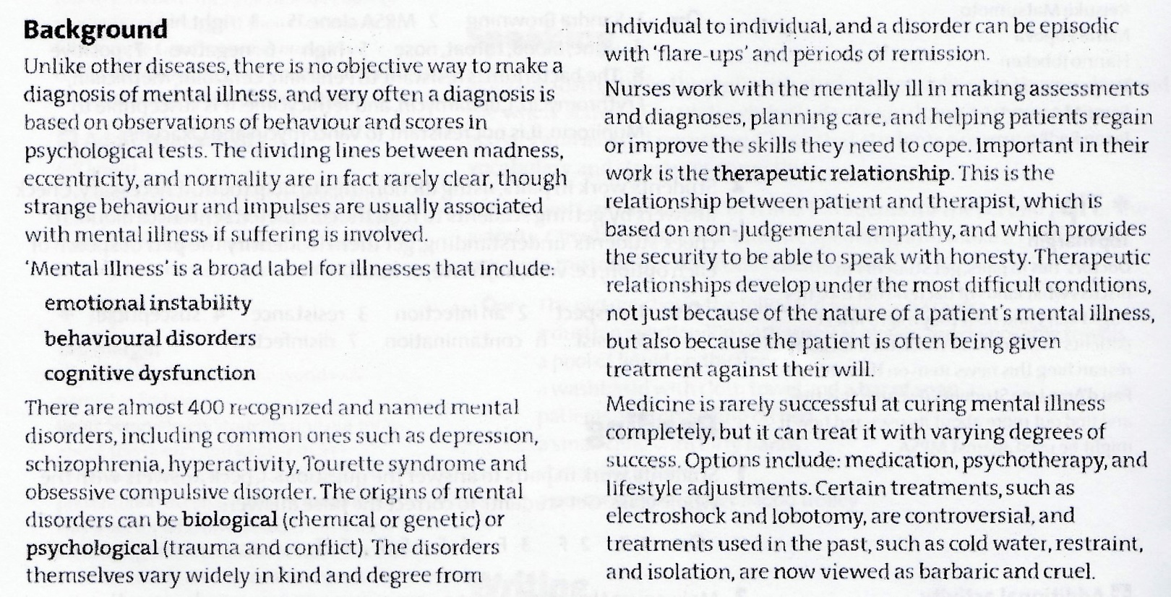

Slide 21
