Slide 1
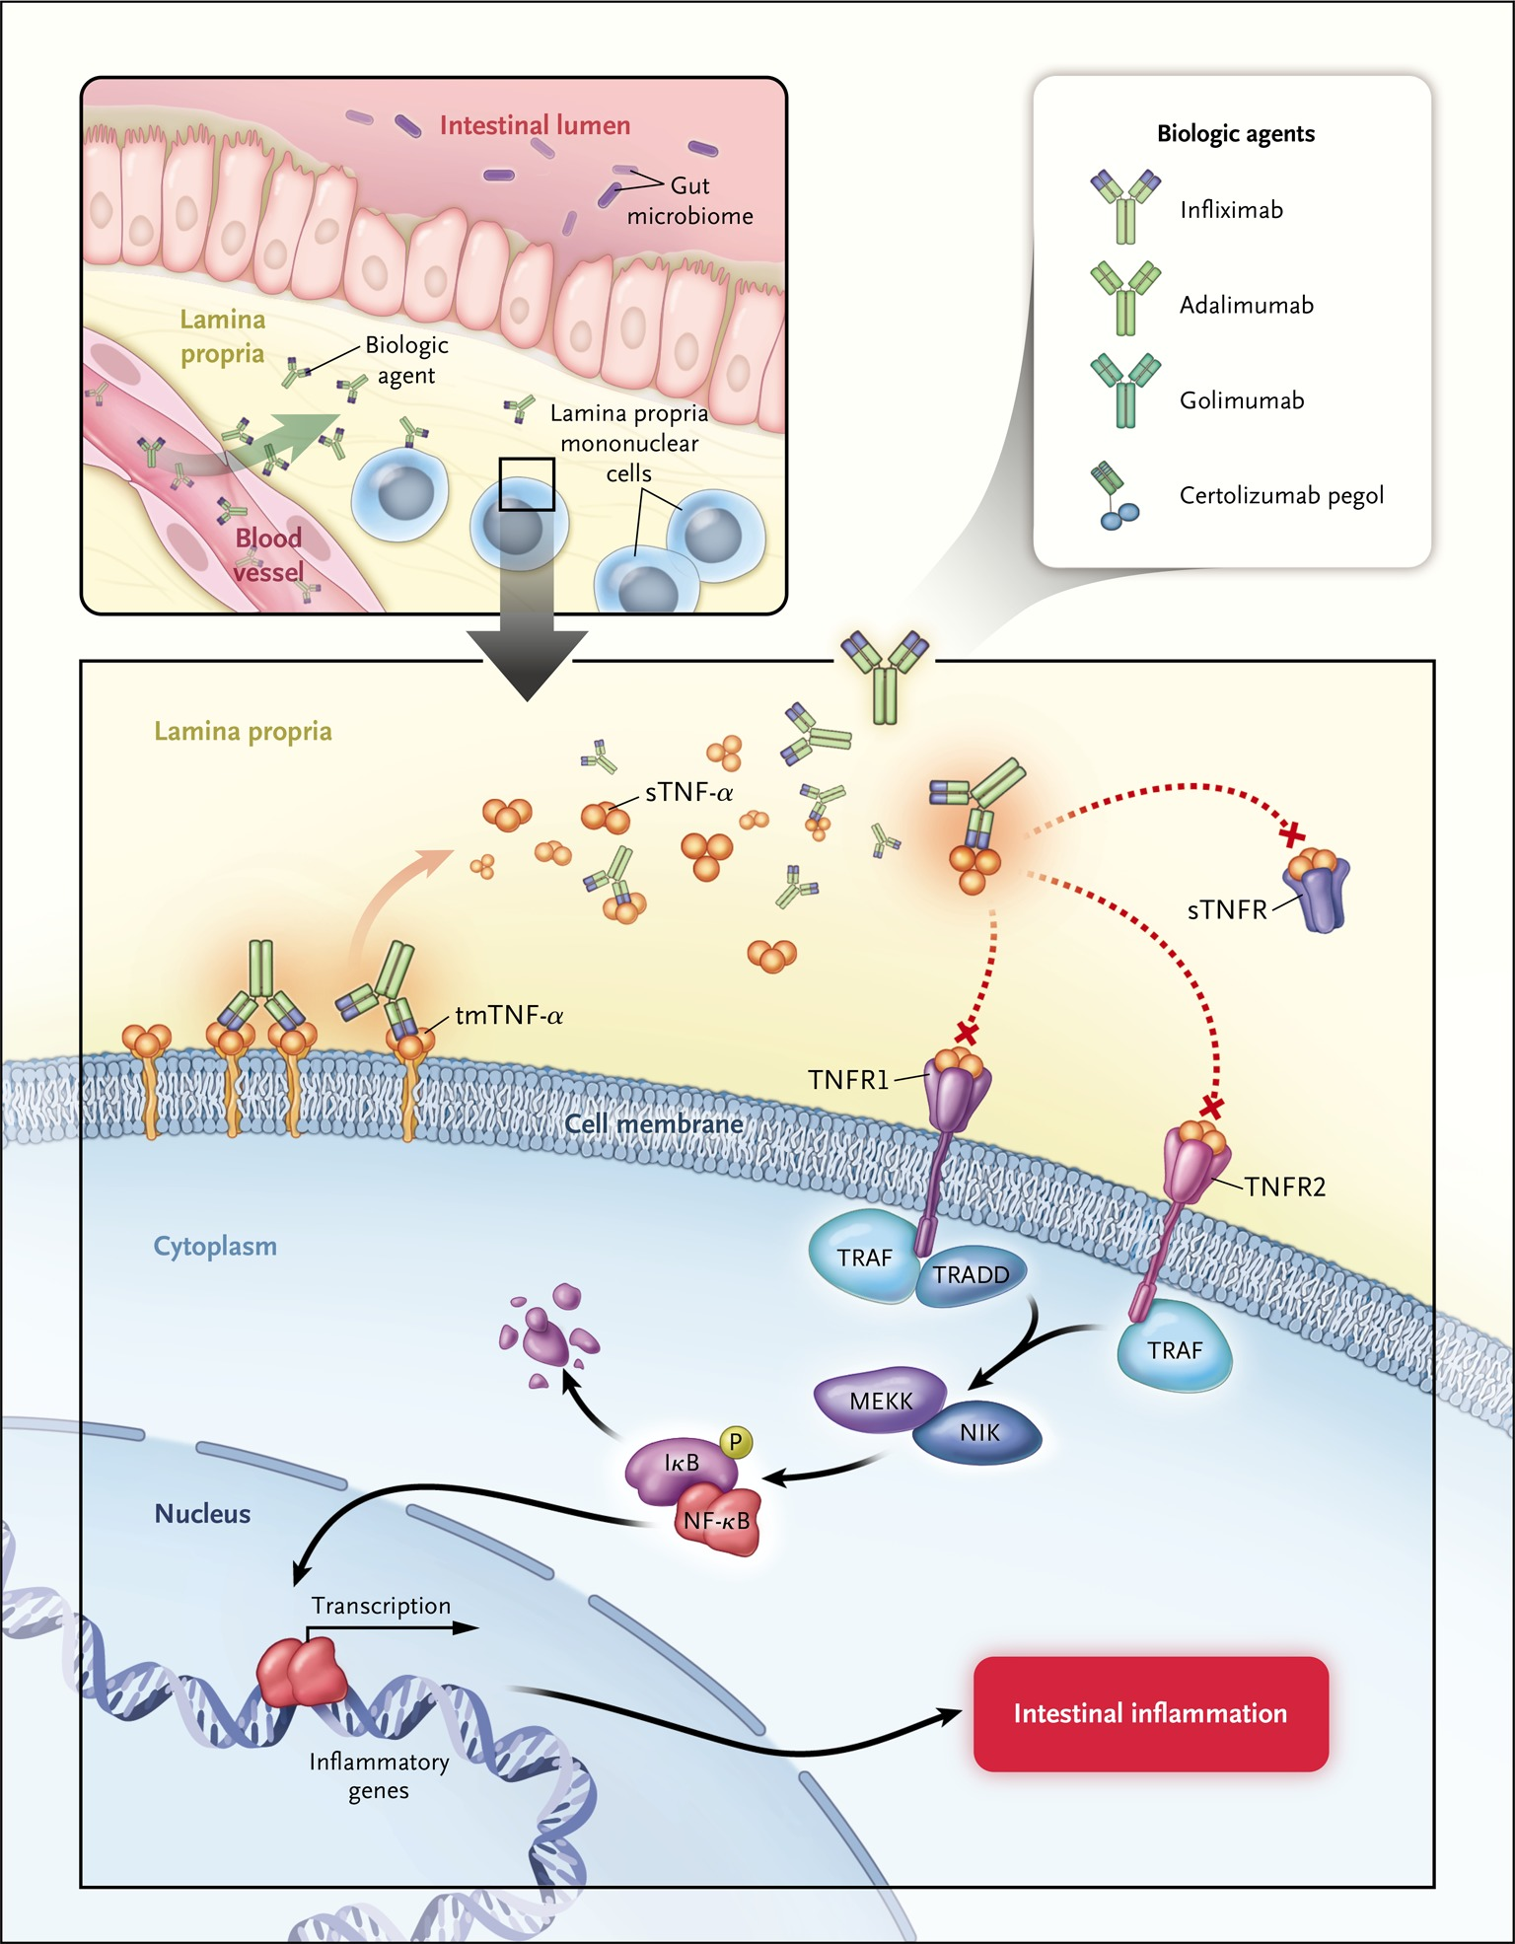
Anti-TNF monoclonal antibodies mechanism of action
Nielsen OH, Ainsworth MA. N Engl J Med 2013; 369:754-62

Slide 2
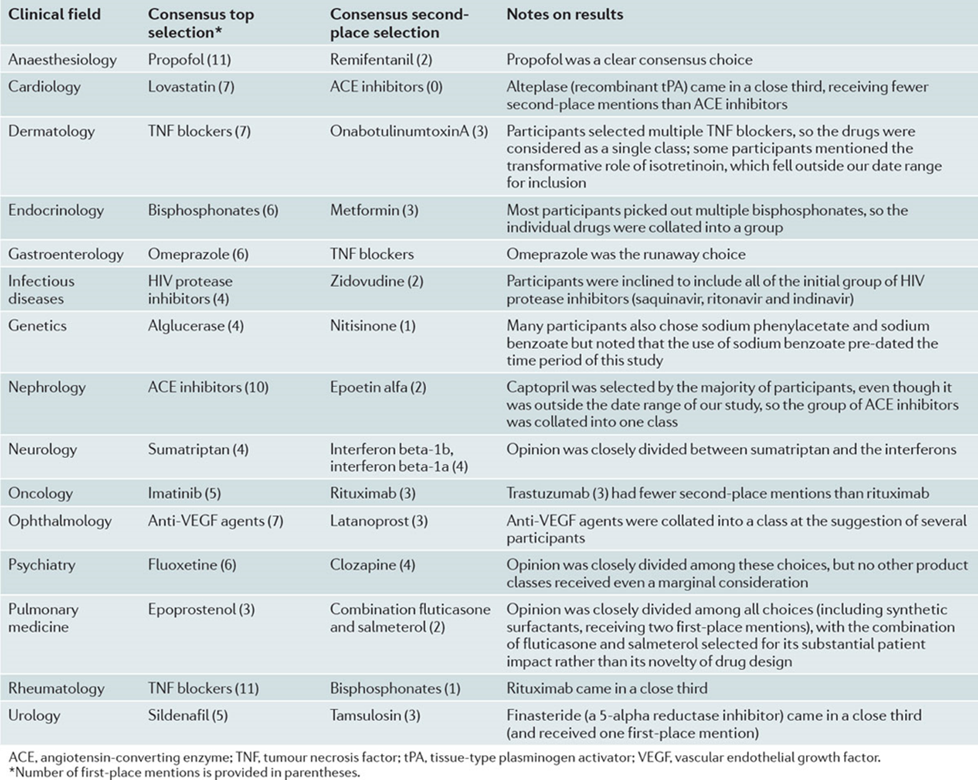
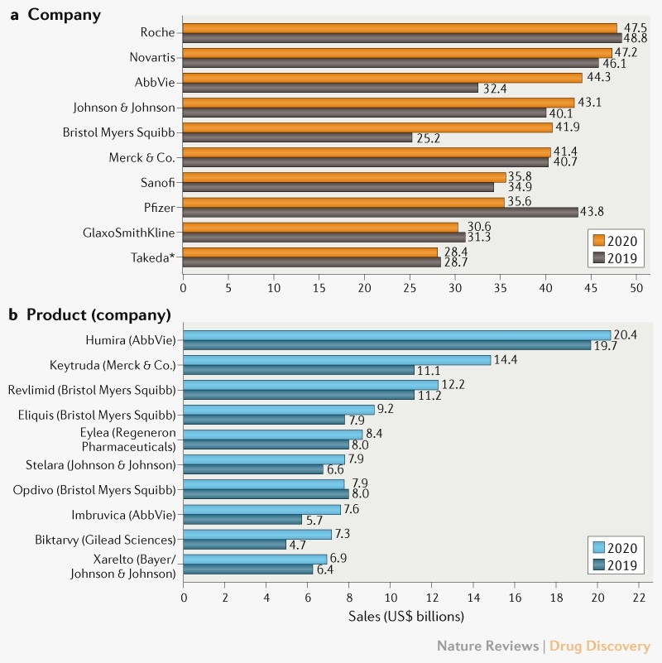
The most transformative drugs of the past 25 years
Top ten drugs by sales globally in 2019 and 2020
adalimumab
pembrolizumab
lenalidomide
apixaban
aflibercept
ustekinumab
nivolumab
ibrutinib
bictegravir + emtricitabine + tenofovir
rivaroxaban
Kesselheim & Avorn. Nat Rev Drug Discov 2013
Urquhart L. Nat Rev Drug Discov 2021

Slide 3
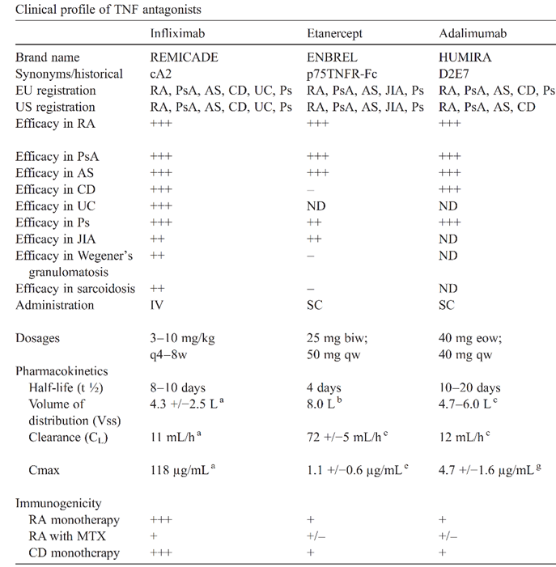
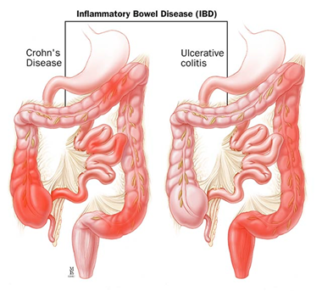
Clinical profile and pharmacokinetics of anti-TNF
anti-TNF agents are administered endovenously or subcutaneously
active to treat inflammatory bowel disease
half-life is long (for antibodies ~ 14 weeks)
Crohn’s disease (CD)
Ulcerative colitis (UC)
Tracey D. et al. Pharmacol Ther 2008; 117:244-79

Slide 4
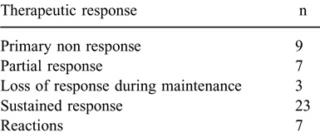
Interindividual variability in response to anti-TNF in pediatric patients with IBD
Infliximab
Adalimumab
(52 weeks of therapy)
18%
14%
6%
47%
14%
Total
49
Primary non response 16/32 50%
Sustained response 8/32 25%
Reactions 0
Naviglio S. et al. J Pediatr Gastroenterol Nutr 2019; 68:37-44
Lucafò & Curci et al. Front Pediatr. 2021; 9:646671

Slide 5
Pharmacological determinants of response to anti-TNF
PHARMACO GENETIC
PHARMACO
KINETIC
Clinical response
PHARMACO
DYNAMIC
Pharmacokinetic
Concentrations of anti-TNF and antibodies to anti-TNF
Pharmacodynamic
Concentration of TNF on immune cells membrane
Pharmacogenetic
Variants in relevant genes

Slide 6
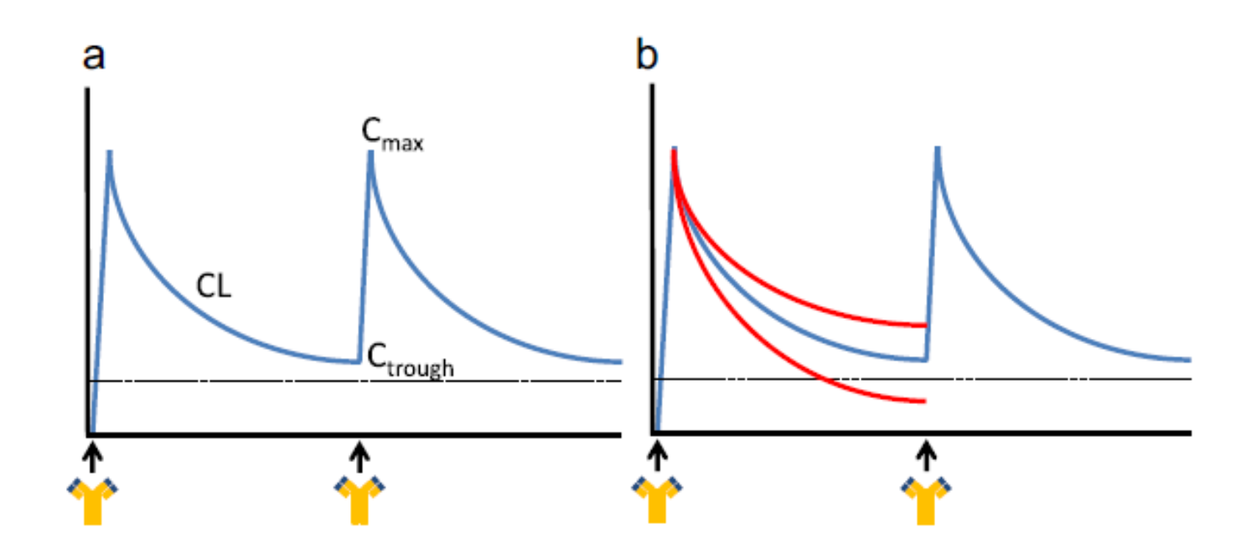
Concentration of anti-TNF agents in pediatric patients with inflammatory bowel disease is associated with therapeutic efficacy
Oude Munnink TH et al. Clin Pharmacol Ther. 2016; 99:419-31

Slide 7
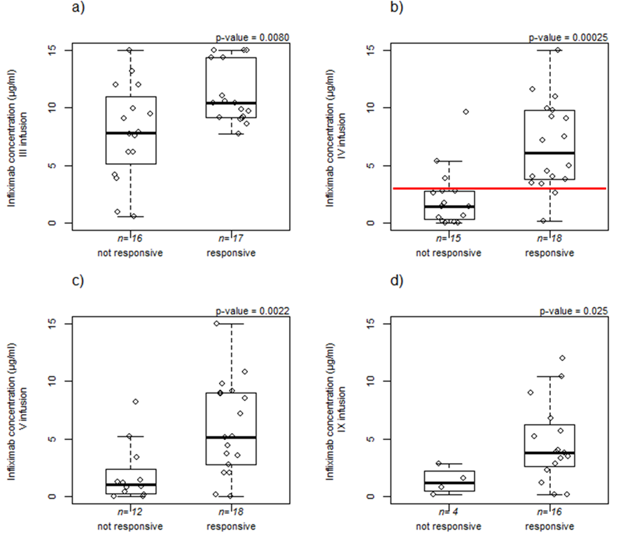
Infliximab concentration at the end of induction predicts efficacy at one year of therapy
response defined as disease activity index < 10
Optimal cut-off = 3.11 µg/ml
Naviglio S. et al. J Pediatr Gastroenterol Nutr 2019; 68:37-44

Slide 8
Adalimumab concentration and efficacy of therapy in pediatric IBD
p-value
p-value
p-value
p-value
13.85 µg/ml
13.85 µg/ml
p-values from linear mixed-effect models
https://www.frontiersin.org/articles/10.3389/fped.2021.646671/full

Slide 9
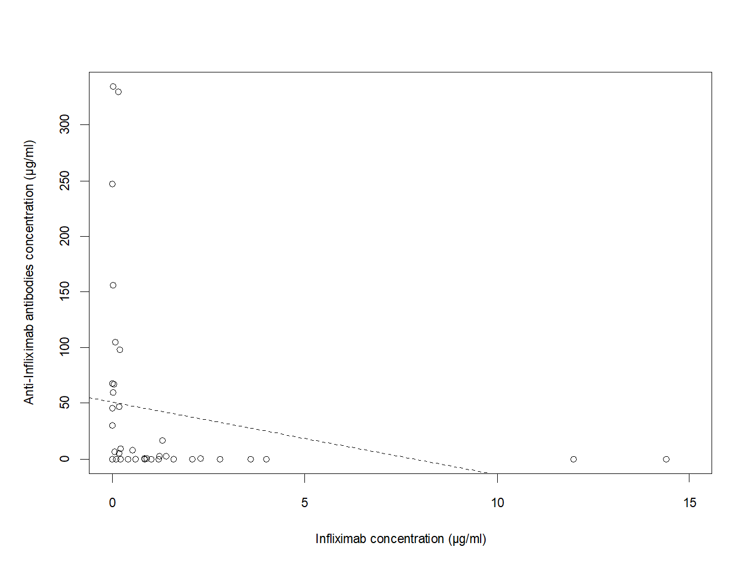
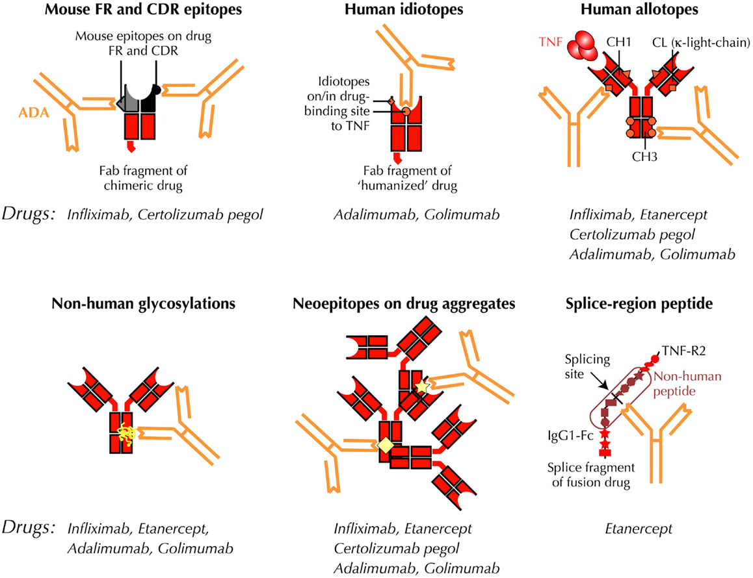
Immunogenicity of anti-TNF biological agents
Bendtzen K. Front Immunol. 2015; 6:109
Naviglio S. et al. J Pediatr Gastroenterol Nutr 2019; 68:37-44

Slide 10
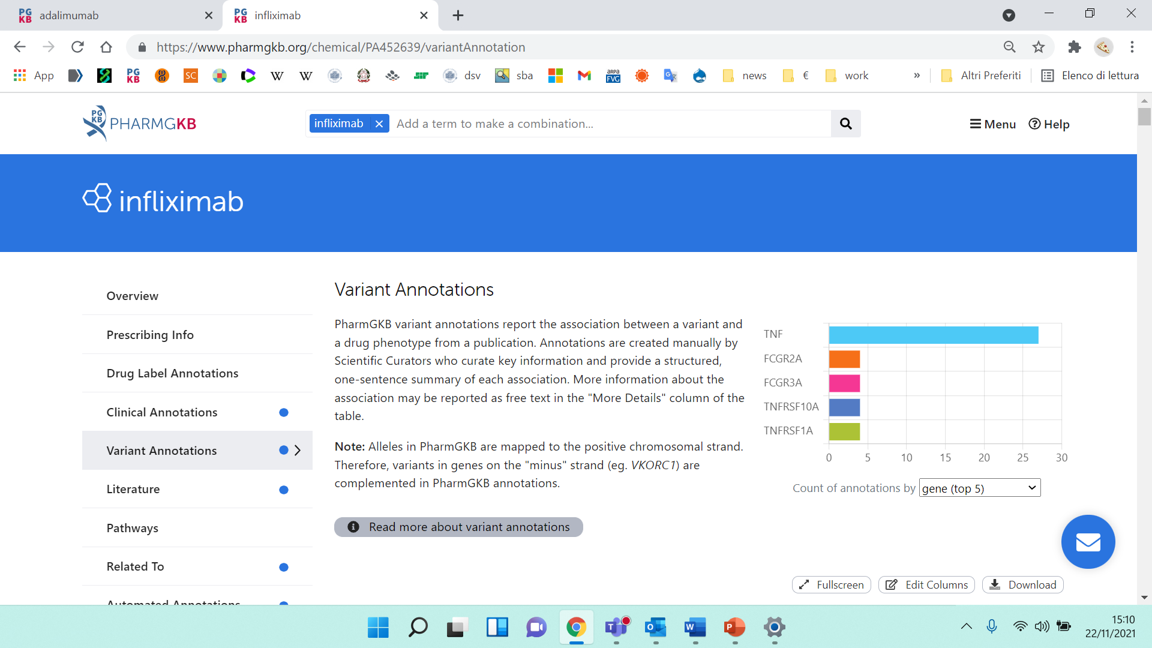
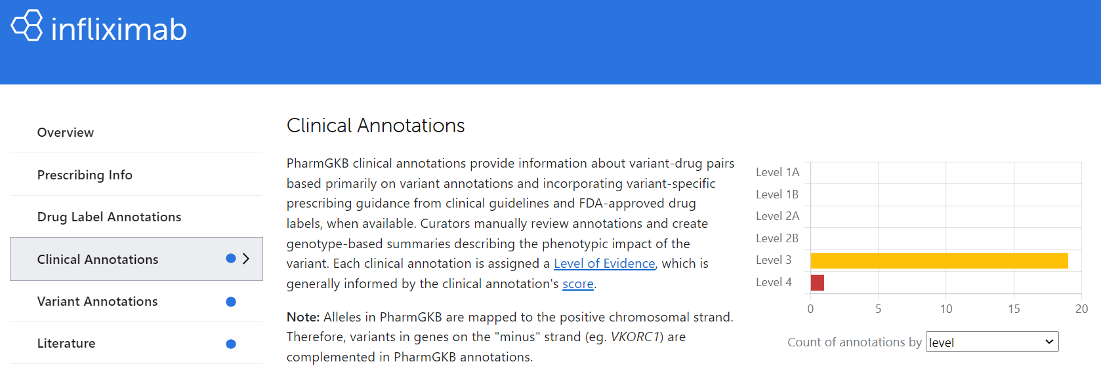
https://www.pharmgkb.org/chemical/PA452639/variantAnnotation
https://www.pharmgkb.org/chemical/PA452639/clinicalAnnotation

Slide 11
Pharmacogenetics variants involved in anti-TNFa response and toxicity in inflammaroty bowel disease patients
Candidate genes involved in immune processes, inflammation, autophagy and apoptosis
Lucafò et al. Expert Opin Drug Metab Toxicol 2018; 14:1209-1223

Slide 12
Objectives of the study
To evaluate in pediatric patients with IBD the association of variants:
FCGR3A rs396991 (559 A>C)
TNFα rs1800629 (-308 G>A)
with
infliximab response
infliximab concentrations
production of anti-drug antibodies

Slide 13
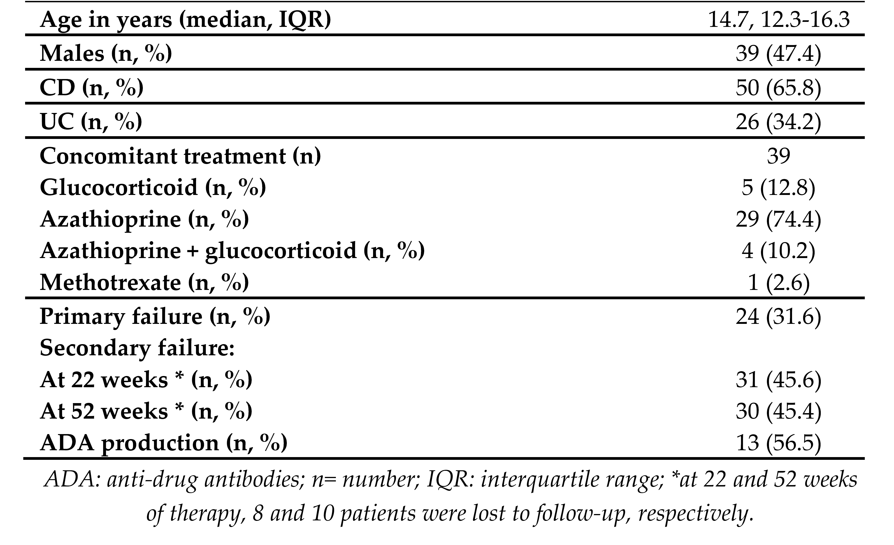
Results: demographic and clinical characteristics of the 76 patients enrolled

Slide 14
Results: genotyping

Slide 15
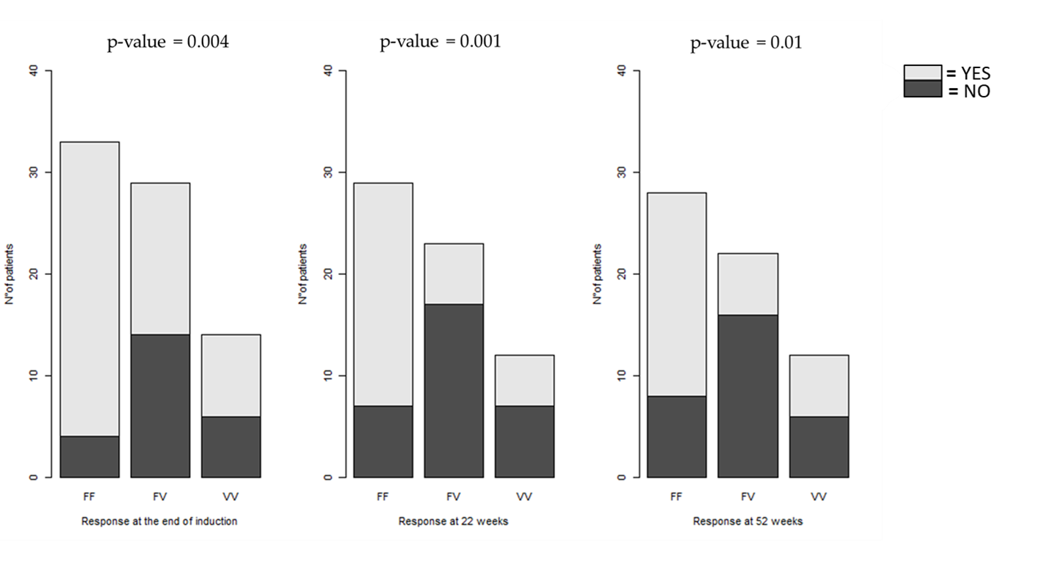
Results: association between the FCGR3A rs396991 variant and infiliximab response in pediatric IBD
rs396991 is a SNP in the FCGR3A gene encoding a receptor for the Fc fragment of IgG. The variant (V) isoform is considered high-binding to IgG1 and IgG3, while the (F) isoform is considered low-binding
https://ascpt.onlinelibrary.wiley.com/doi/10.1111/cts.13075

Slide 16
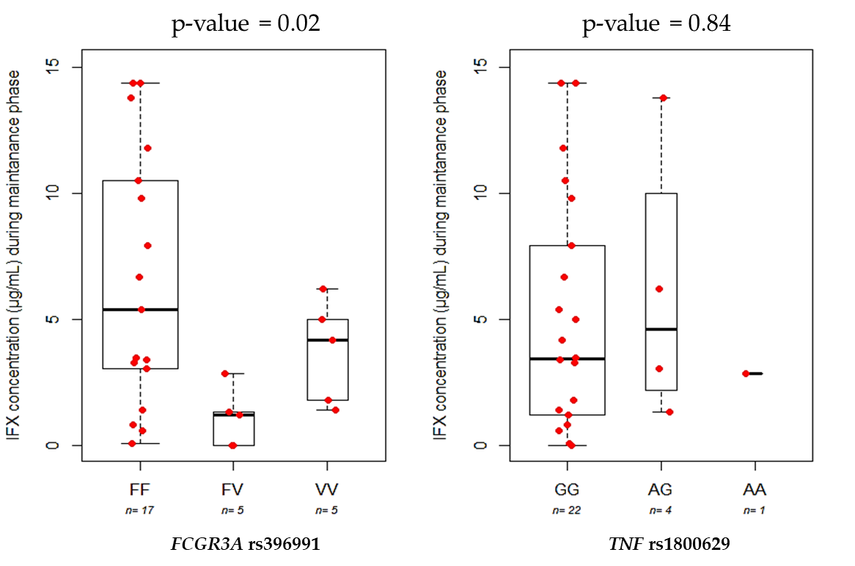
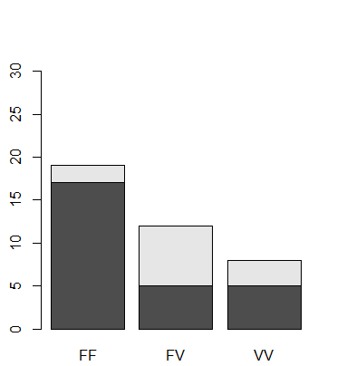
Results: FCGR3A and infliximab concentrations and anti-drug antibodies production
p-value = 0.01
= YES
= NO
ADA PRODUCTION
N° of patients
Figure: Boxplot comparing serum IFX concentration and FCGR3A SNP genotypes.
Figure: Association between FCGR3A SNP and ADA productions
https://ascpt.onlinelibrary.wiley.com/doi/10.1111/cts.13075

Slide 17
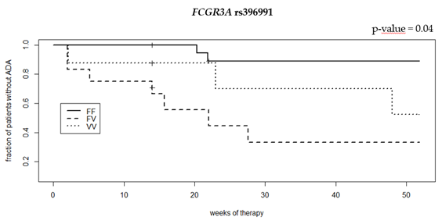
Survival curves of infliximab anti‐drug antibody (ADA) production according to FCGR3A variant
Cox proportional hazard model
https://ascpt.onlinelibrary.wiley.com/doi/10.1111/cts.13075

Slide 18
Conclusion
first study about the role of FCGR3A SNP rs396991 in pediatric IBD patients
this variants affects infliximab response and influence anti-infliximab antibodies production
validation in a larger cohort is required
future pre-treatment genetic testing in gene involved in ADA production such as FCGR3A could be suggested in order to achieve a personalized therapy in pediatric IBD patients

Slide 19
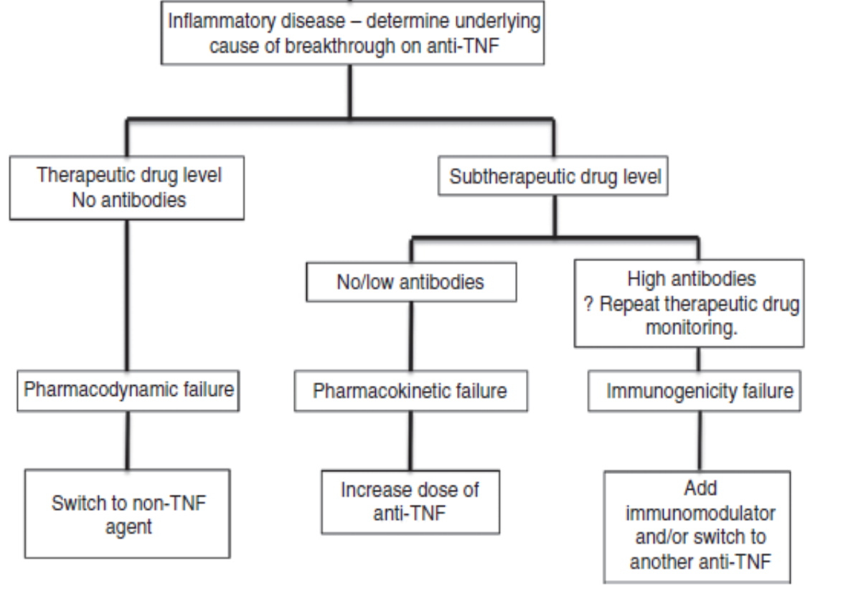
Reactive adjustment of anti-TNF to improve outcomes of therapy
Ding et al., Alimentary Pharmacology & Therapeutics 2016

Slide 20
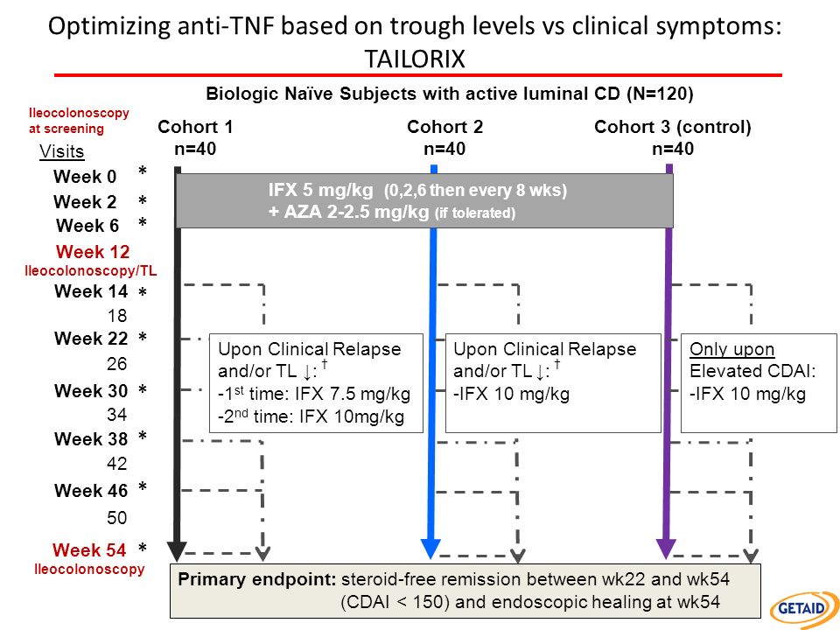
D’Haens G. et al., Gatroenterology 2018; 154: 1343

Slide 21
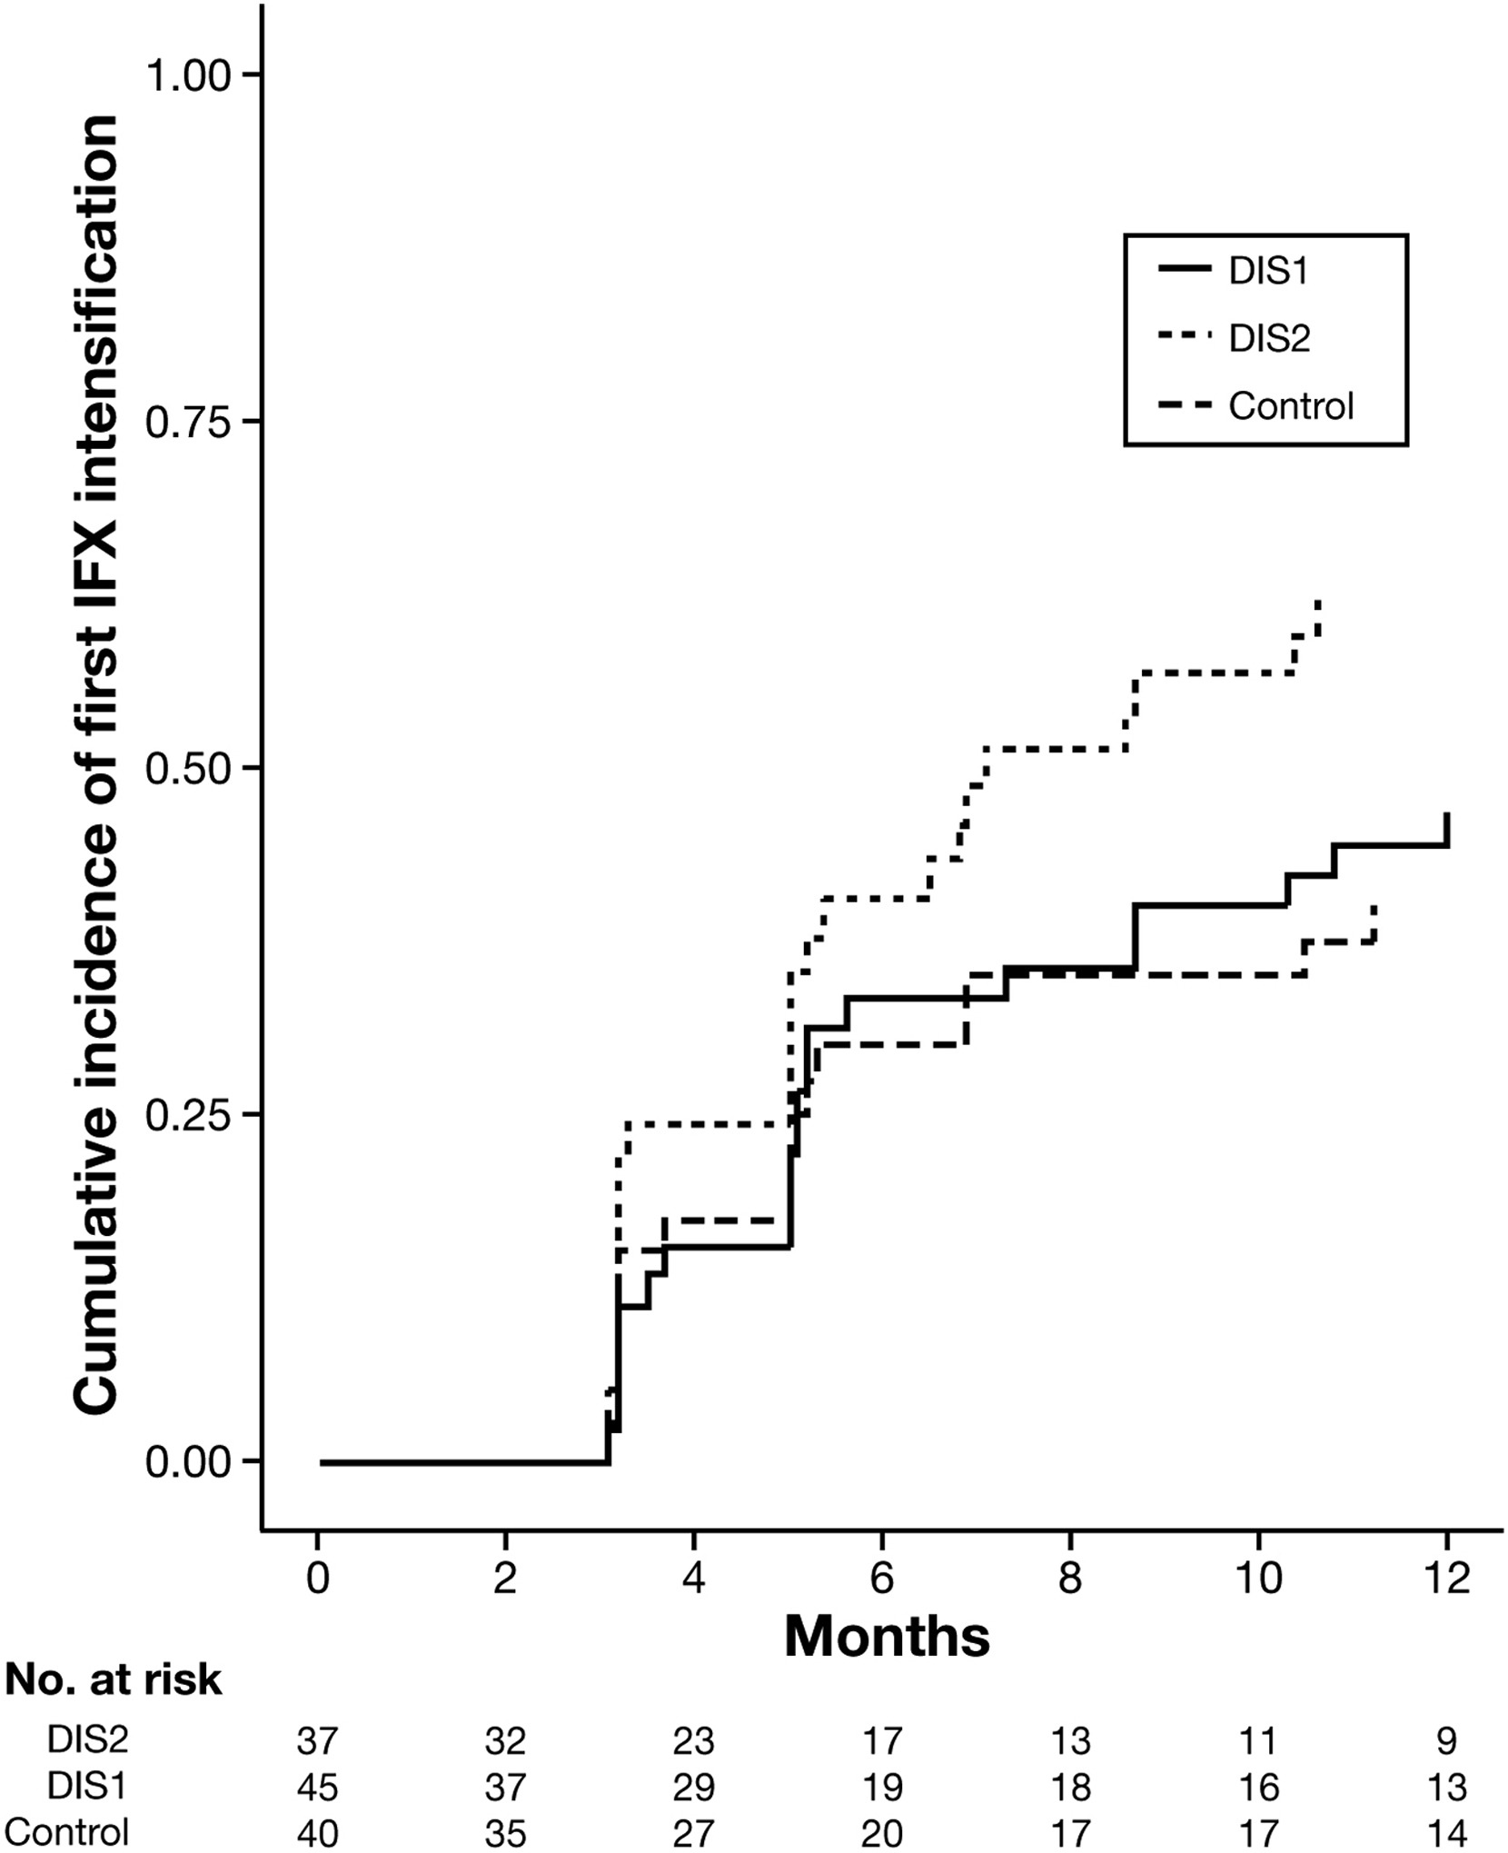
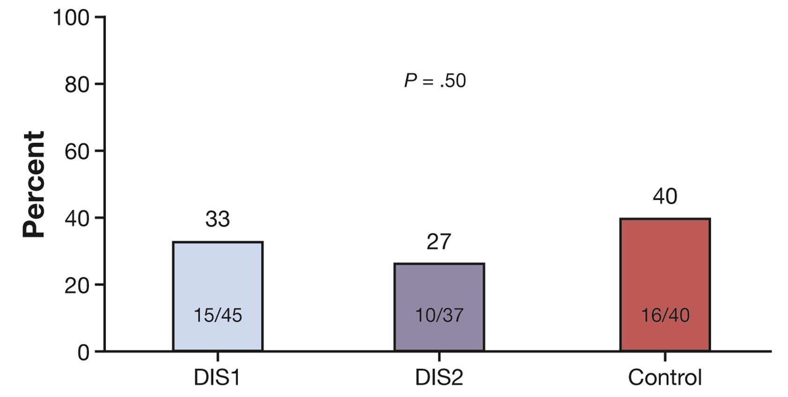
Proactive infliximab monitoring: TAILORIX study
Steroid free remission
Delay of two months between measurement of anti-TNF concentration and change in dosage
In experimental arms the change of anti-TNF dosage was dependent also on clinical variables
After induction is it for infliximab too late modifying anti-TNF dose to benefit patients?
D’Haens G. et al., Gastroenterology 2018; 154: 1343

Slide 22
Monitoraggio pro-attivo dell’infliximab: trial prospettico TAXIT
Vande Casteele et al., Gastroenterology 2015

Slide 23
Dosaggio infliximab guidato dalla farmacocinetica: trial prospettico TAXIT
Remissione a 1 anno di terapia non è migliorata
Vande Casteele et al., Gastroenterology 2015

Slide 24
Aggiustamento dosaggio ed attività di malattia
Vantaggio economico
Vande Casteele et al., Gastroenterology 2015

Slide 25
Proactive therapeutic drug monitoring protocol:
week 10 infliximab concentration
- < 20 ug/ml = dose and frequency adjustment
- >20 and < 25 ug/ml = only frequency or no adjustment
- > 25 ug/ml = no adjustment
Lega et al., Inflammatory Bowel Disease 2018

Slide 26
Proactive therapeutic drug monitoring (pTDM) is better than Standard of care monotherapy (Mono SOC) but similar to Combo therapy (Combo SOC)
Mono pTDM
Combo SOC
Mono SOC
Lega et al., Inflammatory Bowel Disease 2018

Slide 27
Combo therapy (Combo SOC) is the better approach to prevent antibody anti-infliximab (ATI) production?
Combo SOC
Proactive TDM
Mono SOC
Lega et al., Inflammatory Bowel Disease 2018

Slide 28
Conclusioni: anti-TNF
concentrazioni anti-TNF fortemente associate con la risposta alla terapia
esistono saggi rapidi che permettono nel giro di poche ore e su singoli pazienti di ottenere la concentrazione di farmaco
rimane da chiarire la strategia migliore per utilizzare i dosaggi in meniera proattiva

Slide 29
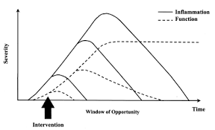
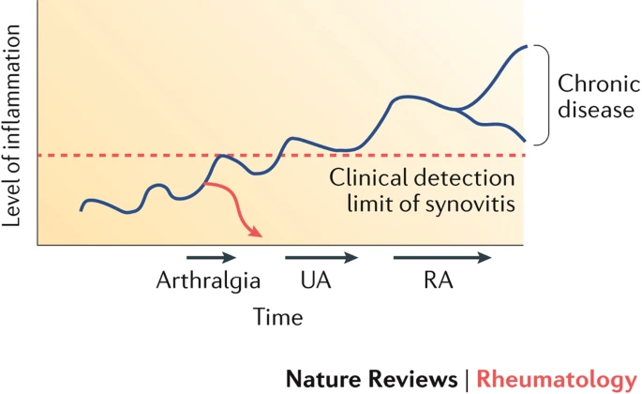
Farmacoterapia patologie immunomediate croniche (artrite reumatoide, malattie infiammatorie croniche intestinali)
https://www.nature.com/articles/nrrheum.2017.185

Slide 30
Strategie di trattamento per le malattie infiammatorie croniche intestinali pediatriche
grave
azatioprina
+ anti-TNF
azatioprina
+ anti-TNF
azatioprina
+ anti-TNF
malattia
glucocorticoidi
+ azatioprina
glucocorticoidi
+ azatioprina
moderata
glucocorticoidi
Terapia « accellerata »
Early
top-down
Terapia convenzionale
Ordas I et al., Gut 2012

Slide 31


Slide 32
COME STA CAMBIANDO L’APPROCCIO TERAPEUTICO?
  FANS nel 90% dei pazienti
  Steroidi per os nel 69% dei pazienti
  Infiltrazioni locali di steroidi nel 66% dei pazienti
  4. Metotrexato nel 56% dei pazienti
  5. Farmaci biologici nel 34% dei pazienti
Biologici
Farmaci
Sperimentali,
Citotossici, Biologici
Methotrexate,
Azatioprina
(1 anno)
Antimalarici, Sali d’oro,
Sulfasalazina
Corticosteroidi
(mesi)
Terapia Fisica, Salicilati, altri FANS
(mesi)
Methotrexate,
3 mesi
Steroidi: “bridge therapy”
solo in caso di urgenza e per tempi brevi (1mese)
FANS,
1 mese MASSIMO

