Slide 1
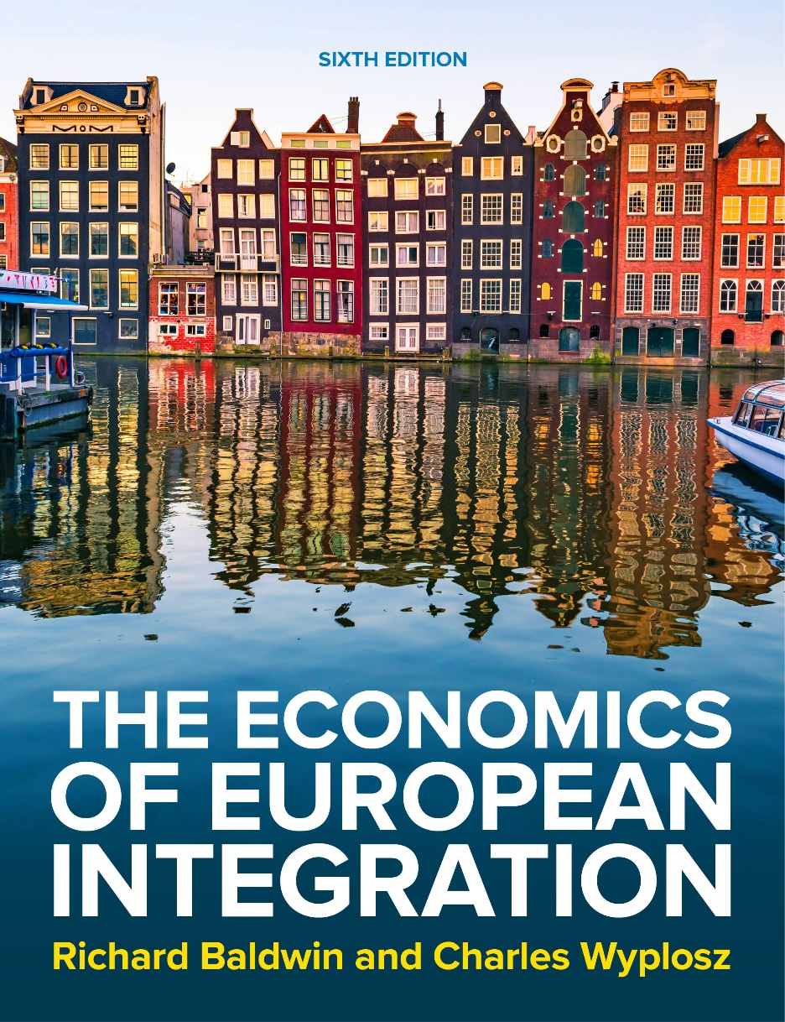
Chapter 17
Fiscal policy and the Stability Pact
The Economics of European Integration, Sixth Edition

Slide 2
Fiscal policy in the monetary union
In a monetary union, fiscal policy means:
the only remaining macroeconomic instrument at national level;
government borrows in slowdown and pays back its debt in an upswing;
government acts as substitute to inter-country transfers in case of asymmetric shock (see discussion of OCA criteria).
Problems of fiscal policy:
effectiveness of fiscal policy depends on private expectations;
slow implementation;
undisciplined fiscal policy results in high public debt which in turn may destabilize economies and triggers contagion effects.

Slide 3
Fiscal policy in the monetary union
Crucial distinction:
Automatic stabilizers—fiscal policy is spontaneously countercyclical:
tax receipts decline when the economy slows down;
welfare spending rises when the economy slows down;
no decision, so no lag—nicely countercyclical;
Figure 17.1 shows the proportion of income loss that is compensated by various redistributive mechanisms when total incomes decline by 5 per cent.

Slide 4
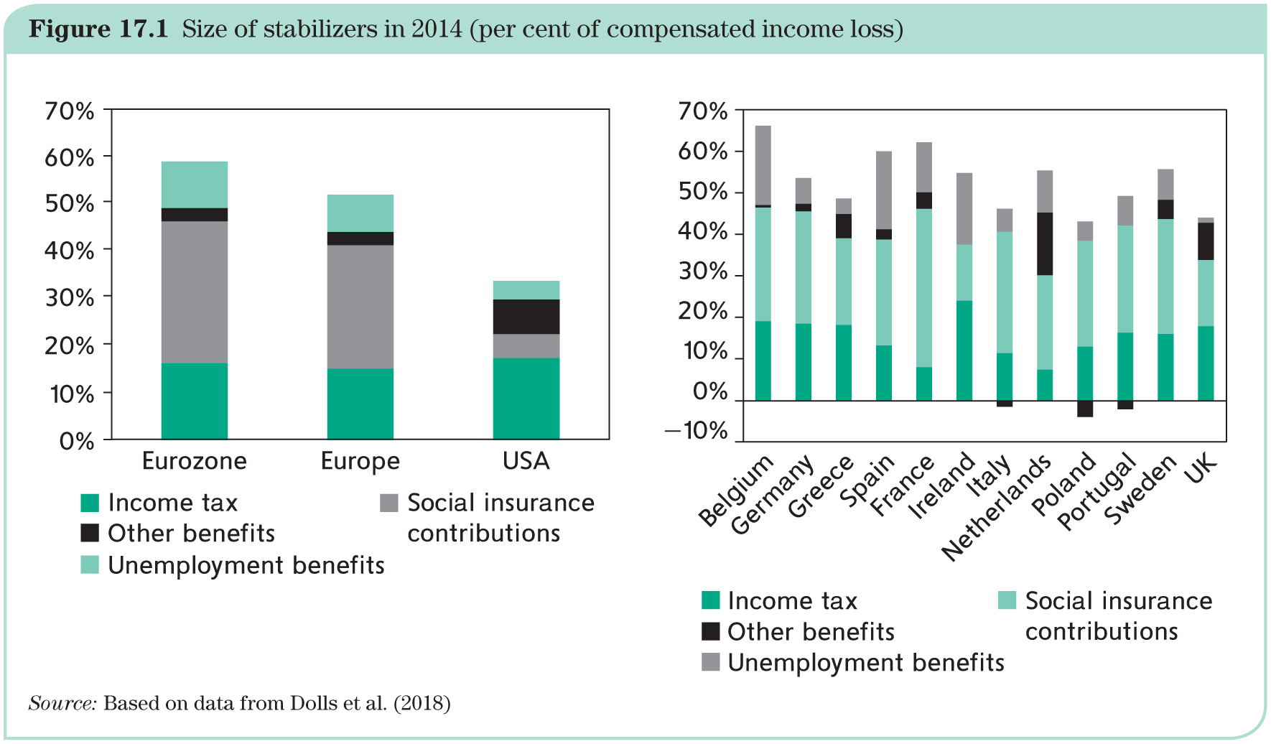
Fiscal policy in the monetary union

Slide 5
Fiscal policy in the monetary union
Crucial distinction (cont’d):
Discretionary fiscal policy—a voluntary decision to change tax rates or spending:
Because of automatic stabilizers, budget figures do not reveal what governments do with fiscal policy;
Indeed, the budget can change for two reasons, 1) explicit actions, i.e. discretionary fiscal policy, 2) economic expansions and automatic stabilizers
Cyclically adjusted budget shows what the balance would be if the output gap is zero in a given year;
Difference between actual and cyclically adjusted budget = footprint of automatic stabilizers;

Slide 6
Fiscal policy externalities
Should fiscal policy be subjected to some form of coordination?
Yes, if national fiscal policies are a source of externalities.
Potential spillover channels:
trade,
inflation,
borrowing costs,
financial distress.
When the externalities/spillovers are significant, fiscal policy coordination helps.
But in practice, fiscal coordination is quite difficult, because fiscal policy is highly political in every country.

Slide 7
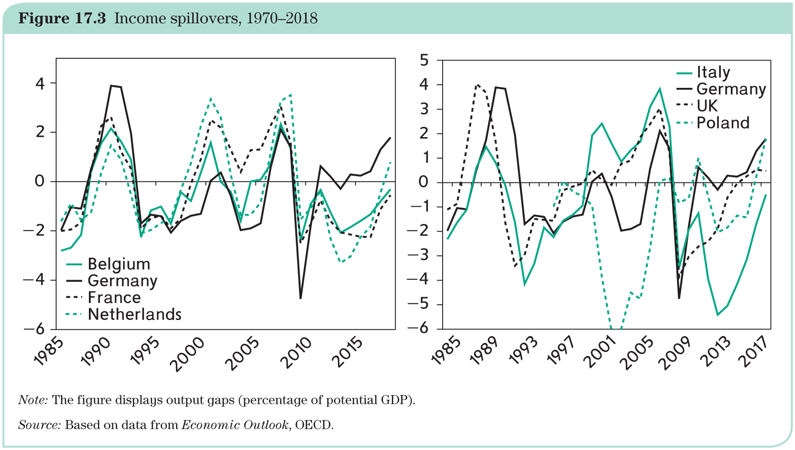
Fiscal policy externalities
Cyclical income (business cycle) spillovers via export and import are strengthened by monetary union through increased trade.

Slide 8
Fiscal policy externalities
The founding fathers of the euro identified four spillovers:
Concerns regarding the tendency of financially hard-pressed governments to call upon the central bank to finance their deficits: debt monetization would undermine ECB’s independence;
Heavy public borrowing by one member country is a sign of fiscal indiscipline that could trouble the international financial markets. If markets believe that one country’s public debt is unsustainable, they could view the whole Eurozone with suspicion;
A government that accumulates a debt that it can no longer service must eventually default: the immediate reaction is a massive capital outflow, a collapse of the exchange rate and stock markets. In the EMU this would happen union-wide;
The mere threat of one member country’s default would so concern all other member governments that they would feel obliged to bail out the nearly bankrupt government. → Thus, Maastricht Treaty, which included a ‘no-bailout’ clause (Article 125).

Slide 9
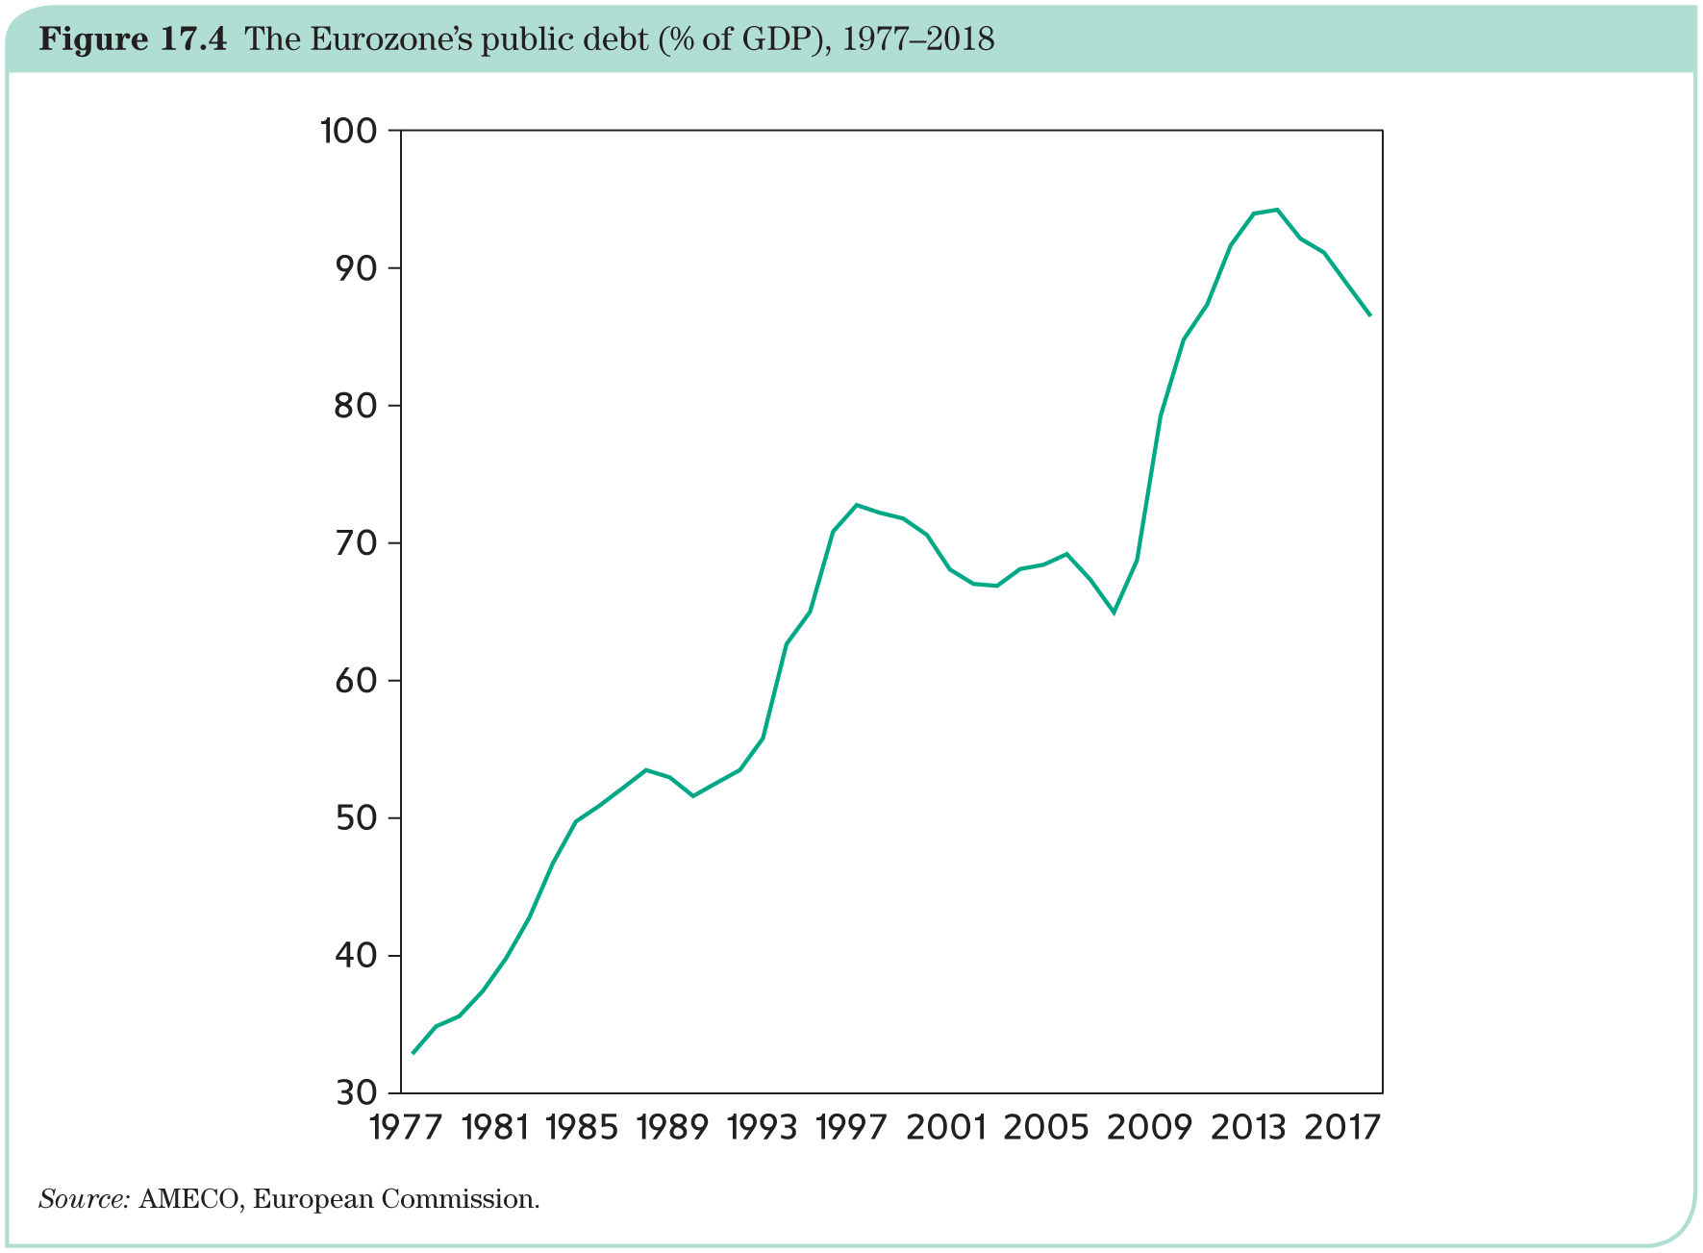
Fiscal policy externalities

Slide 10
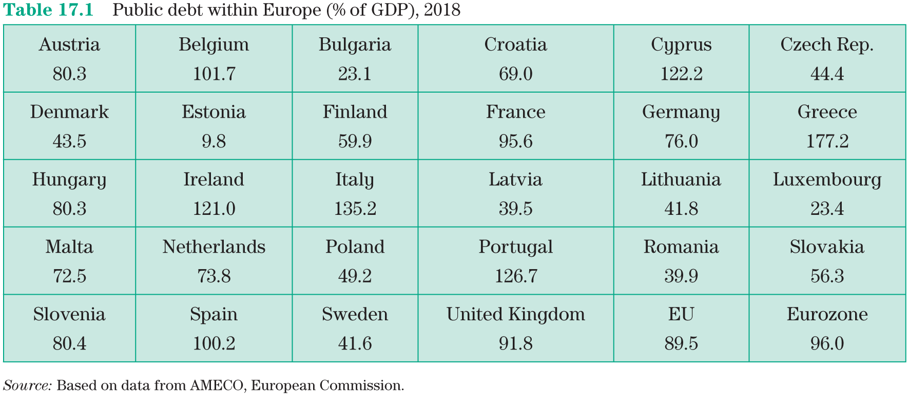
Fiscal policy externalities

Slide 11
Fiscal policy externalities
Deficit bias—build-up of debt reflects failure of democratic control over governments:
Deficits allow governments to deliver goods and services today, but without facing the costs, in effect passing the burden to future governments or even to future generations;
Tempting to do so, especially when elections are near.
Some governments find it appealing to seek external restraint and to invoke ‘Brussels’ as a scapegoat:
Can be blamed when resisting interest groups and political friends;
collective discipline can be used as a substitute for adequate domestic institutions.

Slide 12
Principles
The theory of fiscal federalism deals with the following question: At which level of government (regional, national, supranational) should policies be conducted?
Two arguments for sharing responsibilities:
externalities/spillovers (because inefficient outcomes may emerge when each country is free to act as it wishes)
increasing returns to scale (e.g. some policies are more efficient when carried out on a large scale, such as the army)
Two arguments for retaining sovereignty:
heterogeneity of preferences (e.g. laws concerning family life);
information asymmetries (e.g. where to build roads).
Additional problem: Governments may not act in the best interest of their citizens.
Theory of fiscal federalism does not provide a general answer: Case-by-case approach and often we face trade-offs with no compelling answer.

Slide 13
Principles
Four arguments for and against centralization at the EU level are unlikely to lead to clear-cut conclusions.
Where should the burden of proof lie? The EU has taken the view that the burden of proof lies with those who argue in favour of sharing sovereign tasks:
→ principle of subsidiarity (laid down in Article 5 of the Treaty)
‘In areas which do not fall within its exclusive competence, the Community shall take action, in accordance with the principle of subsidiarity, only if and insofar as the objectives of the proposed action cannot be sufficiently achieved by the Member States and can therefore, by reason of the scale or effects of the proposed action, be better achieved by the Community.’
In other words: Unless there is a strong case of increasing returns to scale or of externality, the presumption is that decisions remain at the national level.

Slide 14
Principles
Implications for fiscal policy:
Microeconomic versus macroeconomic aspects:
Microeconomic = structural component (e.g., income redistribution);
Macroeconomic = stabilization component of fiscal policy (e.g. counter-cyclical instrument)
The case for collective restraint:
serious spillovers;
lag of fiscal discipline in member countries.
The case against collective restraint:
important heterogeneities (e.g. a common fiscal policy would leave each country with counter-cyclical macroeconomic tool);
information asymmetries (e.g. politicians may find hard to understand one another electoral plight, especially across nations)
Overall, it is far from clear that the macroeconomic component of fiscal policy should be subject to common limits and debate is ongoing.

Slide 15
Principles
What does it all mean for fiscal policy in the Eurozone?
In true federal states, there is a powerful federal level of government. In the Eurozone, instead, the Commission budget is far too small to play any macroeconomic role.
The case for policy coordination is convincing. A step has been taken in 2011: ‘European semester’.
In January of each year, the Commission presents its Annual Growth Survey, including forecasts and evaluation of member countries’ economic situation.
This triggers discussions among governments and in the European Parliament.
Following recommendations by the Council, every government submits to the Commission their Stability and Convergence Programmes.
The Commission then assesses the national programmes and submits its conclusions and recommendations in time for the June Council.

Slide 16
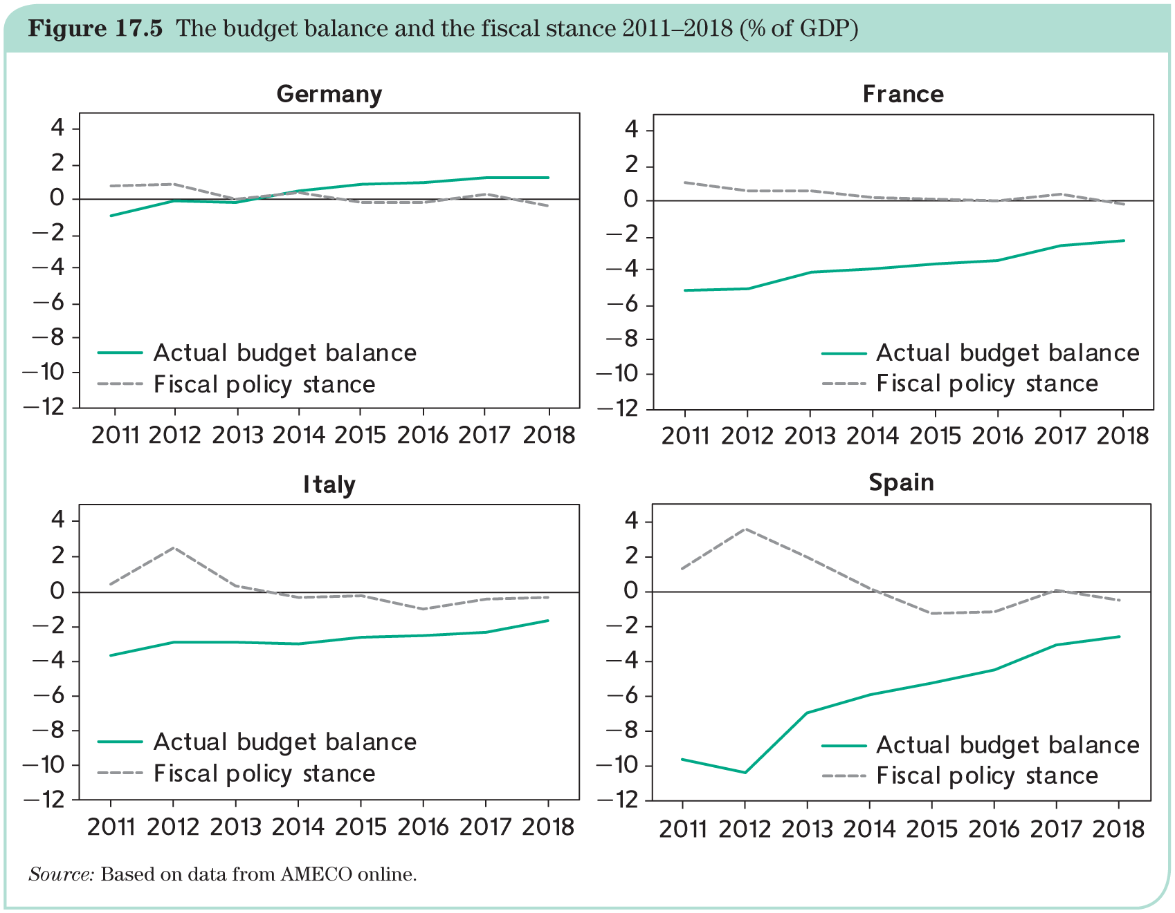
Fiscal coordination in the Eurozone

Slide 17
The Stability and Growth Pact (SGP)
Adopted in 1997, the SGP was meant to avoid excessive deficits, with fines for countries not respecting it. SGP was reformulated in 2005 to avoid its rigidity. It applies to all EU countries.
Another reengineering took place due to the financial crisis:
Six Pack (https://eur-lex.europa.eu/legal-content/EN/TXT/?uri=LEGISSUM:ec0021)
Two Pack (https://ec.europa.eu/commission/presscorner/detail/it/MEMO_13_457);
Treaty on Stability, Coordination, and Governance (TSCG) also known ‘Fiscal Compact’;
strengthen the hand of the Commission.
The SGP consists of five elements. They apply to all EU member countries but only the Eurozone countries are subject to the corrective arm.
1. Definition of what constitutes an ‘excessive deficit’;
2. Preventive arm, designed to encourage governments to avoid excessive deficits;
3. Corrective arm, which prescribes how governments should react to a breach of the deficit limit;
4. Procedures designed to embed member country’s budget process within a European framework;
5. Sanctions.

Slide 18
The Stability and Growth Pact (SGP)
The SGP consists of five elements. They apply to all EU member countries but only the Eurozone countries are subject to the corrective arm.
1. Definition of what constitutes an ‘excessive deficit’;
2. Preventive arm, designed to encourage governments to avoid excessive deficits;
3. Corrective arm, which prescribes how governments should react to a breach of the deficit limit;
4. Procedures designed to embed member country’s budget process within a European framework;
5. Sanctions.

Slide 19
The Stability and Growth Pact (SGP)
‘excessive deficits and debts’
The Stability and Growth Pact considers that deficits are excessive when they are above 3 per cent of GDP;
When an adverse asymmetric shock occurs, the limit can be breached;
The SGP takes into account the structural budget balance, defined as the cyclically adjusted balance net of exceptional spending or revenues;
The SGP requires that the structural budget always be ‘in balance’ or surplus, meaning that the deficit does not exceed 0.5 per cent of GDP;
The public debt is excessive when it exceeds 60 per cent of GDP.

Slide 20
The Stability and Growth Pact (SGP)
‘preventive arm
Many governments exhibit a deficit bias because of domestic pressure and political expediency;
The idea is that the SGP can exert some counter-pressure in the form of peer pressure, called mutual surveillance;
The preventive arm is designed to submit finance ministers to a collective discussion of one another’s fiscal policy in the hope that doing so will help constrain the deficit bias and support budgetary discipline;
The preventive arm is also meant to circumvent using the politically sensitive corrective arm;
Each country must specify its Medium Term Objective (MTO), the budget balance that it commits to achieving within a three-year period. The MTO must be compatible with ‘minimum benchmarks’ established by the European Commission.
If the country adopts a budget that is not in conformity with the requirements put forward by the Council, it triggers the procedure summarized in the next slide. The ultimate sanction is a fine of 0.2% of the country’s GDP.

Slide 21
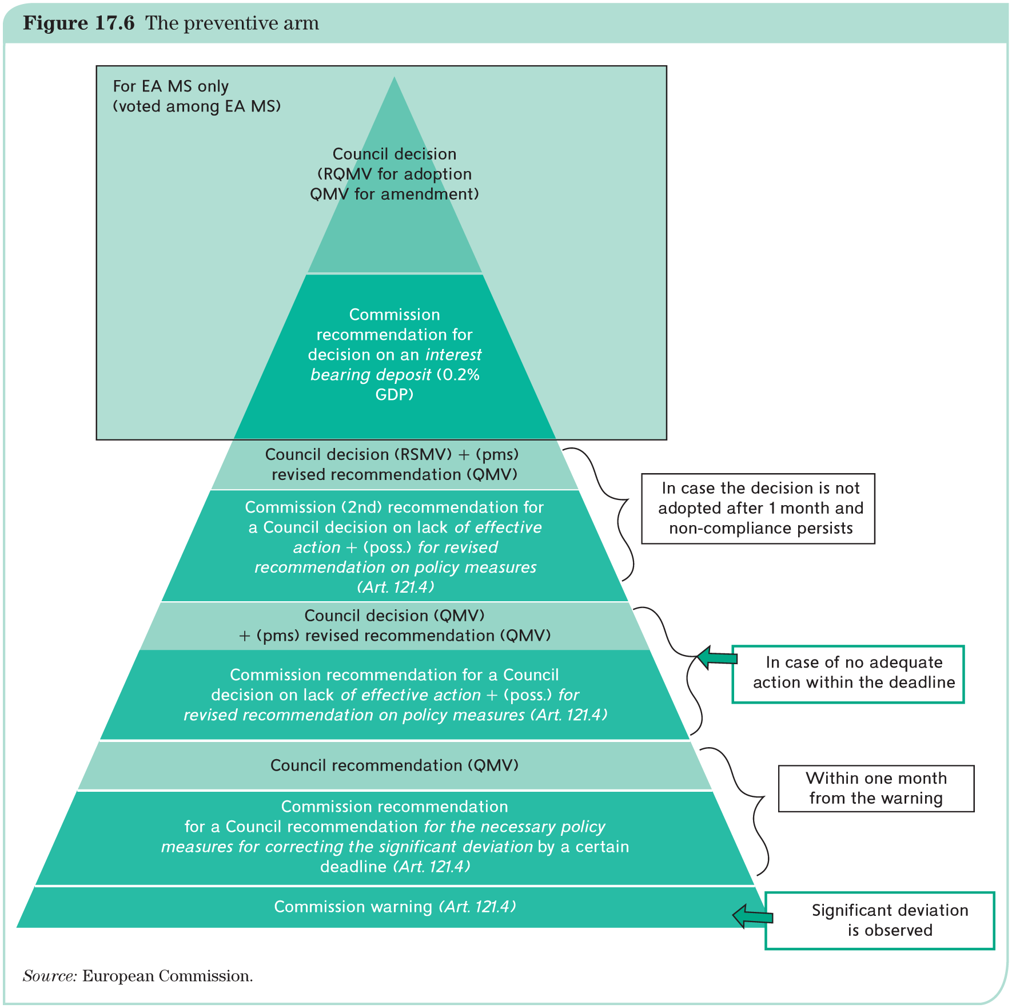
The preventive arm

Slide 22
The Stability and Growth Pact (SGP)
‘corrective arm’
When a country does not meet the requirements of the SGP–the 3 per cent deficit and 60 per cent debt limits–it is declared in excessive deficit by the Council;
The decision is made through qualified majority voting (QMV) upon a recommendation from the Commission;
Given that most Eurozone countries have debts vastly in excess of 60 per cent, the Excessive Debt Procedure (EDP) applies only if a country above the threshold has not reduced its debt by at least 0.5 per cent of GDP on average over the previous three years;
The Council adopts recommendations that are increasingly detailed and urgent when the recommended course of action is not followed. After several failures to comply, a sanction procedure is triggered.

Slide 23
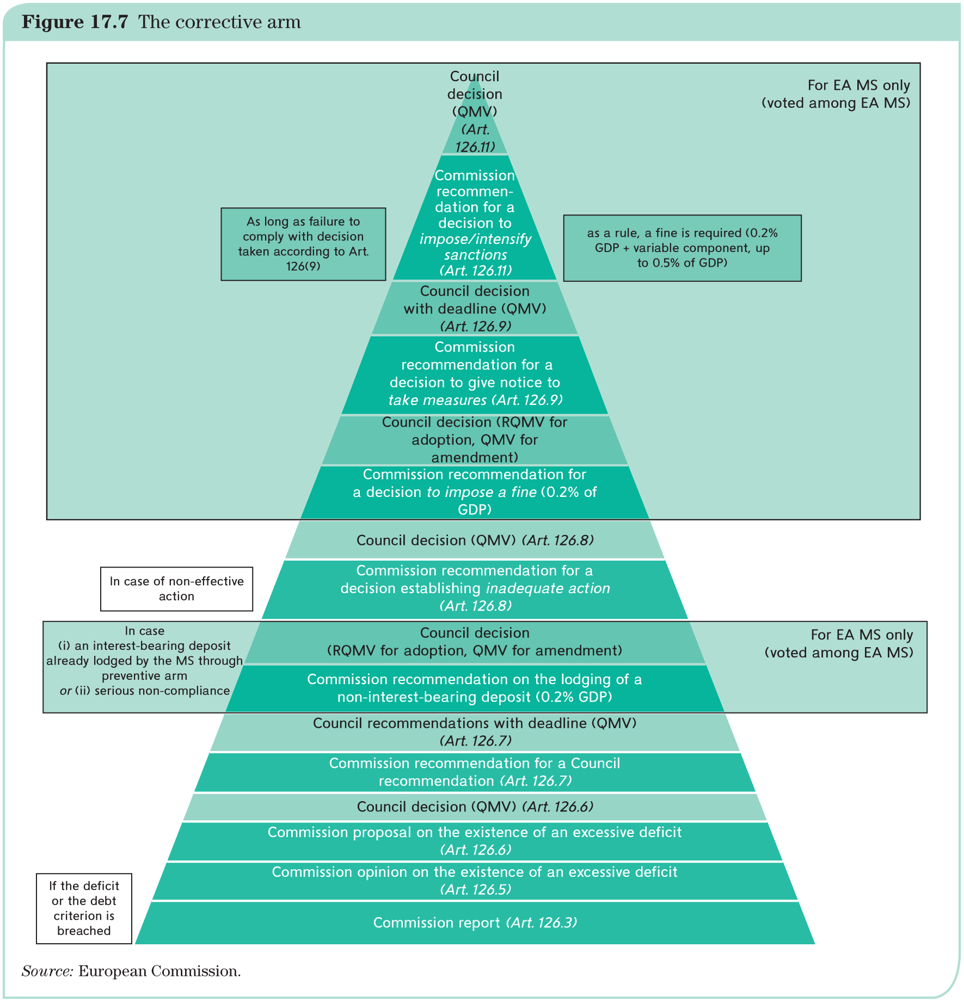
The corrective arm

Slide 24
The Stability and Growth Pact (SGP)
‘sanctions’
Following a next-to-final warning adopted by reversed qualified majority voting (RQMV), the Council imposes a sanction by QMV;
The sanction is a deposit worth 0.2 per cent of the delinquent country’s GDP;
Further non-compliance may result in additional fines up to a maximum of 0.5 per cent of GDP.

Slide 25
The Stability and Growth Pact (SGP)
European Semester
The European semester begins in January with the publication of the SGP’s forecasts for the years to come;
In early spring, each national government submits its Stability and Convergence Programme, including ‘medium-term budgetary strategies’—essentially a statement of intentions covering the next three years;
The Commission assesses these programmes and determines whether they are realistic and compatible with the Medium Term Objectives;
If they are not, the government is asked to adjust its intentions.

Slide 26
The Stability and Growth Pact (SGP)
Appraisal
Excessive Debt Procedure (EDP) does not remove fiscal policy sovereignty. Governments are in full control and agree to bear the consequences of their actions. The procedure involves recommendations, not orders by the Council;
EDP’s intent is clearly pre-emptive. The preventive arm is designed to avoid reaching the stage of corrective action;
EDP applies to all EU countries but fines can be imposed only on Eurozone member countries;
Only two countries (Estonia and Sweden) have never been declared in deficit;
No sanction has ever been imposed.

Slide 27
The Treaty of Stability, Coordination and Governance (Fiscal Compact)
Most of the elements of the Treaty on Stability, Coordination and Governance (TSCG), adopted in 2012, are already included in the SGP.
The intent is to further strengthen the SGP by making fiscal discipline a national obligation.
There is one novel element of TSCG that is of a different nature: it requires that every country adopts a budget rule enshrined in high-level legislation.
Budget rules need to be adopted by member countries—German-like debt brake:
Implemented since 2011, the German debt brake rule requires that the budgets of the federation and of the Länder be in balance.
This requirement is deemed satisfied if the federal structurally adjusted deficit does not exceed 0.35 per cent of GDP.
TSCG is not very precise. It recommends to adopt ‘in principle’ the German rule as a model and asks that it be written ‘in principle’ into each country’s constitution. Complexity and lower-level law make it possible to ignore the law.
Another prescription of the TSCG is that each country subjects budget laws to the scrutiny of a committee of independent experts (fiscal councils).

Slide 28
Why is the pact controversial?
The automatic response of budget balances to cyclical fluctuations, is a source of difficulty for the EDP;
Member countries are forced to conduct pro-cyclical fiscal policies in bad times, with a contractionary effect;
Another difficult issue is related to the phenomenon of an ageing population;
Federal states face the same issues as the European Union: Experience of Germany and USA.

Slide 29
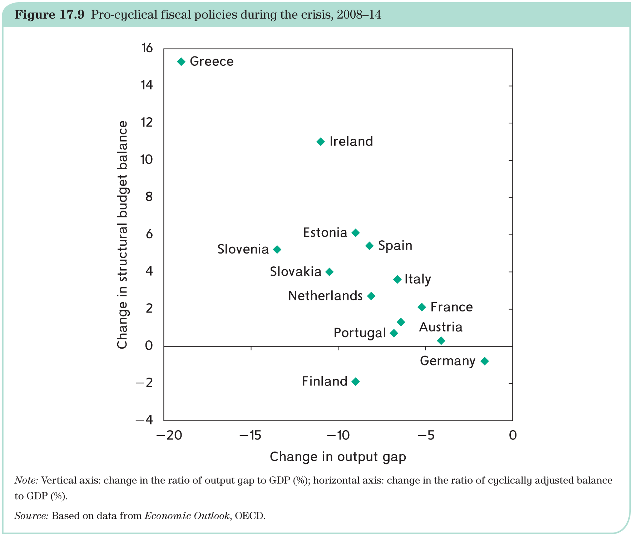
Pro-cyclicality of fiscal policies

Slide 30
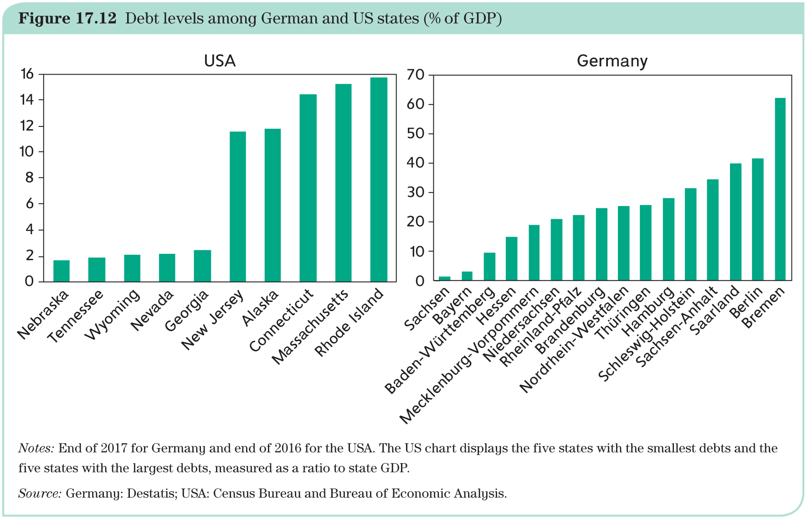
Why is the pact controversial?

Slide 31
The macroeconomic imbalance procedure
External balances of Eurozone countries have increasingly diverged since they adopted the euro.
In theory, such imbalances should be self-correcting but the Hume mechanism has not worked well.
Institutional arrangements and politics have stood in the way of wage and price adjustments made necessary by the absence of national exchange rates.
The response is the macroeconomic imbalance procedure (MIP) introduced in 2012 alongside the reform of the excessive deficit procedure.
MIP also has a preventive and a corrective arm, and it can lead to sanctions after graduated warnings.
MIP relies on a ‘scoreboard’, that is, a large number of indicators, including external balances, the evolution of labour costs, unemployment, financial conditions, and more.

