Slide 1
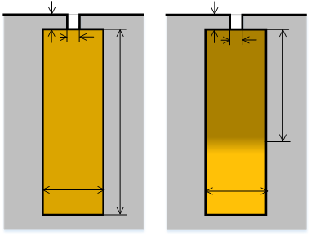

Inductance of a rotor bar embedded in a slot
Fig. 65a
Fig. 65b
We have mentioned [eq. (283), Fig. 62] that, in a solid conductor embedded in a slot, the current distribution is uniform if the frequency is close to zero (Fig. 65a). Conversely, as the frequency increases [i.e. ξ decreases in (283) and Fig. 62], the current tends to concentrate at the conductor side close to the slot opening.
In practice, it is as if the conductor reduced its height to h’_{r1}.
If we consider the formulas for the leakage inductance of a rotor bar (223), applying to the case of uniform current distribution, we can observe from equations (301) that the reduction in the equivalent height of the bar leads to a roughly proportional reduction in its leakage inductance.
(301)

Slide 2
More precisely, the leakage inductance of the embedded bar, taken eddy current effects into account (superscript «ac»), can be estimated as follows:
(302)
where
(301)
is the value (223) found in the hypothesis of uniform current distribution (dc current) and the coefficient k_{L} is the inductance coefficient. It is the counterpart of the resistance coefficient k_{r} previously introduced to correct dc resistance to account for eddy currents.
It can be proved that the coefficient k_{L} for a rectangular bar embedded in a slot has the following form:
(302)
where the non-dimensional coefficient ξ is obtained from (279) and (288) as follows:

Slide 3
(303)
For example, with the following data:
Fig. 66
the diagram in Fig. 67 is obtained for the inductance coefficient:
Fig. 67

Slide 4
For the same data, the diagram shown in Fig. 68 is found for the resistance coefficient as a function of the frequency.
Fig. 68

