Slide 1
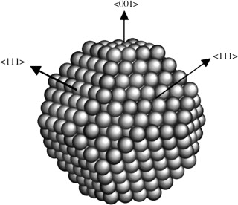
Surfaces
Represent the place in which the solid interacts with the environment.
Atoms on the surface have different chemical environment with respect to those in the bulk.
Vertex
Corner
Different coordination number
Facet
Number of superficial atoms
Metal dispersion =
Total number of atoms

Slide 2
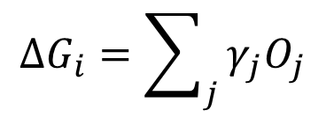
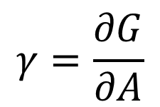
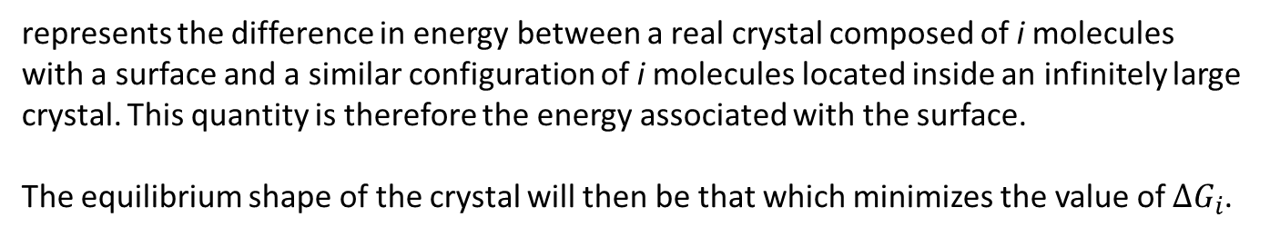
Surfaces
$$γ=\frac{∂G}{∂A}$$
Surface energy
quantifies the disruption of intermolecular bonds that occur when a surface is created.
$${ΔG}_{i}=\sum_{j}{γ_{j}O_{j}}$$
represents the difference in energy between a real crystal composed of i molecules with a surface and a similar configuration of i molecules located inside an infinitely large crystal. This quantity is therefore the energy associated with the surface.
The equilibrium shape of the crystal will then be that which minimizes the value of ${ΔG}_{i}$.

Slide 3
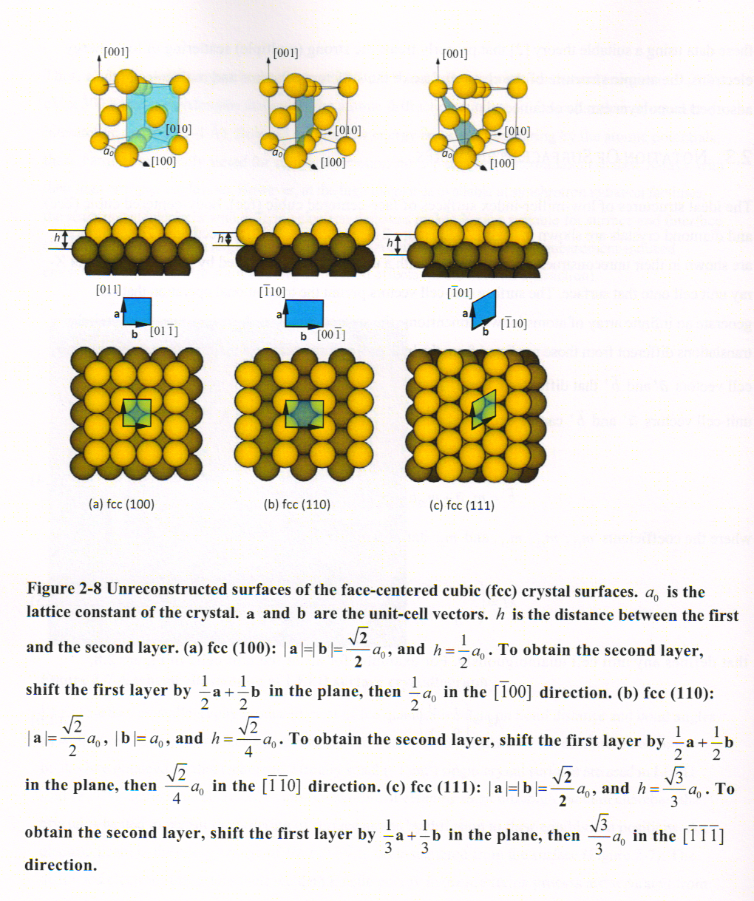
Metal surfaces
FCC metals

Slide 4
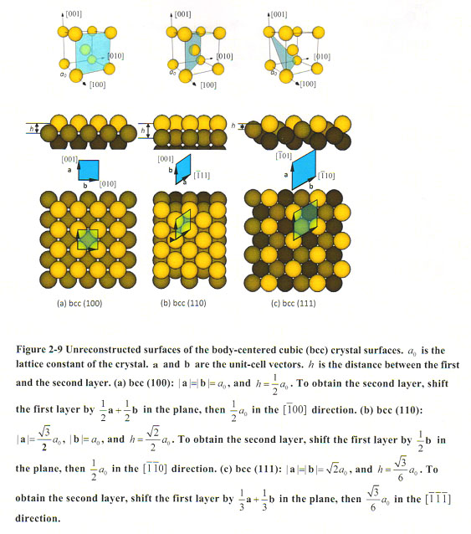
Metal surfaces
BCC metals

Slide 5
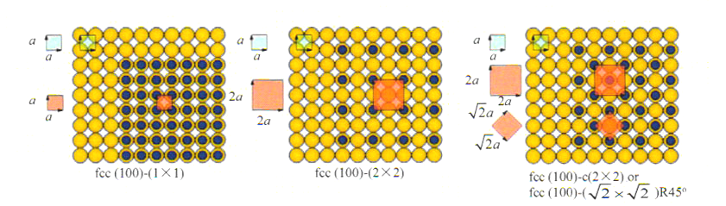
Metal surfaces - Superlattice
fcc (100) – (2x2)

Slide 6
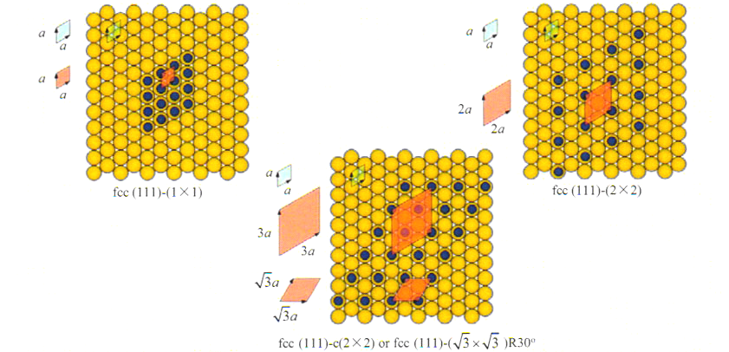
Metal surfaces - Superlattice
fcc (111) – (2x2)

Slide 7
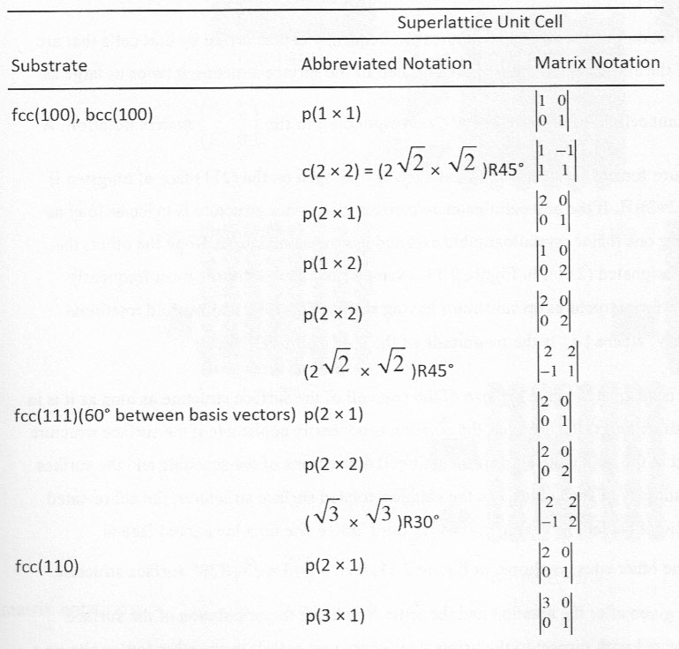
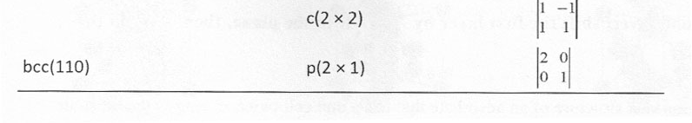
Metal surfaces - Superlattice

Slide 8
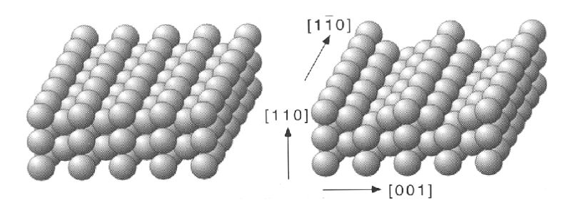
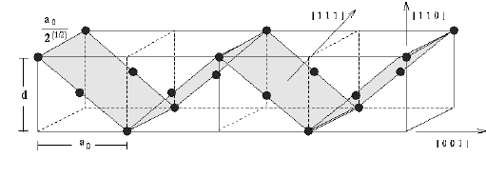
Metal surfaces - Reconstruction
Pd(110)

Slide 9
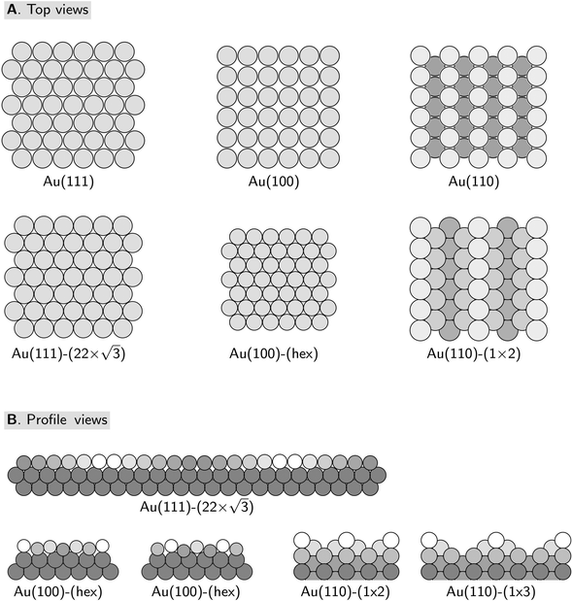
Metal surfaces - Reconstruction

Slide 10
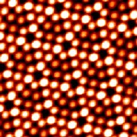
Metal surfaces - Reconstruction
(7x7) Reconstruction of Si (111)
19 dangling bonds of (7x7) reconstructed surface
(12 adatom, 6 rest atom, 1 corner hole)

Slide 11
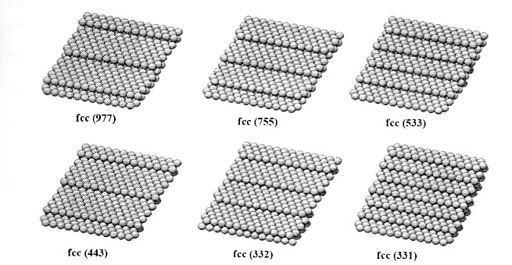
Metal surfaces – High-Miller-Index Stepped Surface
8(111) x (100)
6(111) x (100)
4(111) x (100)

Slide 12
Coverage of adsorbate molecules
Definition of coverage: one monolayer corresponds to one adsorbate atom or molecules for each unit cell of the clean, unreconstructed substrate surface.
For example, the surface coverage of atom on fcc(100) is one-half a monolayer.

Slide 13
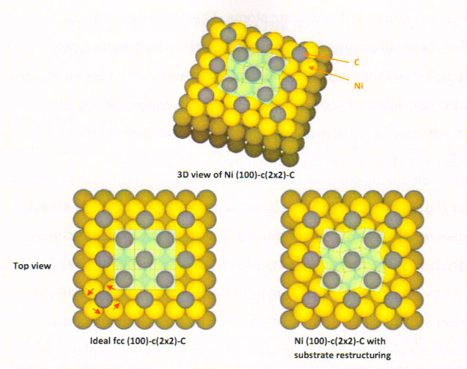
Metal surfaces – Adsorbate induced reconstructuring
Ni (100) – c(2x2) – C
Carbon chemisorption induced restructuring of the Ni (100) surface.
Four Ni atoms surrounding each carbon atom rotate to form reconstructed substrate.

Slide 14
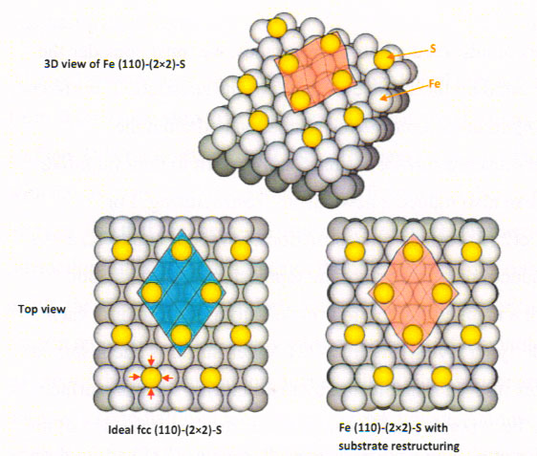
Metal surfaces – Adsorbate induced reconstructuring
Fe (110) – (2x2)-S
S-Fe (110), Sulfur-chemisorption-induced restructuring of the Fe(110) surface.

Slide 15
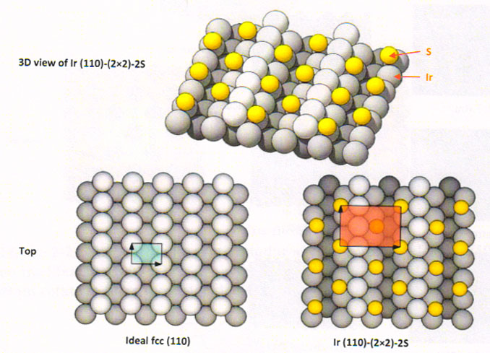
Metal surfaces – Adsorbate induced reconstructuring
Sulfur-chemisorption-induced restructuring of the Ir (110) surface
fcc(110) surface restructures more frequently upon chemisorption than do the closer-packed crystal faces.

Slide 16
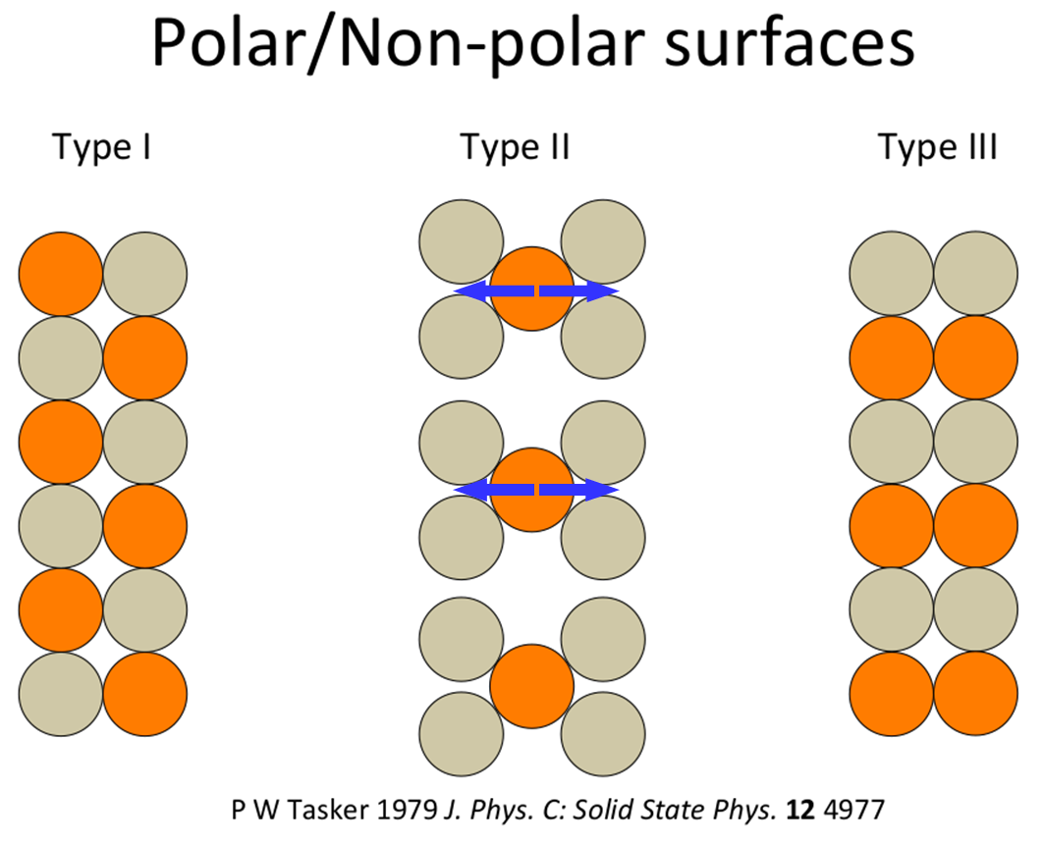
Ionic material surfaces
Stable
Not stable
Type 1 is neutral with equal numbers of anions and cations on each plane and type 2 is charged but there is no dipole moment perpendicular to the surface because of the symmetrical stacking sequence. Both these surfaces should have modest surface energies and may be stable with only limited relaxations of the ions in the surface region. The type 3 surface is charged and has a dipole moment in the repeat unit perpendicular to the surface. This surface can only be stabilized by substantial reconstruction.

Slide 17
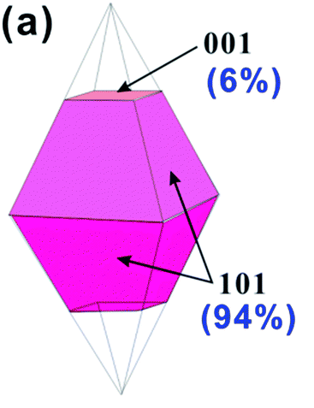
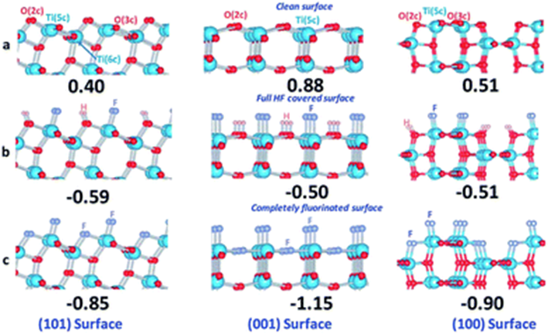
Ionic material surfaces

Slide 18
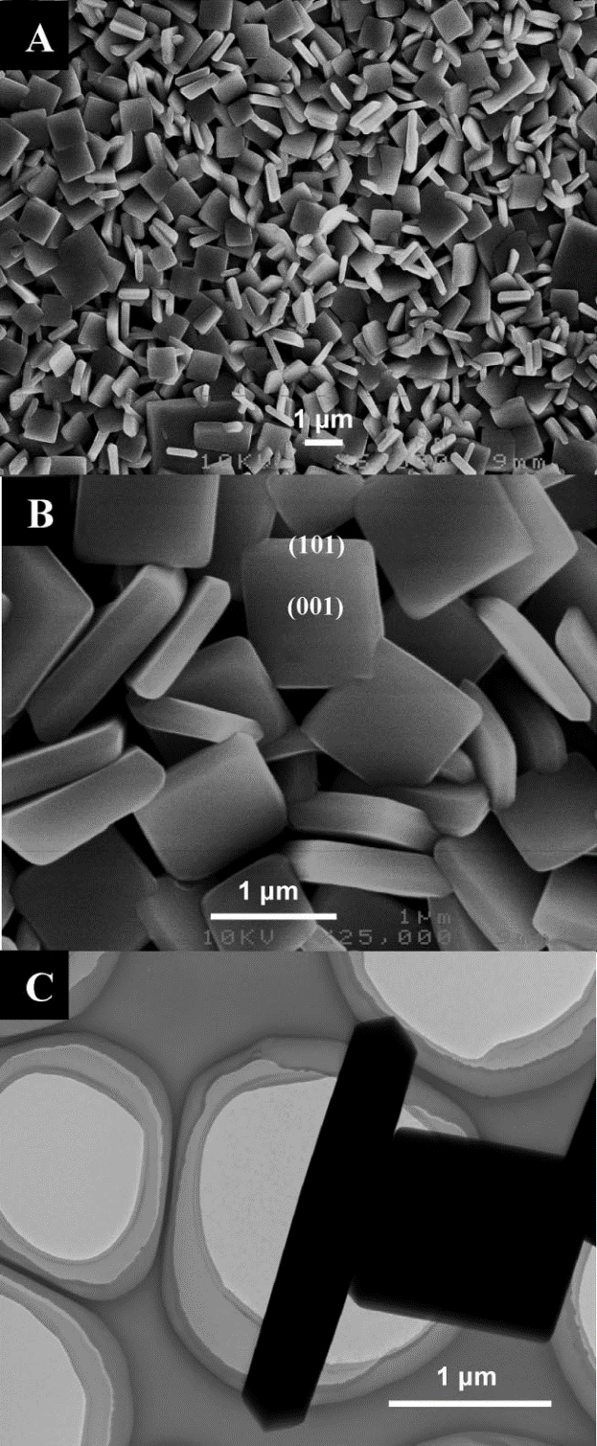
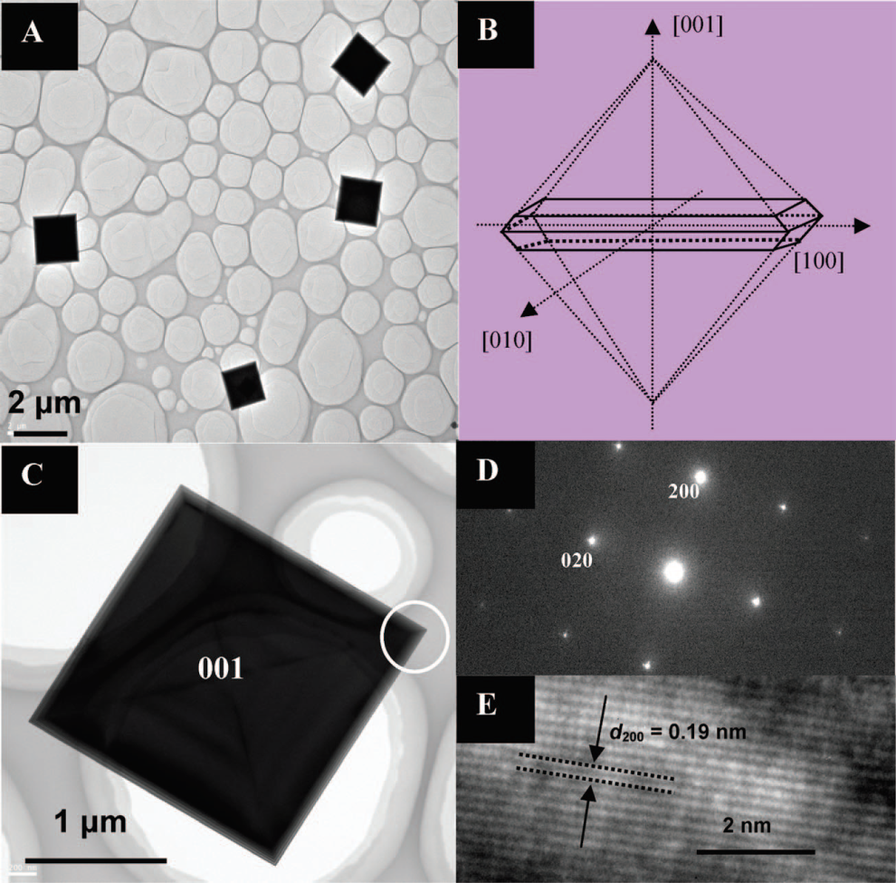
Ionic material surfaces

