Slide 1
Definitions and commonly used terms

Slide 2
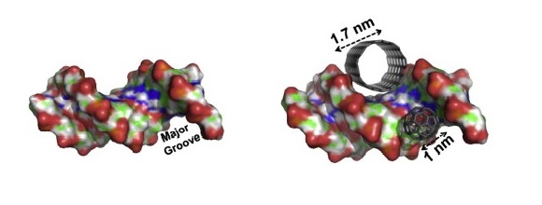
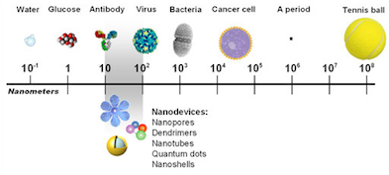
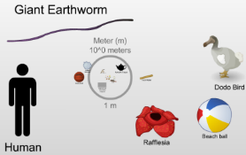
What is nano?
  Nanotechnology is science, engineering, and technology conducted at the nanoscale (about 1 to 100 nanometers)
  Nano can refer to technologies, materials, particles, objects – we are focusing on nanomaterials as these are already being used in workplaces more widely
  A sheet of paper is about 100,000 nanometers thick, a human hair is around 80,000- 100,000 nanometers wide
Human hair and a sheet of paper
The Scale of the Universe video
References:
http://www.cancer.gov/researchandfunding/snapshots/nanotechnology
http://www.nano.gov/nanotech-101
Yanamala N, Kagan VG and Shvedova AA (2013), Adv. Drug Del. Rev. 65, 2070-2077. "Molecular modeling in structural nano-toxicology: Interactions of nano-particles with nano-machinery of cells".
http://htwins.net/scale2/

Slide 3
Different Types of Nanomaterials
Naturally Occurring | Human Origin (Incidental) | Human Origin (Engineered)
Forest fires | Cooking smoke | Metals
Sea spray | Diesel exhaust | Quantum dots
Mineral composites | Welding fumes | Buckyballs/Nanotubes
Volcanic ash | Industrial effluents | Sunscreen pigments
Viruses | Sandblasting | Nanocapsules
Nanotechnology
Notes:
Trainer Notes:
The items in the table are just some examples. There are others.
Another important distinction to make is whether the particle is naturally occurring, of human origin but unintentionally produced or intentionally engineered for a specific purpose.
Naturally occurring: There are many examples of materials that satisfy the size requirements of the nanoscale but that are produced naturally rather than in a factory or research lab. Combustion products (e.g., from a forest fire) and volcanic ash are both composed of a range of substances and particle sizes, some of which are on the nanoscale. Viruses could even be considered nanoscale particles.
Human Origin (incidental): Humans engage in many activities that produce nanoscale particles as an unintentional waste product of the process. Workers may be familiar with examples from welding, sandblasting or other industrial processes. Some of these particles have been implicated in unwanted public or occupational health outcomes.
Human Origin (Engineered): When we speak in this course about nanomaterials we will be talking about the third class shown in the table, the particles that have been intentionally designed to be in the nanoscale and are being studied or used commercially because of their novel properties. Some examples, about which more will be presented later, include nanoscale metals such as nanosilver, semiconducting nanoparticles known colloquially as quantum dots, carbon-based nanomaterials such as nanotubes, ceramic (metal oxide) nanoparticles such as titanium dioxide which is found in sunscreens, and polymeric hydrocarbon-based nanoparticles such as capsules used for drug delivery.
The main differences between Incidental and Engineered nanomaterials are that Engineered nanomaterials are intentionally designed to exploit a novel feature that accompanies the small size and are typically more well-controlled than randomly produced Incidental nanomaterials.

Slide 4
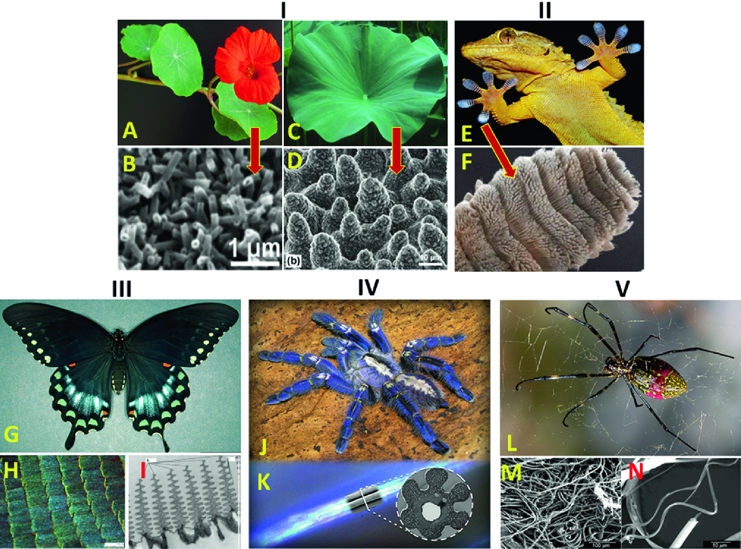
Natural sources of nanomaterials

Slide 5


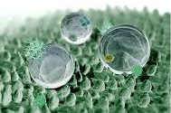
Natural sources of nanomaterials
Biological systems often feature functional nanomaterials.
Lotus effect, hydrophobic effect
with self-cleaning ability
vetri autopulenti
lenti antigraffio
finestre autopulenti
parabrezza e schermi più robusti
vestiti smart
Grafene based films

Slide 6

Self-Cleaning Glass
What is it?
Thin film of TiO₂ bonded to glass
Advantages
Reduces energy usage
Self-cleaning glass
Reduces cost and effort of cleaning glass
Why Nano?
Film doesn’t change glass color
Nano-size enhances the photocatalytic effect
PPG Industries
Notes:
Trainer Notes:
In self-cleaning glass, a thin film of titanium dioxide (TiO₂ or titania) is bonded to glass. Upon exposure to UV from sunlight, the titania catalyzes breakdown of dirt. Rainwater then washes dirt away. The film also creates a hydrophobic surface which causes water to flow in sheets rather than beading up. As a result, little to no streaking occurs after water evaporates.
This coating can also be made to reflect UV light which can result in greater energy efficiency for the building due to reduced air-conditioning costs.

Slide 7

Small Change, Big Savings
What is it?
Thin film of polymer bonded to paint
Advantages
Reduces friction-causing debris build-up on plane surface
Reduces fuel consumption 1-2%  ~$22 million
Why Nano?
Film adds a mere 4 oz to weight of the jet (compared to 176 pounds of paint)
https://www.bbc.com/news/business-12428667
Notes:
Trainer Notes:
UK-based airline Easy Jet is testing a new nanotechnology coating on 8 of its jets in hopes that it can reduce fuel consumption by as much as 2% per jet per year. The coating fills in all the tiny crevices in the surface of the paint, creating an ultra-smooth, low-friction surface that repels debris and reduces drag. For an airline that spends nearly $1.2 billion in fuel per year, the coating could save them 10’s of millions of dollars.
If you have time and Internet access, click on the image to open the website and play a one-minute video
Credit: http://www.bbc.co.uk/news/business-12428667

Slide 8
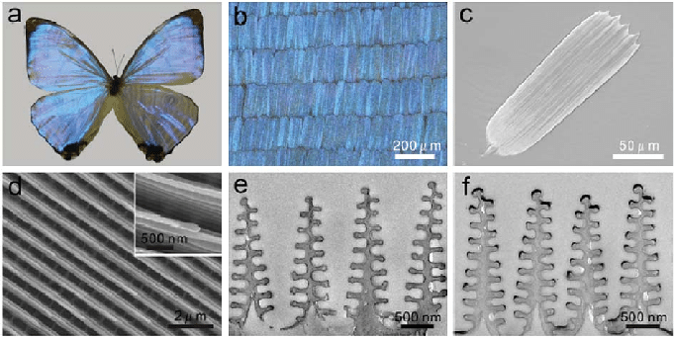
Natural sources of nanomaterials
Biological systems often feature functional nanomaterials.

Slide 9
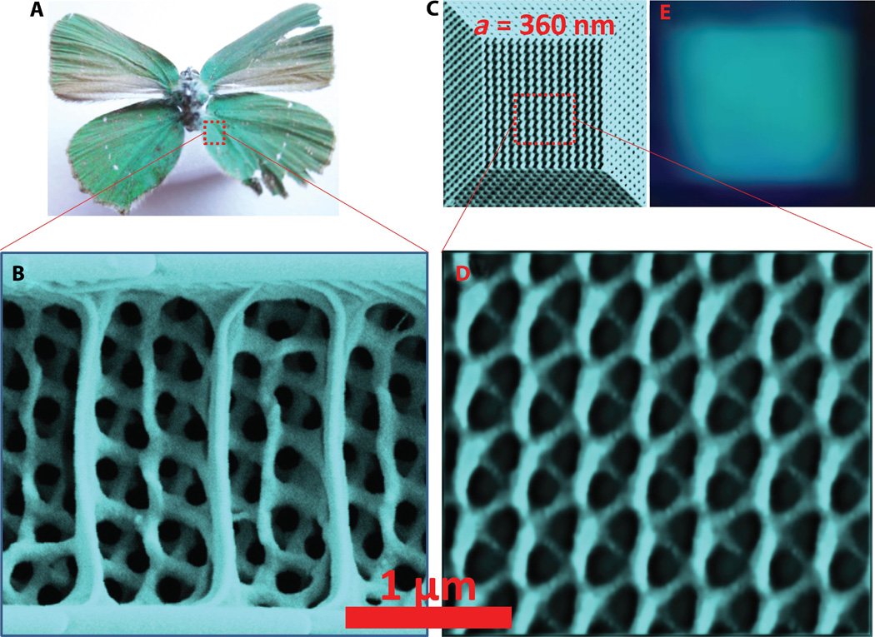
Natural sources of nanomaterials
Sensors, textile, photoapplications….

Slide 10
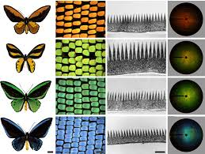
Natural sources of nanomaterials
Biological systems often feature functional nanomaterials.

Slide 11
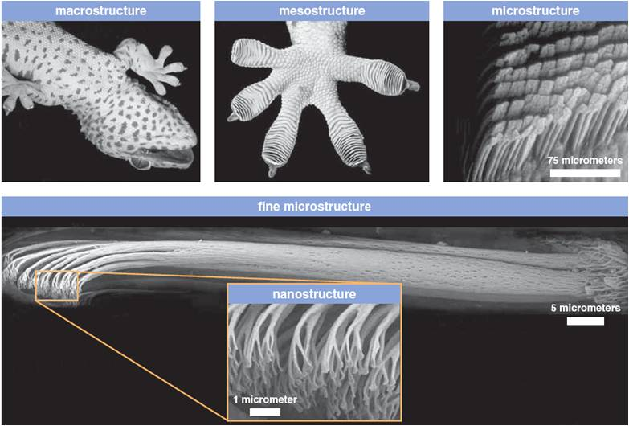
Natural sources of nanomaterials
The "spatulae" on the bottom of gecko feet

Slide 12
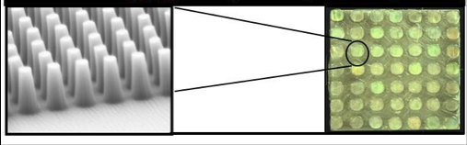
Natural sources of nanomaterials
The "spatulae" on the bottom of gecko feet
Artificial replica

Slide 13
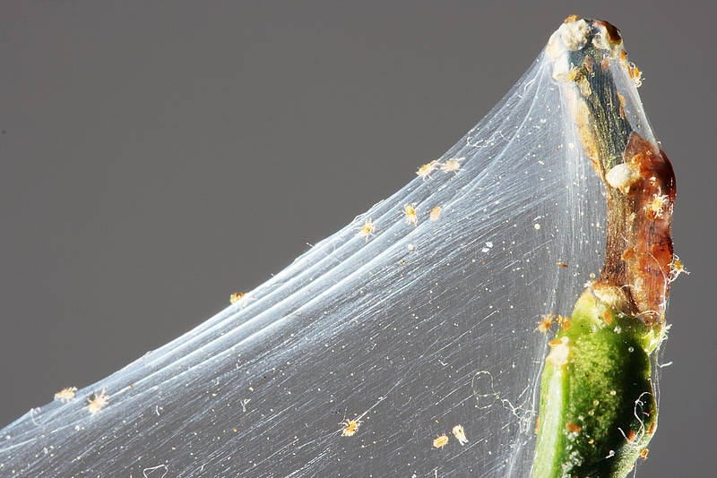
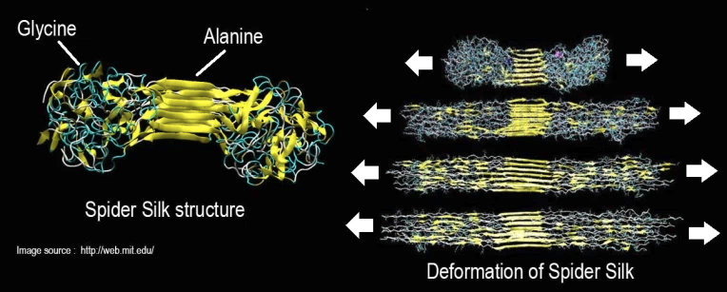
Sources of nanomaterials
Spider silk: nanomaterial that can stop a jumbo jet in the midflight

Slide 14
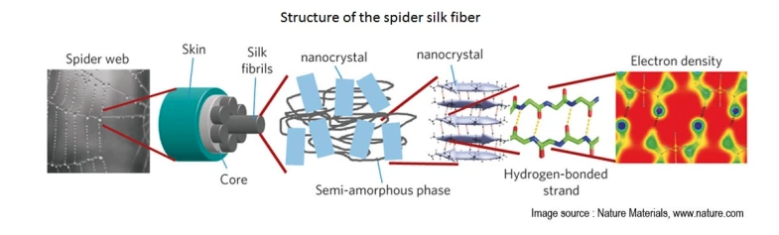
Sources of nanomaterials

Slide 15
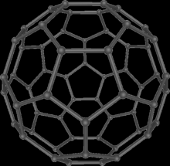
Sources of nanomaterials
Incidental
Nanomaterials may be incidentally produced as a byproduct of mechanical or industrial processes.
vehicle engine exhausts, welding fumes, combustion processes from domestic solid fuel heating and cooking.
VEHICLES
Soot from fuel combustion
Attrition of tires (cars 70 mg/Km, trucks 1 g/Km
Attrition of clutches (3 mg/Km)
Attrition of brakes (20 mg/Km)
Engine wear
Catalyst (0.0005 mg/km of metal oxides)
Fiber-particles from silencers

Slide 16
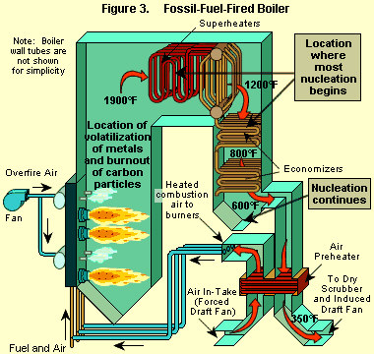
Particulate formation: Combustion particles burnout
Fossil-Fuel-Fired Boiler
Injection of fuel particles
Volatile organic compounds are vaporized and oxidized
ash and char formation

Slide 17
Particulate formation hypothesis of radicals
Formation of aromatic rings
PAH
(Polycycle Aromatic Hydrocarbons)
CH₄
Methane fuel
Desorption
Pyrolise
Chemical condensation
Pyrens
Reactive small molecules and radicals
Graphitisation
• CH₃
Methylradical
H
C
C
H
Acetylene
Corones
Desorption
• C₃H₃
Propargylradical
• C₆H₅
Phenylradical
Ovalenes

Slide 18
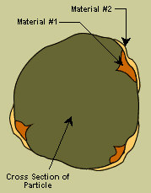
Particulate formation: Homogeneous and heterogeneous nucleation
Homogeneous nucleation is the formation of new particles composed almost entirely of the vapor phase material (one compound).
Heterogeneous nucleation is the accumulation of material on the surfaces of existing particles (more than one compound).

Slide 19
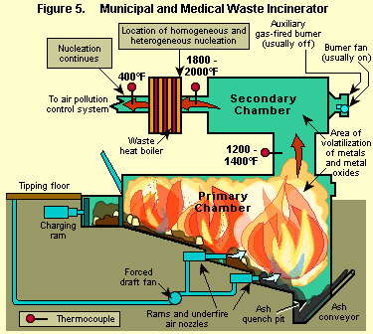
Particulate formation: Homogeneous and heterogeneous nucleation
Municipal and medical waste Incinerator
Condensation of
1. metal/metal oxides like Hg, Pb, Cd; As…
2. Organic compounds

Slide 20
Nanotechnology and Nanoscience:
There are many definitions of these terms. (Home work – find some!)
We will define it as science and technology of structures
made of materials or composites of inorganic and organic materials where at least one dimension is
less than 100 nm, and in addition new phenomena are observed which result from such a small size.
ISO/TS 80004 defines nanomaterial as the "material with any external dimension in the nanoscale or having internal structure or surface structure in the nanoscale", with nanoscale defined as the "length range approximately from 1 nm to 100 nm". This includes both nano-objects, which are discrete pieces of material, and nanostructured materials, which have internal or surface structure on the nanoscale.

Slide 21
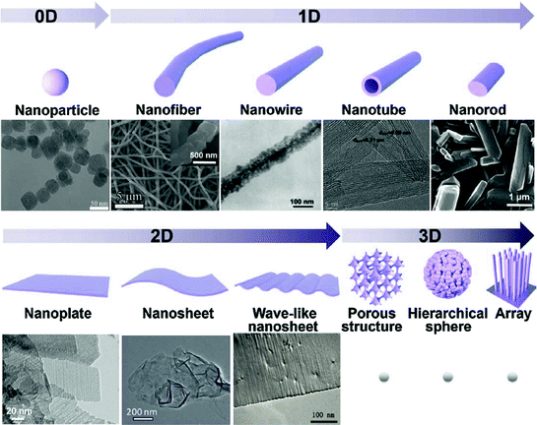
Nanomaterials

Slide 22
Zero-dimensional
A material with all three external dimensions in the nanoscale.
One-dimensional nanostructures
The smallest possible crystalline wires with cross-section as small as a single atom can be engineered in cylindrical confinement.
Two-dimensional nanostructures
2D nanomaterials are materials consisting of a two-dimensional single layer of atoms. The most important representative graphene was discovered in 2004. Thin films with nanoscale thicknesses are considered nanostructures, but are sometimes not considered nanomaterials because they do not exist separately from the substrate.
3D nanostructured materials
Bulk materials that contain features on the nanoscale, including nanocomposites, nanocrystalline materials, nanostructured films, and nanotextured surfaces.

Slide 23
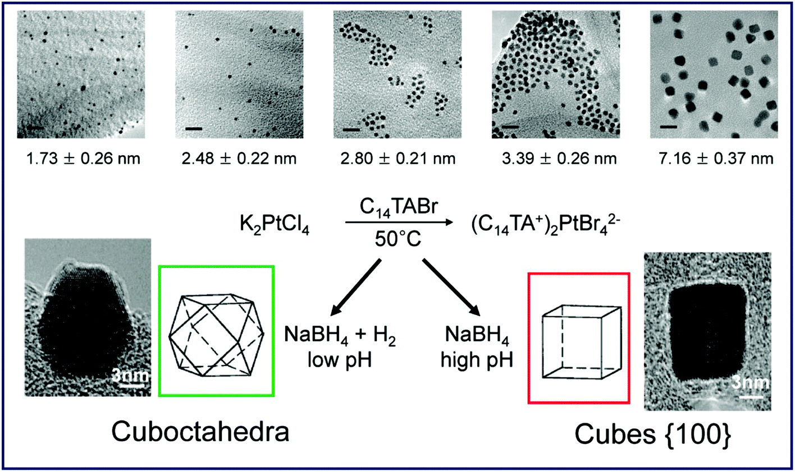
Nanomaterials: Nanoparticle
A nanoparticle is defined a nano-object with all three external dimensions in the nanoscale, whose longest and the shortest axes do not differ significantly.

Slide 24
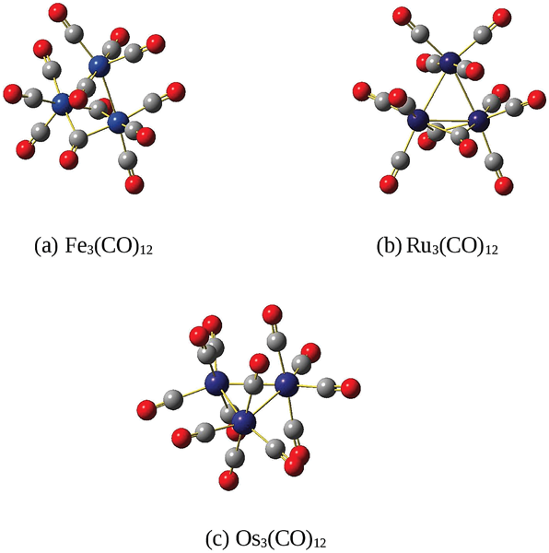
Nanomaterials: Nano and sub nanoparticle
Nanoparticles are smaller than "fine particles“ 100 and 2500 nm.
They are a subclass of the colloidal particles: 1 to 1000 nm.
Metal particles smaller than 1 nm are usually called atom clusters instead (sometimes subnanometer particles).

Slide 25
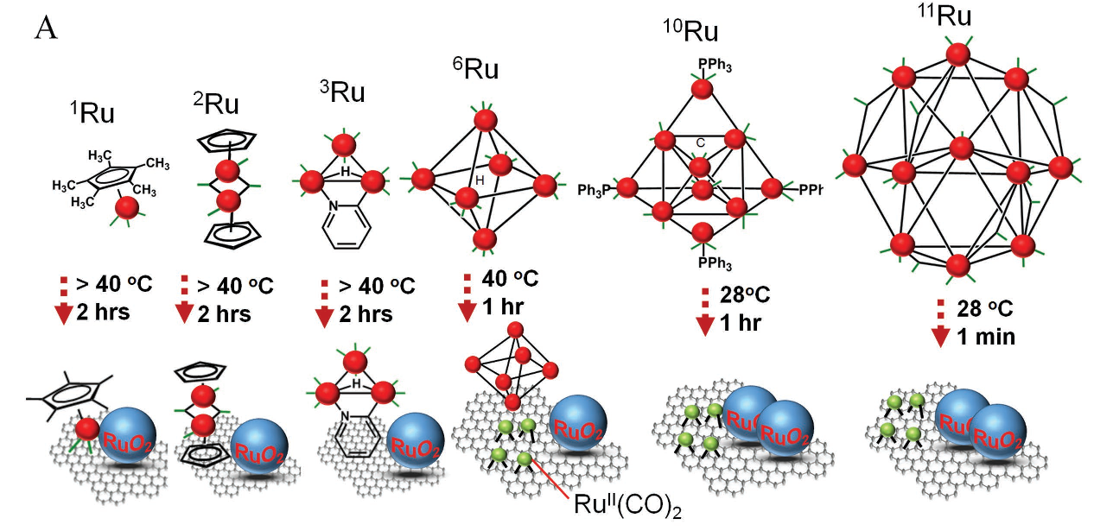
Nanomaterials: Nanoparticle
Metal clusters precursors for nanoparticles and model of surfaces.
Stability, effect of ligands removal,….

Slide 26
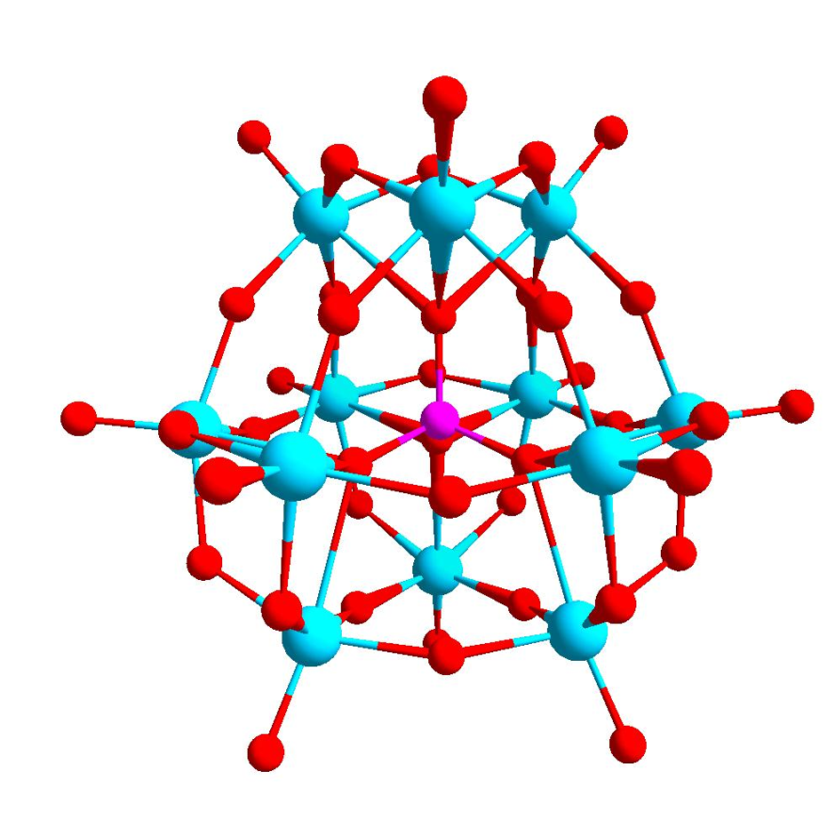
Nanomaterials: Polyoxometalates
POM is a polyatomic ion, usually an anion, that consists of three or more transition metal oxyanions linked together by shared oxygen atoms to form closed 3-dimensional frameworks.
The metal atoms are usually group 6 (Mo, W) or less commonly group 5 (V, Nb, Ta) transition metals in their high oxidation states.
Isopolymetalates are composed of only one kind of metal and oxide Heteropolymetalates are composed of one metal, oxide, and a main group oxyanion (phosphate, silicate, etc.).
The phosphotungstate anion
PW₁₂O₄₀³⁻ consists of a framework of twelve octahedral tungsten oxyanions surrounding a central phosphate group.

Slide 27
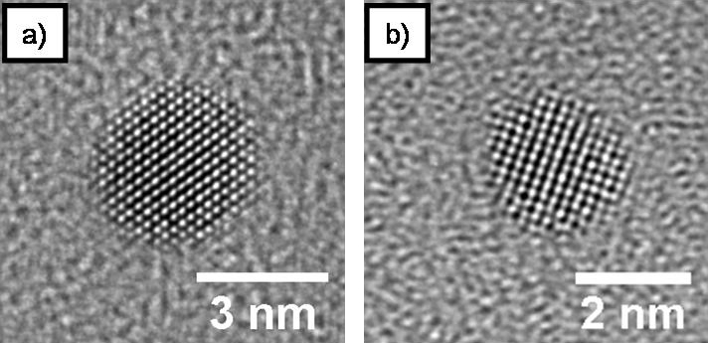


Being much smaller than the wavelengths of visible light (400-700 nm), nanoparticles cannot be seen with ordinary optical microscopes, requiring the use of transmission electron microscopy.
http://www.rsc.org/suppdata/c9/nr/c9nr02731a/c9nr02731a1.gif
Dispersions of nanoparticles in transparent media can be transparent, whereas suspensions of larger particles usually scatter some or all visible light incident on them.
Nanoparticles also easily pass through common filters, such as common ceramic devices, so that separation from liquids requires special nanofiltration techniques.

Slide 28
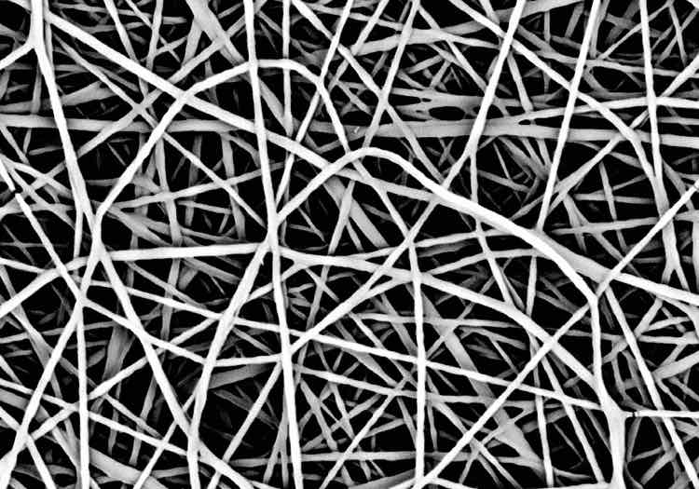
Nanomaterials:
A nanofiber has two external dimensions in the nanoscale.
Filtration
Catalysis
Tissue engineering
Drug delivery
batteries
Inorganic or polimeric

Slide 29
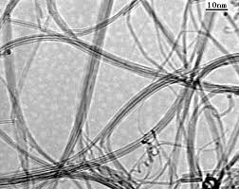
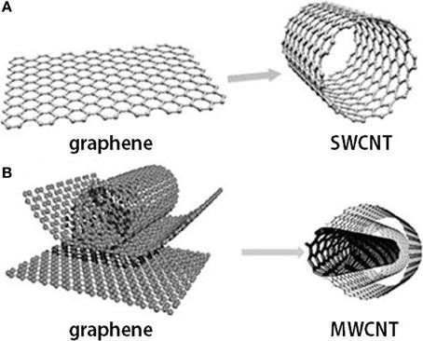
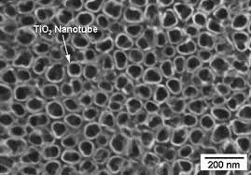
Nanomaterials:
Nanotubes are hollow nanofibers.
C nanotubes
TiO₂ nanotubes

Slide 30
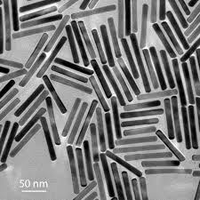
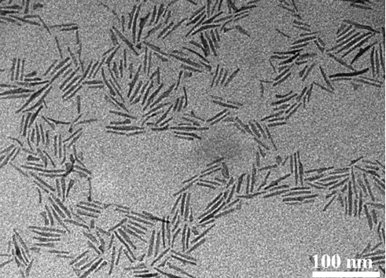
Nanomaterials:
Nanorods are solid nanofibers.
Gold nanoroads
TiO₂ nanoroads

Slide 31
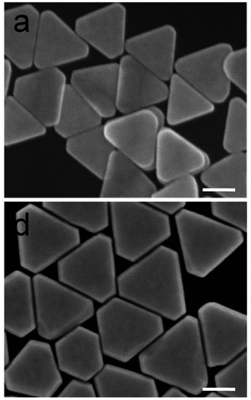
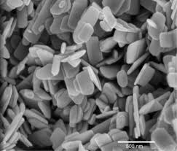
Nanomaterials: Nanoplates
A nanoplate has one external dimension in the nanoscale, and if the two larger dimensions are significantly different it is called nanoribbon.
Gold nanoplate
ZnO nanoplate

Slide 32
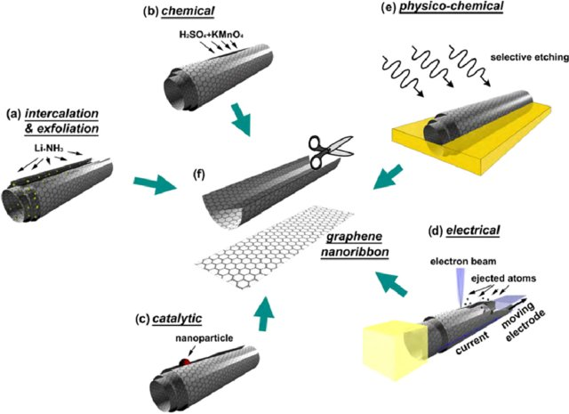
Nanomaterials: Nanoribbons
If the two larger dimensions are significantly different it is called nanoribbon.

Slide 33
Nanomaterials: Nanoribbons
(a)Intercalation-exfoliation of MWCNTs, involving treatments in liquid NH₃ and Li, and subsequent exfoliation using HCl and heat treatments,
(b) a chemical route involving acid reactions that start to break carbon-carbon bonds (e.g. using H₂SO₄ and KMnO₄ as oxidizing agents),
(c) a catalytic approach, in which metal nanoparticles 'cut' the nanotube longitudinally like a pair of scissors, (d) an electrical method by passing an electric current through a nanotube
(e) a physicochemical method by embedding the tubes in a polymer matrix followed by Ar plasma treatment.
(f ) The resulting structures are either GNRs or graphene sheets

