Slide 1
Definitions and commonly used terms

Slide 2
Nanotechnology and Nanoscience:
There are many definitions of these terms. (Home work – find some!)
We will define it as science and technology of structures
made of materials or composites of inorganic and organic materials where at least one dimension is
less than 100 nm, and in addition new phenomena are observed which result from such a small size.
ISO/TS 80004 defines nanomaterial as the "material with any external dimension in the nanoscale or having internal structure or surface structure in the nanoscale", with nanoscale defined as the "length range approximately from 1 nm to 100 nm". This includes both nano-objects, which are discrete pieces of material, and nanostructured materials, which have internal or surface structure on the nanoscale.

Slide 3
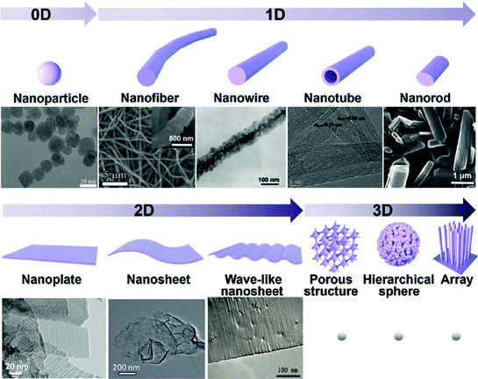
Nanomaterials

Slide 4
Zero-dimensional
A material with all three external dimensions in the nanoscale.
One-dimensional nanostructures
The smallest possible crystalline wires with cross-section as small as a single atom can be engineered in cylindrical confinement.
Two-dimensional nanostructures
2D nanomaterials are materials consisting of a two-dimensional single layer of atoms. The most important representative graphene was discovered in 2004. Thin films with nanoscale thicknesses are considered nanostructures, but are sometimes not considered nanomaterials because they do not exist separately from the substrate.
3D nanostructured materials
Bulk materials that contain features on the nanoscale, including nanocomposites, nanocrystalline materials, nanostructured films, and nanotextured surfaces.

Slide 5
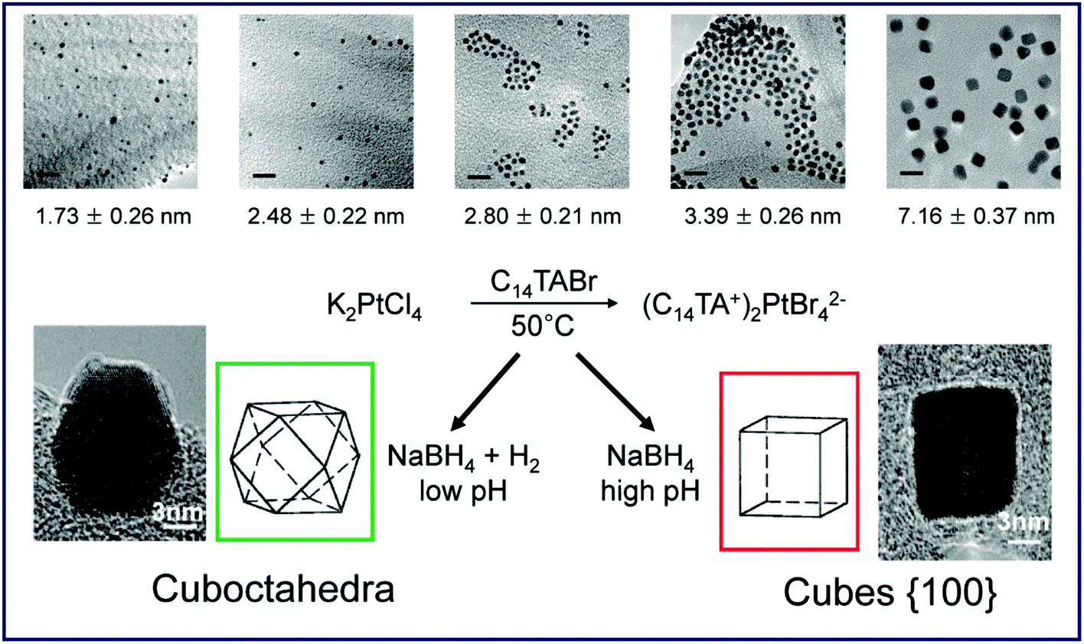
Nanomaterials: Nanoparticle
A nanoparticle is defined a nano-object with all three external dimensions in the nanoscale, whose longest and the shortest axes do not differ significantly.

Slide 6
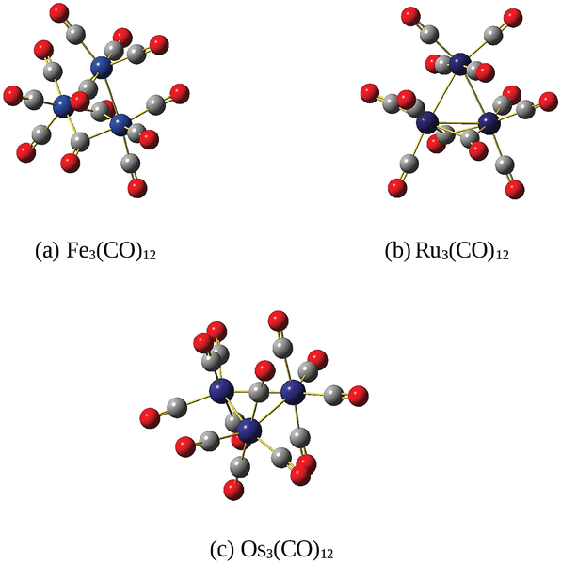
Nanomaterials: Nano and sub nanoparticle
Nanoparticles are smaller than "fine particles“ 100 and 2500 nm.
They are a subclass of the colloidal particles: 1 to 1000 nm.
Metal particles smaller than 1 nm are usually called atom clusters instead (sometimes subnanometer particles).

Slide 7
Nanomaterials: Nanoparticle
Metal clusters precursors for nanoparticles and model of surfaces.
Stability, effect of ligands removal,….

Slide 8
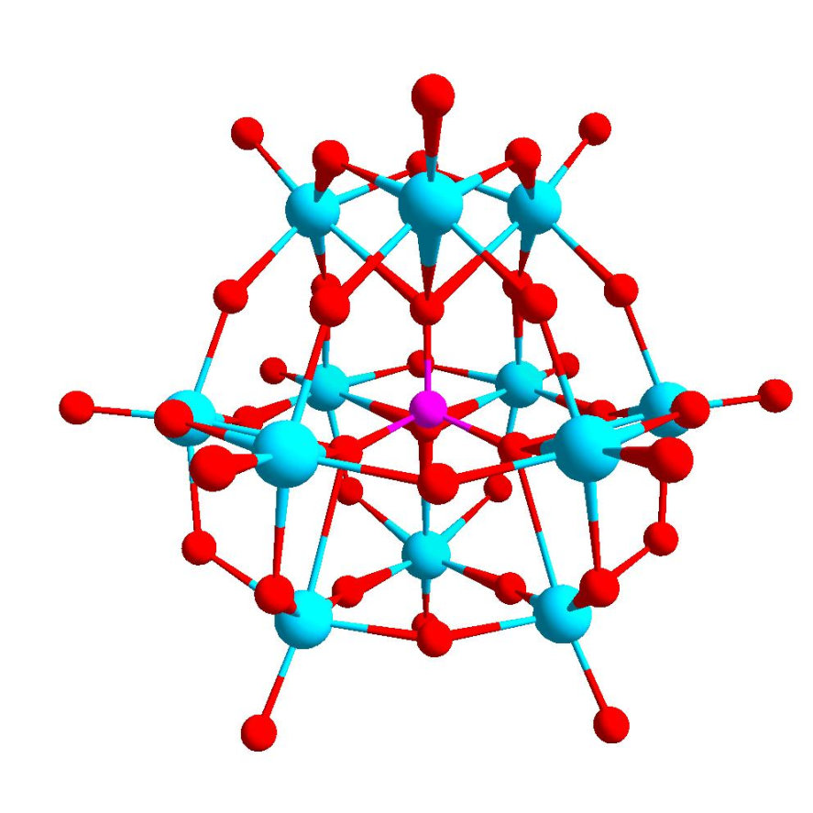
Nanomaterials: Polyoxometalates
POM is a polyatomic ion, usually an anion, that consists of three or more transition metal oxyanions linked together by shared oxygen atoms to form closed 3-dimensional frameworks.
The metal atoms are usually group 6 (Mo, W) or less commonly group 5 (V, Nb, Ta) transition metals in their high oxidation states.
Isopolymetalates are composed of only one kind of metal and oxide Heteropolymetalates are composed of one metal, oxide, and a main group oxyanion (phosphate, silicate, etc.).
The phosphotungstate anion
PW₁₂O₄₀³⁻ consists of a framework of twelve octahedral tungsten oxyanions surrounding a central phosphate group.

Slide 9
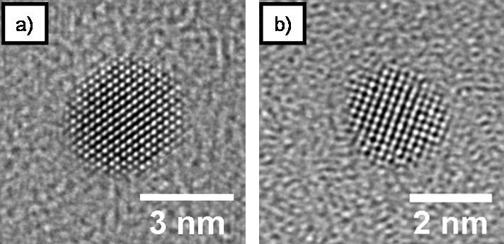
Being much smaller than the wavelengths of visible light (400-700 nm), nanoparticles cannot be seen with ordinary optical microscopes, requiring the use of transmission electron microscopy.
http://www.rsc.org/suppdata/c9/nr/c9nr02731a/c9nr02731a1.gif
Dispersions of nanoparticles in transparent media can be transparent, whereas suspensions of larger particles usually scatter some or all visible light incident on them.
Nanoparticles also easily pass through common filters, such as common ceramic devices, so that separation from liquids requires special nanofiltration techniques.

Slide 10
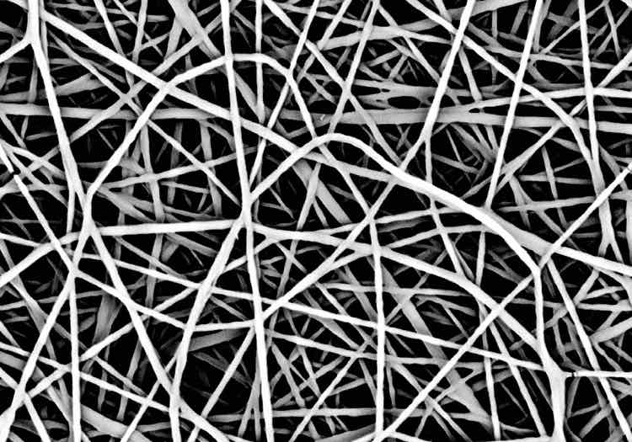
Nanomaterials:
A nanofiber has two external dimensions in the nanoscale.
Filtration
Catalysis
Tissue engineering
Drug delivery
batteries
Inorganic or polimeric

Slide 11
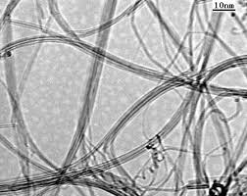
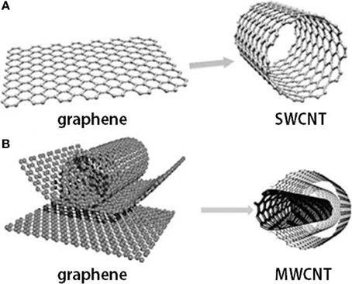
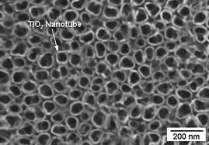
Nanomaterials:
Nanotubes are hollow nanofibers.
C nanotubes
TiO₂ nanotubes

Slide 12
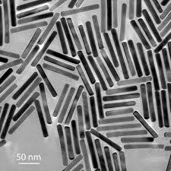
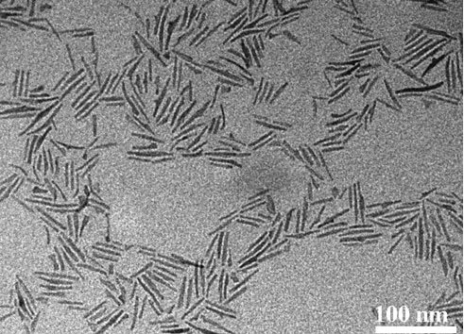
Nanomaterials:
Nanorods are solid nanofibers.
Gold nanoroads
TiO₂ nanoroads

Slide 13
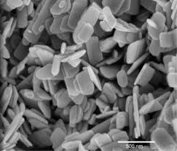
Nanomaterials: Nanoplates
A nanoplate has one external dimension in the nanoscale, and if the two larger dimensions are significantly different it is called nanoribbon.
Gold nanoplate
ZnO nanoplate

Slide 14
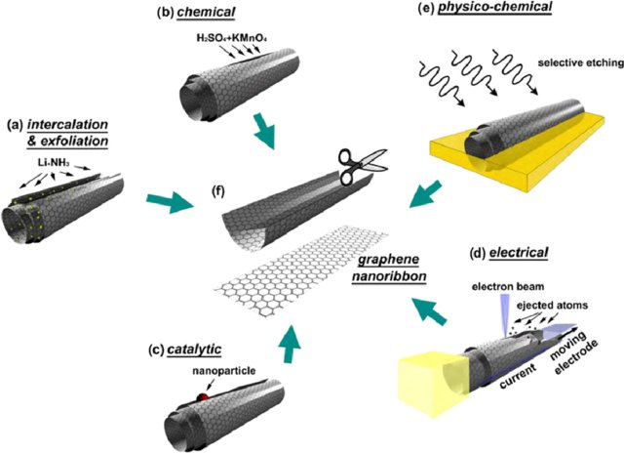
Nanomaterials: Nanoribbons
If the two larger dimensions are significantly different it is called nanoribbon.

Slide 15
Nanomaterials: Nanoribbons
(a)Intercalation-exfoliation of MWCNTs, involving treatments in liquid NH₃ and Li, and subsequent exfoliation using HCl and heat treatments,
(b) a chemical route involving acid reactions that start to break carbon-carbon bonds (e.g. using H₂SO₄ and KMnO₄ as oxidizing agents),
(c) a catalytic approach, in which metal nanoparticles 'cut' the nanotube longitudinally like a pair of scissors, (d) an electrical method by passing an electric current through a nanotube
(e) a physicochemical method by embedding the tubes in a polymer matrix followed by Ar plasma treatment.
(f ) The resulting structures are either GNRs or graphene sheets

Slide 16
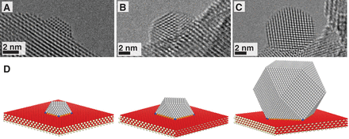
Nanomaterials: Nanocomposites
A nanocomposite is a solid containing at least one physically or chemically distinct region, or collection of regions, having at least one dimension in the nanoscale.
The use of nano building blocks can allow to design and create new materials with unprecedented flexibility and improvement in their physical properties. In the broadest sense this definition can include porous media, colloids, gels and copolymers, but is more usually taken to mean the solid combination of a bulk matrix and nano-dimensional phase(s) differing in properties due to dissimilarities in structure and chemistry.
The mechanical, electrical, thermal, optical, electrochemical, catalytic properties of the nanocomposite will differ markedly from that of the component materials. SINERGIC EFFECT

Slide 17
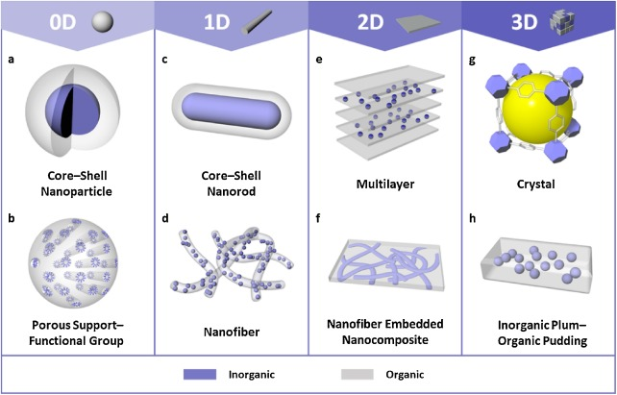
https://www.sciencedirect.com/science/article/pii/S1748013218304225

Slide 18
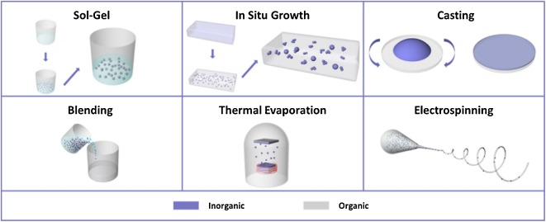

Slide 19
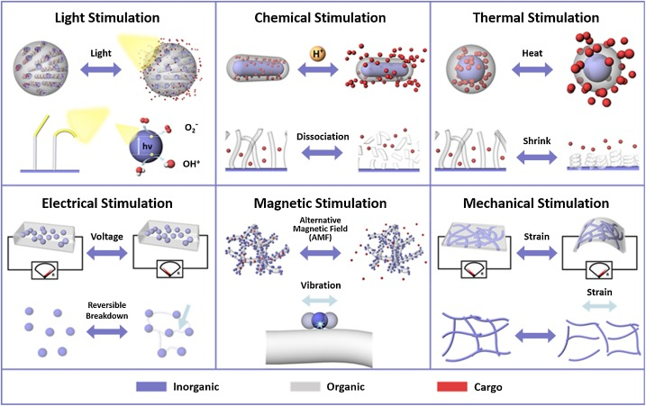

Slide 20
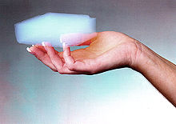
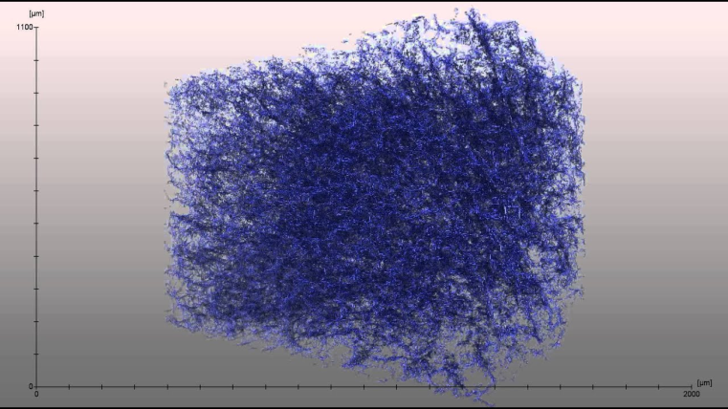
A nanofoam has a liquid or solid matrix, filled with a gaseous phase, where one of the two phases has dimensions on the nanoscale.
Foam is an object formed by trapping pockets of gas in a liquid or solid.
Aerogel is a synthetic porous ultralight material derived from a gel, in which the liquid component for the gel has been replaced with a gas
Insulating materials
Catalysis
Gas storage
Separation / filtration
Carbon nanofoam

Slide 21
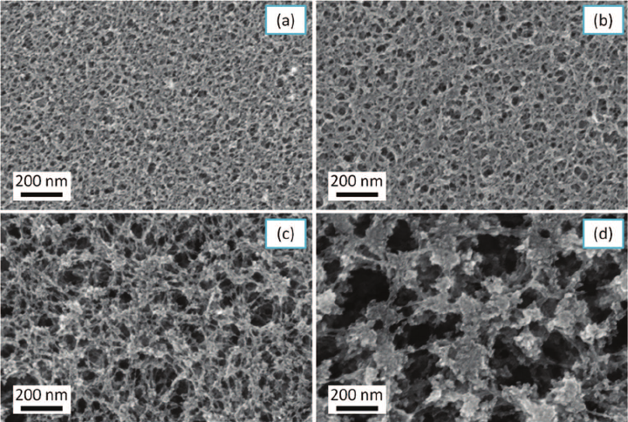
A nanoporous material is a solid material containing nanopores, cavities with dimensions on the nanoscale.
The skeletal portion of the material is often called the "matrix" or "frame".
Activated carbon and zeolites are two examples of bulk nanoporous materials.
The pores are typically filled with a fluid (liquid or gas).
A nanoporous material with consistently sized pores has the property of letting only certain substances pass through, while blocking others. Chromatography, catalysis, filtration,…

Slide 22
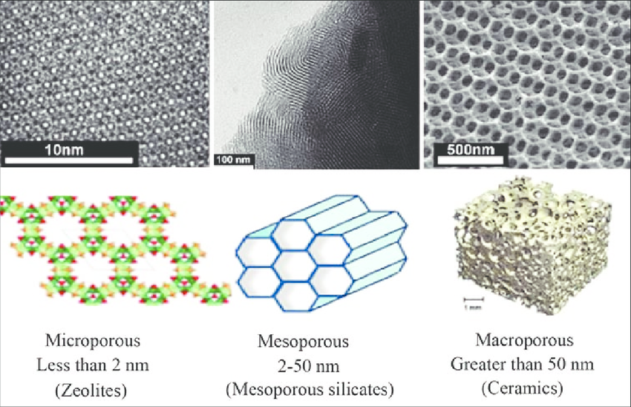
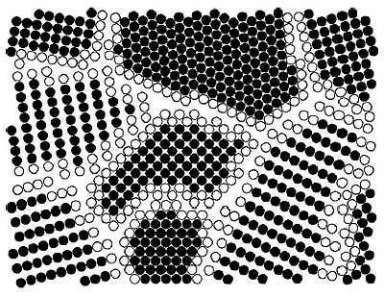
Nanoporous materials and nanofoam are sometimes considered nanostructures but not nanomaterials because only the voids and not the materials themselves are nanoscale.
A nanocrystalline material has a significant fraction of crystal grains in the nanoscale.
Although the ISO definition only considers round nano-objects to be nanoparticles, other sources use the term nanoparticle for all shapes

Slide 23
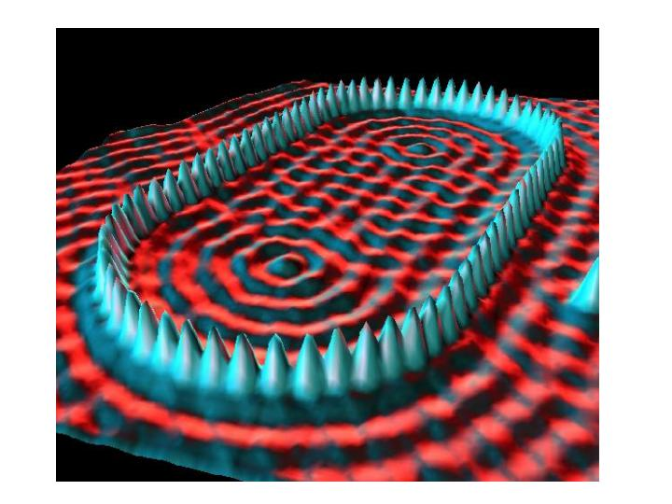
Instrumentation / Imaging
“Quantum Corral”
48 Fe atoms positioned by the STM used
to image them
http://www.nano.gov/html/facts/home_facts.html

Slide 24
Physical and Chemical Properties that can Change at the Nanoscale
Color
Melting temperature
Crystal structure
Chemical reactivity
Electrical conductivity
Magnetism
Mechanical strength
…
Notes:
Trainer Notes:
This is a partial list of some of the physical and chemical properties that can change for a given nanomaterial. Not all of these changes will be relevant for every nanoparticle; each will have its own set of variable properties.

Slide 25
Some Other Size-Dependent Properties
Fe₃O₄, Magnetite (4 nm)
CdSe (8 nm)
Magnetism
Emission
Notes:
Trainer Notes:
Optional additional examples of properties that change as a result of the nanoscale size of the object.
LEFT: The form of iron oxide known as magnetite exhibits size-dependent magnetism. The magnetic strength of a permanent magnet does not change with the magnet’s size at the macroscale. But tiny magnets can actually exhibit larger magnetic fields than bigger magnets. The figure shows a parameter associated with magnetic field strength H plotted against particle diameter D. Note that as the magnet gets smaller the field strength goes up until it reaches a maximum.
[This is called superparamagnetism and can be explained by the fact that at a certain size, within the nanoscale, the material can form a single crystal (or domain) in which all the magnetic moments are aligned in the same direction. In larger magnets, multiple “domains” are present with slightly misaligned magnetic fields, which weakens the overall field strength. An analogy is the difference in power between a tug-of-war team that is all pulling straight back vs. one in which some of the members are pulling the rope off to one side or the other. The overall pulling power of the team is weakened if all members are not pulling in the same direction.]

Slide 26
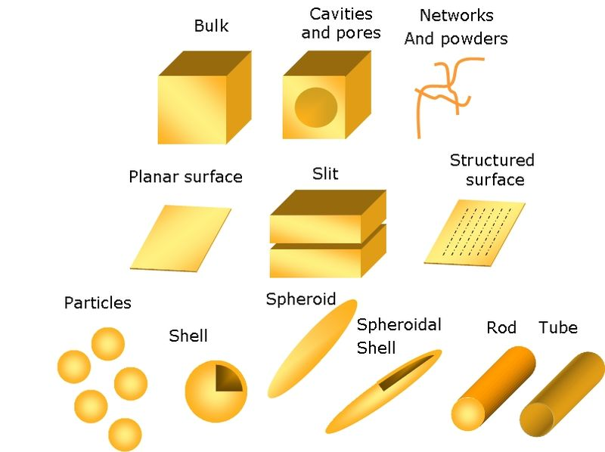
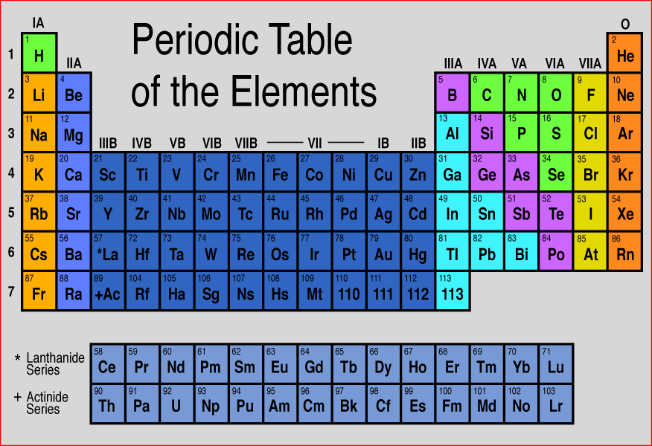
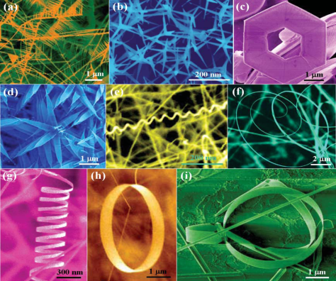
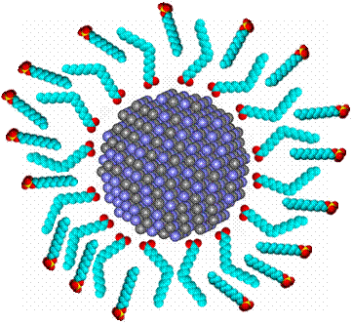
Nanomaterials Exhibit Diversity in…
Chemical composition
Form or shape
Surface treatments
Notes:
Trainer Notes:
TOP: Novel materials can be made just by taking elements in the periodic table and combining them to form objects within the nanoscale range. There is incredible chemical diversity among nanomaterials.
MIDDLE: Note the wide variety of different shapes of the objects shown in the middle image (and that the color was added to the microscope images for visual appeal). Now reveal that each one of those objects has exactly the same chemical formula: ZnO. Nanoscientists and engineers can take the same substance and shape it into many different types of nanoscale objects. There is great structural diversity among nanomaterials.
BOTTOM: Manufacturers often change the surface of a nanoparticle during product formulation to achieve the desired dispersability, stability or activity. These surface modifications may impact the properties to such an extent that the surface-treated particle is, for all purposes, an entirely different substance than the non-treated particle.
Image credits: (top) http://facstaff.gpc.edu; (middle left) K. Molhave, Opensource Handbook of Nanoscience and Nanotechnology, (middle right) Zhong Lin Wang, (bottom) CBEN, Rice University

