Slide 1
Physisorption, surface area and porosity

Slide 2
Brunauer Emmett and Teller (BET equation):
n amount of adsorbate (g) at the pressure P
n_{m} amount of adsorbate corresponding to the formation of a monolayer
C BET constant
P₀ saturation pressure
M_{w} è Molecular weight of the adsorbate N_{a} Avogadro Number a_{m} “cross section area” of the adsorbate.

Slide 3
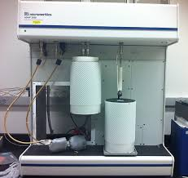

Slide 4
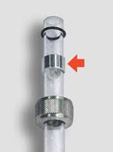
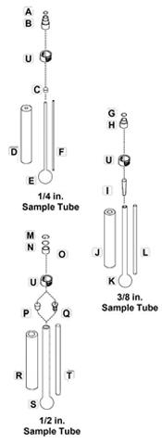
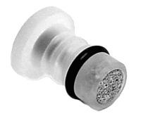

Slide 5
What is a Gas Sorption Analyzer?
Does it actually measure surface area and pore size?
NO!! It simply records various pressures of gas in the sample cell due to adsorption and desorption. The instrument then calculates the amount (as STP volume) of gas adsorbed/desorbed.
Surface area, pore size are calculated by PC software
Pressure measurements are critical!

Slide 6
Low Surface Area Materials
Vapour pressure at 77 K
Kr = 267 Pa N₂ = 101325 Pa
The gas adsorption amount in the volumetric method is calculated from the difference between the number of dosed molecules and number of unadsorbed gas molecules at equilibrium pressure.
In other words, by assuming both molecular sizes equal and adsorption pressure equal to 50 Pa, it is necessary to measure the pressure change of 0.16% (=50/30400) for N₂ and 63% (=50/1830) for Kr at the same relative pressure (P/Po=0.3, N₂=30400Pa, Kr = 80Pa).
Obviously, it is easier to measure larger pressure change, and therefore, the accuracy of the measurement is better. For this reason, the lower the saturation vapour pressure at the adsorption measurement temperature, the more accurate the measurement of low surface areas and so Xe, with vapour pressure equal to 0.23 Pa at 77 K, is still a better gas to measure low surface areas. Unfortunately, Xe is much more expensive than Kr.
Nitrogen 0.162 nm²
Krypton 0.210 nm²
https://www.microtrac.it/it/applicazioni/conoscenza-base/method-of-small-surface/

Slide 7
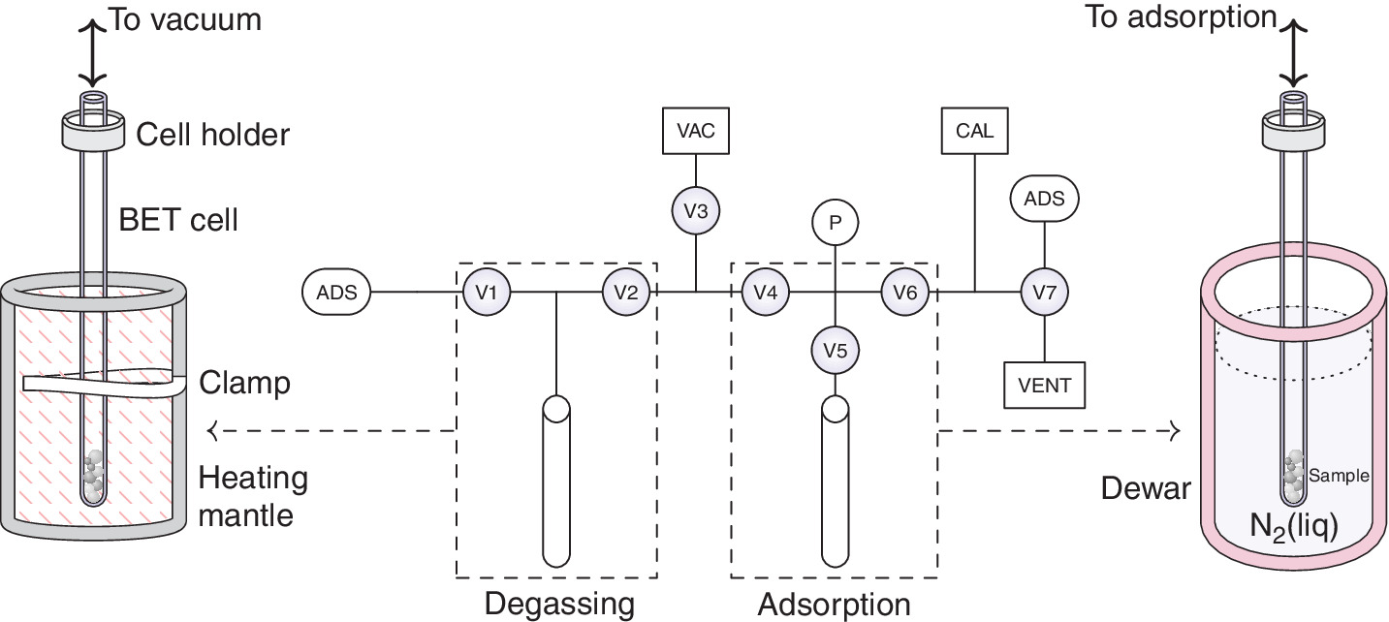
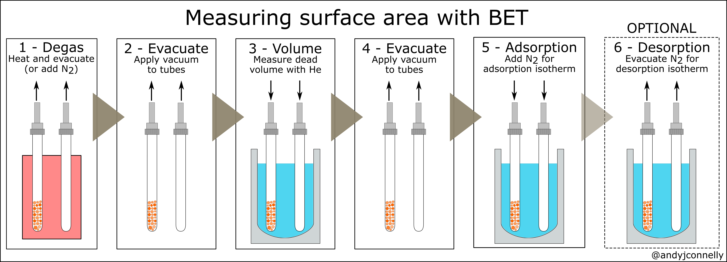
https://andyjconnelly.wordpress.com/2017/03/13/bet-surface-area/

Slide 8
Degas
Important step before measurement of surface area or pore size/volume
Surfaces armust be ‘cleaned’ of water/organic vapours in two ways:
With heating under a vacuum
Under a flow of dry, inert gas.
No modification must be induced

Slide 9
What is the result?
Desorption curve may overlay on,
or appear to left of,
the adsorption curve
The values on the y-axis are calculated from pressure measurements (and temperature values)

Slide 10
What to Analize?

Slide 11
What to Analize?

Slide 12
What to Analize?

Slide 13
What to Analize?

Slide 14
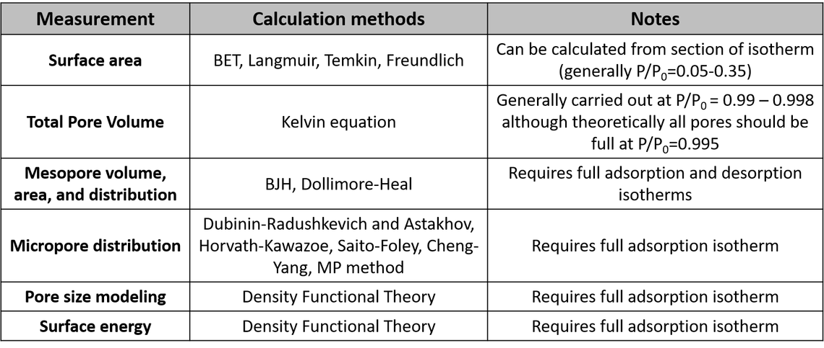

Slide 15
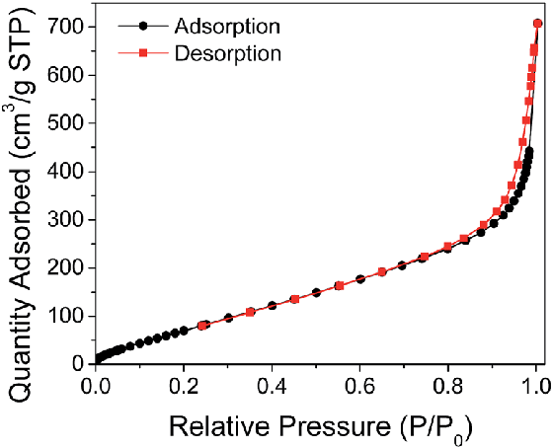
Total Pore Volume

Slide 16
Pore Size: Kelvin Equation

Slide 17
Pore Size: Kelvin Equation

Slide 18
