Slide 1
Chemisorption, surface area and metal dispersion

Slide 2
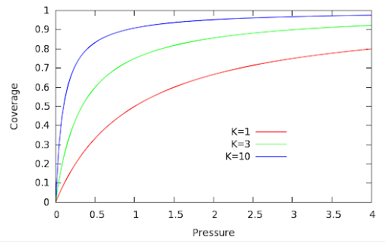

Slide 3
Metal surface atoms (N_{(s)M}) and metal surface area (S_{M})
n = number of surface metal atoms that are occupied by the chemisorption of a gas molecule.
ex : H₂ on Pt : n = 2 because of dissociative adsorption: 1 molecule H₂ dissociates to 2 H atoms adsorbed on 2 Pt atoms
v adsorbed gas volume
V_{m} volume of a mole of metal atom
N_{a} Avogadro’s number
S surface of one metal atom

Slide 4
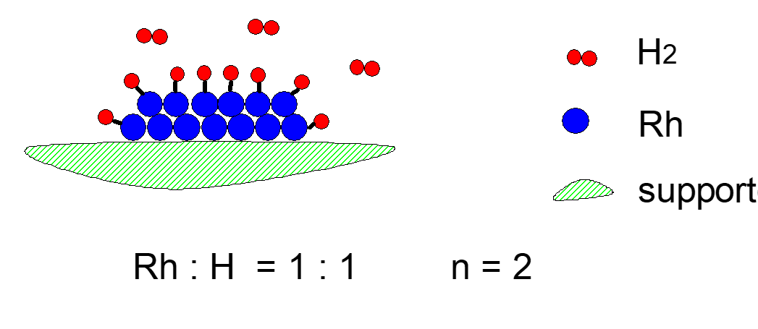
Chemisorption stoichiometry
corner atoms are usually more active than atoms on the flat surfaces
stoichiometry of chemisorption may also change
Nanoparticle < 1nm → n < 2

Slide 5
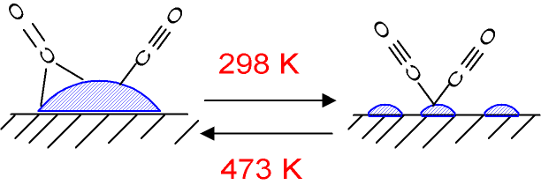
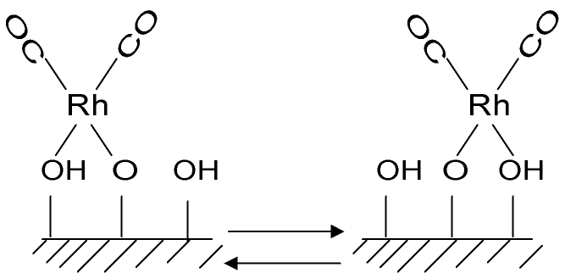
Rh/Al₂O₃

Slide 6
Chemisorption and Physisortion: the role of support in nanocomposites
Gas adsorption
Pressure
Physisorption is investigated at 77 K but occurs at higher temperature

Slide 7
Chemisorption and Physisortion: the role of support in nanocomposites
Adsorption
Pressure

Slide 8
1.1% Pt/γ-Al₂O₃
Adsorbimento a 573 K di H₂. Curva (a) adsorbimento su 2.031 g di catalizzatore, (c) adsorbimento su 1.00 g di Al₂O₃, (d) adsorbimento su quantità di supporto corrispondente a quella del campione (2.00 g) ed espressa nella stessa scala della curva (a), (b) differenza tra la curva a e d.

