Slide 1
Precipitation of magnetite Fe₃O₄ nanoparticles
2 Fe³⁺ + Fe²⁺ + 8 OH⁻ → Fe₃O₄↓ + 4 H₂O
The size and shape of the nanoparticles can be controlled by adjusting pH, ionic strength, temperature, or the Fe(II)/Fe(III) concentration ratio.
Optimum conditions for this reaction are pH between 8 and 14, Fe³⁺/Fe²⁺ ratio of 2:1 and a non-oxidizing environment.
2 Fe₃O₄ + O₂ → 2 γ - Fe₂O₃ maghemite
"Magnetic Iron Oxide Nanoparticles: Synthesis, Stabilization, Vectorization, Physicochemical Characterizations, and Biological Applications". Chemical Reviews. 108 (6): 2064–110

Slide 2
Ferrofluid Fe₃O₄ nanoparticles
Ferrofluids are composed of very tiny nanoscale particles (diameter usually 10 nanometers or less) of magnetite, hematite or some other compound containing iron, and a liquid. This is small enough for thermal agitation to disperse them evenly within a carrier fluid, and for them to contribute to the overall magnetic response of the fluid.
Common ferrofluid surfactants
The surfactants used to coat the nanoparticles include, but are not limited to:
oleic acid
tetramethylammonium hydroxide
citric acid
soy lecithin
These surfactants prevent the nanoparticles from clumping together, ensuring that the particles do not form aggregates that become too heavy to be held in suspension by Brownian motion. The magnetic particles in an ideal ferrofluid do not settle out, even when exposed to a strong magnetic, or gravitational field.

Slide 3
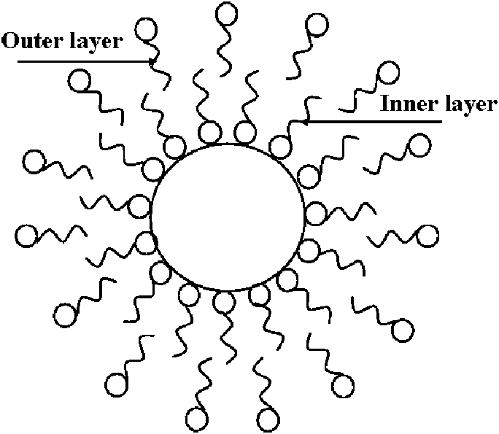
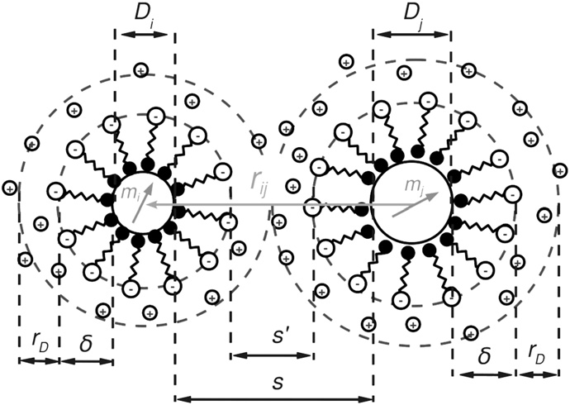
Ferrofluid surfactants
A surfactant has a polar head and non-polar tail (or vice versa), one of which adsorbs to a nanoparticle, while the non-polar tail (or polar head) sticks out into the carrier medium, forming an inverse or regular micelle, respectively, around the particle.
Electrostatic repulsion then prevents agglomeration of the particles.

Slide 4
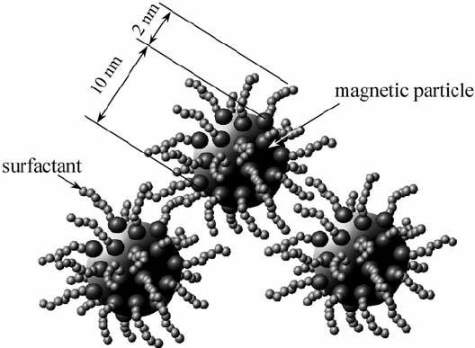
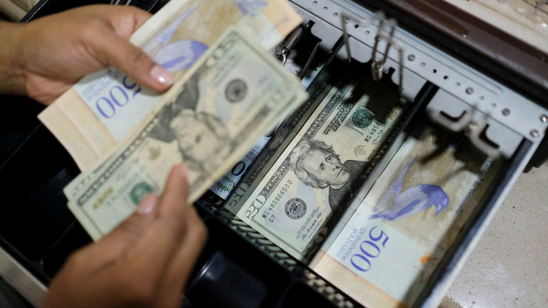
Ferrofluid surfactants
The addition of surfactants decreases the packing density of the ferroparticles while in its activated state, thus decreasing the fluid's on-state viscosity, resulting in a "softer" activated fluid. While the on-state viscosity (the "hardness" of the activated fluid) is less of a concern for some ferrofluid applications, it is a primary fluid property for the majority of their commercial and industrial applications and therefore a compromise must be met when considering on-state viscosity versus the settling rate of a ferrofluid.
The backgrounds from behind the president's face on a $1, $5 and $10 bill: Note the different spacing used in each one.

Slide 5
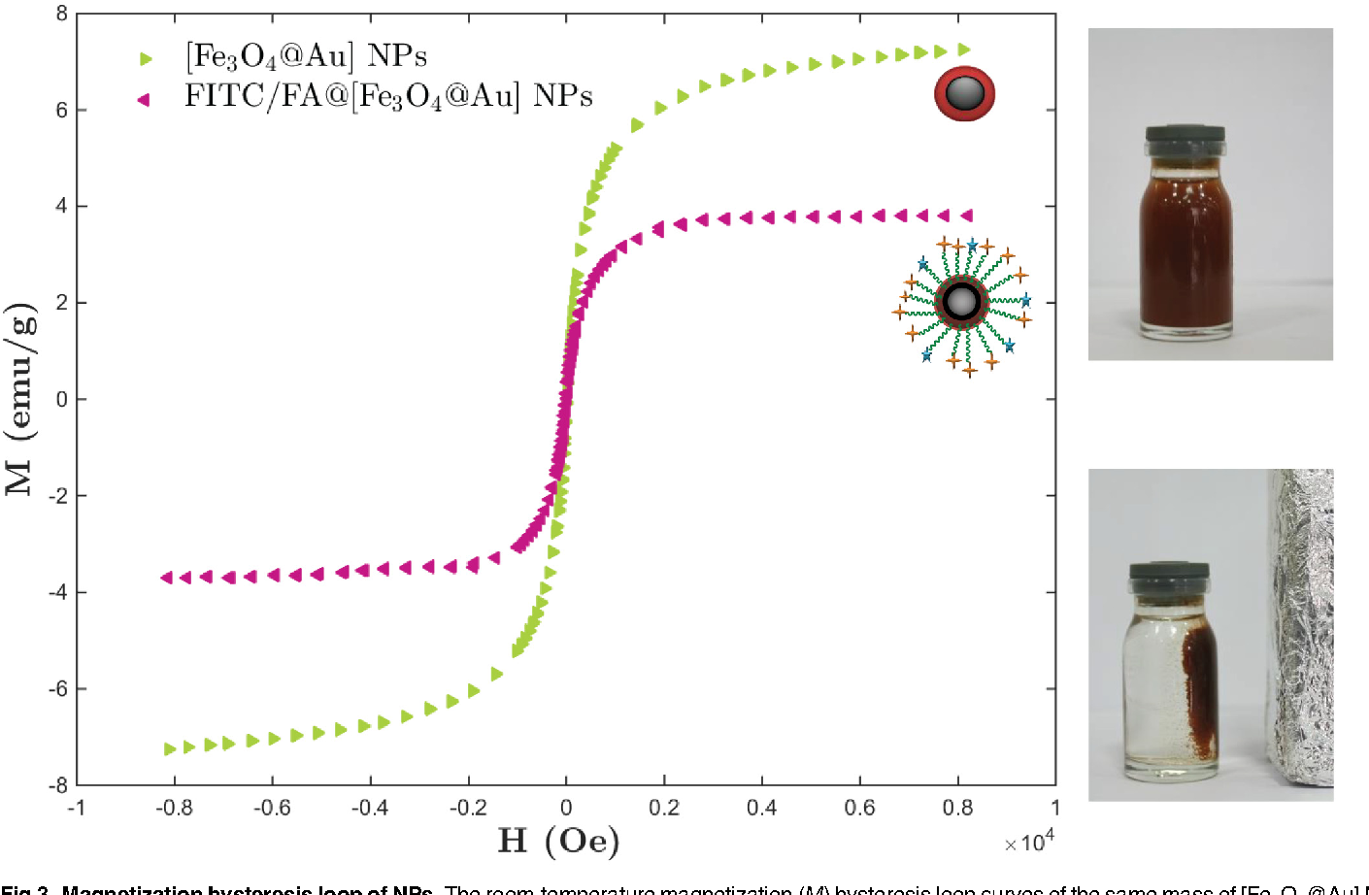
Ferrofluid surfactants
While surfactants are useful in prolonging the settling rate in ferrofluids, they also prove detrimental to the fluid's magnetic properties (specifically, the fluid's magnetic saturation).
Magnetic saturation is the state reached when an increase in applied external magnetic field H cannot increase the magnetization of the material further.

Slide 6
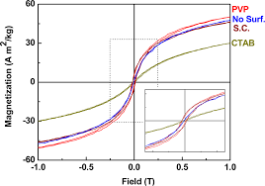
Ferrofluid surfactants
Surfactants prove detrimental to the fluid's magnetic saturation.
Size effects
J.Phys.Chem.C 2014, 118, 16209−16217

Slide 7
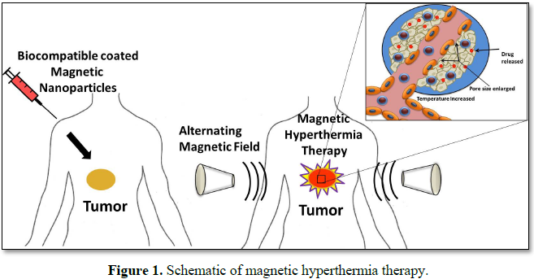
Fe₃O₄ nanoparticles anticancer applications
Iron oxide nanoparticles may be used in magnetic hyperthermia as a cancer treatment method. In this method, the ferrofluid which contains iron oxide is injected to the tumor and then heated up by an alternating high frequency magnetic field. The temperature distribution produced by this heat generation may help to destroy cancerous cells inside the tumor.

Slide 8
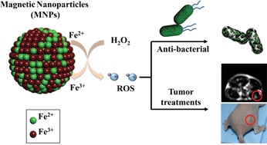
Fe₃O₄ nanoparticles anticancer applications
Iron oxide nanoparticles are used in cancer magnetic nanotherapy that is based on the magneto-spin effects in free-radical reactions and semiconductor material ability to generate oxygen radicals, furthermore, control oxidative stress in biological media under inhomogeneous electromagnetic radiation. The magnetic nanotherapy is remotely controlled by external electromagnetic field reactive oxygen species (ROS) and reactive nitrogen species (RNS)-mediated local toxicity in the tumor during chemotherapy with antitumor magnetic complex and lesser side effects in normal tissues.
J. Mater. Chem. B, 2013,1, 5100-5107

Slide 9
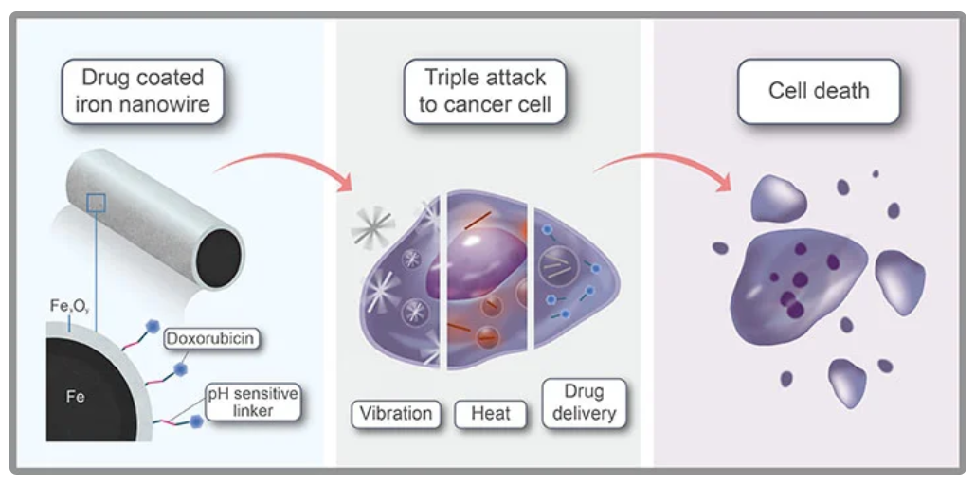
Fe₃O₄ nanoparticles
Magnetic complexes that consist of iron oxide nanoparticles loaded with antitumor drug have additional advantages over conventional antitumor drugs due to their ability to be remotely controlled while targeting with a constant magnetic field and further strengthening of their antitumor activity by moderate inductive hyperthermia (below 40 °C).

Slide 10
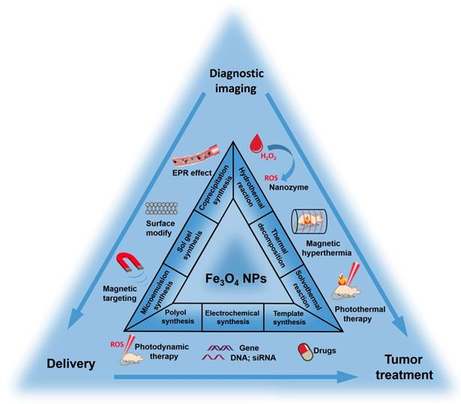
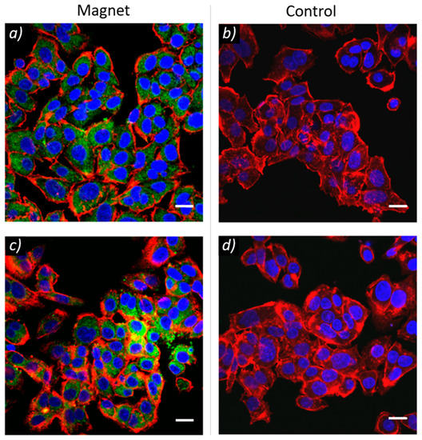
Fe₃O₄ nanoparticles
Multifunctional magnetic complexes with magnetic memory can combine cancer magnetic nanotherapy, tumor targeting and medical imaging functionalities in theranostics approach for personalized cancer medicine.

Slide 11
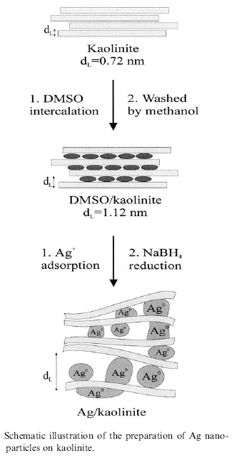
Colloidal methods: Silver
The reduction of AgNO₃ by NaBH₄ in aqueous solution can produce small diameter (< 5nm) silver nanoparticles.
The reduction can take place even in confined space, such as between layers of kaolinite, a layered silicate clay material that functions to limit particle growth.
Dimethyl sulfoxide is used as a capping agent to prevent aggregation of the Ag particles.
R. Patakfalvi et al. / Colloids and Surfaces A: Physicochem. Eng. Aspects 220 (2003) 45/54

Slide 12
Sol-Gel technique
Sol-gel technology is a well established colloidal chemistry technology, which offers possibility to produce various materials with novel, predefined properties in a simple process and at relatively low process cost.
The sol is a name of a colloidal solution made of solid particles (50-100 nm in diameter) suspended in a liquid phase.
+
The gel can be considered as a solid
scaffold incorporating the solvent.
Sol-gel process consists
in the chemical transformation of a liquid (the sol)
into a gel state and with subsequent post-treatment
and transition into solid oxide material.
The point of gelification depends on pH, ionic strength, temperature,
concentration….
The main benefits of sol–gel processing are
the high purity and uniform nanostructure
achievable at low temperatures.
Ultra-fine α-alumina 99.99%, high purity & ultra-fine TiO₂, SiO₂ & Al₂O₃ with controlled porosity

Slide 13
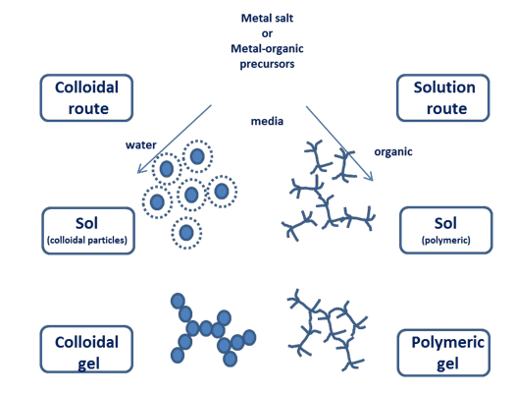

Slide 14
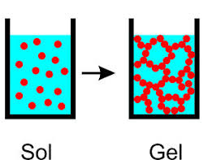
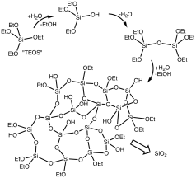
Sol-Gel technique
partial hydrolysis of metal alkoxides to form reactive monomers,
M-OR + H₂O → M-OH + ROH
2. condensation of these monomers to form colloid-like oligomers (sol formation),
M-OH + XO-M → M-O-M + X-OH (X = H o R) water or alcohol condensation
M-OH + XO-M → M-(OH)-M-OX (X = H o R)
3. additional hydrolysis to promote polymerization
and cross-linking leading to a three-dimensional
matrix (gel formation).
This process occurs in liquid solution of organometallic precursors (Tetramethyl orthosilicate (TMOS), Tetraethyl orthosilicate (TEOS), Zr(IV)-Propoxide, Ti(IV)-Butoxide, etc. ), which, by means of hydrolysis and condensation reactions, lead to the formation of a new phase (SOL).

Slide 15
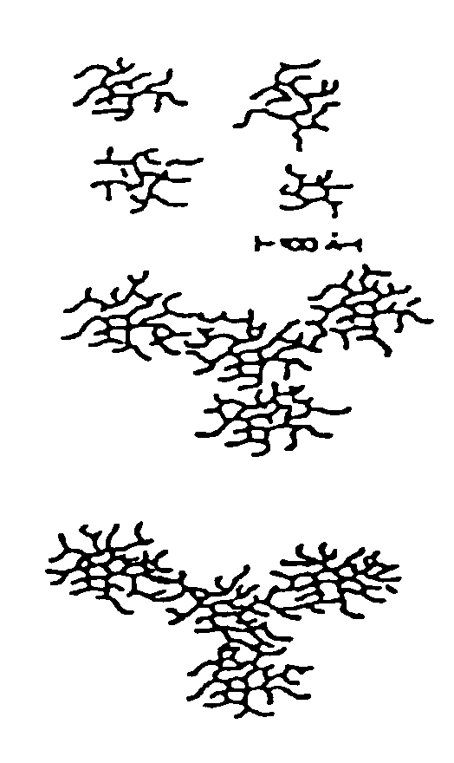
Basic catalysis
δ⁻
δ⁻
Away from gelation point: isolated branched structure
Closed to gelation point
Growth and branch
Gelation point
Interconnected Polymers

Slide 16
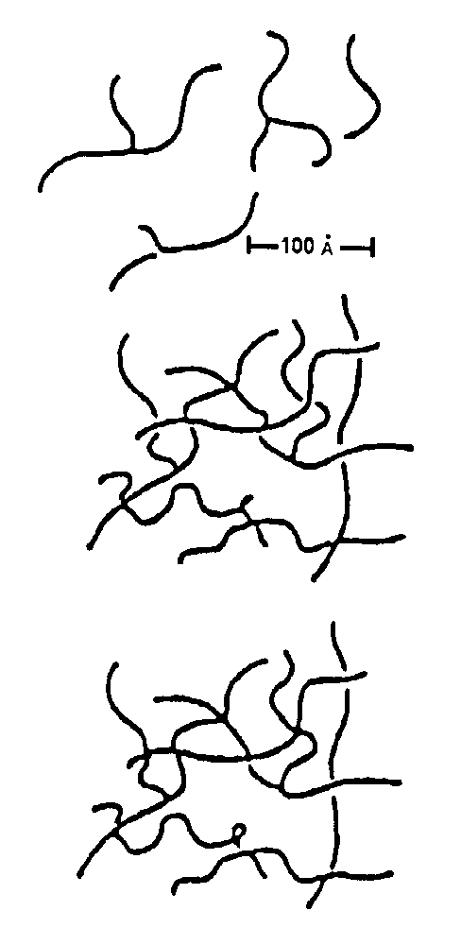
Acid Catalysis
+
δ⁺
δ⁺
Away from gelation point
Closed to gelation point
Primary interconnection
Gelation point
Branching from the interconnection points

Slide 17
Sol-Gel technique
In the case of the colloid, the particle density may be so low that a significant amount of fluid may need to be removed initially for the gel-like properties to be recognized. The simplest method is to allow time for evaporation and sedimentation to occur, and then, if necessary, pour off the remaining liquid. Centrifugation can also be used to accelerate the process of phase separation.
Removal of the remaining liquid (solvent) phase requires a drying process, which is typically accompanied by a significant amount of shrinkage and densification. The rate at which the solvent can be removed is ultimately determined by the distribution of porosity in the gel. The ultimate microstructure of the final component will clearly be strongly influenced by changes imposed upon the structural template during this phase of processing.

Slide 18
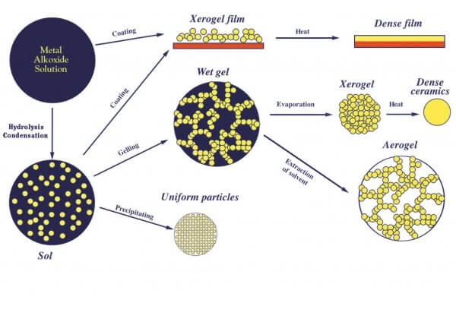
Sol-Gel technique

Slide 19
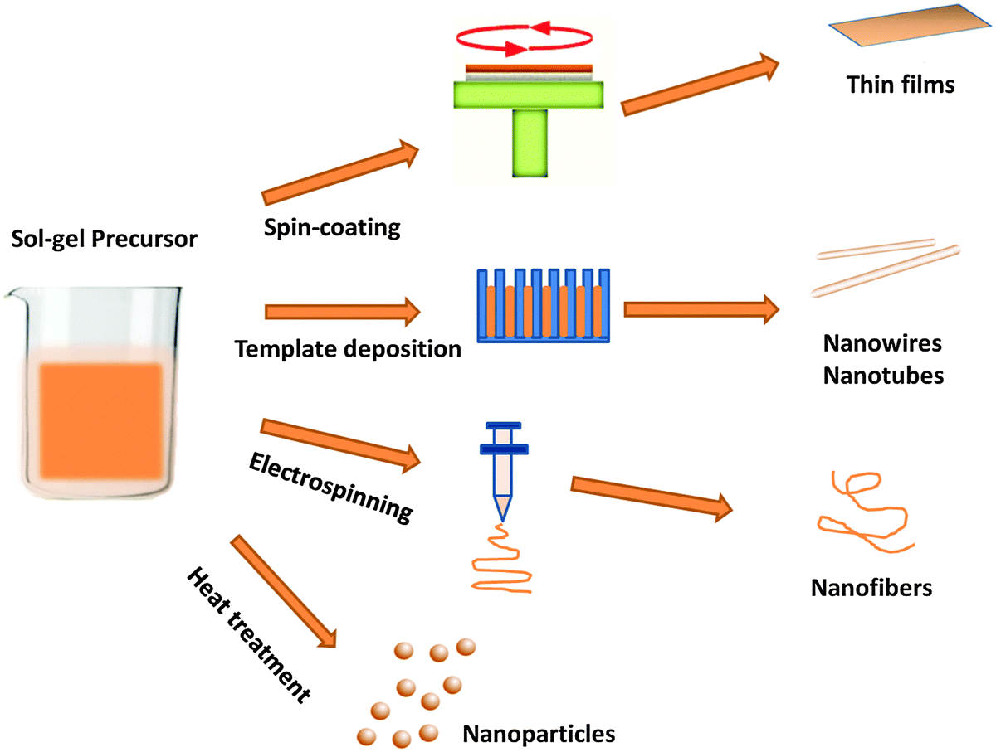
Sol-Gel technique

Slide 20
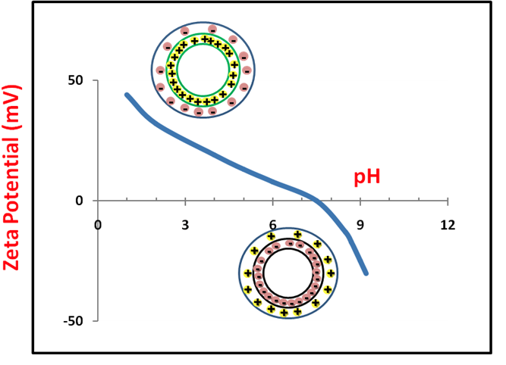
Sol-Gel technique
At low pH the particle surface is protonated and positively charged.
At high pH the particle surface is negativelly charged.
Surface charge is compensated by ions in solution.
The zeta potential is a key indicator of the stability of colloidal dispersions. The magnitude of the zeta potential indicates the degree of electrostatic repulsion between adjacent, similarly charged particles in a dispersion. For molecules and particles that are small enough, a high zeta potential will confer stability, i.e., the solution or dispersion will resist aggregation.

Slide 21
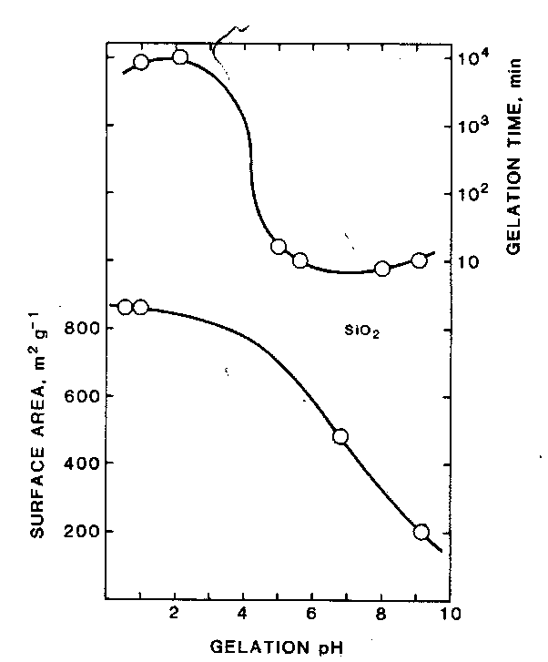
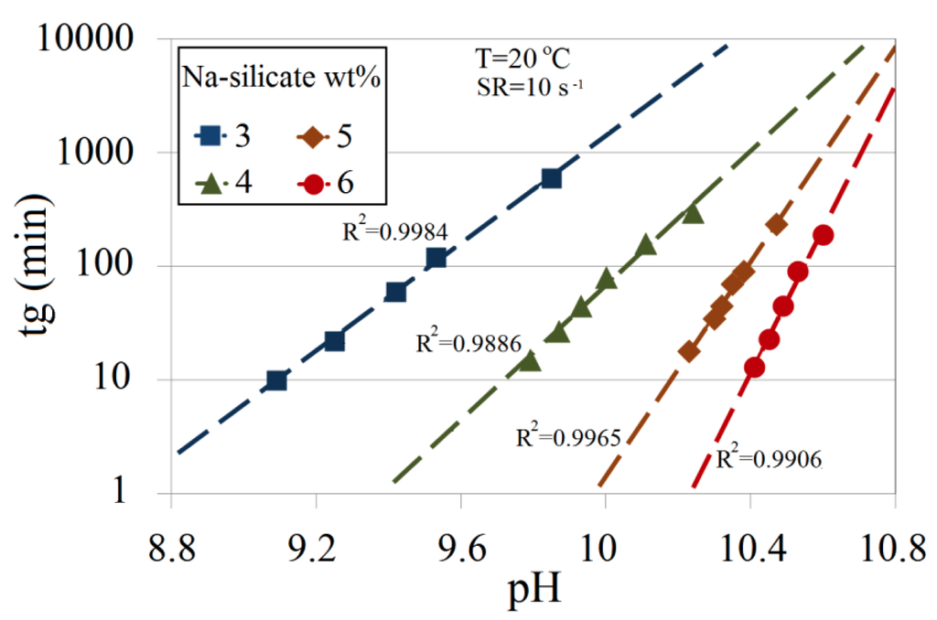
Stability behavior of a colloid depending on zeta potential
Zeta potential (mV) | Stability behavior
0 to ±5 | Rapid coagulation or flocculation
± 10 to ± 30 | Incipient instability
± 30 to ± 40 | Moderate stability
± 40 to ± 60 | Good stability
> 61 | Excellent stability
Gelation time is minimum at zero zeta potential (IEP)
Dependence of Silica gelation time from pH and concentration
Energies 2014, 7, 568-590

