Slide 1
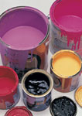
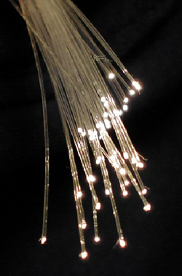
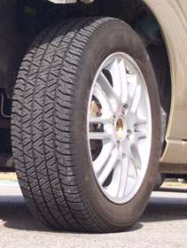
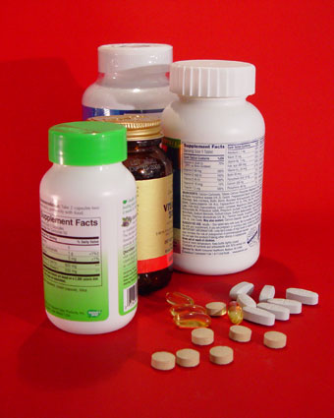
Pyrolysis: Industrial method for many products
TiO₂
Tires
Optical
fibers
Paints
SiO₂
Carbon Black
Makeup
Carbon black - 8 million tons $8 billion
TiO₂ - 2.5 million tons, $5 billion
SiO₂ - 2.0 million tons, $2 billion
Inks

Slide 2
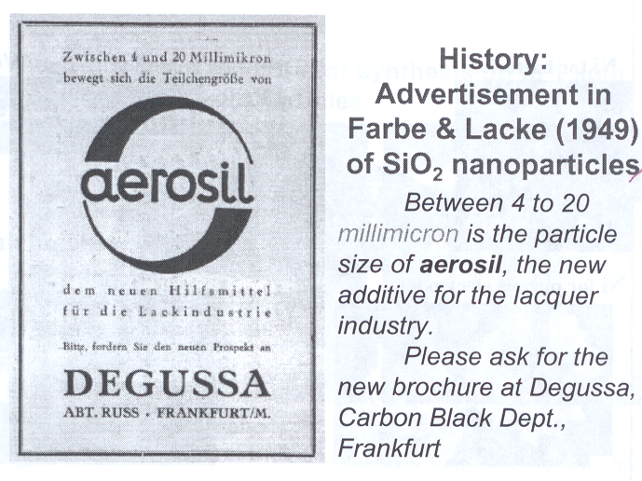

Slide 3
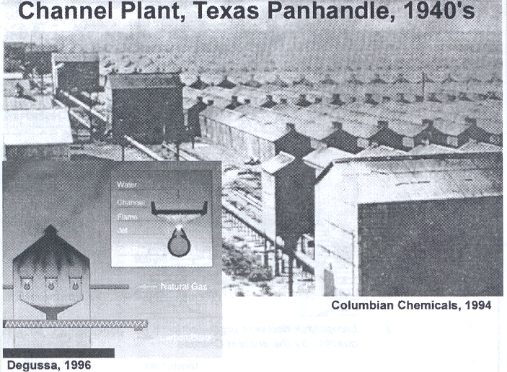

Slide 4
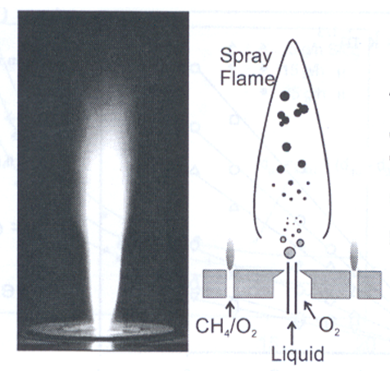
Pyrolysis: popular method for creating nanoparticles, especially oxides
A precursor (liquid or gas) is forced through an orifice at high pressure and burned.
The resulting ash is collected to recover the nanoparticles.
Large volume of gas leads to high rate of material synthesis.
Flame Spray Pyrolysis (FSP)
Aggregation
Condensation
Coagulation
Nucleation
Droplet evaporation
Versatile
Large Variety of precursors
Controllable
Scalable

Slide 5
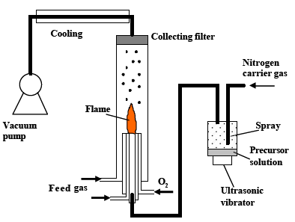
Pyrolysis: System Overview

Slide 6
Pyrolysis
Aggregates and Agglomerates:
Aggregate – An assemblage of particles rigidly joined together by chemical or sinter-forces.
Agglomerate – A loosely coherent assembly of particles and/or aggregates held together by weak interactions
Aggregates Agglomerates

Slide 7
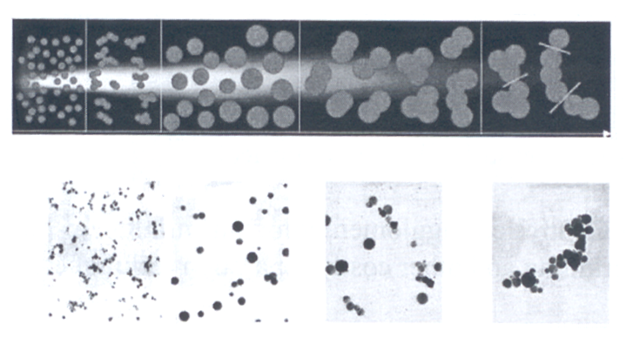
Pyrolysis: Agglomerate Formation Sequence
TiO₂
Monomers
Transient Hard
Agglomerates
Spherical
Particles
Hard Agglomerates
Soft Agglomerates
Distinction between hard and soft agglomerates is largely empirical.
Controlled agglomeration can minimize post-grinding and other costly separation techniques.

Slide 8
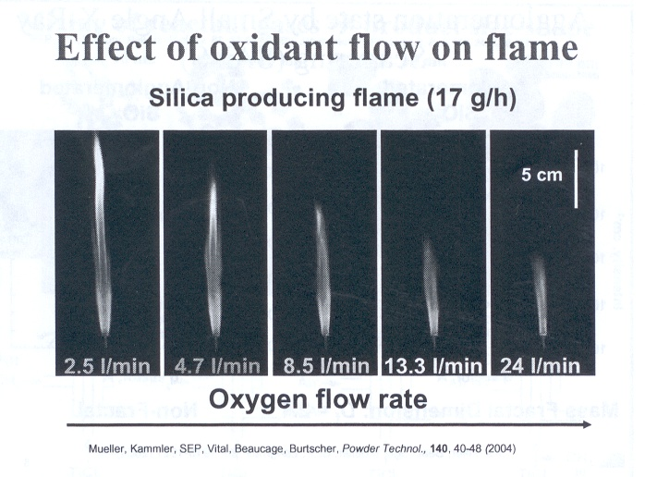
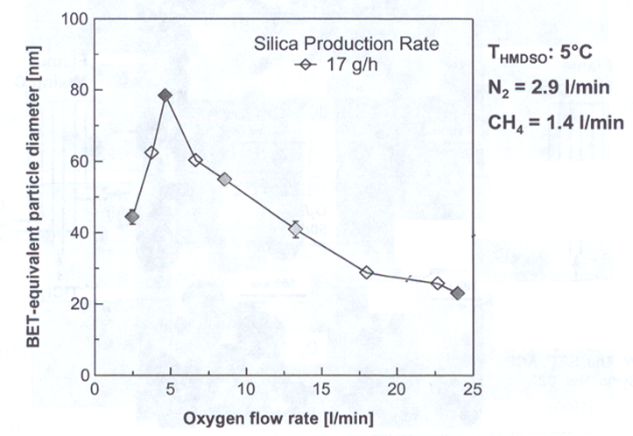
Pyrolysis: Particle Size Controlled by O₂ Flow
Impact of oxygen
Aids in combustion
Provides chemistry in the reaction
Acts as a dilutent, cools the flame, prevents agglomeration
All of these variables can be decoupled by burner design. Which is cheaper than increasing oxygen flow.
Excess oxygen makes the flame burn cooler resulting in smaller diameter particles

Slide 9
Flame Pyrolysis
Particle Formation and Growth by Gas Phase Chemical Reaction, Coagulation, Sintering and Surface Growth:
O₂
TTIP
Molecules
TiO₂
Molecules
TiO₂
Particles
TiO₂
Aggregates
Decreasing Temperature
Titanium-Tetra-Iso-Propoxide
C₃H₇O
OC₃H₇
Ti
C₃H₇O
OC₃H₇

Slide 10
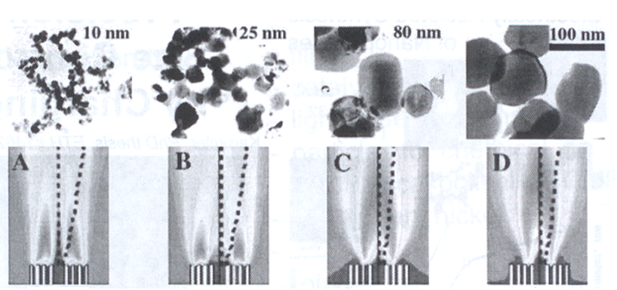
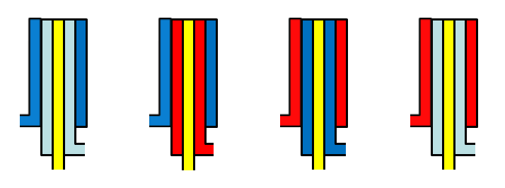
Flame Pyrolysis: Jet Design
CH₄
CH₄
Air
Air
Air
CH₄
Air
Air
TiCl₄
TiCl₄
TiCl₄
TiCl₄

Slide 11
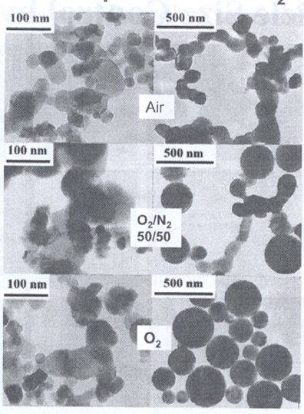
Flame Pyrolysis: Jet Design
Effect of Oxidant Composition on TiO₂ Morphology:
Flame mixing B
Flame mixing C
CH₄
Oxidant
Oxidant
CH₄
TiCl₄
TiCl₄

Slide 12
Flame Pyrolysis: Nozzle Quenching
Desired
Flame length is controlled by rapid quenching
Prevents agglomeration by inhibiting growth processes in the early stages of growth.
Provides precise control of particle size
Vapor

Slide 13
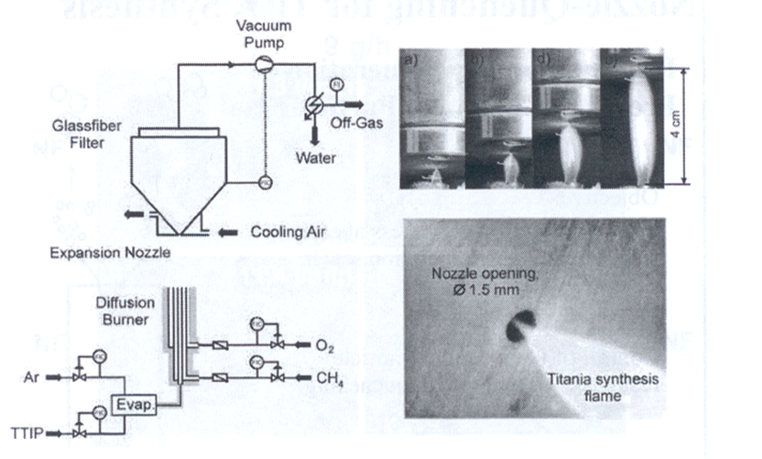
Flame Pyrolysis: Nozzle Quenching
Nozzle Quenching controls flame length and particle size.

Slide 14
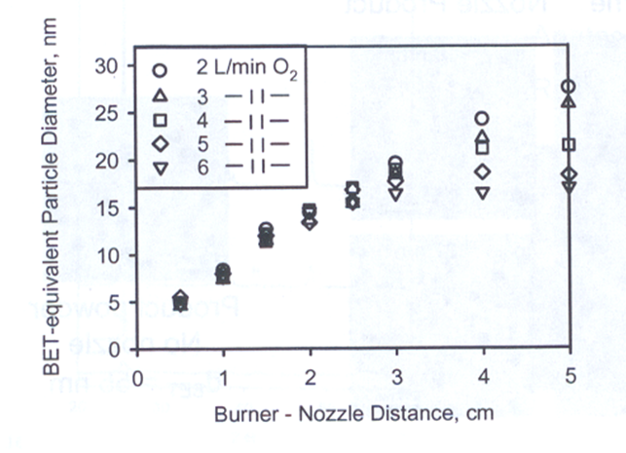
Flame Pyrolysis: Nozzle Quenching
TiO₂ Particle Size Control by Nozzle Quenching

Slide 15
Pyrolysis: Electrostatic Charging
Particle size can also be controlled by generating an electric field across the flame.
A large electric field (hundreds of kV/m) is generated between two plate electrodes situated on opposite sides of the flame.
Similar to nozzle quenching, the electric field limits particle growth by reducing the residence time in the high temperature region of the flame.
In addition, the electric field charges the particles. This results in electrostatic repulsion between newly formed particles, preventing coagulation.
S. Vemury, S.E. Pratsinis, L. Kibbey, Electrically-controlled flame synthesis of nanophase TiO₂, SiO₂, and SnO₂ powders. JMR, Vol. 12, 1031-1042. 1997.

Slide 16
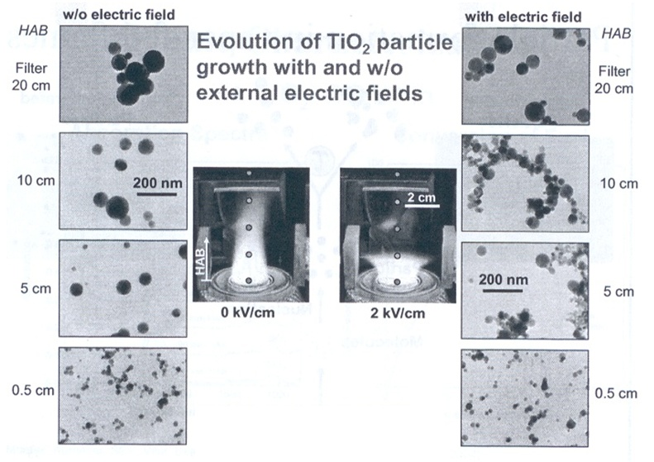
Pyrolysis: Electrostatic Charging

Slide 17
Flame Pyrolysis: Advantages & Disadvantages
Pyrolysis is a high yield method that can fulfill the strong demand for nanoparticles.
Can be customized to produce unique nanoparticles.
Broad distribution of particle sizes and morphology.

Slide 18
Spray Pyrolysis
An aerosol process that
atomize a solution and
heats the droplets to
produce solid particles.
Simple and low cost for powder and thin film deposition process
Applicable to large areas;
No need of exotic or expensive precursors;
No need of vacuum.

Slide 19
Spray Pyrolysis
Metals (Cu, Ni, Co,…) and metal oxides powders
Converting microsized liquid droplets of precursors or precursors mixture into solid particles trough heating
Droplets → evaporation → solute condensation → decomposition & reaction → sintering
e.g. silver particles made from Ag₂CO₃ or AgNO₃ with NH₄HCO₃ @ 400 °C

Slide 20
Spray Pyrolysis
The precursor must be dissolved in the liquid, but not react with it.
The product must not dissolve in the liquid, and must not react with the liquid.
There must be a large volume decrease for the reaction of precursor to product.
Transport of the leaching agent in the liquid and the fugitive compounds formed must be sufficiently rapid.

Slide 21
Spray Pyrolysis Advantages
Spherical morphology
Narrow particle size distribution
Easy preparation of powders with complex formation
Relatively homogeneous composition
Continuously production
Reaction occurs at the microcapsule reactor (droplets)

Slide 22
Spray Pyrolysis limitations
Technique is quite empirical, with a number of variables that can affect the final product:
- solute concentration
- atomization technique
- temperature, temperature gradient
- residence time in furnace
- carrier gases

Slide 23
Spray Pyrolysis

Slide 24
Spray Pyrolysis
Nozzle to substrate distance
Droplet size: relates to size of product
Substrate temperature
Solution concentration
Solution flow rate
Atomization rate – affects scalability of the process
Droplet velocity – affects residence time with the furnaces and ultimately size particle

Slide 25
Spray Pyrolysis

Slide 26
Spray Pyrolysis
Messing et al. J. Am.Ceram.Soc 1993

Slide 27
Spray Pyrolysis
Droplet to particles conversion process

Slide 28
Heating Time, Heating Temperature

Slide 29
Spray Pyrolysis

Slide 30
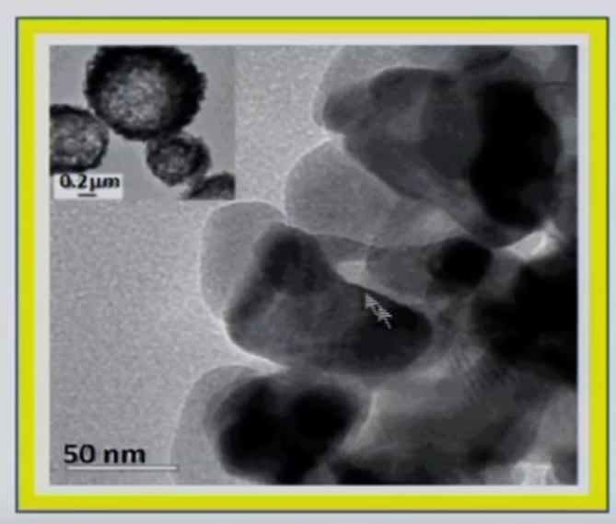
Spray Pyrolysis
Low temperature and high initial solute concentrations Dense particles (aggregates of nanocrystals)
High temperature and high solvent evaporation rate Hallow particles
Nanoparticle < 100 nm
Dilute solutions and
very small initial droplet size

Slide 31
Conventional Spray Pyrolysis

Slide 32
Low Pressure Spray Pyrolysis

Slide 33
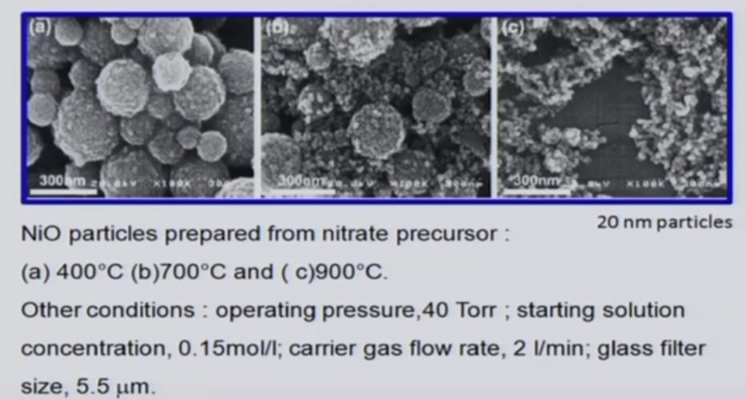
Low Pressure Spray Pyrolysis

Slide 34
Salt-assisted Spray Pyrolysis

Slide 35
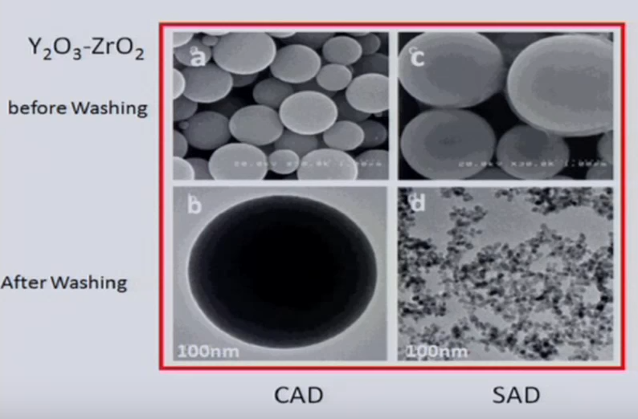
Conventional vs Salt-assisted Spray Pyrolysis
Conventional Salt-assisted

Slide 36
Electrospray Pyrolysis
By applying a 3KV electric field to the liquid coming from a cylindrical tube, it becomes conic.

Slide 37
Electrospray Pyrolysis

Slide 38
https://www.youtube.com/watch?v=I4w0nlrVU94

Slide 39
https://www.youtube.com/watch?v=hRDD4l1dzaI

Slide 40
Spray Process
https://www.youtube.com/watch?v=mmtXFlIQD9E

Slide 41
Spray Pyrolysis: nanofilm
https://www.youtube.com/watch?v=eJbuY4HJFV0

Slide 42
Flame Spray Pyrolysis: nanofilm
https://www.youtube.com/watch?v=pAYsH7xnV6s

