Slide 1
Chemical Vapor Deposition
Chemical vapor deposition (CVD) is a vacuum deposition method used to produce high quality, high-performance, solid materials from a gas precursor.
Thermal decomposition :
SiH₄ (g) ⟶ Si (s) + 2 H₂ (g) 650 °C
Reduction :
WF₆ (g) + 3 H₂ (g) <-> W(s) + 6 HF (g) 300 °C
Oxidation :
SiH₄ (g) + O₂ (g) ⟶ SiO₂ (s) + 2 H₂ (g) 450 °C
Compound formation :
BF₃ (g) + NH₃ (g) ⟶ BN (s) + 3 HF (g) 1100 °C

Slide 2
Chemical Vapor Deposition

Slide 3
https://www.youtube.com/watch?v=9XKGVHPXXho

Slide 4
Oxides preparation
Various metal oxides can be prepared by the reaction of a volatile metal compound (often a chloride) with O₂ or water vapor:
MX_{n} (g) + (n/4) O₂ (g) → MO_{n/2} (s) + (n/2) X₂ (g)
MX_{n} (g) + (n/2) H₂O (g) → MO_{n/2} (s) + n HX₂ (g)
The water vapor can be directly introduced or obtain in the reaction chamber from a suitable reaction:
1) CO₂ + H₂ ↔ CO + H₂O
2) O₂ + H₂ → H₂O
3) C_{x}H_{y} + O₂→ CO₂ + H₂O

Slide 5
Chemical Vapor Deposition
Ultrahigh vacuum CVD (UHVCVD) – CVD at very low pressure, typically below 10⁻⁶ Pa ( ≈ 10⁻⁸ torr).
Low-pressure CVD (LPCVD) – CVD at sub-atmospheric pressures. Reduced pressures tend to reduce unwanted gas-phase reactions and improve product uniformity.
Atmospheric pressure CVD (APCVD) – CVD at atmospheric pressure.

Slide 6
LPCVD
https://www.coursera.org/lecture/nanotechnology/chemical-vapor-deposition-process-demonstration-EWSQl

Slide 7
CVD Classification by type of substrate heating
Hot wall CVD – CVD in which the chamber is heated by an external power source and the substrate is heated by radiation from the heated chamber walls.
Cold wall CVD – CVD in which only the substrate is directly heated either by induction or by passing current through the substrate itself or a heater in contact with the substrate. The chamber walls are at room temperature.

Slide 8
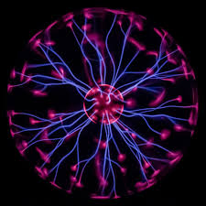
CVD and Plasma methods
Plasma is a state of matter in which an ionized gases becomes highly electrically conductive to the point that long-range electric and magnetic fields dominate the behavior of the matter.
Plasma Enhanced CVD (PECVD)
CVD that utilizes plasma to enhance chemical reaction rates of the precursors. PECVD processing allows deposition at lower temperatures, which is often critical in the manufacture of semiconductors. The lower temperatures also allow for the deposition of organic coatings, such as plasma polymers, that have been used for nanoparticle surface functionalization.

Slide 9
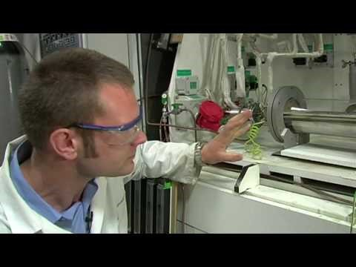
https://www.youtube.com/watch?v=gtJqNqXLg9w

Slide 10
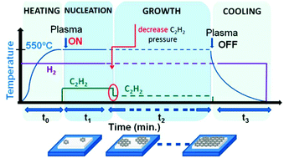
Direct synthesis of graphene on silicon oxide by low temperature plasma enhanced chemical vapor deposition
Nanoscale, 2018,10, 12779-12787

Slide 11
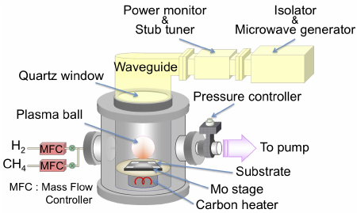
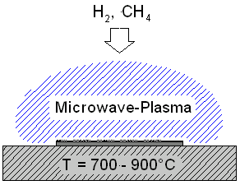
Microwave plasma-assisted CVD (MPCVD)

Slide 12
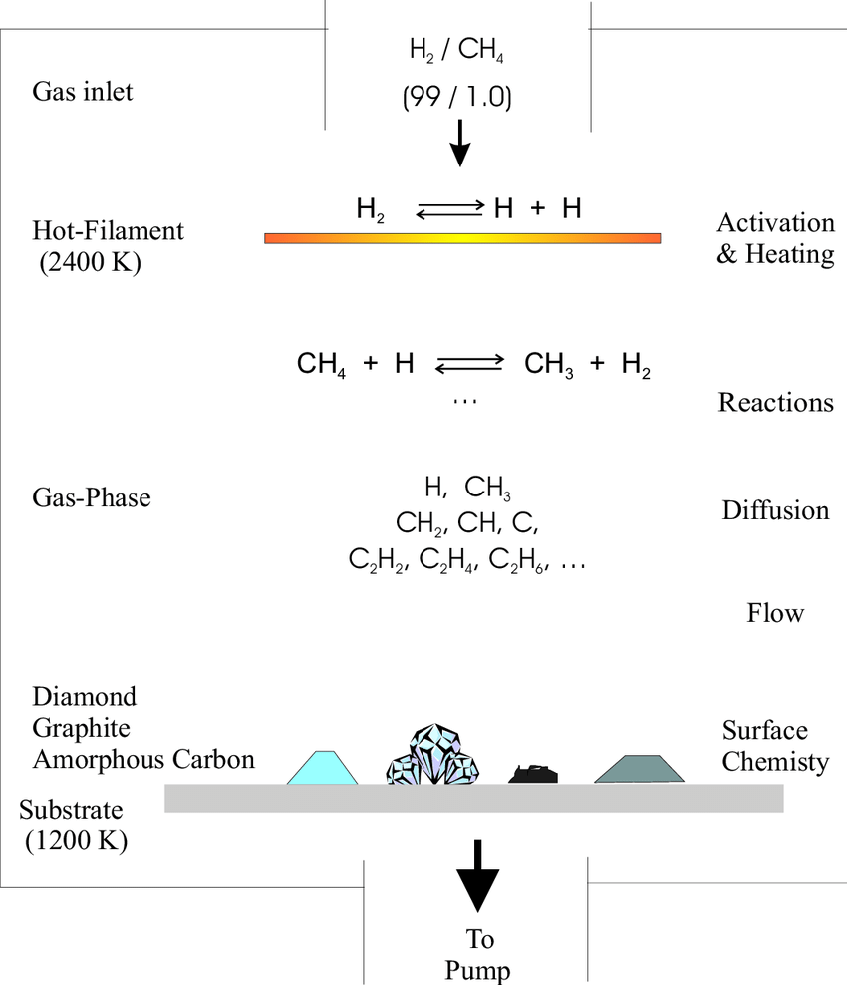
MW Plasma
Dissociation

Slide 13
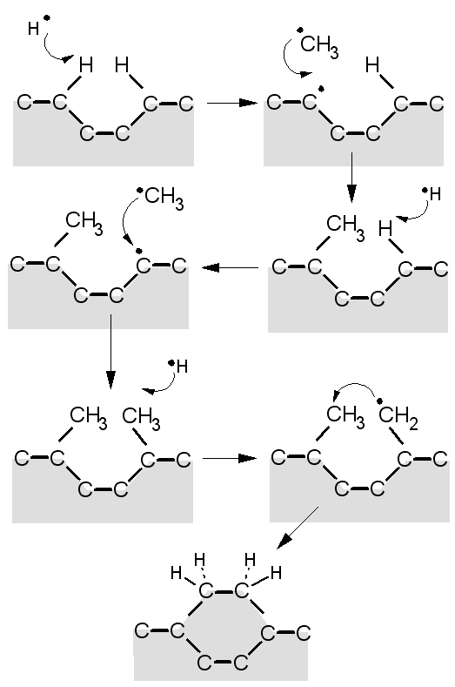
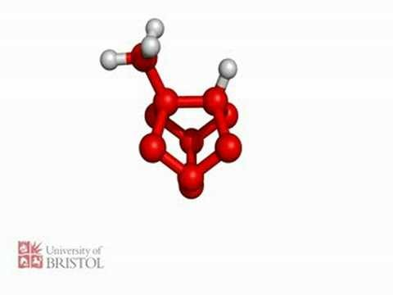
https://www.youtube.com/watch?v=n4hjudErUsQ
http://www.chm.bris.ac.uk/pt/diamond/mwpecvd1.htm

Slide 14
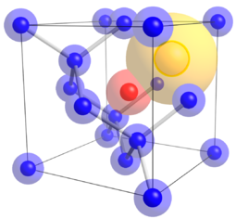
N-V center defect consists of a nitrogen atom in place of a carbon atom next to a vacancy within the diamond’s lattice structure.
Nitrogen-vacancy Center: the blue atoms represent Carbon atoms, red atom represents Nitrogen atom substituting for a Carbon atom, and yellow atom represents a lattice vacancy

Slide 15
Nanodiamonds: inertness and hardness
Skin care: Nanodiamonds are well-absorbed by human skin. They also absorb more of the ingredients in skin care products than skin itself. Thus they cause more of the ingredients to penetrate the deeper layers of the skin. Nanodiamonds also form strong bonds with water, helping to hydrate the skin.
Micro-abrasive: Polishes and engine oil additives for lubrication.
Catalysis: Support or metal free catalyst
Medical: low cytotoxicity of diamond nanoparticles affirms their utilization as biologically compatible materials. Drug delivery.
Sensors: electro- mechanical- system and response to magnetic field.
Optical and Quantum computing: Single-defect nanodiamonds.

Slide 16
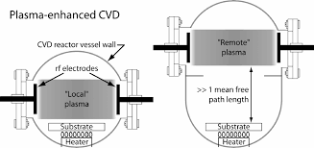
Remote Plasma-Enhanced CVD (RPECVD)
Similar to PECVD except that the wafer substrate is not directly in the plasma discharge region. Removing the wafer from the plasma region allows processing temperatures down to room temperature.

Slide 17
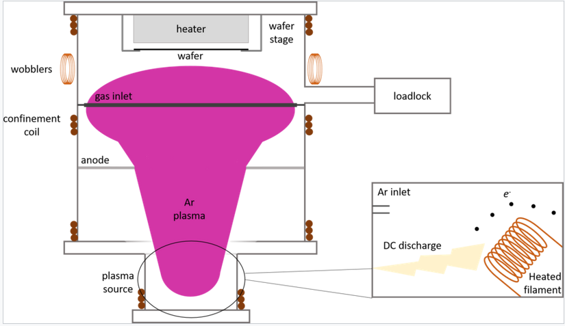
Low-Energy Plasma-Enhanced CVD (LEPECVD)
CVD employing a high density, low energy plasma to obtain epitaxial deposition of semiconductor materials at high rates and low temperatures.

Slide 18
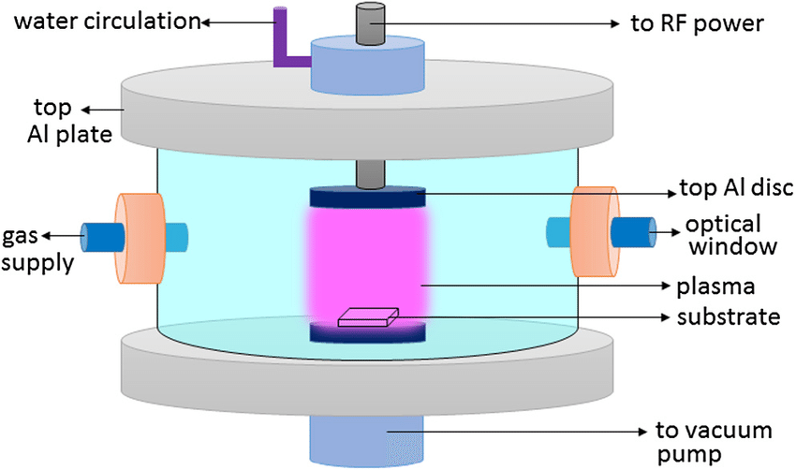
RF Plasma Synthesis

Slide 19
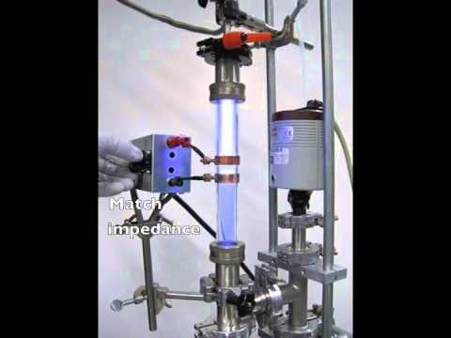
RF Plasma Synthesis
https://www.youtube.com/watch?v=5Un_HnOl6lQ

