Slide 1
Inquinamento atmosferico:
un problema dei nostri tempi?
Sarà tagliata la testa a chi verrà trovato colpevole
di bruciare carbone mentre il Parlamento è in sessione
King Edward I, 1311
…le unte, pesanti volute marrone che continuano
a passarci davanti ed a condensarsi in gocce oleose
sui vetri delle finestre...
A. Conan Doyle, 1895
Smog: Smoke + fog

Slide 2

History
OSHA stands for the Occupational Safety and Health Administration, an agency of the U.S. Department of Labor
OSHA’s responsibility is worker safety and health protection
On December 29, 1970, President Nixon signed the OSH Act
This Act created OSHA, the agency, which formally came into being on April 28, 1971

Slide 3
1995-1960 Public debate
1962 Silent Spring R. Carson (DDT and pesticide)
1961 Thalidomide (10.000 phocomelic kids - 5000 in Germany)
1971 Niagara falls artificial canal used for storing waste from chemical and plastic industries - benzene, dioxin,…- (1930-1950), 1953 cover with earth, sold to city hall, build a school… kids death, cancer,… 700 ppb, cost 20 million $, new city)
1970 Cuyahoga River (Ohio), flaming river due to the presence of organic pollutant
1982 Times Beach (Missuri) Dioxin pollution in 26 cities (300-700 ppb, cost 33 million $)

Slide 4
1970 Clean Air Act
1980 CFC
1986 Bhopal (1984) Union Carbide – pesticide production (carbaryl)
Storage of enormous quantities of reaction intermediates CH₃-N=C=O Methyl isocianate)
Cooling system out of service
Security alarm out of service
Water leakage into the storing tanks
Preassure increase in the storing tanks
Emergency Planning and Community Right-to-Know Act

Slide 5
What Rights Do You Have ?
You have the right to:
  A safe and healthful workplace
  Know about hazardous chemicals
  Information about injuries and illnesses in your workplace
  Complain or request hazard correction from employer
  Training
  Hazard exposure and medical records
  File a complaint
  Be free from retaliation for exercising safety and health rights

Slide 6
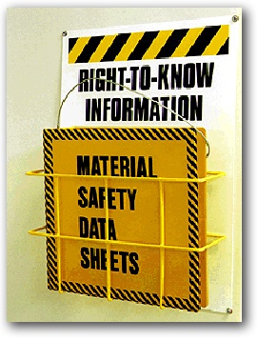
Your Right to Know about Hazardous Chemicals
Employers must have a written, complete hazard communication program that includes information on:
  Container labeling,
  Material Safety Data Sheets (MSDSs), and
  Worker training.
  The training must include the physical and health hazards of the chemicals and how workers can protect themselves; including specific procedures the employer has implemented to protect workers, such as work practices, emergency procedures, and personal protective equipment.

Slide 7
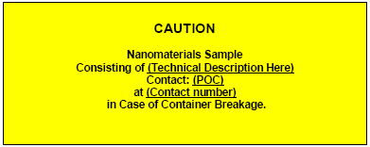
Container Labels
Containers should indicate that the contents contain nanomaterials
There is no unified standard for nanomaterial container labels
A simple label can alert others to the presence of a substance of known or uncertain toxicity.

Slide 8
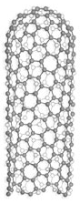
Substances EPA Recognizes as Distinct
Notes:
Trainer Notes:
Regarding the first two decision points, here are several examples of substances that bear similarity to one another but are considered by EPA to have distinct “particular molecular identities”
Substances with different molecular formulas (ethane and propane)
Isomers, or substances with the same molecular formula but a different way of bonding the atoms to each other (n-butanol and 2-butanol)
Substances with the same molecular formula but different crystal structures (shown here are anatase and rutile titanium dioxide)
Allotropes, or variants of a substance consisting of only one atom (note that the carbon nanotube on the left *is* considered to be a distinct substance from diamond and graphite, two other allotropes of carbon)

Slide 9

Pesticidal Device or Pesticide?
Notes:
Trainer Notes:
Background:
Silver has been known to be a potent antimicrobial device for millennia. Silver is also highly toxic to many forms of animal life (though not as much to humans); therefore, EPA enforces limits on the release of silver into the natural environment.
Ionic silver (Ag⁺) and nanosilver are being incorporated into an increasing number of household products and sporting goods to make them “germ-free”. These include food storage containers, socks and underwear, disinfectant spray products, toothpastes and others. The rise of silver use in consumer products has led to increased concerns over the release of silver in the environment.
Case Study:
The manufacturer of a new washing machine began marketing its products as superior to conventional machines on the basis that the silver ions released during the wash cycle would actively kill odor-causing bacteria. Clothes can be cleaned at lower water temperature, thereby saving energy, and with less detergent. Moreover, the company claimed that the silver residue left on the fabrics would extend the antibacterial action for up to one month post-wash.
In 2005 EPA made a decision to classify the washing machine as a pesticidal device due to the antibacterial claim made by the manufacturer. This permitted the machine to be sold without further regulation. Several waste water treatment plant operators joined together to petition EPA to reclassify the machine as a pesticide.
Questions:
Why would waste water treatment plant operators care about silver washing machines?
Silver is a regulated component of treatment plant effluent. Plant operators are responsible to keep their effluents (liquid) and sludge (solid) releases within federal standards for a variety of toxic substances, including silver. Excess releases of silver from washing machine discharges could result in fines or increased costs to remove the silver.
Bonus: Waste treatment plants rely on microbes to digest raw sewage so excess silver could potentially disrupt or deactivate the bacterial workforce within the plant.
What is the technical basis for the waste water treatment plant operators’ petition?
The plant owners argued that silver is a substance. Therefore the mechanism of action was not merely physical or mechanical.
What do you think EPA did in response to the petition?
In 2007 EPA reclassified the machine as a pesticide and requested information from the manufacturer about the potential impact of the machine on silver levels in the waste treatment system.
Additional Facts:
One source estimates the global production of nanosilver to be 500,000 kg per year.
This real-life case was reported as the first case of federal regulation of a nanomaterial because the product had the word “nano” in its name and the manufacturer’s marketing materials mentioned nanosilver as the active agent. In all likelihood these are simply garden variety silver ions released via electrolysis of a silver metal block.

Slide 10
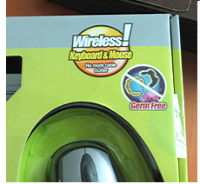
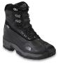
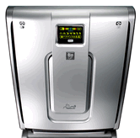
Other EPA Actions on NanoSilver
$208,000 Fine
Suit Filed; Claim removed
$82,400 Fine
Notes:
Trainer Notes:
EPA has taken several other definitive actions against products of nanotechnology that make antimicrobial claims. Without exception the fines were a result of failing to register the products with the EPA prior to promoting them with the antimicrobial claims.
Left: EPA fines ATEN Technology, Inc. $208,000 for failure to register antimicrobial computer products including computer-mouse keyboard combinations that claimed to be “germ-free” [Feb 2008]
Center: EPA files suit against VF Corporation (owner of North Face brand) for failing to register dozens of products containing the AgION antimicrobial foot bed liner [Sept 2009]
Right: EPA fines Kinetic Solutions Inc for failing to register its Rabbit Air air purifiers which tout the use of “Nano-Silver Sterilization - Features a Nano-Silver pre-filter to help kill airborne bacteria, mold and viruses.” [Dec 2010]
Bottom line: If you make an antimicrobial claim, regardless of whether there’s nanotechnology involved or not, you’d better register your product with the EPA.
Additional Facts:
If the manufacturers had not made the antimicrobial claim, the products would not have required registration! Of course, that would take away much of their alleged added value but this highlights a weakness of FIFRA.

Slide 11


REACH
Registration, Evaluation, Authorization & Restriction of Chemicals
Ensuring a high level of protection of human health
Ensuring a high level of protection of environment
Promotion of alternative test methods
Free circulation of substances on internal market
Enhancing competitiveness and innovation

Slide 12
What is risk?

Slide 13
pericolo
rischio

Slide 14
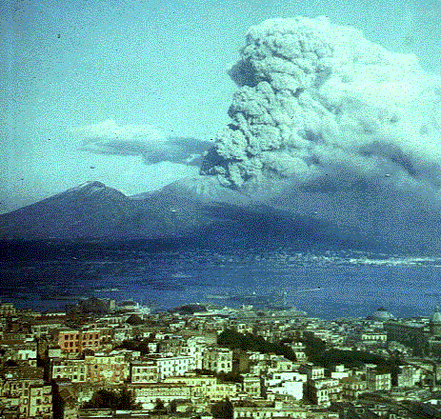
percezione-consapevolezza-accettazione
del rischio
Vesuvio:
rischio consapevole

Slide 15
benefici
sicurezza
rischi
costi

Slide 16
Cost of pollution control
Cost
Total cost
control:
Technological cost
Effect:
Social cost
Effect
Control
0 100
Degree of control

Slide 17



Risk Due to a Hazardous Substance
Risk = f(Hazard, Exposure)
Controlling Exposure = “end of the pipe solution”
“Command and control” laws

Slide 18
Database of hazardous substances.
Continuos updating (ppm, ppb, …)
new knowledge
Acceptable risk? 1: 1.000.000 ?
Workers:
Use of DPI (gloves, mask, glasses, ….) and protection / alarm systems.
Training courses.
High cost

Slide 19
Paracelso
“Each substance is a pollutant, whose toxicity depends on the concentration.”
Benzene vs propane order of magnitude
Synergetic toxicity
Millions of compounds / thousend of new compounds every year

Slide 20
Risk is a function of
Severity of possible harm
Probability of the occurrence of that harm

Slide 21
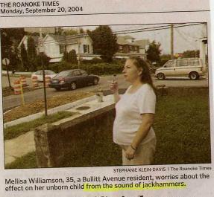
How do most of us do with risk comparisons?
“A Bullitt Avenue resident worries about the effect on her unborn child from the sound of jackhammers.”

Slide 22
NanoRisk Framework

Slide 23
The entire life cycle needs to be considered
Extraction & Processing
Manufacture of
Nanomaterial
Distribution
&
Transport
Manufacture of
Nanoproduct
Distribution
&
Transport
End-of-Life
Use
?
?
Amount of nano waste
Complexity of nano waste
Risk to workers
Notes:
Trainer Notes:
[This is a graphic created by David Rejeski of the Wilson Center for Scholars to depict the entire life cycle of a nanoproduct and to consider the amount and complexity of the waste throughout that life cycle. Bruce Lippy added potential worker risks to the cycle.]

Slide 24
Control banding is a qualitative administrative approach that defines risks and sets controls
Risk = probability X severity

Slide 25
Control Banding has been used for years in the pharmaceutical industry
Band No. | Range of exposure concentrations | Hazard group | Control
1 | >1 to 10 mg/m³ dust >50 to 500 ppm vapor | Skin and eye irritants | Use good industrial hygiene practice and general ventilation
2 | >0.1 to 1 mg/m³ dust >5 to 50 ppm vapor | Harmful on single exposure | Use local exhaust ventilation
3 | >0.01 to 0.1 mg/m³ dust >0.5 to 5 ppm vapor | Severely irritating and corrosive | Enclose the process
4 | <0.01 mg/ m³ dust <0.5 ppm vapor | Very toxic on single exposure, reproductive hazard, sensitizer* | Seek expert advice
*Exposure to any concentration of a sensitizer requires expert advice
Notes:
Trainer Notes:
[Go through the chart of control banding, adopted from NIOSH. Introduce the subject and discuss it’s history. Ask students which jobs that they work on may control banding be suitable for. Below is excerpted text from NIOSH that provides background information on control banding.]
The occupational exposure limit (OEL) is the marker that shows the level of control needed for a chemical. Repeated daily exposure by inhaling a chemical at an airborne concentration below its OEL is unlikely to lead to harm in most workers. However, many thousands of chemicals are in use, and it is not possible to have an OEL for every chemical, chemical mixture, fume, or emission. Nonetheless, it is possible to determine the broad hazard group to which a chemical belongs (Table 1) and on that basis to determine the necessary level of control, or control band.
The concept of control banding was developed in the late 1980s by occupational health experts in the pharmaceutical industry. This industry uses large numbers of new chemical compounds with few toxicity data. The experts reasoned that such compounds could be classified into bands by their toxicity and by their need for restriction of exposure. Each band was aligned with a control scheme. Early references on the concept included a manual published by the Association of the British Pharmaceutical Industry in October 1995 and a paper by Naumann et al. [1996] (see reference list below). In the early 1990s, as the European system for classification and labeling developed, occupational health experts began to examine the alignment between the classification, the exposure limit, and data on exposure and control systems [Gardner and Oldershaw 1991].
Control banding is not currently appropriate for many situations, including "hot" processes, open spray applications, gases, and pesticides. These situations involve more complex exposures requiring additional considerations that are not yet fully addressed by current control banding strategies. In addition, control banding does not yet cover safety hazards, environmental issues, or ergonomic issues. Researchers are exploring ways to integrate these additional workplace issues into the control banding concept.

Slide 26
Lawrence Livermore developed a Control Banding Nanotool (Sam Paik, LLNL)
Courtesy Sam Paik and Lawrence Livermore National Laboratory

Slide 27
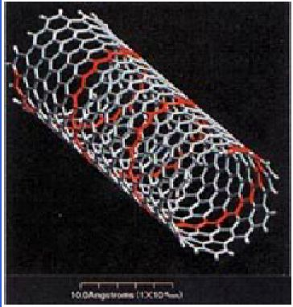
The Nanotool sets Severity Factors
Nanomaterial: 70% of Severity Score
Surface Chemistry (10 pts)
Particle Shape (10 pts)
Particle Diameter (10 pts)
Solubility (10 pts)
Carcinogenicity (6 pts)
Reproductive Toxicity (6 pts)
Mutagenicity (6 pts)
Dermal Toxicity (6 pts)
Asthmagen (6 pts)
Courtesy Sam Paik and Lawrence Livermore National Laboratory
Notes:
Trainer Notes:
Nanomaterial: 70% of Severity Score
Surface Chemistry (10 pts)
Particle Shape (10 pts)
Particle Diameter (10 pts)
Solubility (10 pts)
Carcinogenicity (6 pts)
Reproductive Toxicity (6 pts)
Mutagenicity (6 pts)
Dermal Toxicity (6 pts)
Asthmagen (6 pts)
[Point out that the tool focuses mainly on the nanomaterial, but because often data are not available, the tool only gives 70% of the score to the nanomaterial.]

Slide 28
Factors for the parent material get 30% of severity score
Occupational Exposure Limit (10 pts)
Carcinogenicity (4 pts)
Reproductive Toxicity (4 pts)
Mutagenicity (4 pts)
Dermal Toxicity (4 pts)
Asthmagen (4 pts)
  (Maximum points indicated in parentheses)
Courtesy Sam Paik and Lawrence Livermore National Laboratory
Notes:
Trainer Notes:
Factors for the parent material get 30% of severity score.
Occupational Exposure Limit (10 pts)
Carcinogenicity (4 pts)
Reproductive Toxicity (4 pts)
Mutagenicity (4 pts)
Dermal Toxicity (4 pts)
Asthmagen (4 pts)
[This is an interesting approach because there will invariably be more data on the “macro” sized version of the material, e.g. carbon black or graphite rather than CNT.]

Slide 29
Nanotool uses probability factors, too
Estimated amount of material used (25 pts)
Dustiness/mistiness (30 pts)
Number of employees with similar exposure (15 pts)
Frequency of operation (15 pts)
Duration of operation (15 pts)
Courtesy Sam Paik and Lawrence Livermore National Laboratory
Notes:
Trainer Notes:
Nanotool uses probability factors, too.
Estimated amount of material used (25 pts)
Dustiness/mistiness (30 pts)
Number of employees with similar exposure (15 pts)
Frequency of operation (15 pts)
Duration of operation (15 pts)

Slide 30
Nanotool results were comparable to judgment of professionals
36 operations at LLNL
For 21 activities, CB Nanotool recommendation was equivalent to existing controls
For 9 activities, CB Nanotool recommended higher level of control than existing controls
For 6 activities, CB Nanotool recommended lower level of control than existing controls
Courtesy Sam Paik and Lawrence Livermore National Laboratory
Notes:
Trainer Notes:
Nanotool results were comparable to judgment of professionals.
36 operations at LLNL
For 21 activities, CB Nanotool recommendation was equivalent to existing controls
For 9 activities, CB Nanotool recommended higher level of control than existing controls
For 6 activities, CB Nanotool recommended lower level of control than existing controls

Slide 31
CB Nanotool as LLNL Policy
Overall (30 out of 36), CB Nanotool recommendation was equal to or more conservative than IH expert opinions
LLNL decided to make CB Nanotool recommendation a requirement
CB Nanotool is an essential part of LLNL’s Nanotechnology Safety Program
Courtesy Sam Paik and Lawrence Livermore National Laboratory
Notes:
Trainer Notes:
CB Nanotool as LLNL Policy
Overall (30 out of 36), CB Nanotool recommendation was equal to or more conservative than IH expert opinions
LLNL decided to make CB Nanotool recommendation a requirement
CB Nanotool is an essential part of LLNL’s Nanotechnology Safety Program

Slide 32
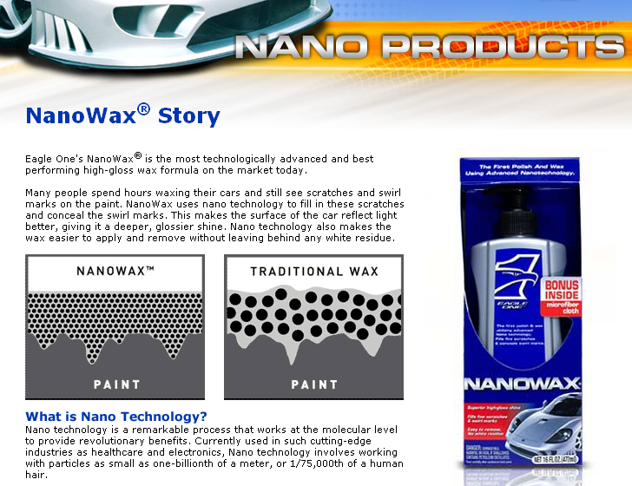
Example SDS: NanoWax
Notes:
Here is another example: a product called NanoWax. The finer particles apparently fill in scratches and swirl marks in the paint and reflect light better. I don’t wash my car, so I can’t vouch for this product.

Slide 33
NanoWax SDS
Section 8: Exposure Controls/PPE
WAX EMULSION: No exposure limits established (NLE)
ALIPHATIC PETROLEUM DISTILLATES (64741-66-8): NLE
ALUMINUM SILICATE (66402-68-4): NLE
POLY(DIMETHYLSILOXANE) (63148-62-9): NLE
ALKYL QUATERNARY AMMONIUM BENTONITE (68953-58-2) : NLE
TETRAGLYCERYL MONOOLEATE (9007-48-1): NLE
GLYCOL (107-21-1)
OSHA PEL 50 ppm - Ceiling
ACGIH TLV 100 mg/m3 - Ceiling as an aerosol
No indication which component is nano-sized. Is it important in this application?
Notes:
Trainer Notes:
If we look at the chemicals in the product, there is no indication which component is nano-sized. I have highlighted aluminum silicate as a likely candidate.
SECTION 8: EXPOSURE CONTROLS/PERSONAL PROTECTION
WAX EMULSION: No exposure limits established (NLE)
ALIPHATIC PETROLEUM DISTILLATES (64741-66-8): NLE
ALUMINUM SILICATE (66402-68-4): NLE
POLY(DIMETHYLSILOXANE) (63148-62-9): NLE
ALKYL QUATERNARY AMMONIUM BENTONITE (68953-58-2) : NLE
TETRAGLYCERYL MONOOLEATE (9007-48-1): NLE
GLYCOL (107-21-1)
OSHA VPEL 50.000 ppm - Ceiling
ACGIH TLV 100.000 mg/m3 - Ceiling as an aerosol
No indication which component is nano-sized. Is it important in this application? I assume the aluminum silicate, but since I never seem to wash my car, I don’t know.

