Slide 1
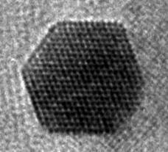
Transmission Electron Microscopy

Slide 2
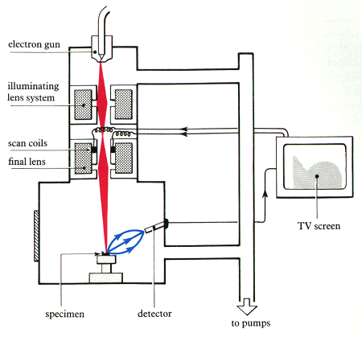
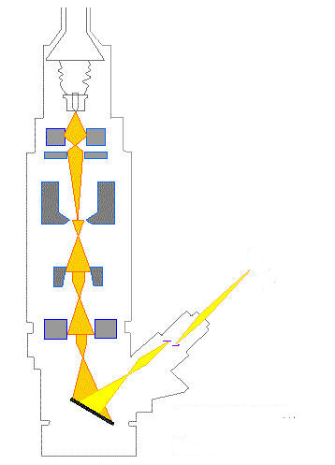
SEM & TEM
Electron gun
Electron gun
Electron gun
Electron gun
Condenser lens
Condenser lens
Objective lens
Objective lens
Specimen
Specimen
Projector lens
Projector lens
Fluorescent screen
Fluorescent screen
Digital camera
Specimen
Digital camera
Scanning electron microscope
Transmission electron microscope

Slide 3
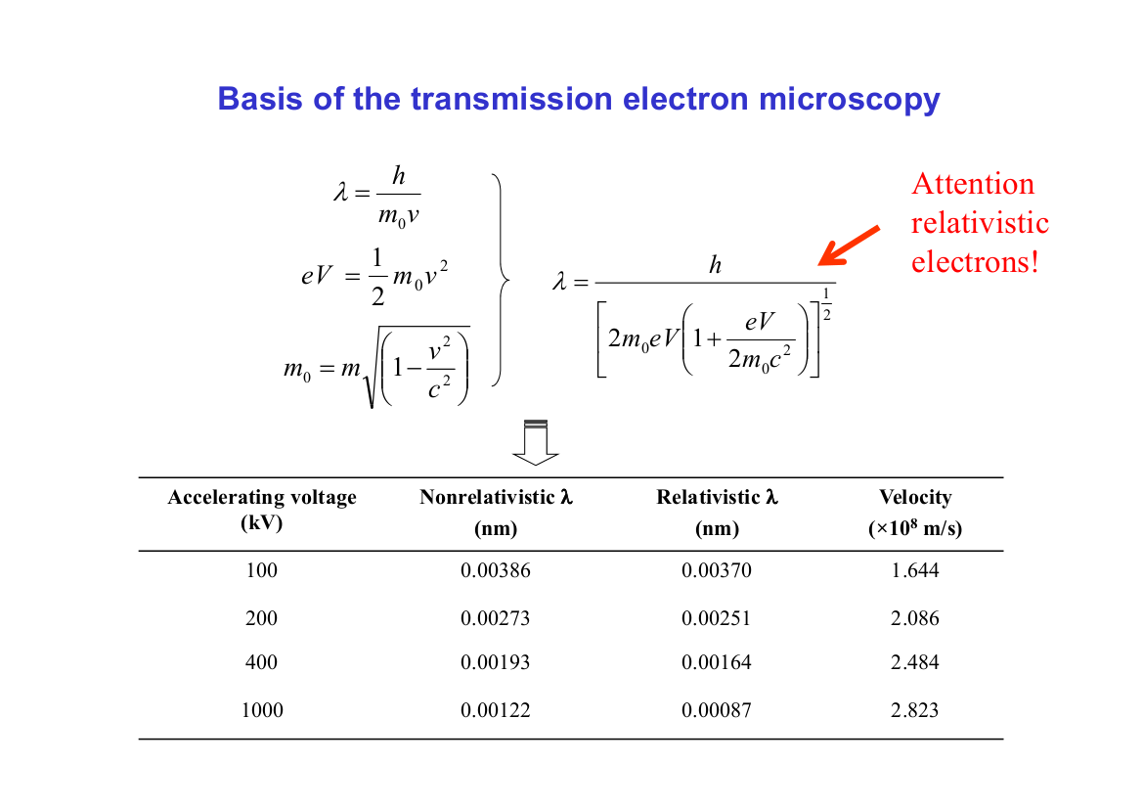

Slide 4
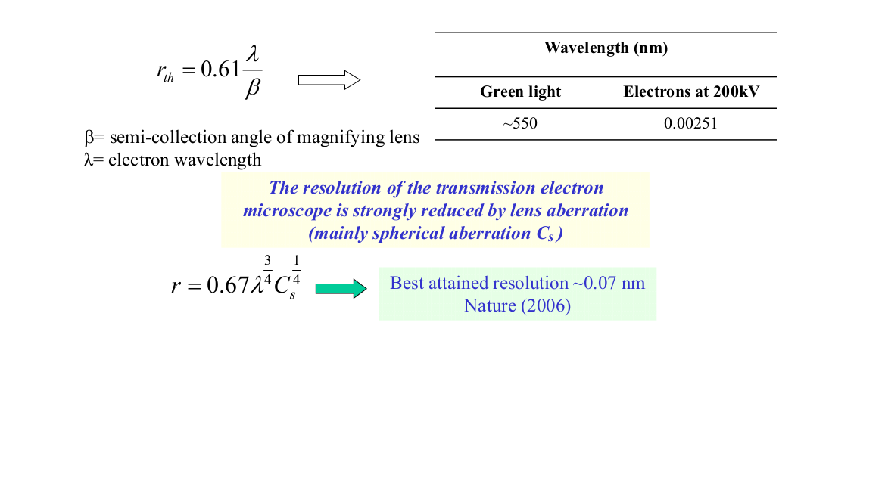
Theoretical resolution r_{th}

Slide 5
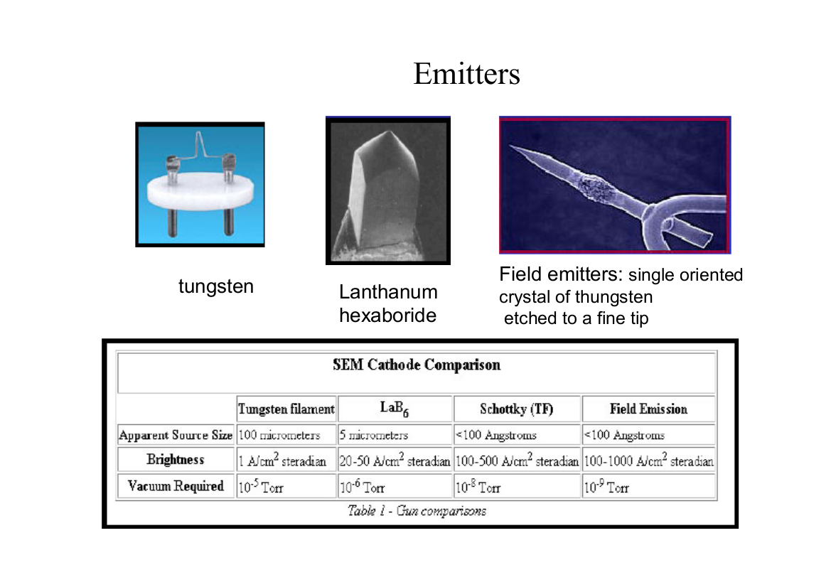

Slide 6
Accelerating voltage
Electrons emitted by the filament are accelerated by a series of anodes. For transmission electron microscopy, accelerating voltages typically range from 60 kV to 300 kV. Higher accelerating voltages give higher resolution, but less contrast. High accelerating voltages can also result in greater specimen damage. For these reasons, studies of biological samples tend to employ low accelerating voltages (60 kV to 100 kV), while studies of inorganic materials, which often require higher resolution, usually employ an accelerating voltage of 200 kV or more.

Slide 7
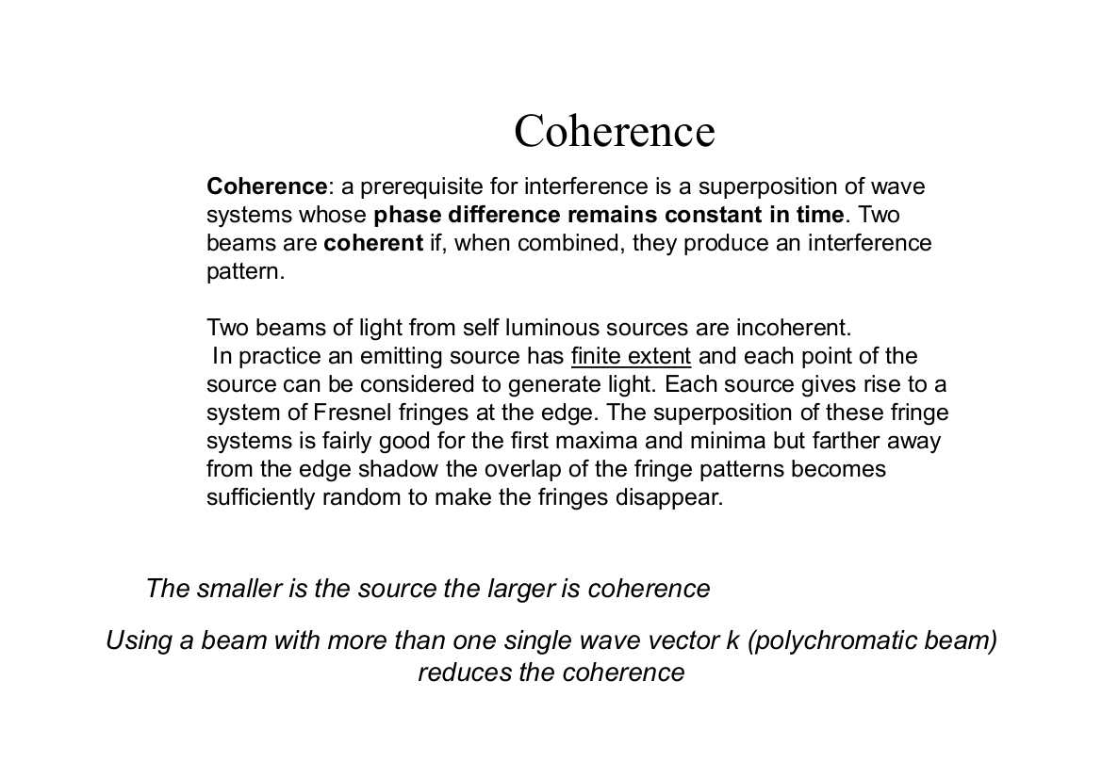

Slide 8
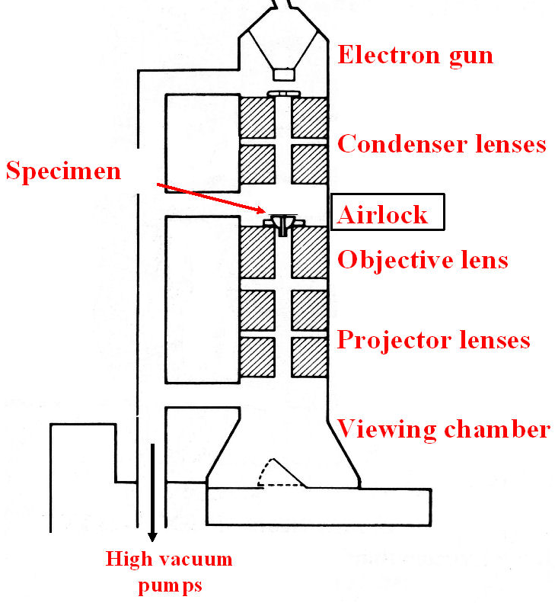
Components of the TEM
Electrons emitted by the gun are accelerated, typically by 80 - 200 kV.
The condenser lenses focus the beam onto the specimen, which is introduced into the microscope through an airlock.
The objective lens forms a focussed image, which is enlarged by the projector lenses.
The image is viewed on a fluorescent screen or a computer monitor.

Slide 9
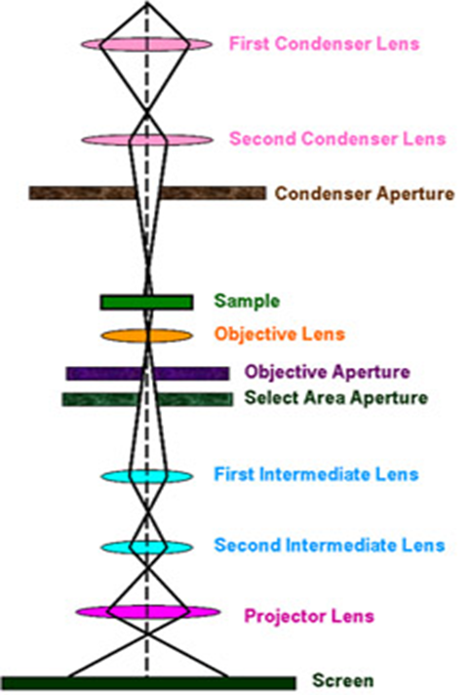
Scheme of beam within a TEM

Slide 10
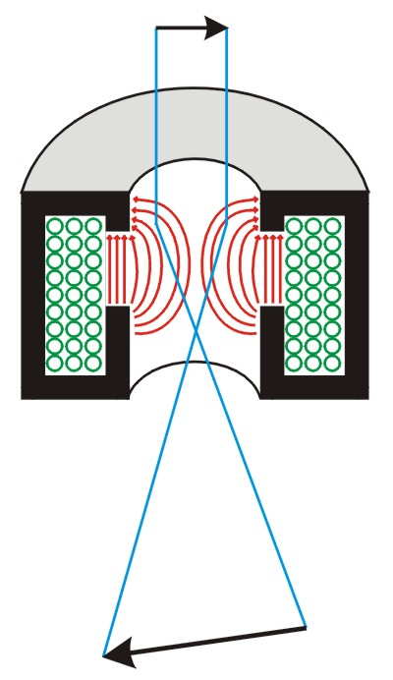
Electromagnetic lenses
All modern TEMs use electromagnetic lenses. These consist of a coil of copper wires inside iron pole pieces.
A current through the coils creates a magnetic field, symbolized by red lines in the diagram on the left. Electrons close to the centre are less strongly deflected than those passing through the lens far from the axis.

Slide 11
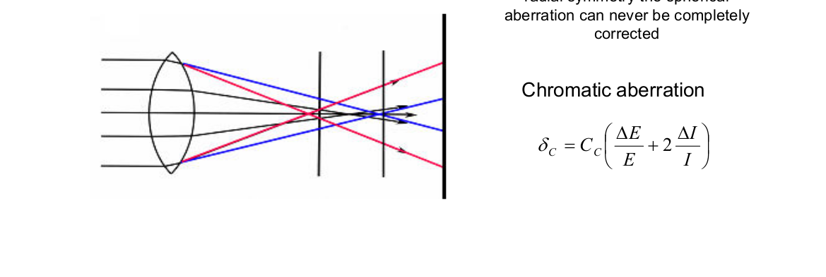
Chromatic aberration
Chromatic aberration is caused by a lens having a different refractive index for different electron energies. It is present in all electron lenses, but can be reduced by minimising the energy spread of the electron source. Field emission sources have the lowest energy spread. There is currently interest in developing chromatic aberration correctors for TEM, but this is still at quite an early stage.

Slide 12
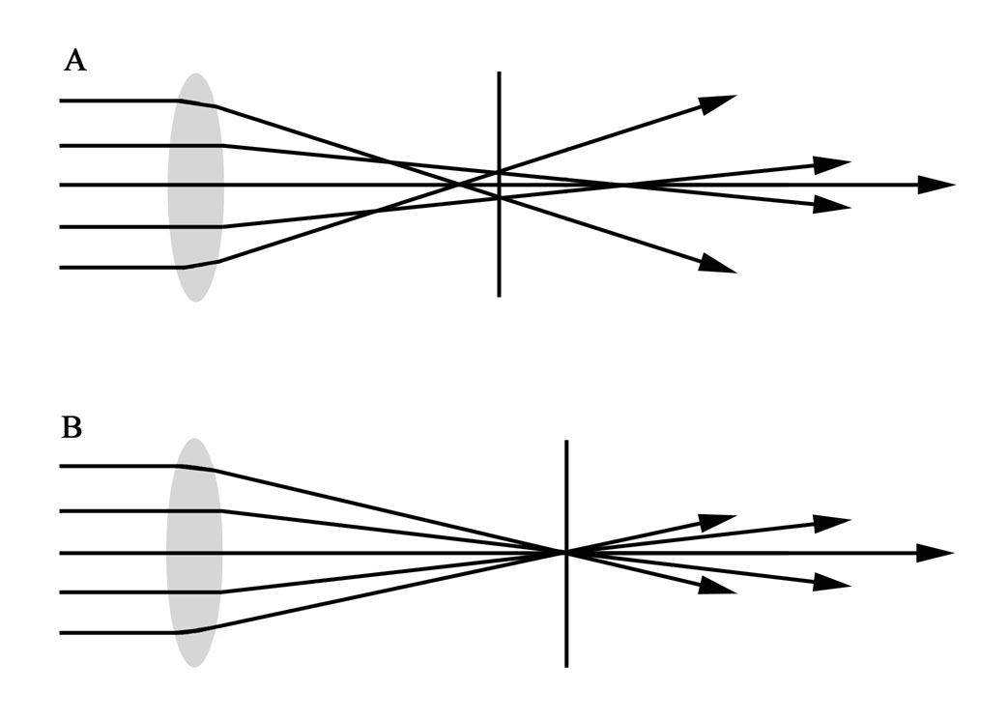
Spherical aberration
A lens suffers from spherical aberration if it focuses rays more tightly if they enter it far from the optic axis than if they enter closer to the axis. It therefore does not produce a perfect focal point. This is illustrated in diagram A on the right.

Slide 13
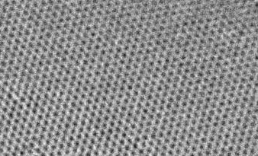
Spherical aberration correctors
In recent years, spherical aberration correctors have been developed for transmission electron microscopes, and this has greatly improved their resolving power. Aberration corrected TEMs can have a resolution of 0.1 nm or better.
Using these new ultra-high resolution TEMs it is possible to image the atomic structure of crystals such as graphite, as shown on the right.

Slide 14
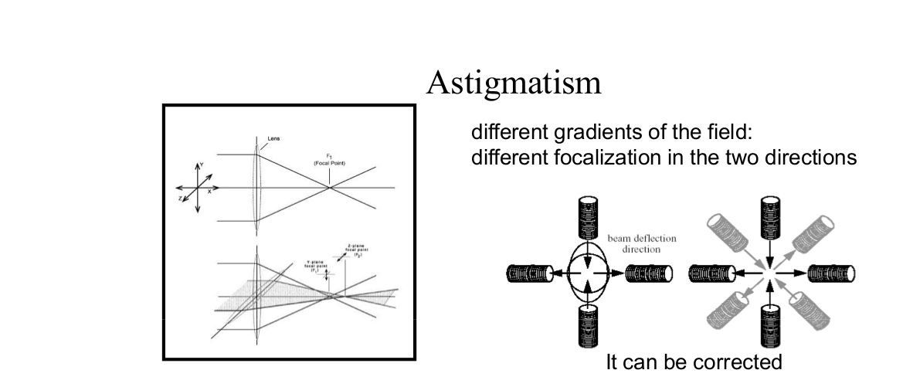

Slide 15
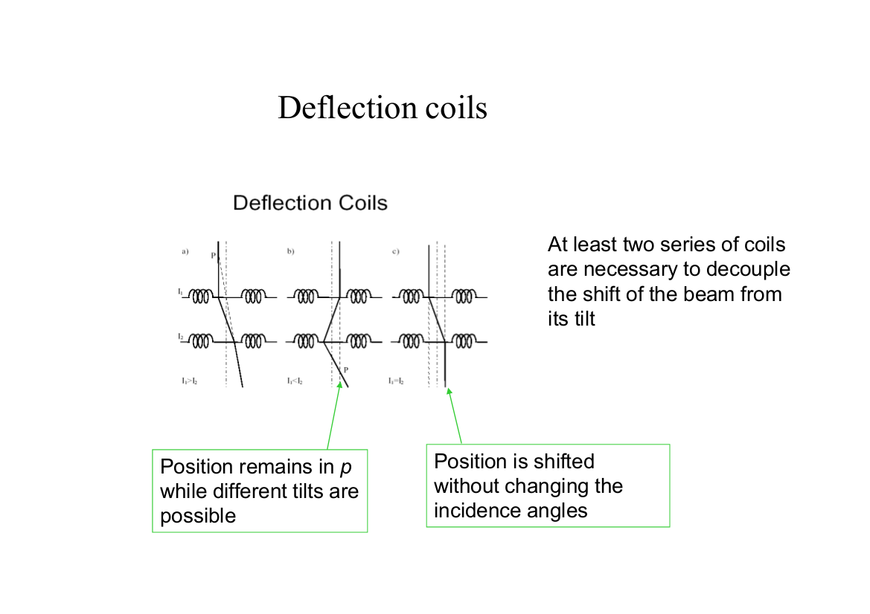

Slide 16
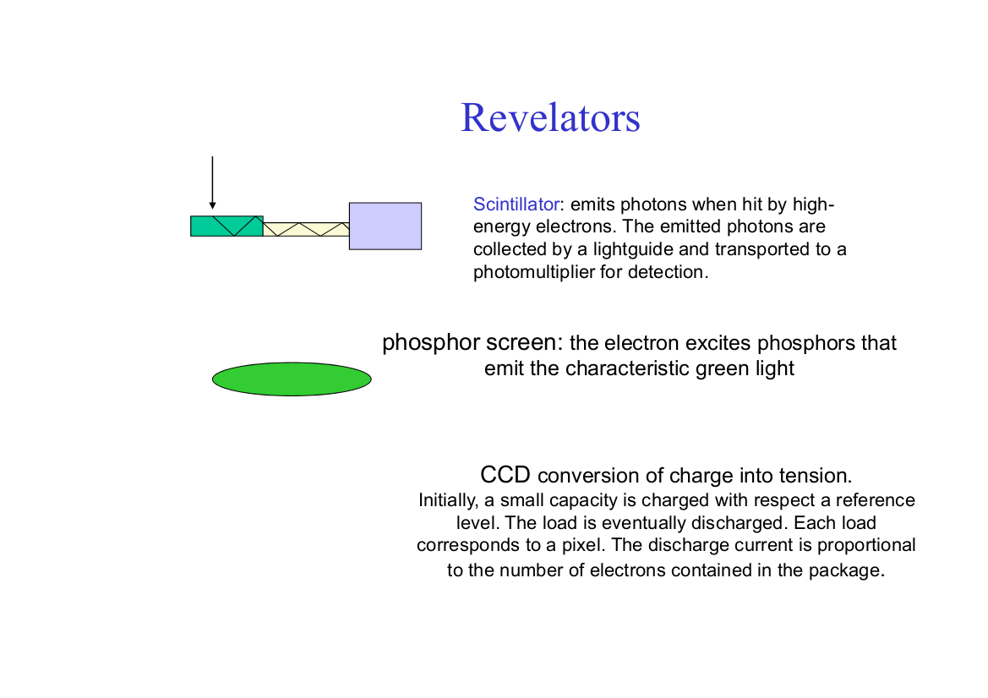

Slide 17
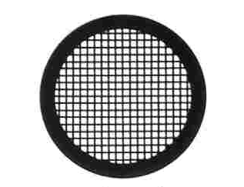
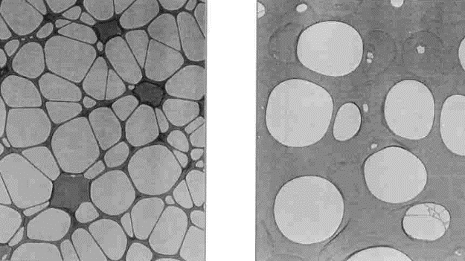
Transmission electron microscopy
Specimens for TEM
3 mm TEM grid
Carbon films

Slide 18
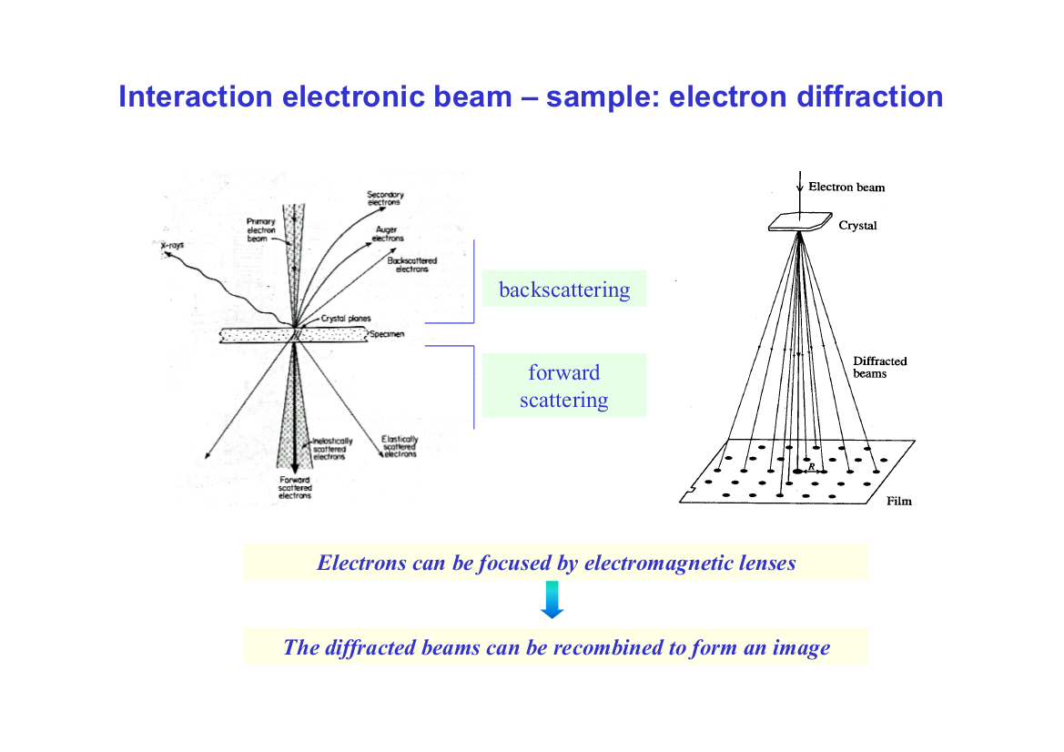

Slide 19
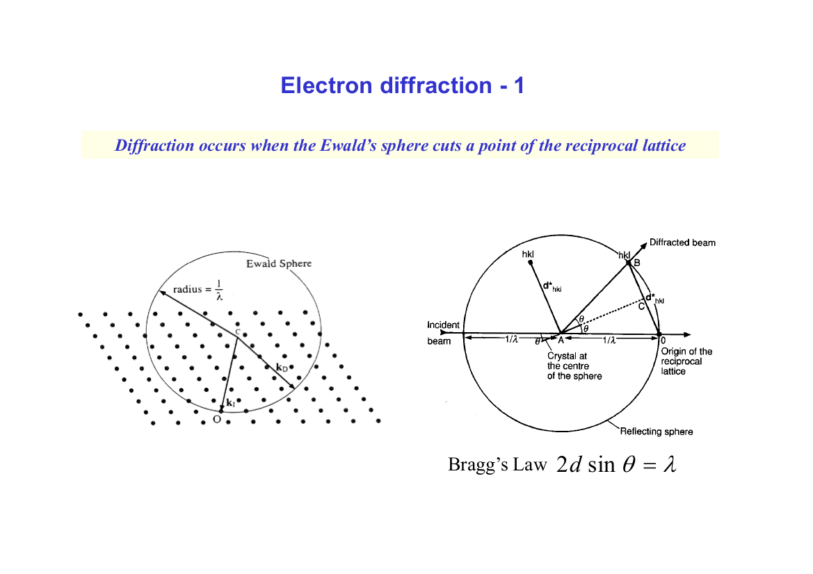

Slide 20
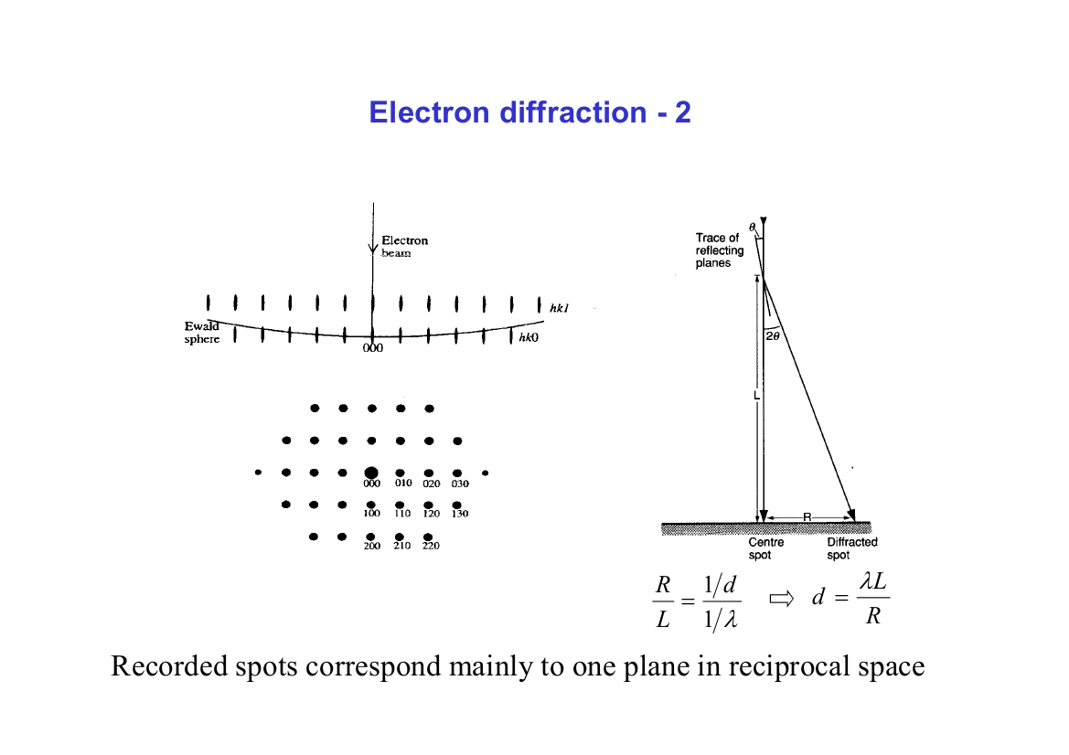

Slide 21
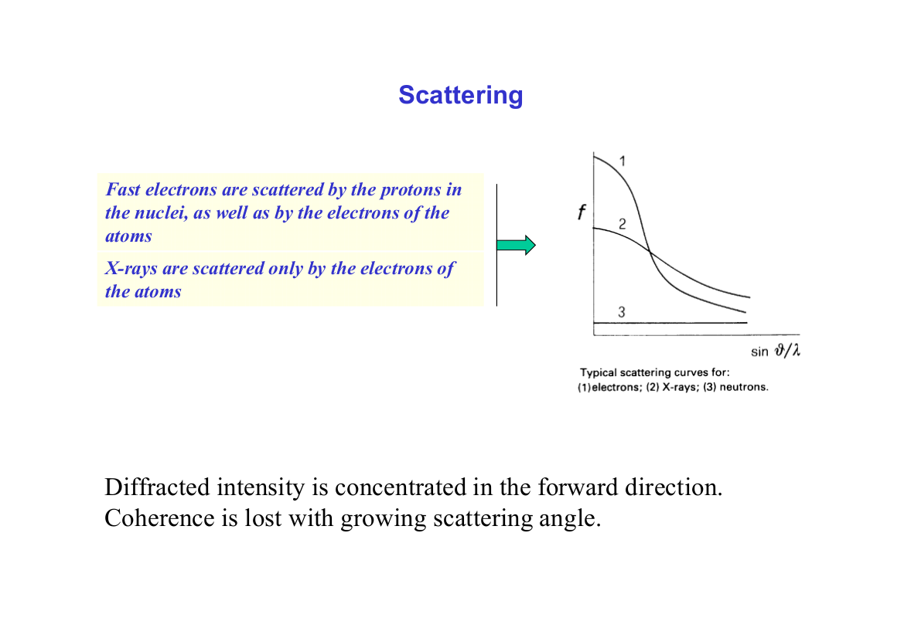

Slide 22
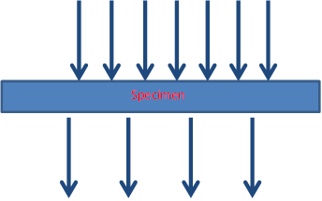
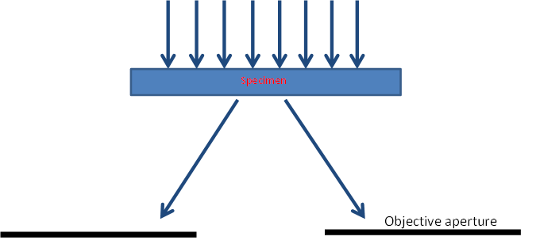
Contrast in the TEM – Scattering
Biological and “soft matter”
Absorption contrast:
Heavy atoms absorb more electrons than light atoms.
Scattering contrast:
Some electrons blocked by objective aperture.

Slide 23
Positive staining
Electron-dense heavy metal salt selectively stains certain features within the sample.
Block copolymer containing polystyrene and polymethylmethacrylate stained with ruthenium tetroxide.

Slide 24
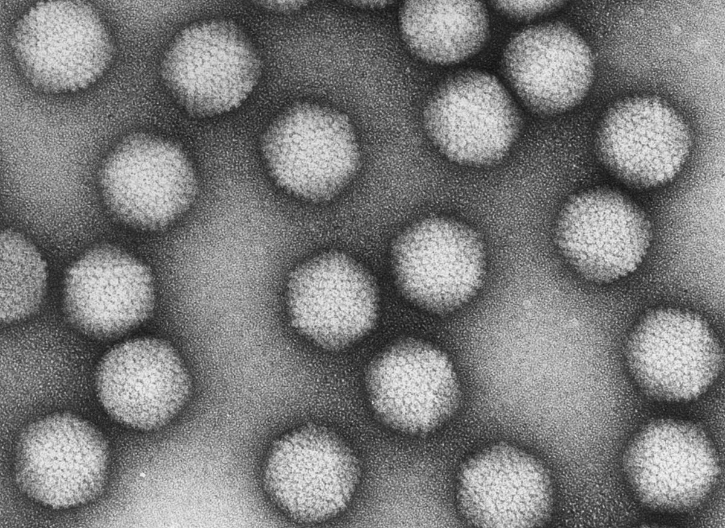
Biological TEM - negative staining
Surrounding biomolecules with thin amorphous layer of heavy metal salt. Reveals structure, and reduces structural flattening that occurs in the absence of stain.
Commonly used stains: uranyl acetate, uranyl formate, sodium/potassium phosphotungstate, ammonium molybdate.
Adenovirus negatively stained with uranyl acetate

Slide 25
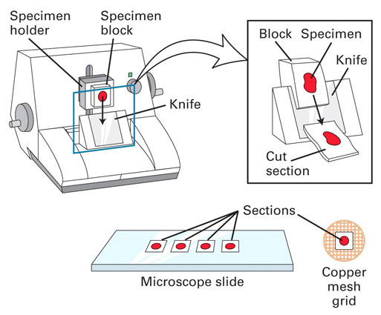
Biological TEM – preparing specimens from tissue
Fix → dehydrate → set in resin → section → deposit on grids → stain
Microtome

Slide 26
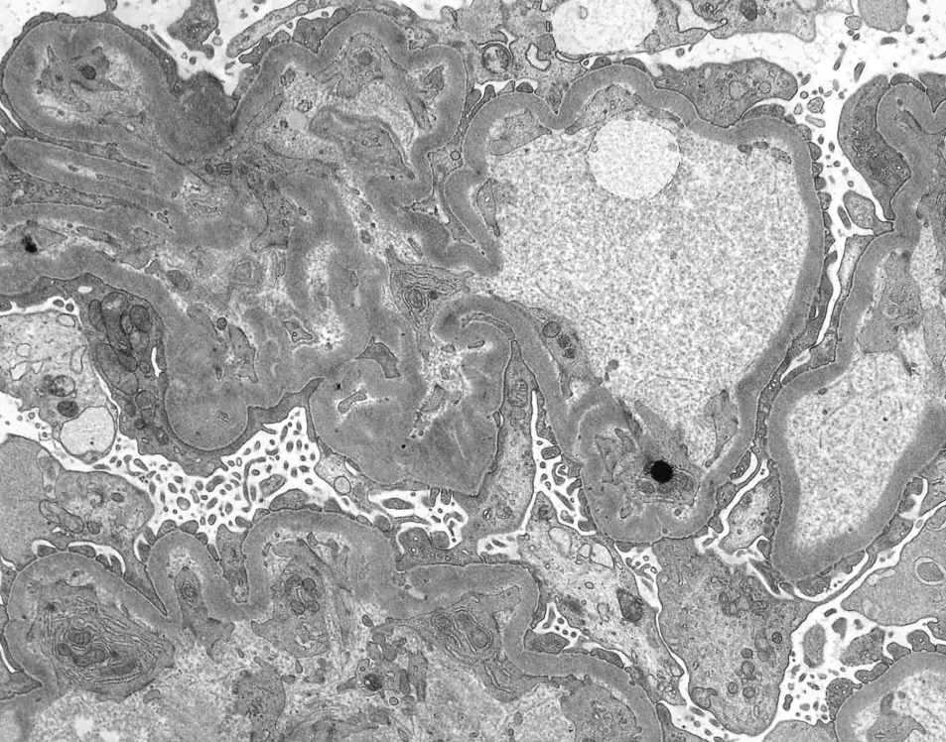
Biological TEM – thin section
Kidney

Slide 27
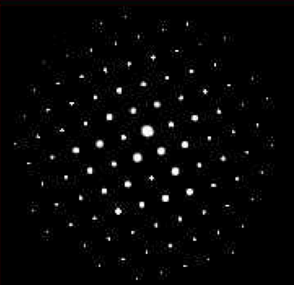
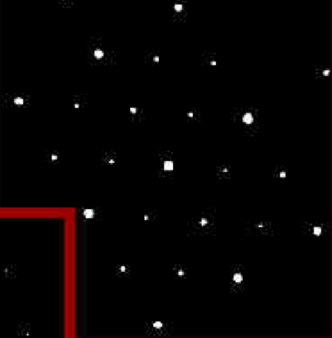
Contrast in the TEM - Diffraction
Diffraction pattern from single crystal
Cr₂₃C₆ - F cubic
a = 10.659 Å
Ni₂AlTi - P cubic
a = 2.92 Å

Slide 28
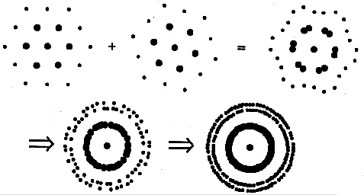
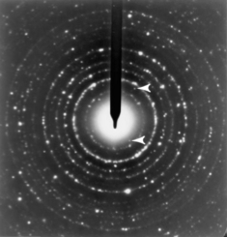
Contrast in the TEM - Diffraction
Polycrystalline materials
polycrystalline BaTiO₃ spotty Debye rings

Slide 29
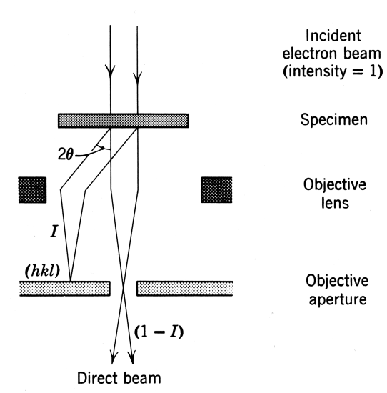
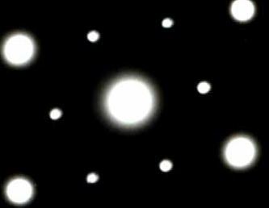
Contrast in the TEM - 2
Diffraction contrast

Slide 30
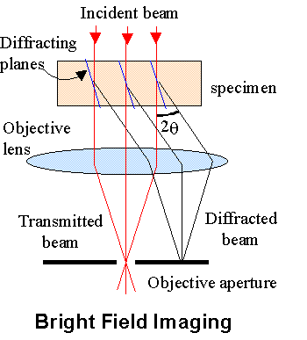
Bright Field Imaging
If the main portion of the near-forward scattered beam is used to form the image
  transmitted beam
  000 beam
  zero-order beam

Slide 31
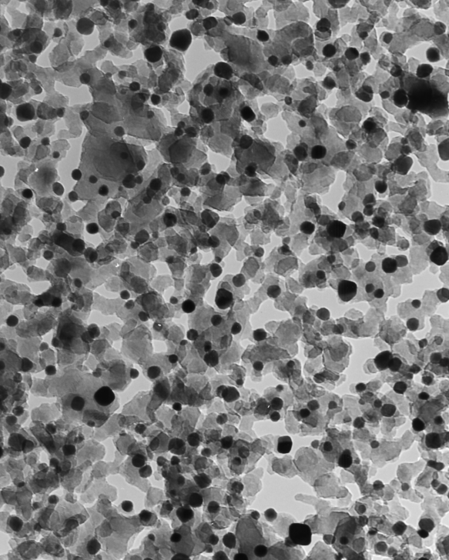
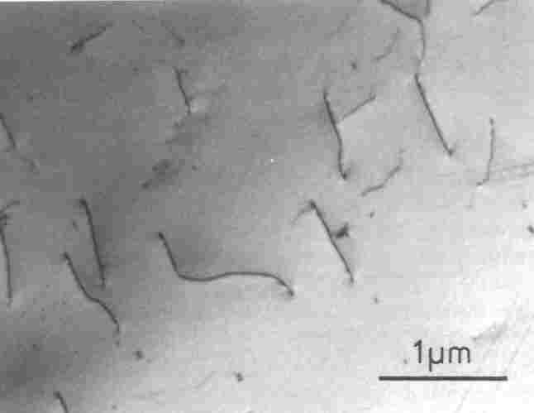
Transmission electron microscopy
TEM in physical science – bright field imaging
Dislocations in stainless steel foil
Platinum/alumina catalyst

Slide 32
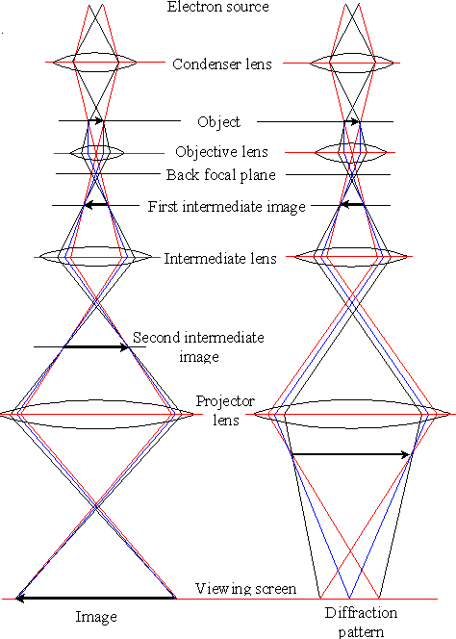
Ray Paths in the TEM

Slide 33
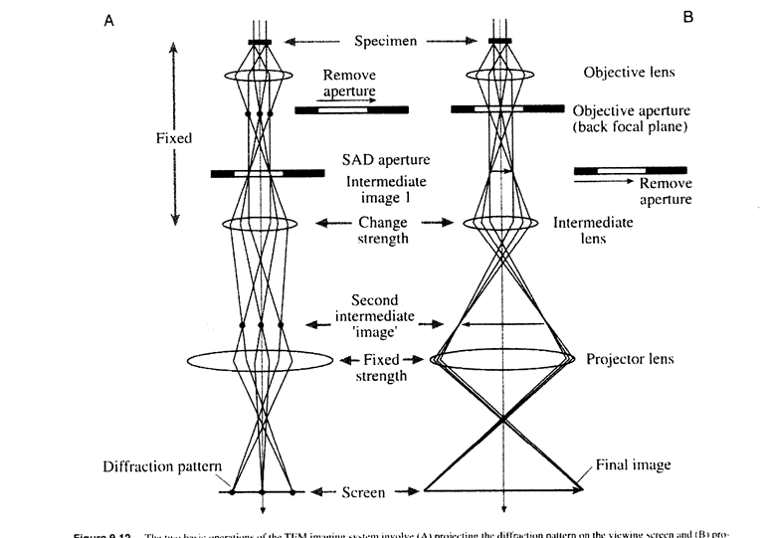

Electron Diffraction
TEM Imaging Modes: Diffraction vs BF

Slide 34
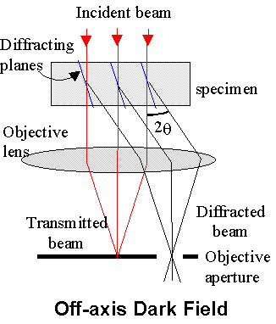
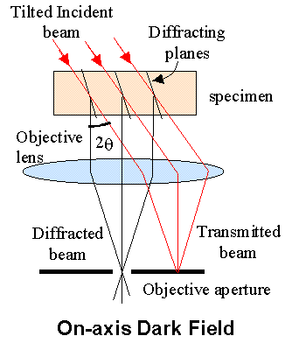
Dark Field Imaging
If the transmitted beam is excluded from the image formation process
  off-axis imaging
  tilted beam imaging

Slide 35
TEM Imaging:
Ray Paths

Slide 36
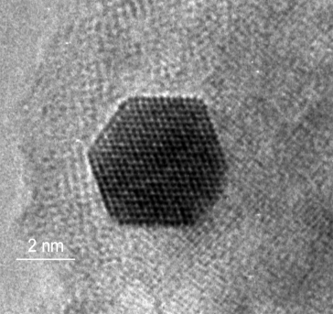
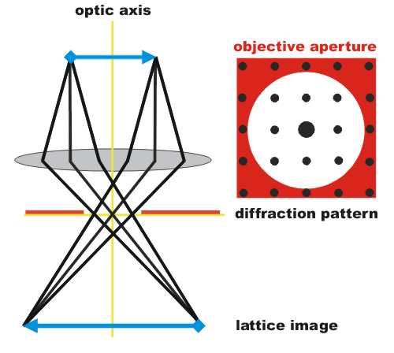
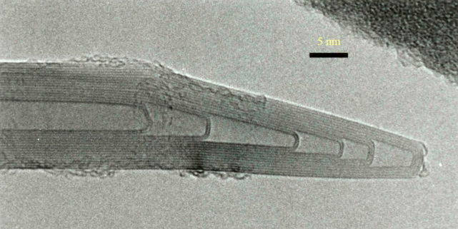
Contrast in the TEM - 3
Phase contrast: lattice imaging

Slide 37
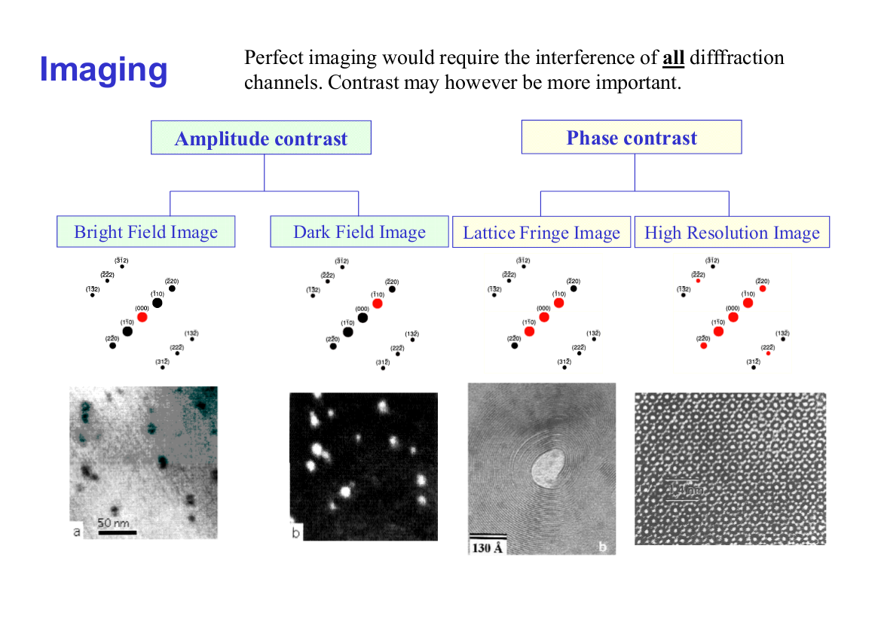

Slide 38
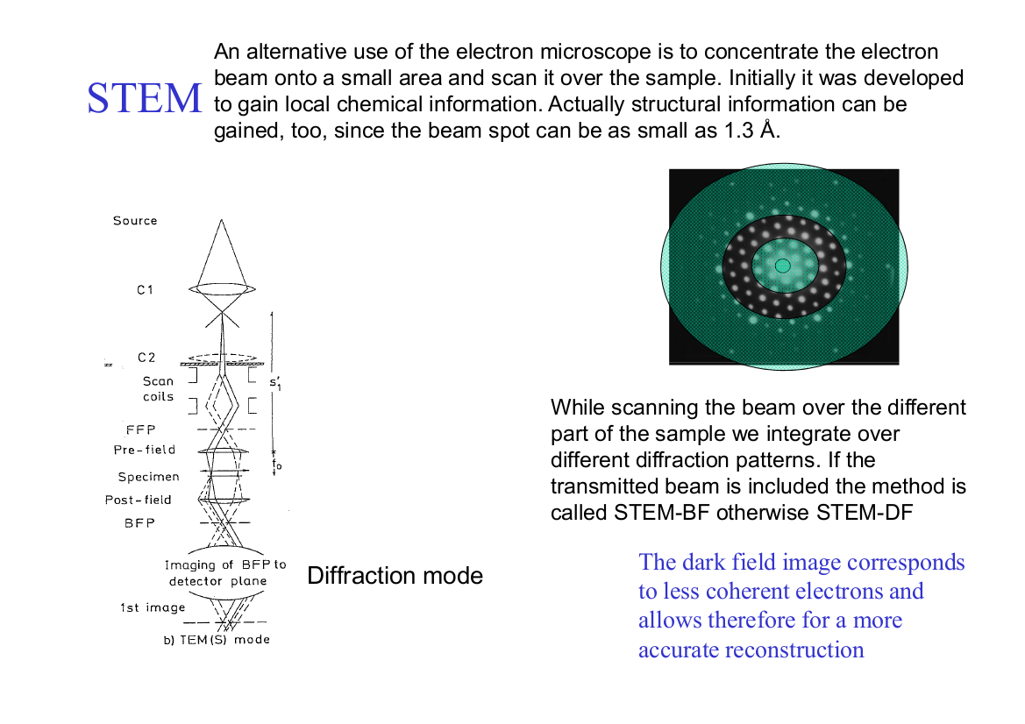

Slide 39
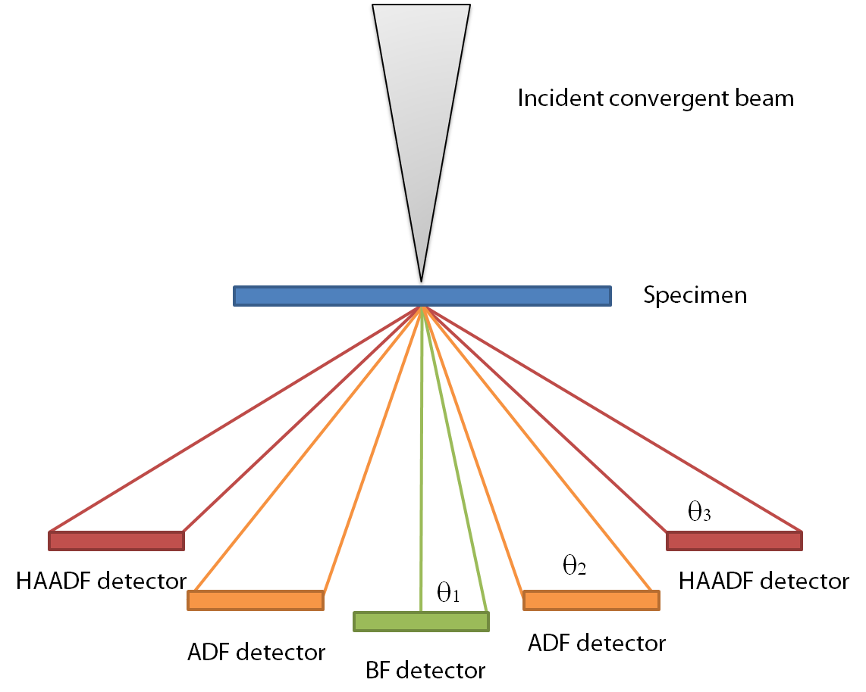
High Angular Annular Dark Field
Scattered intensity = f(Z²)
HAADF detector is highly sensitive to heavy atoms
θ₃ > 50 mrad
Scattered
electrons
θ₂ 10 – 50 mrad
Diffracted
electrons
θ₁ < 10 mrad
Transmetted
electrons

Slide 40
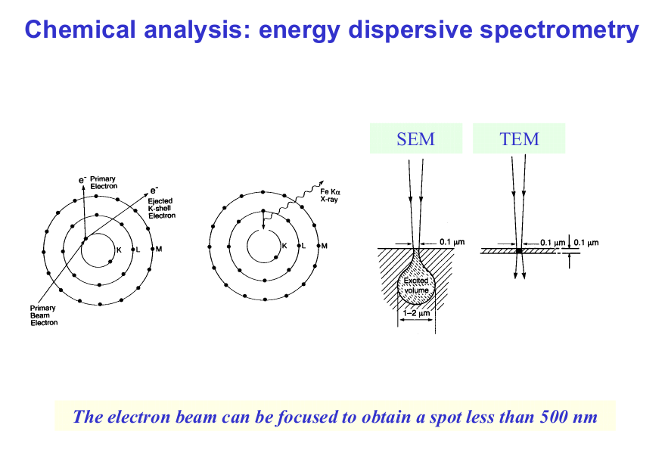

Slide 41
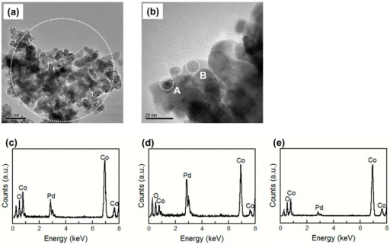
Energy Dispersed Spectroscopy

Slide 42
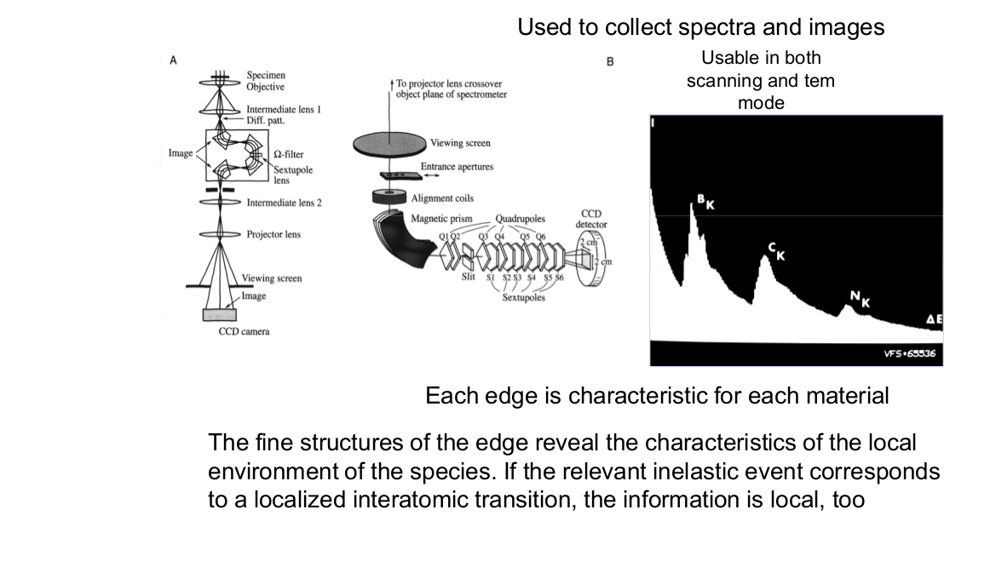
Electron Energy Loss Spectroscopy
- EELS -

Slide 43
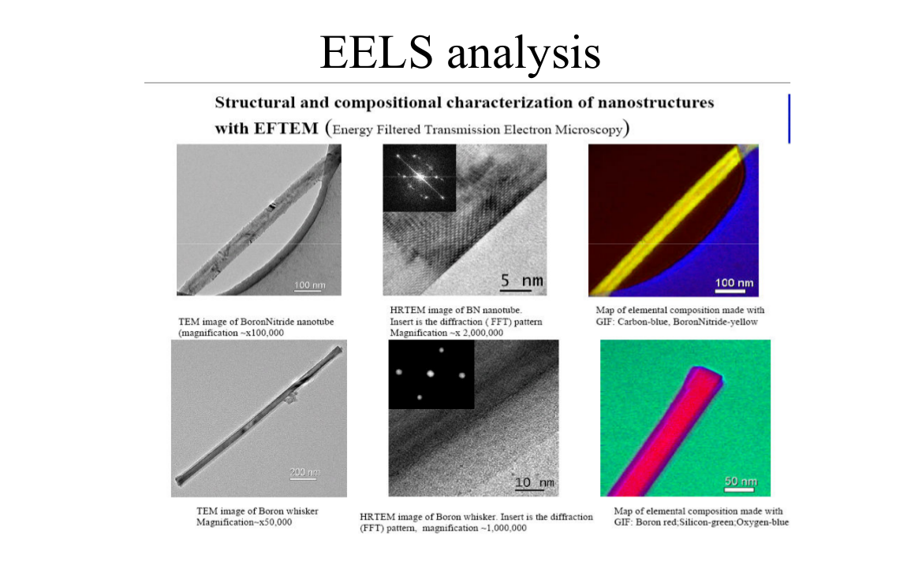

Slide 44


Slide 45


