Slide 1
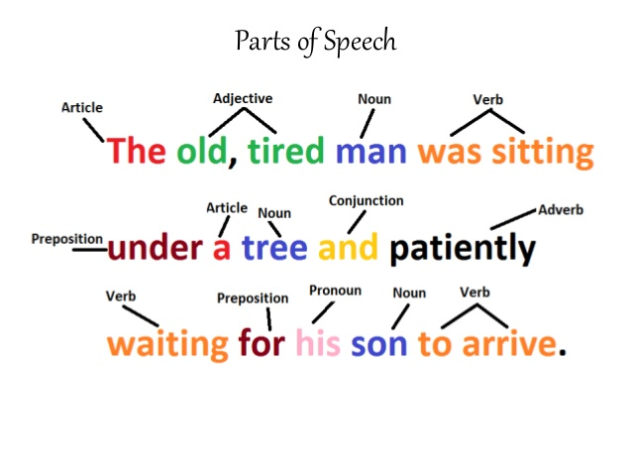

Slide 2
Past Perfect Simple
The Past Perfect simple expresses action in the past before another action in the past. This is the past in the past.
The train left at 9am. We arrived at 9:15am. When we arrived, the train had left.
The past perfect refers to time up to a point in the past (time up to then), just as the present perfect refers to something that happened in the time up to the moment of speaking (time up to now).
  You can sometimes think of the past perfect like the present perfect, but instead of the time being now the time is before.
I wasn't hungry. I had just eaten. now
They were hungry. They had not eaten for five hours.
I didn't know who he was. I had never seen him before. X X
"Mary wasn't at home when I arrived." / "Really? Where had she gone?"

Slide 3
Past Perfect Simple
The past perfect is often used in reported speech after verbs like: said, told, asked, thought, wondered:
He told us that the train had left.
I thought I had met her before, but I was wrong.
He explained that he had closed the window because of the rain.
I wondered if I had been there before.
I asked them why they had not finished.
The past perfect is often found in more formal writing, such as fiction. The simple past can be used to say that a certain event happened, but then the fiction writer uses the past perfect to explain what had happened before that event:
Billy felt great that evening. Earlier in the day, Annie had caught one fish, and he had caught three. They had had a delicious picnic near the lake and they had gone swimming again. It had been a nearly perfect vacation day.

Slide 4
Past Perfect Simple
We often use the past perfect to refer to situations which have changed. In speaking, had is often stressed:
Are you going anywhere today?
I had planned to go to the beach but look at the rain! (had is stressed; the meaning is ‘I have now changed my mind’).
I’m very happy working as an engineer but I had wanted to be an actor when I was younger.

Slide 5
Past Perfect Progressive
Past Perfect Progressive

Slide 6
Past Perfect Progressive
The past perfect progressive emphasizes the duration of an activity that was in progress before another activity or time in the past.
This tense may also express an activity in progress close in time to another activity or time in the past.
It also occurs in reported speech.
This tense is used less frequently compared to other verb tenses.
The Past Perfect progressive is like the past perfect tense, but it expresses longer actions in the past before another action in the past:
John started waiting at 9am. I arrived at 11am. When I arrived, John had been waiting for two hours.
X X
duration now

Slide 7
Past Perfect Progressive
John was very tired. He had been running.
I could smell cigarettes. Somebody had been smoking.
Suddenly, my car broke down. I was not surprised. It had not been running well for a long time.
Had the pilot been drinking before the crash?
For example, imagine that you meet Steve at 11:00 am. Steve says to you:
"I’m angry. I’ve been waiting for two hours”
Later, you tell your friends:
“Steve was angry. He had been waiting for two hours”.

Slide 8
Exercises
Make the past perfect simple:
When I arrived at the cinema, the film ____________________ (start).
She ____________________ (live) in China before she went to Thailand.
After they ____________________ (eat) the shellfish, they began to feel sick.
If you ____________________ (listen) to me, you would have got the job.
Julie didn’t arrive until after I ____________________ (leave).
When we ____________________ (finish) dinner, we went out.
The garden was dead because it ____________________ (be) dry all summer.
He ____________________ (meet) her before somewhere.
We were late for the plane because we ____________________ (forgot) our passports.
She told me that she ____________________ (study) a lot before the exam.

Slide 9
Exercises
11. The grass was yellow because it ___________________ (not / rain) all summer.
12. The lights went off because we ___________________ (not / pay) the electricity bill.
13. The children ___________________ (not / do) their homework, so they were in trouble.
14. They ___________________ (not / eat) so we went to a restaurant.
15. We couldn’t go into the concert because we ___________________ (not / bring) our tickets.
16. She said that she ___________________ (not / visit) the UK before.
17. Julie and Anne ___________________ (not / meet) before the party.
18. I ___________________ (not / have) breakfast when he arrived.
19. He ___________________ (not / use) email before, so I showed him how to use it.
20. You ___________________ (not / study) for the test, so you were very nervous.

Slide 10
Exercises
The storm destroyed the sandcastle that we ________________ (build).
He (not / be) ______________ to Cape Town before 1997.
When she went out to play, she (do / already) ______________ her homework.
My brother ate all of the cake that our mum _________________ (make) .
The doctor took off the plaster that he (put on) _______________ six weeks before.
The waiter brought a drink that I (not / order) ___________________ .
I could not remember the poem we (learn) _________________ the week before.
The children collected the chestnuts that (fall) ____________________ from the tree.
(he / phone) ________________ Angie before he went to see her in London?
She (not / ride) ________________ a horse before that day.

Slide 11
Exercises
Make the past perfect progressive positive:
I _______________________________ (work) all day, so I didn’t want to go out.
She _______________________________ (sleep) for ten hours when I woke her.
They _______________________________ (live) in Beijing for three years when he lost his job.
When we met, you _______________________________ (work) at that company for six months.
We _______________________________ (eat) all day, so we felt a bit ill.
He was red in the face because he _______________________________ (run).
It _______________________________ (rain), and the road was covered in water.
I was really tired because I _______________________________ (study).
We _______________________________ (go) out for three years when we got married.
It _______________________________ (snow) for three days.

Slide 12
Exercises
Make the past perfect progressive or the simple past:
I ________________________ (wait) for hours, so I was really glad when the bus finally ________________________ (arrive).
Why ________________________ (be) the baby’s face so dirty? He ________________________ (eat) chocolate.
I ________________________ (see) John yesterday, but he ________________________ (run) so he was too tired to chat.
It ________________________ (rain) and the pavement ________________________ (be) covered with puddles.
When I ________________________ (arrive), it was clear that she ________________________ (work). There were papers all over the floor and books everywhere.
They ________________________ (study) all day so, when we ________________________ (meet), they were exhausted.
The boss ________________________ (talk) to clients on Skype for hours, so she ________________________ (want) a break.
I ________________________ (drink) coffee all morning. By lunchtime, I ________________________ (feel) really strange.
Lucy ________________________ (hope) for a new car, so she was delighted when she ________________________ (get) one.
I ________________________ (dream) about a holiday in Greece! I couldn’t believe it when my husband ________________________ (book) one as a surprise!

Slide 13
Reading
Researchers are working on machine learning systems to identify COVID-19 cases by the sounds of a person’s cough.
One system has demonstrated a high success rate in detecting COVID-19 in people with no physical signs of the disease. Such a tool could be important in the fight against COVID-19, which can be spread by people who do not even know they are infected.
Researchers at the Massachusetts Institute of Technology, MIT, recently published a paper reporting results of the system.
The team created an artificial intelligence (AI) model to examine the sounds of people who produced a forced cough. The sounds were collected from people who recorded them on computers or mobile devices. The individuals were also asked to provide information about any symptoms they were experiencing, as well as whether they had been officially tested for COVID-19.
People then sent the recordings and data to researchers through the internet or their devices. Researchers reported they had received more than 70,000 recordings, amounting to about 200,000 individual cough examples. The team then trained the model on the cough sounds, as well as spoken words.

Slide 14
Reading
When the new cough recordings were fed into the system, it correctly identified 98.5% of coughs from people confirmed to have COVID-19, the researchers reported. The model also detected 100% of coughs in people who reported they had tested positive for the virus, but had no signs of the disease.
One of the project’s leaders is Brian Subirana, a research scientist in MIT’s Auto-ID Laboratory. Subirana and his team had already been developing AI models to examine forced-cough recordings to search for signs of Alzheimer’s disease. Such signs can include changes in personality and memory loss, but Alzheimer’s can also cause nerve and muscle problems, including weakened speech.
The MIT team says its latest model trained to identify Alzheimer’s disease from cough sounds had also shown good progress as a possible way to help detect the condition.
So when the coronavirus pandemic developed, Subirana told MIT News, he thought the same model structure might work for COVID-19. This is because there was evidence that COVID-19 infected individuals may also experience voice muscle weakness.

Slide 15
Reading
Subirana said the researchers discovered “a striking similarity” in the ability of the model to detect Alzheimer’s and COVID-19. The experiment showed that the way a person produces sound changes if they are infected with COVID-19 even if no physical signs are present, he added.
The team says it is working to develop “a user-friendly app” that could be used on a wide basis to detect COVID-19 cases. This would make it possible for users to cough into their phone and receive immediate information on whether they might be infected and should seek an official test.
The effective use of such a tool could also “diminish the spread of the pandemic if everyone uses it before going to a classroom, a factory, or a restaurant,” Subirana explained.
U.S. researchers at Pennsylvania’s Carnegie Mellon University are also using machine learning methods to develop a “voice-based testing system for COVID-19.” That system also uses recordings of coughs – as well as some vowel sounds and the alphabet – to identify “signatures” of the virus, the Pittsburgh Post-Gazette reported.
And in Britain, a similar project is being carried out by engineers at the University of Cambridge. Researchers working on that system reported in July they had created a machine learning tool that could correctly identify COVID-19 cases based on cough and breath sounds. Those models performed with a success rate of about 80 percent in laboratory tests, the team reported.

