Slide 1
Lingua Inglese
Tecniche della Prevenzione
Assistenza Sanitaria
A.A. 2021-2022

Slide 2
Elements of a language
Language is the ability to produce and comprehend spoken and written words.
Linguistics is the study of language.

Slide 3
The structure of a language has several levels
Phonetics / Phonology
Morphology
Syntax
Semantics
Pragmatics

Slide 4
Language begins with sounds
Phonetics is the study of individual speech sounds (all the sounds a human being can make).
Phonology is the study of phonemes¹: the speech sounds of a language (i.e. which sounds make up different languages).
¹A phoneme is the smallest unit of sound that may cause a change of meaning within a language, but that doesn’t have meaning by itself.

Slide 5
Sounds create words
Morphology: the study of words, their structure, and other meaningful units of language like suffixes and prefixes.
The basic unit of morphology are morphemes¹.
¹The smallest linguistic unit within a word that can carry a meaning.

Slide 6
Words are quite useless unless they are combined to form sentences
Syntax is the set of rules, principles, and processes that govern the structure of sentences in a given language, specifically word order.
Every language has a different set of syntactic rules, but all languages have some form of syntax.

Slide 7
Meaning resides in words, sentences and their combination
Semantics is about the meaning of sentences.
It analyzes words and what real-world objects or concepts those words stand for.
By using grammatical rules to combine words into logical sentences, humans can convey an infinite number of concepts.
It is the study of meaning in the human language.

Slide 8
Meaningful communication among individuals
Pragmatics is the language in use.
Context is how everything within language works together to convey a certain meaning, including tone of voice and body language.

Slide 9


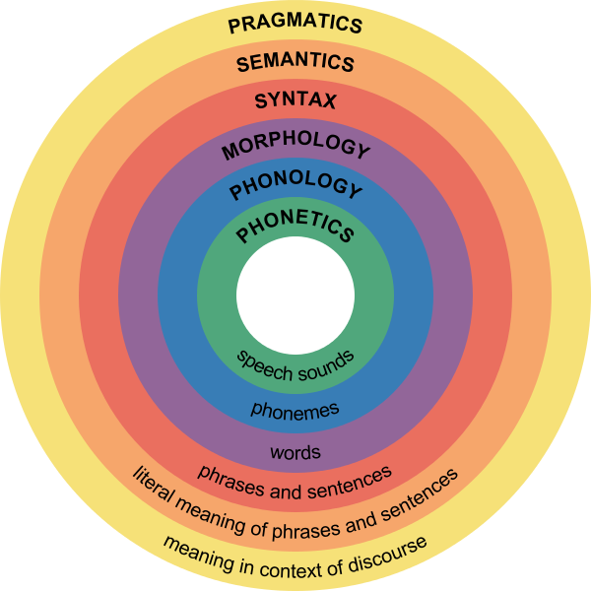

Major levels of linguistics

Slide 10

Two of the concepts that make language unique are grammar and lexicon
Grammar
Lexicon
Grammar is a set of rules for generating logical communication.
Speakers of a language have internalized the rules and exceptions for that language’s grammar.
Every human language has a lexicon — the sum total of all of the words in that language.

Slide 11
The importance of language
11
Language shapes our social interactions and brings order to our lives.
Complex language is one of the defining factors that makes us human.

Slide 12
The importance of context
12
How important is context to reading? Extremely! In the 1970s, a famous study was conducted by Bransford and Johnson.
Participants were asked to listen to a passage and then answer questions. The passage was similar to the following.
Take a minute to read it:

Slide 13


The importance of context
This is a fairly easy process. It can be completed at home or at a different place if the necessary machinery isn’t available. First, items are put into different groups. But if there isn’t too much to deal with, one group may be enough. It’s important to look at everything carefully: a mistake could ruin a group. This first phase doesn’t take very long, especially the more times you do it. The next phase goes faster. Once it is taken care of, it won’t require your attention until it is finished. At that point, the items will be separated again. These groups will determine where everything goes. Once things are put away, you have finished until the process is repeated the next time.

Slide 14
Did the reading make sense to you? If you were confused, you are not alone. It’s difficult to make sense of.
Then participants were given the title:
“Washing Clothes”
and asked to read it again.
Try this now.
As you can see, context makes a significant difference. That is why you have probably already learned how helpful it is to look at chapter heads and subheads when you are reading a textbook. And don’t forget to look at photos and other illustrations even before you start to read – or do an exercise.
All of this information will help you read more efficiently.

Slide 15
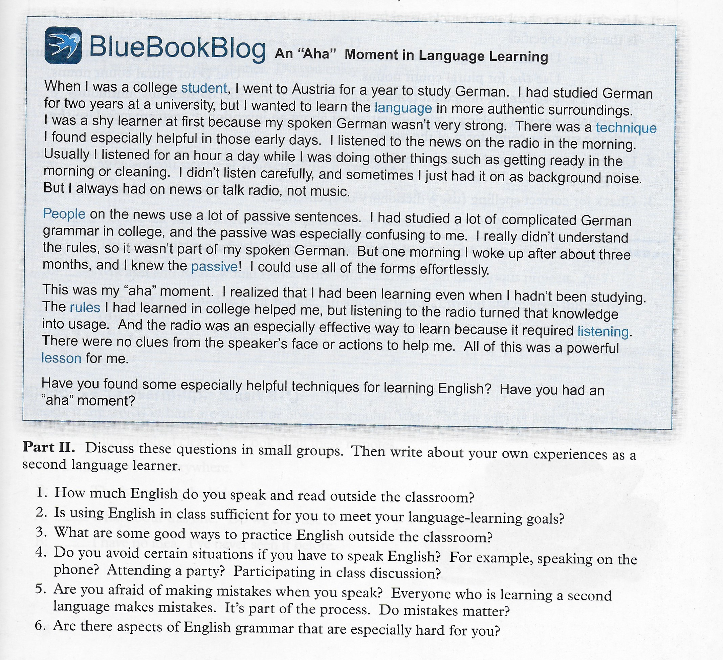

Slide 16
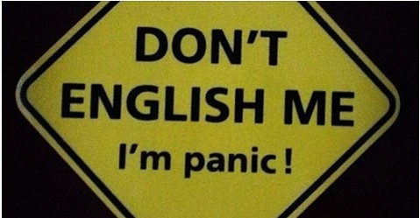
Learning English may be a difficult task, but it doesn’t need to be a frightening experience
16

