Slide 2
The 12 Basic English Tenses
Simple Present I do
Present Progressive I am doing
Present Perfect I have done
Present Perfect Progressive I have been doing
Simple Past I did
Past Progressive I was doing
Past Perfect I had done
Past Perfect Progressive I had been doing
Simple Future I will do
Future Progressive I will be doing
Future Perfect I will have done
Future Perfect Progressive I will have been doing

Slide 3
Simple Present
The simple present says that something was true in the past, is true in the present, and will be true in the future.
It expresses general statements of fact and general truths.
Water consists of hydrogen and oxygen
The average person breathes 21,600 times a day
The world is round
The simple present is used to express habitual or everyday activities.
I get up at seven every morning
I always eat a salad for lunch

Slide 4
Present Progressive
The present progressive expresses an activity that is in progress at the moment of speaking.
The students are sitting at their desks right now.
The present progressive is a temporary activity that began in the past, is continuing at present, and will probably end at some point in the future.
I need an umbrella because it is raining.
I am taking five courses this semester.

Slide 5
Simple Present and Present Progressive
Simple Present
now
past XXXXXXXXXXXXXXXX future
Present Progressive
X X
start now finish?
---------------------------------------
…in progress…

Slide 6
Exercises Complete the sentences. Use the simple present or the present progressive of the verbs in parentheses:
1) a. Kristin is in the shower. She (wash) ___________________ her hair.
b. Kristin (wash) ________________ her hair every other day or so.
2) a. Tony usually (sit) _________________ in the front row during class.
b. Today he (sit) ____________________ in the last row.
a. Andrew (work) __________________ the night shifts on weekends.
b. He’s not home now. He (work) _____________________ a double shift.
a. After six days of rain, I’m glad that the sun (shine) ____________________.
b. Every morning, the sun (shine) ______________ in my bedroom window and (wake) ________________ me up.
a. Babies (grow) ________________ very quickly. Newborn babies are very different from three-month olds.
b. Your baby (grow) ________________ so fast. She isn’t a newborn anymore!
a. Please, be quiet. I (try) _____________ to concentrate on my math homework.
b. Each day, our math teacher (try) ______________ to explain the material clearly, but I am
very confused.

Slide 7
Simple Present and Present Progressive: affirmative, negative, question forms
 | Simple Present | Present Progressive
AFFIRMATIVE | I help You, We, They help He/She/It helps | I am helping You, We, they are helping He/She/It is helping
NEGATIVE | I do not help You, We, They do not help He/She/It does not help | I am not helping You, We, they are not helping He/She/It is not helping
QUESTION | Do I help? Do you, we, they help? Does he/she/it help? When do I help? | Am I helping? Are you, we, they helping? Is he/she/it helping? When am I helping?

Slide 8
Exercises Complete the sentences with Do, Does, Is or Are
On an airplane
________________ you ready for takeoff?
________________ the plane taking off soon?
________________ you nervous?
________________ you have your seat belt on?
________________ the seats comfortable?
________________ your seat comfortable?
________________ the seat go back more?
________________ they serve food on this flight?
________________ the movie beginning?
________________ you like to fly?
________________ the co-pilot flying the plane?
________________ the co-pilot sleep during the flight?
________________ the pilots sleep during the flight?
________________ the plane on autopilot?

Slide 9
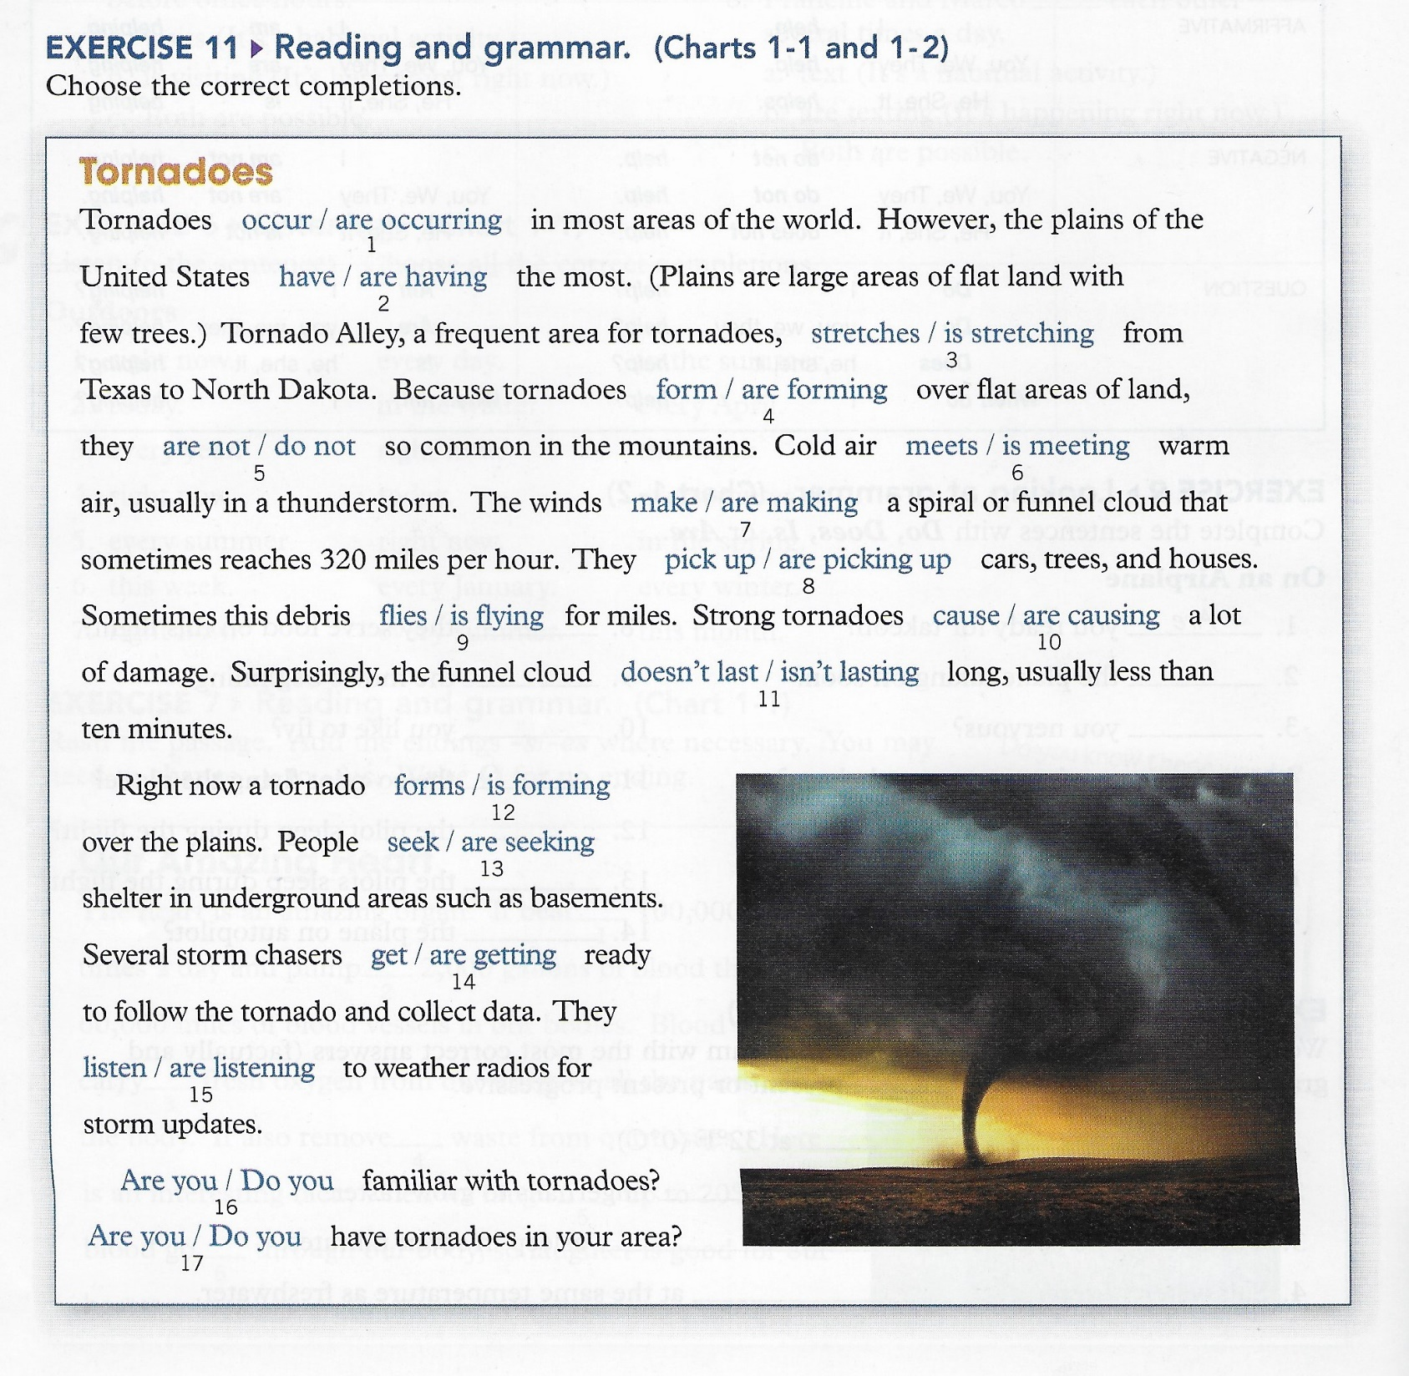

Slide 10
Verbs not usually used in the progressive (stative verbs)
Some verbs – like know – are stative or non-progressive.
They describe states, not actions, and are rarely used in progressive tenses.
States are conditions or situations that exist.
Ex. I know your cousin.
Common verbs that are usually non-progressive
Know | Like | Dislike | Belong | Consist of | Hear | Agree
Believe | Appreciate | Fear | Possess | Contain | Sound | Disagree
Doubt | Care about | Hate | Own |  |  | Mean
Recognize | Please | Mind |  | Exist | Seem | Promise
Remember | Prefer |  | Desire | Matter | Look like | Amaze
Suppose |  |  | Need |  | Resemble | Surprise
Understand |  |  | Want
 |  |  | Wish

Slide 11
Stative verbs that can be used in progressive tenses
Some verbs – like think – have both non-progressive and progressive meanings.
I think that your cousin is very nice (think = believe)
I’m thinking about my trip to Rome (am thinking = thoughts are going around in my mind right now)
Common verbs with both non-progressive and progressive meanings
Look | It looks cold outside | Amy is looking out of the window
Appear | Jack appears to be tired today | She’s appearing on a TV show today
Think | I think that Mr. Smith is a good teacher | I’m thinking about my family right now
Feel | I feel that Mr. Smith is a good teacher | I’m feeling a little tired today
Have | I have a bike | I’m having a good time
See | Do you see that bird? | The doctor is seeing a patient right now
Taste | The soup tastes salty | The chef is tasting the soup
Smell | Something smells bad. What is it? | Ann is smelling her new perfume
Love | John loves his baby daughter | John is enjoying parenthood. He’s loving it!
Be | Mary is young, but wise | You’re being foolish! Go see a doctor!

