Slide 1
PLAGIARISM
WHAT IS IT AND HOW TO AVOID IT

Slide 2
OFFICIAL DEFINITION
To plagiarize (verb):
▶ to use the words or ideas of another person as if they were your own words or ideas
▶ to steal and pass off (the ideas or words of another) as one's own : use (another's production) without crediting the source
▶ to commit literary theft : present as new and original an idea or product derived from an existing source

Slide 3
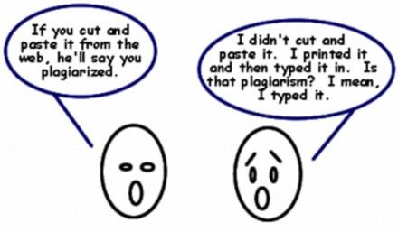
WHAT DOES PLAGIARISM LOOK LIKE?
▶ Copying someone’s work
▶ Citing a source improperly
▶ Failure to cite a source
▶ Creation of false sources
▶ Turning in another person’s work as your own

Slide 4
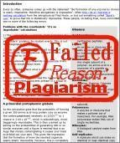
CONSEQUENCES/PUNISHMENT
▶ Failure of assignment!
▶ It is very easy to tell if you have plagiarized!

Slide 5
HOW TO AVOID PLAGIARISM
1. SUMMARIZE
▶ You must reference the original source
▶ Your summary should be shorter than the text you are summarizing
▶ You must use your own words, usually with a very limited use of quotations

Slide 6
HOW TO AVOID PLAGIARISM
2. Paraphrase
▶ You must reference the original source
▶ The text you produce may be shorter or longer than the original text
▶ You must use your own words

Slide 7
HOW TO AVOID PLAGIARISM
3. Quote
▶ You must reference the original source
▶ The text produced is the exact length of the original text quoted (unless ellipses are used)
▶ You must use the original author’s exact words and you must put quotation marks around them
▶ You must include the page number of the source from which you borrowed the author’s original language
▶ You can introduce quotes with phrases like According to Bob Jones, “xxx” or Bob Jones stated, “xxx”

Slide 8
IMPORTANT REMINDERS
Always double check all your citations for accuracy,
proper formatting, author and page number.
Make sure all your in text citations match the sources listed in the Works Cited.
Anyone reading your work should be able to easily locate the original source of any material you use in your own work.

Slide 9
GOOD SOURCES
▶ University presses (Harvard, Cambridge)
▶ Major Publishing Houses (Penguin, Random House)
▶ Well Known Organizations (United Nations, Government websites)
▶ Well-Known Newspapers (New York Times)
▶ Well Known Media Sources (BBC, CNN)
▶ Magazines
▶ Online Journals (JSTOR)

Slide 10
BAD SOURCES
▶ Wikipedia
▶ Personal Blogs
▶ Non-credible newspapers, magazines, editorials
▶ Think about “bias”

