Slide 1
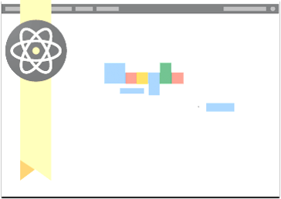
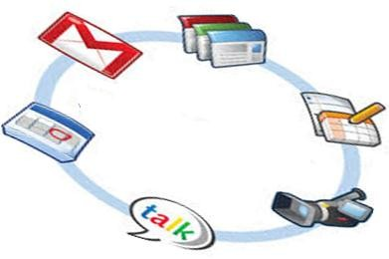


AND its
Dr. Abdulrahaman A. Momin Assistant Professor, Department of Biochemistry, BV (DTU) Medical College,
Pune

Slide 2

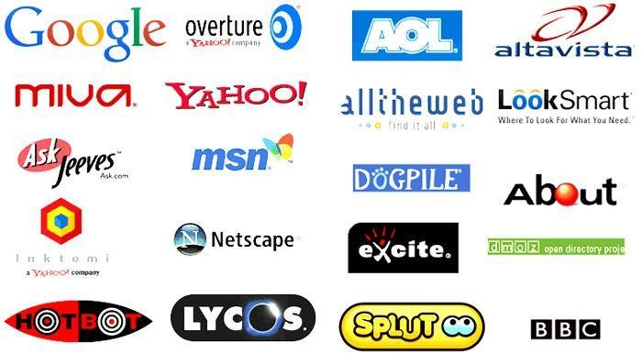
Search engines

Slide 3
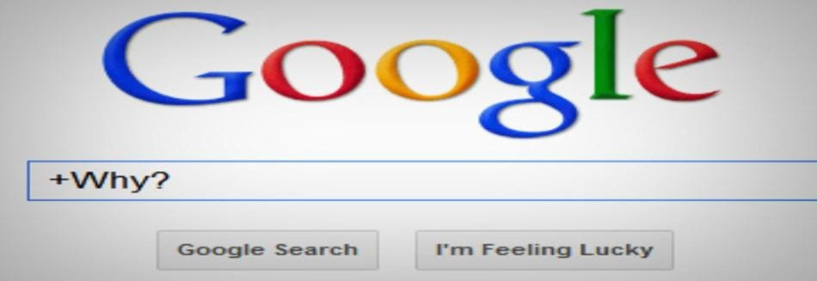
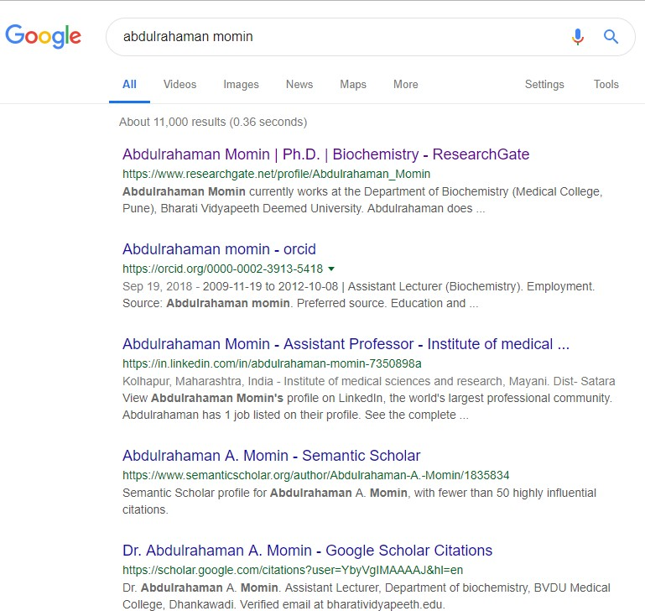

Why Google?
Faster
it even reveals to you how quick
Large number of results in a fraction
Most results are sorted according to ‘relevance’ and are within the first page
And most important “It’s free”

Slide 4


But my teacher said not to use Google!
NO
Google searches public Web content. Your teacher says "Don't use Google," meaning that you should not use the public Web content.
You should use “Google Scholar”.

Slide 5
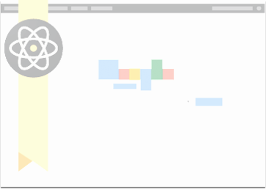

Google teamed up with publishers so they let them search behind their firewalls
“Standing on the shoulders of giants”
“Discovering truth by building on previous discoveries".
Modified the algorithm so it excludes non- scholarly material to help relevance
Included library locations for full-text access (Library Link)

Slide 6

What is Google Scholar?
Designed to locate scholarly information, including peer- reviewed articles, theses, books, preprints, abstracts, and court opinions from academic publishers, professional societies, online repositories, universities, and other Web sites.
Launched in 2004
It provides a simple way to broadly search for scholarly
literature.
From one place, you can search across many disciplines and sources
It allows users to search for digital or physical copies of articles, whether online or in libraries.
It relies primarily on keyword searching to return relevant results.
Your search is interdisciplinary, retrieving broad results.

Slide 7
Like Google, Google Scholar returns the most relevant results first, based on an item's full text, author, source, and the number of times it has been cited in other sources.
Google Scholar will not necessarily get you to the
full text of every search result.
The retrieval is organized by relevancy ranking rather than reverse chronology; older results may appear first.

Slide 8
How to open google scholar account
No worry, if you have Gmail account
http://scholar.google.co.in/
If not, simply Sign Up for Gmail/Google account
Single account sufficient for all google apps
Pricing Options: Free access via any Web browser.

Slide 9
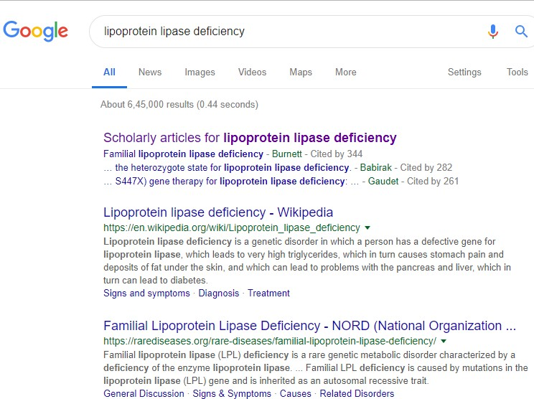
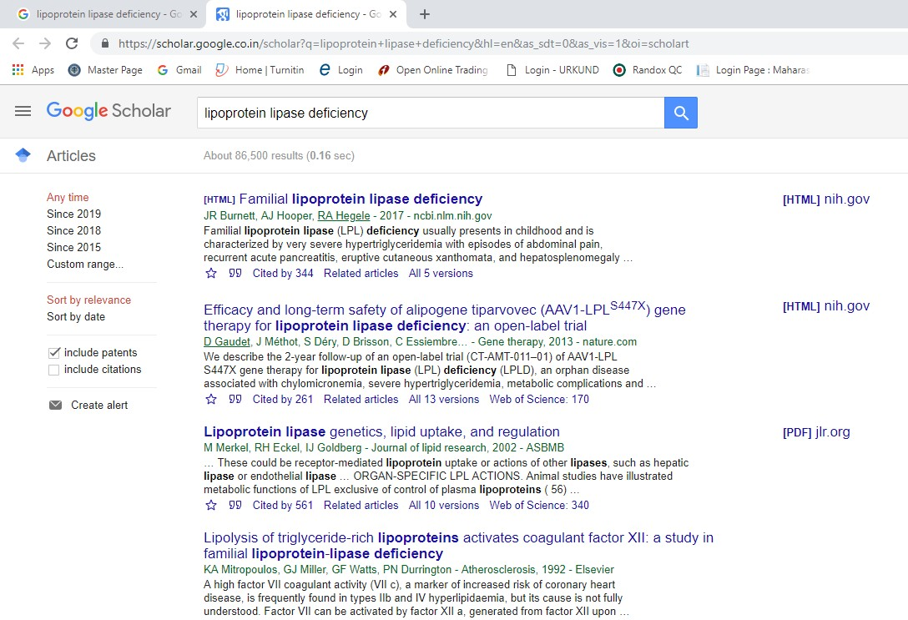
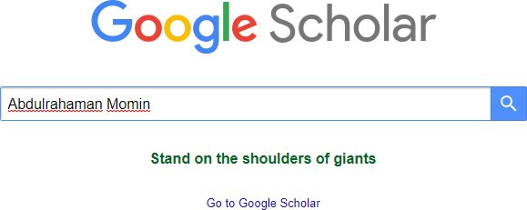

Slide 10
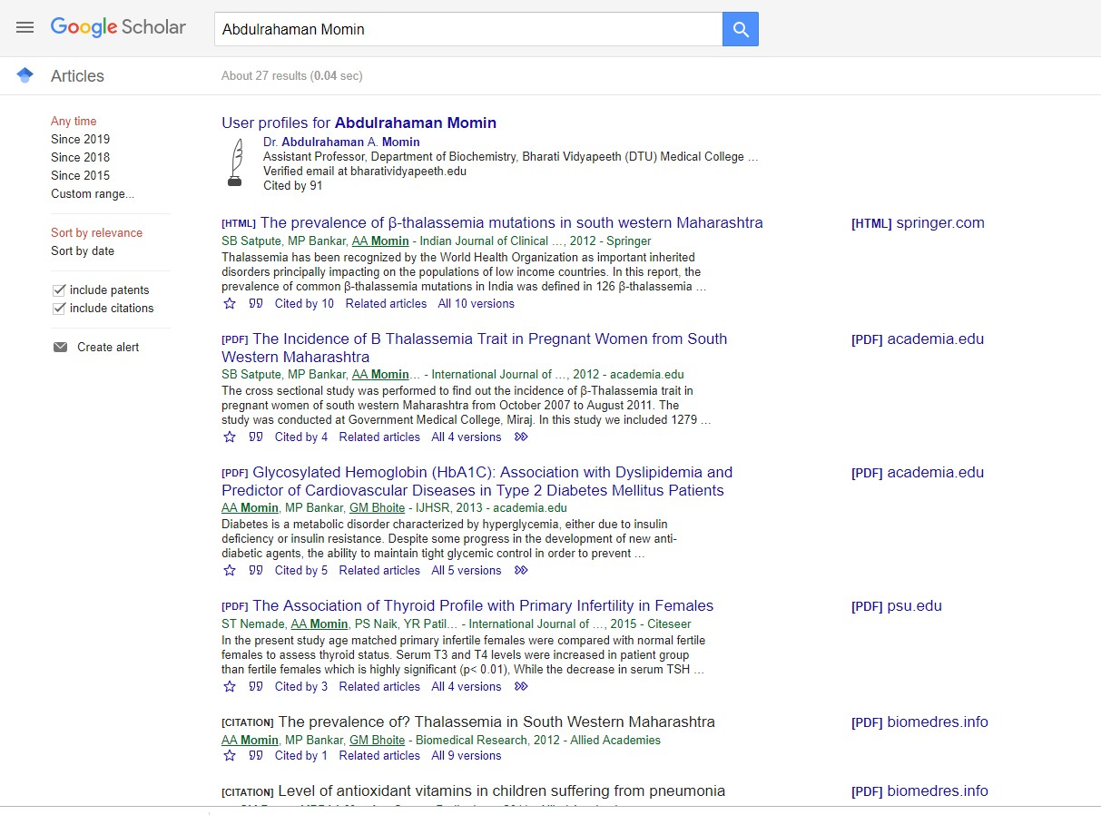
Title & Authors
Articles related to your paper
Cite the article (Next page)
Save to “My library” previously only found
Versions of your article
in CiteSeer, Scopus,
and Web of Science.

Slide 11
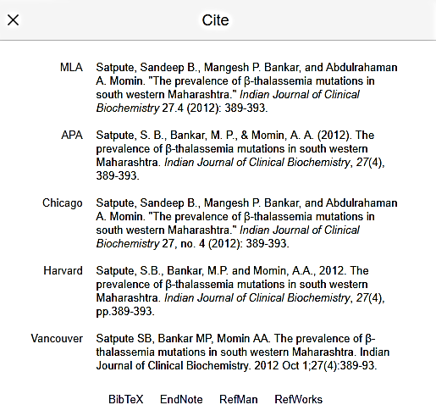

Slide 12
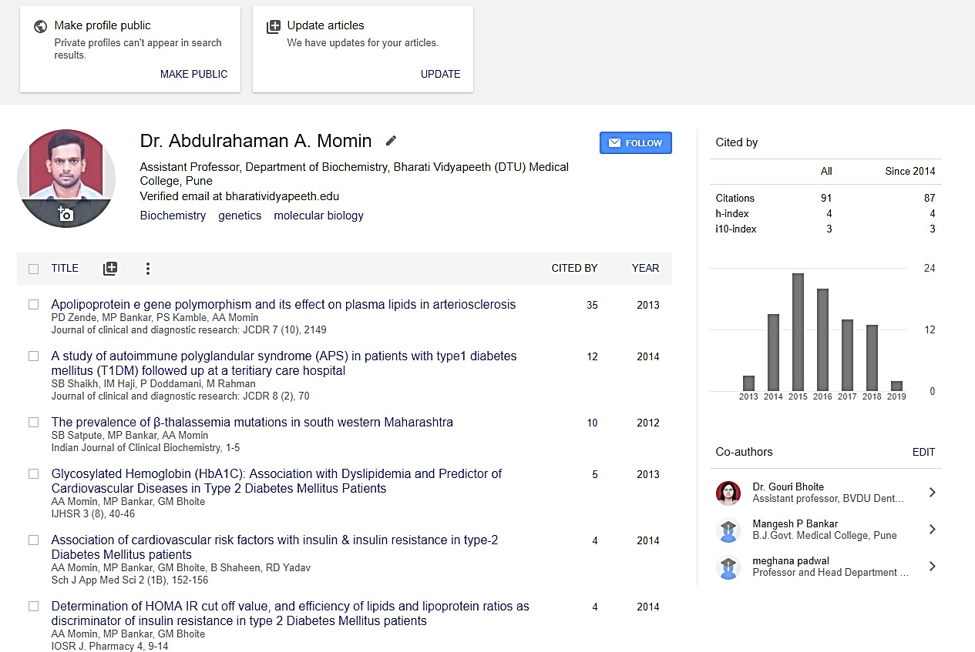

Appear in Google Scholar results when
Your citation metrics are computed and updated automatically as Google Scholar finds new citations to your work on the web.
people search for your name

Slide 13
How do I see the citation graph for one of my articles?

Slide 14
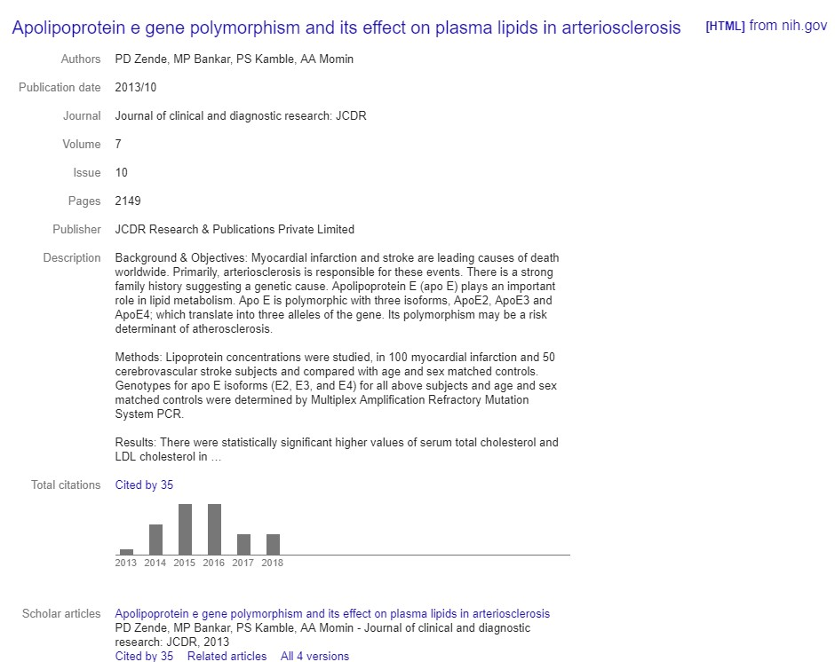

Slide 15
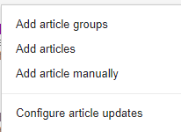
How to add article manually?
You can add groups of related articles
You can choose to have your list of articles updated automatically or review the updates yourself, or to manually update your articles at any time.

Slide 16
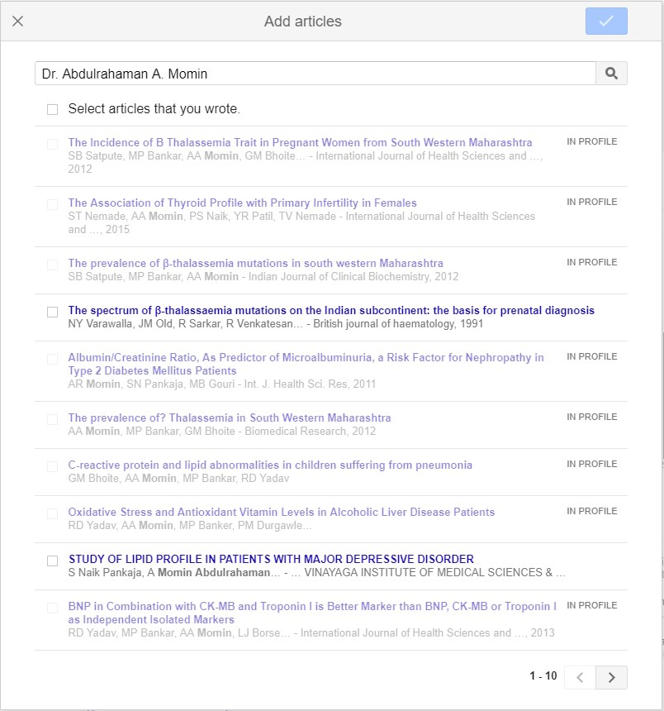
How to add article manually?

Slide 17
How to add article manually?

Slide 18
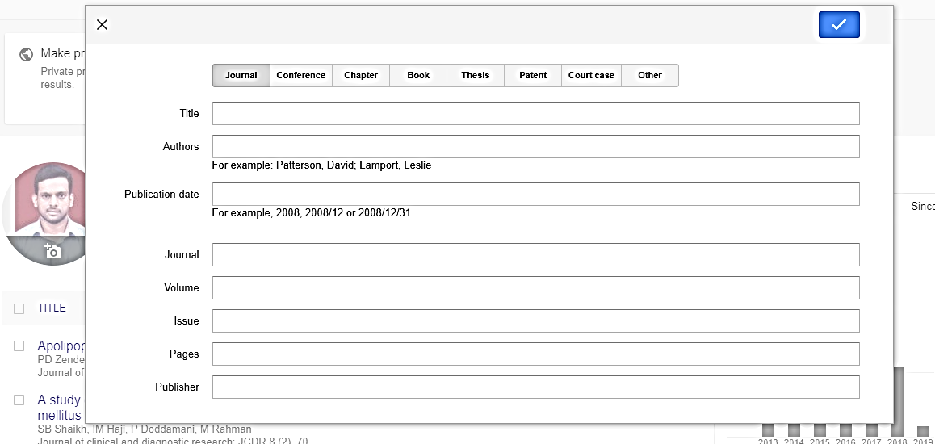
Add article manually
Apolipoprotein e gene polymorphism and its effect on plasma lipids in arteriosclerosis
PD Zende, MP Bankar, PS Kamble, AA Momin
2013/10
Journal of Clinical and Diagnostic research 7
10
2149-2152
JCDR Research & Publications Private Limited

Slide 19
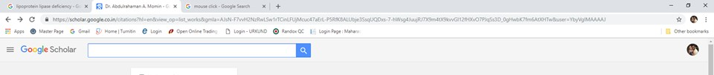
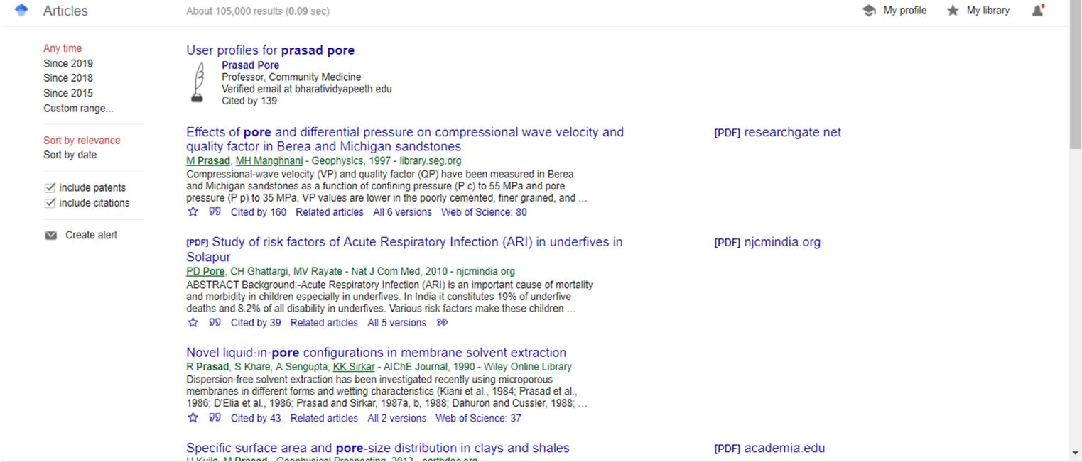
How to search the profile of scholars or researchers?
Prasad Pore

Slide 20
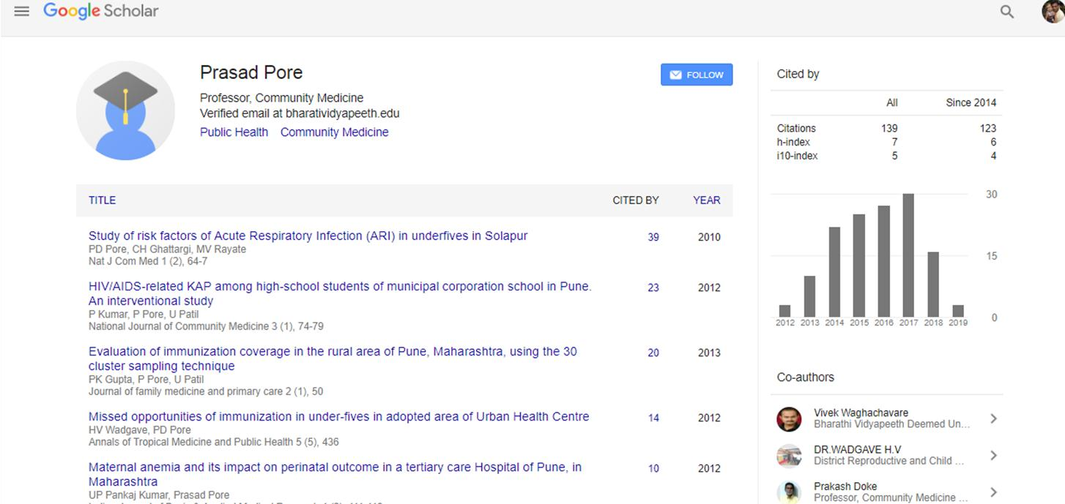
Point to note

Slide 21
Metrics
Google Scholar Metrics provide an easy way for authors to quickly gauge the visibility and influence of recent articles in scholarly publications.
Scholar Metrics summarize recent citations to many publications, to help authors as they consider where to publish their new research.
Google Scholar automatically calculates and displays the
individual's total citation count, h-index, and i10-index.
To see which articles in a publication were cited the most and who cited them, click on its “Cited by” to view the articles.
You can also explore publications in research areas of your
interest
A metrics feature now supports viewing the impact of
the
academic journals, and whole fields of science, via
"metrics" button.

Slide 22
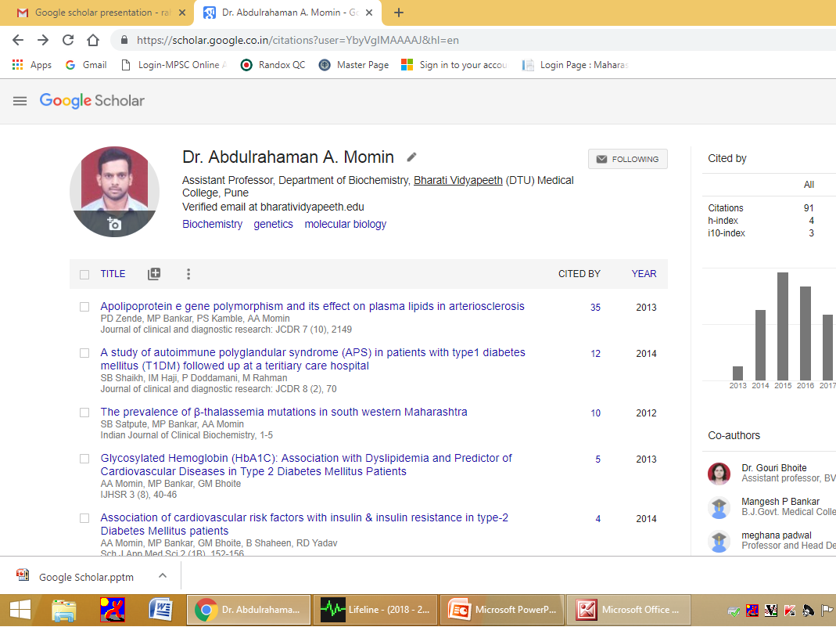


Slide 23
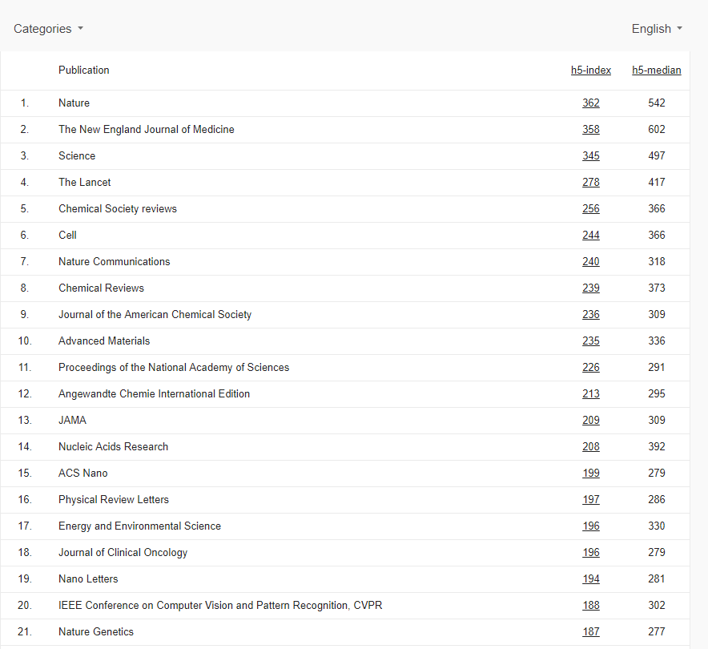
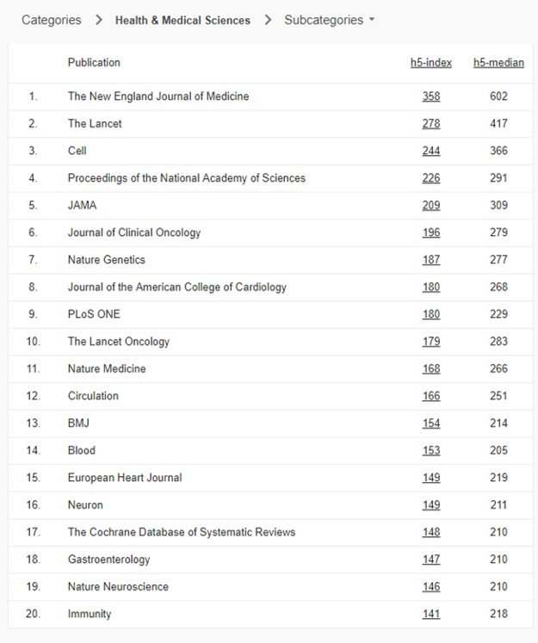
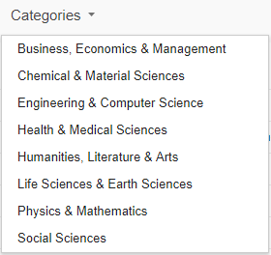
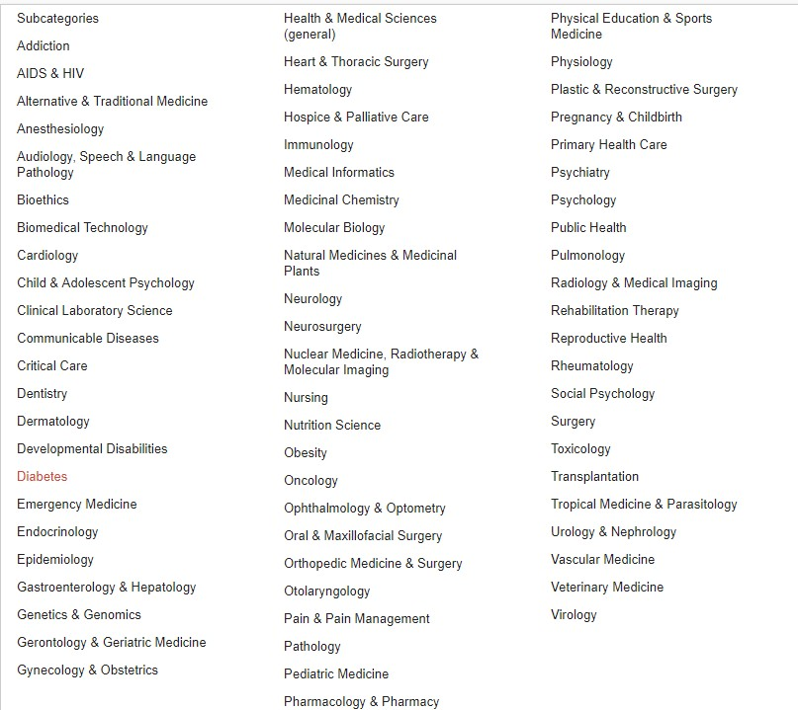
This reveals the top journals in a field of interest, and the articles generating these journal's impact can also be accessed.
To get started, you can browse the top 100 publications in several
languages, ordered by their five-year h-index and h-median metrics.

Slide 24
H-Index
The index was suggested in 2005 by Jorge E. Hirsch,
a physicist and is sometimes called the Hirsch
index or Hirsch number.
The h-index is an author-level metric that attempts
to measure both the productivity and citation
impact of the publications of a scientist or scholar.
The index is based on the set of the scientist's most cited papers and the number of citations that they have received in other publications.
The index can also be applied to the productivity and impact of a scholarly journal as well as a group of scientists, such as a department or university or country.

Slide 25
i10-index
The i10-index is the newest in the line of journal metrics and was introduced by Google Scholar in 2011.
It is a simple and straightforward indexing measure found by tallying a scholar’s total number of published papers with at least 10 citations.
i20-index
i20-index The i20-index, proposed in this editorial note, is obtained by tallying a scholar’s total number of published papers with at least 20 citations

Slide 26
Alternatives to Google Scholar
Web of Knowledge (Web of science)
Scopus
SOLO
Subject specialised federated searches e.g PubMed, Scirus for scientific information.

Slide 27
Web of Knowledge (Web of science)
“One platform for access to objective content and powerful tools that let you search, track, measure and collaborate in the sciences, social sciences, arts, and humanities.”
Scopus
“Scopus is the largest abstract and citation database of peer-reviewed literature and quality web sources with smart tools to track, analyze and visualize research”

Slide 28
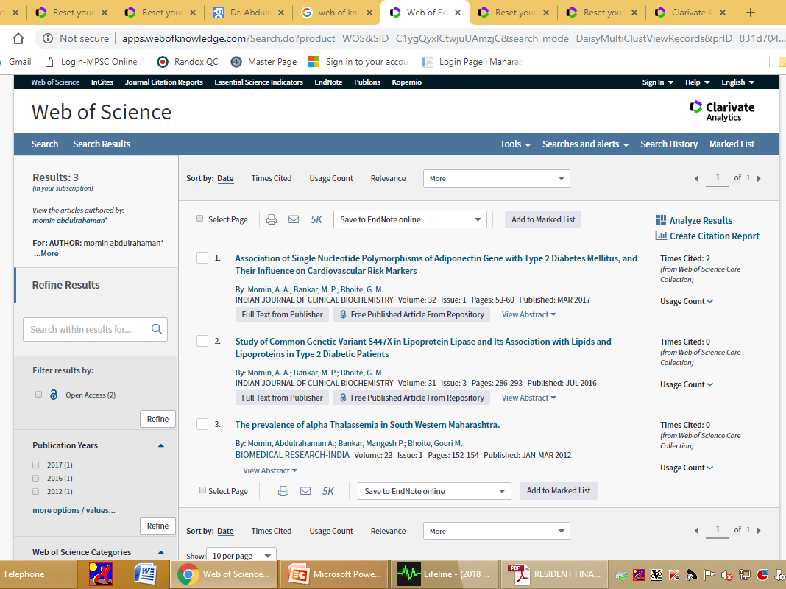

Slide 29
