Slide 1
Physisorption, surface area and porosity

Slide 2
100 Kg H₂O
V = 100 L
V = a³ = 100 dm³ a = 4.64 dm
Surface 6 x a² = 129 dm²
1 cube
100 Kg H₂O
V_{i} = 1 L
V_{i} = a_{i} ³ = 1 dm³ a = 1 dm
Total surface 100 x 6 x a_{i} ²
= 600 dm²
100 cubes

Slide 3
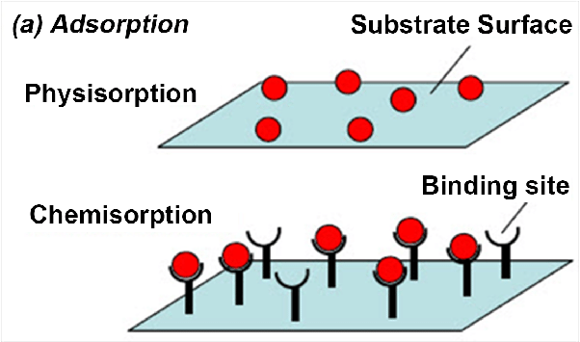
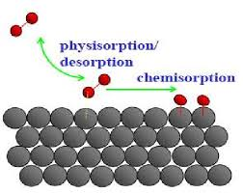
Physisorption and chemisorption

Slide 4
Adsorption and Reaction at Surfaces
PHYSISORPTION | CHEMISORPTION
WEAK, LONG RANGE BONDING Van der Waals interactions (e.g. London dispersion, dipole-dipole).. | STRONG, SHORT RANGE BONDING Chemical bonding involving orbital overlap and charge transfer.
NOT SURFACE SPECIFIC Physisorption takes place between all molecules on any surface providing the temperature is low enough. | SURFACE SPECIFIC Marked variation between crystal planes E.g. Chemisorption of hydrogen takes place on transition metals but not on gold or mercury.
ΔΗ_{ads} = 5 ….. 50 kJ mol⁻¹ Related to factors like molecular mass and polarity (i.e. ~ heat of liquefaction) | ΔΗ_{ads} = 50 ….. 500 kJ mol⁻¹ Wide range (related to the chemical bond strength)
Non activated with equilibrium achieved relatively quickly. Increasing temperature always reduces surface coverage. | Can be activated, in which case equilibrium can be slow and increasing temperature can favour adsorption.
No surface reactions. | Surface reactions may take place:- Dissociation, reconstruction, catalysis.
MULTILAYER ADSORPTION BET Isotherm used to model adsorption equilibrium. | MONOLAYER ADSORPTION Langmuir Isotherm used to model adsorption equilibrium..

Slide 5
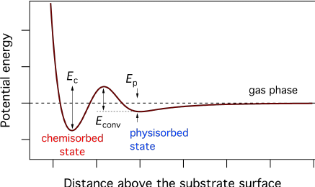

Slide 6
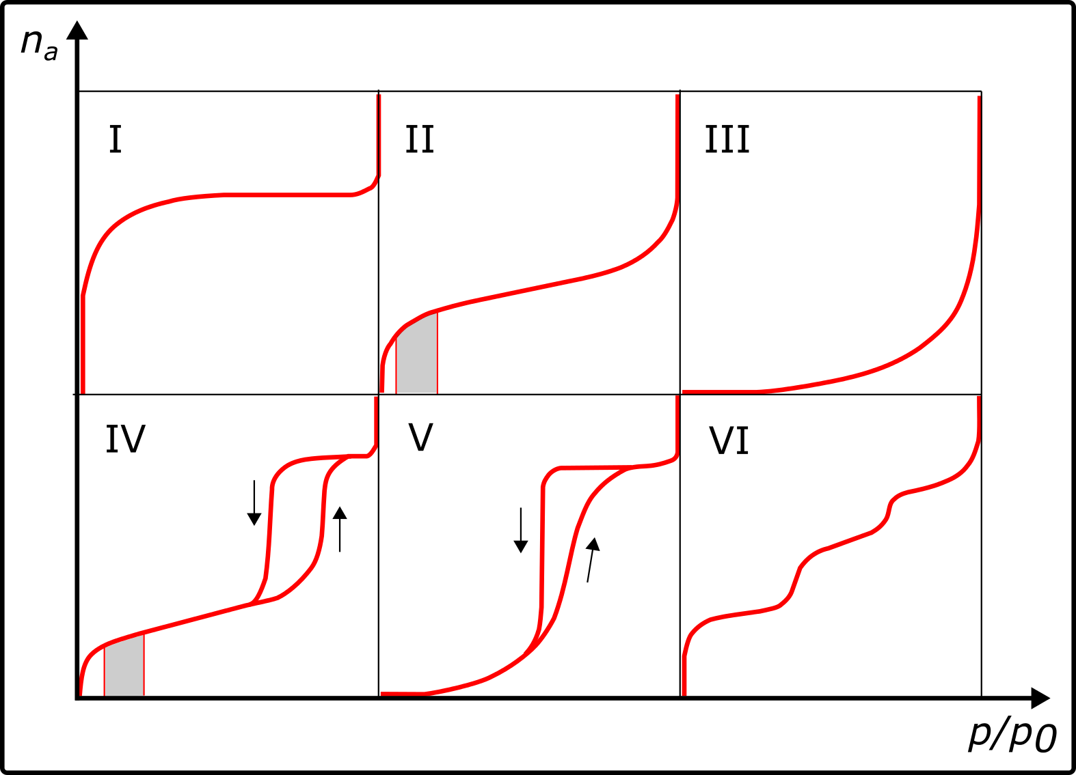

Slide 7
Type I Pores are typically microporus with the exposed surface residing almost exclusively inside the microspores, which once filled with adsorbate, leave little or no external surface for further adsorption.
Type II Most frequently found when adsorption occurs on nonporous powders or powders with diameters exceeding micropores. Inflection point occurs near the completion of the first adsorbed monolayer.
Type III Characterised by heats of adsorption less than the adsorbate heat of liquification, adsorption proceeds as the adsorbate interaction with an adsorbed layer is greater than the interaction with the adsorbent surface.
Type IV Occur on porous adsorbents with pores in the range of 2 – 100nm. At higher pressures the slope shows increased uptake of adsorbate as pores become filled, inflection point typically occurs near completion of the first monolayer
Type V Are observed where there is small adsorbate-absorbent interaction potentials (similar to type III), and are also associated with pores in the 2 –100 nm range.
Type VI The reversible stepwise Type VI isotherm is representative of layer-by-layer adsorption on a highly uniform nonporous surface.

Slide 8
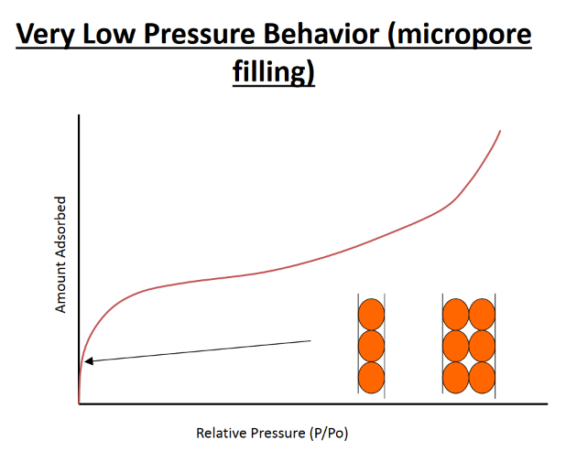

Slide 9
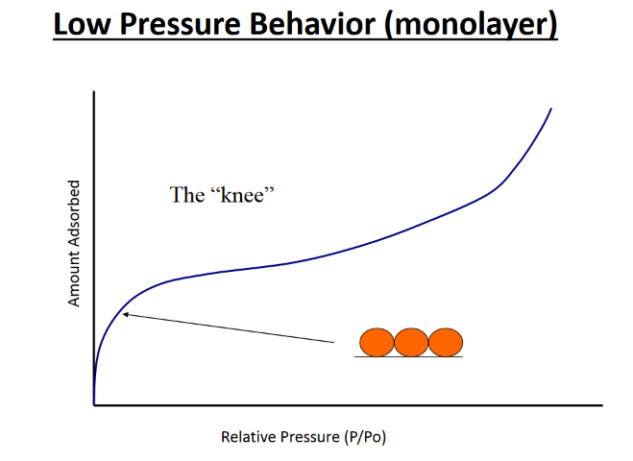

Slide 10
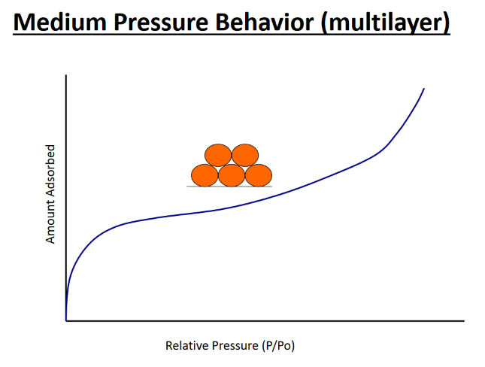

Slide 11
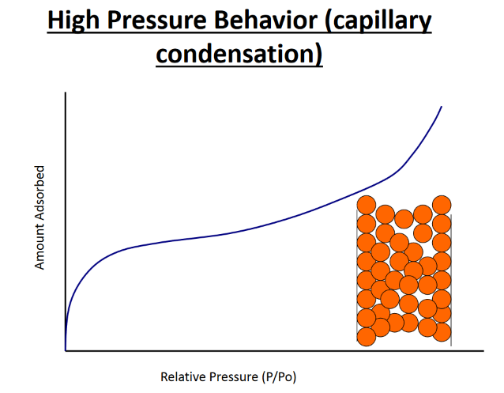

Slide 12
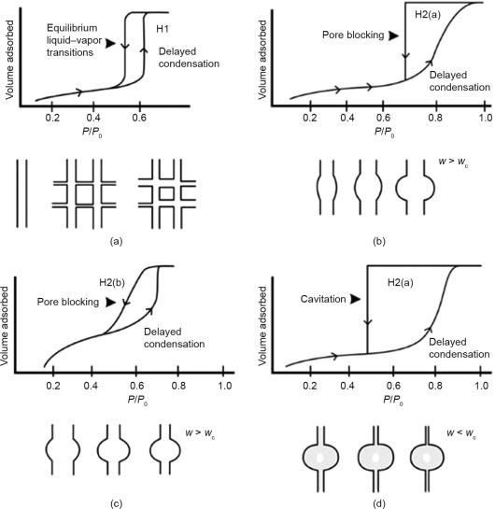
IUPAC
Classification
Macroporous
> 50nm
Mesoporus
2-50 nm
Microporus
< 2nm

Slide 13
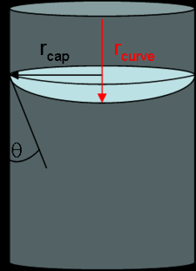
Where...
P_{v} = equilibrium vapor pressure
P_{sat} = saturation vapor pressure
H = mean curvature of meniscus
γ = liquid/vapor surface tension
V_{l} = liquid molar volume
R = ideal gas constant
T = temperature

Slide 14
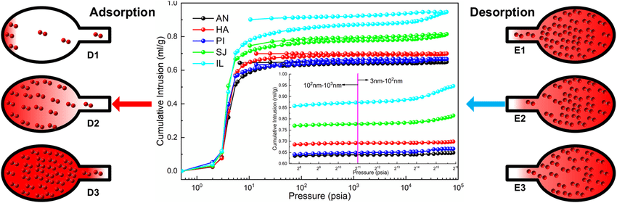
Hysteresis

Slide 15
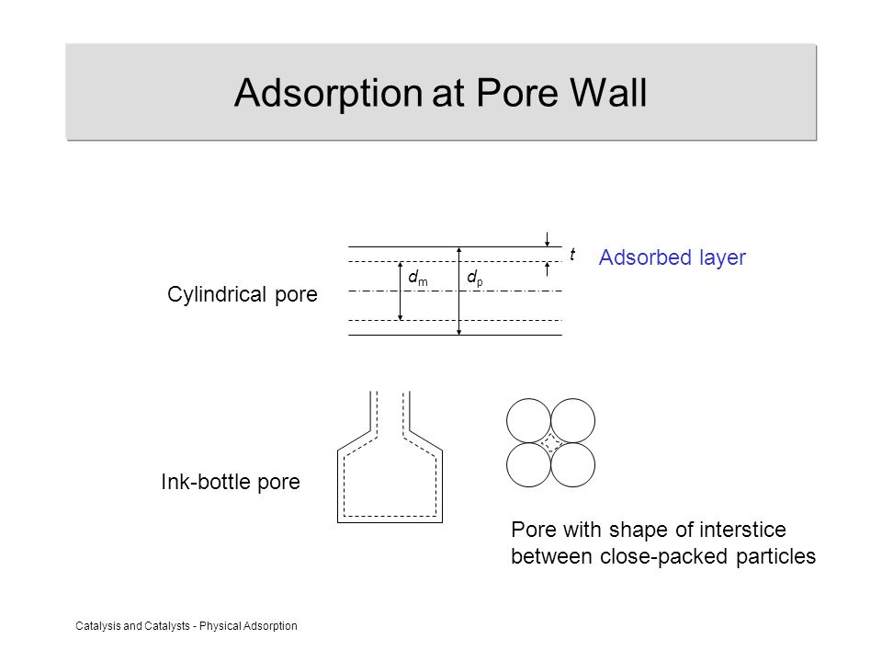
Heterogeneity of pores

Slide 16
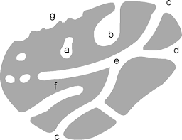
Heterogeneity of pores

Slide 17
Adsorption
Kinetic behavior of the adsorption process
Rate of arrival of adsorption is equal to the rate of desorption
Heat of adsorption was taken to be constant and unchanging with the degree of coverage, θ

Slide 18
Langmuir Assumption
Gas molecules behave ideally
Only 1 monolayer forms
All sites on the surface are equal
No adsorbate-adsorbate interaction
Adsorbate molecule is immobile

Slide 19
Langmuir Isotherm
An isotherm describes the dependence of volume, concentration , or in the case of a surface, coverage q, on pressure p at constant temperature T at equilibrium.
q = [ƒ(p)]^{T}
In the equilibrium between the gas phase and the adsorbed phase, LeChatelier's Principle predicts that at constant temperature an increase in pressure will increase the number of molecules adsorbed on the surface since the volume occupied by the molecules at the surface (per mole) is smaller.
This can, however, reach a limiting value. The number of molecules adsorbed at any pressure p will also depend on the strength of the adsorbate bond to the surface.
p
q

Slide 20
Langmuir Isotherm
Langmuir’s “checkerboard” model of adsorption assumes that a surface is composed of a finite number of equivalent adsorption sites.
So the maximum coverage is obtained when all sites are filled. The coverage θ is expressed in terms of the number of molecules adsorbed in relation to the number of available sites. i.e. When all sites are filled, θ = 1.
Consider the equilibrium:
A_{gas} A_{adsorbed}
p
k_{ads}
θ
The Rate of adsorption is proportional to:
The number of surface collisions n from the gas phase
per second, which is proportional to the pressure p .
2) area of bare surface available for adsorption (1 - θ).
ie. rate of adsorption = k_{ads} P (1 - θ)

Slide 21
Langmuir Isotherm
Consider the equilibrium:
A_{gas} A_{adsorbed}
p
k_{des}
θ
Rate of desorption proportional to:
1) the fraction of surface covered by adsorbate θ.
i.e rate of desorption = k_{des} θ

Slide 22
At equilibrium
Rate of adsorption = Rate of desorption
θ = 1
b = 100
k_{ads} p (1 - θ) = k_{des} θ
b = 50
θ
b = 10
If we write b = k_{ads} / k_{des}
p
θ = bp / (1+bp) ……….. The Langmuir Isotherm
Since b = k_{ads} / k_{des} , this is the same as an equilibrium constant K
And since ln K = -ΔG/RT one can write:
b = exp (-ΔG/RT ), i.e b reflects the strength of the adsorbate bond to the surface.
Since θ = n_{ads} / n_{max}
p / n_{ads} = 1 / b n_{max} + p / n_{max}

Slide 23
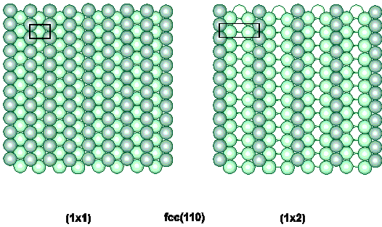
Langmuir Isotherm
Limitations and approximations
“finite number of equivalent adsorption sites”
different surface adsorbate structures
surface reconstruction

Slide 24
Langmuir Isotherm
Limitations and approximations
“finite number of equivalent adsorption sites”
lateral interactions between adsorbates
Enthalpy of adsorption ΔH_{ads}
depends on site/coverage

Slide 25
Langmuir Isotherm
Limitations and approximations
rate of adsorption = k_{ads} p (1 - θ)
X
assumes collision at a vacant site is required for adsorption
precursor kinetics
rate of adsorption i.e. sticking probability (S)
S α (1 - θ)
θ

Slide 26
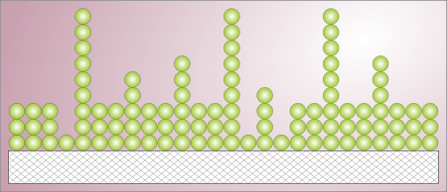
The concept of the B.E.T. theory is an extension of the Langmuir theory, which is a theory for monolayer molecular adsorption, to multilayer adsorption with the following hypotheses
1. gas molecules physically adsorb
on a solid in layers infinitely;
2. gas molecules only interact
with adjacent layers; and
3. the Langmuir theory can be applied to each layer.
4. the enthalpy of adsorption for the first layer is constant and greater than the second (and higher).
5. the enthalpy of adsorption for the second (and higher) layers is the same as the enthalpy of liquefaction.

Slide 27
Physisorption
Brunauer, Emmett and Teller – BET Theory
* Multilayer adsorption
* Dynamic equilibrium
θ_{o} Fraction of surface unoccupied
A₁ condensation coefficient (adsorption probability)
N_{m} n° of molecules in a monolayer
E₁ Energy of adsorption
ν₁ adsorbate’s vibrational frequency
1.
2.
3.
First layer
4.
Second layer

Slide 28
5.
n^{th} layer
Assuming ν, E and A constant for 2nd, 3rd,…n^{th} layer (liquid state)
L heat of liquefaction
6.
7.

Slide 29
7.
11.
12.
8.
13.
9.
14.
10.

Slide 30
The total number of molecules adsorbed at equilibrium is
15.
Substituting for θ₁, θ₂ , …
from 11-14.
16.
Since α and β are constant
17.
18.
from 7-10.

Slide 31
Substituting in 16.
19.
20.
21.
1 = θ₀ + θ₁ + θ₂ +.....θ_{n}
22.
Substituting 22 into 20
23.

Slide 32
Replacing q_{n} in 23. with αβ^{n-1}θ_{o} from 14.
24.
Replacing a in 24. with Cb from 17.
25.
Since
26.
27.

Slide 33
From 20.
28.
Substituting 28 in 27.
29.
30.
Introducing θ_{o} from 30. into 20
= 1 when
N/N_{m} = infinite
31.
Condensation on the surface or P/P₀ = 1

Slide 34
Considering Eq. 10 for P/P₀ = 1 , β= 1 when
33.
32.
Introducing b into 31.
34.
Recalling that N/N_{m} = n/n_{m}

Slide 35
Brunauer Emmett and Teller (BET equation):
n amount of adsorbate (g) at the pressure P
n_{m} amount of adsorbate corresponding to the formation of a monolayer
C BET constant
P₀ saturation pressure
M_{w} è Molecular weight of the adsorbate N_{a} Avogadro Number a_{m} “cross section area” of the adsorbate.

