Slide 1
Definitions and commonly used terms

Slide 2
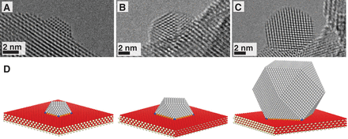
Nanomaterials: Nanocomposites
A nanocomposite is a solid containing at least one physically or chemically distinct region, or collection of regions, having at least one dimension in the nanoscale.
The use of nano building blocks can allow to design and create new materials with unprecedented flexibility and improvement in their physical properties. In the broadest sense this definition can include porous media, colloids, gels and copolymers, but is more usually taken to mean the solid combination of a bulk matrix and nano-dimensional phase(s) differing in properties due to dissimilarities in structure and chemistry.
The mechanical, electrical, thermal, optical, electrochemical, catalytic properties of the nanocomposite will differ markedly from that of the component materials. SINERGIC EFFECT

Slide 3
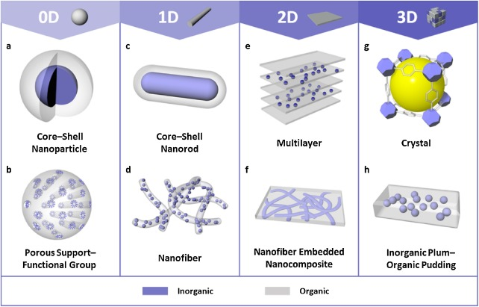
https://www.sciencedirect.com/science/article/pii/S1748013218304225

Slide 4
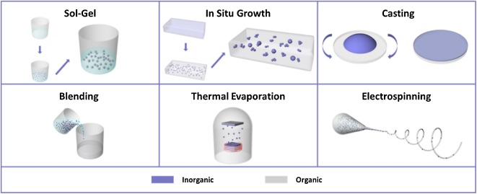

Slide 5
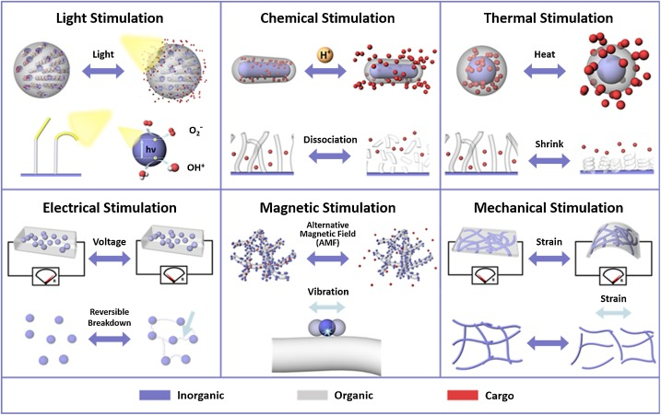

Slide 6
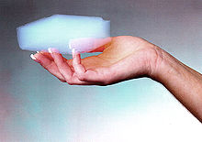
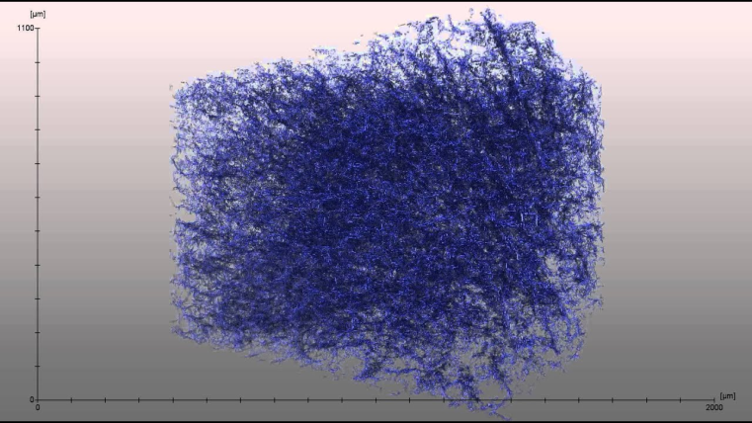
A nanofoam has a liquid or solid matrix, filled with a gaseous phase, where one of the two phases has dimensions on the nanoscale.
Foam is an object formed by trapping pockets of gas in a liquid or solid.
Aerogel is a synthetic porous ultralight material derived from a gel, in which the liquid component for the gel has been replaced with a gas
Insulating materials
Catalysis
Gas storage
Separation / filtration
Carbon nanofoam

Slide 7
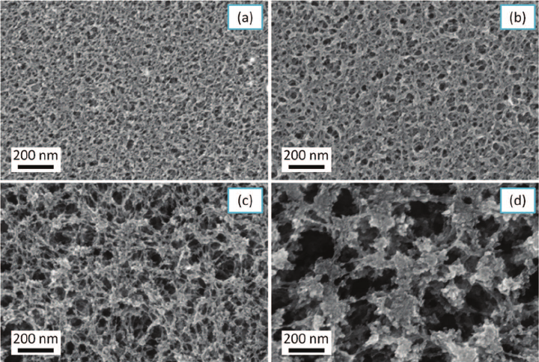
A nanoporous material is a solid material containing nanopores, cavities with dimensions on the nanoscale.
The skeletal portion of the material is often called the "matrix" or "frame".
Activated carbon and zeolites are two examples of bulk nanoporous materials.
The pores are typically filled with a fluid (liquid or gas).
A nanoporous material with consistently sized pores has the property of letting only certain substances pass through, while blocking others. Chromatography, catalysis, filtration,…

Slide 8
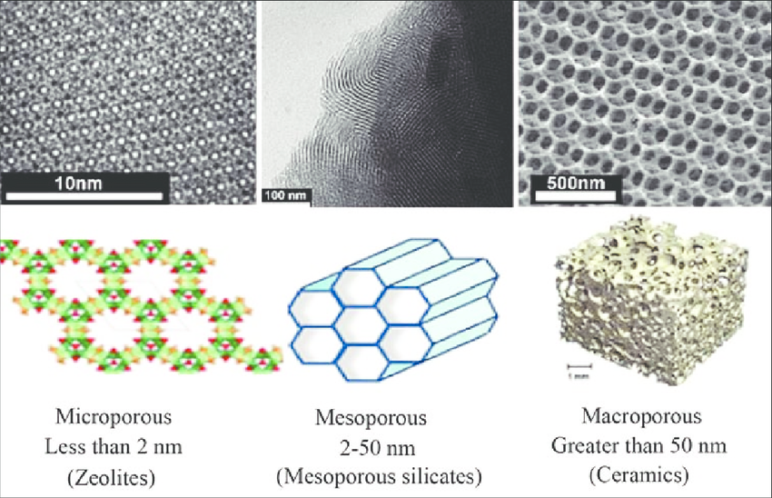
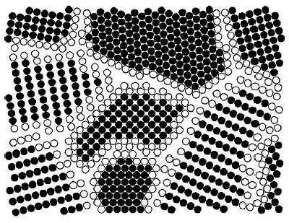
Nanoporous materials and nanofoam are sometimes considered nanostructures but not nanomaterials because only the voids and not the materials themselves are nanoscale.
A nanocrystalline material has a significant fraction of crystal grains in the nanoscale.
Although the ISO definition only considers round nano-objects to be nanoparticles, other sources use the term nanoparticle for all shapes

Slide 9
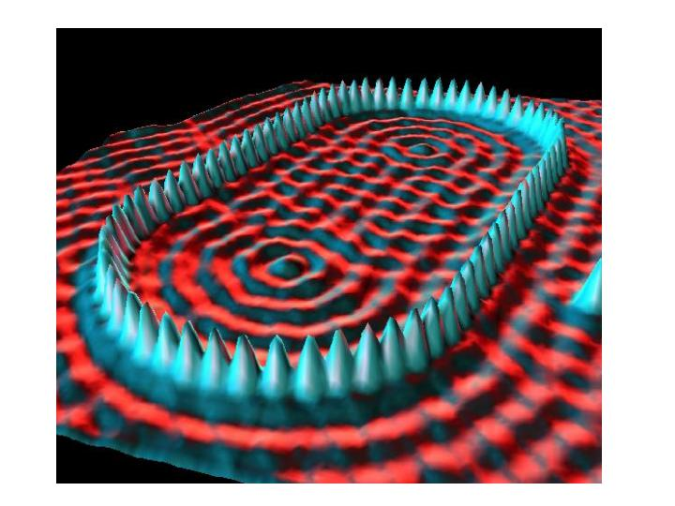
Instrumentation / Imaging
“Quantum Corral”
48 Fe atoms positioned by the STM used
to image them
http://www.nano.gov/html/facts/home_facts.html

Slide 10
Physical and Chemical Properties that can Change at the Nanoscale
Color
Melting temperature
Crystal structure
Chemical reactivity
Electrical conductivity
Magnetism
Mechanical strength
…
Notes:
Trainer Notes:
This is a partial list of some of the physical and chemical properties that can change for a given nanomaterial. Not all of these changes will be relevant for every nanoparticle; each will have its own set of variable properties.

Slide 11
Physical and Chemical Properties that can Change at the Nanoscale
Color
Melting temperature
Crystal structure
Chemical reactivity
Electrical conductivity
Magnetism
Mechanical strength
…
Notes:
Trainer Notes:
This is a partial list of some of the physical and chemical properties that can change for a given nanomaterial. Not all of these changes will be relevant for every nanoparticle; each will have its own set of variable properties.

Slide 12
Physical and Chemical Properties that can Change at the Nanoscale
Color
Melting temperature
Crystal structure
Chemical reactivity
Electrical conductivity
Magnetism
Mechanical strength
…
Notes:
Trainer Notes:
This is a partial list of some of the physical and chemical properties that can change for a given nanomaterial. Not all of these changes will be relevant for every nanoparticle; each will have its own set of variable properties.

Slide 13
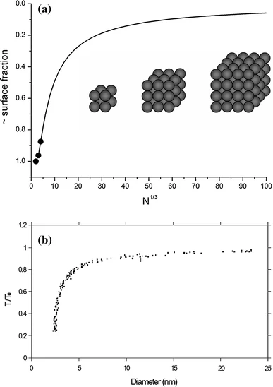
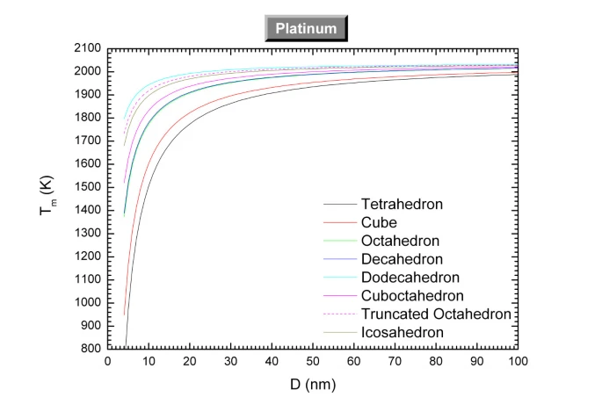
Models of size-dependent nanoparticle melting tested on Au and Pt
Pt
Au
https://link.springer.com/article/10.1007/s10853-014-8544-1/figures/1
https://nanoscalereslett.springeropen.com/articles/10.1186/1556-276X-6-396
Notes:
Trainer Notes:
https://link.springer.com/article/10.1007/s10853-014-8544-1/figures/1
https://nanoscalereslett.springeropen.com/articles/10.1186/1556-276X-6-396

Slide 14
Models of size-dependent nanoparticle melting tested on Au and Pt
Pt
Au
https://link.springer.com/article/10.1007/s10853-014-8544-1/figures/1
https://nanoscalereslett.springeropen.com/articles/10.1186/1556-276X-6-396
Notes:
Trainer Notes:
https://link.springer.com/article/10.1007/s10853-014-8544-1/figures/1
https://nanoscalereslett.springeropen.com/articles/10.1186/1556-276X-6-396

Slide 15
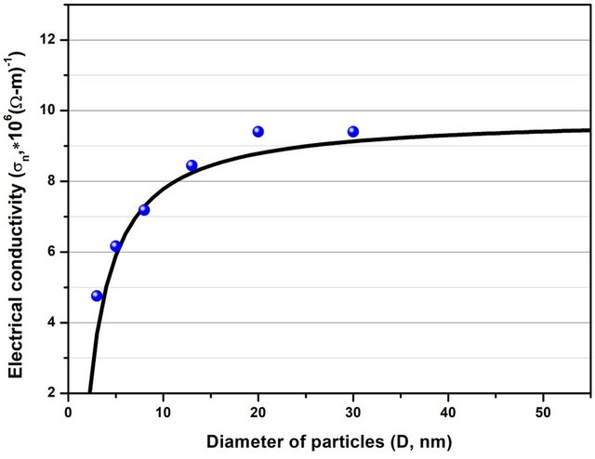
Dependence of electrical conductivity on the size of spherical Cu nanoparticles model and experimental data (blue sphere)
Applied Physics A 127(5):385
DOI:
10.1007/s00339-021-04535-4
Notes:
Trainer Notes:

Slide 16
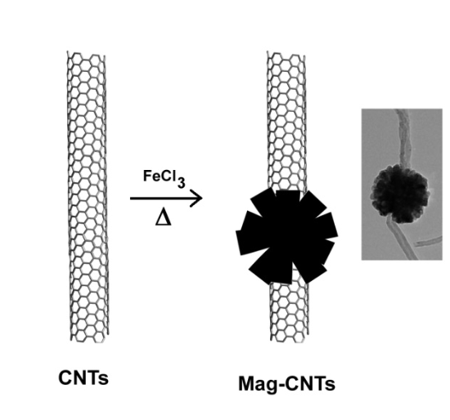
Magnetism
Fe₃O₄, Magnetite (4 nm)
Magnetism
Notes:
Trainer Notes:
Optional additional examples of properties that change as a result of the nanoscale size of the object.
LEFT: The form of iron oxide known as magnetite exhibits size-dependent magnetism. The magnetic strength of a permanent magnet does not change with the magnet’s size at the macroscale. But tiny magnets can actually exhibit larger magnetic fields than bigger magnets. The figure shows a parameter associated with magnetic field strength H plotted against particle diameter D. Note that as the magnet gets smaller the field strength goes up until it reaches a maximum.
[This is called superparamagnetism and can be explained by the fact that at a certain size, within the nanoscale, the material can form a single crystal (or domain) in which all the magnetic moments are aligned in the same direction. In larger magnets, multiple “domains” are present with slightly misaligned magnetic fields, which weakens the overall field strength. An analogy is the difference in power between a tug-of-war team that is all pulling straight back vs. one in which some of the members are pulling the rope off to one side or the other. The overall pulling power of the team is weakened if all members are not pulling in the same direction.]

Slide 17
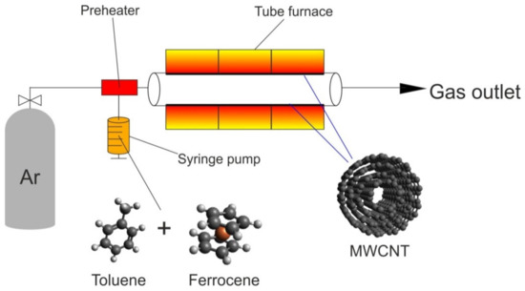
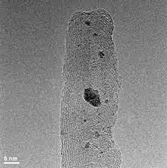
Magnetic CNTs

Slide 18
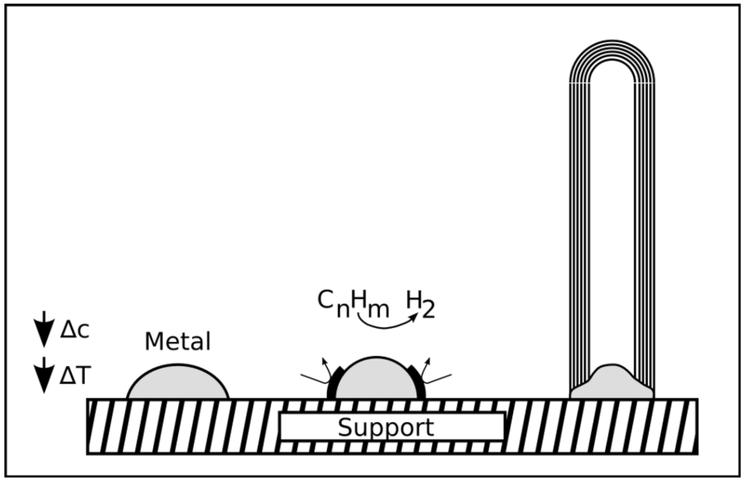
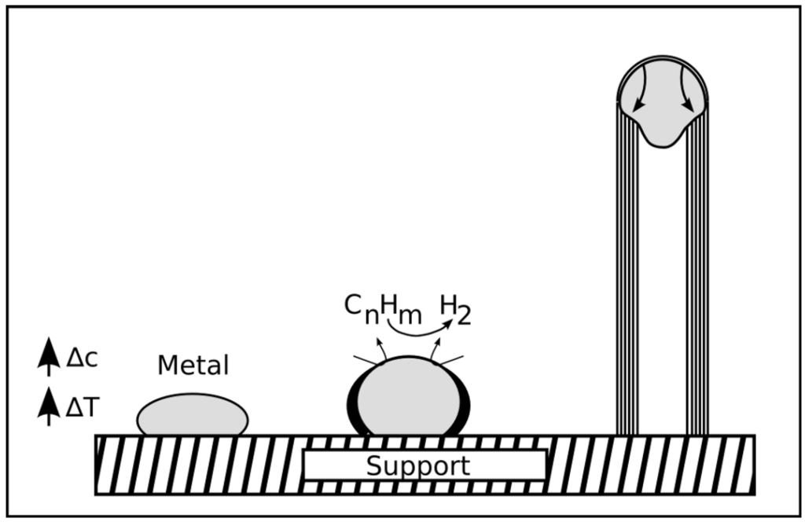
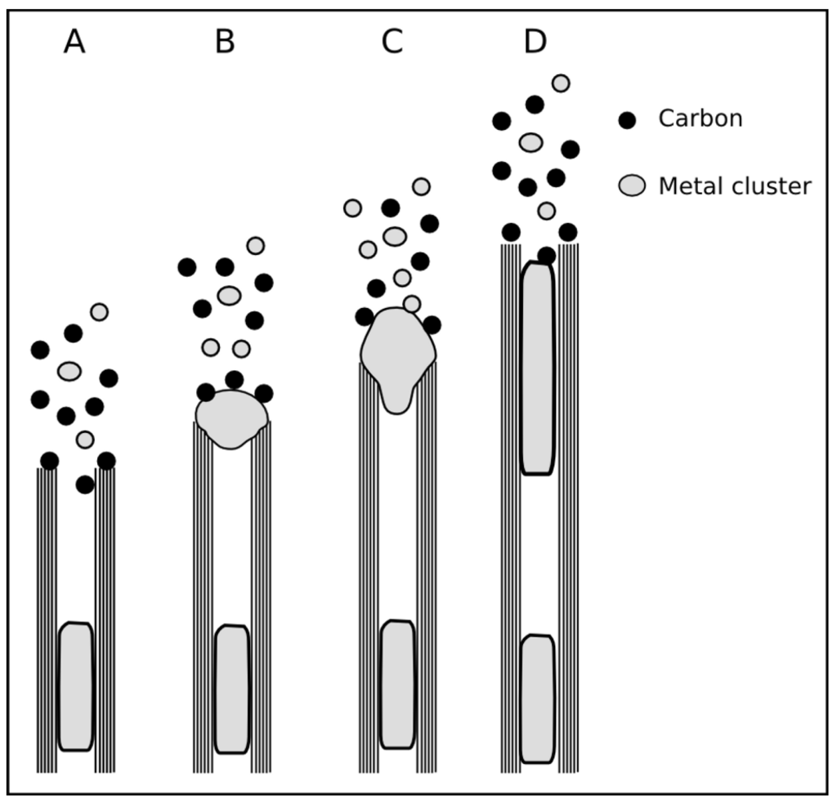
Magnetic CNTs
https://www.mdpi.com/1996-1944/3/8/4387/htm

Slide 19
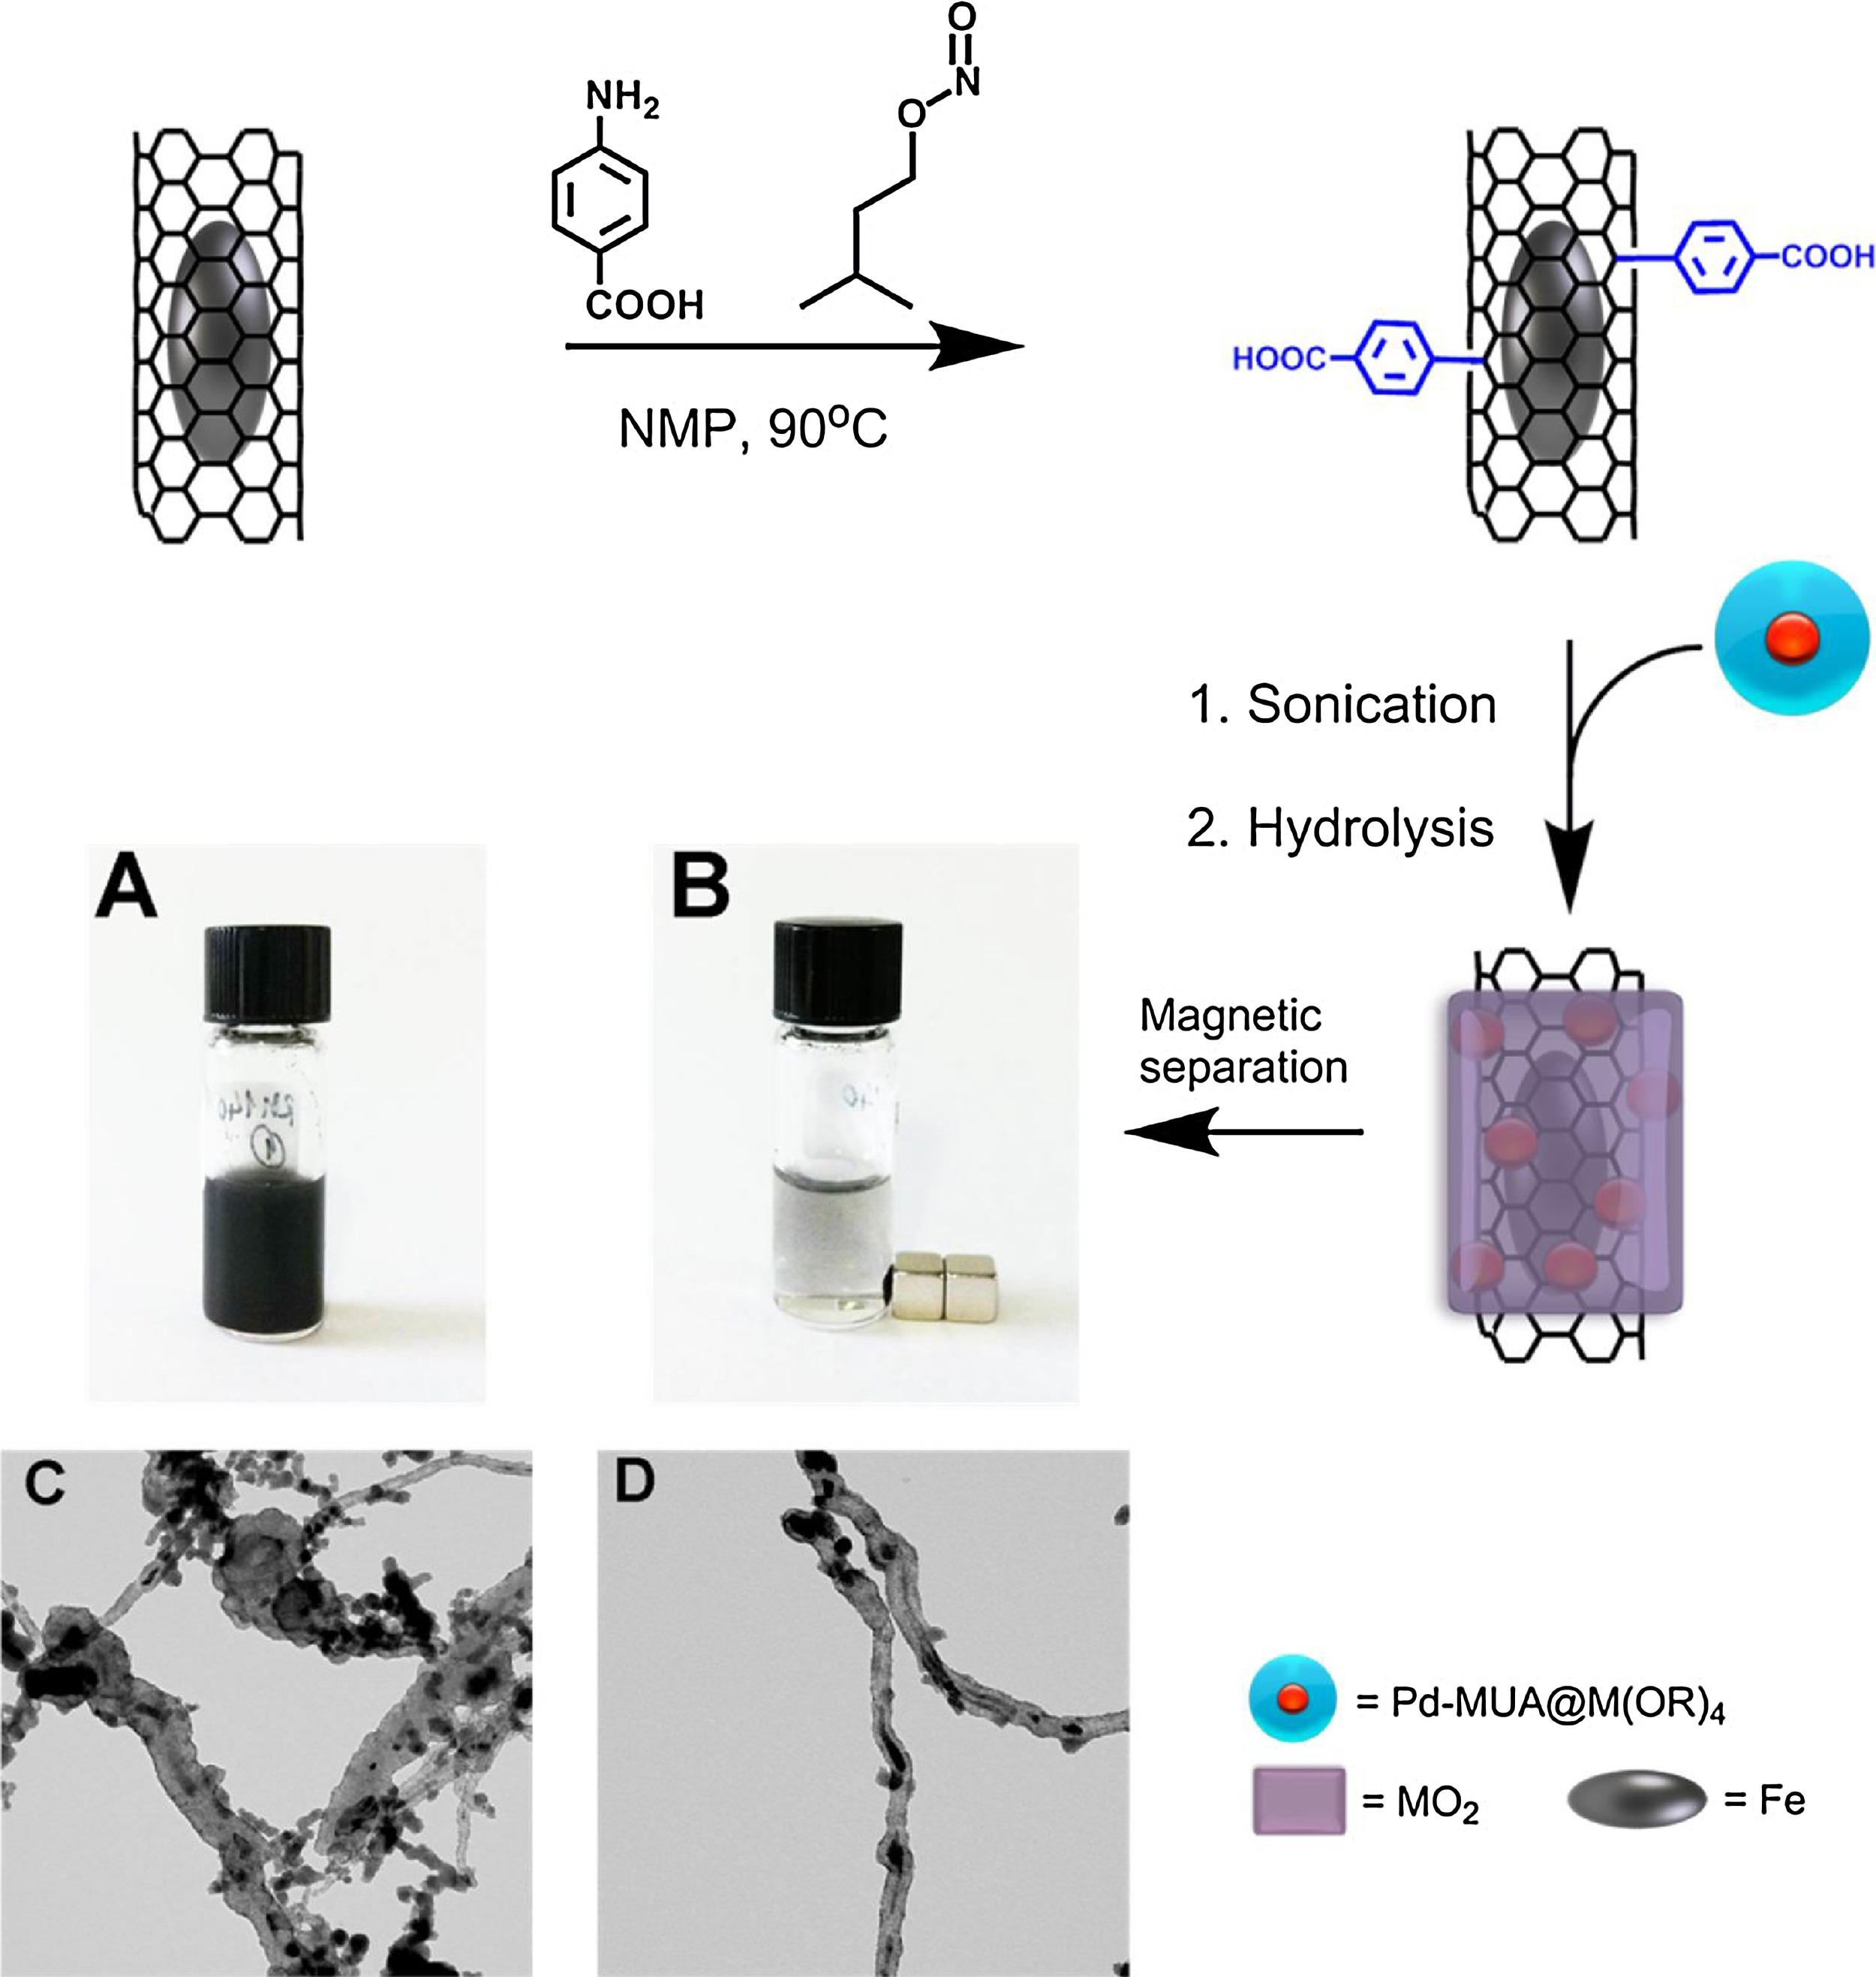
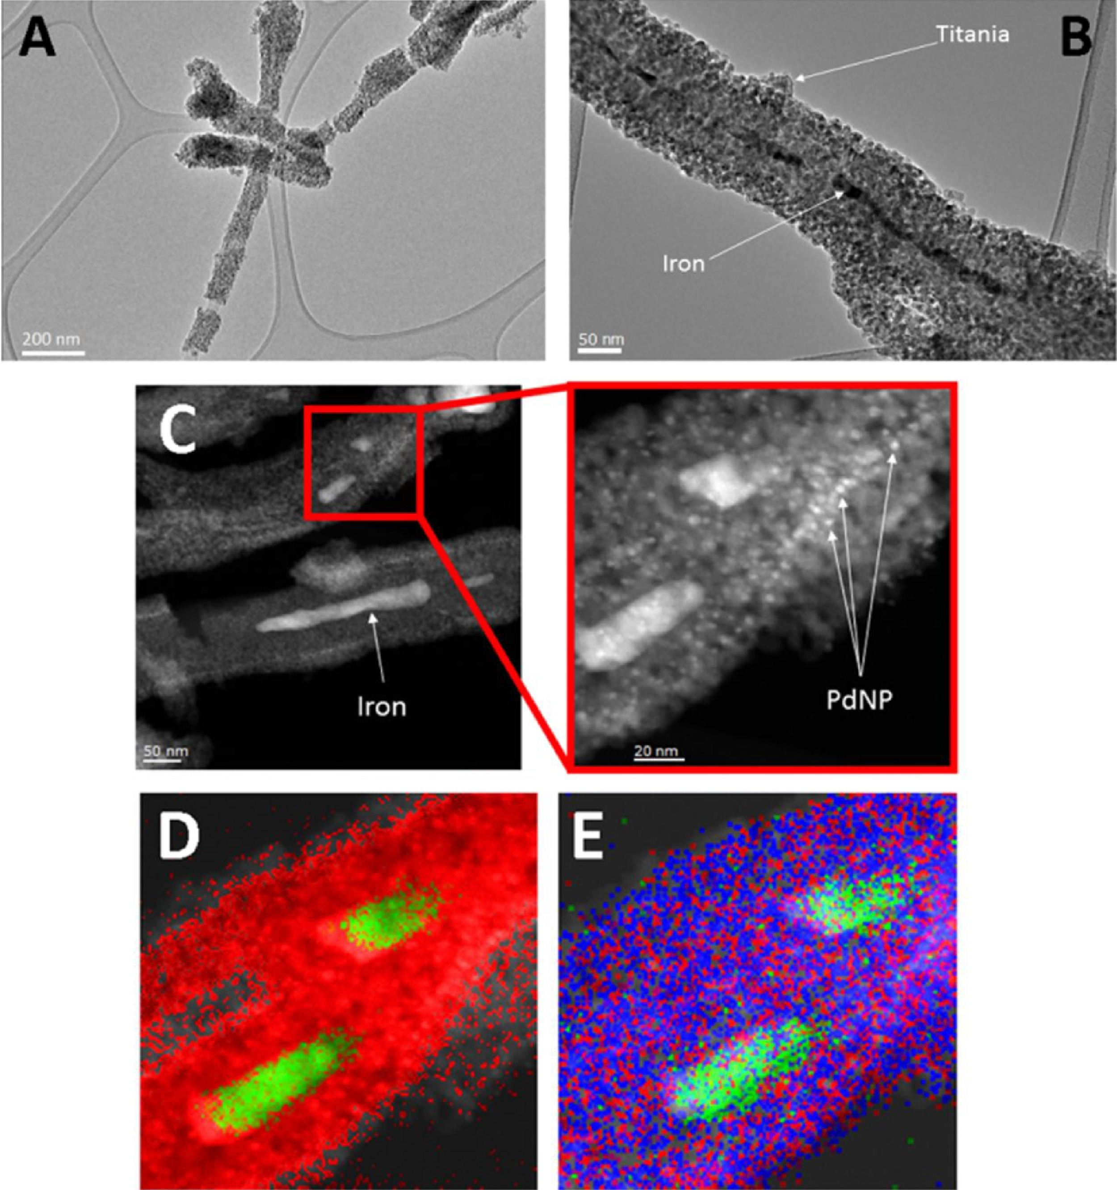
Magnetic nanoparticles
Purification by magnetic separation
Appl. Catal. B-Environ. 227 (2018), 356-365
Before
After

