Slide 1
CRISI
PERICOLO
OPPORTUNITÀ

Slide 2
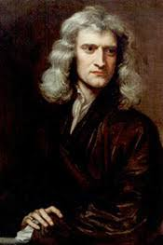
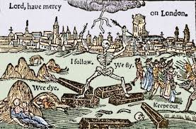
nanorods
nanorods
Peste a Londra 1665-66
Isaac Newton nato nel 1642 Newton approfittò dell’interruzione delle lezioni dovuta alla peste per proseguire gli studi per conto suo; durante questo periodo di isolamento quasi assoluto, e a soli 22 anni, scoprì le Identità di Newton, il metodo di Newton, approssimò la serie armonica tramite i logaritmi e cominciò a sviluppare il calcolo infinitesimale.

Slide 3
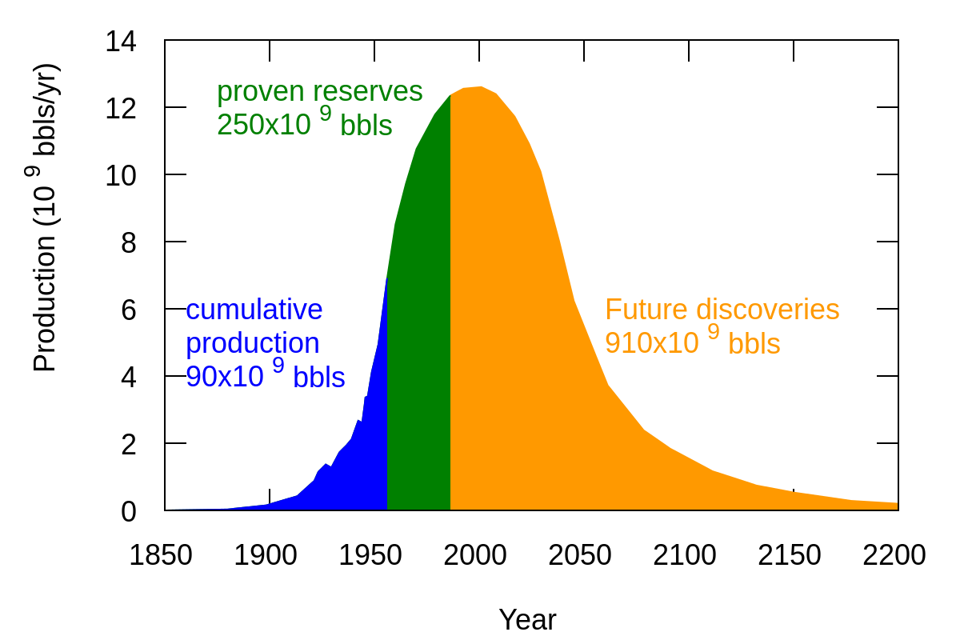
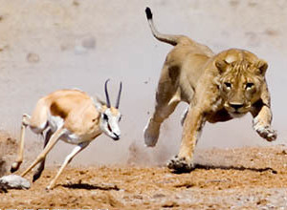
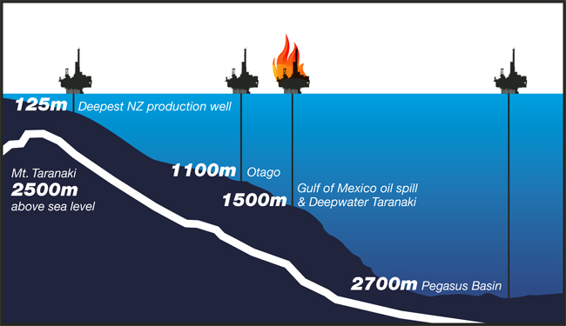
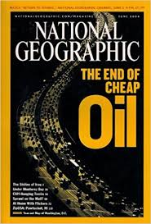
Depletion:
EROEI = Energy Delivered / Energy Required to Deliver that Energy

Slide 4
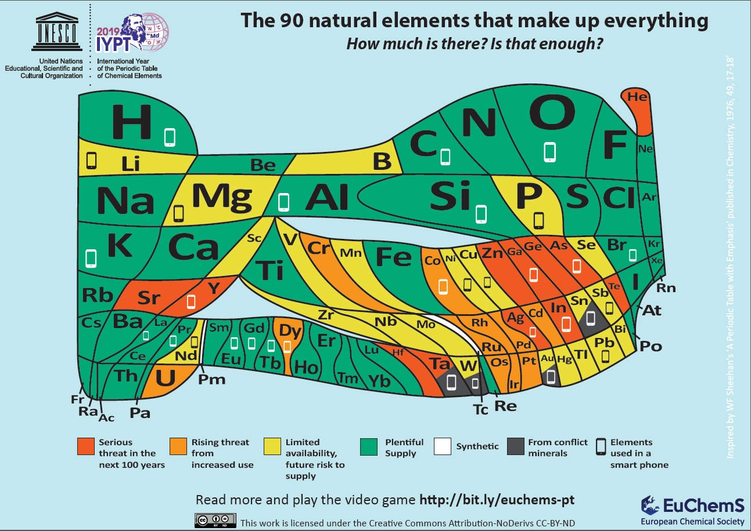

Slide 6
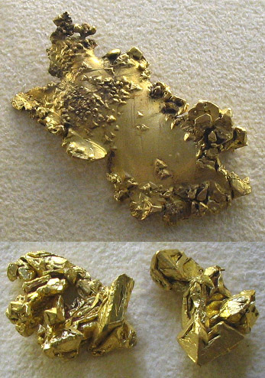
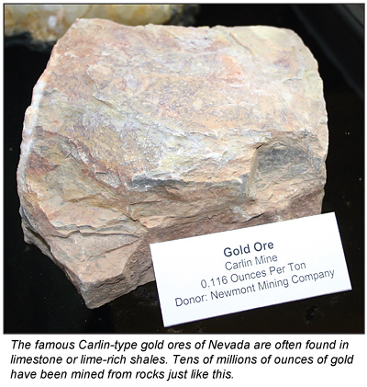
Depletion:
As you eat the cake, it becomes less and less tasty

Slide 7
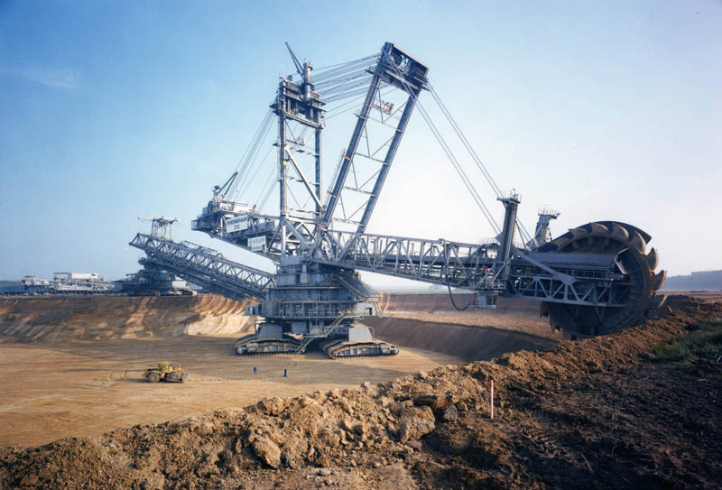
Mining requires energy

Slide 8
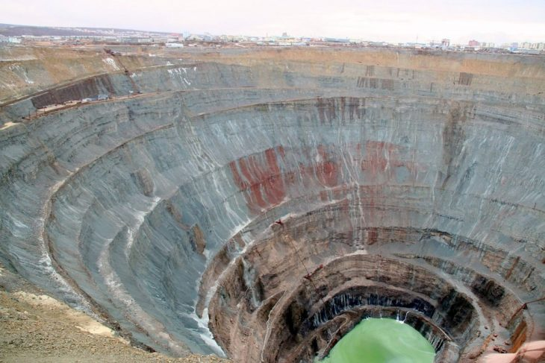
Incredible Open-Pit Mines
Mirny Mine, Russia

Slide 9
Toxicity: scientific facts and more….
Ni hydrogenation catalysts have been replaced by Ru/C catalyst
More Asbestos! More Asbestos! More Asbestos!
President Trump’s long-time love affair with asbestos is making its way into federal policy

Slide 10
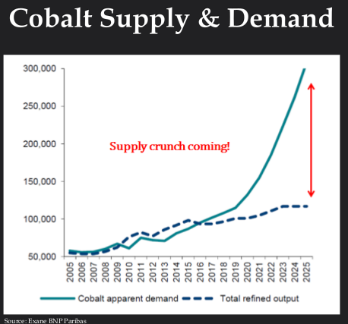
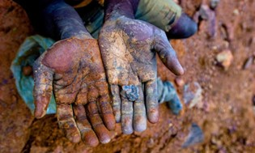
Ethical Cobalt extraction
Replacing noble metals with base metal

Slide 11
Lesson Overview
Purpose : To provide students with introductory information about nanotechnology and nanomaterials
Topics
How small is a nanometer?
Definitions and commonly used terms
How is the nanoscale different from the macroscale or the atomic scale?
Major classes of nanomaterials and their benefits
Notes:
Trainer Notes:
Explain that this is intended to be an introduction to a very broad and diverse area. This module can in no way cover all of nanotechnology and nanomaterials but will provide a basic understanding of what they are, some of the types of materials workers may encounter and some of the features that warrant focused health and safety training. Some of this material may be well understood by those who have a background in chemical safety. These students should be encouraged to share their knowledge with their peers and provide examples for discussion.

Slide 12
Learning Objectives
At the end of this module you should be able to
Contrast objects at the nanoscale with larger and smaller forms of matter
Define key terms in nanotechnology
Explain some of the ways nanomaterial properties differ from molecules and microscale particles
Describe some of the physical and chemical characteristics that can change at the nanoscale
Describe some of the major classes of nanomaterials produced today and their properties and potential benefits
Notes:
Trainer Notes:
Review these objectives with the class and explain that you will return to them at the end of the module to see if the learning objectives have been achieved. You can also post them on a flipchart or repeat this slide as you move between Topics to indicate where you are in the timeline of the module if desired.

Slide 13
How small is a nanometer?

Slide 14
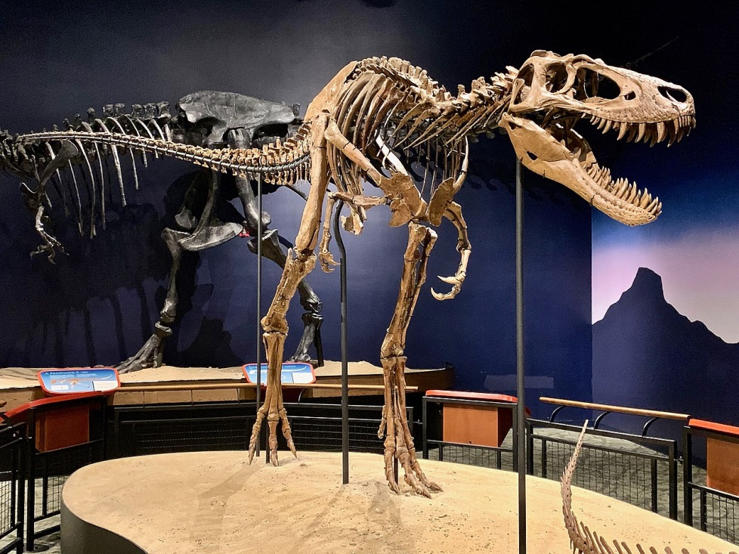
Topic 1: How small is a nano?
Dinosaur
Nanotyrannus lancensis
nano dinosaur

Slide 15
Topic 1: How small is a nano?
Nanodates for single busy workers
One session of multiple 5 minutes date!!

Slide 16
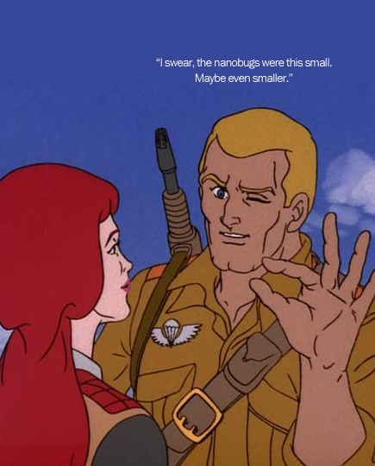
Topic 1: How small is a nanometer?
1 nm = 0.000000001 m
= 10⁻⁹ m
= one billionth meter
http://www.sniffcode.com/view.php?id=8
Notes:
Trainer Notes:
If desired, ask the class to point out the fallacy in the cartoon. (Or you could just let them laugh.) The size of any object worthy of the name “nanobug” cannot be estimated by squeezing together one’s fingers nor seen by squinting one’s eyes! The nanoscale is much too small for us to experience directly with our senses.
IMPLICATION FOR WORKERS: As with chemical substances, nanoscale objects may be present in the working environment with little to alert the worker of a possible exposure. Just because you can’t see it, feel it, smell it or taste it doesn’t mean it’s not there.

Slide 17
Handout 1
VIRUS
Courtesy Office of Basic Energy Sciences, Office of Science, U.S. DOE
Notes:
Trainer Notes:
The nanometer is difficult to conceptualize because we cannot experience it directly with our senses. Be sure to emphasize that “nano” does not simply mean “very small” and that there are many forms of matter much smaller than a nanometer, including electrons, atoms and most molecules. Rather, the nanoscale is in between the very small atomic regime and the larger regime of microparticles and colloids.
On the left of the diagram are naturally occurring objects of various sizes. On the right are human-designed objects of various sizes.
Note that there are plenty of natural objects that fall within the nanoscale, notably DNA and some larger proteins. Whether these can be called “nanotechnology” will be addressed in Topic 2.

Slide 18
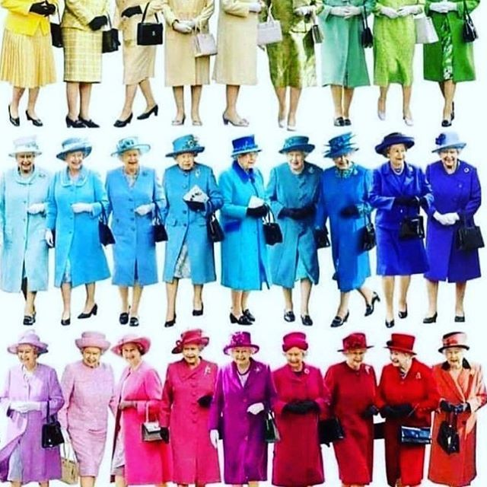
Quantum Effects
Band gap depends on particle size (number of atoms in the particle)

Slide 19
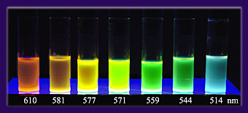
Quantum Effects
Band gap depends on particle size (number of atoms in the particle)
4 nm
2 nm
Fluorescence of cadmium selenide nanoparticles

Slide 20
How is the nanoscale different from the macroscale or the atomic scale?

Slide 21
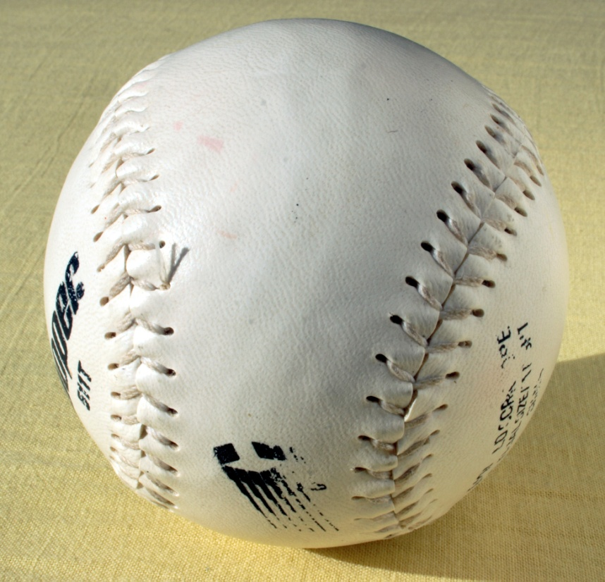
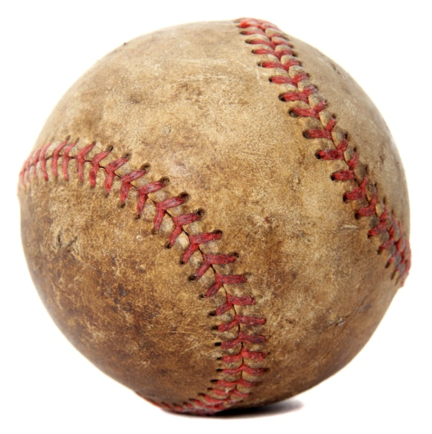
Topic 3: How is the nanoscale different from the macroscale or the atomic scale?
Baseball: ~2.8 inches in diameter
Softball: ~3.8 inches in diameter
Notes:
Trainer Notes (OPTIONAL):
Ask the students how different a baseball is from a softball. Prompt the students to respond that baseballs and softballs are different in size but not really different in terms of their properties or their composition. Changing the size of the ball has only a modest impact on how it behaves. When either ball is hit, it is fairly easy to figure out where it’s going to end up. This is how big objects behave and we’re all familiar with this from our everyday experience.
But the same is not true for objects at the nanoscale. The reason is that nanoscale objects resemble atoms a lot more than they resemble baseball.
IMAGE CREDIT softball: en.wikipedia.org; baseball is microsoft clipart

Slide 22
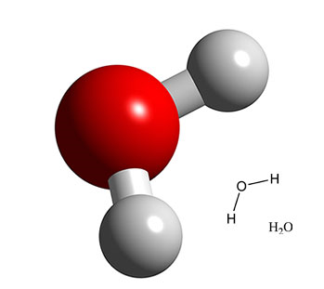
Nanomaterial Properties Can Change with Size
The nanoworld
At the nanometer scale, fundamental physical and chemical properties depend on the size of the object.
Notes:
Trainer Notes:
Explain that very small forms of matter such as atoms and molecules have their own set of rules and don’t behave the same way as larger objects. In other words, a water molecule is not just a very, very small water drop. They are made of the same chemical substance, H₂O, but they behave very differently. In order to understand the nanoscale it’s helpful to consider how gaseous water vapor in the atmosphere becomes a water drop that falls to Earth.
Start with an individual water molecule. We can’t see or feel individual water molecules but when conditions are right the individual molecules start to cluster together into tiny droplets. The droplet may start off as a cluster of 5 or 6 molecules, at which point it’s not much different than a single molecule. However, the bigger the cluster gets, the more it begins to resemble a raindrop. As more and more molecules cluster together, the droplet gets heavier and heavier until eventually it falls from the sky, getting some unlucky person below all wet. In other words, there is a point at which the cluster of water molecules stops resembling an individual gas-phase molecule and starts resembling a liquid-phase raindrop. The water undergoes a smooth transition from gas to liquid simply as a result of its change in size.
This is an important concept for nanomaterials. The nanoscale world lies between the realms of molecules (such as H₂O) and larger objects we can perceive with our senses (such as a raindrop). A nanoparticle’s properties can change with its size because it is transitioning from the atomic world to the macroscopic world. Unlike water, though, the changes some substances go as they transit through the nanoscale can include properties we wouldn’t expect to change. This will be explored with specific examples on the next slides.

Slide 23
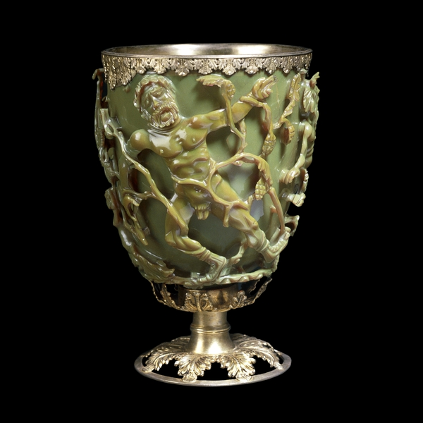
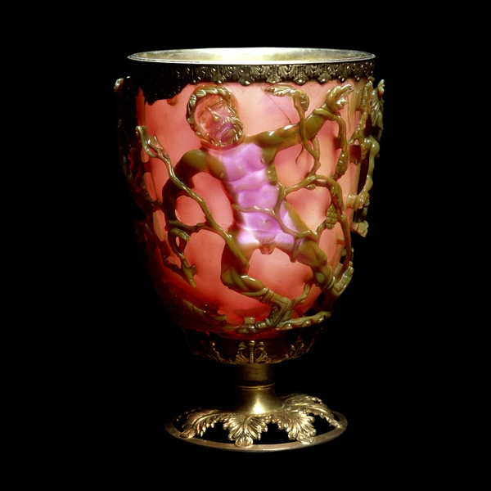
Early Nanotechnologists
Lycurgus Cup
http://www.britishmuseum.org/explore/highlights/highlight_objects/pe_mla/t/the_lycurgus_cup.aspx
Notes:
Trainer Notes: (OPTIONAL EXTRA SLIDE)
Explain that while the term nanotechnology is new, in fact artisans have been making and working with nanoparticles for millenia.
The Lycurgus [lie∙KUR∙guss] cup is a stunning example of dichroic (“two colors”) glass from the late Roman period (4th century AD). The cup appears green in reflected light and red when lit from behind. Modern analysis revealed the glass contains 50-100 nm particles of a silver-gold alloy. These small size of these particles is responsible for the dichroic effect.
There are many other examples of the shape-shifting nature of nanomaterials.
The cup depicts the triumph of Dionysus over King Lycurgus who attacked one of Dionysus’s maenads, Ambrosia. She transforms herself into a vine and holds him captive while Dionysus sets his followers to kill him.

Slide 24
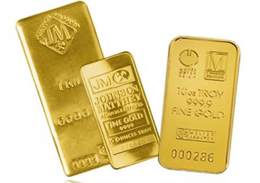
Would you buy this gold?
Gold (~ 10 nm)
Bulk Gold (Au) = Yellow
Conductive
Nonmagnetic
Chemically inert
Nano Gold = Red
Loses conductivity at ~ 1-3 nm
Becomes magnetic ~ 3 nm
Explosive and catalytic!
Notes:
Trainer Notes:
Prompt the audience to list some of the properties of bulk gold: lustrous (shiny), ductile (can be drawn into wires), malleable (can be pounded into sheets), yellow color, inert (doesn’t easily react chemically, especially with atmospheric oxygen) and nonmagnetic. These qualities make gold extremely valuable because it can be shaped into various forms, doesn’t corrode and is pleasing to the eye.
But what about nanogold?
Well if you take gold down to the nanoscale it becomes red (10 nm)! Or green or blue, depending on the size.
It also
Melts at a lower temperature (830°C for a 5-nm particle and 350°C at 2 nm vs. 1064°C for bulk gold);
Ceases to be metallic between 1-3 nm but becomes magnetic at that size AND
Becomes an excellent catalyst!
IMPLICATION FOR WORKERS: You cannot assume that you understand the behavior of a nanomaterial just because you understand the same material at the atomic/molecular or macroscopic levels.

Slide 25
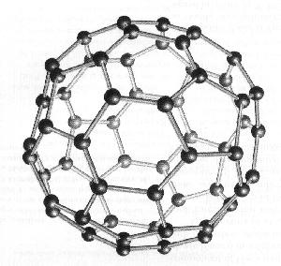
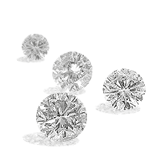
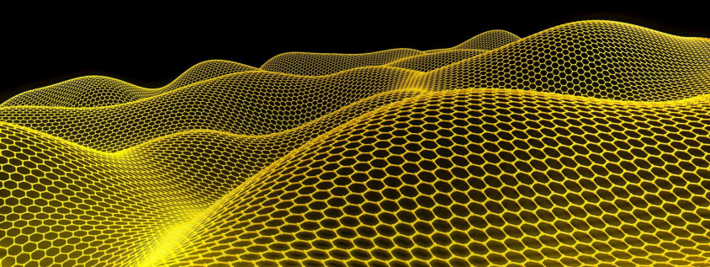
Effects of Nanoscale
Nanoscale Carbon
Structural differences:
Bulk Carbon
C₆₀ (Buckeyball)
1996 Nobel Prize
Carbon Nanotubes
Sumio Iijima - 1991
Graphite
Diamond
Graphene 2010 Nobel Prize

