Slide 1
STRONG METAL/SUPPORT INTERACTION
(SMSI) EFFECT
S.J. Tauster et al; J. Am. Chem. Soc. 100, 170 (1978)
  Typically associated with reducible supports
  At low T_{redn} (200ºC) the material exhibits a
    “conventional” chemical behaviour
  At high T_{redn} (500ºC) strong perturbation of the
    chemisorptive and catalytic properties
  Reversibility. Reoxn. + mild Redn. allows to
    regenerate the material
Classic SMSI system: M/TiO₂

Slide 2
Rh(5%)/TiO₂
SMSI Effect. Chemical Evidence
H/Rh Catalytic Activity*
Red. 200°C 0.43 17
Red. 500°C 0 0
Red. 500°C
Reox. 400ºC 0.23 7
Red. 200ºC
S. Bernal et al, Appl. Catal. 99, 1 (1993)
* Benzene hydrogenation (25ºC) (cm³ cyclohexane /g_{Rh}.s)

Slide 3
Rh(5%)/TiO₂
HREM micrograph
Catalyst reduced at 200ºC
3 nm
Rh
TiO₂ – A [111]
High density of clean and well faceted Rh particles

Slide 4
Rh(5%)/TiO₂
HREM Micrograph
Catalyst reduced at 500ºC
3 nm
Rh
TiO₂ – A [111]
TiO_{2-x} migrates onto and partly covers the metal microcrystals (DECORATION)

Slide 5
Rh(5%)/TiO₂
HREM micrograph
Catalyst reduced at 500ºC
Rh
At T_{red} = 500ºC:
A significant fraction of the Rh microcrystals look like clean (Partial Decoration)

Slide 6
Rh(5%)/TiO₂
Reversibility of the SMSI Effect
2 nm
Red. 500ºC + Ox. 400ºC
+ Red. 200ºC
Rh [110]
TiO₂ – R [110]
Reoxn. at 400ºC-500ºC followed by a mild reduction allows to recover the catalyst from the SMSI state

Slide 7
Metal Decoration in Rh/Ce(M)O_{2-x}
700 ºC < T_{red} < 900º C
Rh/CeO₂ Red. 700ºC in H₂

Slide 8
Metal Decoration Effects in Pt/Ce(M)O_{2-x}
700 ºC < T_{red} < 900º C
(111) sop.
(111) Pt
0.34 nm
Pt
Simulated image
0.34 nm
Pt/CeTbO_{x} T_{red}: 700ºC
Monocapa de soporte
Pt [110]
8°
soporte[011]

Slide 9
Nano-structure of HT (900ºC) reduced Rh
T_{red} ≥ 900º C
2.2
3 nm
2.3
54°
decoration
65°
decoración
Twinned Rh particle.
Metal sintering on HT reduction
2.2
61°
2.2
3 nm
2.2
2.2
1.9
1.9
No evidence of formation of Rh-Ce intermetallics

Slide 10
Pt-Ce Alloying Phenomena
Pt
T_{red} > 900º C
5 nm
[010] CePt₅
90°
42°
4.66
4.22
3.02
Pt/CeO₂ Red. 1173 K en H₂
CePt , CePt₂
CePt₅ , Ce₃Pt₂ , Ce₇Pt₃

Slide 11
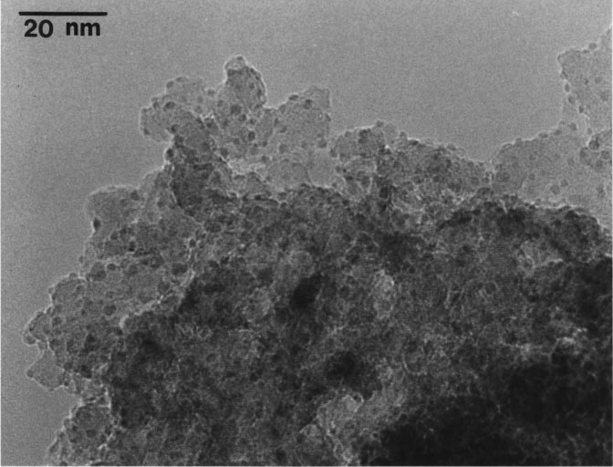
Effect of the support on metal dispersion: Ce_{0.6}Zr_{0.4}O₂ vs Al₂O₃
50
40
30
20
10
0
Frequency / %
d_{m} = 2.5 nm
5 wt % Rh /Al₂O₃
TEM
H₂ Chemisorption
EXAFS
0 1 2 3 4 5 6
Particle diameter / nm
J.Catal, 190, 2001, 182

Slide 12
Effect of the support on metal dispersion: Ce_{0.6}Zr_{0.4}O₂ vs Al₂O₃
50
40
30
20
10
0
d_{m} = 1.2 nm
Frequency / %
d_{m} = 2.5 nm
5 wt % Rh /Al₂O₃
0 1 2 3 4 5 6
5 wt % Rh /Ce_{0.6}Zr_{0.4}O₂
Particle diameter / nm
J.Catal, 190, 2001, 182

Slide 13
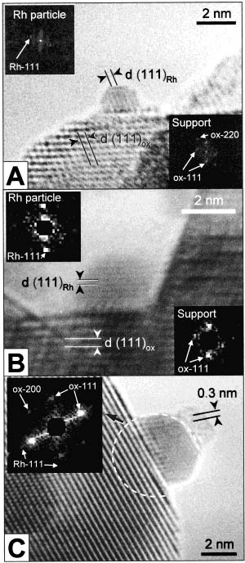
Effect of temperature on metal dispersion: Rh/Ce_{0.68}Zr_{0.32}O₂
150°C
2.4 nm
2.4 nm
Frequency / %
0
1
2
3
4
5
6
7
Particle diameter / nm
J.Phys.Chem. B, 104,2000, 4667

Slide 14
Effect of temperature on metal dispersion: Rh/Ce_{0.68}Zr_{0.32}O₂
150°C
2.4 nm
2.4 nm
2.7 nm
500°C
Frequency / %
0
1
2
3
4
5
6
7
Particle diameter / nm
J.Phys.Chem. B, 104,2000, 4667

Slide 15
Effect of temperature on metal dispersion: Rh/Ce_{0.68}Zr_{0.32}O₂
150°C
2.4 nm
2.7 nm
4.2 nm
500°C
Frequency / %
900°C
0
1
2
3
4
5
6
7
Particle diameter / nm
J.Phys.Chem. B, 104,2000, 4667

Slide 16
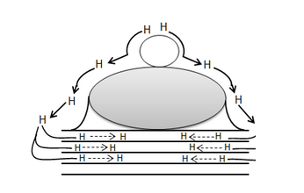
Metal nanoparticle and chemisorption
Hydrogen spillover is the migration of hydrogen atoms from the metal catalyst onto the nonmetal support or adsorbate
Reducible oxides TiO₂, CeO₂
Apparent Dispersion >>> 100%
Low Temperature chemisorption (-90° C)
HR-TEM vs Chemisorption data

Slide 17
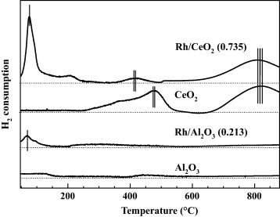
Rh/CeO₂ Reducibility
H₂
Noble metal
Support

Slide 18
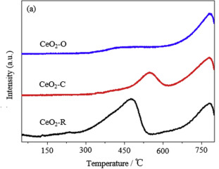
CeO₂ Reducibility

Slide 19
Rh/Ce_{0.68}Zr_{0.32}O₂ Chemical deactivation
H₂
Noble metal
Support
H₂ ads. (- 90ºC): D_{H} = H/Rh_{T}
HREM: D_{HREM} = Rh_{S}/Rh_{T}
D_{H} / D_{HREM} = H/Rh_{S}
J. Phys. Chem. B, 104, 2000, 4667

Slide 20
Pd on Al₂O₃ and ZrO₂ after treatment in 0.2 Torr O₂ at 560°C
Rogriguez N.M. et al., J. Catal 157, 676-686 (1995)
Pd
PdO
PdO
Al₂O₃
Al₂O₃
Low Metal Loading
High Metal Loading
PdO
“PdAlO_{x}”
PdO
Al₂O₃
Al₂O₃
Al₂O₃
150°C
350 - 650°C
> 800°C
PdO
PdO
PdO
ZrO₂
ZrO₂
ZrO₂
150°C
350 - 850 °C
> 890°C

Slide 21
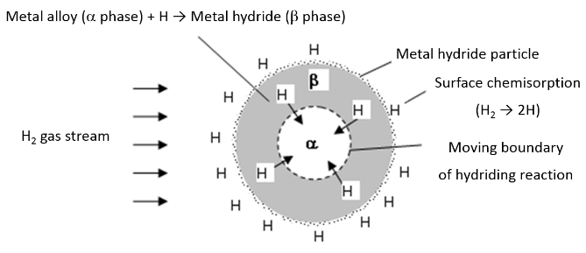
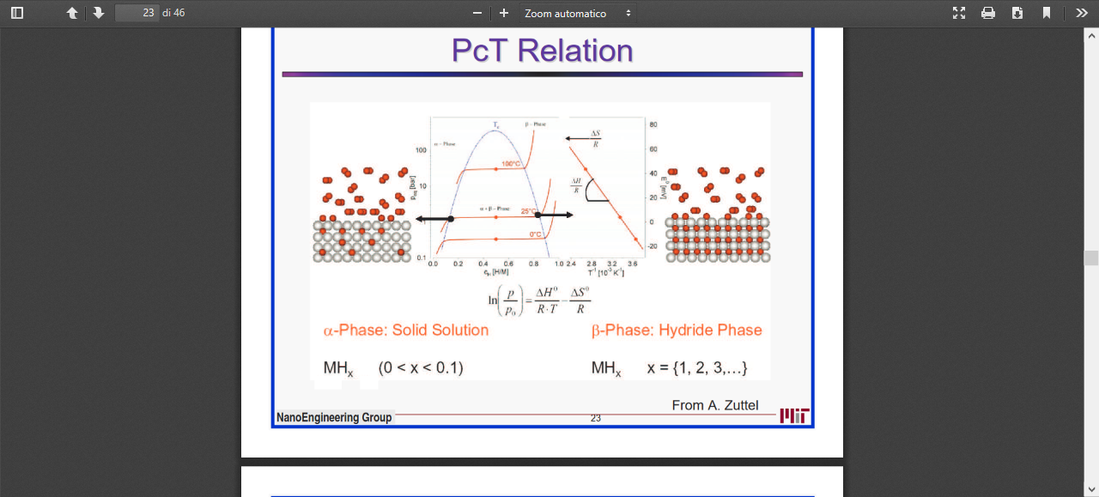
Metal Hydrides and chemisorption
Phase: Solid Solution
MH_{x}
(0 < x < 0.1)
β Phase: Hydrides
MH_{x}
( x = 1, 2, 3, ..)
Metal : Al, Mg, Li, Be,….

Slide 22
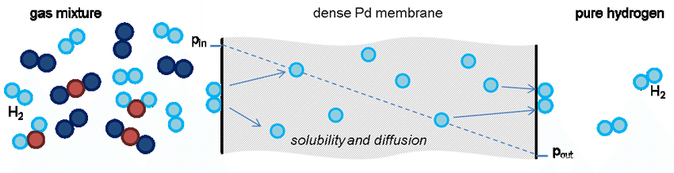
Pd nanoparticle and chemisorption
Pd bulk hydrides vs surface at room temperature
decomposes at 80 °C
Pd/Al₂O₃ H₂ Chemisorption at 100 °C, low physisorption
Pd/CeO₂ H₂ Chemisorption ?? RT very low pressure
α-PdH_{x} phase exists at x < 0.017
β -PdH_{x} phase is realised for x > 0.58
intermediate x values correspond to α-β mixtures

Slide 23
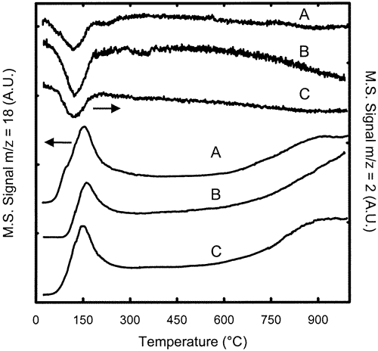
M/CeO₂ based materials reducibility
TPR-MS profiles for fresh Rh/Ce_{0.68}Zr_{0.32}O₂ (A), Pt/Ce_{0.68}Zr_{0.32}O₂ (B), and Pd/Ce_{0.68}Zr_{0.32}O₂ (C): H₂ uptake (upper traces) and H₂O evolution (lower traces).

Slide 24
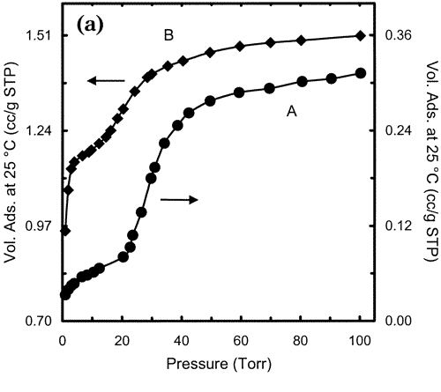
Pd nanoparticle and chemisorption at 25°C
(A) and the same sample oxidized at 427 °C and rereduced at 150 °C (B)

