Slide 1
Fundamental elements of taxation
Introduction to Italian Law – Tax Law

Slide 2
Executive summary
Taxation and definition of taxes;
Characteristics of tax;
Taxes vs. other kind of payments;
Taxes as a constitutional duty.

Slide 3
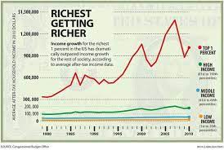
Taxes through the ages
Ancient times: material dues
Modern time: public expenditures, redistribution effects, policy
Medieval times: market dues, tolls for use of roads, ferries, land rent

Slide 4
Concept of taxation
Taxation is the inherent power of the State to impose and demand contribution upon persons, properties or rights for the purpose of generating revenues for public expenses.
The State needs financial means to grant public services: taxation is an expression of sovereignty.

Slide 5
The benefit principle
This holds that:
the individuals should be taxed in proportion to the benefits they receive from the public authority;
taxes should be paid by those people who receive the direct benefit of the public programs and projects out of the taxes paid.

Slide 6
The ability-to-pay principle
This principle holds that taxes should relate with the people’s income or the ability to pay
people with greater income or wealth who can afford to pay more taxes should be taxed at a higher rate than people with less wealth
A clear application of this principle is the individual income tax (Irpef).

Slide 7
Definition of “taxes” 1/2
In Italian Tax system taxes are not defined, but several statutes, even of constitutional level, refer to this concept
According to art. 75 It. Const., abrogative referendum is not admissible in the case of tax laws
Under art. 81 It. Const., “it is not possible to introduce new taxes and new expenditures in the law approving the budget”
Jurisdiction on taxes is performed by a special judge
7

Slide 8
Definition of “taxes” 2/2
Taxes are financial means to grant public expenditure;
They consist of legal obligations of payment, which arise in connection to the demand of public services, or just because the taxpayer has the “ability to pay”, id est a taxable capability in terms of “economic strength” (income, property, consumption, etc.);
8

Slide 9
Characteristics of tax 1/2
Enforced contribution. Tax payment is not voluntary, and the imposition doesn't depend on the will of the person taxed;
It is generally payable in cash;
Proportionate to the income or wealth of the taxpayer;
It is levied on person or property, on acts, rights, privileges;
9

Slide 10
Characteristics of tax 2/2
It is levied by the State which has jurisdiction over the person or property;
It is based on statute laws;
Assessment and collection are possible only if a prior law is enacted by the law making body of the State;
Tax couldn't be enforced by the tax administration.
10

Slide 11
Taxes vs. other kind of payments
Tax distinguishes from toll, fees, price, etc.: tax is an expression of sovereignty, while toll or price are paid for the use of other’s property
A tax is enforced only by public authority (i.e. the State), while a toll may be imposed by a private individual or legal entity
Tax shall be distinguished from penalties: a tax is intended to raise revenues given a certain taxable capacity, while a penalty is thought to regulate conduct
11

Slide 12
Taxes as a constitutional duty
Art. 53.1 It. Const.: “Everybody shall contribute to public expenditure, in relation to his taxable capacity” (ability to pay)
Art. 53.2 It. Const.: “The taxation system shall be based on progression criteria”
What does “taxable capacity” mean?
Who is the rule thought for?
12

Slide 13
The historical reasons of the aforesaid expression
Other constitutions, such as the German one, don’t refer to tax at all, because the power to levy taxes is implied in the idea of sovereignty;
During the works of the Italian Constituent Assembly, at the beginning no mention to tax issues was proposed;
Afterwards, it was decided to insert a reference to tax matter in the It. Constitution.
13

Slide 14
The safeguard of the elementary needs of the individual
Some proposed to insert an expression as the one contained in the old Statuto Albertino, which made reference to the properties of individuals (“averi”, that means broadly “property”);
But others were worried of granting no taxation under a minimum threshold calculated according to the elementary needs of the individual (exemption of the minimum of subsistence);
This is why the formula “taxable capacity” was chosen (not every economic capacity shows a capacity to contribute).
14

Slide 15
Taxable capacity and jurisdiction to tax
Art. 53 It. Const. refers not only to citizens or residents individuals, but to “everyone”
It means that even foreign (not residents) individuals and legal entities can be legally obliged to pay taxes to Italian State or Regions, depending on a reasonable link with the Italian territory (in terms of source of income)
15

Slide 16
Double taxation issues
The major part of the States abide to the worldwide taxation principle for resident taxpayers and to the territoriality principle for non-resident taxpayers
The overlapping of two tax claims by two different jurisdictions (the source State and the residence State) raises an actual risk of double taxation of the same income
It is addressed by domestic law of the residence State (for instance, granting a tax credit against taxes paid abroad) and/or by bilateral tax treaties for the avoidance of double taxation

Slide 17
Expression of solidarity principle
Art. 53 It. Const. is an aspect of solidarity duties, and it is considered a projection of art. 2 It. Const. (“The Republic expects the fundamental duties of political, economic and social solidarity to be fulfilled”).
Art. 53 It. Const., according to the Italian Constitutional Court, covers only taxes levied upon a taxable capacity, no matter on how many services are requested by the taxpayer.
On the opposite, fees and taxes based on the benefit principle shouldn't be covered by art. 53 It. Const.
17

Slide 18
“Ability to pay” as ground for taxation. The “sacrifice” theory
Taxable capacity, or “ability to pay”, is the theoretical amount of tax which each individual taxpayer is able to contribute to his government;
It is based on the principle that individuals with higher income or greater wealth should pay more taxes than those with lower income or lesser wealth
The lower the wealth, the lower the “sacrifice” requested to the taxpayer in paying taxes
18

Slide 19
Some issues on taxable capacity
The Italian Constitutional Court has settled some principles regarding art. 53 It. Const.:
The taxable capacity shall be actual and current, so tax statutes introducing financial obligations of payment based on past facts could be unconstitutional, if taxable capacity is likely to be absent when the law is enforced;
The effectiveness means that taxable capacity cannot be only alleged or presumed
19

Slide 20
Taxable capacity as a matter of equality
Taxable capacity thus relates to the economic capacity of each taxpayer as compared to the economic capacity of individuals in different circumstances
Taxable capacity is more a matter of equitable distribution of tax burden among taxpayers than a tool to determine the actual amount that can be paid by each individual taxpayer
20

Slide 21
Taxable capacity and equality principle
The rule stated in art. 53 It. Const. is at first glance a duty for taxpayers, but it’s also a limit to the power of the legislator, who cannot impose taxes when taxable capacity is lacking;
In this respect, a tax not founded on taxable capacity would be unconstitutional;
On the other hand, even a tax law issued without taking into account the equality principle would be unconstitutional.
21

Slide 22
Some cases 1/3
The Italian Constitutional Court has sometimes judged unconstitutional statutes tax law in which equality principle was violated
ILOR
In a judgment concerning a tax on income stemming from “capital” (“Ilor”), it was considered inconsistent (and unconstitutional) that, given the aim to tax income arising from “capital”, income from professional services was taxed
22

Slide 23
Some cases 2/3
Taxation of selected income
Sometimes lawmaker put a tax burden on income stemming from specific sources (pensions, public officers wages)
The Italian Constitutional Court held as unconstitutional the taxation of selected income like that, for the infringment of equality and fairness in taxation
23

Slide 24
Some cases 3/3
The so-called “Robin Hood Tax” as a case of excessive profit tax
A statute law raised the corporation tax rate for selected activities (oil and gas, electric power producers), on the assumption of a greater taxable capability due to extra-profits made in the past
This is quite odd, since IT Corporation tax is a flat rate tax: raising tax rate only for certain activities could infringe equality principle
Italian Constitutional Court decision n. 10/2015
24

Slide 25
Art. 53.2 Cost: progressivity
Progressive income tax: the rates of individual income tax, and in some countries rates of corporate income tax, are usually progressive, i.e. an increasing proportion of income must be paid in tax as the income increases.
This is defended on the grounds that the marginal utility of additional layers of income and wealth constantly decreases (and taxable capacity correspondingly increases) so that a larger proportion of tax may be taken from successive slices of income or capital

Slide 26
In your opinion…

Slide 27
Is there a limit in the percentage of taxation? 1/2
There’s an issue concerning the existence (or not) of a superior limit in imposing taxes, so that the taxpayer is granted certain amount of income after the taxation;
Some argue that such a limit exists.
For instance according to German Const. Court, tax should refrain from collecting more than 50 per cent of the income of the individual
27

Slide 28
Is there a limit in the percentage of taxation? 2/2
Some argue that such a limit can be founded on the right to freely perform an economic activity (art. 41 It. Const.) and on right of property (art. 42 It. Const.)
The underlying idea is that taxation can’t “expropriate” the income or properties of taxpayers
28

Slide 29
Flat rate or proportional tax
Flat rate taxation occurs where a single rate of tax is applied regardless of the amount of income
In some countries, flat rate taxation may be applied as a unilateral method for the avoidance of double taxation (instead of the foreign tax credit)
In many countries corporations are subject to tax at a flat rate

Slide 30
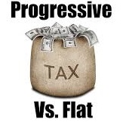
Flat or progressive?
Personal income taxes are no more “comprehensive” income taxes
Personal income taxes do not grant the protection of the minimum of subsistence
The international perspective
Simplification
Higher compliance
Minimum of subsistence protected

Slide 31
In your opinion…

Slide 32
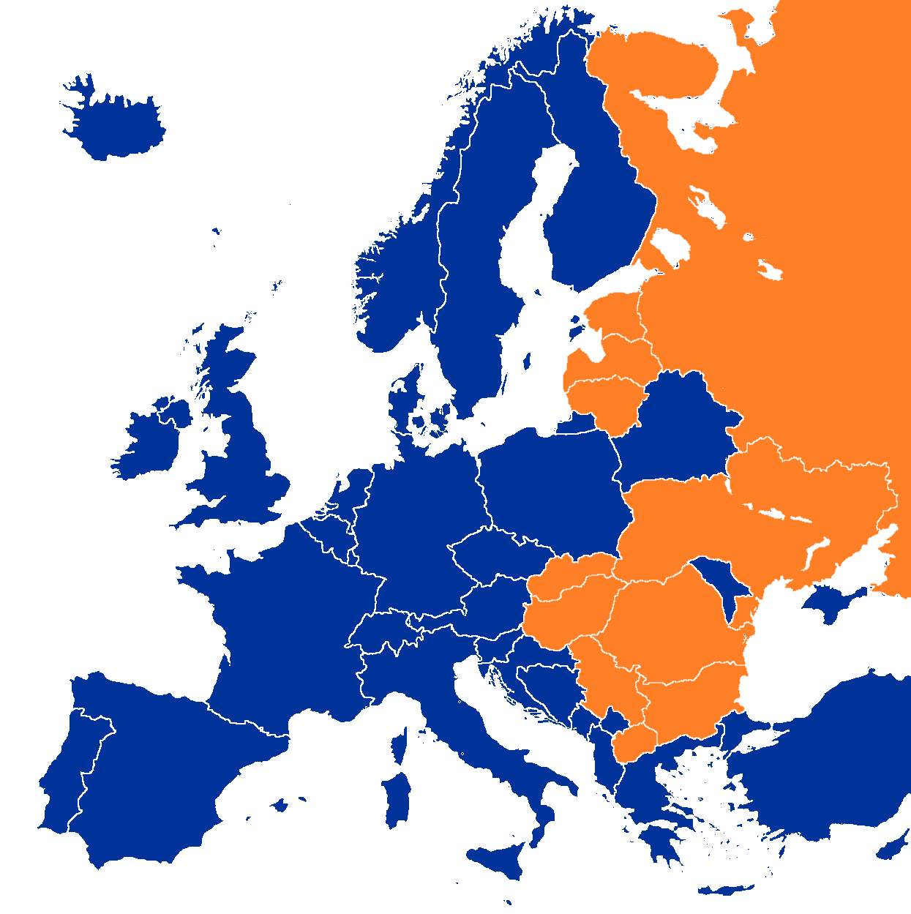
Esthonia
Lithuania
Latvia
Russia
Serbia
Slovakia
Ukraine
Romania
Macedonia
Bulgaria
Hungary
Notes:
Hungary introduced a flat tax on personal incomes in 2011, substituting the previous double rates progressive system (17% and 32%) with a lower single tax rate of 16% combined with a family tax allowance granted to families with numerous children.
After its enactment, in 2012 the tax yield increased significantly, recording a + 2% compared to 2011.
This striking performance is due to an increase in the Vat collected: presumably, the lower tax burden on personal incomes has left taxpayers more money to spend in transactions subject to Vat.

Slide 33
Regressive taxes 1/2
A tax is regressive when it takes a greater percentage of a lower income than a high income, i.e. when the burden of paying the tax falls proportionately more heavily on those least able to pay it
As far as direct taxes are concerned, regression can be avoided or mitigated by establishing exemption limits and providing relief for dependents and for health insurance or life assurance

Slide 34
Regressive taxes 2/2
Indirect taxes on commodities and services are more likely than direct taxes to be regressive, but the regressive effect of such taxes may also be mitigated by exempting food and other necessities such as the cost of medical services and medicine from indirect taxation or by imposing lower than normal rates of tax on such goods and services

