Slide 1
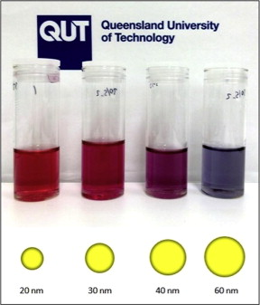
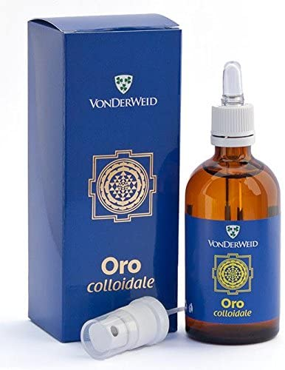
Colloidal Chemical Methods
Examples: Gold
A common method for preparing colloidal gold nanoparticles involves combining hydrogen tetrachloroaurate (HAuCl₄) and sodium citrate (Na₃C₆H₅O₇) in a dilute solution.
Upon dissociation, the citrate ions (C₆H₅O₇³⁻) reduce Au³⁺ to yield 30-40 nm gold particles.

Slide 2
Formation of Gold Nanoparticles
Sodium
Citrate
Red Color = Gold NP
HAuCl₄
HAuCl₄
Gold
NP
Heat
Heat a solution of chloroauric acid (HAuCl₄) up to reflux (boiling). HAuCl₄ is a water soluble gold salt.
Add trisodium citrate, which is a reducing agent.
Continue stirring and heating for about 10 minutes.
During this time, the sodium citrate reduces the gold salt (Au³⁺) to metallic gold (Au⁰).
The neutral gold atoms aggregate into seed crystals.
The seed crystals continue to grow and eventually form gold nanoparticles.
J. Chem. Ed. 2004, 81, 544A.

Slide 3
Formation of Gold Nanoparticles
Reduction of gold ions: Au(III) + 3e⁻ → Au(0)
Seed Crystal
10’s to 100’s of Atoms
Nucleation of Au(0) seed crystals:
Growth of nanoparticles:
Isotropic
Growth
Spherical
Nanoparticles
Surface capped
with citrate anions
Seed
Adding surfactant to growth solution
caps certain crystal faces and promotes
growth only in selected directions.
Anisotropic
Growth
Nanorods

Slide 4
Colloidal Gold Nanorod Clusters
A seed solution of gold nanoparticles was prepared by borohydride (30 mM, 0.3 mL) reduction of HAuCl₄ (0.25 mM, 5 mL) in aqueous cetyltrimethylammonium bromide (CTAB) solution (0.1 M).
2. An aliquot of seed solution (24 μL) was added to a growth solution (10 mL) containing CTAB (0.1 M), HAuCl₄ (0.5 mM), ascorbic acid (0.8 mM), …... Mixtures were left undisturbed for 4 h at 27 °C.
Langmuir 2012, 28, 24, 8826-8833

Slide 5
Colloidal methods : Molybdenum
1-5 nm molybdenum nanoparticles can be created at room temperature by reducing MoCl₃ in a toluene solution in the presence of sodium triethylborohydride (NaBEt₃H).
MoCl₃ + 3NaBEt₃H → Mo + 3NaCl + 3BEt₃ + (3/2) H₂
The main applications of molybdenum nanoparticles are as additives in alloys for hi-tech applications, such as high-vacuum or corrosive environments.
Some of these areas are as follows:
- High-temperature lubrication;
- Hard alloys, cutting tools, textiles;
- Microelectronics films;
- Sintering additives, coatings, plastics, nanowire and nanofiber;
- High-power vacuum valve, heater tube and X-ray tube.

Slide 6
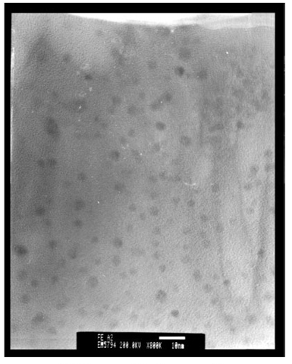
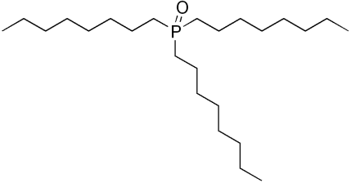
Colloidal methods: Iron
3 nm Fe nanoparticles produced by reducing FeCl₂ with sodium borohydride (NaBH₄) in xylene.
Trioctylphosphine oxide (TOPO) was introduced as a capping agent to prevent oxidation and aggregation.
TEM image of Fe nanoparticles
Phys. Chem. Chem. Phys., 2001, 3, 1661-1665

Slide 7
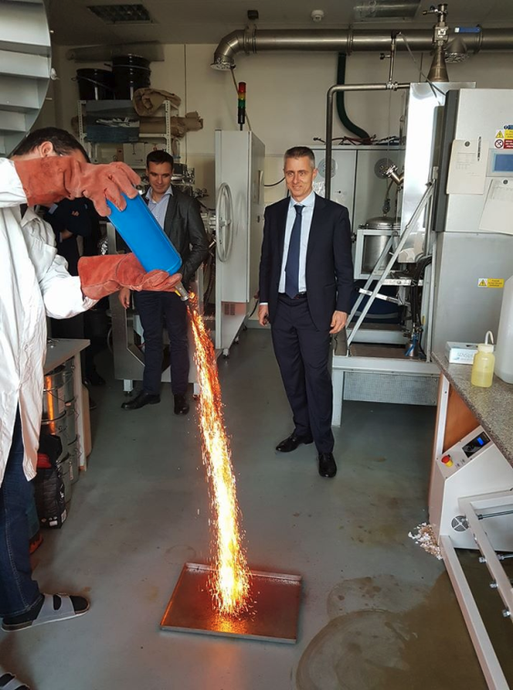
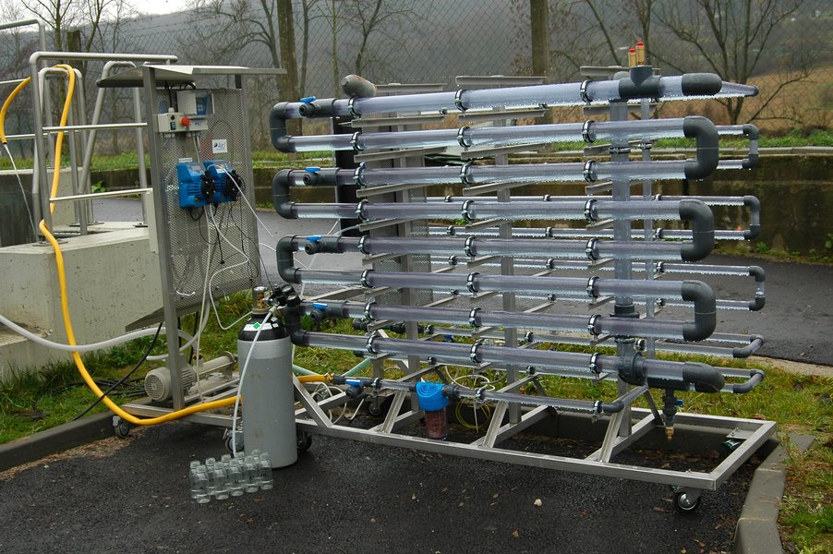
Colloidal methods : Iron
NaBH₄ (0.2 M) is added into FeCl₃•6H₂O (0.05 M) solution (~1:1 volume ratio). Ferric iron is reduced via the following reaction:
4 Fe³⁺ + 3BH₄ ⁻ + 9H₂O → 4Fe⁰ + 3H₂BO₃⁻ + 12H⁺ + 6H₂
Nano zero-valent iron for groundwater cleanup, have been deployed at full-scale cleanup sites
https://nanoiron.cz/en/

Slide 10
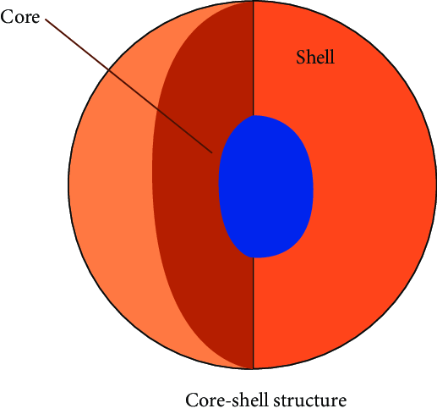
Colloidal methods : M/Fe core-shell nanoparticles
Palladized Fe particles are prepared by soaking the nanoscale iron particles with an ethanol solution of 1wt% of palladium acetate ([Pd(C₂H₃O₂)₂]₃). This causes the reduction and deposition of Pd on the Fe surface:
Pd²⁺ + Fe ⁰ → Pd⁰ + Fe²⁺
Similar methods may be used to prepared Fe/Pt, Fe/Ag, Fe/Ni, Fe/Co, and Fe/Cu bimetallic particles. With the above methods, nanoparticles of diameter 50-70 nm may be produced. The average specific surface area of Pd/Fe particles is about 35 m²/g.

Slide 11
Precipitation of magnetite Fe₃O₄ nanoparticles
2 Fe³⁺ + Fe²⁺ + 8 OH⁻ → Fe₃O₄↓ + 4 H₂O
The size and shape of the nanoparticles can be controlled by adjusting pH, ionic strength, temperature, or the Fe(II)/Fe(III) concentration ratio.
Optimum conditions for this reaction are pH between 8 and 14, Fe³⁺/Fe²⁺ ratio of 2:1 and a non-oxidizing environment.
2 Fe₃O₄ + O₂ → 2 γ - Fe₂O₃ maghemite
"Magnetic Iron Oxide Nanoparticles: Synthesis, Stabilization, Vectorization, Physicochemical Characterizations, and Biological Applications". Chemical Reviews. 108 (6): 2064–110

Slide 12
Ferrofluid Fe₃O₄ nanoparticles
Ferrofluids are composed of very tiny nanoscale particles (diameter usually 10 nanometers or less) of magnetite, hematite or some other compound containing iron, and a liquid. This is small enough for thermal agitation to disperse them evenly within a carrier fluid, and for them to contribute to the overall magnetic response of the fluid.
Common ferrofluid surfactants
The surfactants used to coat the nanoparticles include, but are not limited to:
oleic acid
tetramethylammonium hydroxide
citric acid
soy lecithin
These surfactants prevent the nanoparticles from clumping together, ensuring that the particles do not form aggregates that become too heavy to be held in suspension by Brownian motion. The magnetic particles in an ideal ferrofluid do not settle out, even when exposed to a strong magnetic, or gravitational field.

Slide 13
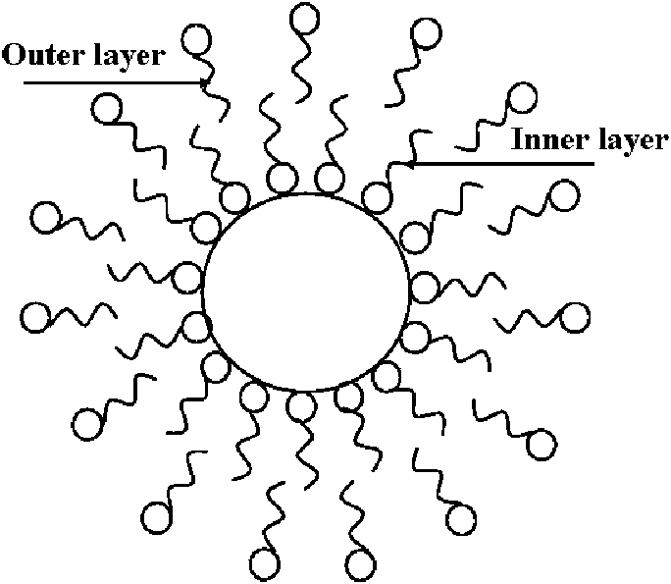
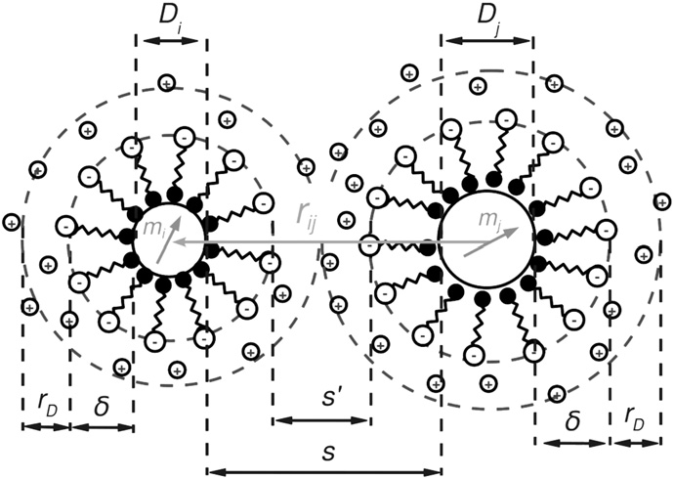
Ferrofluid surfactants
A surfactant has a polar head and non-polar tail (or vice versa), one of which adsorbs to a nanoparticle, while the non-polar tail (or polar head) sticks out into the carrier medium, forming an inverse or regular micelle, respectively, around the particle.
Electrostatic repulsion then prevents agglomeration of the particles.

Slide 14
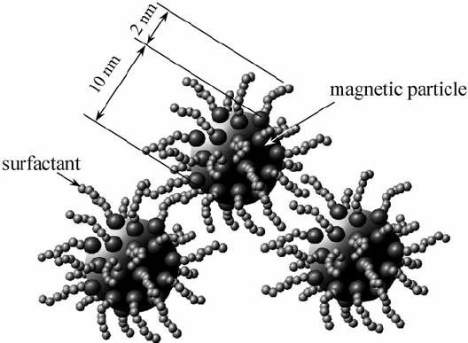
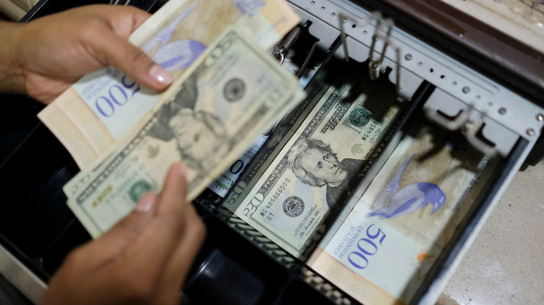
Ferrofluid surfactants
The addition of surfactants decreases the packing density of the ferroparticles while in its activated state, thus decreasing the fluid's on-state viscosity, resulting in a "softer" activated fluid. While the on-state viscosity (the "hardness" of the activated fluid) is less of a concern for some ferrofluid applications, it is a primary fluid property for the majority of their commercial and industrial applications and therefore a compromise must be met when considering on-state viscosity versus the settling rate of a ferrofluid.
The backgrounds from behind the president's face on a $1, $5 and $10 bill: Note the different spacing used in each one.

Slide 15
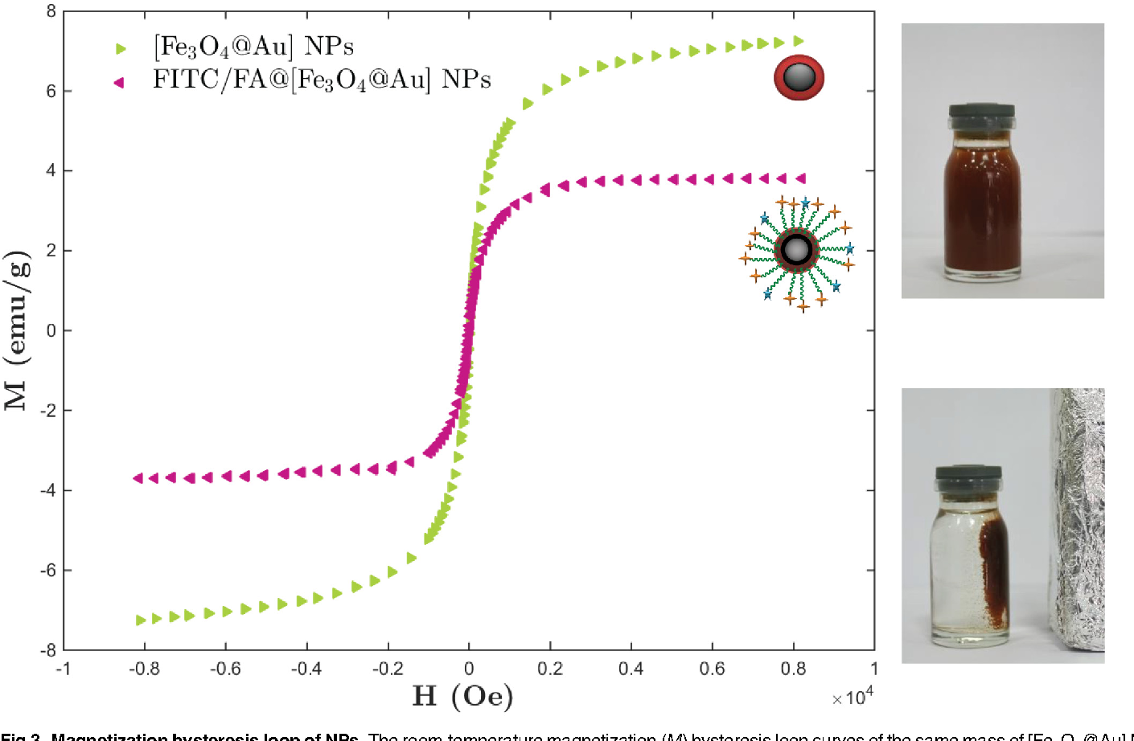
Ferrofluid surfactants
While surfactants are useful in prolonging the settling rate in ferrofluids, they also prove detrimental to the fluid's magnetic properties (specifically, the fluid's magnetic saturation).
Magnetic saturation is the state reached when an increase in applied external magnetic field H cannot increase the magnetization of the material further.

Slide 16
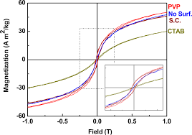
Ferrofluid surfactants
Surfactants prove detrimental to the fluid's magnetic saturation.
Size effects
J.Phys.Chem.C 2014, 118, 16209−16217

Slide 17
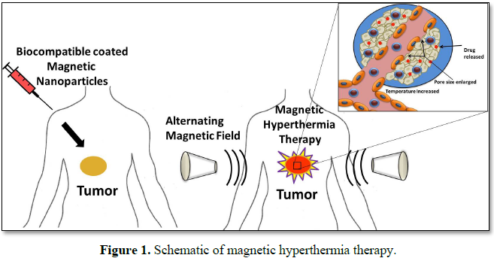
Fe₃O₄ nanoparticles anticancer applications
Iron oxide nanoparticles may be used in magnetic hyperthermia as a cancer treatment method. In this method, the ferrofluid which contains iron oxide is injected to the tumor and then heated up by an alternating high frequency magnetic field. The temperature distribution produced by this heat generation may help to destroy cancerous cells inside the tumor.

Slide 18
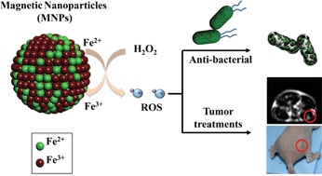
Fe₃O₄ nanoparticles anticancer applications
Iron oxide nanoparticles are used in cancer magnetic nanotherapy that is based on the magneto-spin effects in free-radical reactions and semiconductor material ability to generate oxygen radicals, furthermore, control oxidative stress in biological media under inhomogeneous electromagnetic radiation. The magnetic nanotherapy is remotely controlled by external electromagnetic field reactive oxygen species (ROS) and reactive nitrogen species (RNS)-mediated local toxicity in the tumor during chemotherapy with antitumor magnetic complex and lesser side effects in normal tissues.
J. Mater. Chem. B, 2013,1, 5100-5107

Slide 19
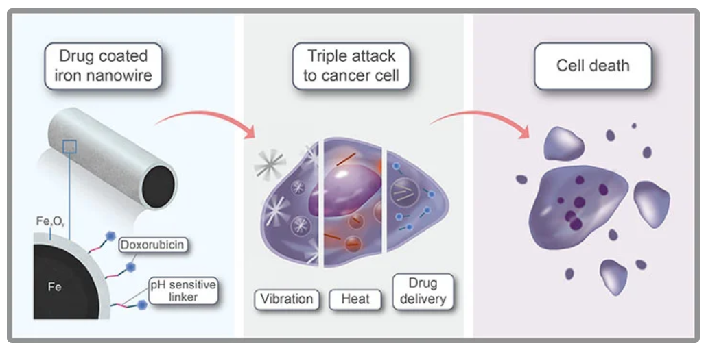
Fe₃O₄ nanoparticles
Magnetic complexes that consist of iron oxide nanoparticles loaded with antitumor drug have additional advantages over conventional antitumor drugs due to their ability to be remotely controlled while targeting with a constant magnetic field and further strengthening of their antitumor activity by moderate inductive hyperthermia (below 40 °C).

Slide 20
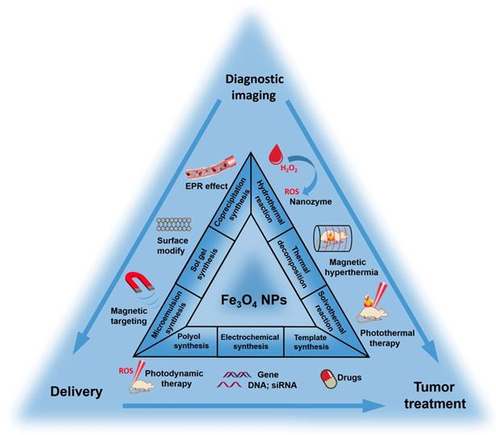
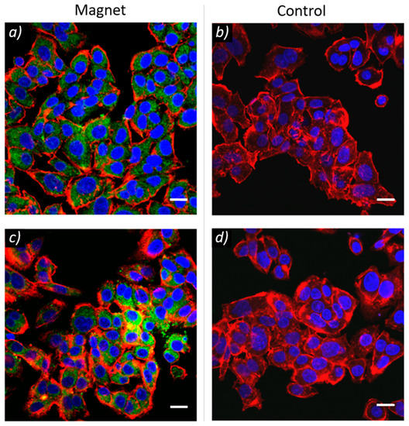
Fe₃O₄ nanoparticles
Multifunctional magnetic complexes with magnetic memory can combine cancer magnetic nanotherapy, tumor targeting and medical imaging functionalities in theranostics approach for personalized cancer medicine.

Slide 21
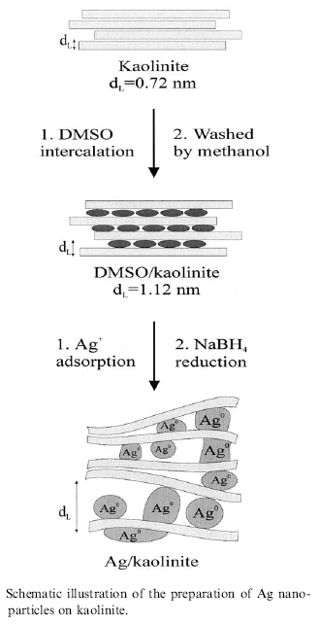
Colloidal methods: Silver
The reduction of AgNO₃ by NaBH₄ in aqueous solution can produce small diameter (< 5nm) silver nanoparticles.
The reduction can take place even in confined space, such as between layers of kaolinite, a layered silicate clay material that functions to limit particle growth.
Dimethyl sulfoxide is used as a capping agent to prevent aggregation of the Ag particles.
R. Patakfalvi et al. / Colloids and Surfaces A: Physicochem. Eng. Aspects 220 (2003) 45/54

Slide 22
Sol-Gel technique
Sol-gel technology is a well established colloidal chemistry technology, which offers possibility to produce various materials with novel, predefined properties in a simple process and at relatively low process cost.
The sol is a name of a colloidal solution made of solid particles (50-100 nm in diameter) suspended in a liquid phase.
+
The gel can be considered as a solid
scaffold incorporating the solvent.
Sol-gel process consists
in the chemical transformation of a liquid (the sol)
into a gel state and with subsequent post-treatment
and transition into solid oxide material.
The point of gelification depends on pH, ionic strength, temperature,
concentration….
The main benefits of sol–gel processing are
the high purity and uniform nanostructure
achievable at low temperatures.
Ultra-fine α-alumina 99.99%, high purity & ultra-fine TiO₂, SiO₂ & Al₂O₃ with controlled porosity

Slide 23
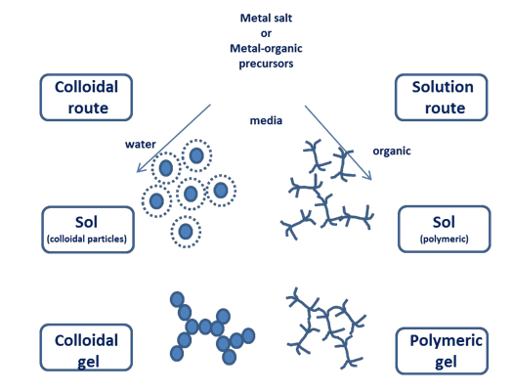

Slide 24
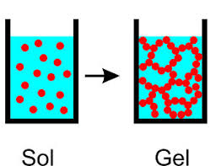
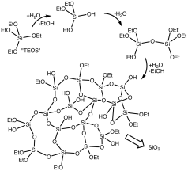
Sol-Gel technique
partial hydrolysis of metal alkoxides to form reactive monomers,
M-OR + H₂O → M-OH + ROH
2. condensation of these monomers to form colloid-like oligomers (sol formation),
M-OH + XO-M → M-O-M + X-OH (X = H o R) water or alcohol condensation
M-OH + XO-M → M-(OH)-M-OX (X = H o R)
3. additional hydrolysis to promote polymerization
and cross-linking leading to a three-dimensional
matrix (gel formation).
This process occurs in liquid solution of organometallic precursors (Tetramethyl orthosilicate (TMOS), Tetraethyl orthosilicate (TEOS), Zr(IV)-Propoxide, Ti(IV)-Butoxide, etc. ), which, by means of hydrolysis and condensation reactions, lead to the formation of a new phase (SOL).

Slide 25
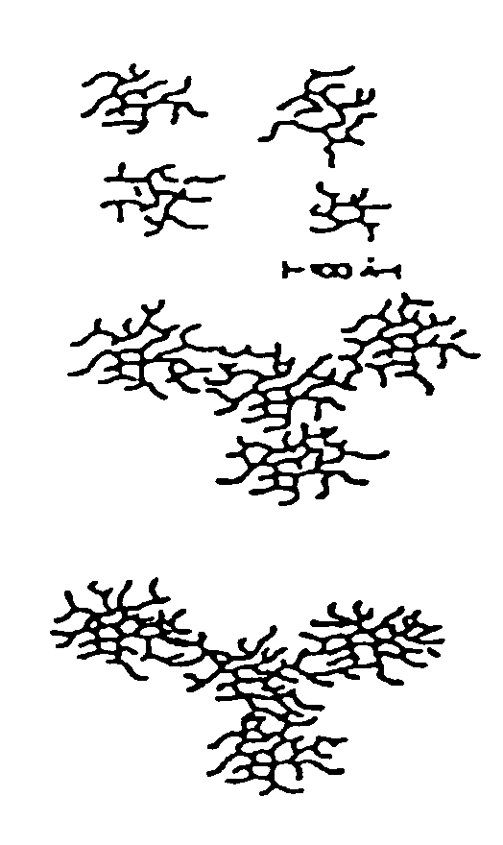
Basic catalysis
δ⁻
δ⁻
Away from gelation point: isolated branched structure
Closed to gelation point
Growth and branch
Gelation point
Interconnected Polymers

Slide 26
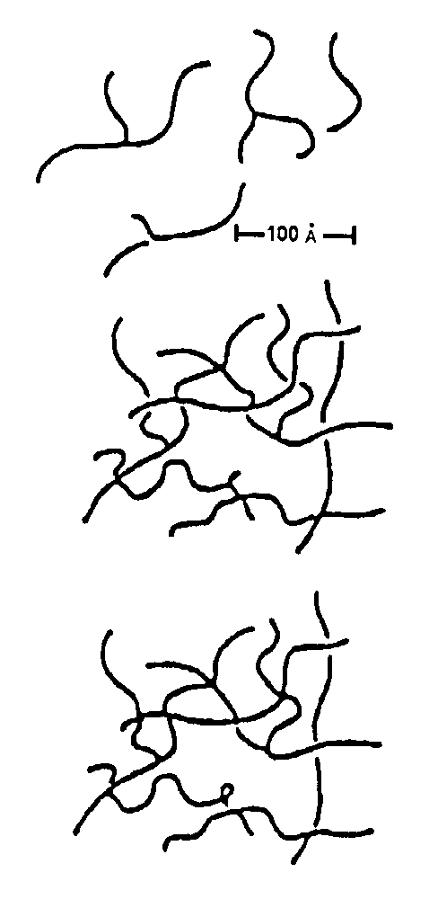
Acid Catalysis
+
δ⁺
δ⁺
Away from gelation point
Closed to gelation point
Primary interconnection
Gelation point
Branching from the interconnection points

