Slide 1
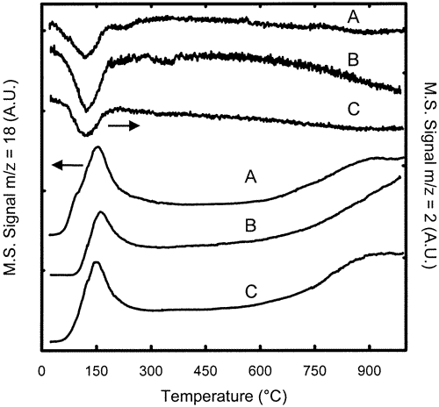
M/CeO₂ based materials reducibility
TPR-MS profiles for fresh Rh/Ce_{0.68}Zr_{0.32}O₂ (A), Pt/Ce_{0.68}Zr_{0.32}O₂ (B), and Pd/Ce_{0.68}Zr_{0.32}O₂ (C): H₂ uptake (upper traces) and H₂O evolution (lower traces).

Slide 2
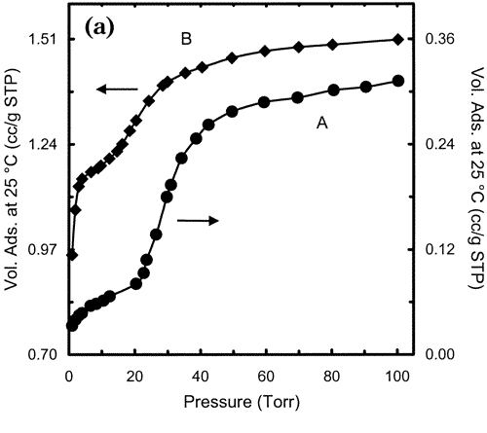
Pd nanoparticle and chemisorption at 25°C
(A) and the same sample oxidized at 427 °C and rereduced at 150 °C (B)

Slide 3
Nanoparticle Synthesis
  Wet Chemistry
  High-temperature decomposition of organic precursors
  Attrition
  Pyrolysis
  RF Plasma
  Pulsed Laser Method
  Biosynthesis
  …..

Slide 4
Liquid phase synthesis
Precipitating nanoparticles from a solution of chemical compounds can be classified into five major categories:
(1) colloidal methods;
(2) sol – gel processing;
(3) microemulsions method;
(4) hydrothermal synthesis;
(5) polyol method.
Solution precipitation relies on the precipitation of nanometer-sized particles within a continuous fluid solvent. An inorganic metal salt, such as chloride, nitride and so on, is dissolved in water. Metal cations exist in the form of metal hydrate species, for example, Al(H₂O)₆³⁺ or Fe(H₂O)₆³⁺.
These hydrates are added with basic solutions, such as NaOH or NH₄OH.
The hydrolyzed species condense and then washed, filtered, dried and calcined in order to obtain the final product.

Slide 5

Colloidal Chemical Methods
Colloidal methods are simple, easy, cheap and well established wet chemistry precipitation processes in which solutions of the different ions are mixed under controlled temperature and pressure to form insoluble precipitates.
For metal nanoparticles the basic principles of colloidal preparation were known since antiquity. E.g. gold colloids used for high quality red and purple stained glass from medieval times to date.
However, proper scientific investigations of colloidal preparation methods started only in 1857 when Faraday has published results of his experiments with gold. He prepared gold colloids by reduction of HAuCl₄ with phosphorus.
Aggregation is prevented by electrostatic repulsion or the introduction of a stabilizing reagent that coats the particle surfaces.
Particle sizes range from 1-200 nm and are controlled by the initial concentrations of the reactants and the action of the stabilizing reagent.

Slide 6
Precipitation/coprecipitation
Mg²⁺_{(aq)} + 4H₂O → Mg(OH)₂ +2H₃O⁺_{(aq)}
K_{ps} = [Mg²⁺ ][OH⁻]² = 1,8 x 10⁻¹¹
Fine tuning of pH to avoid consecutive precipitation
Metal precursors chlorides, nitrates, acetate,..
Precipitating agents, NaOH, NH₄OH, Na₂CO₃….
Precipitate must
Be cheap:
have low solubility;
be easy to decompose;
lead to safe decomposition.

Slide 7
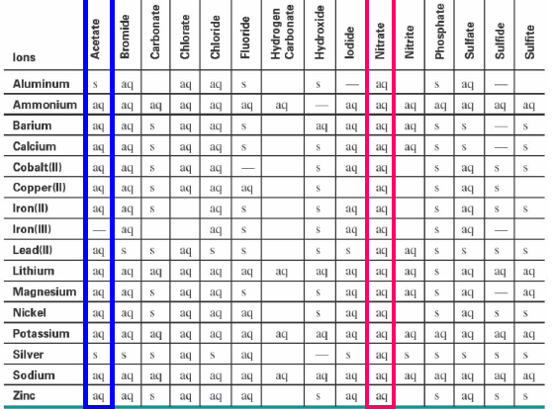
Solubility : RT and atm P

Slide 8
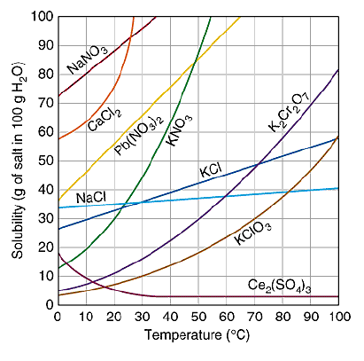
Solubility : effect of temperature

Slide 9
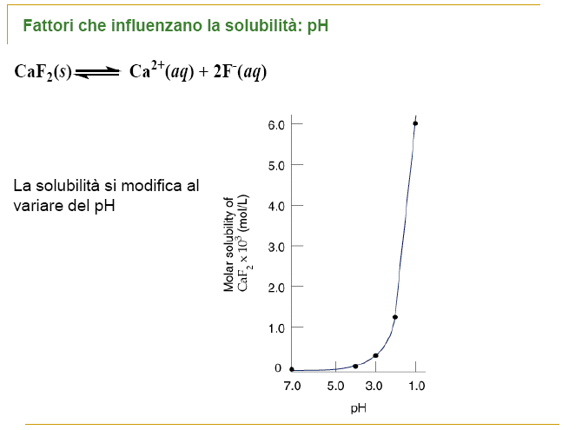
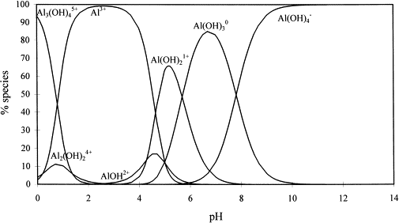
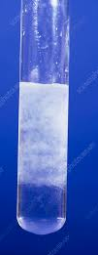
Solubility : effect of pH

Slide 10
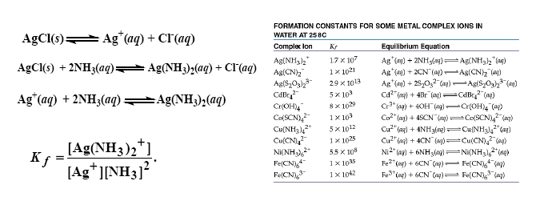
Solubility : Complex formation

Slide 11
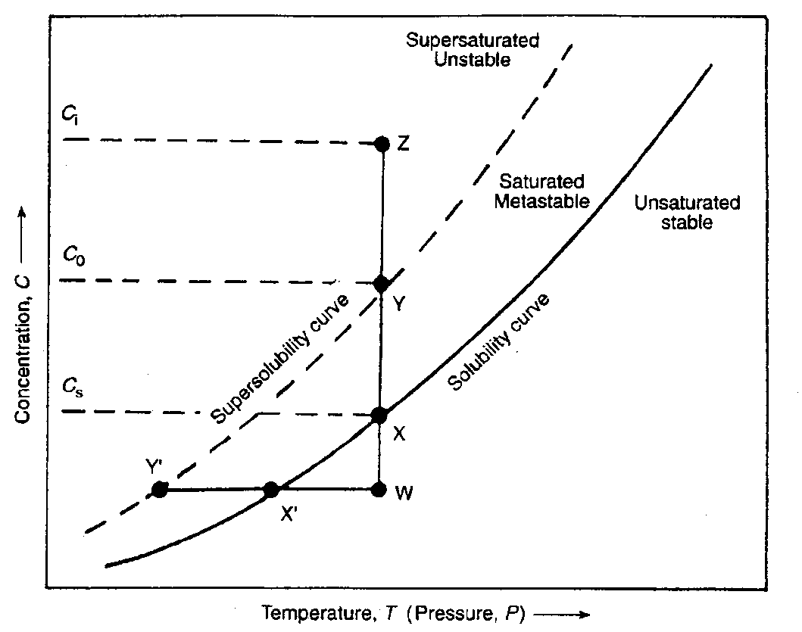
Precipitation/coprecipitation
Precipitation occurs in three steps
supersaturated solution;
nucleation;
grain growth
The solubility curve is a function of temperature and concentration (pH); the supersaturated solution is unstable. The supersaturated conditions can be obtained by solvent evaporation, by dropping the temperature or by increasing the pH of the solution.
• Saturated solution: A solution that contains the maximum amount of a solute that can be dissolved at equilibrium at a given temperature.
• Unsaturated solution: A solution that contains less than the maximum amount of a solute that can be dissolved at a given temperature.
• Supersaturated solution: A solution that contains more than the maximum amount of a solute that can be dissolved under equilibrium conditions at a given temperature. When a supersaturated solution is disturbed in any way, the excess solute will separate and the equilibrium solubility is restored.

Slide 12
Precipitation /co-precipitation
Nucleation = the appearance of «solid nuclei» in the solution. It can be homogeneous (agglomeration of ions from the pure solution) or heterogeneous (crystallization agents).
The dimension of the final nanoparticles depends on the ration between the rates of nucleation and growth, and on the possible aging strategies.
nucleation growth
The rate of nucleation depends on the level of supersaturation (easier preparation with low solubility compounds)
Highly soluble compounds leads to a rapid dissolution of the smallest nanoparticles followed by deposition on the largest nanoparticles with the obtainment of large precipitate.
primary
time
          Induced /secondary

Slide 13
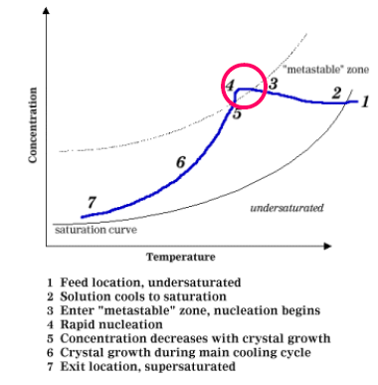
Precipitation /co-precipitation

Slide 14
Precipitation/coprecipitation
Weimarn’s law
D x C₀ = constant
C₀ = initial concentration
D = particle dimention
C_{s} = solubility
L₁’ > L₁” > L₁”’ = solubility
When C₀ is high = the precipitation is controlled by nuclei formation
When C₀ is small = the precipitation is controlled by the rate of nuclei growth

Slide 15
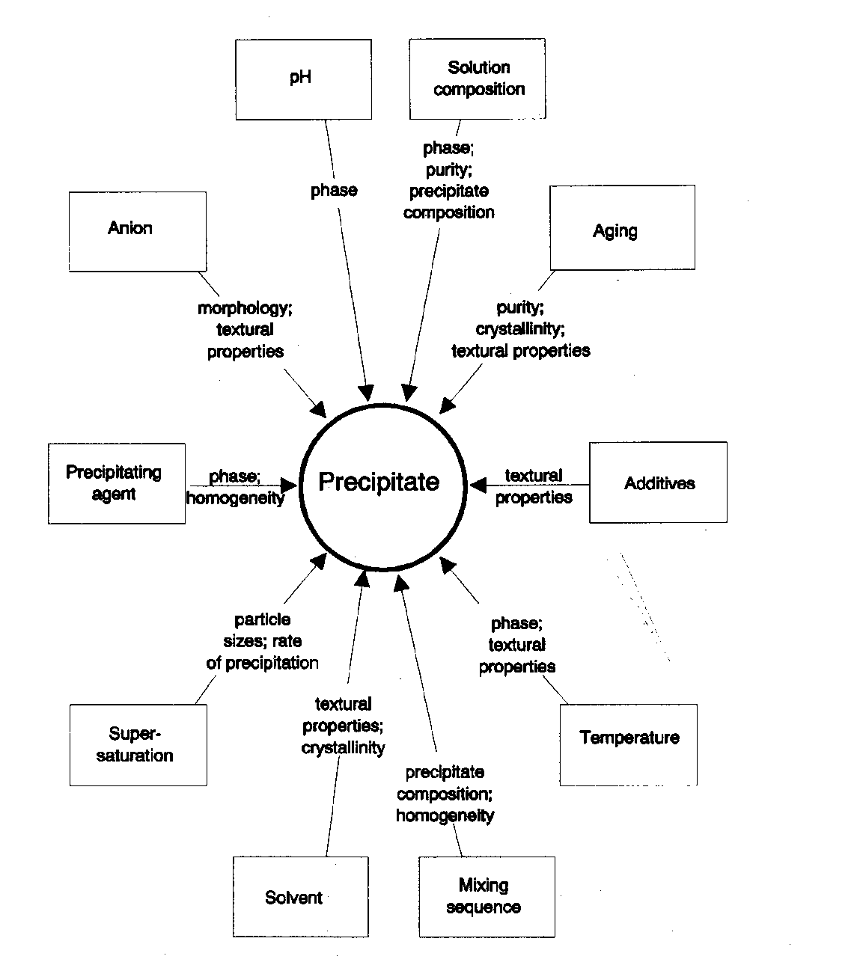
Factors influencing precipitate formations

Slide 16
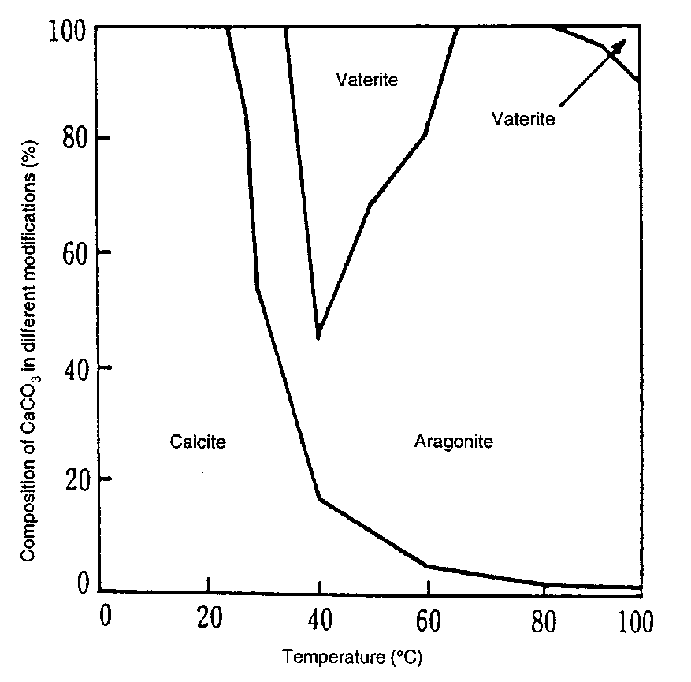
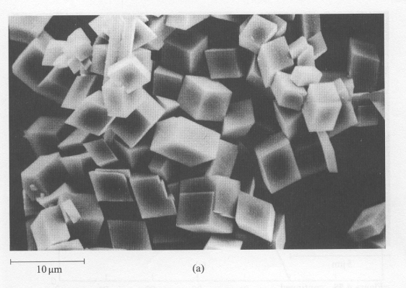
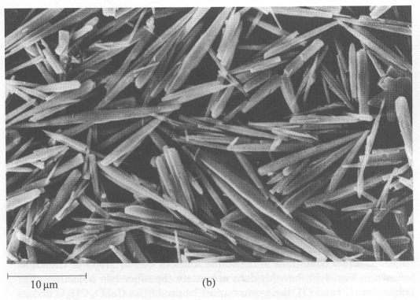
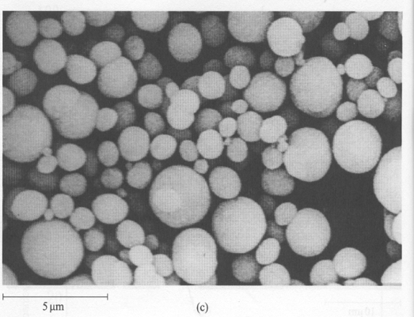
Precipitation/coprecipitation
Effect of Temperature and Concentration on the precipitation of CaCO₃
(a) Calcite (T<25°C)
(b)Aragonite (70-80°C)
(c) Vaterite (T> 40°C high concentration)
Ca(HCO₃)₂ (aq) → CaCO₃ ↓ + H₂O + CO₂

Slide 17
Precipitation/coprecipitation
Ca(OH)₂
CaCl_{2 (aq)}+2 NaOH _{(aq)} → Ca(OH)₂ _{(s)} + 2 NaCl _{(aq)}

Slide 18
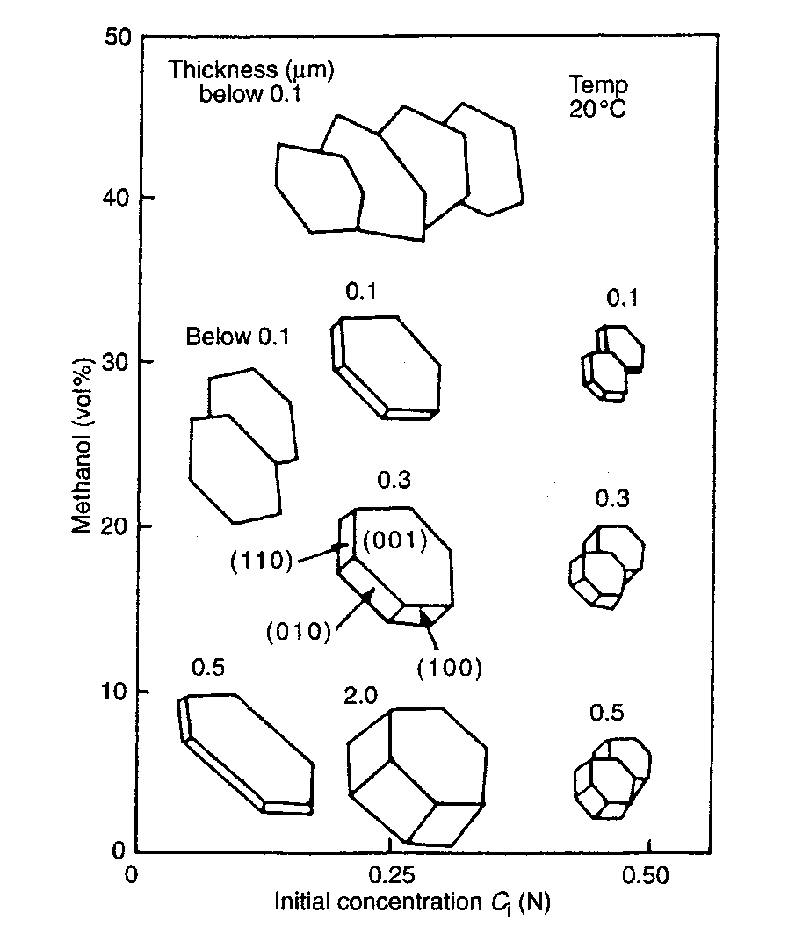
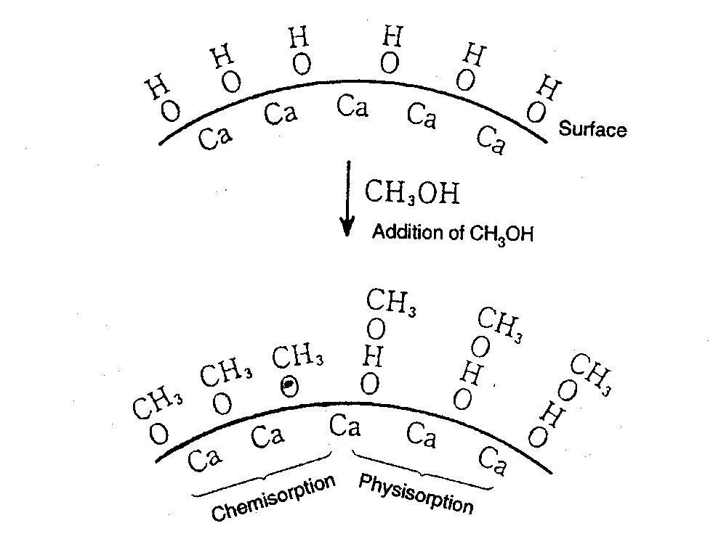
Precipitation/coprecipitation
Addition of NaOH to a CaCl₂/H₂O/methanol solution
Adsorption of •OCH₃ on the 001 facets with the suppression /inhibition of their growth

Slide 19
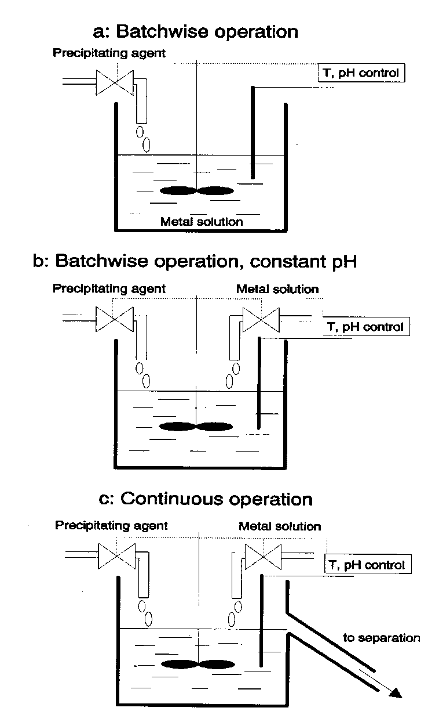
Precipitation by increasing pH
:
  increasing the pH (one element to precipitate)
  at constant pH (the most used case)
  at constant pH in a continuous flow

